Slide 1
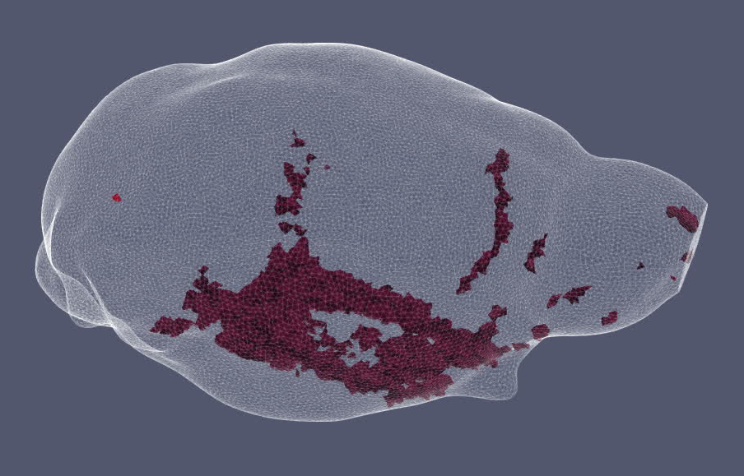
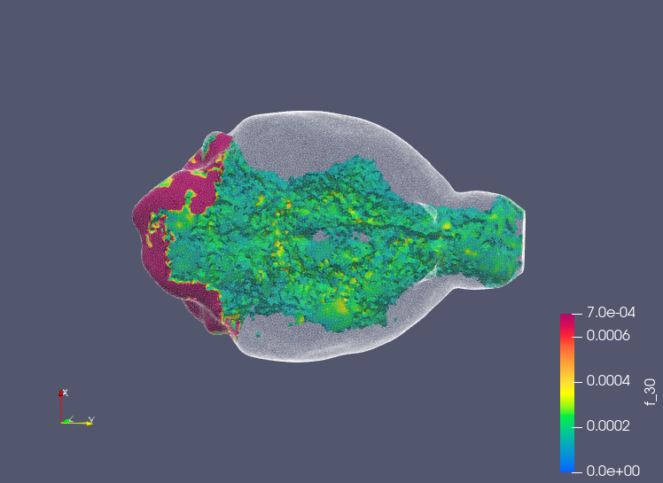
Injection Site
Major Arteries
0 mM 0.7 mM

