Slide 2
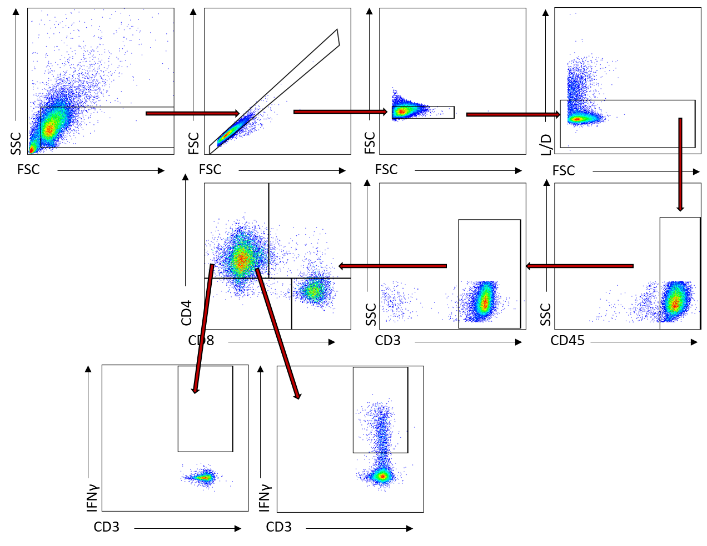
Supplementary Figure 1
Gating Strategy

Slide 3
Supplementary Figure 2
A
B
C

Slide 4
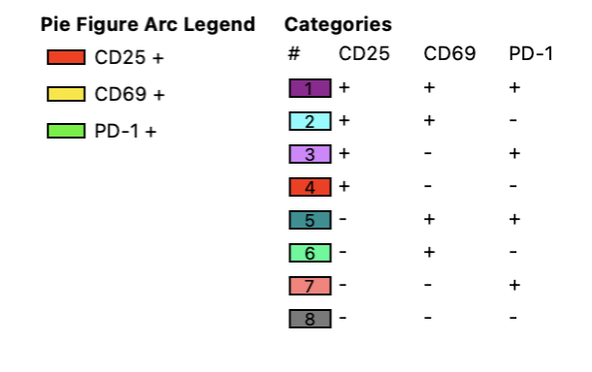



Supplementary Figure 3
A
B

Slide 5
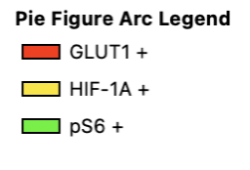
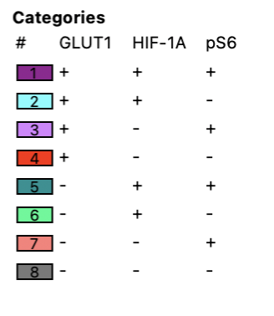
Supplementary Figure 4
A
B
C
PBMC
D
Synovium
E

