Slide 1
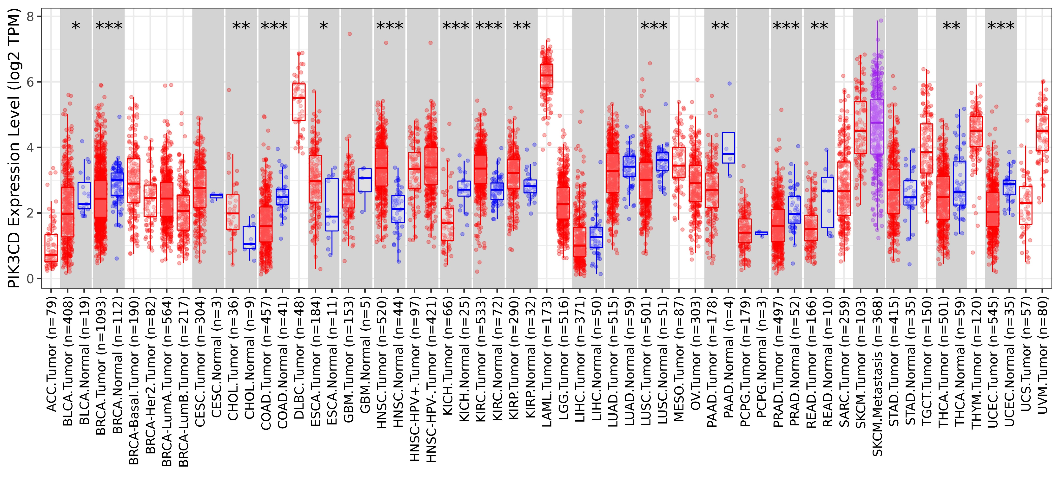
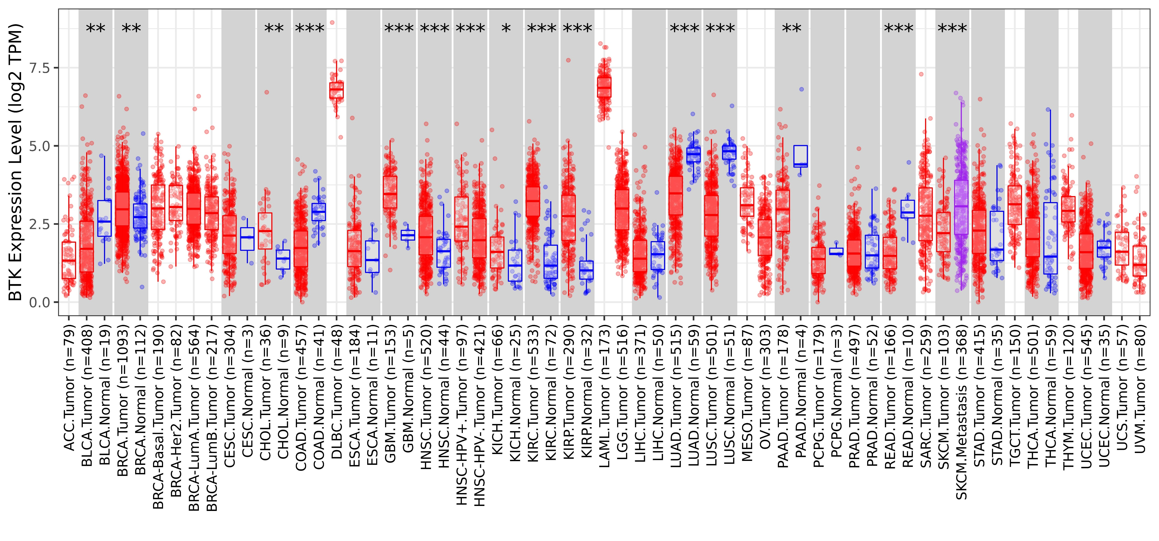
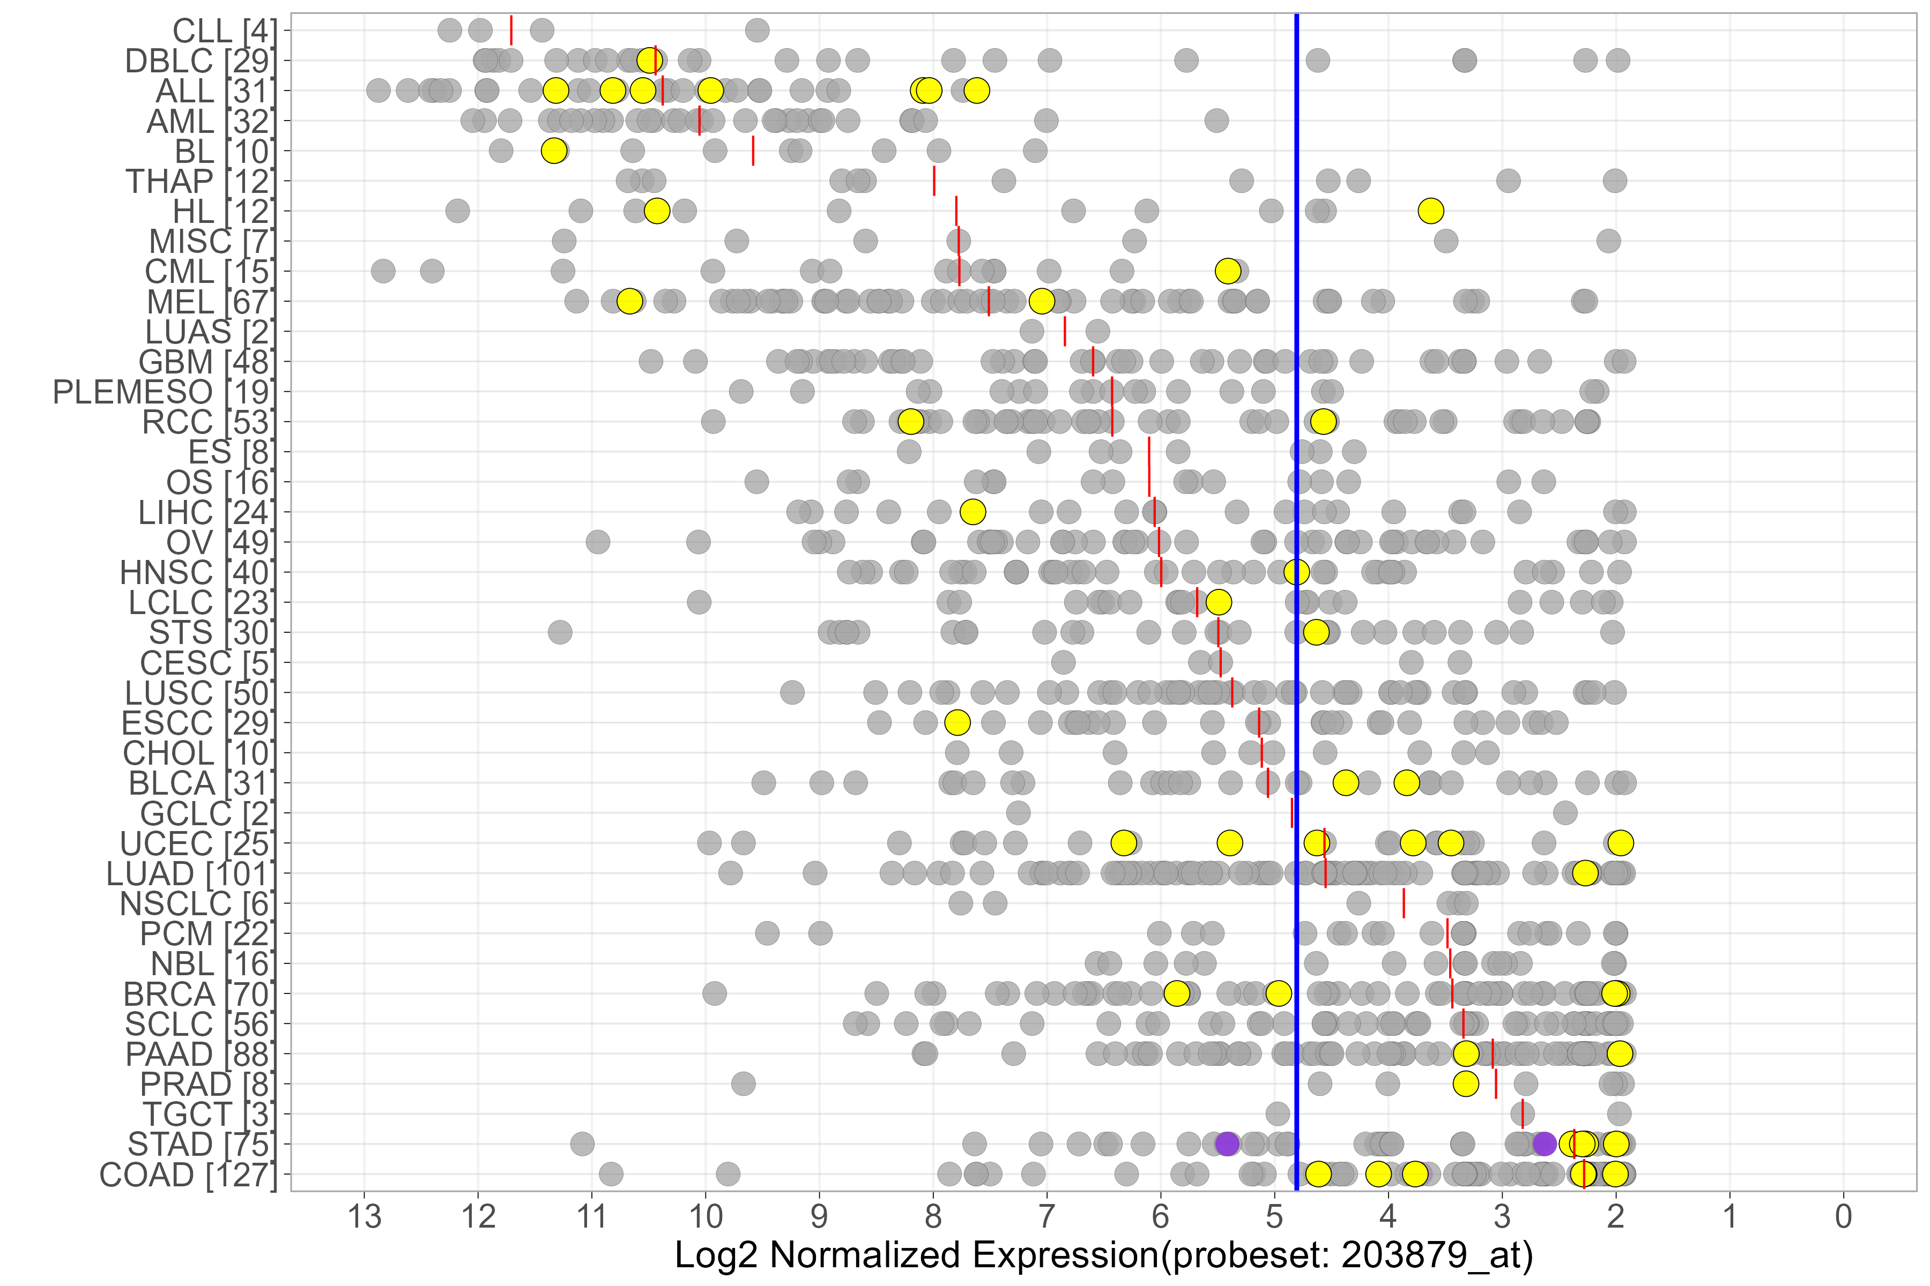
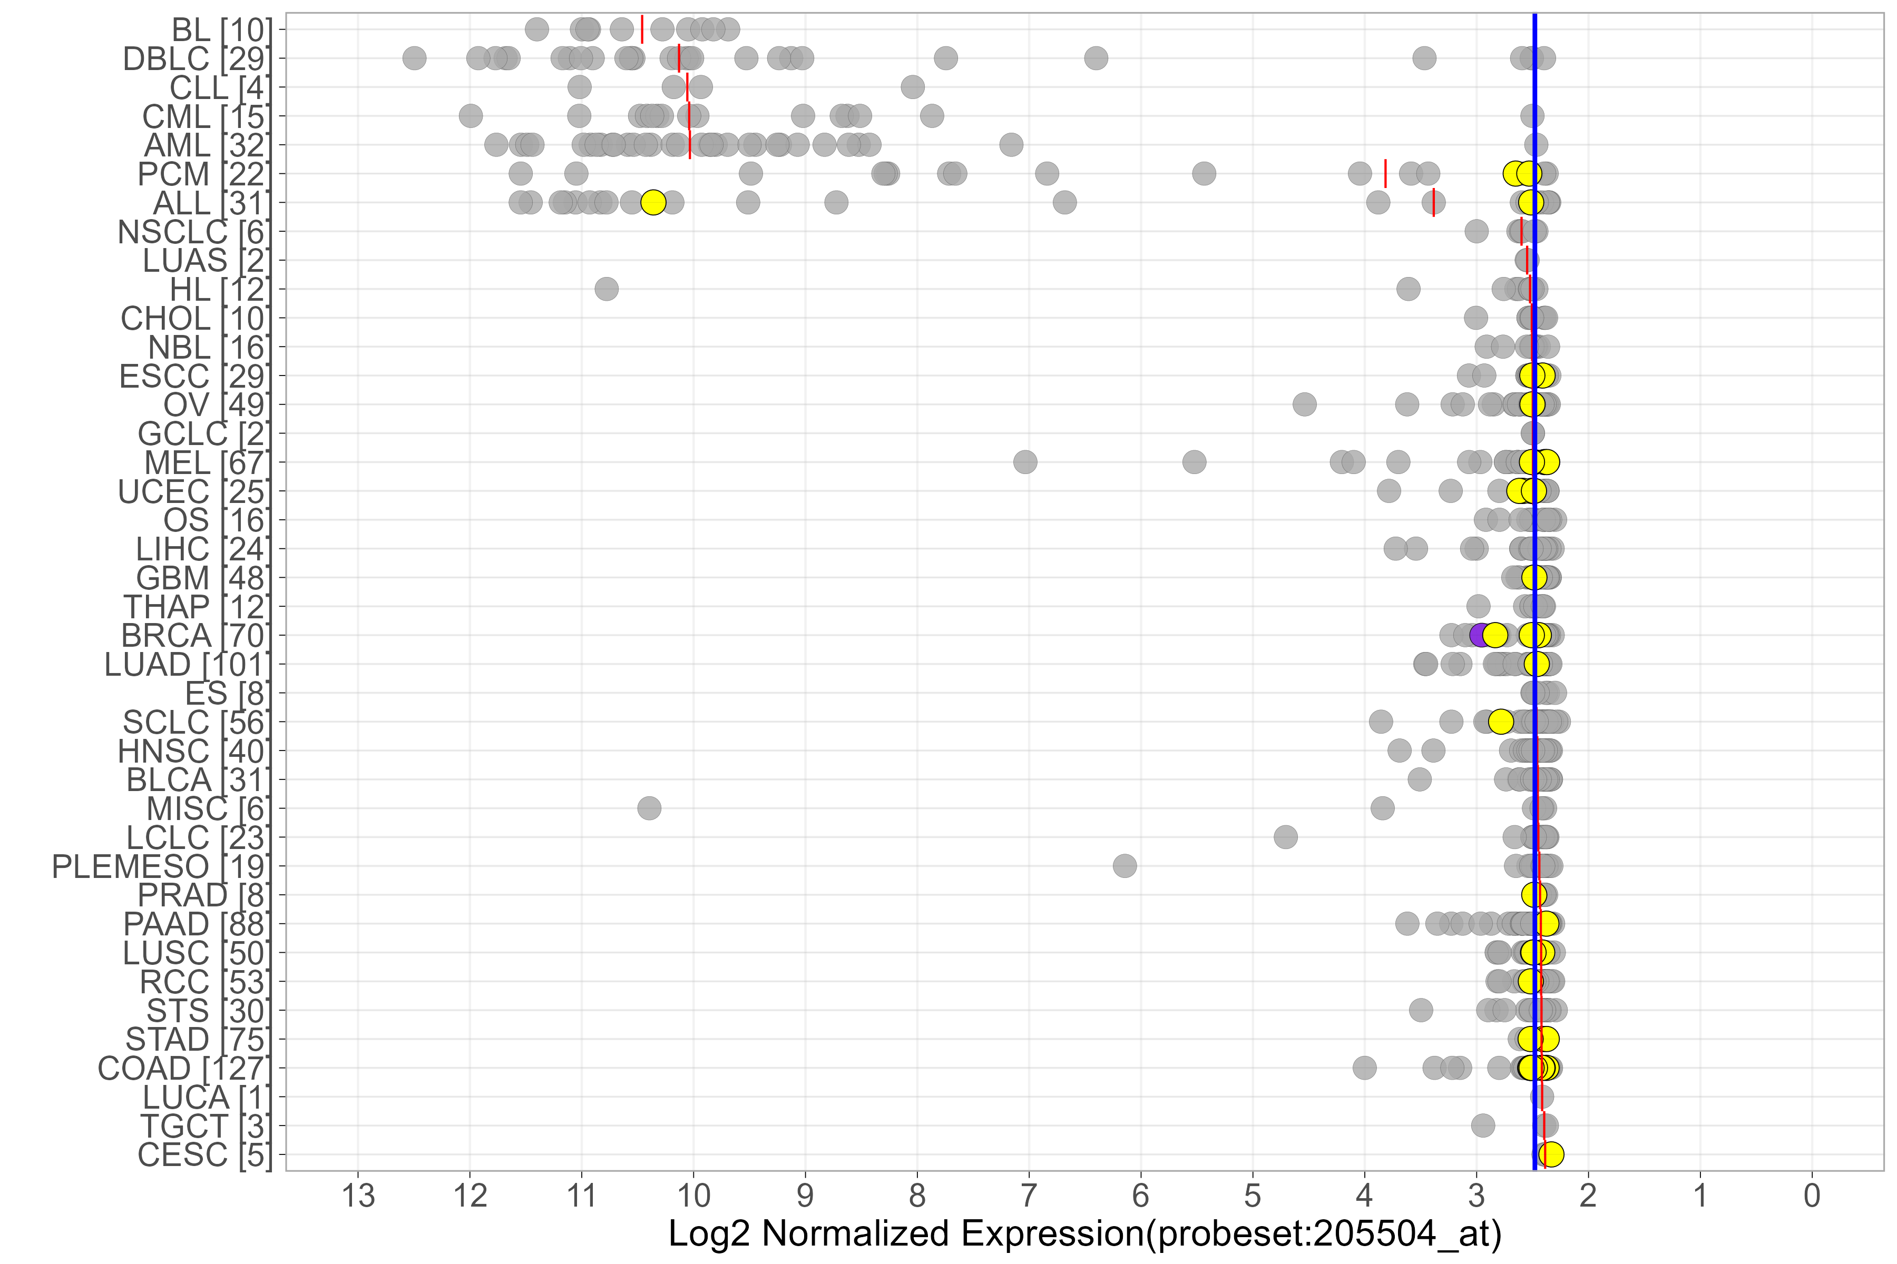
Suppl Figure 1
a
PIK3CD
b
BTK
c
PIK3CD
d
BTK

Slide 2
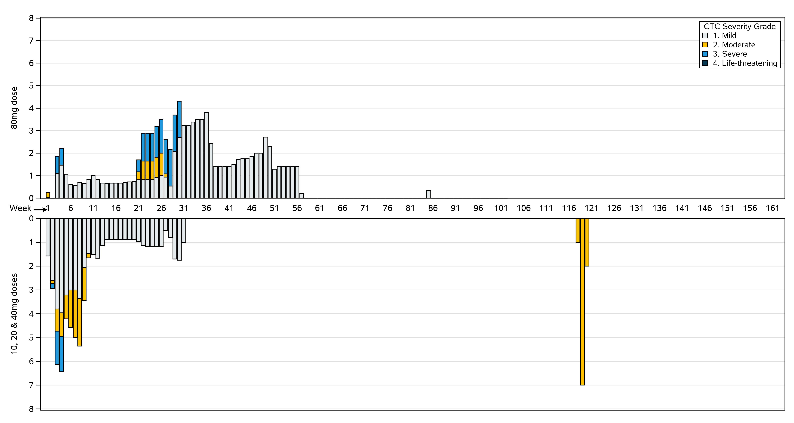
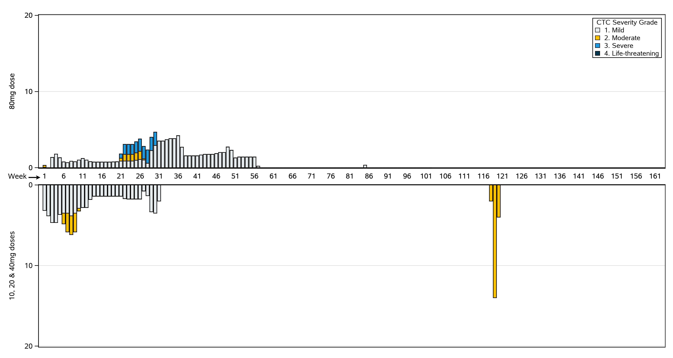
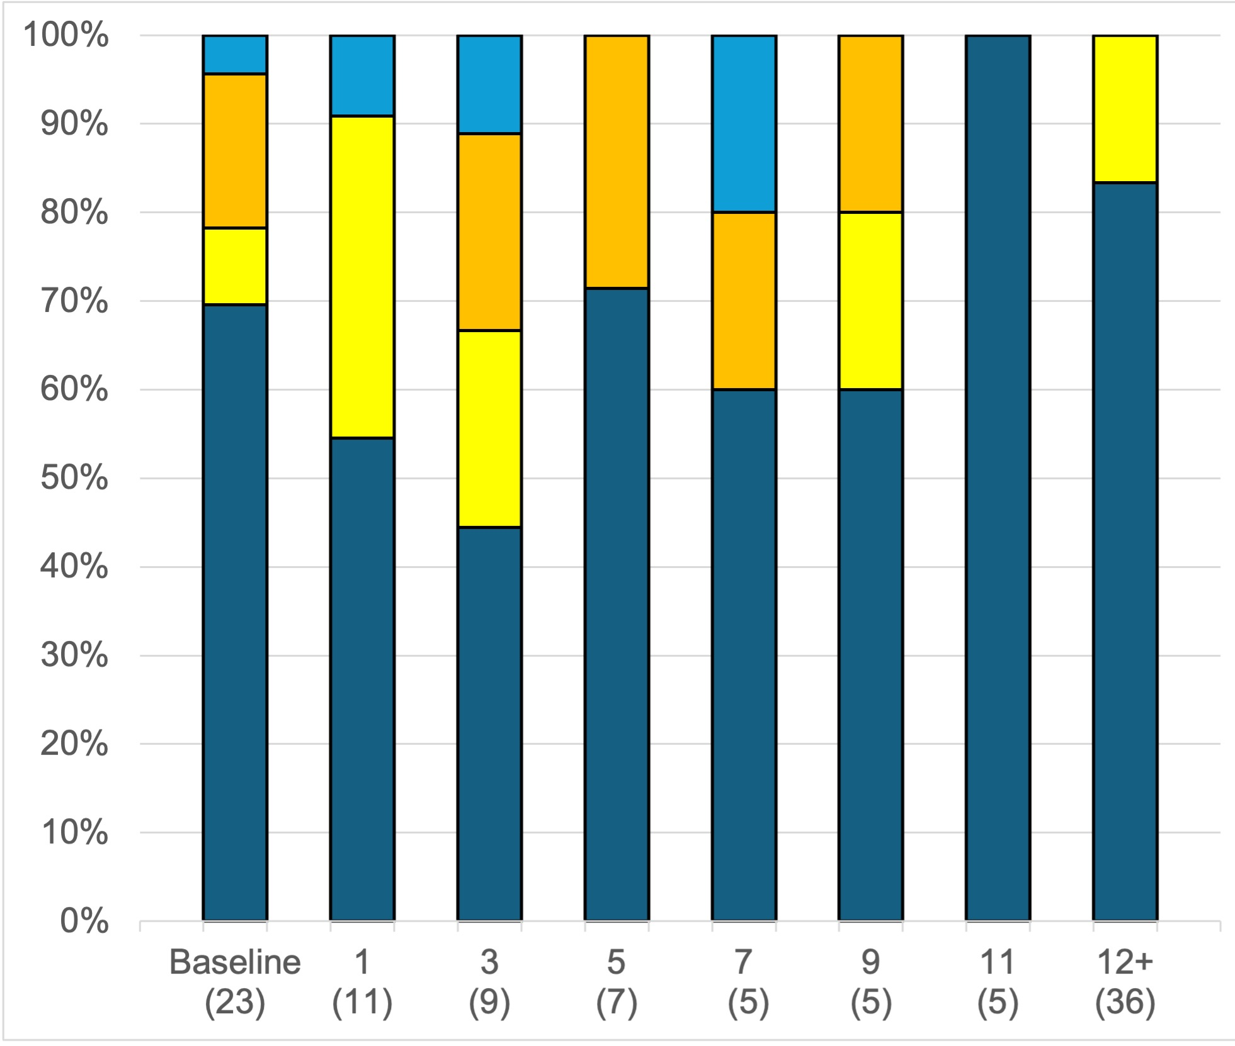
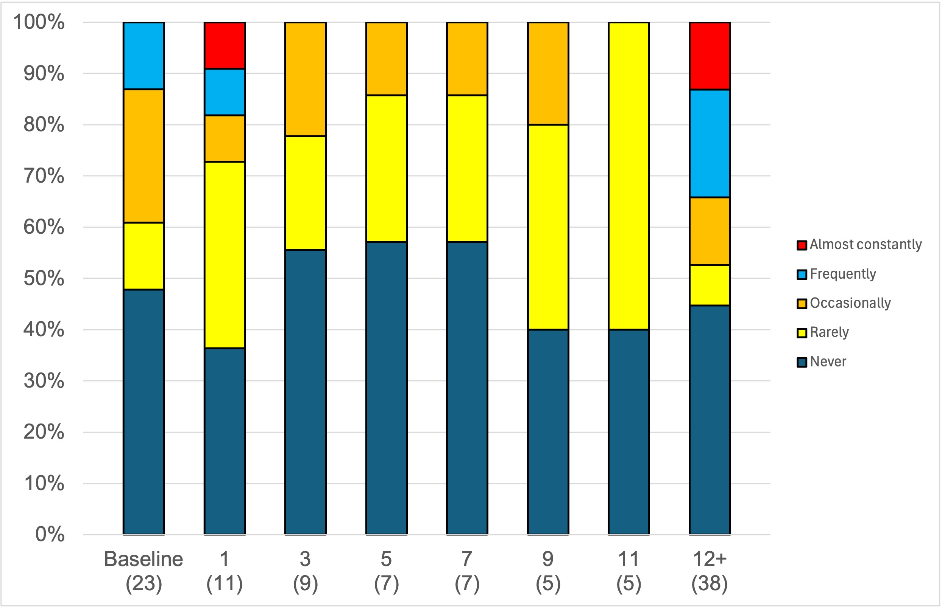
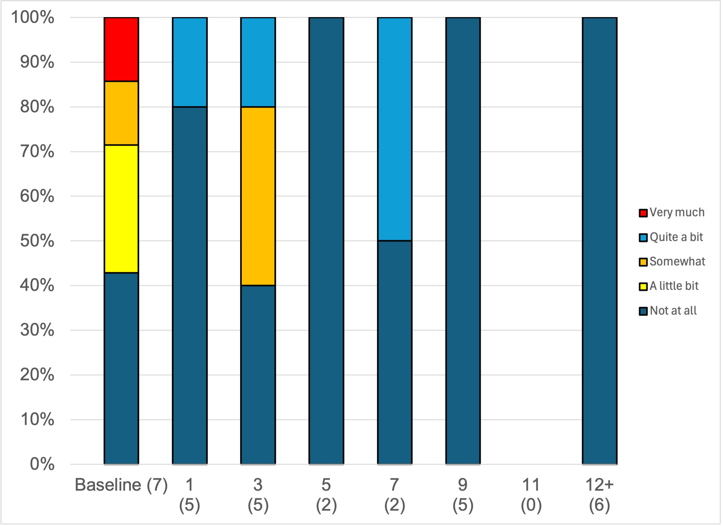
Supplemental Figure 2
a
b
c
Abdominal pain frequency
d
Pain frequency
e
Abdominal Pain interference

Slide 3
Suppl Figure 3
a
b
c
d

Slide 4
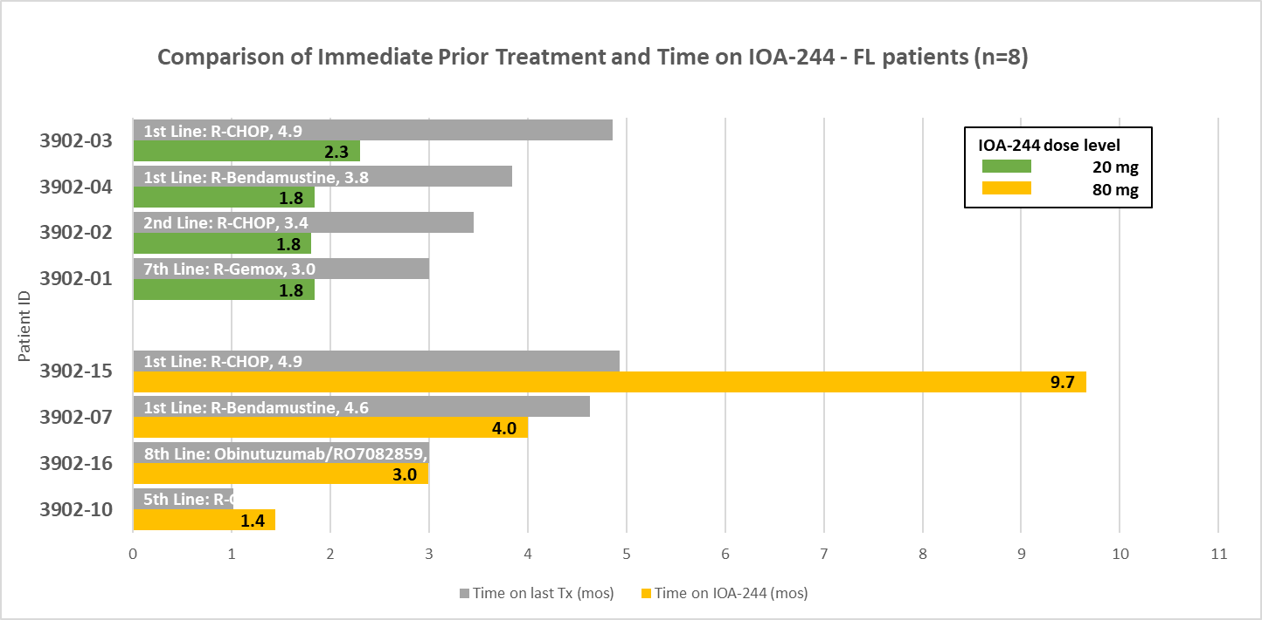
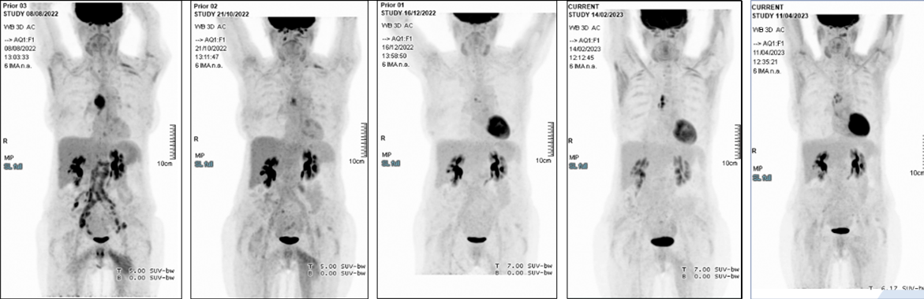
a
Suppl Figure 4
b
c
d
Baseline
8 weeks
16 weeks
24 weeks
32 weeks

Slide 5
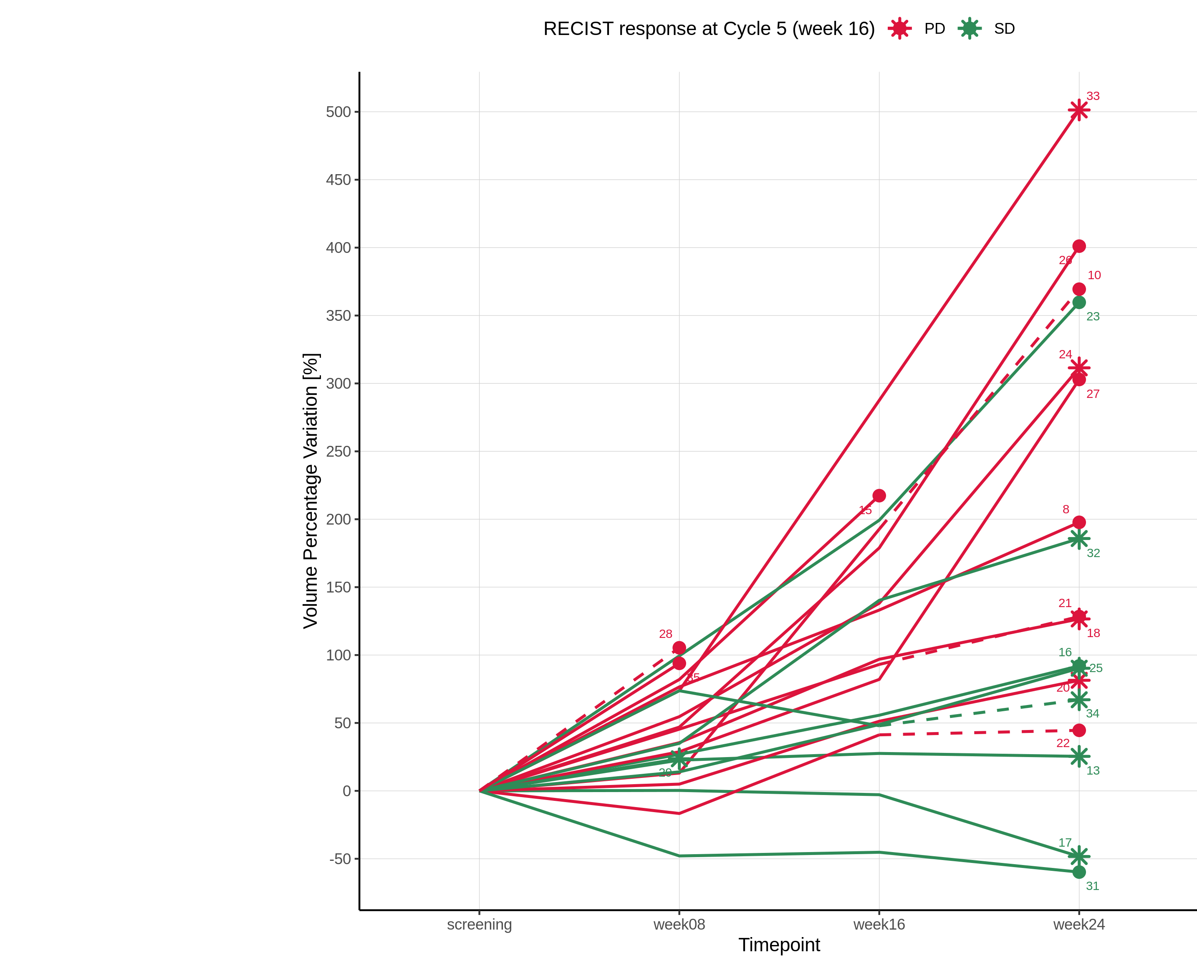
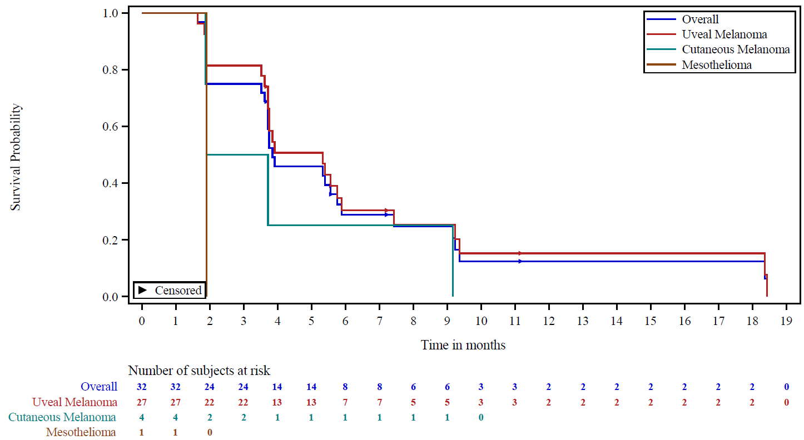
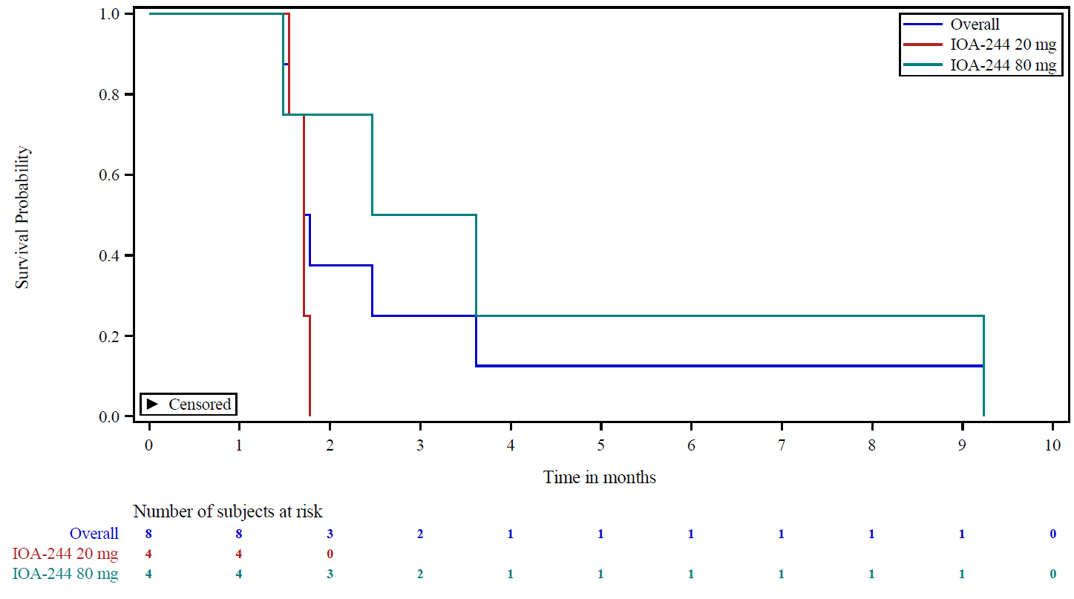
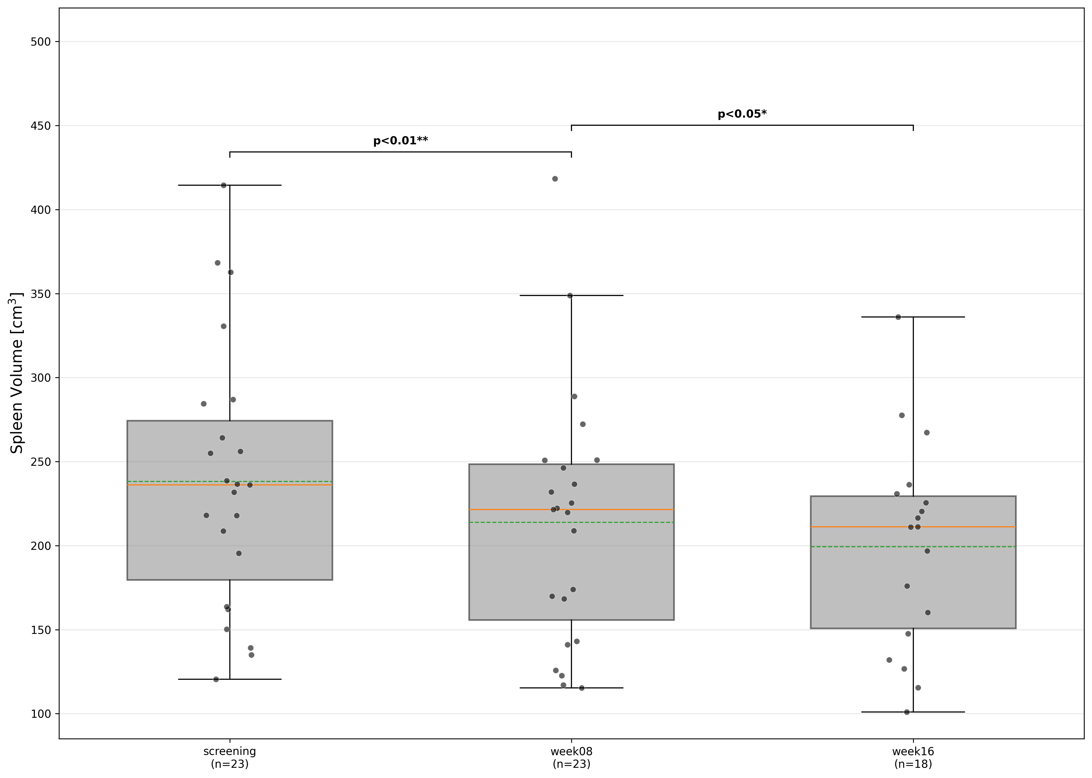
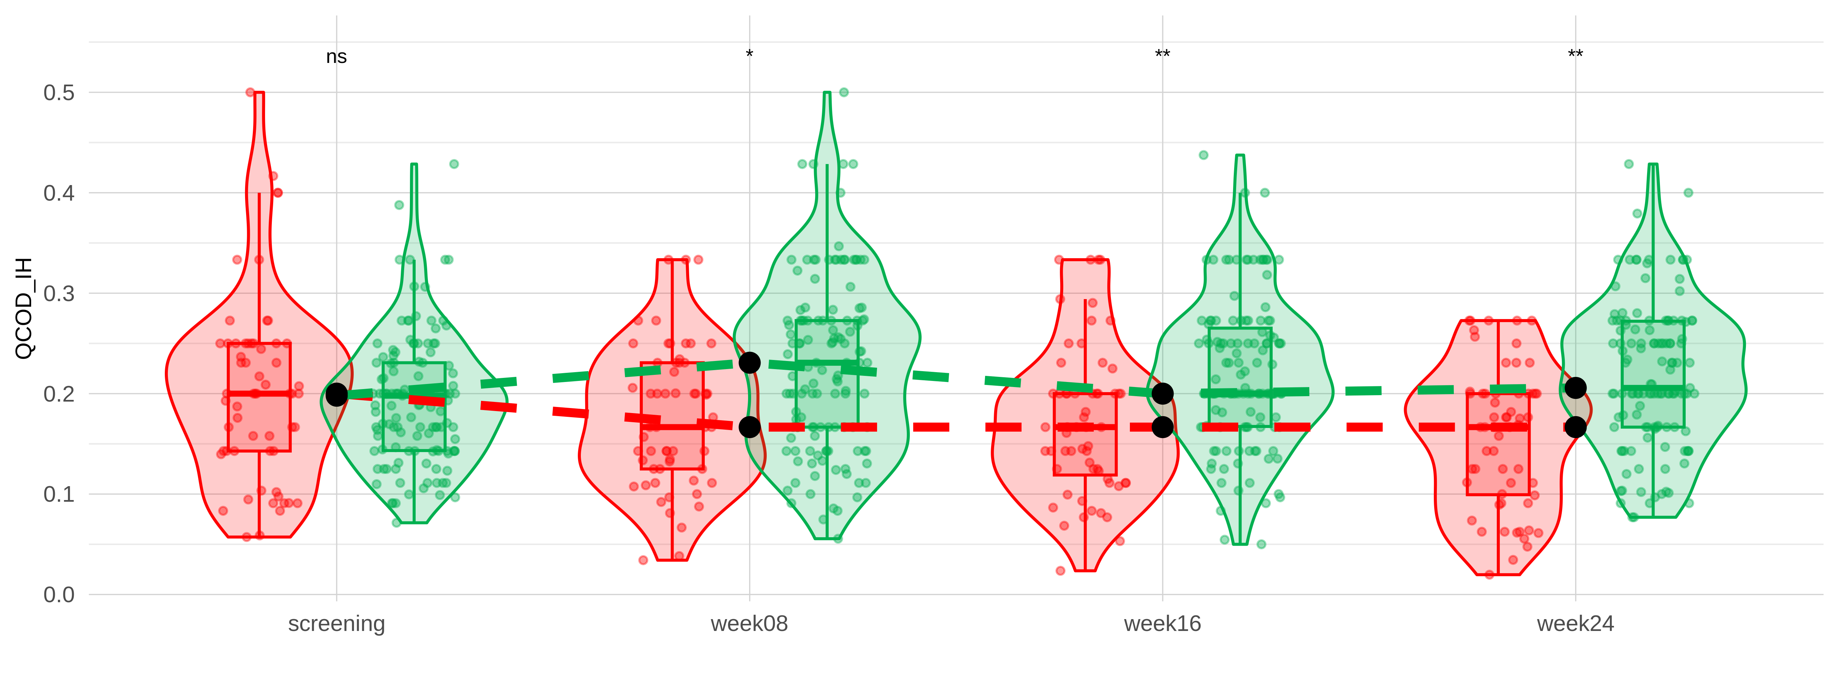
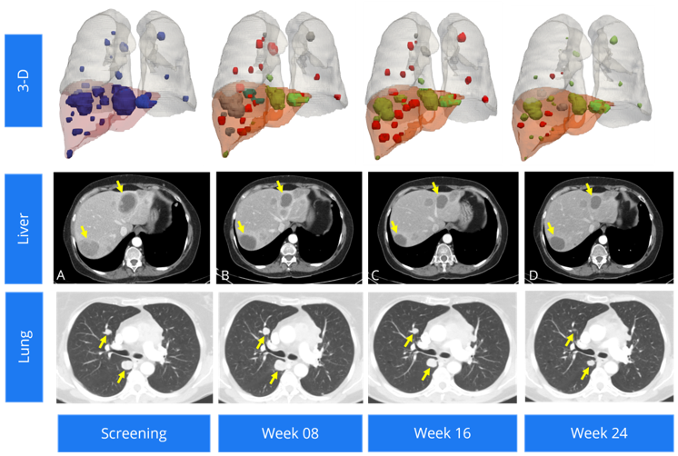
Suppl Figure 5
a
b
c
d
e
f

Slide 6
a
PD
Suppl figure 6
18
20
30
22
24
26
27
33
35
36
b
SD
17
19
23
25
32
34
29
31
c
15
TMB
(mut/Mb)
0
RECIST

Slide 7
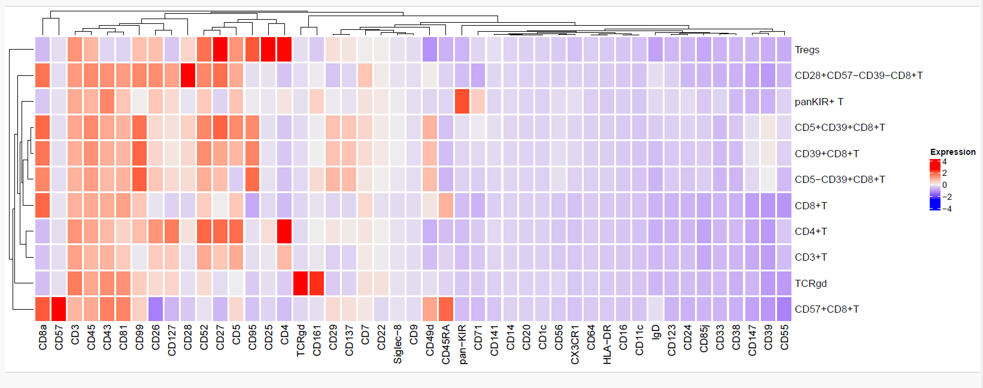
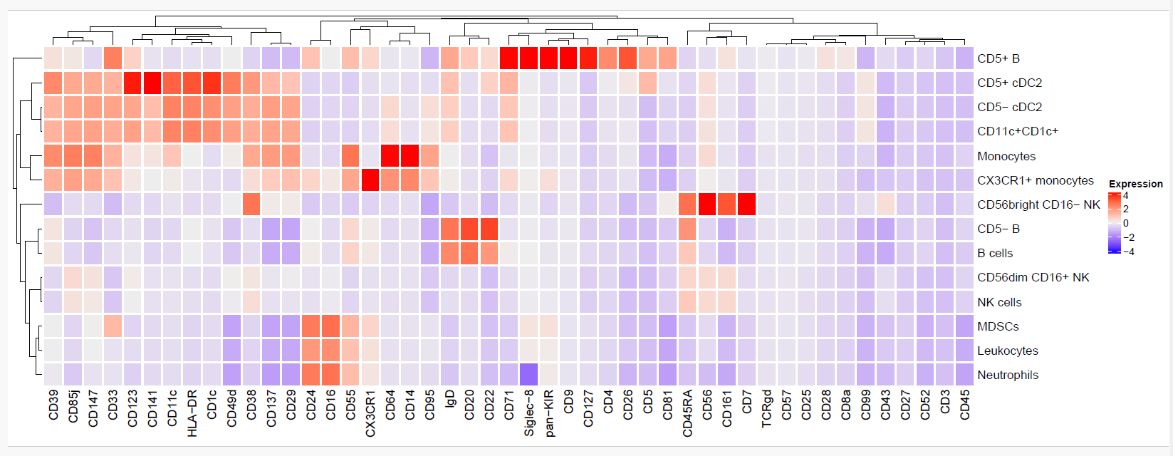
Suppl Figure 7
a
b

Slide 8
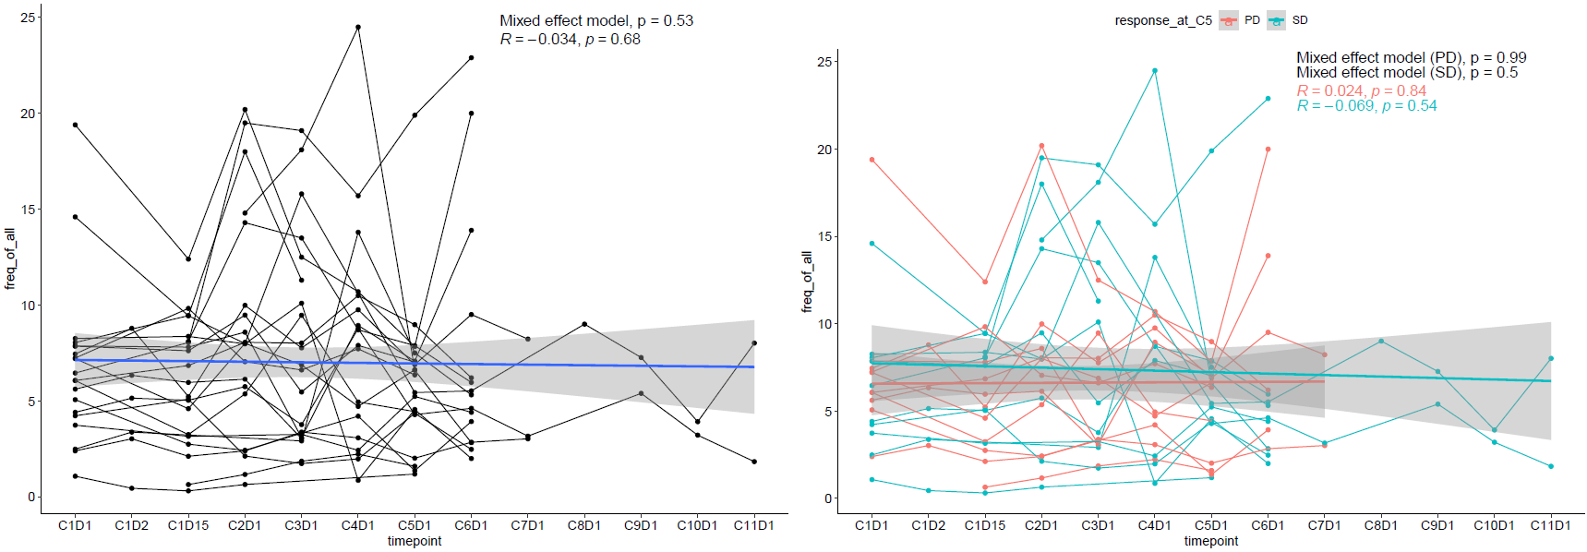
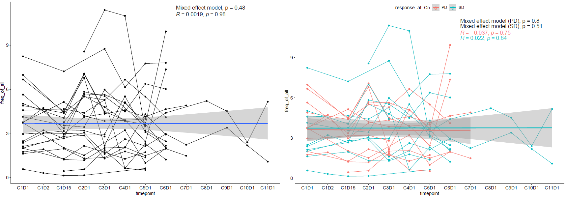
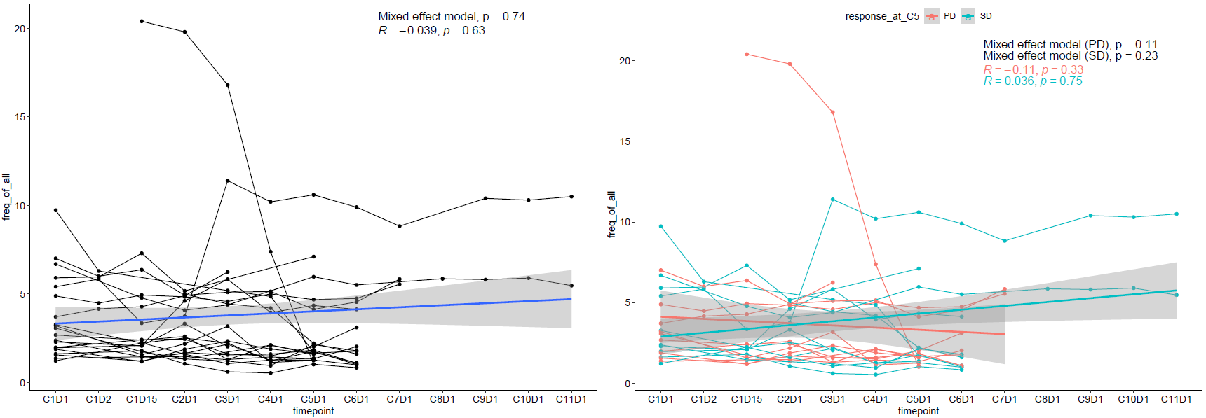
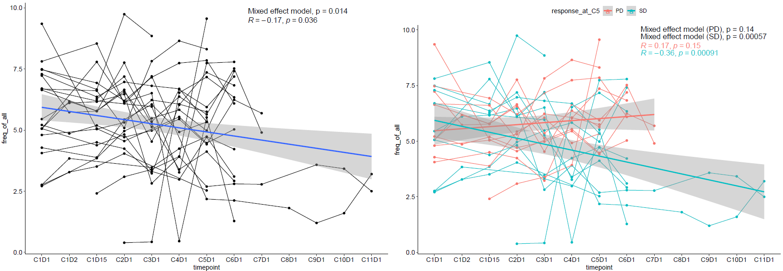
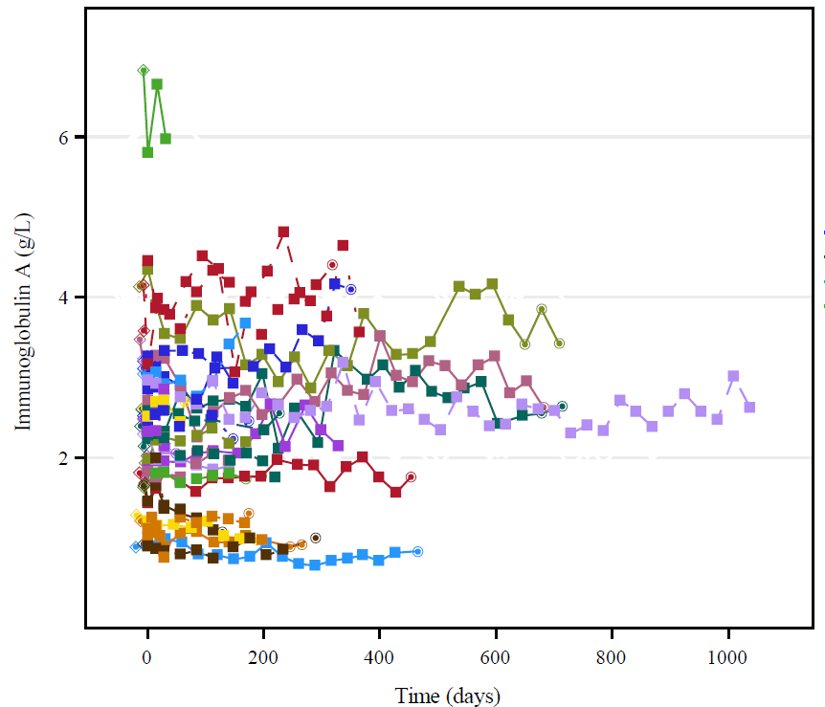
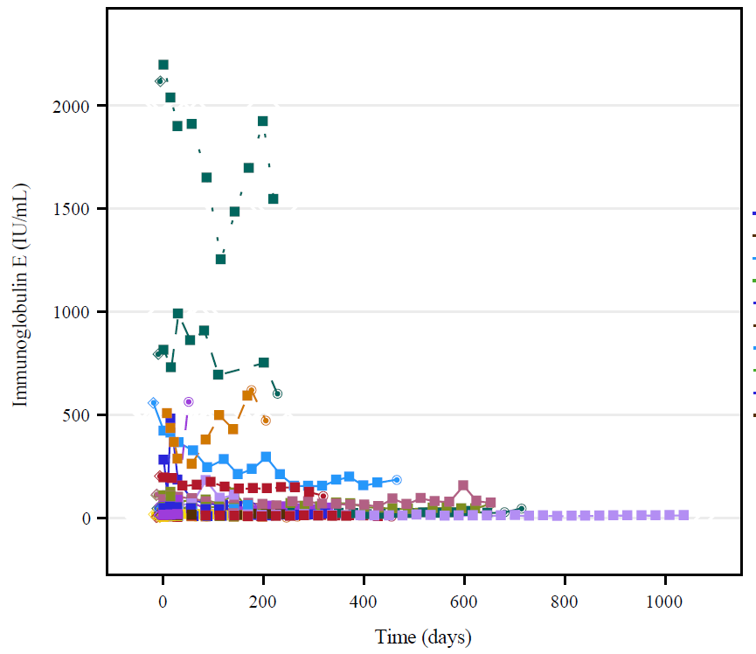
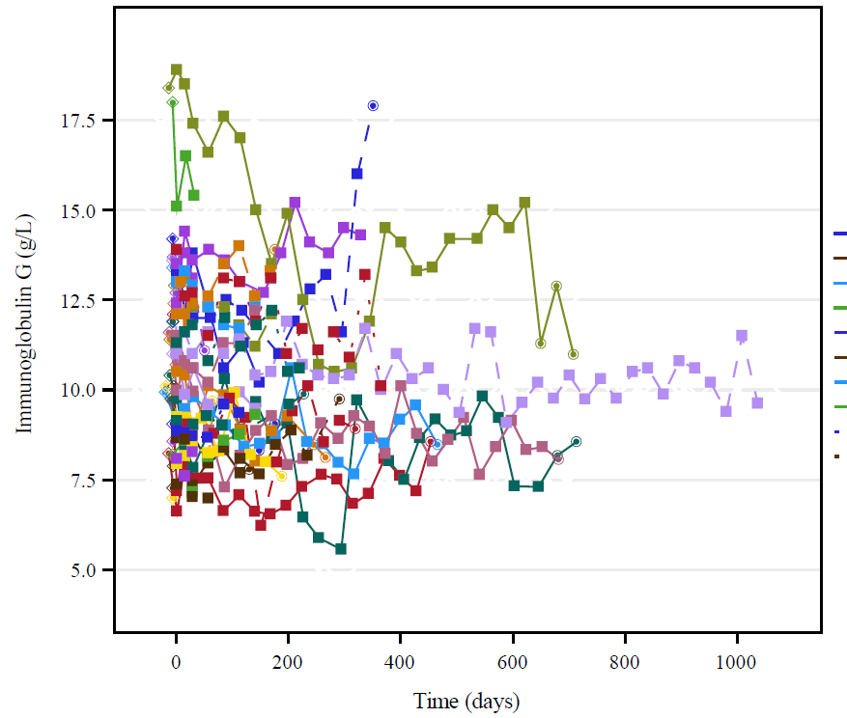
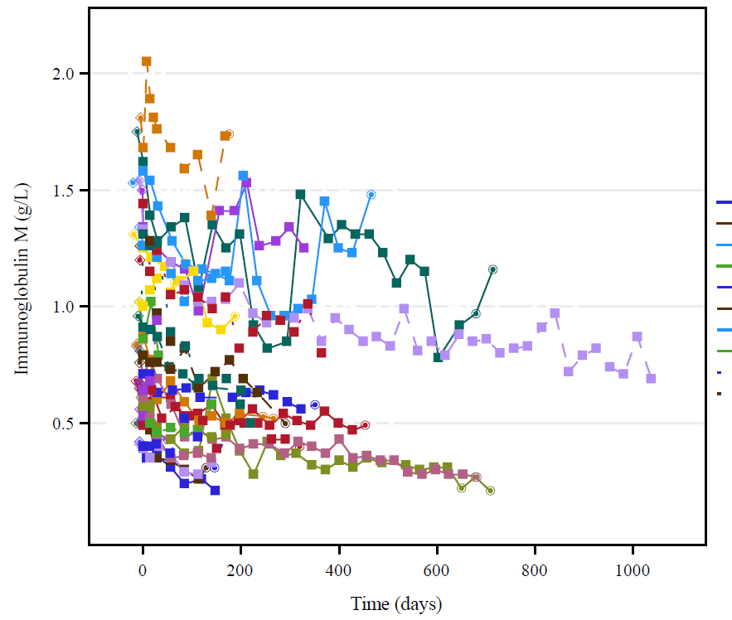
a
CD4⁺ (% of all cells)
Suppl Figure 8
b
CD8⁺ (% of all cells)
c
CD20⁺ (% of all cells)
d
CD14⁺ (% of all cells)
e
IgA
IgE
IgG
IgM

Slide 9
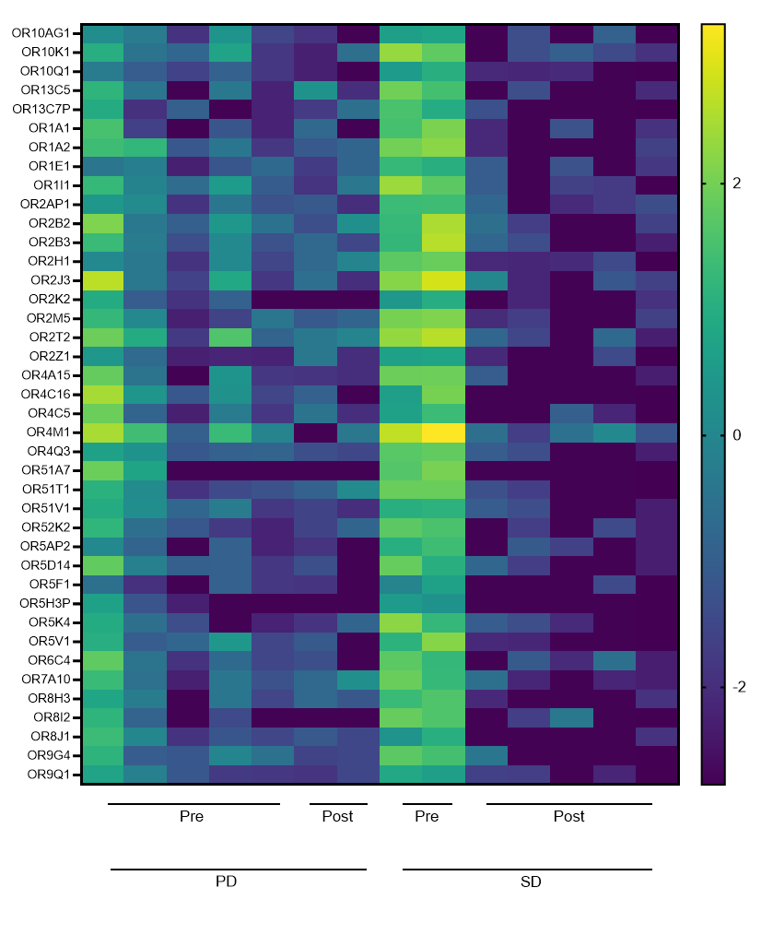
Suppl Figure 9
a
SD
b
PD
<0.001
<0.001
<0.001
c
d
e

