Slide 1
Fig 1 C MOPC21

Slide 2
Fig 1 C N478

Slide 3
Fig 1 E hu skin mopc21

Slide 4
Fig 1 E hu skin N472

Slide 5
Fig 1 E hu skin N478

Slide 6
Fig 1 E mo skin MOPC21

Slide 7
Fig 1 E mo skin N472

Slide 8
Fig 1 E mo skin N478

Slide 9
Fig 1 E sum 190 mopc21

Slide 10
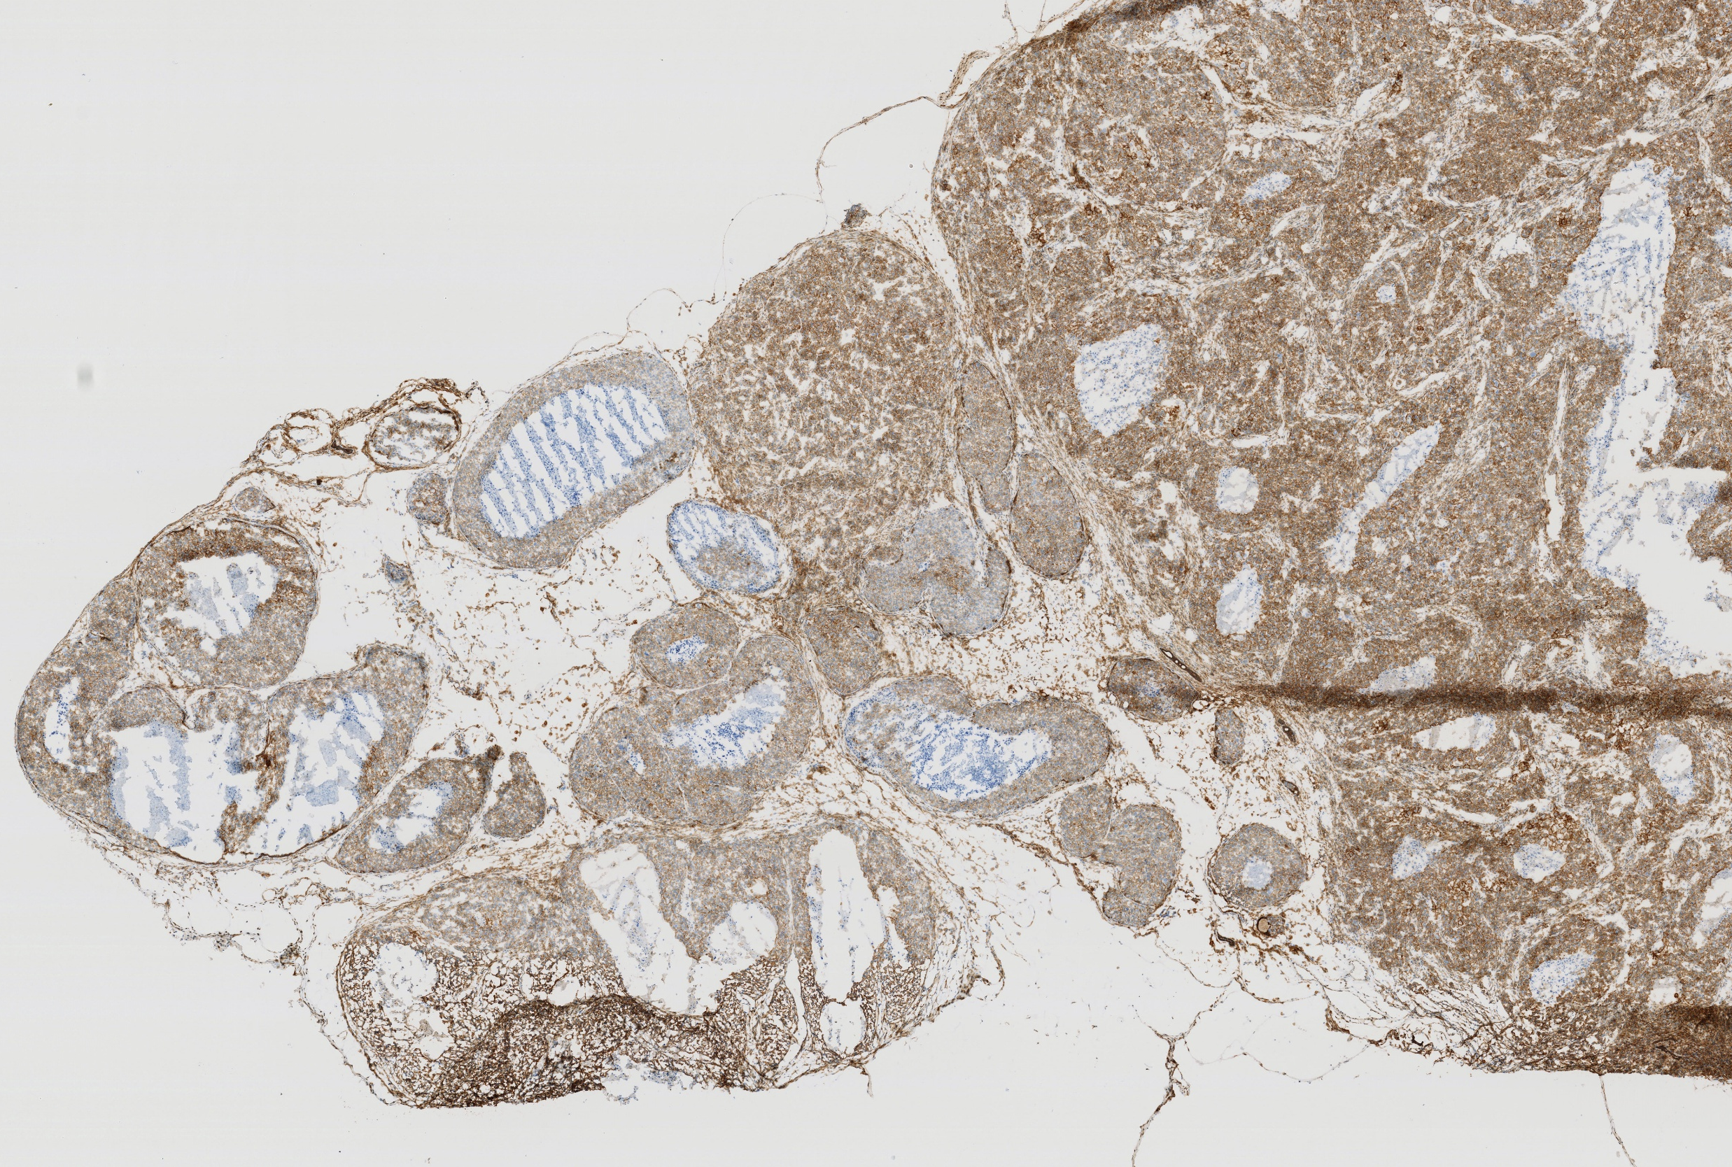
Fig 1 E sum 190 N472

Slide 11
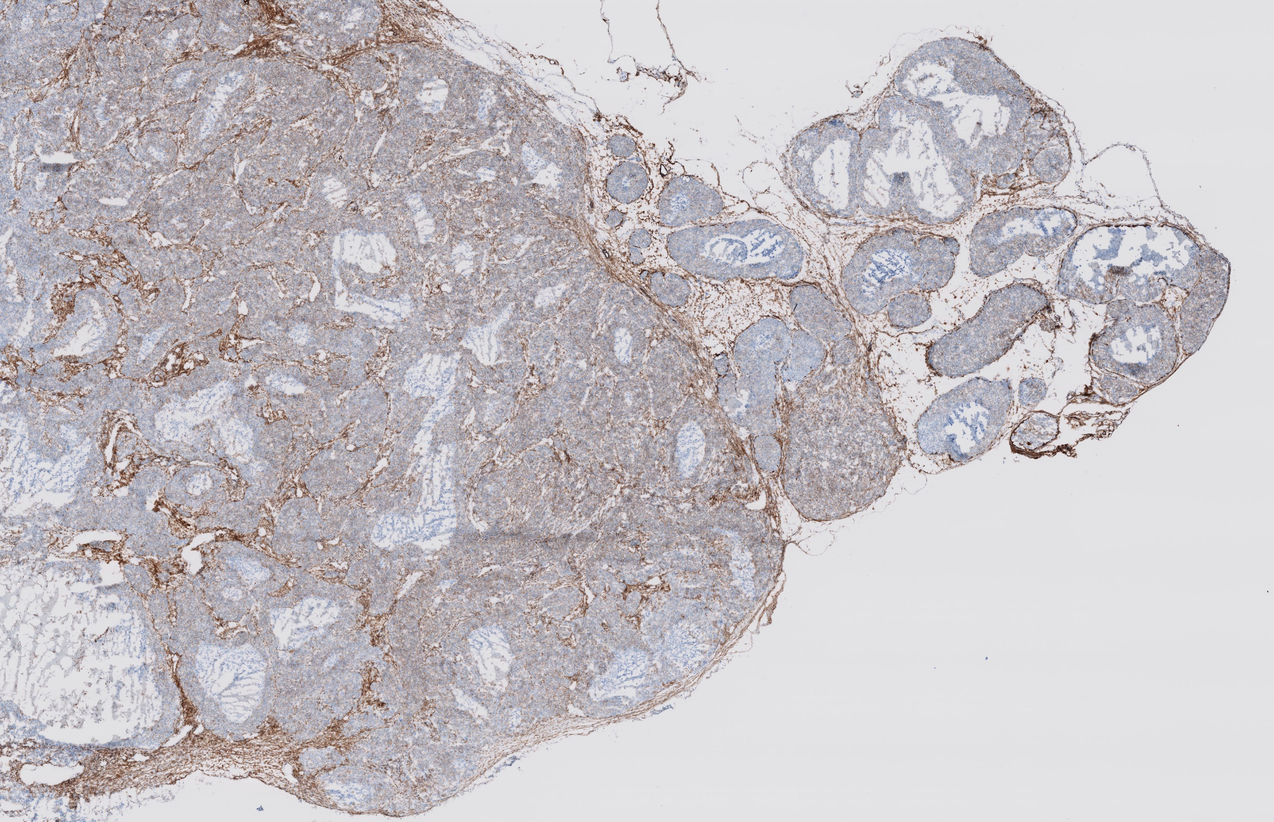
Fig 1 E sum 190 N478

Slide 12
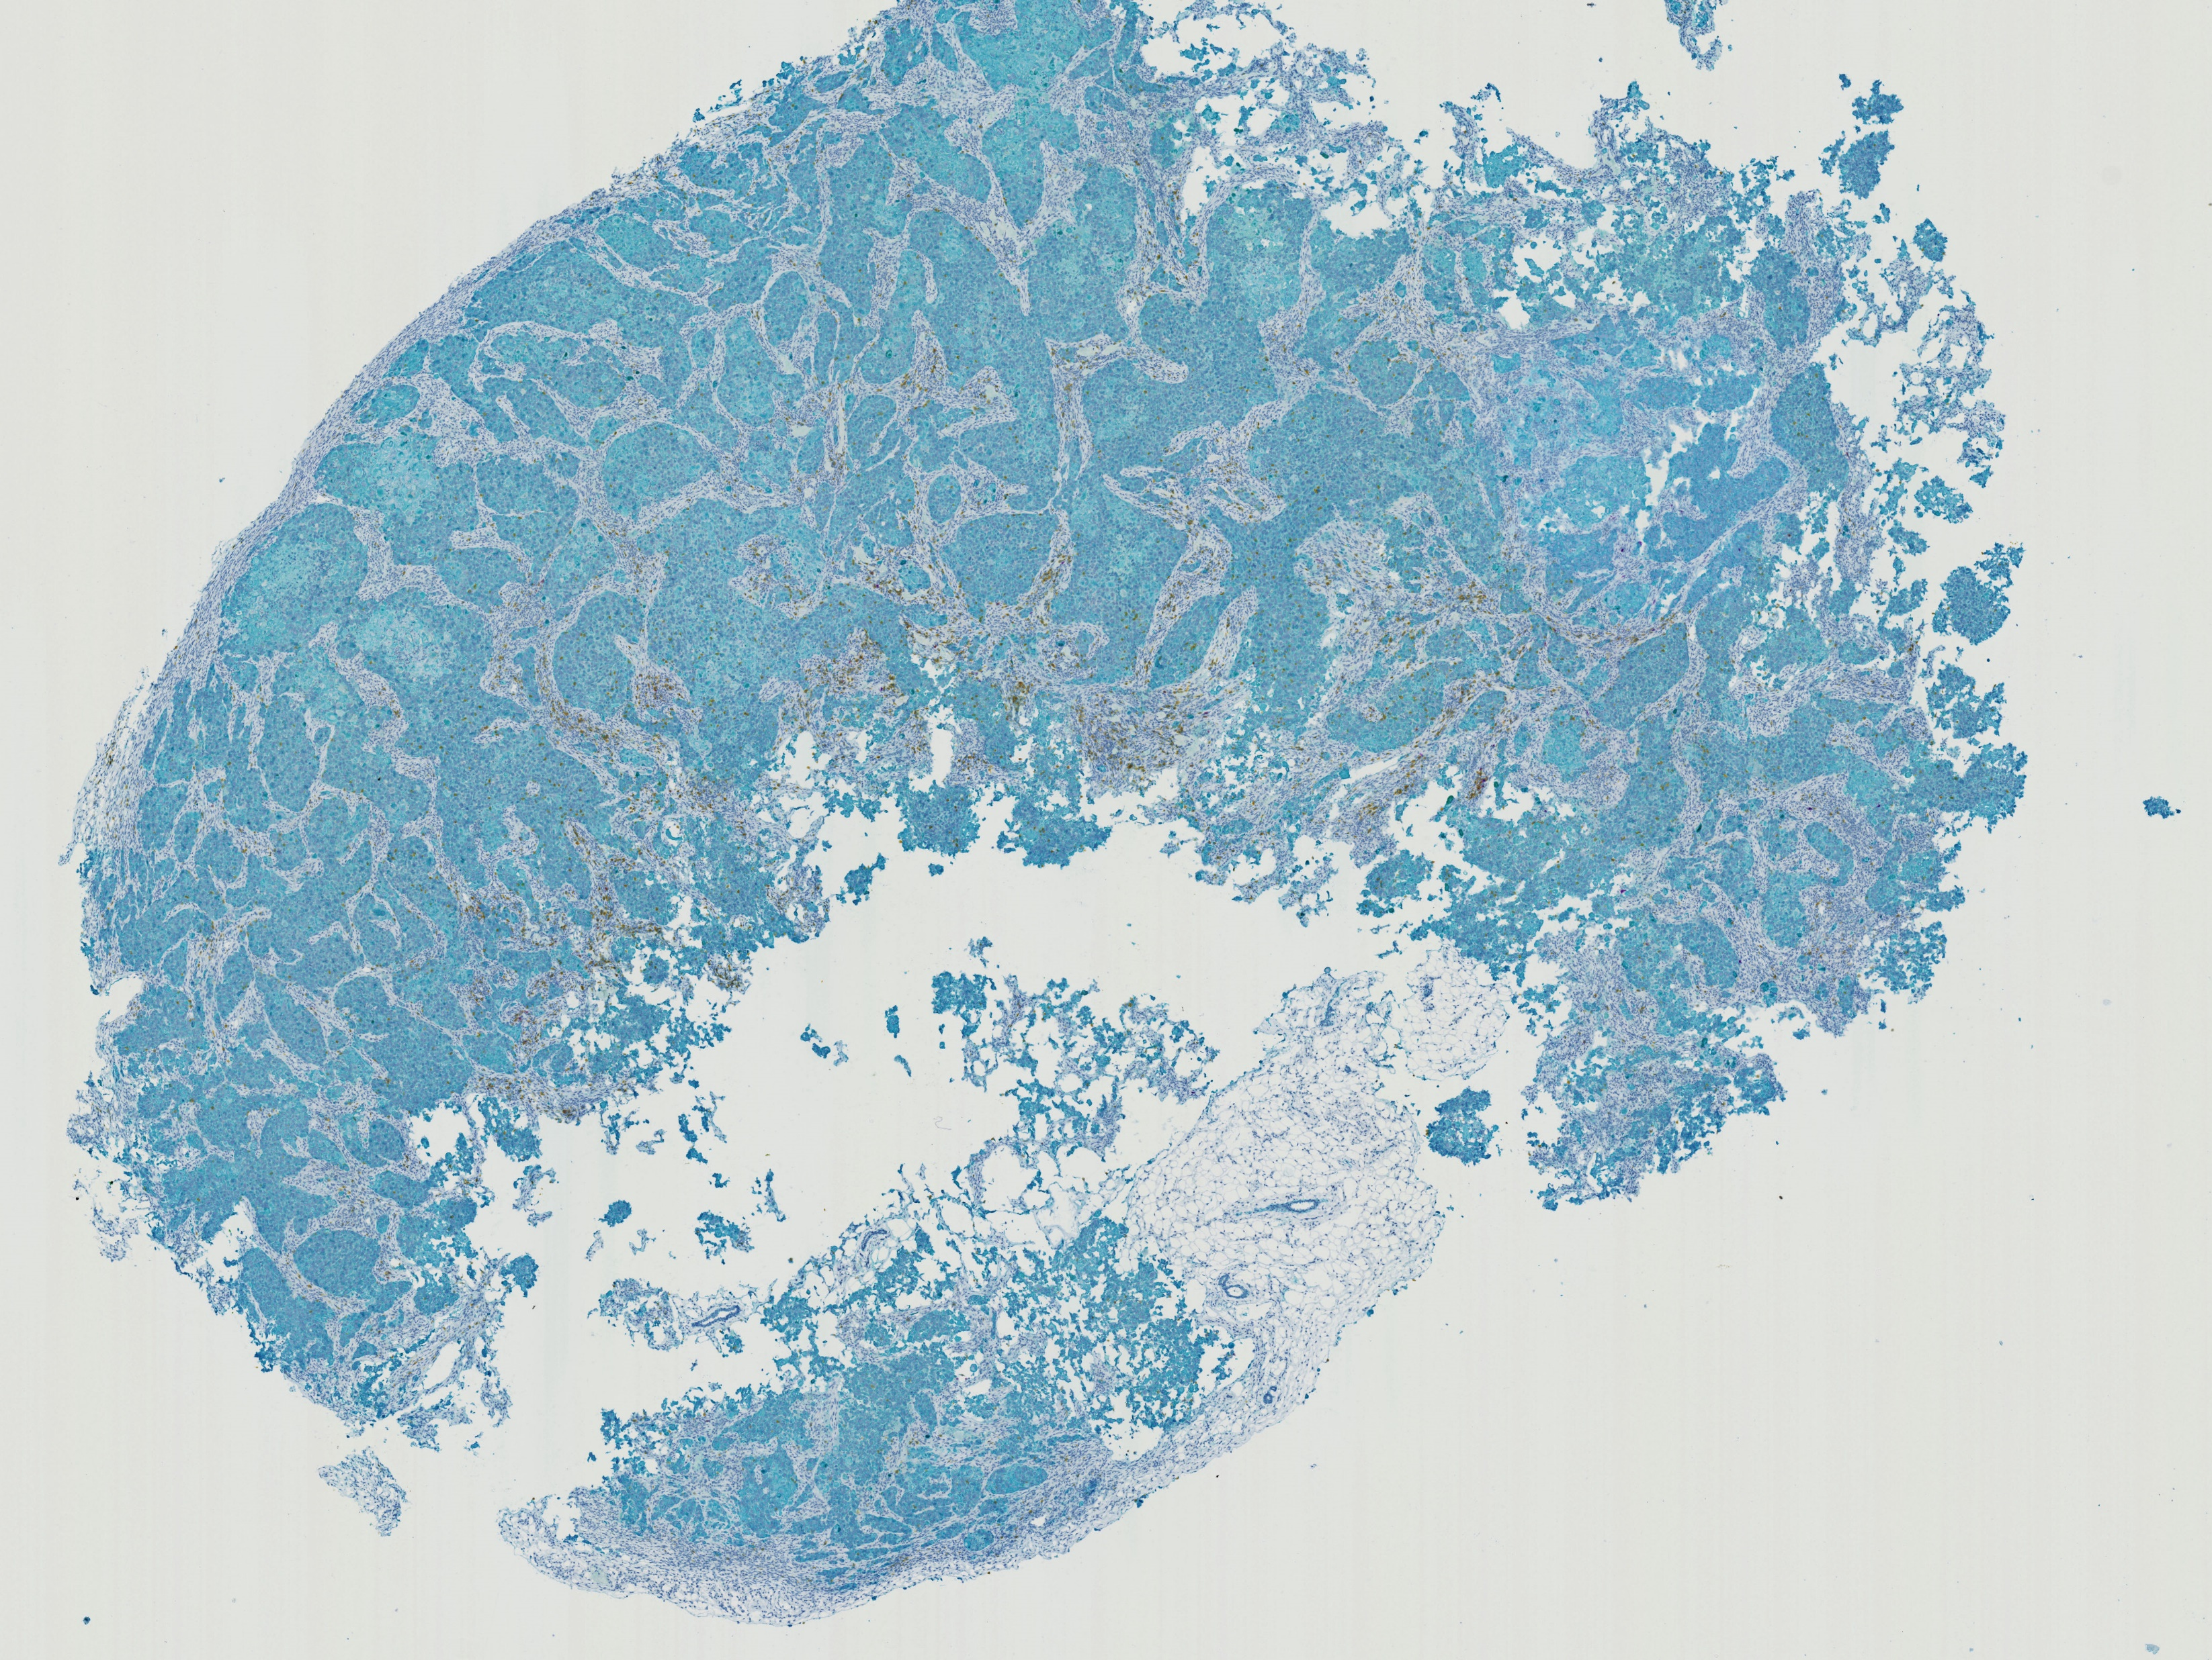
Fig 3i CD19 CAR

Slide 13
Fig 3i Nectin-4-CAR

Slide 14
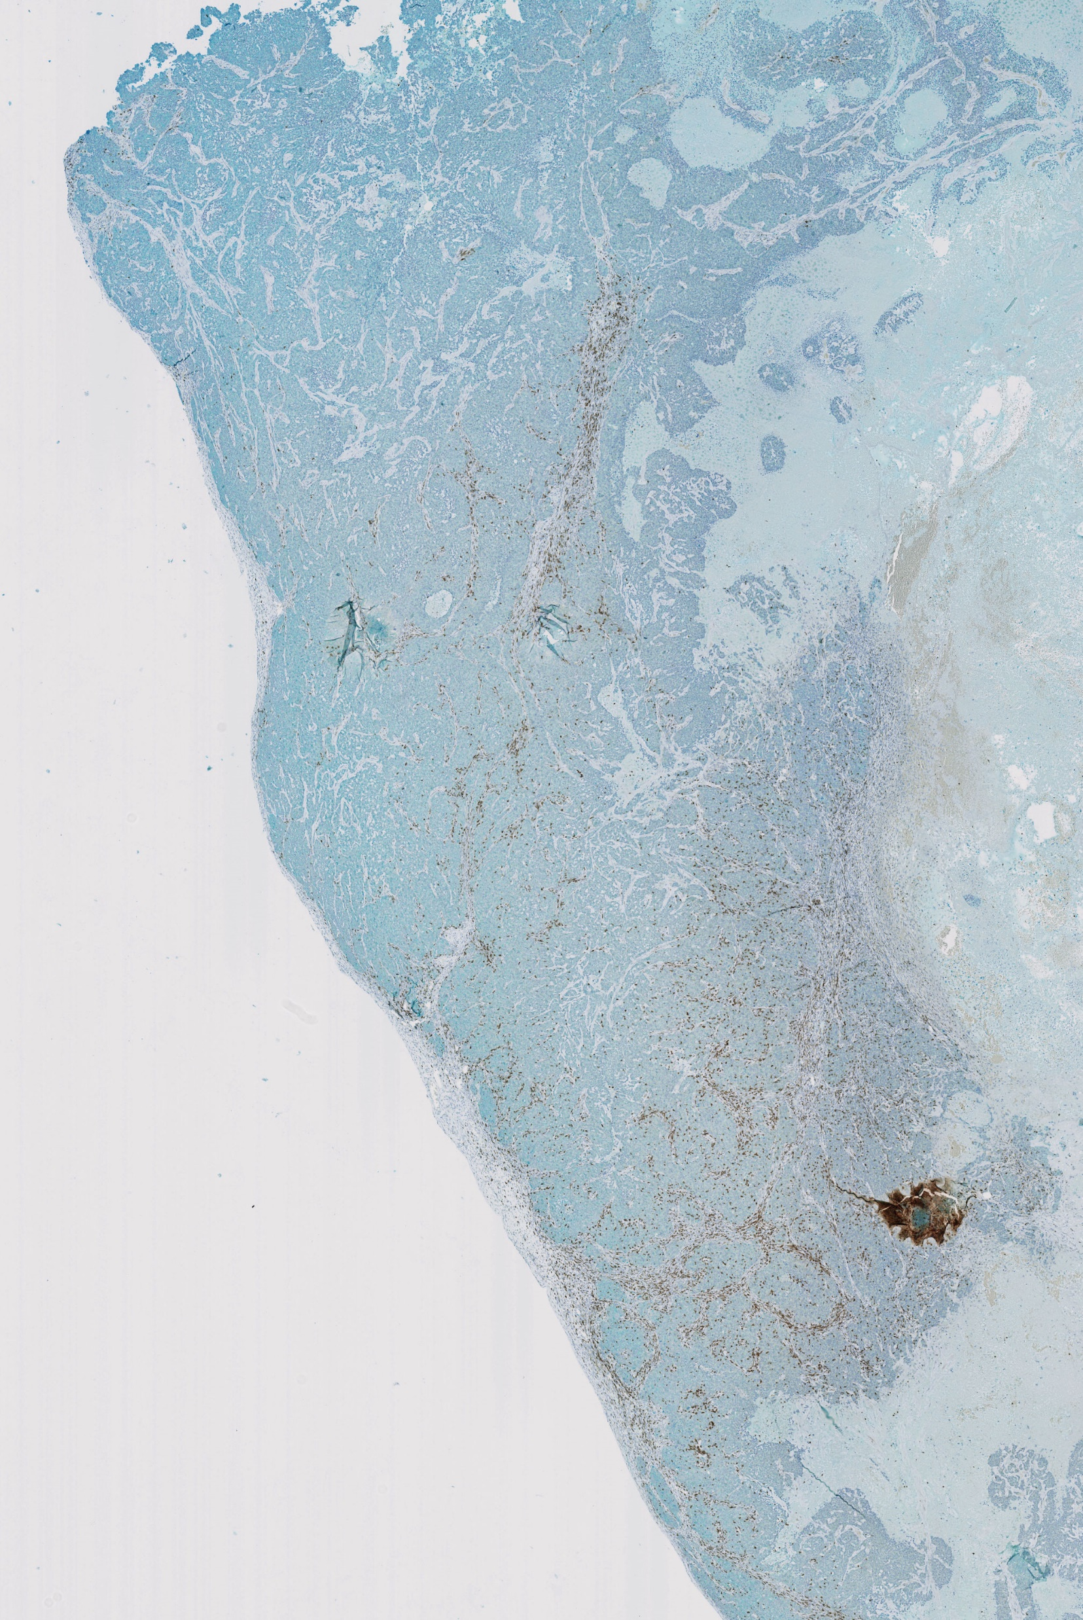
Fig 7D N4 CAR
X2.5
X20

Slide 15
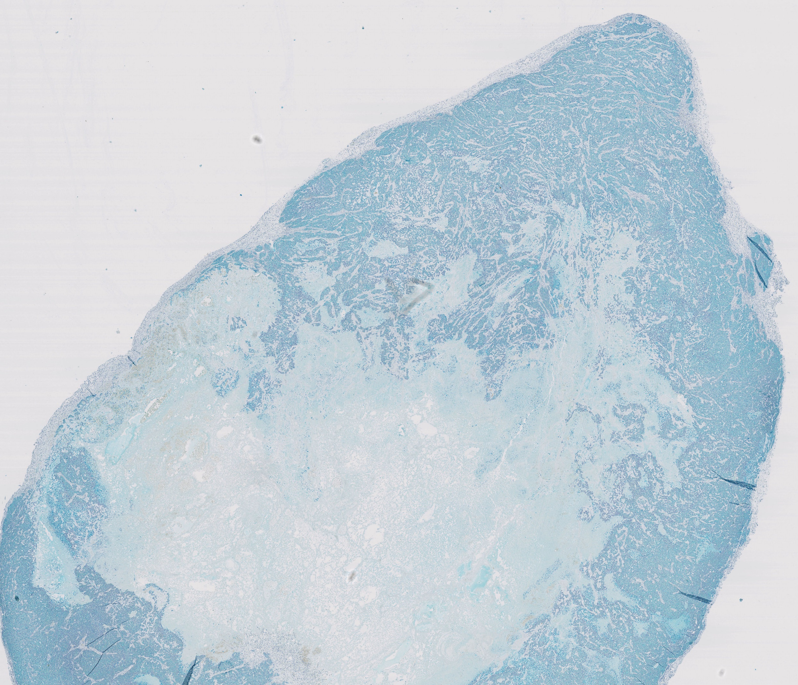
Fig 7D CD19 CAR
X20
X2.5

Slide 16
Fig S6 N4CAR

Slide 17
Fig S6 CD19 CAR

