Slide 1
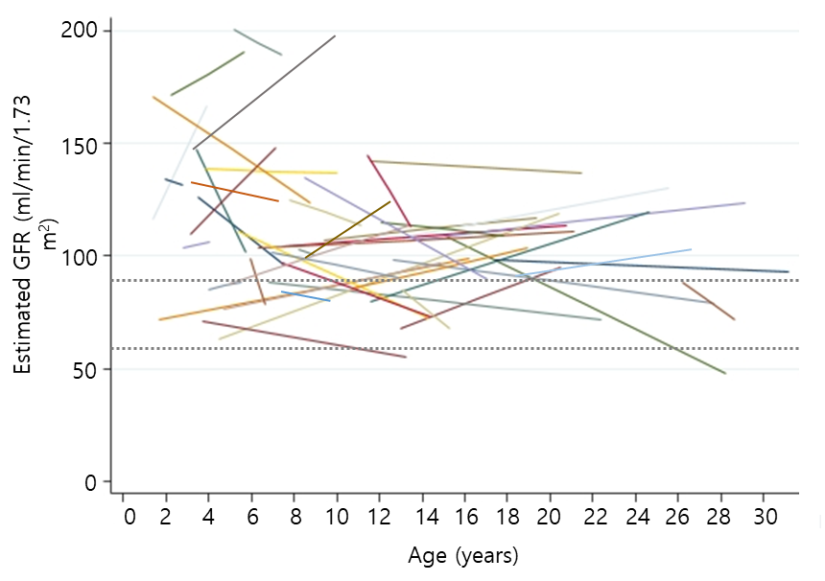
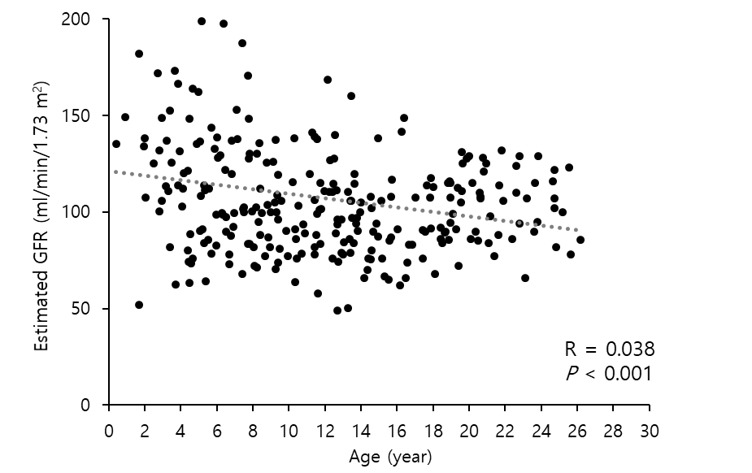
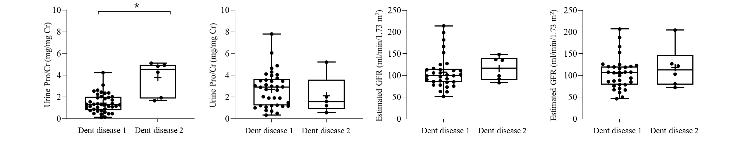
Clinical characteristics and genetic analyses
of Korean children with Dent disease
AIM: to assess the spectrum of genetic variants, clinical manifestations, and long-term outcomes in patients with Dent disease
DESIGN & OUTCOMES
Nationwide, retrospective
Long-term follow-up
Trajectory of kidney function
Pathogenic CLCN5 variants
42 patients
Median 6.8 years old
Proteinuria
Kidney function
At diagnosis
Last follow-up
At diagnosis
Last follow-up
Comparison of Proteinuria & kidney function
Pathogenic OCRL variants
6 patients
Median 5.7 years old
CONCLUSION: Over a third of Dent disease patients developed chronic kidney disease. Accordingly, clinicians should carefully monitor kidney function through the childhood.
Yang et al. 2025

