Slide 1
n=0
the escalating dose will be continued
1× 10⁴ (±30%)/kg (n = 3)
n=1
3 additional subjects will be enrolled
DLT or not
Clinical trial will
be stopped
Clinical trial will
be stopped
n≥1
n=0
n>1
5× 10⁴ (±30%)/kg (n = 3)
n=0
the escalating dose will be continued
n=1
3 additional subjects will be enrolled
Phase Ia
DLT or not
Clinical trial will
be stopped
Clinical trial will
be stopped
n≥1
n=0
n>1
1× 10⁵ (±30%)/kg (n = 3)
n=0
n=1
End of dose exploration
3 additional subjects will be enrolled
DLT or not
Clinical trial will
be stopped
n=0
Clinical trial will
be stopped
n≥1
End of dose exploration in phase Ia, selection of appropriate dose for phase Ib
n>1
Phase Ib
Dose expansion by selecting the appropriate dose for stage Ib
Figure.S1 Dose-escalation strategy in phase I trial

Slide 2
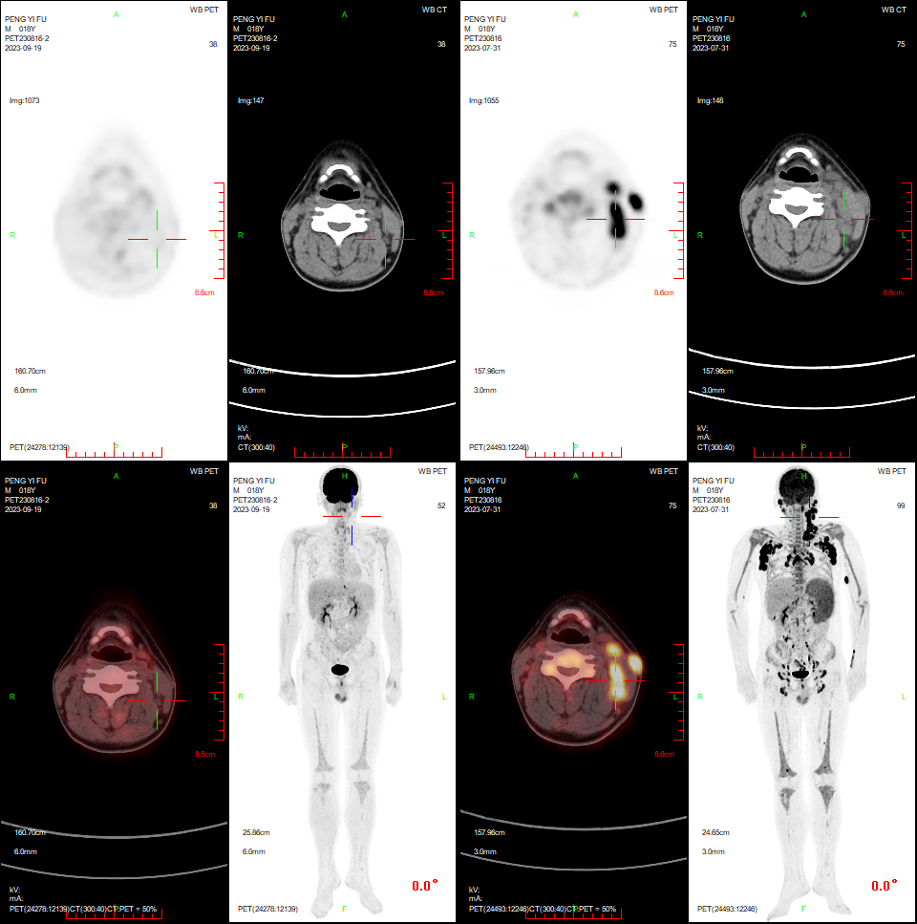
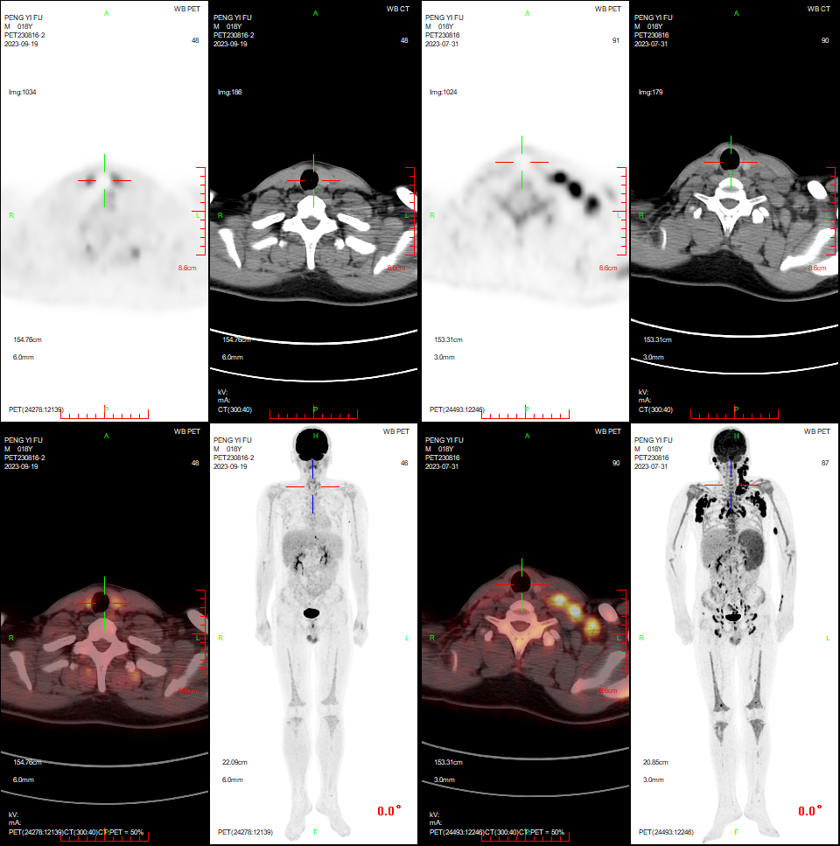
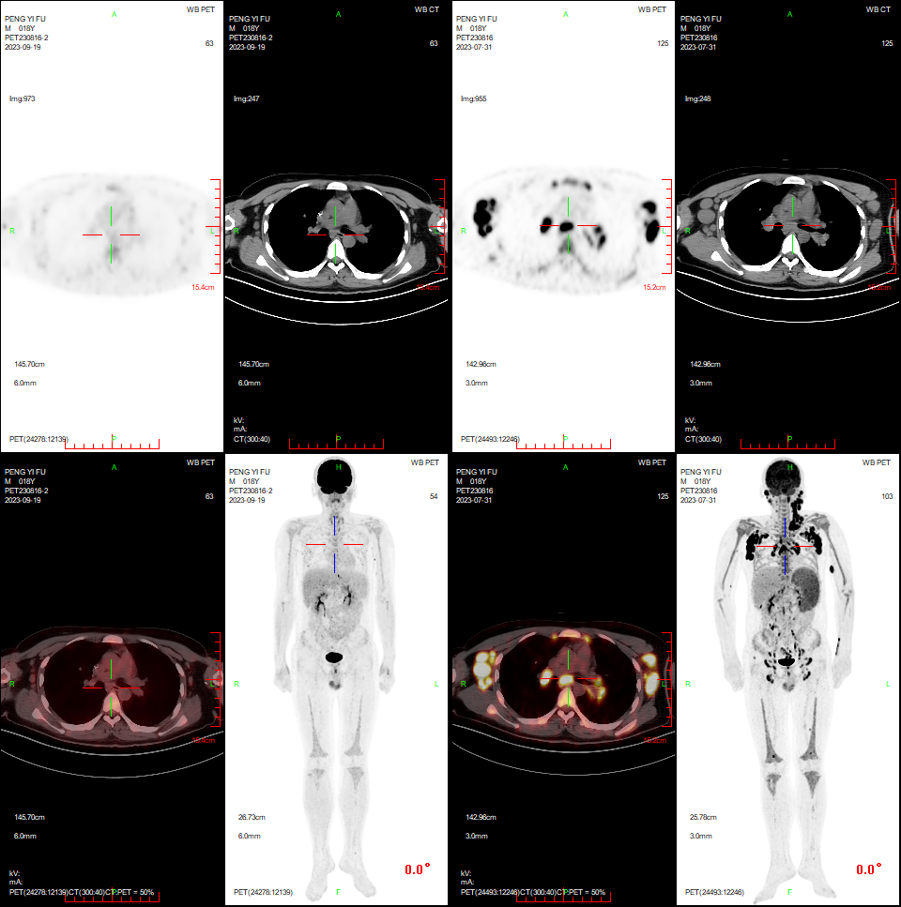
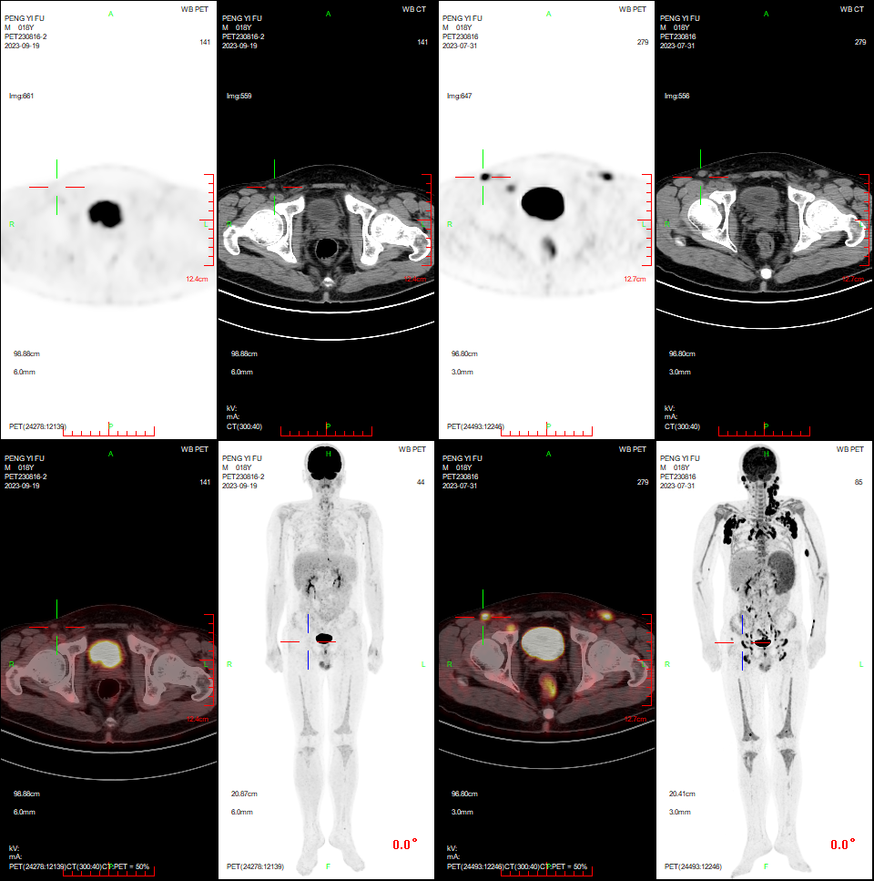
Pt033
Before treatment (PET/CT)
Day 28(PET/CT)

Slide 3
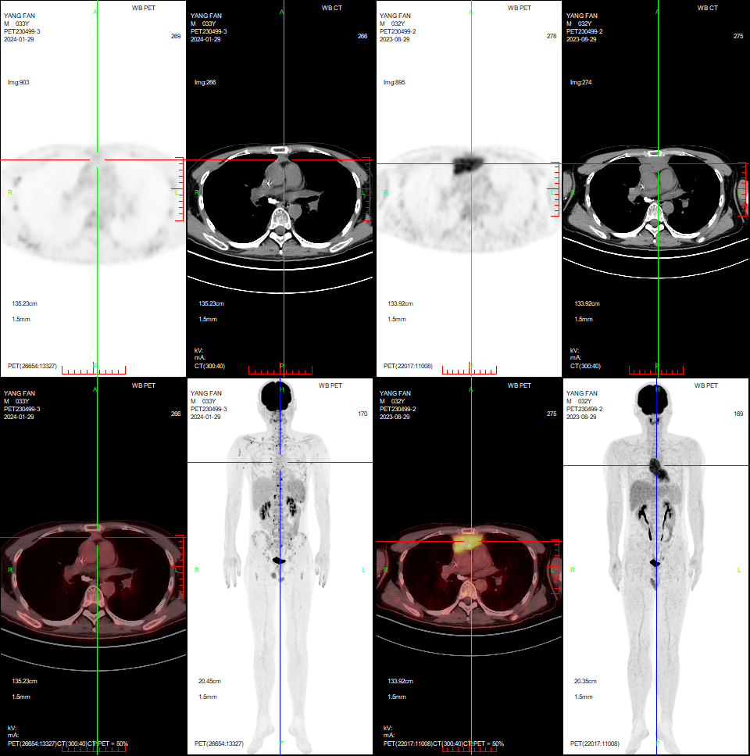
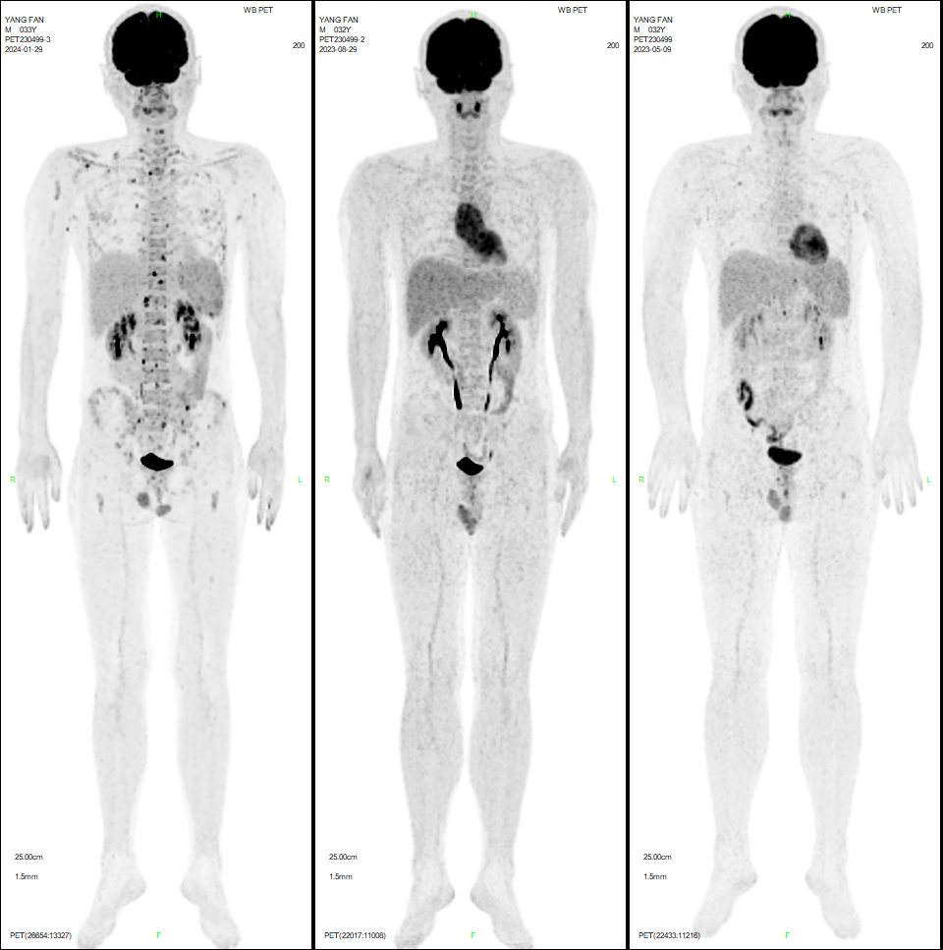
Pt 037
Before treatment (PET/CT) Day 30 (PET/CT）
Figure.S2A Complete Remission of Extramedullary Diseases in 033 Patients. Representative PET/CT scans of 2 patients before and after CAR T cell treatment showing the remission status in extramedullary lesions. Patient 033 had a left neck, armpit and groin lymphonode lesion,patient 037 had mediastinal mass. Following therapy with CD7 CAR T cells, patient 033,037 achieved complete remission. Abbreviations:PET/CT, position-emissiontomography.

Slide 4
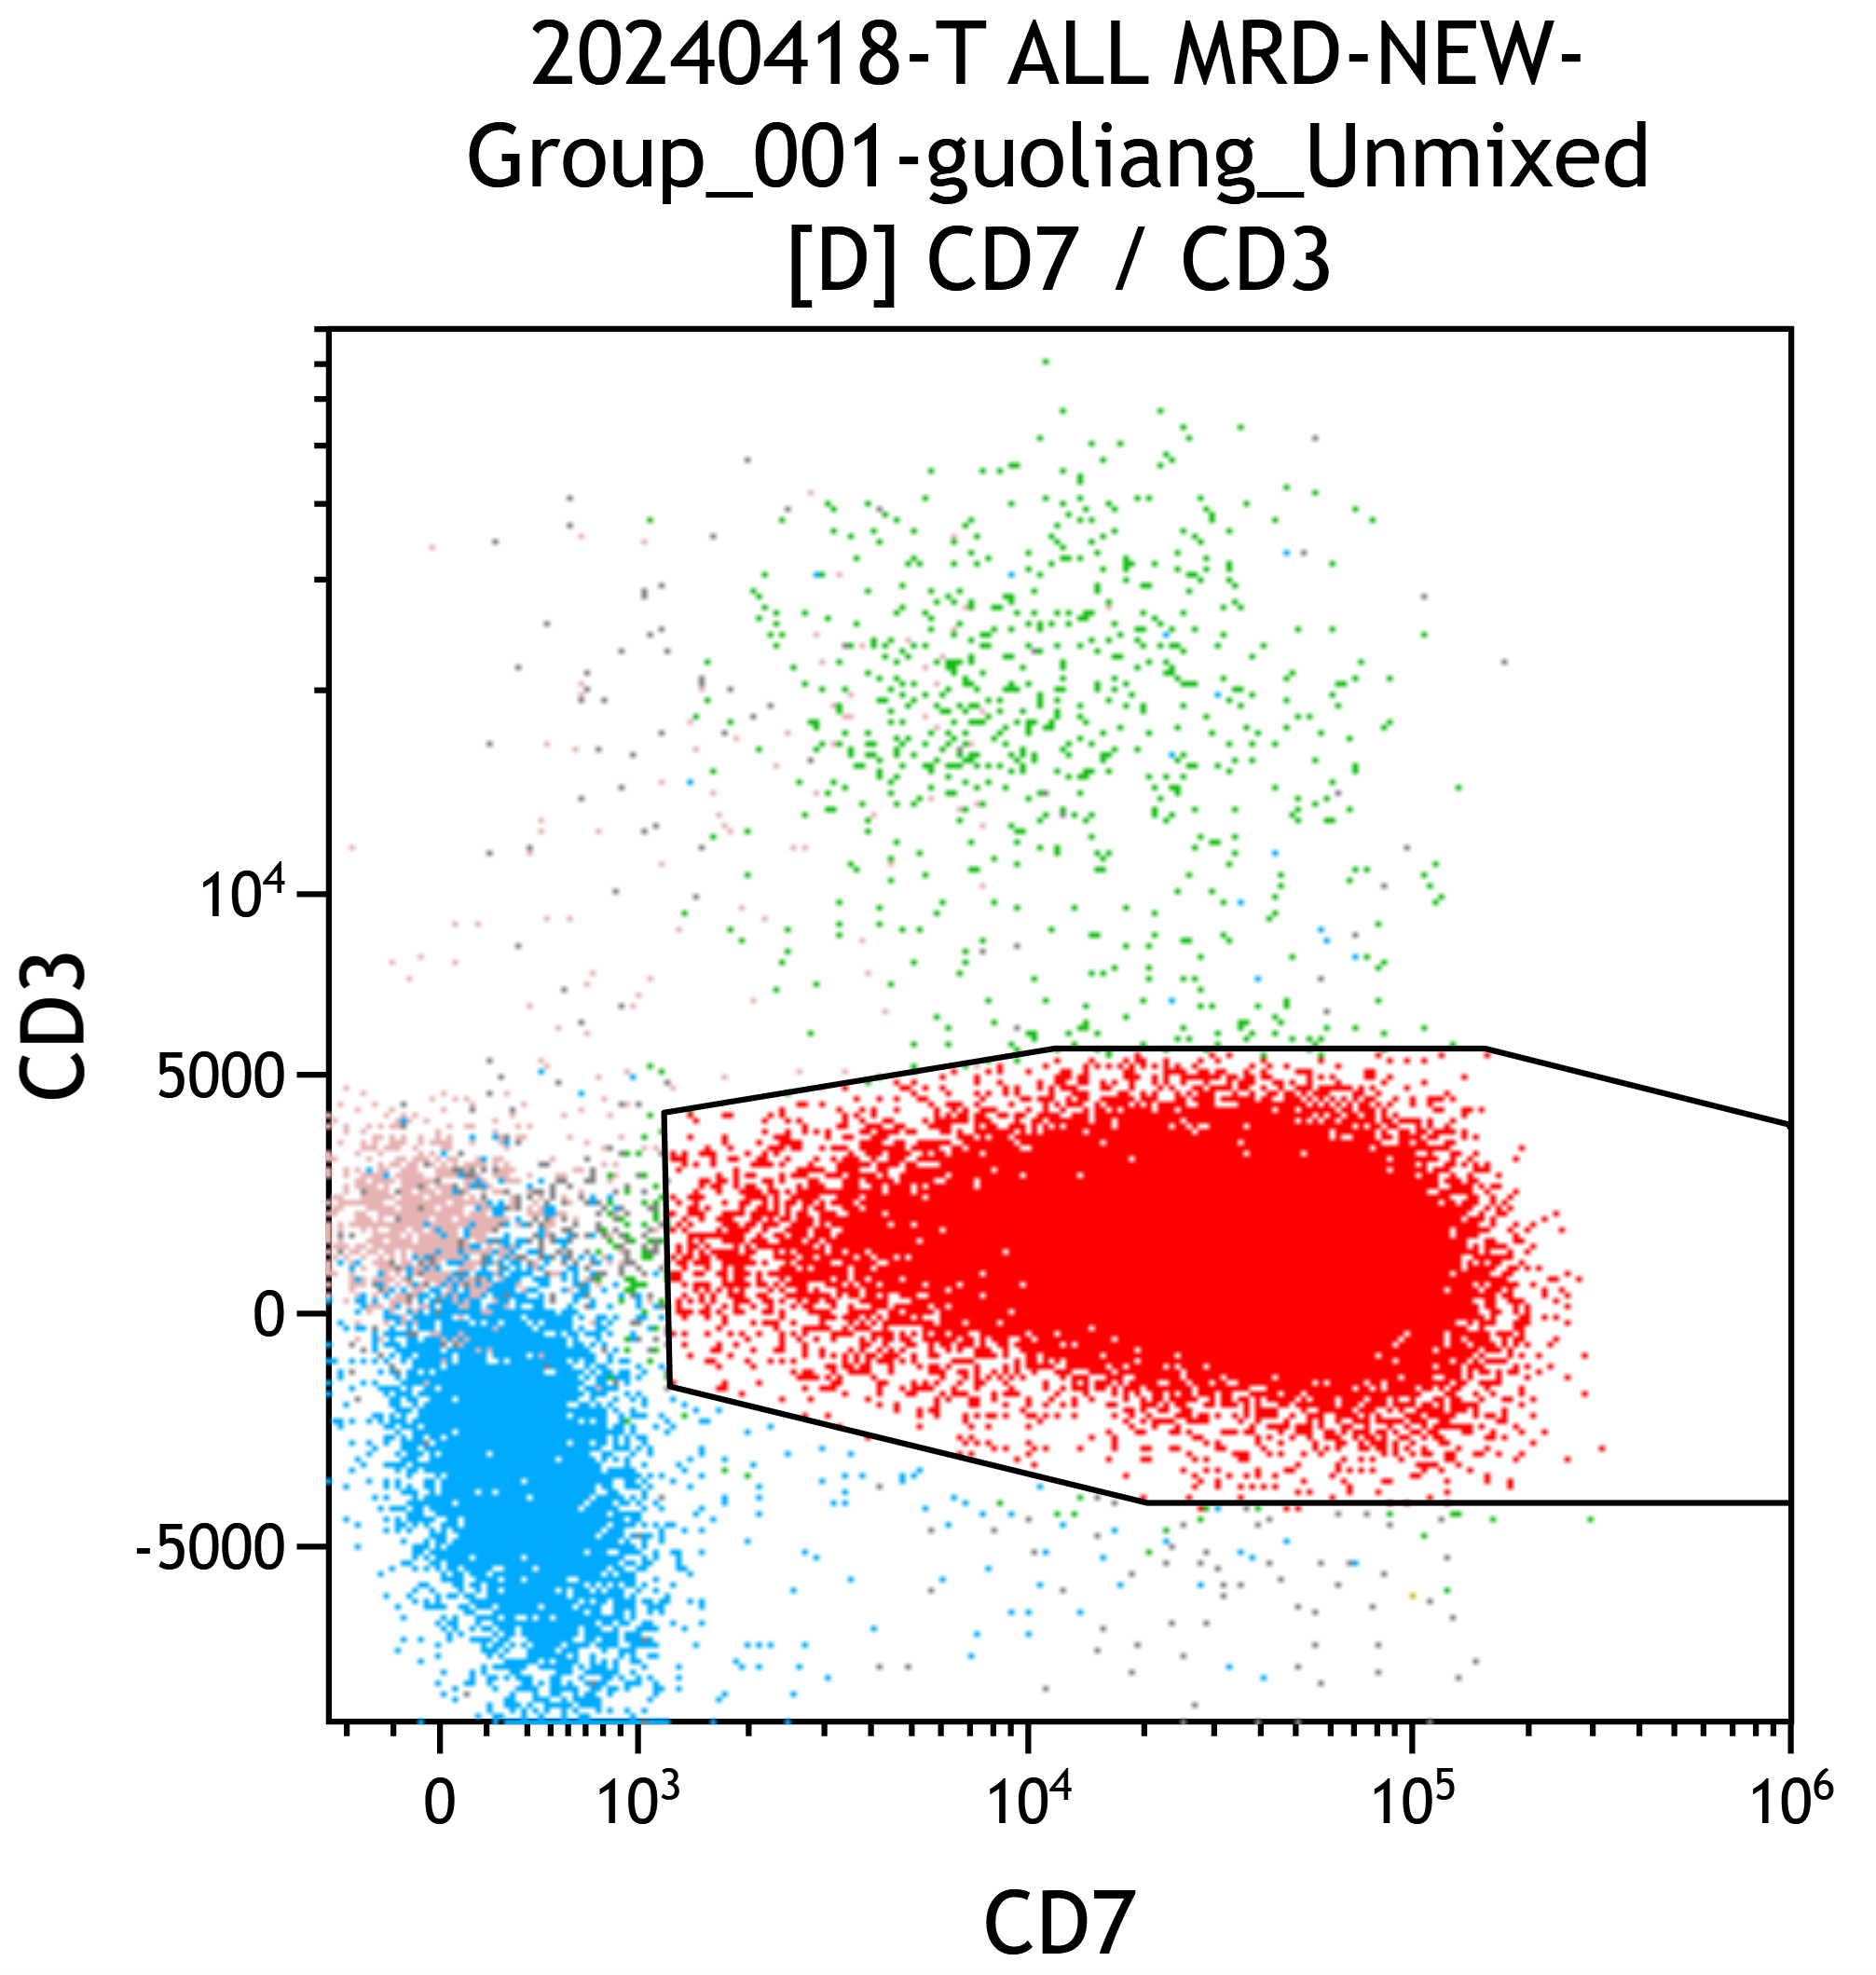
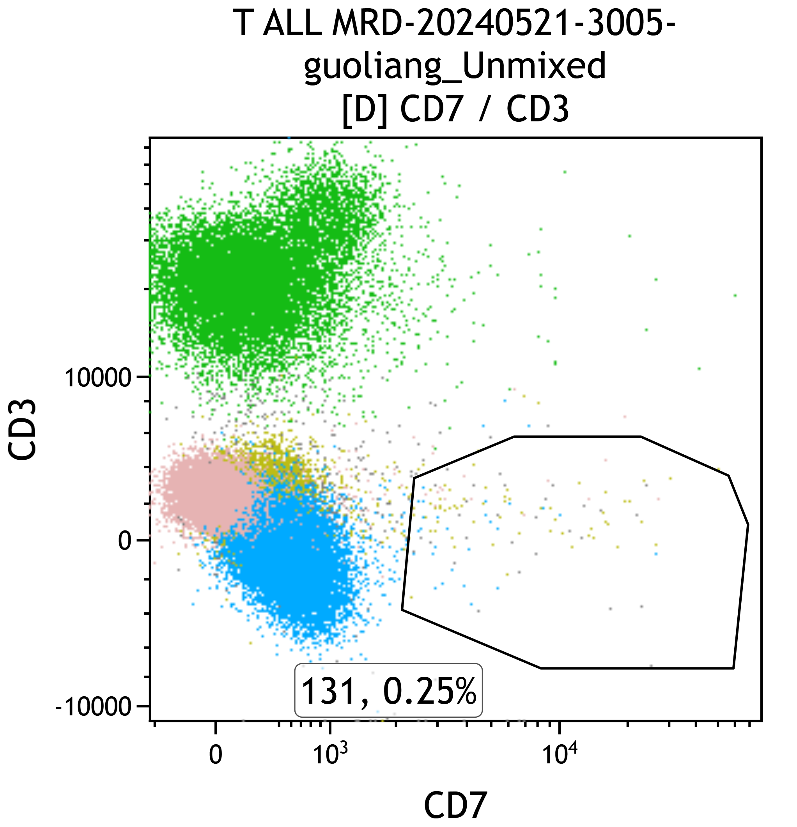
(A) Before treatment (B) Day 28 after CD7 CART infusion
Figure S2B Flow cytometry plots show blasts and normal T cells in the bone marrow of patient 009 at enrollment and remission. Red dots (A) indicate blasts among mononuclear cells. CD7 CAR T cells eliminated CD7+ blasts but allowed the presence of CD7- normal T cells (green dots in (B)) in the bone marrow of individual patients.

Slide 5
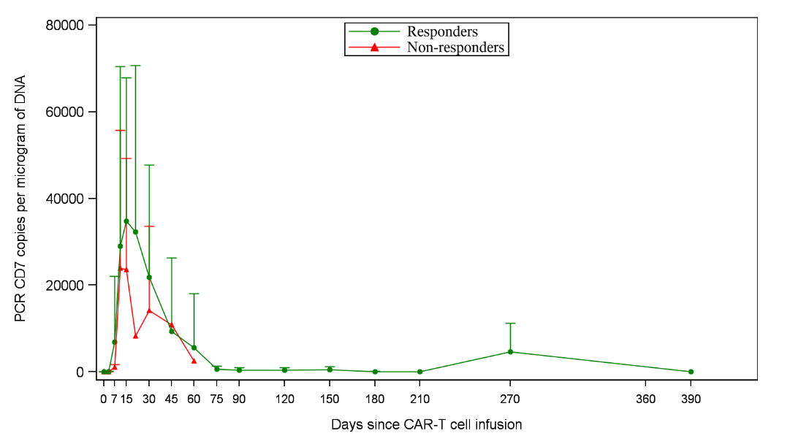
(A) (B)
Figure.S3 (A) The kinetics of CAR-T cells in the peripheral blood of individual patients, as determined by flow cytometry. (B) The kinetics of CAR transgene copies per microgram of genomic DNA of PBMCs in individual patients, as determined by PCR. In (A) and (B), panels were separated according response to CAR-T therapy, with each dose being assigned a unique color. The CAR-T cell pharmacokinetics were discontinued to be followed after SCT according to protocol.

Slide 6
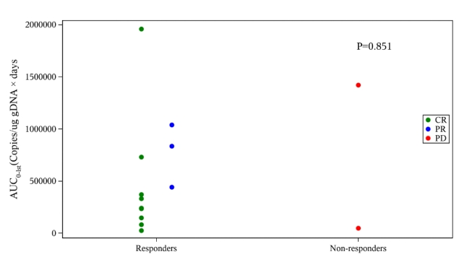
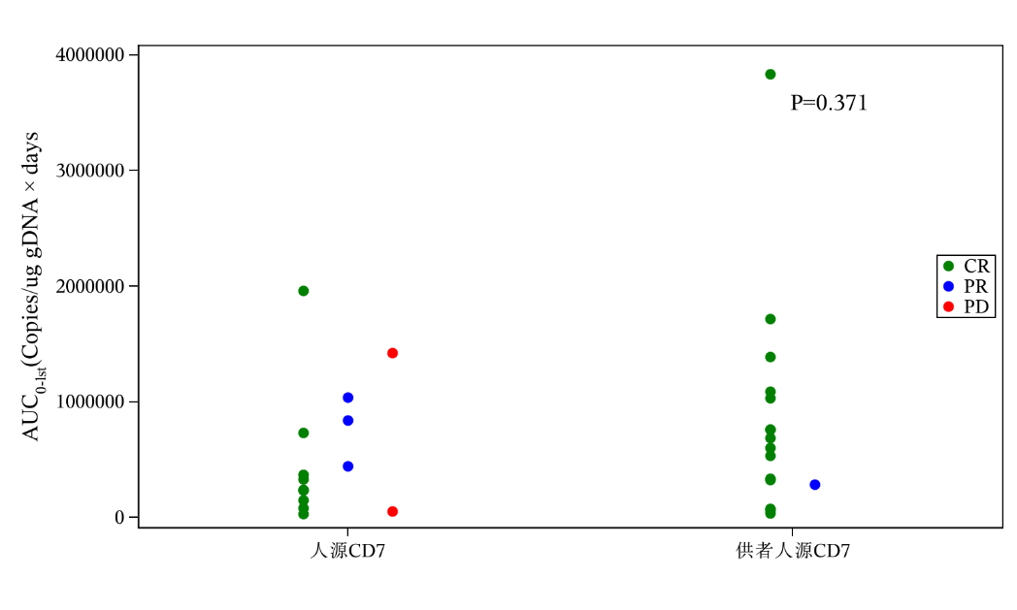
Responders Non-responders
Autologous CD7-CART Donor-derived CD7-CART
(A) (B)
Figure.S4 AUC of CAR T cells in the peripheral blood according to response on day 30 (A) or T-cell origin (B).

Slide 7
(A) (B)
Figure.S5 Pharmacokinetic profiles of CAR-T cells in three refractory patients(Pt 003,011,025), with each patient represented by a distinct color. (A) The kinetics of CAR-T cells in the peripheral blood of individual patients, as determined by flow cytometry. (B) The kinetics of CAR transgene copies per microgram of genomic DNA of PBMCs in individual patients, as determined by PCR.

Slide 8
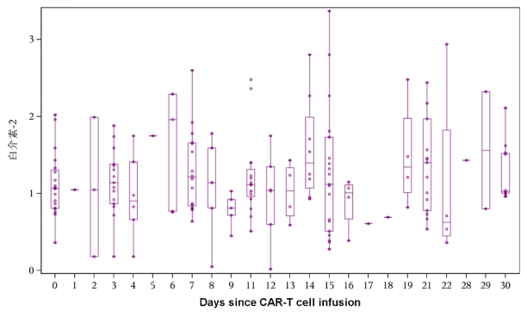
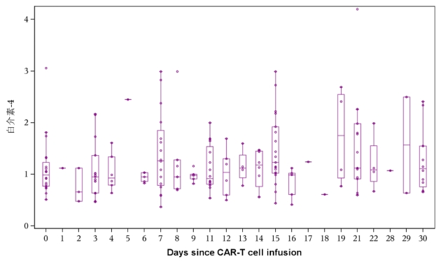
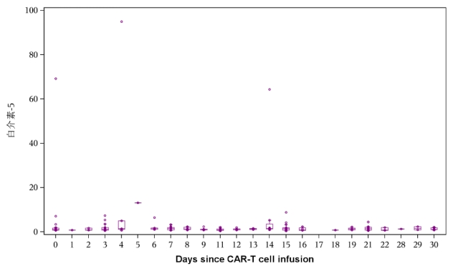
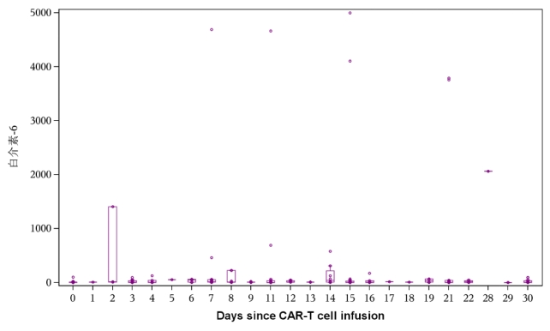
Interleukin 2 (pg/ml)
Interleukin 4 (pg/ml)
Interleukin 5 (pg/ml)
Interleukin 6 (pg/ml)

Slide 9
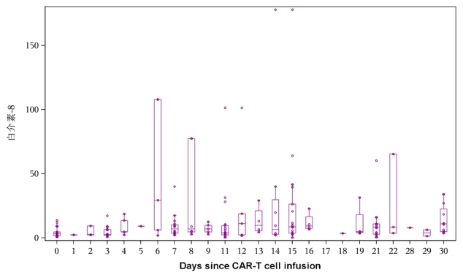
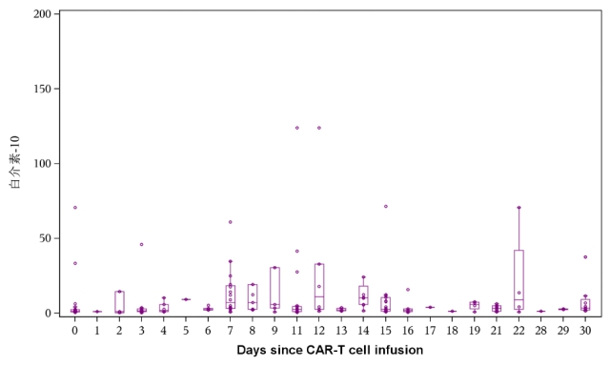
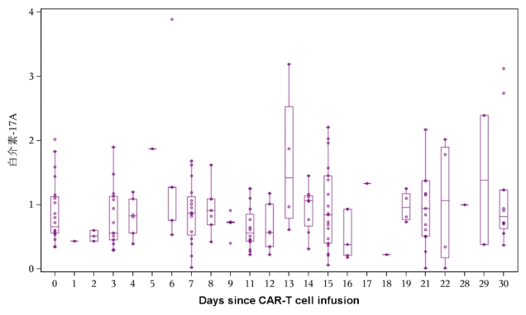
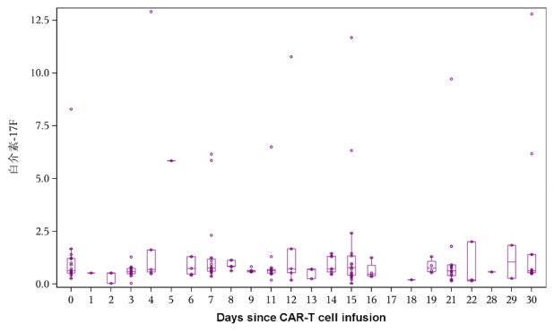
Interleukin 8 (pg/ml)
Interleukin 10 (pg/ml)
Interleukin 17A (pg/ml)
Interleukin 17F (pg/ml)

Slide 10
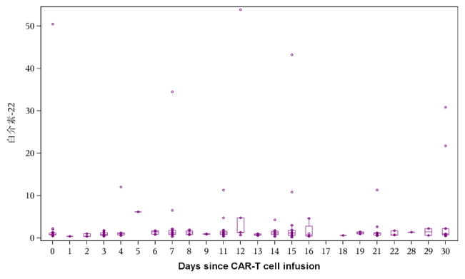
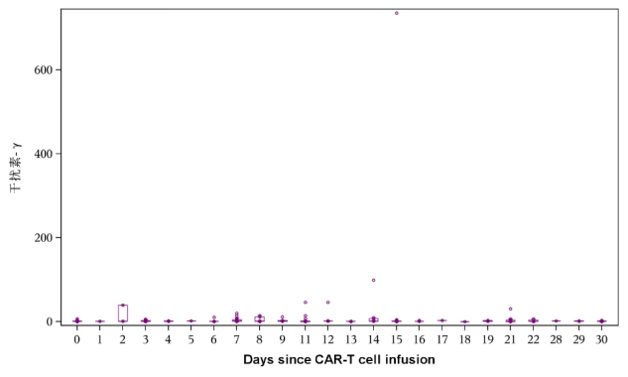
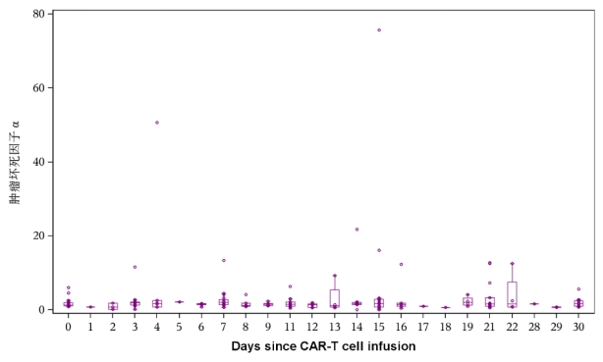
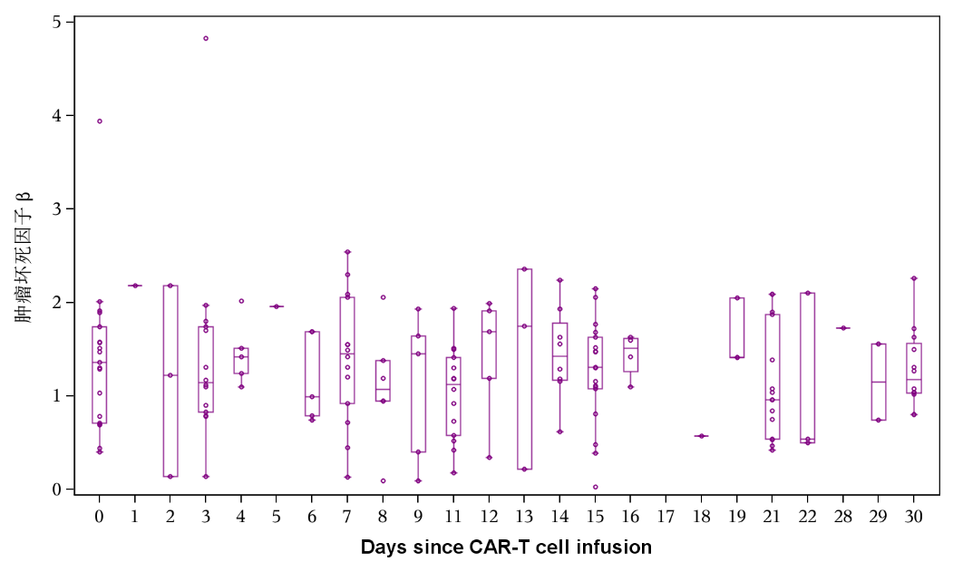
Interferon γ (pg/ml)
Interleukin 22 (pg/ml)
Tumor Necrosis Factor α (pg/ml)
Tumor Necrosis Factor β (pg/ml)
Figure.S6 Biomarkers in the Serum.
Shown are the levels of biomarkers in serum of individual patients, as determined by flow cytometry.

Slide 11
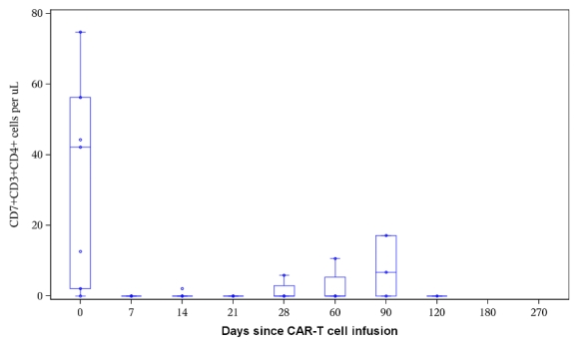
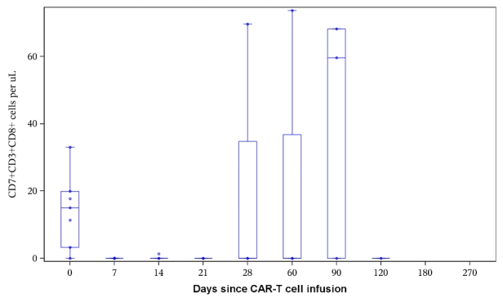
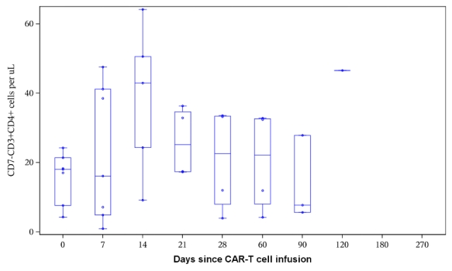
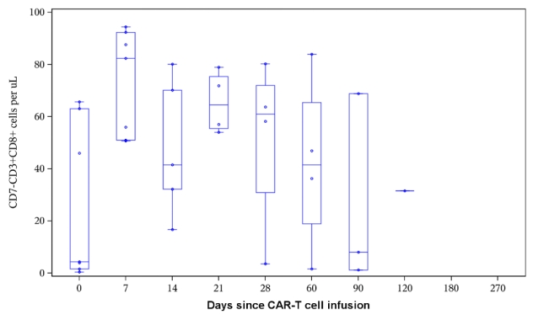
Figure.S7 Different T Cell Subpopulations in the Peripheral Blood.
Absolute numbers of CD7-CD3+CD4+, CD7+CD3+CD4+, CD7-CD3+CD8+ and CD7+CD3+CD8+ T cells at different time points since CAR T cell infusion in the peripheral blood of individual patients, as determined by flow cytometry.CAR T and leukemia cells were excluded in this analysis.

Slide 12
(A) (B)
Supplementary Fig Pharmacokinetic profiles of CAR-T cells in patients with severe CRS(Pt 010,012) and ICANS(Pt 010,026), with each patient represented by a distinct color. (A) The kinetics of CAR-T cells in the peripheral blood of individual patients, as determined by flow cytometry. (B) The kinetics of CAR transgene copies per microgram of genomic DNA of PBMCs in individual patients, as determined by PCR.

