Slide 1


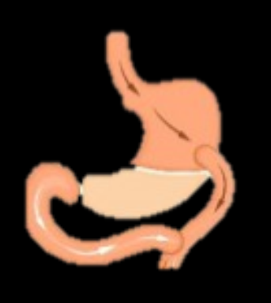


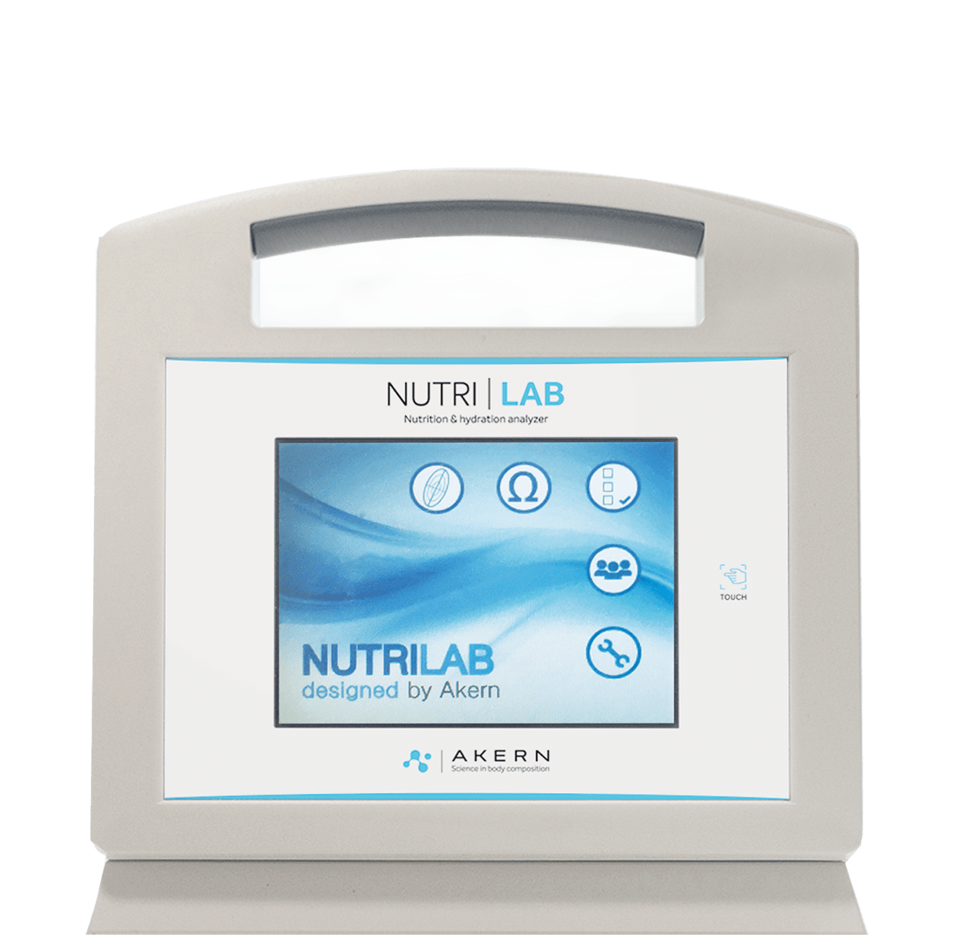


“Effect on Body Composition of Protein Supplementation During the First Six Months After Bariatric Surgery”
Conclusion
METHODS
RESULTS
CONCLUSIONS
181 patients
There was maintenance of lean mass index (LPD -1.37 (0.69) kg vs.HPD +0.31 (0.79) kg; p = 0.01) in HPD patients at one month, with no differences in fat mass loss.
At six months, there was less los
of lean mass index (LPD -2.75 (2.01) kg vs.HPD -1.24 (2.06) kg; p = 0.00) and phase angle (LPD -1.25 (51.77) kg vs. HPD +0.83 (0.12) kg; p = 0.01) in HPD patients.
The administration of a normocaloric, high-protein oral nutritional supplement during the first weeks after bariatric surgery was associated with greater preservation of lean mass index and phase angle, without compromising medium-term fat mass loss.
Although the group without supplementation showed greater total weight loss, this difference could be attributed to a greater reduction in fat-free mass, which may have negative implications for patient functionality and nutritional status.
217 kcal->11,70 g protein
817kcal->65,70 g protein
Pre-surgery
1-month
6-months
Patients on HPD showed maintenance of lean mass index and phase angle compared to those on LPD during the first six months after bariatric surgery
Notes:
LU Biter, MMA Van Buuren, GHH Mannaerts
JA Apers, M Dunkelgrun, GHEJ Vikgen, May 2017

