Slide 1
Fig.S1
CAP-H2-GFP
CAP-D3-GFP
Supplementary Figure S1. Spot-like condensin II localisation in nuclei of the root meristem.
Condensin II localisation visualised by fluorescent protein (green) produced by the pCAP-H2::CAP-H2-GFP and pCAP-D3::CAP-D3-GFP transgenes in interphase nuclei in the root meristem around the stem cell niche (the root-tip is on the right). Arrowheads indicate nuclei with a spot-like localisation of condensin II. The images are shown as maximum z-projections. Bars = 50 μm.

Slide 2
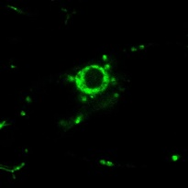
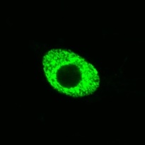
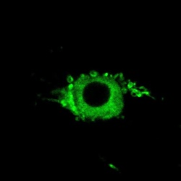

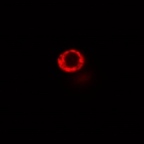
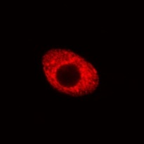
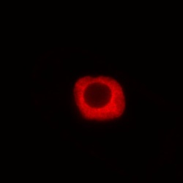
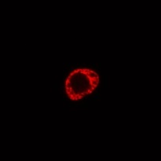
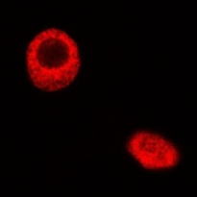
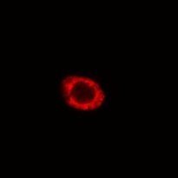
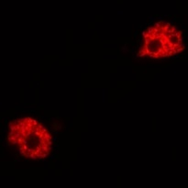
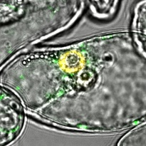
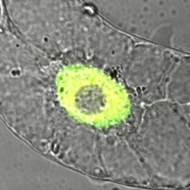
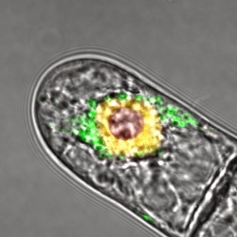
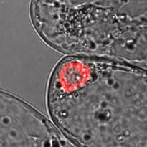
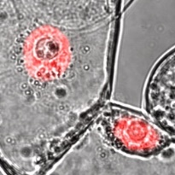
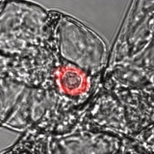
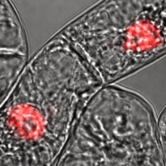
Fig.S2
Positive
control
Negative
controls
nYFP-CAP-G2
cYFP-SUN1
cYFP-CAP-H2
nYFP-SUN2
nYFP-SUN2
cYFP-SUN2
cYFP-GUS
nYFP-CAP-G2
nYFP-GUS
cYFP-SUN1
nYFP-GUS
cYFP-CAP-H2
cYFP-GUS
nYFP-SUN2
YFP
H2B-tdTomato
Merged
Supplementary Figure S2. Condensin II components interact with SUN proteins.
Bi-FC assays showing that condensin II subunits GAP-G2 and CAP-H2 interact with SUNs in planta. Different combinations of genes were transiently expressed in tobacco BY-2 cells as positive and negative controls. Bar = 5 μm.

Slide 3
Fig.S3
Col-0
*
cap-h2-2
*
crwn1/4
*P < 0.001
Supplementary Figure S3. Mutations affecting condensin II and CRWNs reduce the number of separated centromere signals.
The number of separated centromere signals per nucleus was counted. Centromeres were visualised using 35S::tdTomato-CENH3. The frequency distribution of the number of centromere signals in each mutant was statistically compared to that in the wild type using a chi-squared test (*, p < 0.01, n = 40).

Slide 4
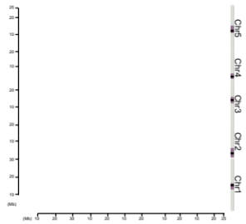
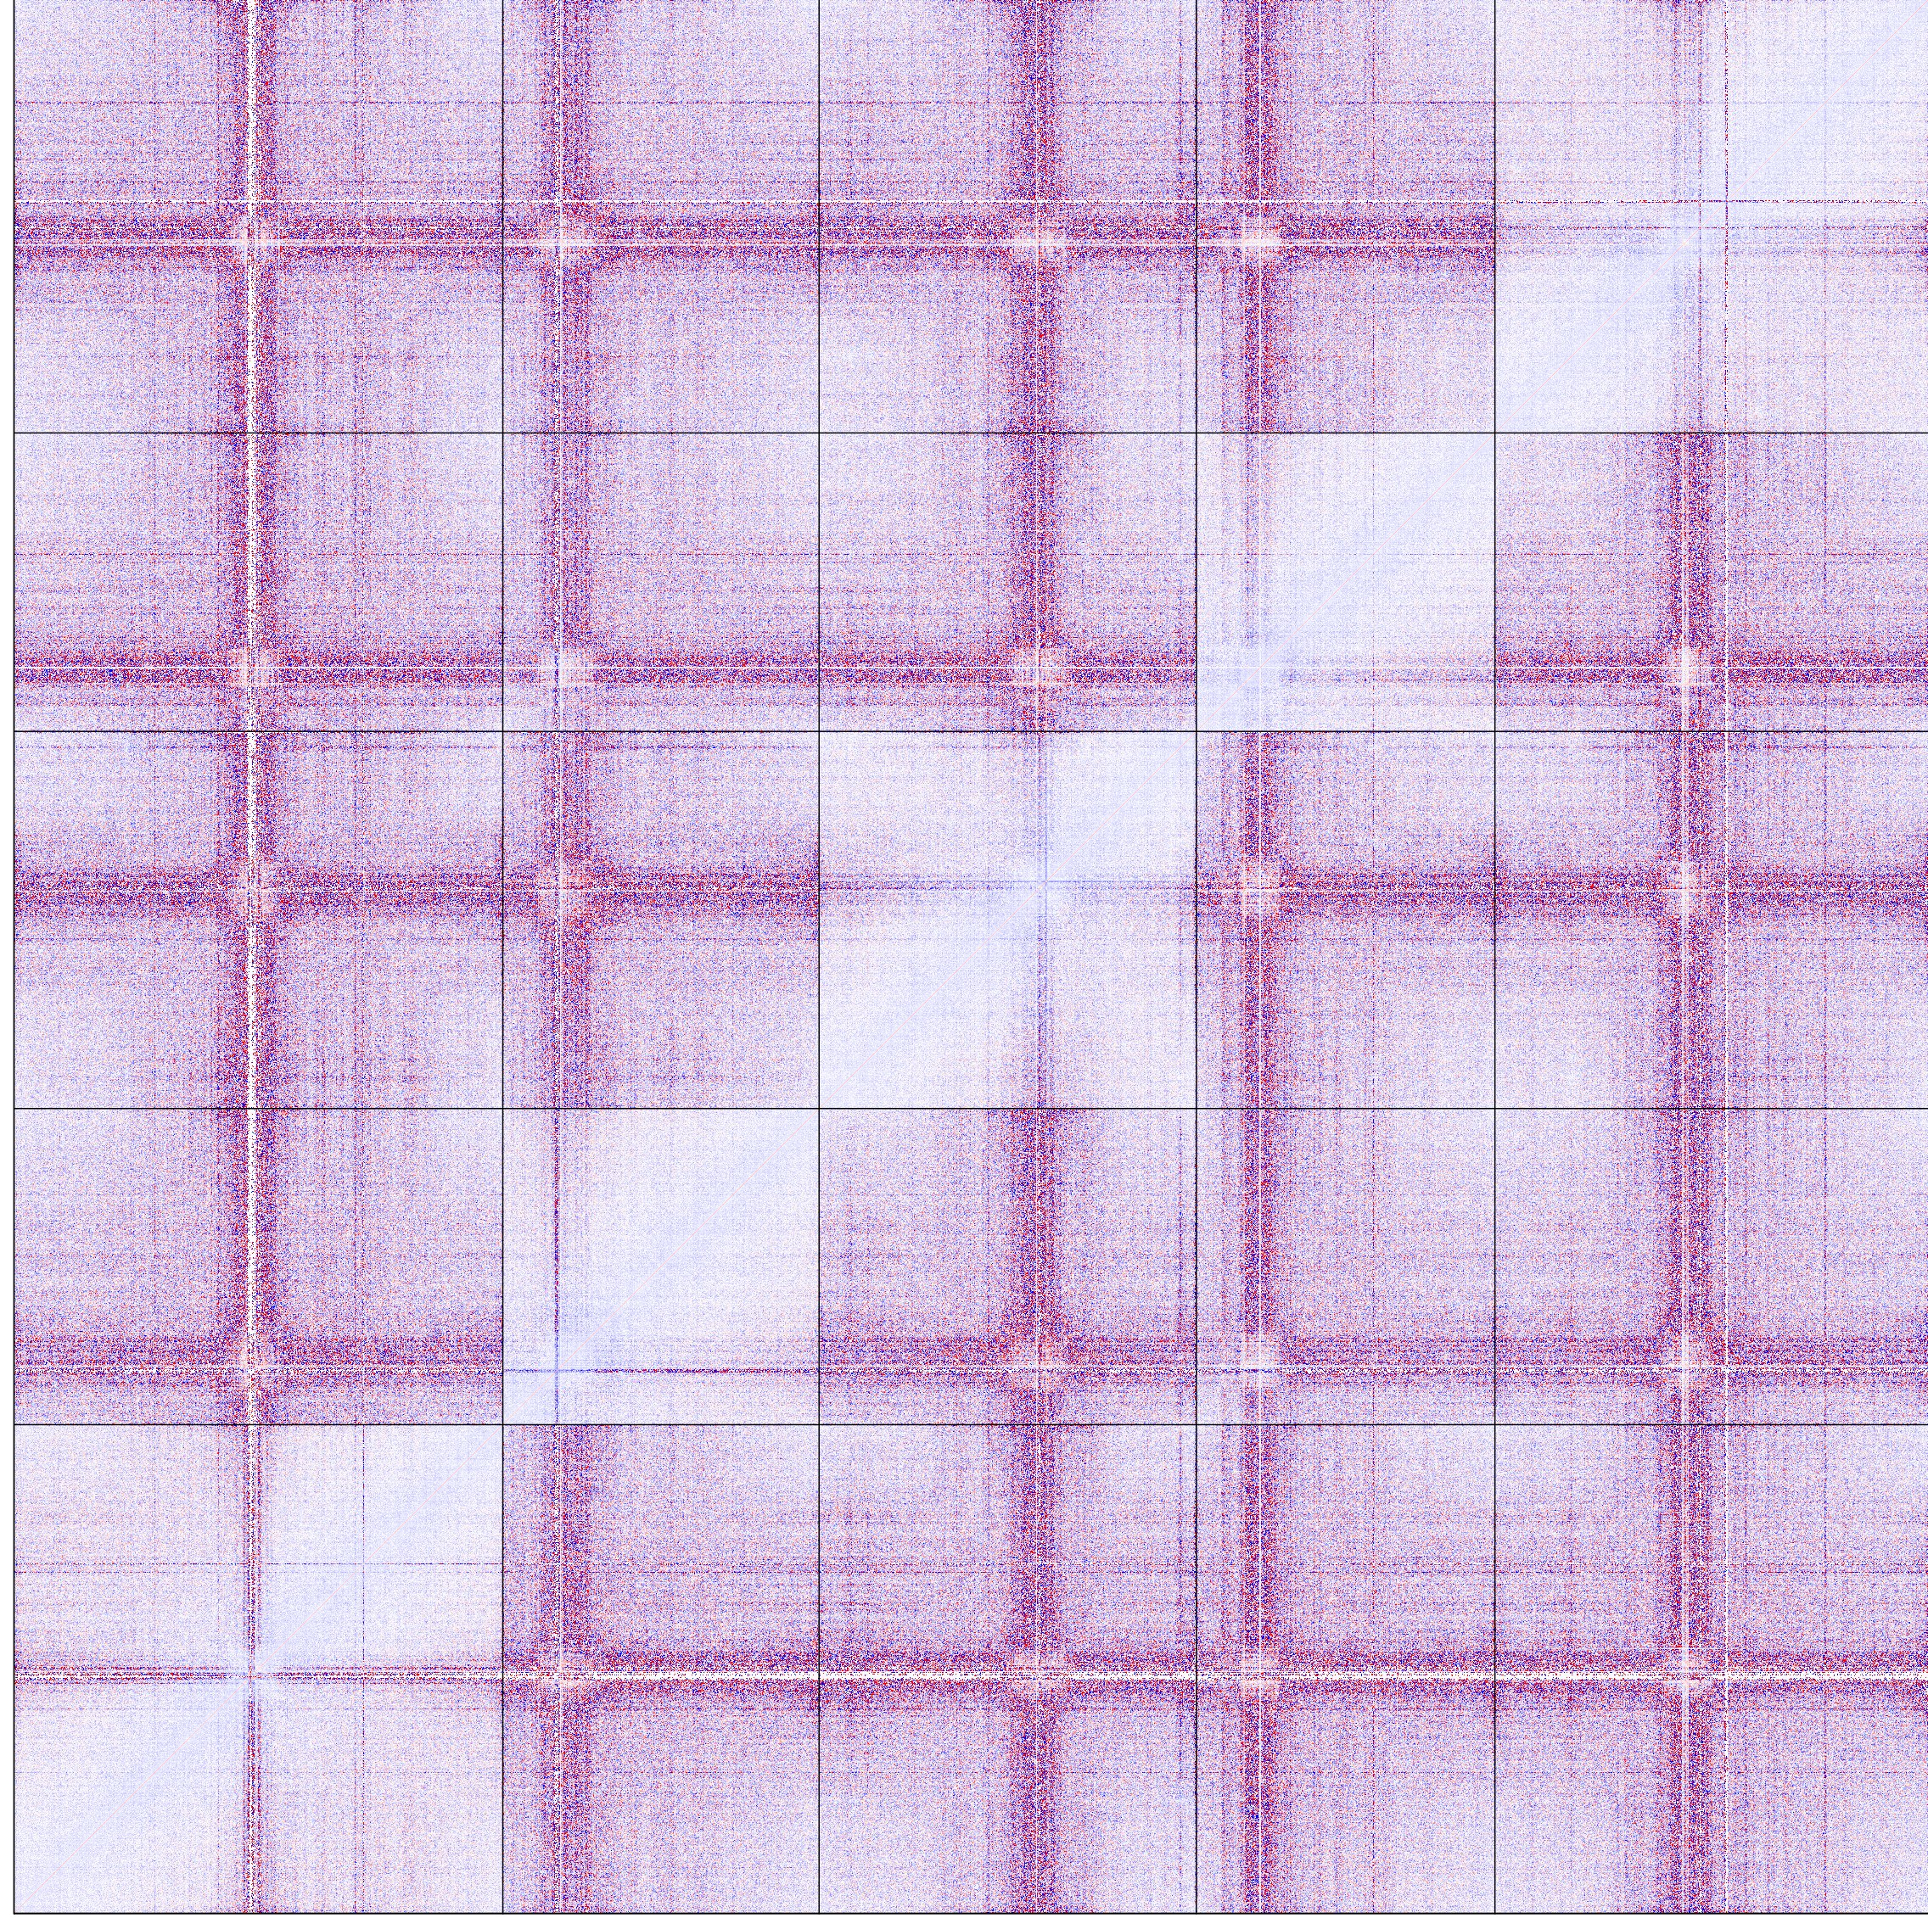
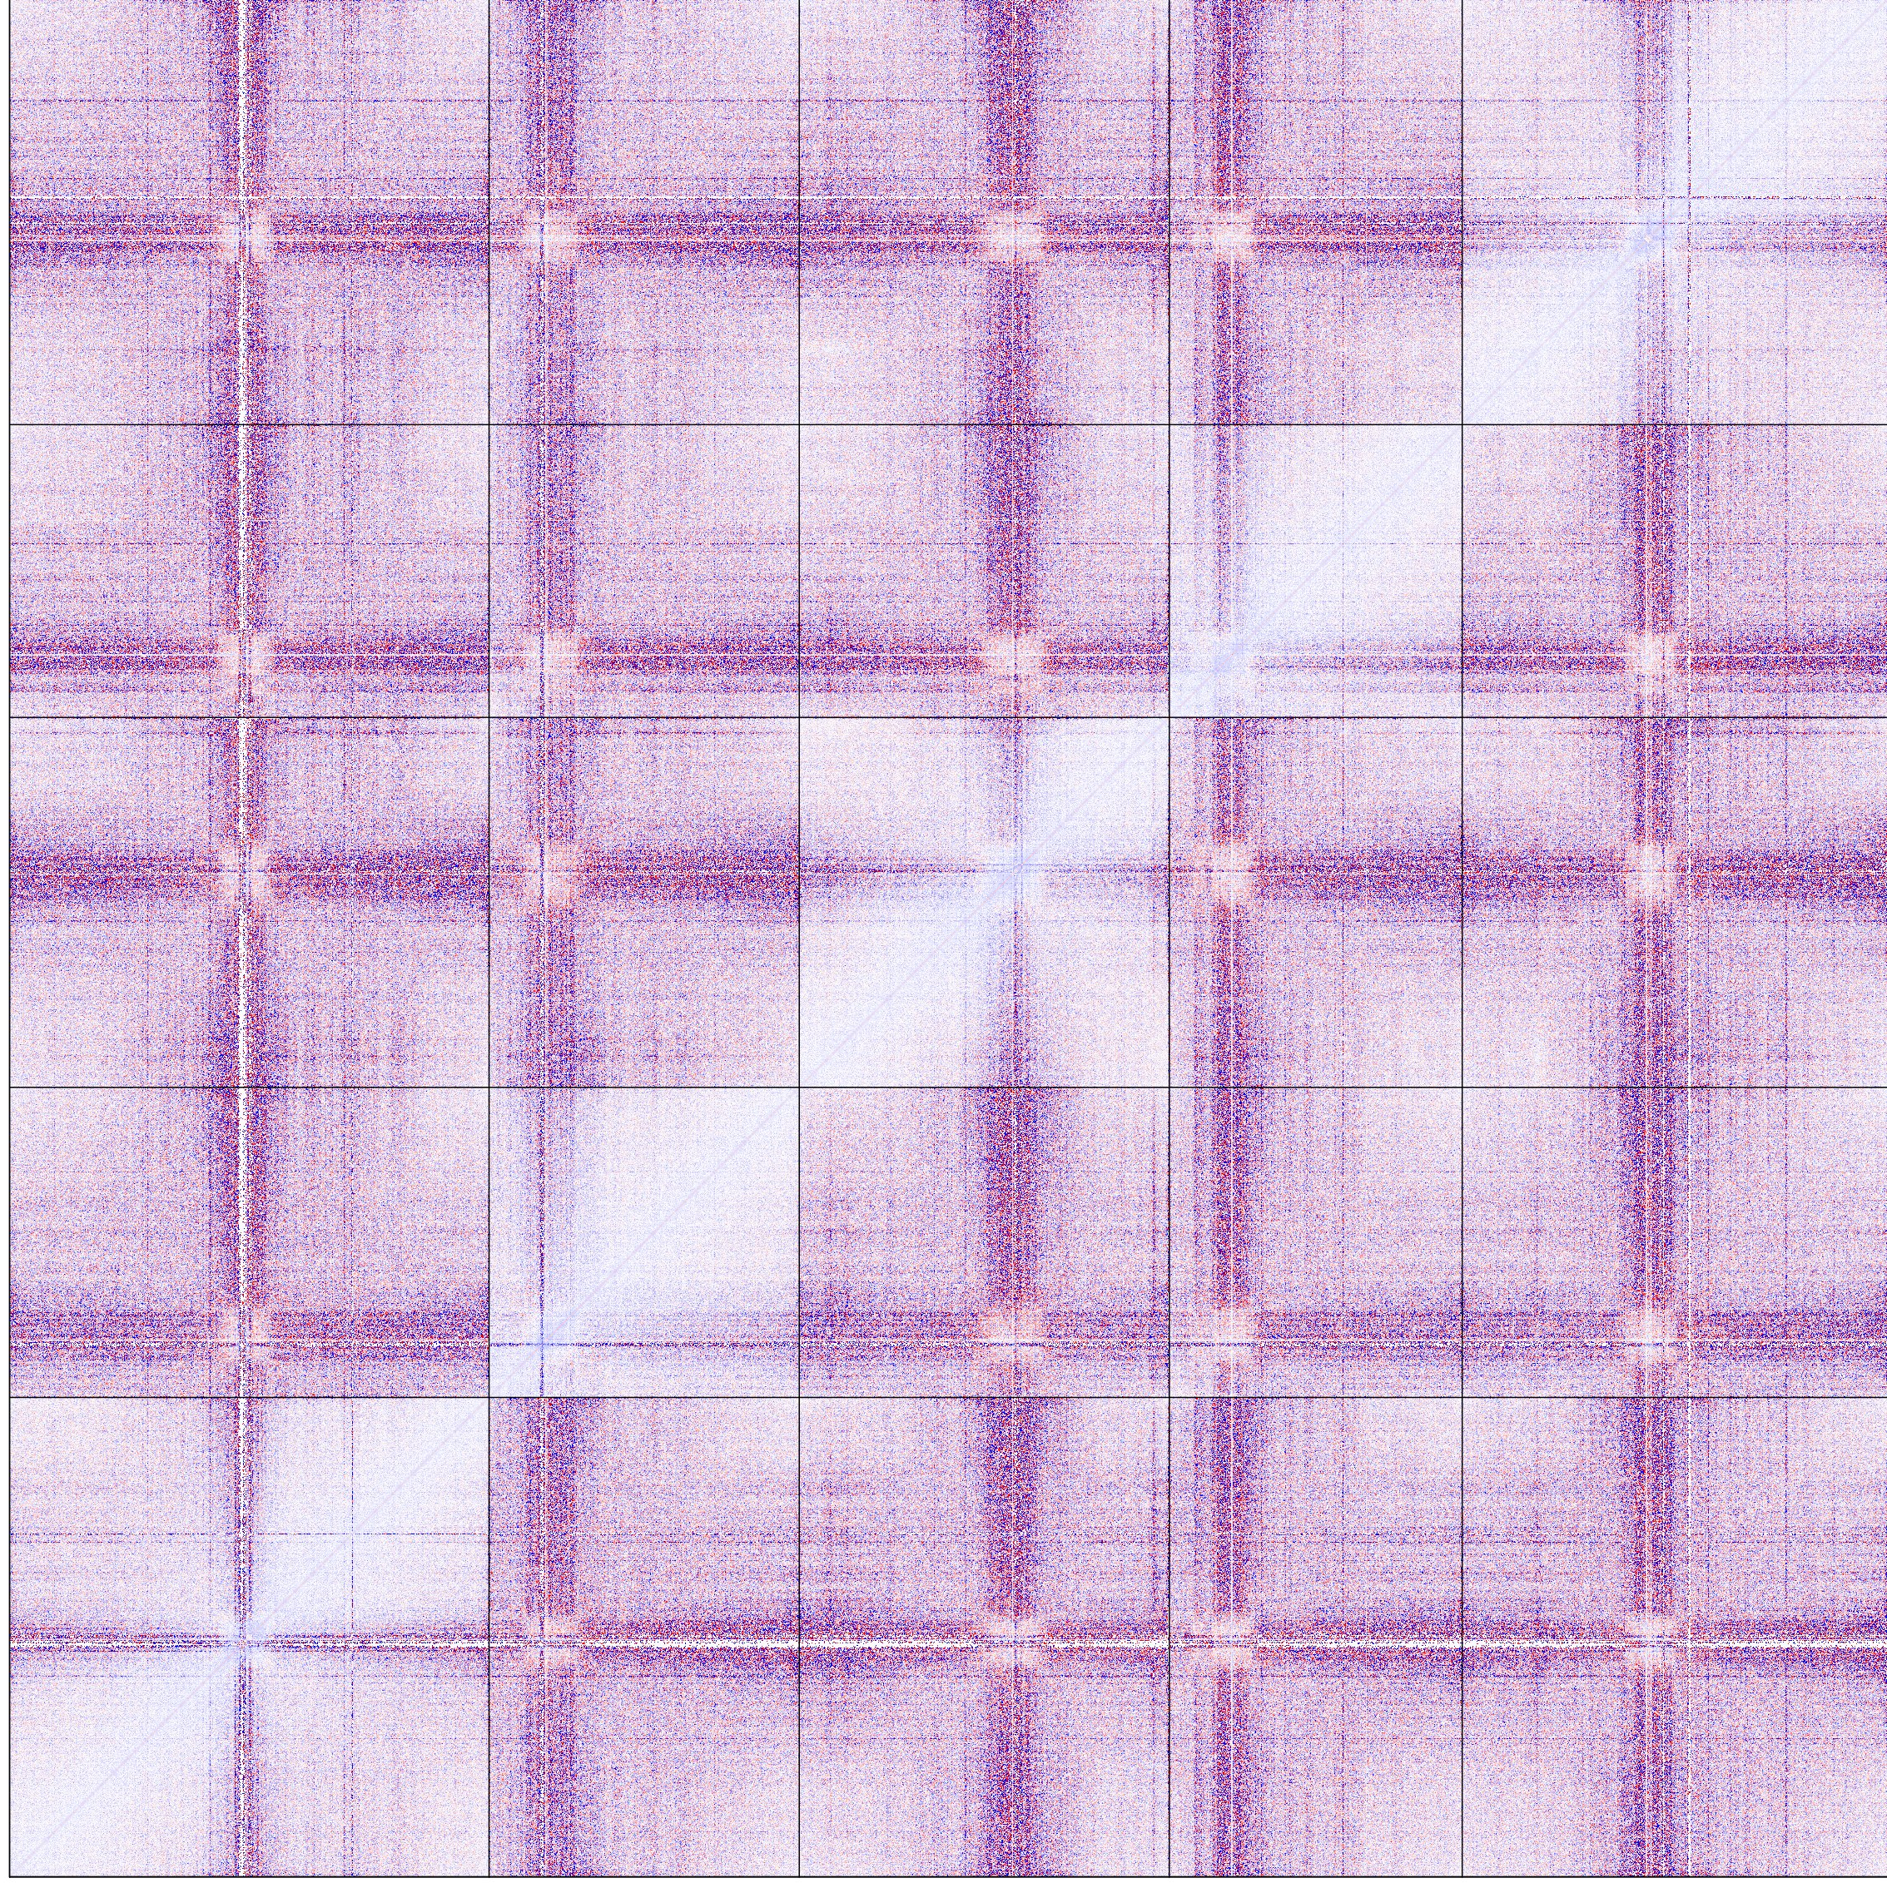
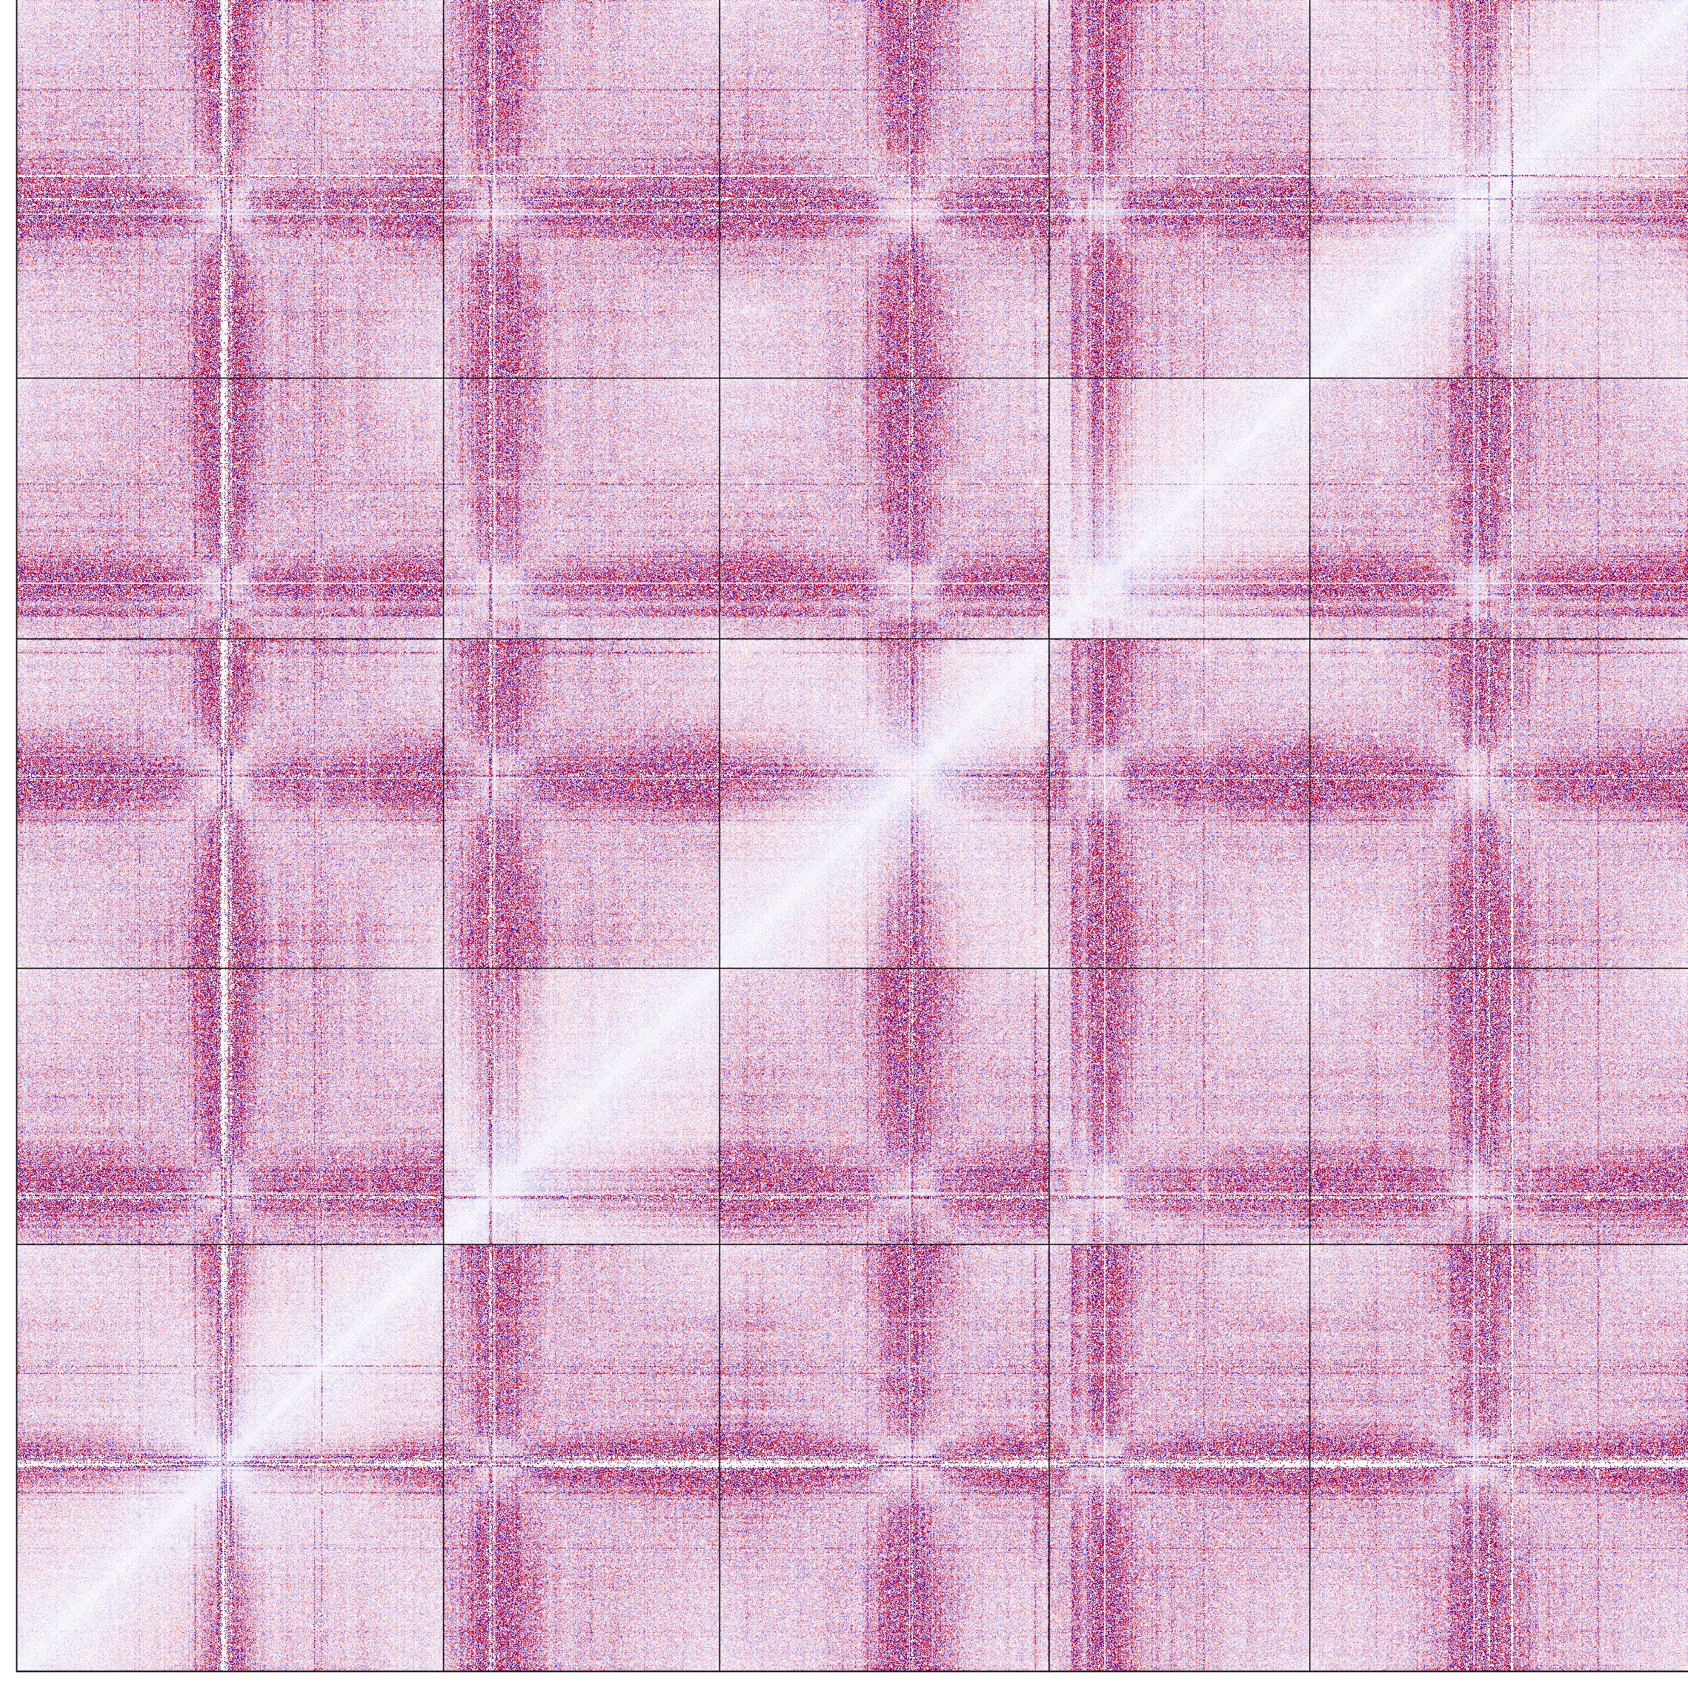
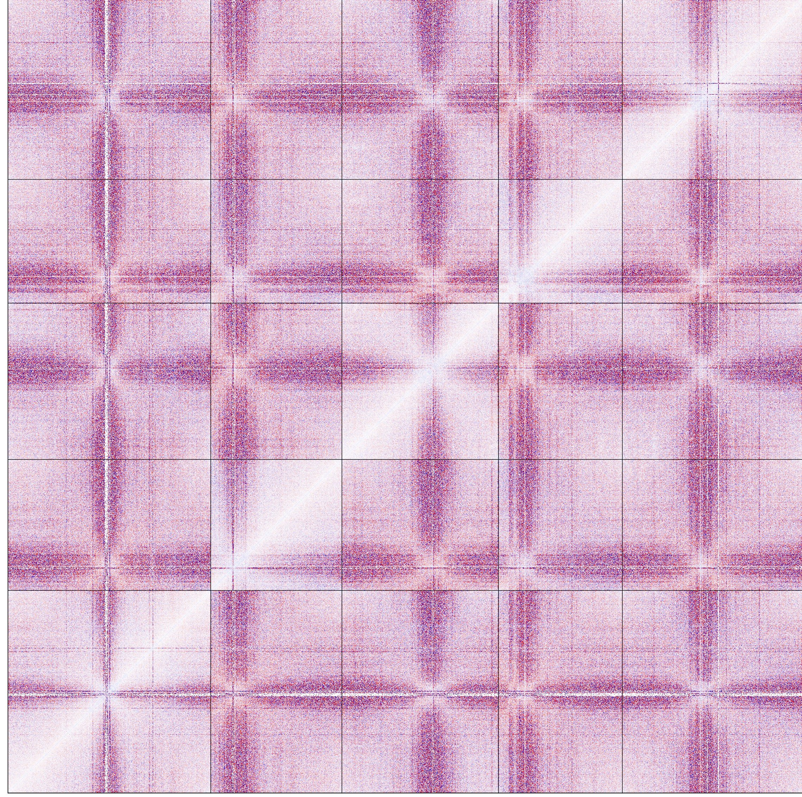
Fig.S4
a
b
Col-0_{(rep1)} vs Col-0_{(rep2)}
cap-h2_{(rep1)} vs cap-h2_{(rep2)}
0.85
0.9
0.95
1
Pearson correlation
0.93
0.94
0.94
0.94
0.96
0.97
0.96
1
cap_rep2
0.93
0.93
0.93
0.94
0.95
0.96
1
0.96
cap_rep1
0.92
0.93
0.93
0.94
0.97
1
0.96
0.97
Col_rep1
crwn1/4_{(rep1)} vs crwn1/4_{(rep2)}
cap-h2crwn1/4_{(rep1)}
vs cap-h2crwn1/4_{(rep2)}
0.9
0.93
0.92
0.93
1
0.97
0.95
0.96
Col_rep2
0.93
0.94
0.94
1
0.93
0.94
0.94
0.94
crwn_rep1
0.93
0.93
1
0.94
0.92
0.93
0.93
0.94
cap_crwn_rep2
0.92
1
0.93
cap_rep2
0.94
0.93
0.93
0.93
0.94
crwn_rep2
1
0.92
0.93
cap_rep1
cap_crwn_rep1
0.93
0.9
0.92
0.93
0.93
Col_rep1
Col_rep2
crwn_rep1
cap_crwn_rep2
Replicate 1
Replicate 2
Supplementary Figure S4. Validation of Hi-C data.
a, Comparison of genome-wide Hi-C maps from various samples (bin size: 50 kb).
b, Enrichment of interaction frequencies, obtained by calculating the relative difference between Hi-C maps of the two respective biological replicates (bin size: 50 kb).
crwn_rep2
cap_crwn_rep1

Slide 5
Fig.S5
Inter-chromosomal pericentromere
Between two halves of pericentromere
Inter-chromosomal arm
25
25
25
20
Chr5
20
Chr5
20
Chr5
10
10
10
20
20
20
10
Chr4
10
Chr4
10
Chr4
(Mb)
(Mb)
(Mb)
(Mb)
10
20
10
20
25
(Mb)
10
20
10
20
25
(Mb)
10
20
10
20
25
25
Inter-arm
25
Pericentromere-arm
25
Intra-arm
20
20
Chr5
20
Chr5
10
Chr5
10
10
20
20
20
10
Chr4
10
Chr4
10
Chr4
(Mb)
(Mb)
(Mb)
(Mb)
10
20
10
20
25
(Mb)
10
20
10
20
25
(Mb)
10
20
10
20
25
Cis-interaction
Interior of centromere
Trans-interaction
25
20
Chr5
10
20
10
Chr4
(Mb)
(Mb)
10
20
10
20
25
Supplementary Figure S5. Regions of chromatin interactions described in the manuscript.
Magnified images of chromatin interactions in chromosomes 4 and 5 in cap-h2crwn1/4 are shown in Figure 6a. The regions pointing to each type of chromatin interaction we described are shown.

Slide 6
Fig.S6
Up-regulated genes
118 genes
Down-regulated genes
46 genes
cap-h2-2
3
1
24
8
91
37
crwn1/4
58 genes
25 genes
8
2
√2 ≤ to < 2
6
2 ≤ to < 4
22
32
4 ≤
17
Supplementary Figure S6. Differentially expressed genes in mutants showing abnormal centromere distribution.
Numbers of up- and down-regulated genes in cap-h2-2 and crwn1/4 mutants compared to the wild type are shown (threshold ≥ √2, FDR < 0.1, p < 0.05) (n = 3).

Slide 7
Fig.S7
a
Col-0_0h
Col-0_1h
Col-0_3h
b
0 h
1 h
3 h
cap-h2-2
crwn1/4
Col-0
Supplementary Figure S7. Gene expressions in response to DNA damage induction are comparable between the wild type and the defective in centromere positioning.
a, Altered gene expression in wild-type roots (n = 4) after one and three hours of DNA damage treatments.
b, Comparison of gene expression in response to DNA damage treatments between wild-type and mutant plants. The levels of respective gene expression are shown as log2 values (a,b) (n = 4).

