Slide 1
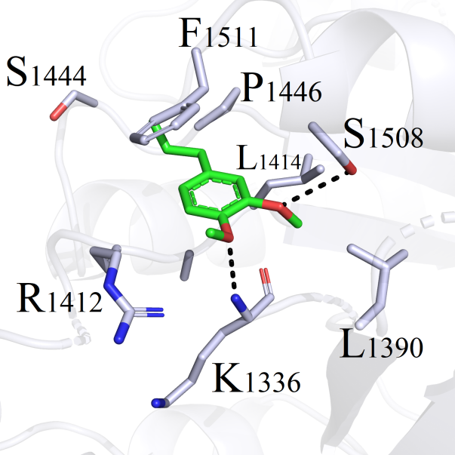
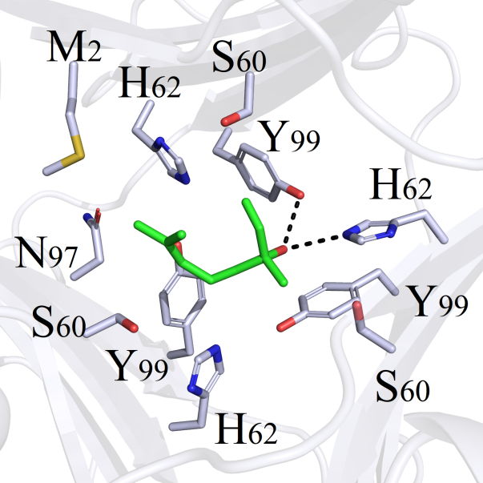
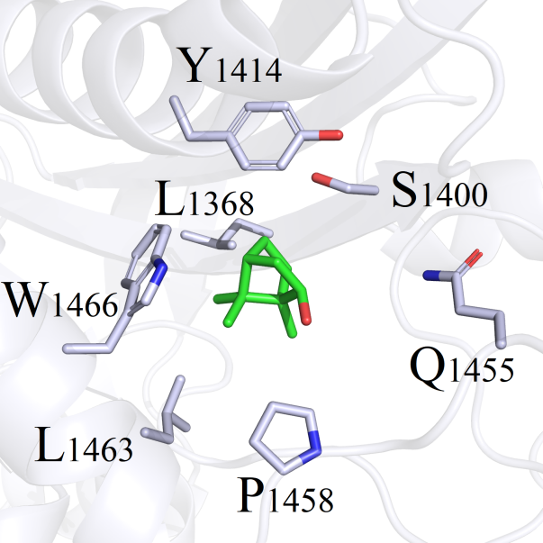
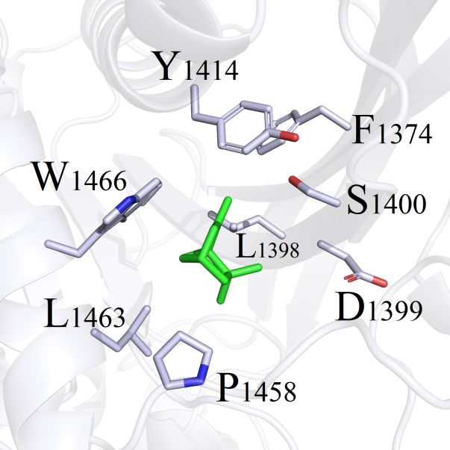
Fig.S1 Shanshan Xiao et.al
LRRK2 - Methyl eugenol
MIF - Linalool
EP300 - Camphor
EP300 - α-Pinene

