Slide 1
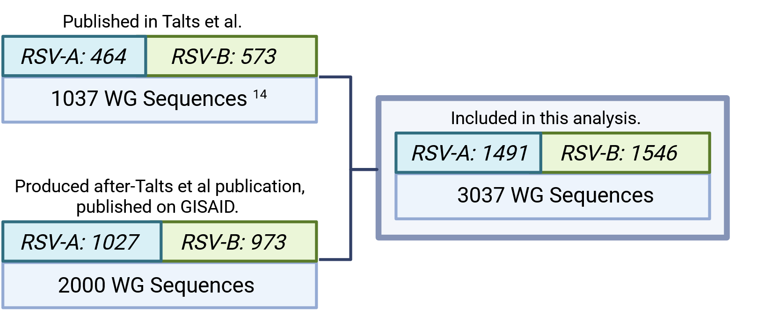
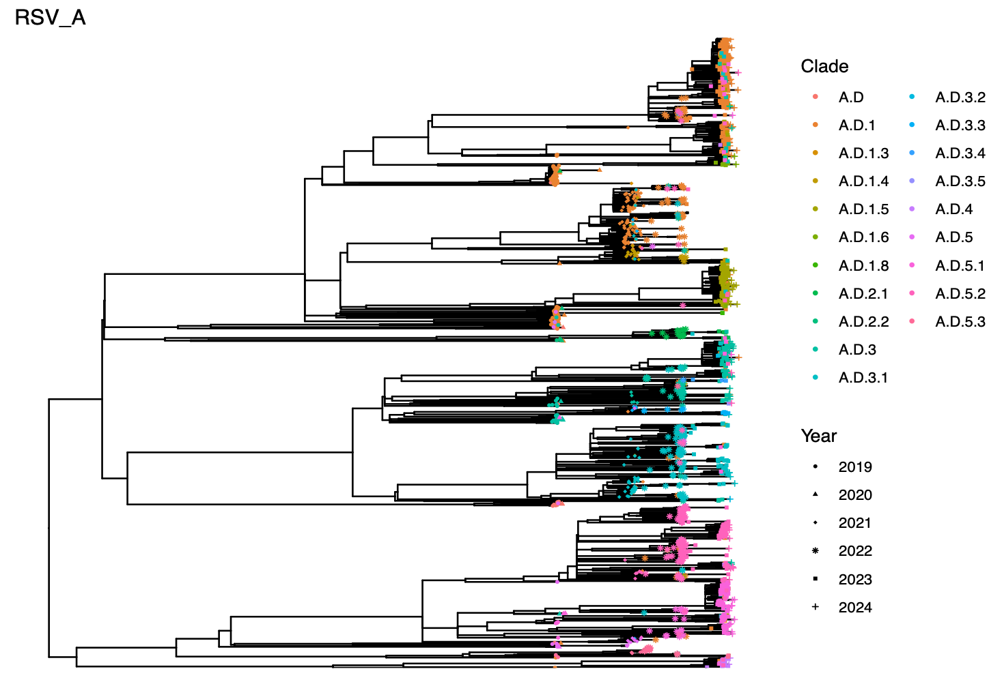
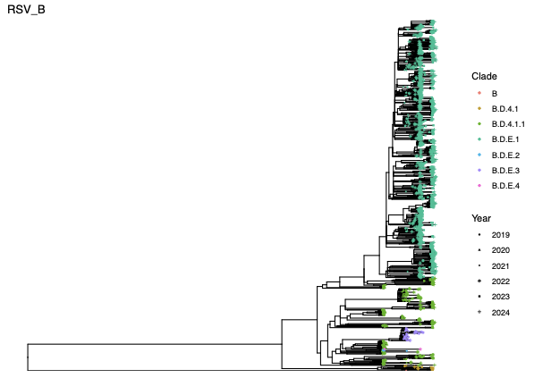
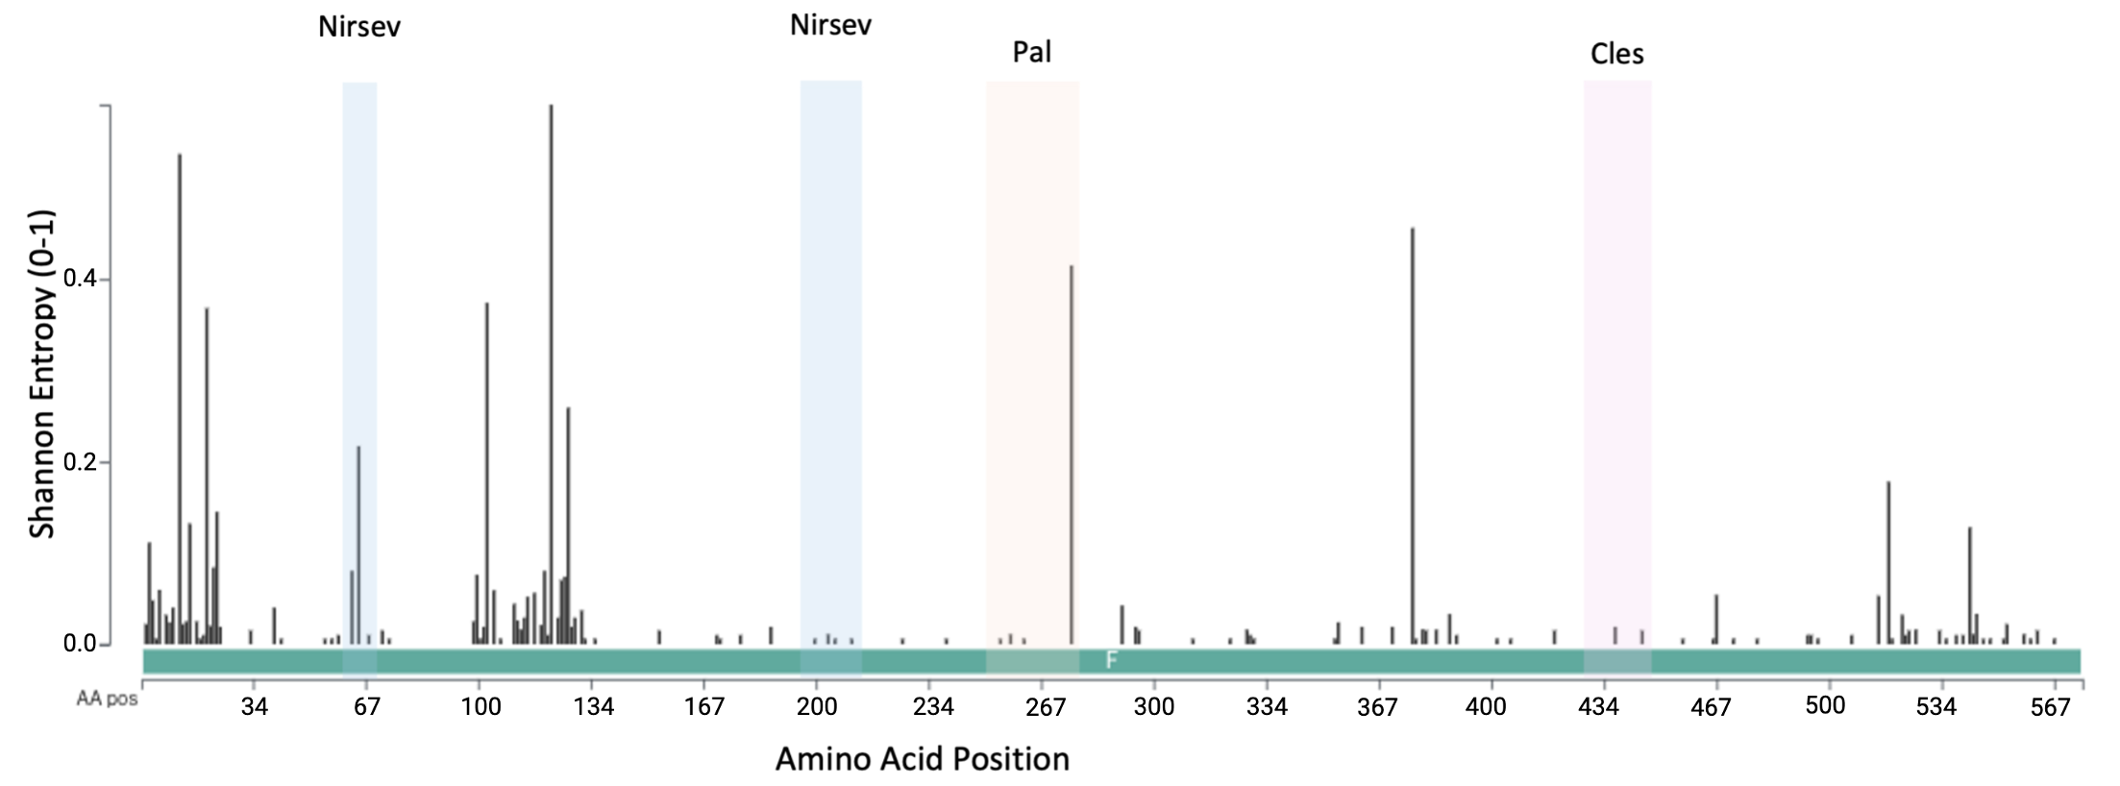
A
B
C
D
F
E
65: 0.217
68: 0.01
211: 0.006
Figure 1 Phylogeny of RSV A sequences collected in UK from 2019-2023 and conservation of RSV-F. Source of sequences for analysis (A). RSV WG sequence numbers obtained over the years plotted by collection date of the sample; black bars indicate sequences produced with legacy methods and pink bars with a newer method (B). Phylogenetic tree with RSV-A sequences (C; n=1491) and RSV-B sequences (D; n=1,546) generated in the current study. Amino acid diversity across the coding region of RSV-F in this set of sequences (E). Shaded regions on the graph highlight relevant antibody binding sites. Created with Nextclade. Low entropy (close to 0) indicates high conservation with greater values indicating high variability (1= random). Map of recovery of mutants: colours represent year of sampling, number represents frequency and the shapes represent the different variants (F).

Slide 2
Figure 2. K68E provides resistance to nirsevimab but has a relative fitness cost. (A) Neutralisation curves for mutant recombinant RSV (nirsevimab binding site/site 0 mutants) with an in-house produced nirsevimab-like antibody. (B) IC₅₀ values plotted as dilution factor of antibody rather than absolute concentration. Wild-type and mutant viruses were grown in HEp-2 cells and harvested at several time points before titrating by RT-qPCR and RSV immune-staining plaque assay. (C) RNA was extracted and underwent RT-qPCR for RSV L gene. (D) Infectious virus was quantified by immuno-staining plaque assay. (E) BCi-NS1.1 cells in air-liquid interface were infected with WT rgRSV or K68E rgRSV at MOI 0.1 and challenged with the antibody at 100ng/μL. Supernatant was collected at each timepoint, RNA was extracted and underwent RT-qPCR. In some groups, virus was pretreated with 100ng/μL antibody for 1 hour before incubation (+Ig) (F) Supernatant collected from the ALI at 72hpi was directly plated on plaque assay to determine viral load. BALB/c mice were infected with 5.5x10⁴ PFU WT rgRSV or K68E rgRSV intranasally, disease measured by weight loss (G); viral load by PFU on d4 after infection (H). For B, statistical significance was determined by ordinary one-way ANOVA and Tukey’s multiple comparisons test. For C, G significance was measured by t-test.

Slide 3
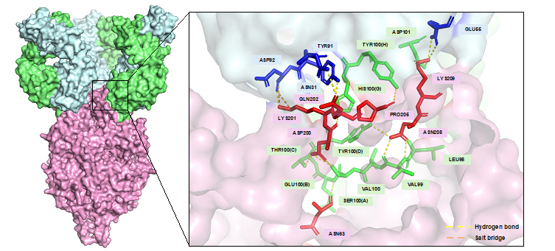
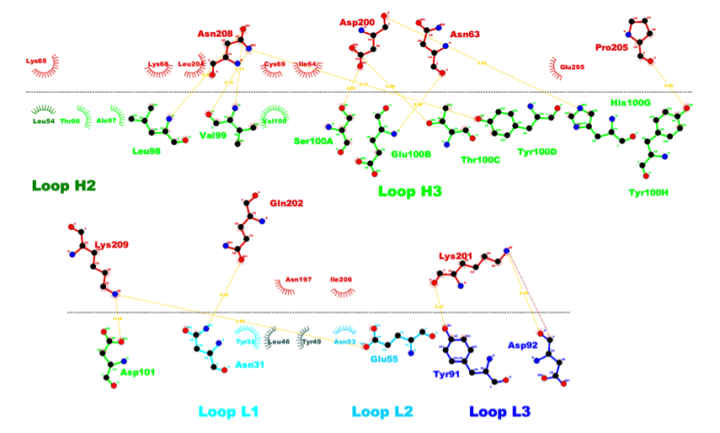
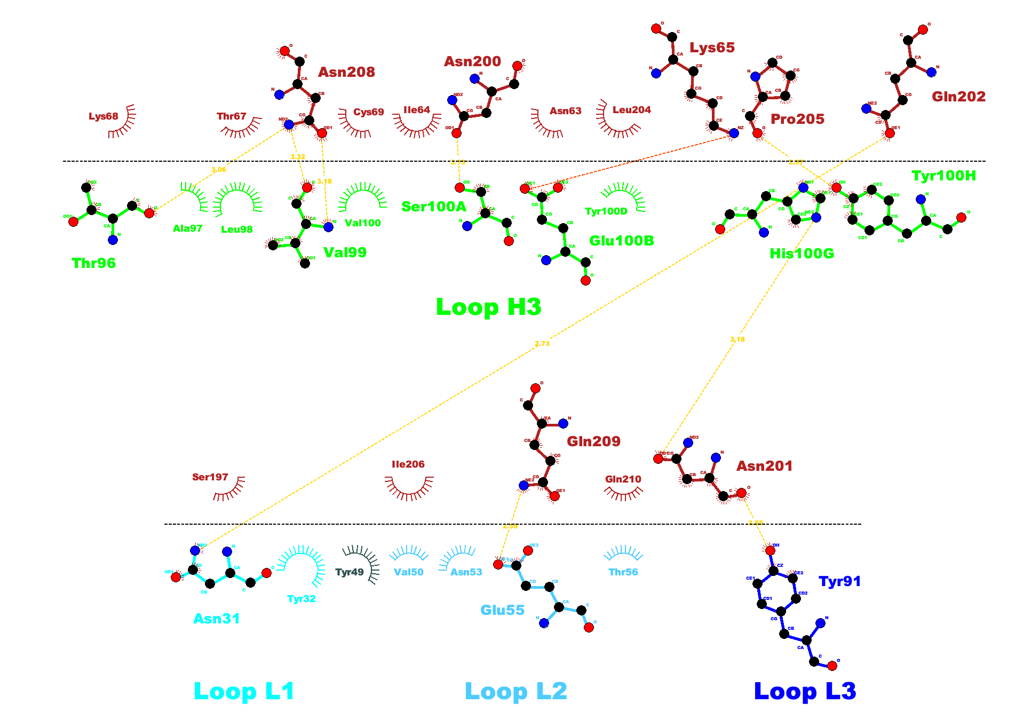
A
Antibody
F: Antigen
B
C
Antigen
Antibody
Antigen
D
Antibody
E
Antigen
Antibody
F
G
Antigen
Antibody
Figure 3. Bioinformatic modelling antigen-antibody interactions reflects the crystal structure and correlates with antibody resistance. (A) Three-dimensional crystallised structure of RSV-A F protein trimer bound to nirsevimab (PFB: 5UDC; pink RSV-F protein, dark green heavy chain, light green light chain) (B) Linear interface for crystal structure of RSV-A F protein bound to nirsevimab (PDB: 5UDC). (C) Predicted binding interface of hRSV/A/England/397/2017 WT RSV-A F protein bound to nirsevimab. F protein was produced using Robetta comparative modelling, antibody PDB was retrieved from SAbDab. (D) Kd for the interactions was then estimated using PRODIGY, this was plotted against actual IC50 for nirsevimab generated using in vitro assays. (E) Linear interface for crystal structure of RSV-B F protein bound to nirsevimab (PDB: 5UDD). (F) Predicted binding interface of RSV-B/13-001273 WT RSV-B F protein bound to nirsevimab. F protein was produced using Robetta comparative modelling, antibody PDB was retrieved from SAbDab. (G) Kd for the interactions was then estimated using PRODIGY, this was plotted against actual IC50 for nirsevimab generated using in vitro assays.

Slide 4
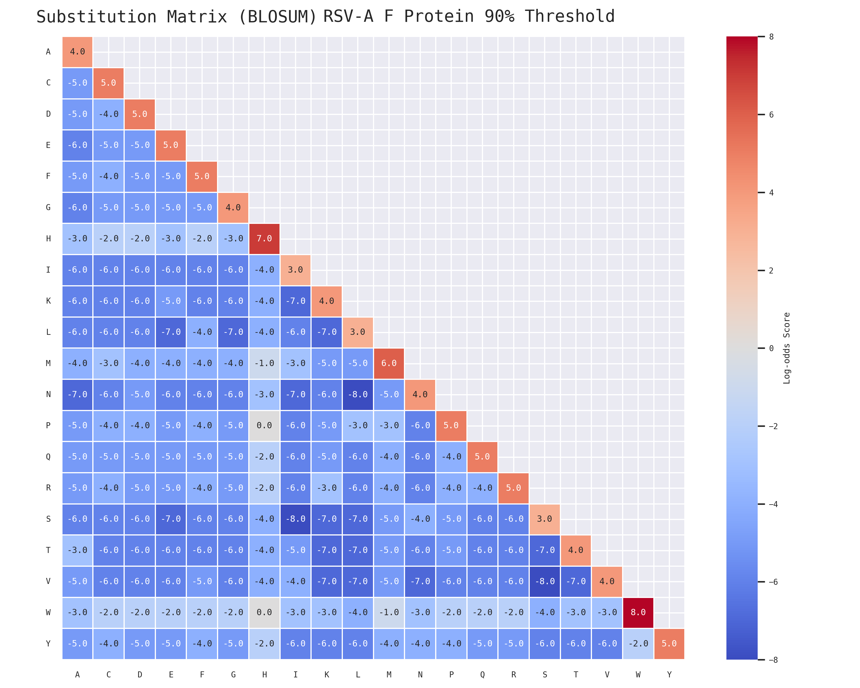
A
B
Mutation | Kd (M) | Predicted IC₅₀ | IC₅₀ FC | Relative Likelihood
N63T | 1.9 × 10⁻⁸ | 7.25 | 13.60 | -6
I64V | 1.5 × 10⁻⁸ | 5.72 | 10.70 | -4
D200E | 1.1 × 10⁻⁸ | 4.20 | 7.86 | -5
K201N | 9.0 × 10⁻⁹ | 3.43 | 6.43 | -6
C
D
E
G
F
F
Mutation | Kd (M) | Predicted IC₅₀ | IC₅₀ FC | Relative Likelihood
N200T | 2.0 × 10⁻⁹ | 36 | 10.00 | -6
N208R | 2.8 × 10⁻⁸ | 56 | 11.67 | -5
Figure 4. Predicting antibody escape in RSV A and B. (A) Amino acid substitutions were made for each residue of interest in RSV-A. Kd was predicted using PRODIGY. (B) RSV-A mutations selected for further analysis with predicted >6 fold increase in Kd and found in GISAID EpiRSV database. (C) Selected mutations generated as rgRSV and tested for neutralisation by nirsevimab like antibody. (D) IC50 of generated mutants (E) Amino acid substitutions were made for each residue of interest in RSV-B. Kd was predicted using PRODIGY. (F) RSV-B mutations selected with predicted >6 fold increase in Kd and found in GISAID EpiRSV database. (G) BLOSUM-like matrix for substitution likelihood in the RSV F protein from RSV A.

Slide 5
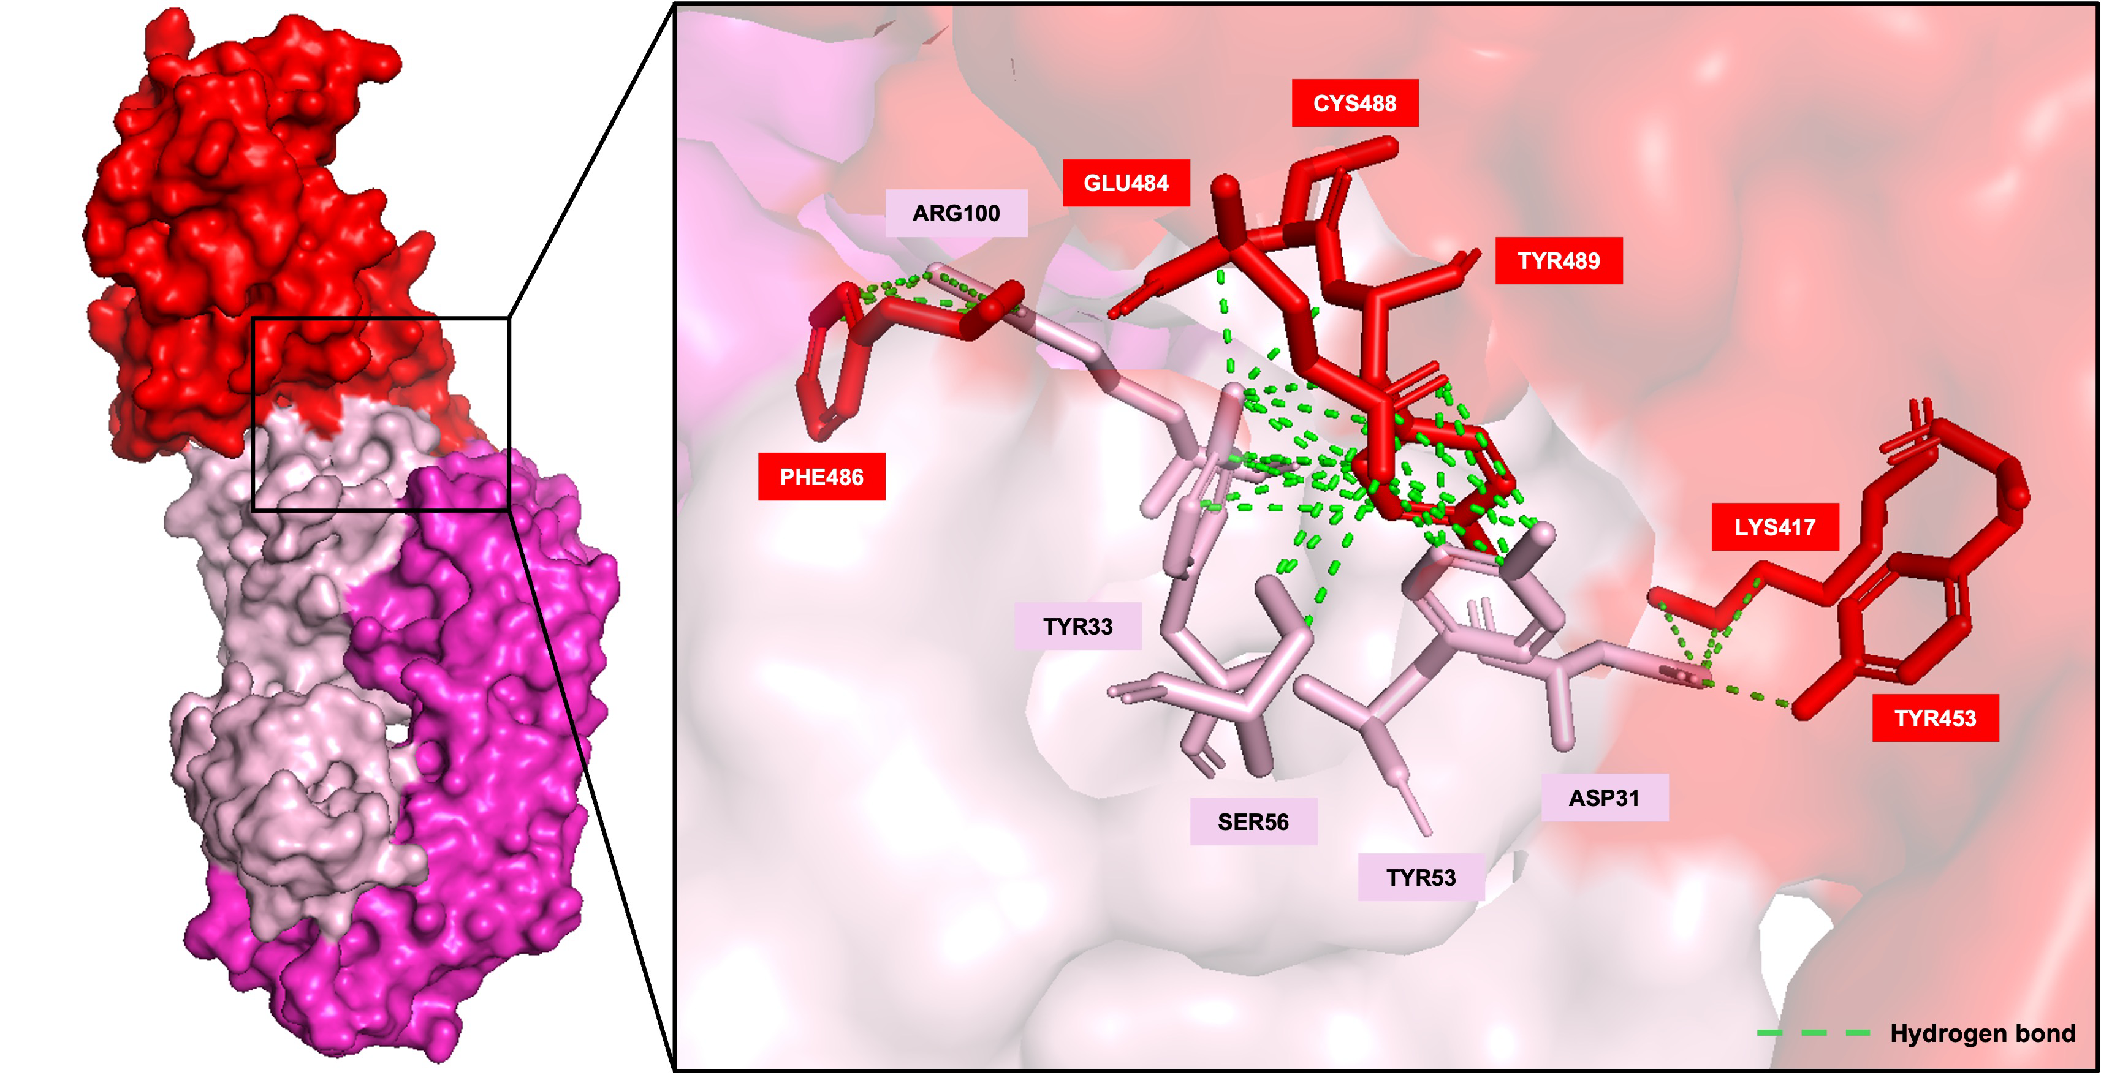
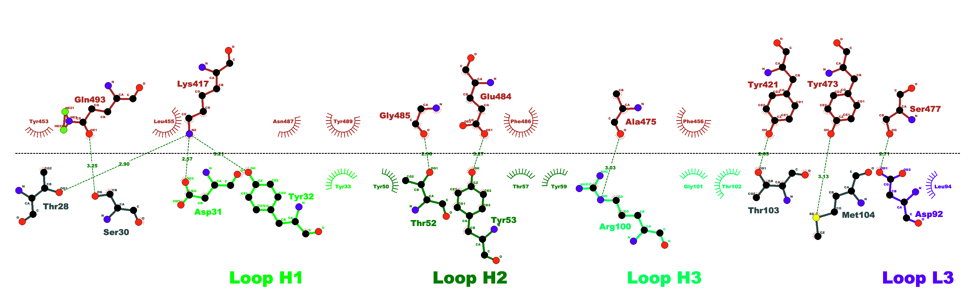
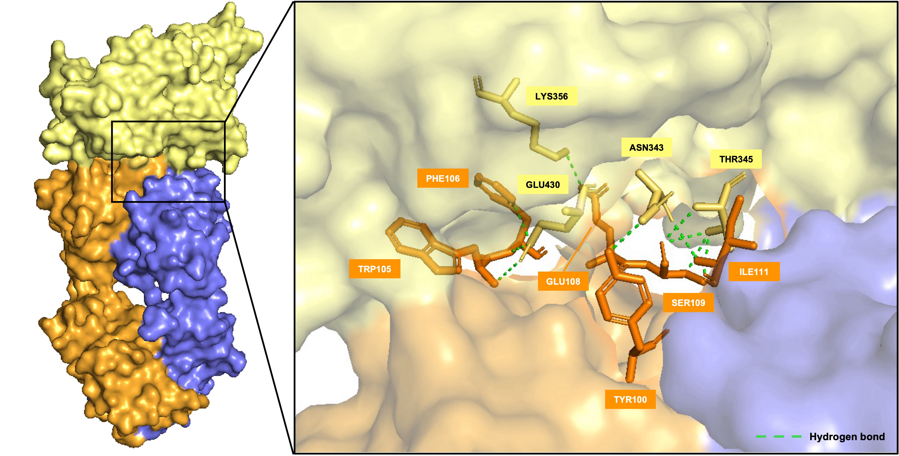
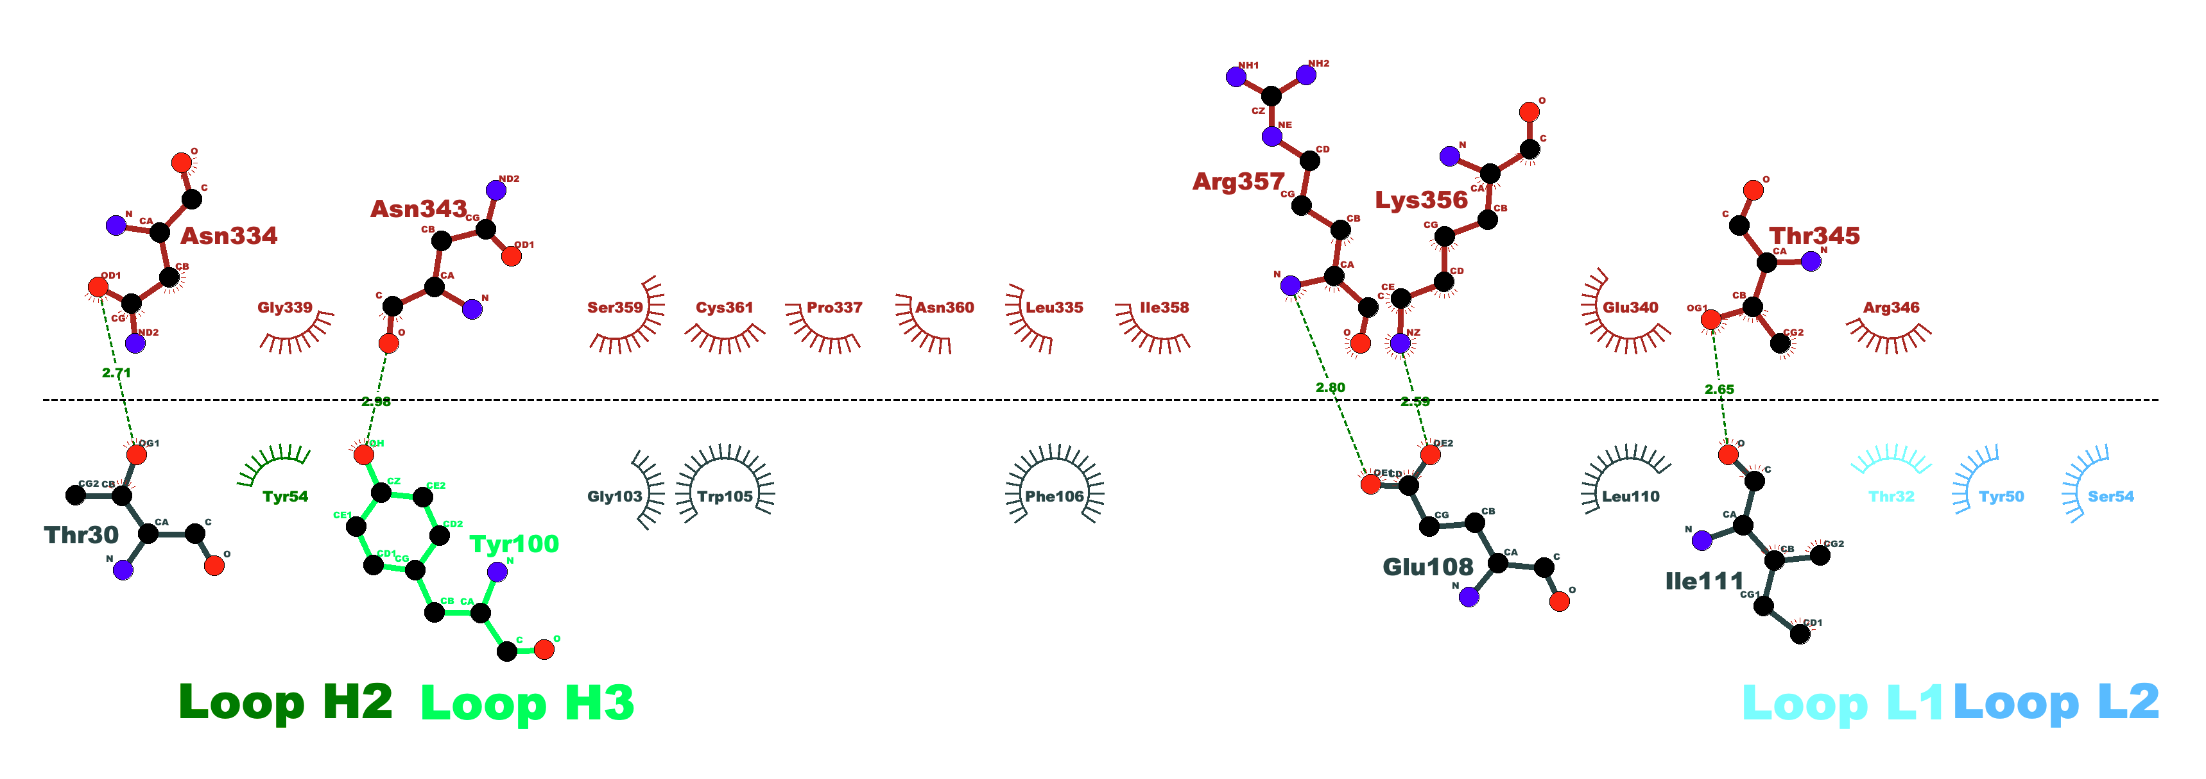
A
Spike (Delta)
B
Spike (Delta)
C
casirivimab
casirivimab
D
Spike (Omicron)
E
F
Spike (Omicron)
sotrovimab
sotrovimab
Figure 5. Antibody: antigen interaction pipeline can be applied to SARS-CoV-2. Binding interface of SARS-CoV-2 receptor-binding domain (Delta) in complex with casirivimab (REGN10933, PDB: 6XDG; red=RBD, pink=Heavy Chain, Magenta=light chain). B) Predicted binding interface of SARS-CoV-2 receptor-binding domain in complex with casirivimab (DockQ 0.354). C) Correlation between predicted K_{D} (nM) and experimental K_{D} (nM). D) Binding interface of SARS-CoV-2 receptor-binding domain (Omicron) in complex with sotrovimab (S309, PDB: 7BEP; yellow=RBD, orange=heavy chain, blue=light chain. E) Predicted binding interface of SARS-CoV-2 BA.1 receptor-binding domain in complex with casirivimab (DockQ 0.506). F) Correlation between predicted K_{D} (nM) and experimental K_{D} (nM).

Slide 6
Figure S1. Validating the binding and neutralisation capacity of produced nirsevimab-like antibody. A) Purified fractions containing protein (as per nanodrop reading) were combined and run on an SDS-PAGE gel producing a large protein band. B) ELISA to show binding of produced antibody to pre-fusion RSV-F protein. Different concentrations of the antibody were used (displayed on x axis) producing a gradient of optical densities (y axis) but showing clear binding of the antibody to RSV-F. C) Neutralisation of live virus. The produced antibody was used in a plaque reduction neutralisation test (PRNT) with wild-type recombinant RSV cultured with a series of dilutions of antibodies and titrated through an immune-staining assay. PFUs were normalised to cell only well (0 plaques) as a measure of 100% neutralisation and a well without antibody for 0% neutralisation and graphs produced using GraphPad Prism non-linear regression curve fit (version 10.0.2).

Slide 7
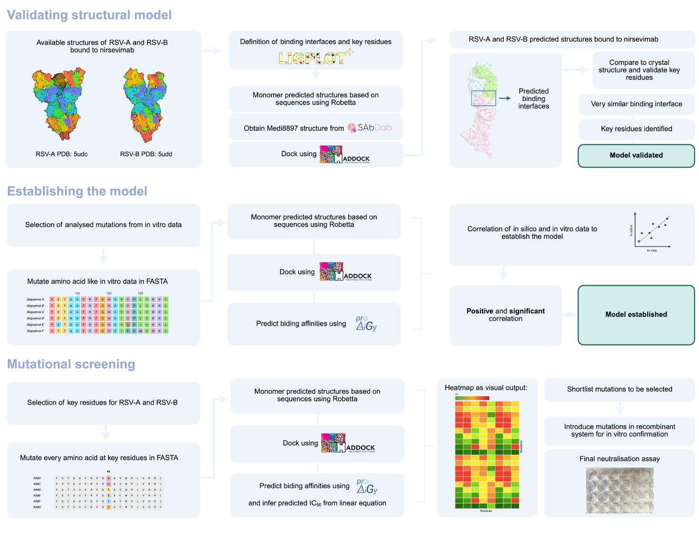
Figure S2. In silico pipeline to generate antibody-antigen models and potential MARM. 1) The structural model of RSV-A (PDB: 5UDC) and RSV-B (PDB: 5UDD) bound to nirsevimab is validated by comparing the crystal structure binding interfaces with the predicted ones. The structures of the F protein are predicted using Robetta (comparative modelling) and docked to nirsevimab using HADDOCK. Predicted binding interfaces are visualised using LigPlot. 2) The model was established by correlation in vitro IC50 data with predicted KD using Prodigy. 3) Key residues were selected and mutated with every amino acid, potential MARMs were selected for further analysis. Created with BioRender.com

Slide 8
A
B
C
D
Figure S3. Goodness of fit for models. DockQ and iRMSD scores for nirsevimab and RSV-A (A) and RSV-B (B). Scores for SARS-CoV-2 Spike and casirivmab (C), and sotrovimab (D). In interface scores: H – heavy chain, L – light chain, A antigen: so HL (heavy-light pairing), HA (heavy chain-antigen pairing) and LA (Light chain-antigen pairing).

Slide 9
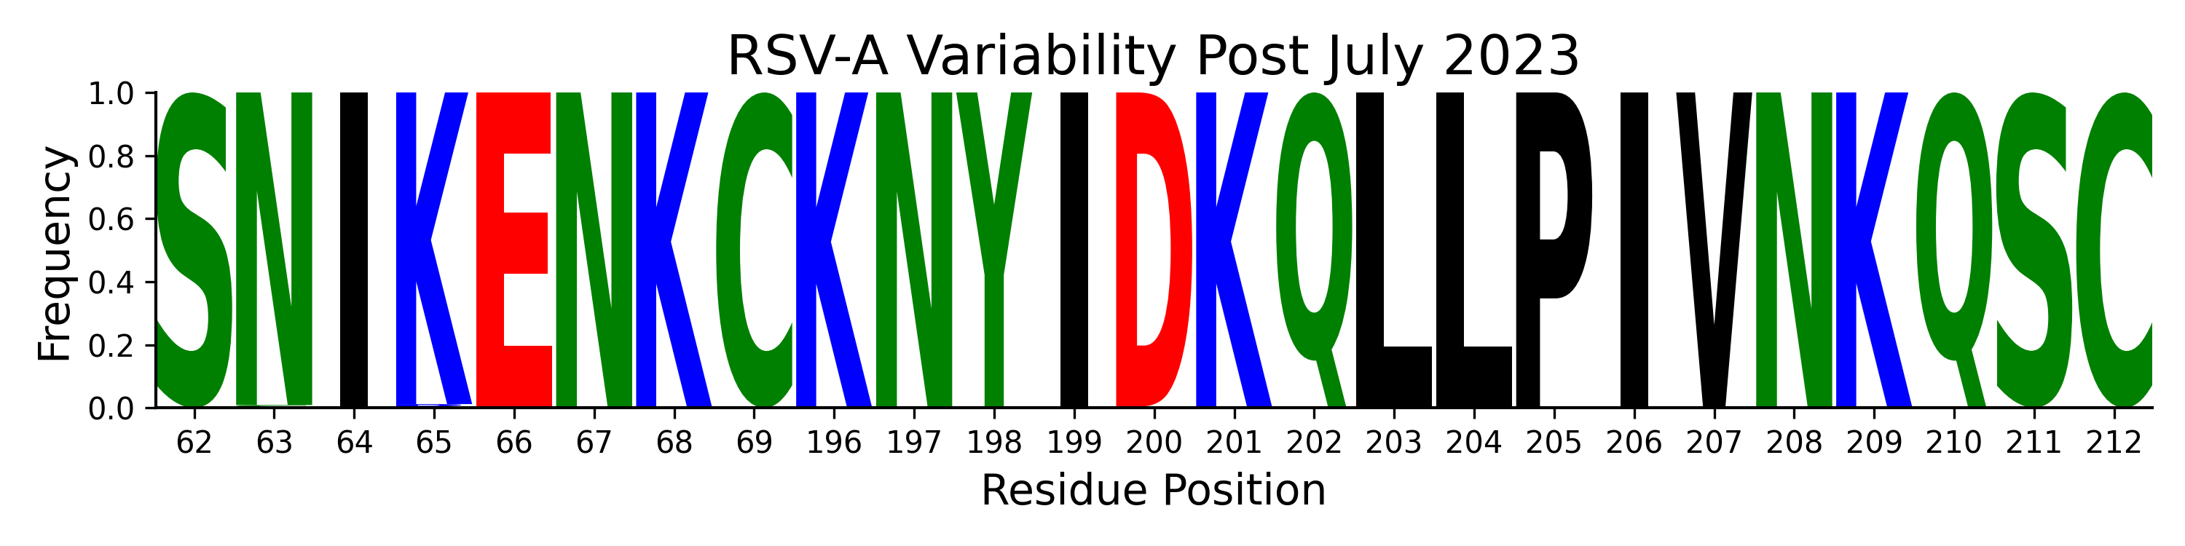
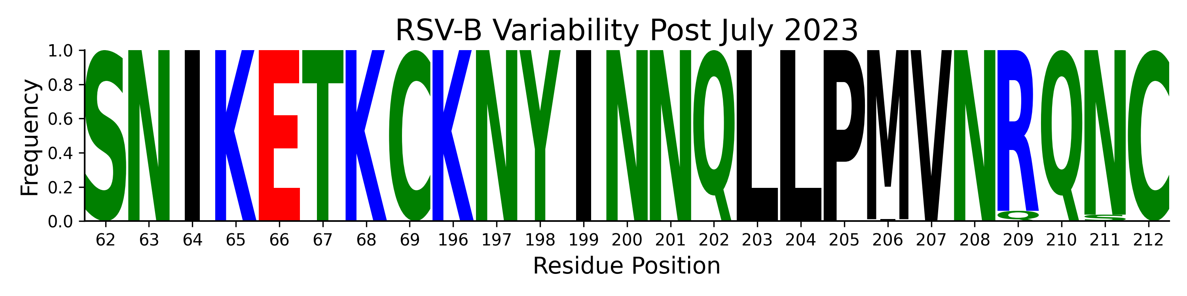

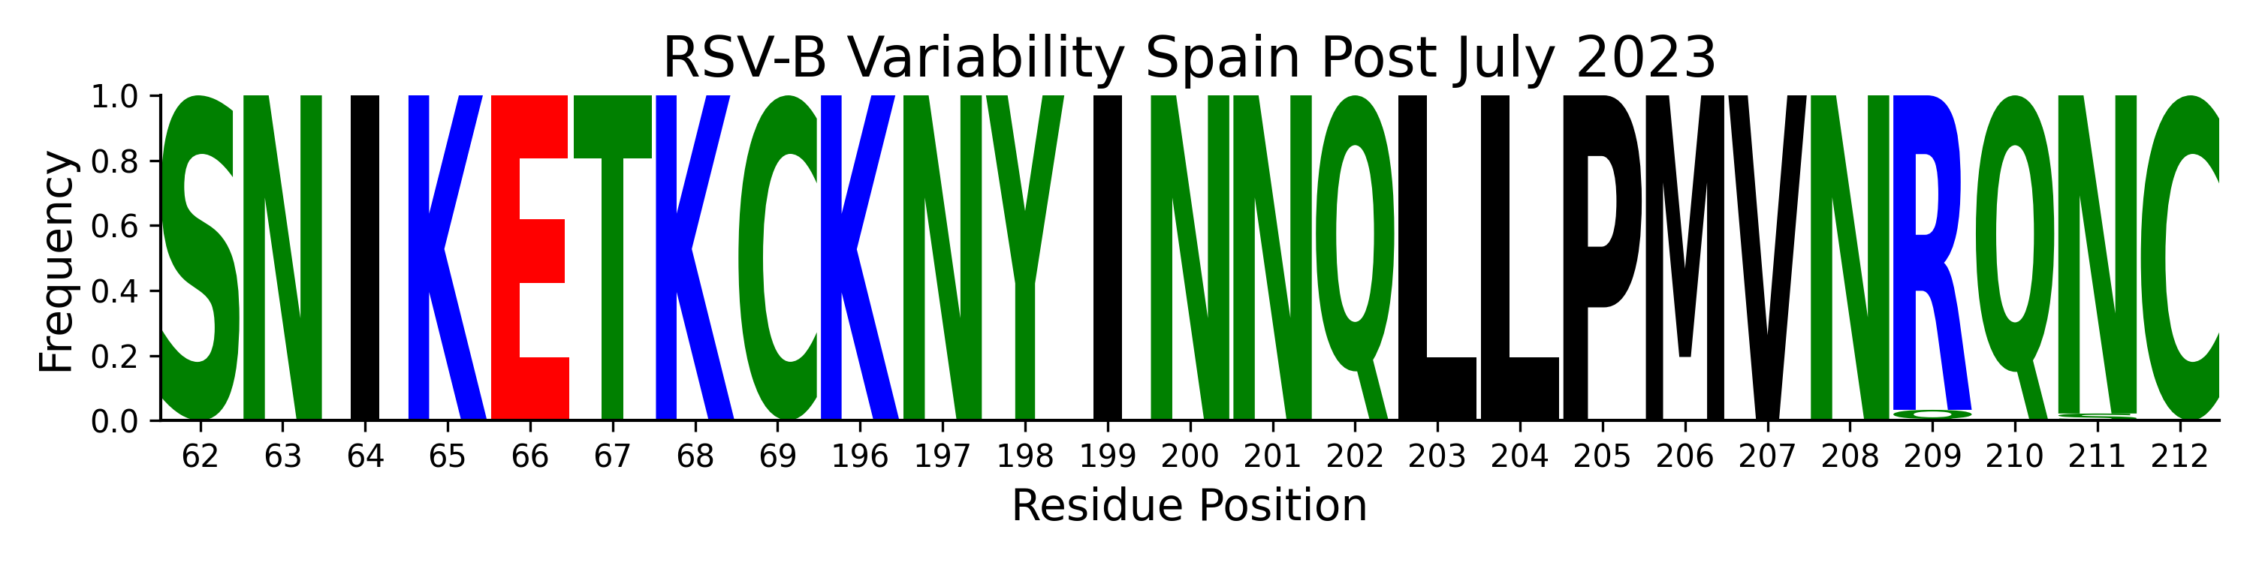

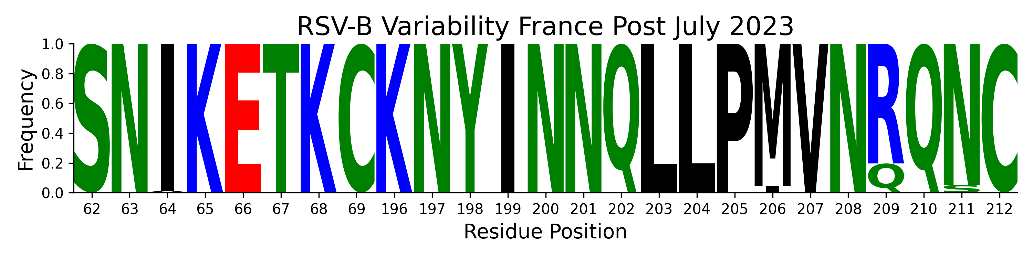



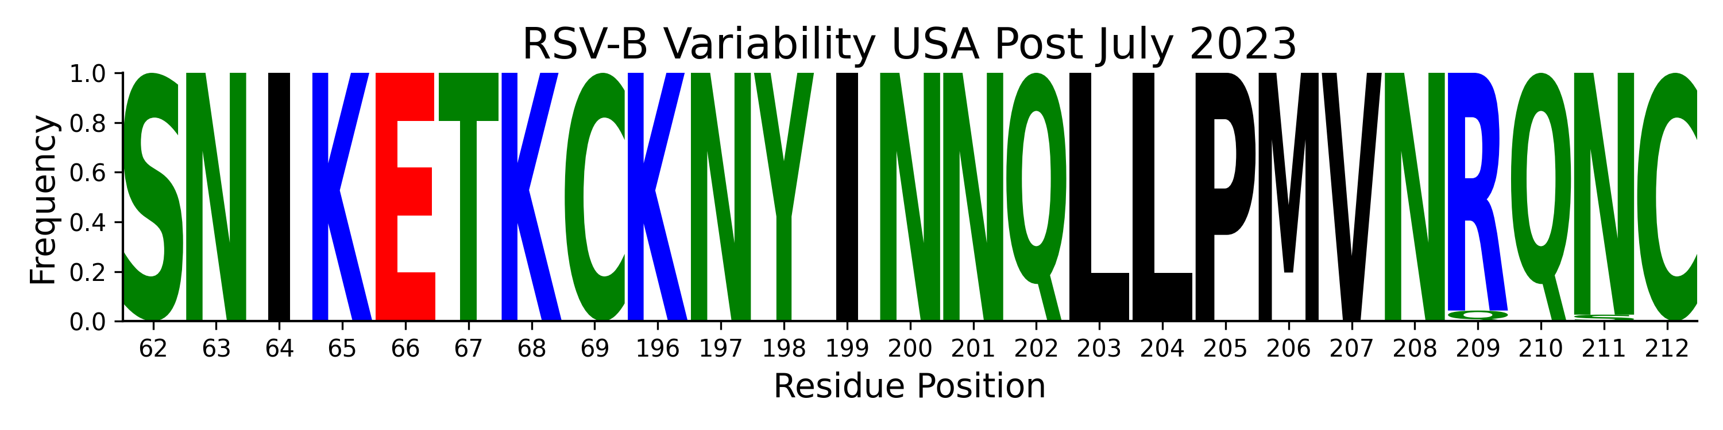
Global: 9,605 sequences
Global: 9,667 sequences
Spain: 2,225 sequences
Spain: 2,200 sequences
France: 1,380 sequences
France: 1,035 sequences
UK: 1,232 sequences
UK: 1,113 sequences
USA: 3,038 sequences
USA: 2,978 sequences
Figure S4. Sequence Logo for site Ø. Amino acid frequency for site Ø for RSV-A (A) and RSV-B (B) globally, and from Spain, France (nirsevimab widely used); UK (nirsevimab only used in high risk pre-term babies from 2025) and USA (mixed uptake).

Slide 10
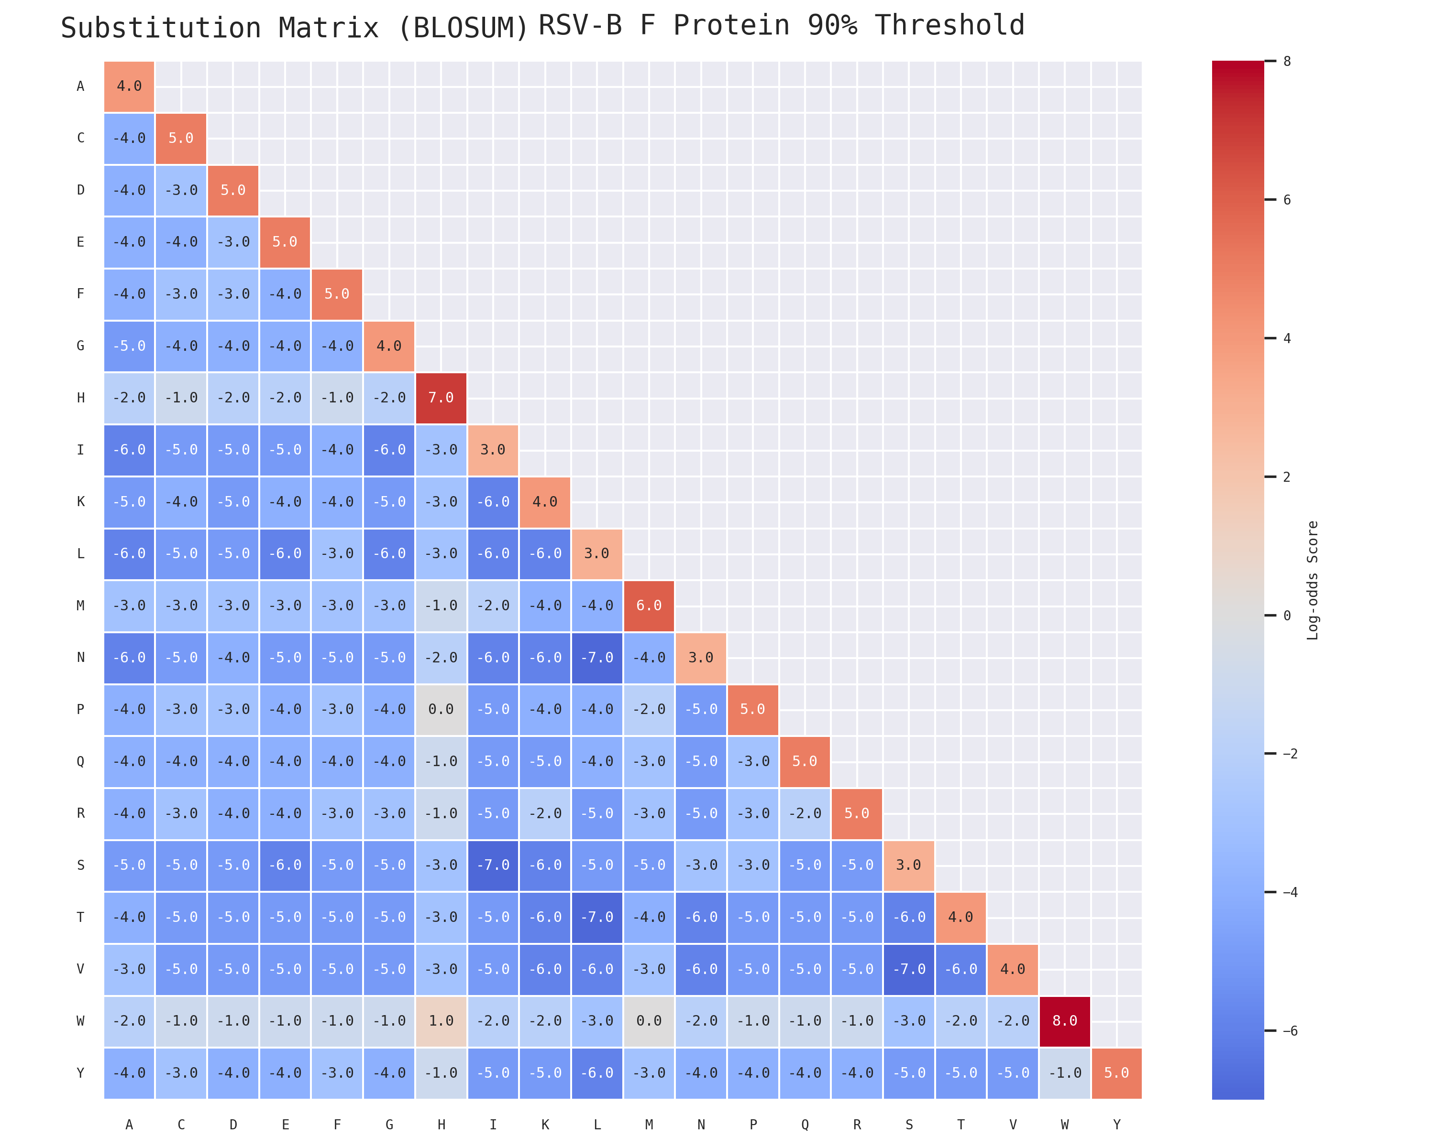
Figure S5. Substitution Matrix for F protein from RSV B. Generated from available RSV-B F gene sequence data.

Slide 11
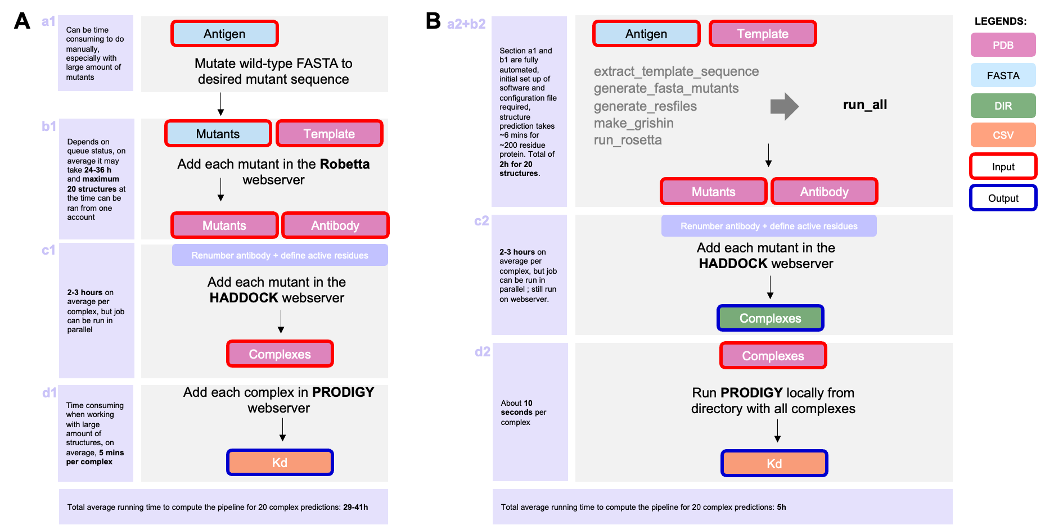
Figure S6. Accelerated pipeline for model generation and mutant analysis. A) Pipeline using webservers vs B) Pipeline using GitHub packages. Initially the wild type sequence was manually mutated at each residue of interest (a1), and every sequence was submitted to the Robetta webserver (b1) along with its template. This step was the most time consuming, as the webserver queue typically takes between 24-36 hours to complete and allows a maximum of 20 structure predictions at the time. In the automated pipeline the required inputs required are the antigen sequence and the template PDB. In a configuration file the user specifies the mutations and a single script executes all the necessary steps, including preparation of the template FASTA for the alignment, Grishin alignment, resfiles, mutant sequence generation and RosettaCM (a2+b2). This process takes around 6 minutes for a 200 residue protein prediction. The antibodies were renumbered using a custom script and then used for HADDOCK inputs along with the mutant PDBs. Active residues were defined within the HADDOCK webserver. This part remained unchanged for both pipelines (c1, c2). In pipeline A, each complex from HADDOCK had to be submitted manually to the Prodigy webserver, which was time consuming and overall took about 5 minutes per complex, including set up and run (d1). In pipeline B, all of the HADDOCK outputs were placed in one directory and Prodigy can be run directly from the command line to process al complexes simultaneously. This significantly reduced the run time to about 10 seconds per complex (d2).

