Slide 1
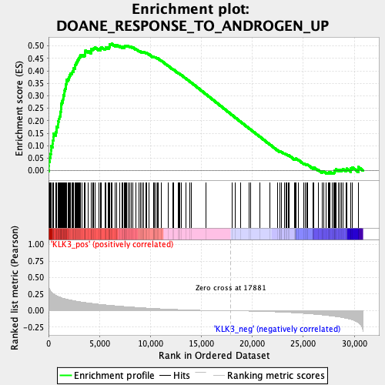
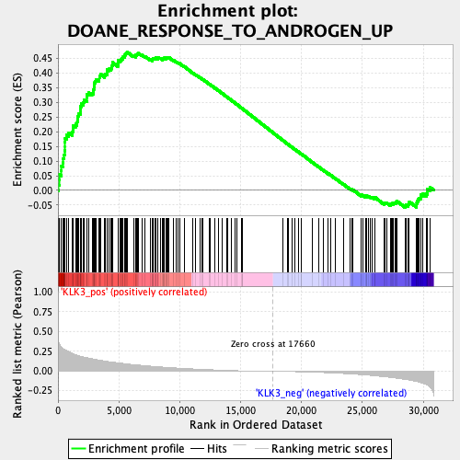
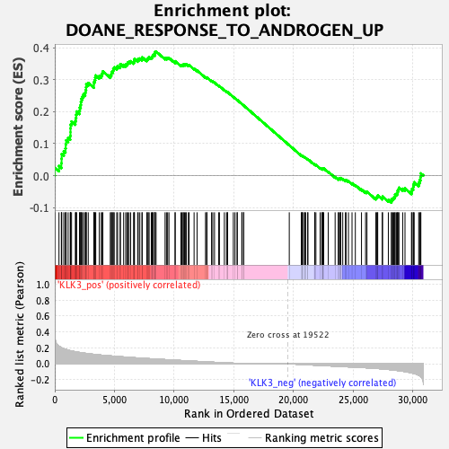
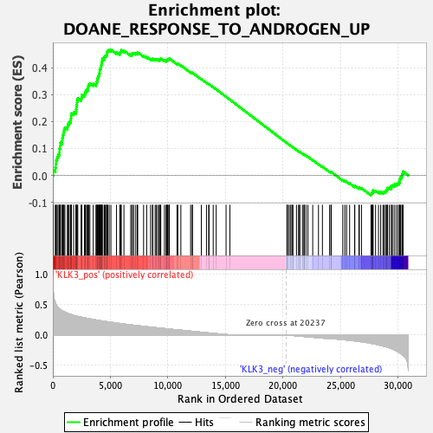
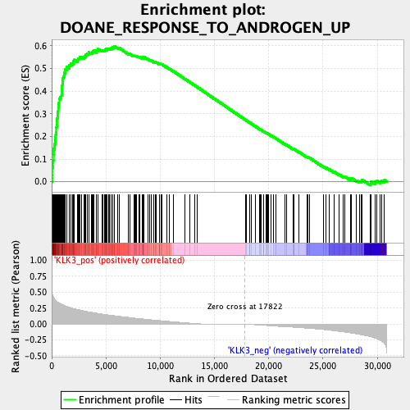
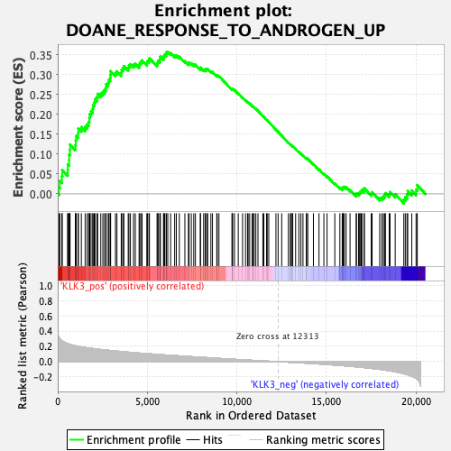
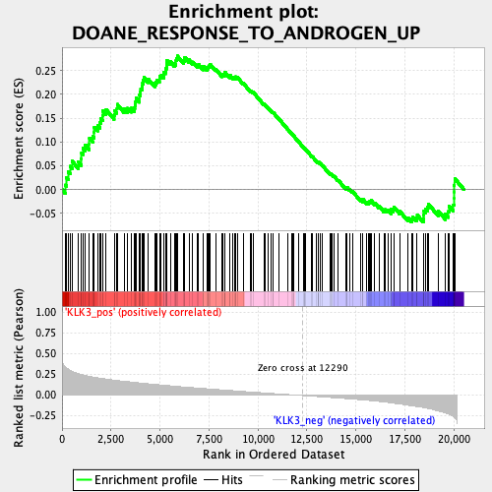
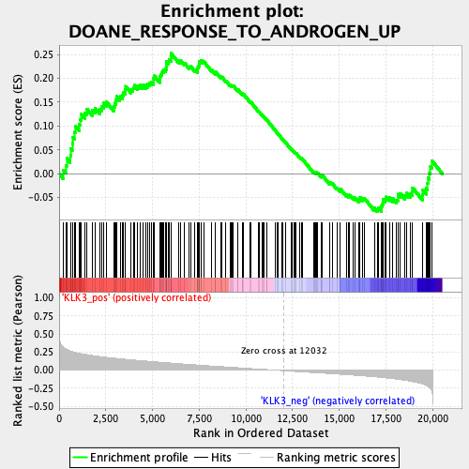
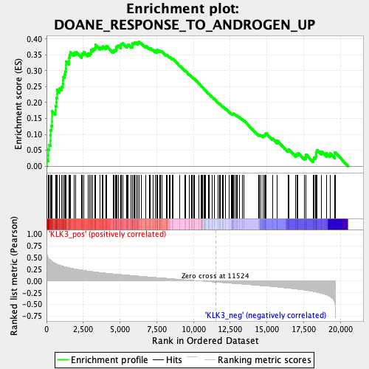
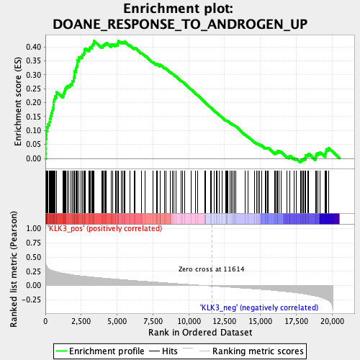
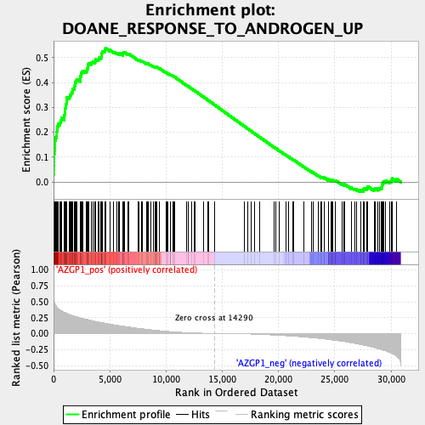
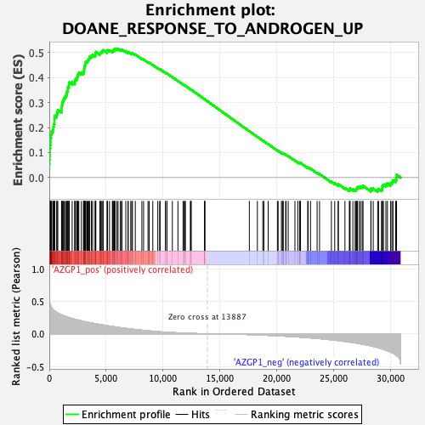
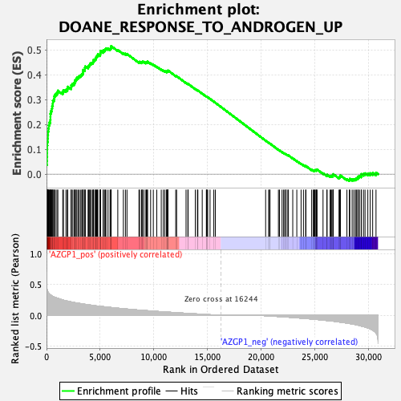
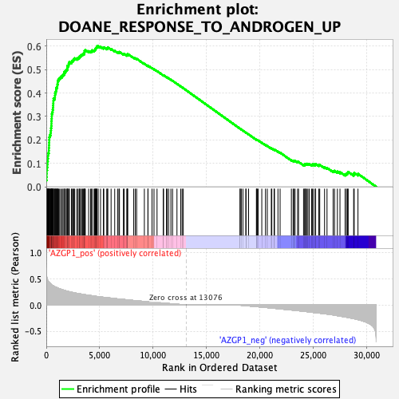
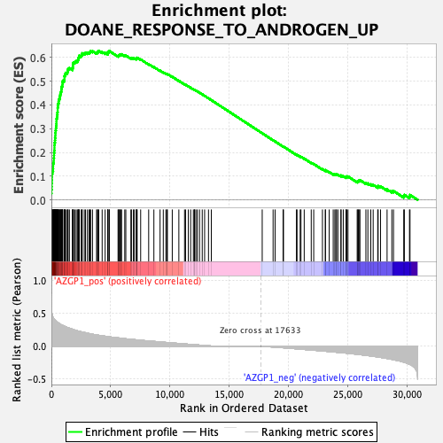
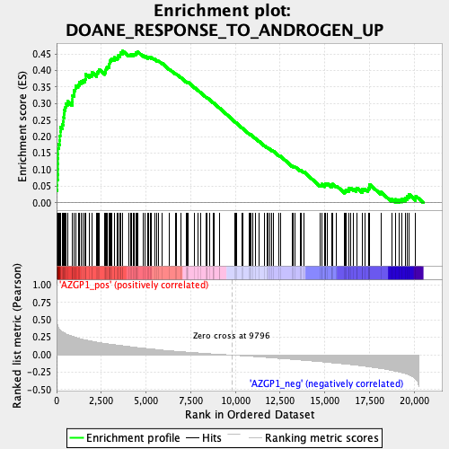
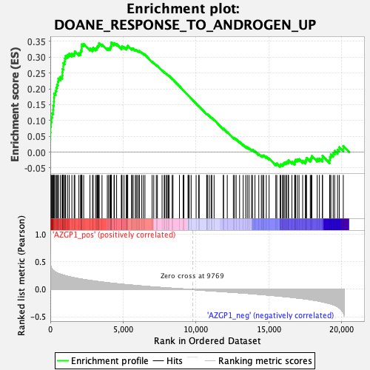
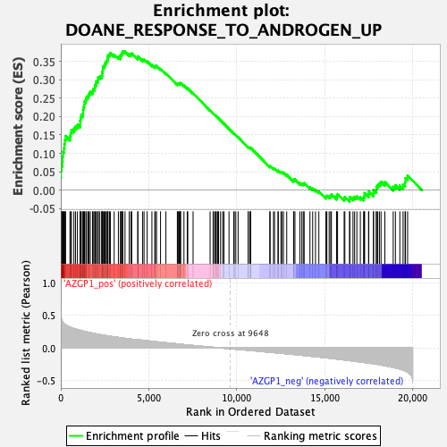
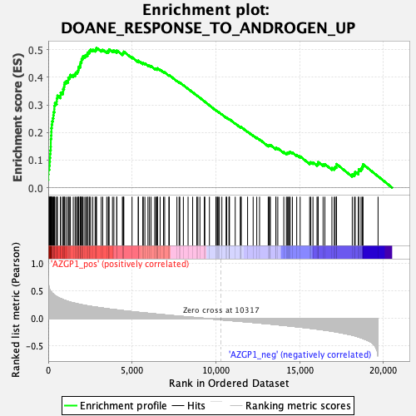
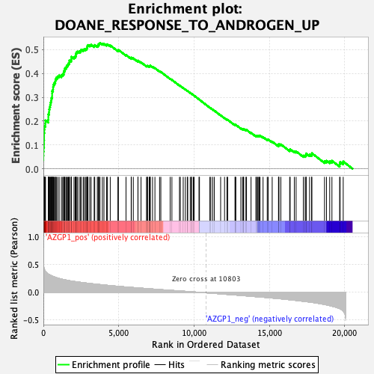
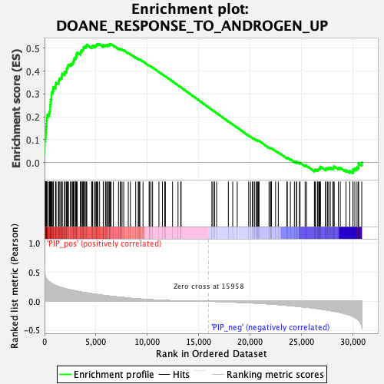
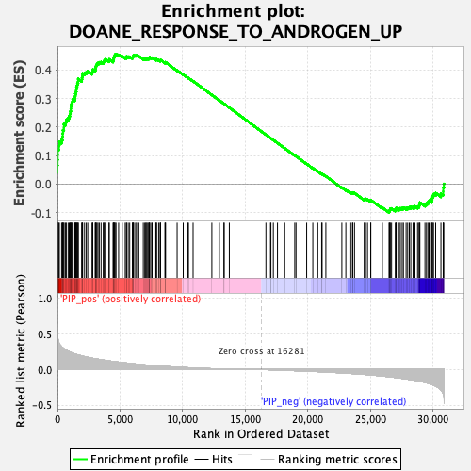
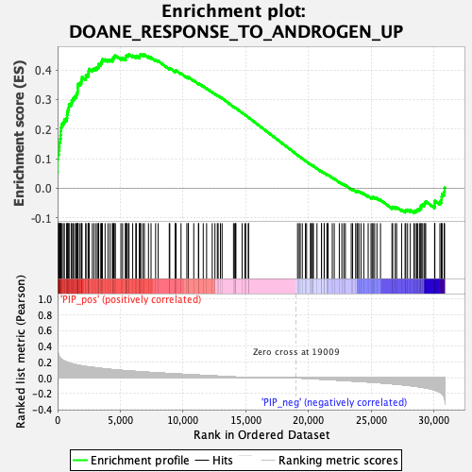
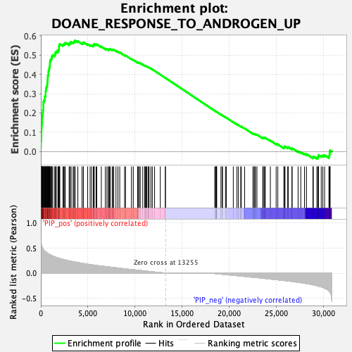
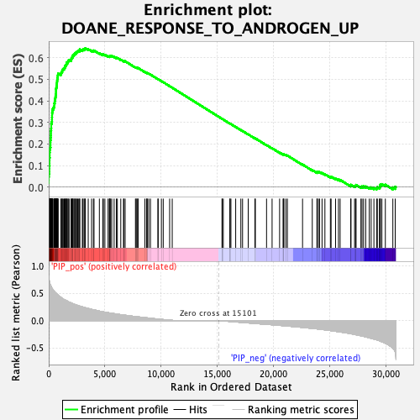
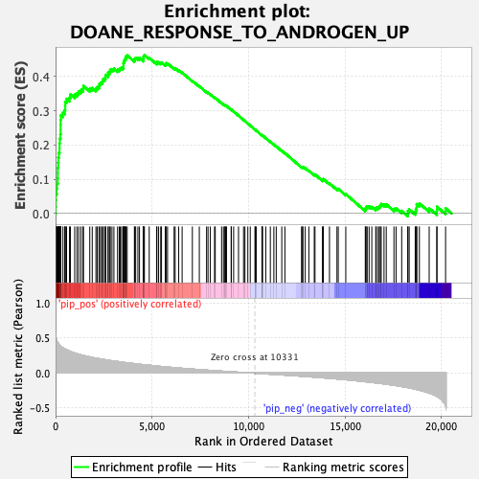
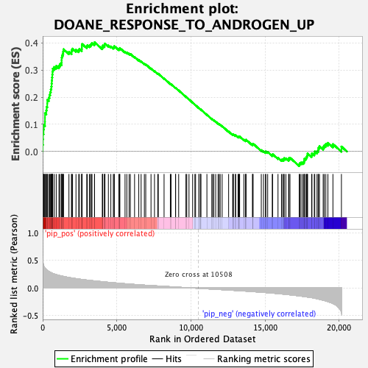
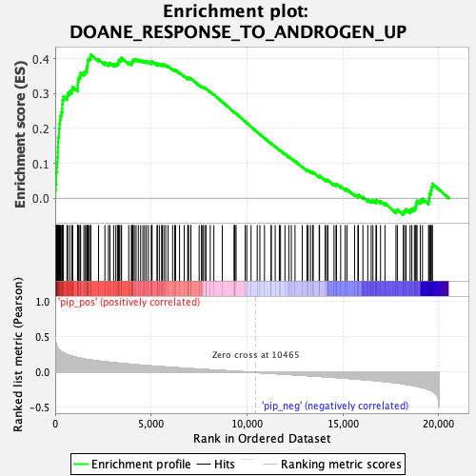
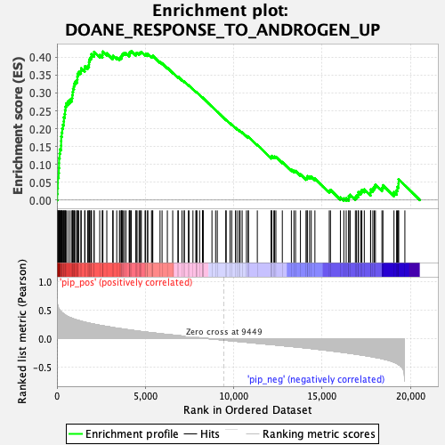

Supplemental Figure 7
a
Whole cohort
Luminal
Luminal HER2
HER2
TNBC
NES=1.92
p=0.001
NES=1.82
p=0.001
NES=1.43
p=0.042
NES=1.48
p=0.069
NES=1.85
p=0.008
SCAN-B cohort
KLK3
NES=1.49
p=0.049
NES=1.23
p=0.157
NES=1.04
p=0.364
NES=1.47
p=0.112
NES=1.64
p=0.045
TCGA cohort
b
Whole cohort
Luminal
Luminal HER2
HER2
TNBC
NES=2.05
p=0.001
NES=1.99
p=0.001
NES=1.90
p=0.001
NES=1.99
p=0.001
NES=1.94
p=0.001
SCAN-B cohort
AZGP1
NES=1.93
p=0.001
NES=1.56
p=0.010
NES=1.58
p=0.031
NES=2.00
p=0.001
NES=2.05
p=0.001
TCGA cohort
c
Whole cohort
Luminal
Luminal HER2
HER2
TNBC
NES=1.95
p=0.001
NES=1.76
p=0.002
NES=1.73
p=0.001
NES=1.91
p=0.001
NES=2.04
p=0.001
SCAN-B cohort
PIP
NES=1.92
p=0.001
NES=1.78
p=0.001
NES=1.75
p=0.009
NES=1.64
p=0.034
NES=2.04
p=0.001
TCGA cohort

