Slide 1
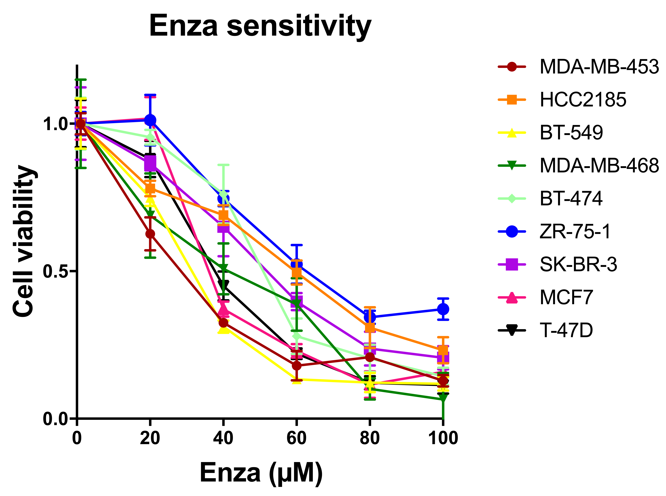
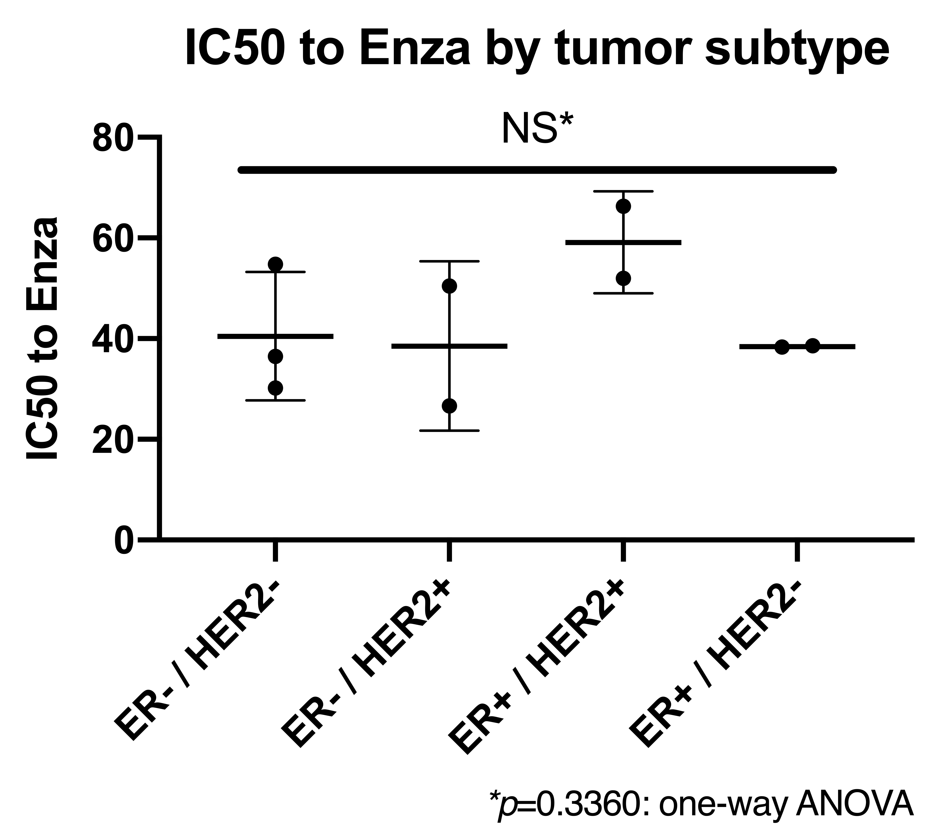
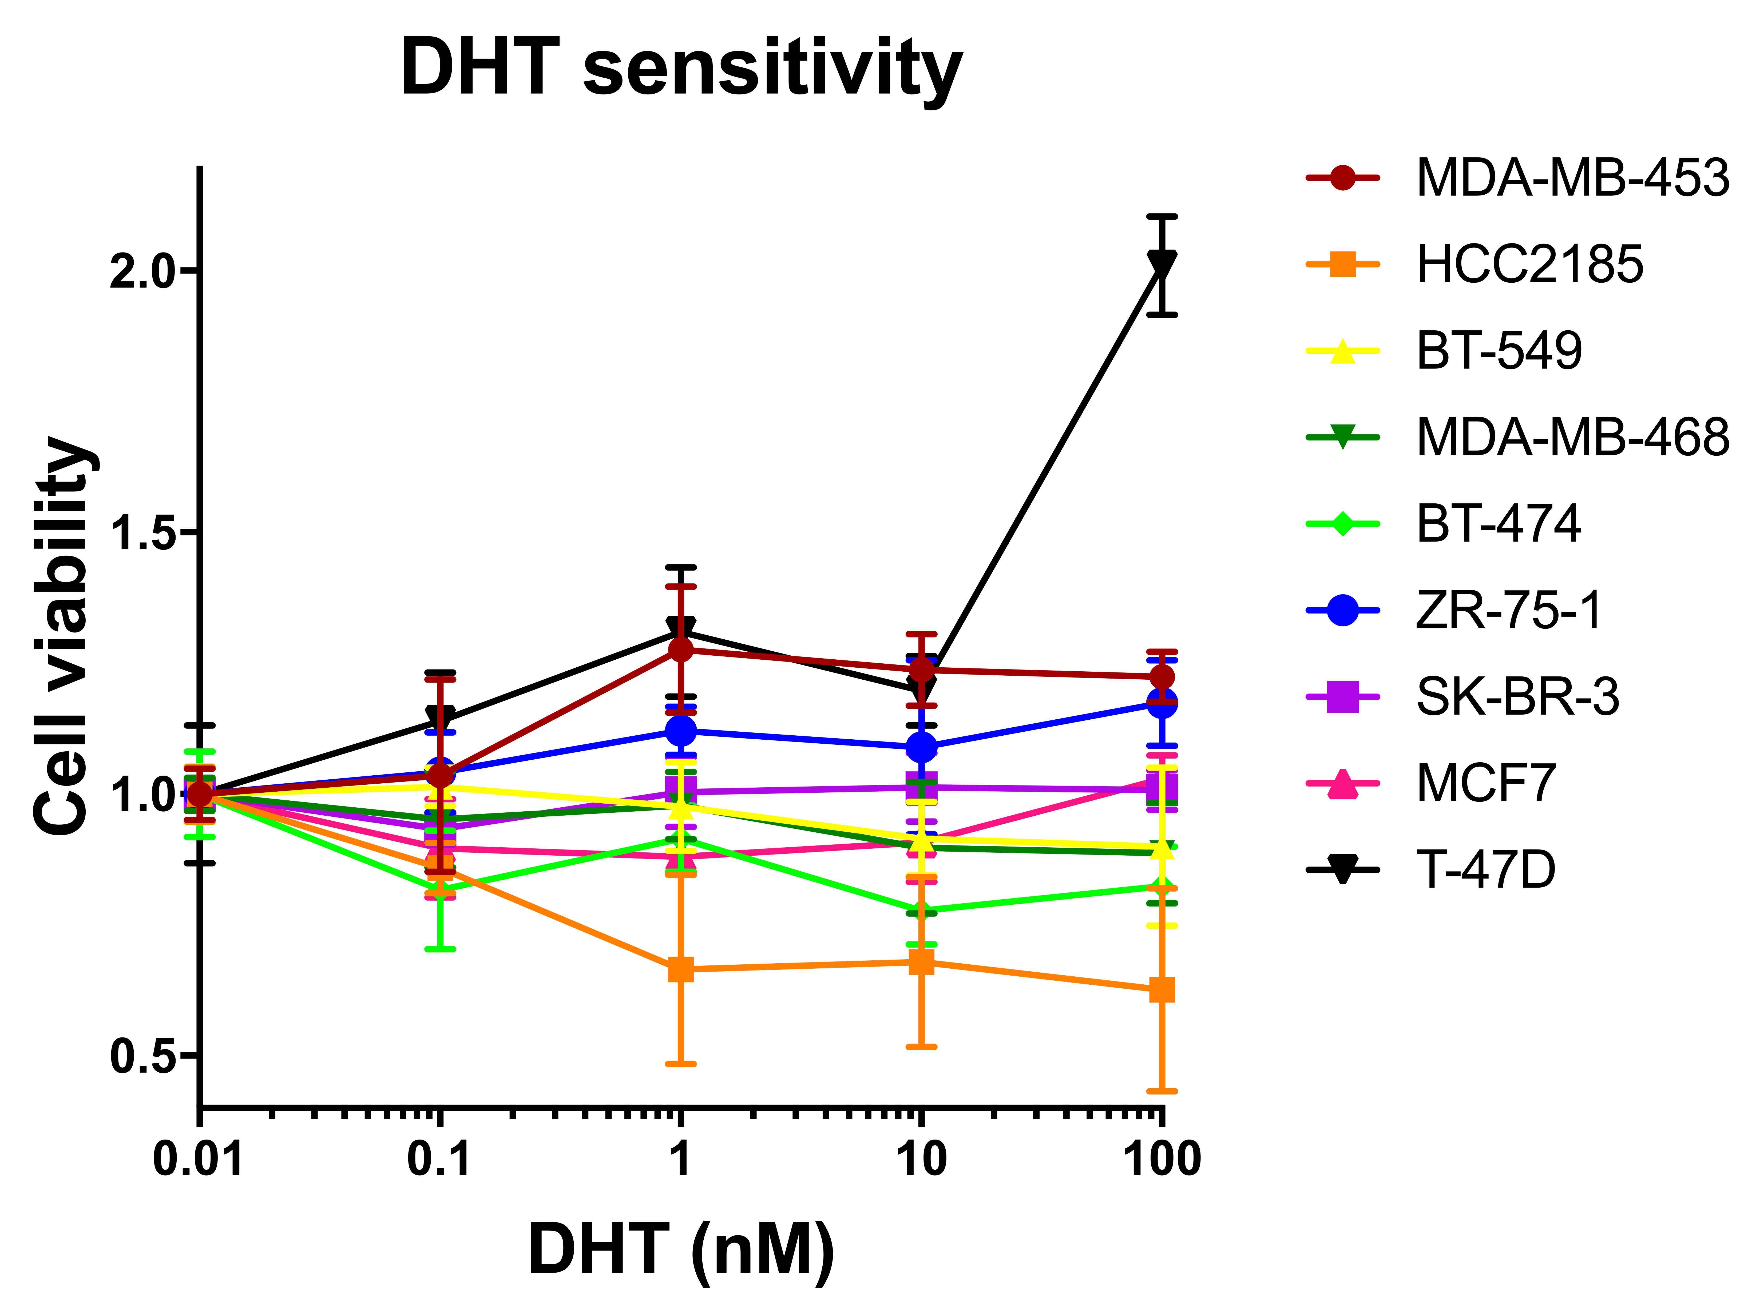
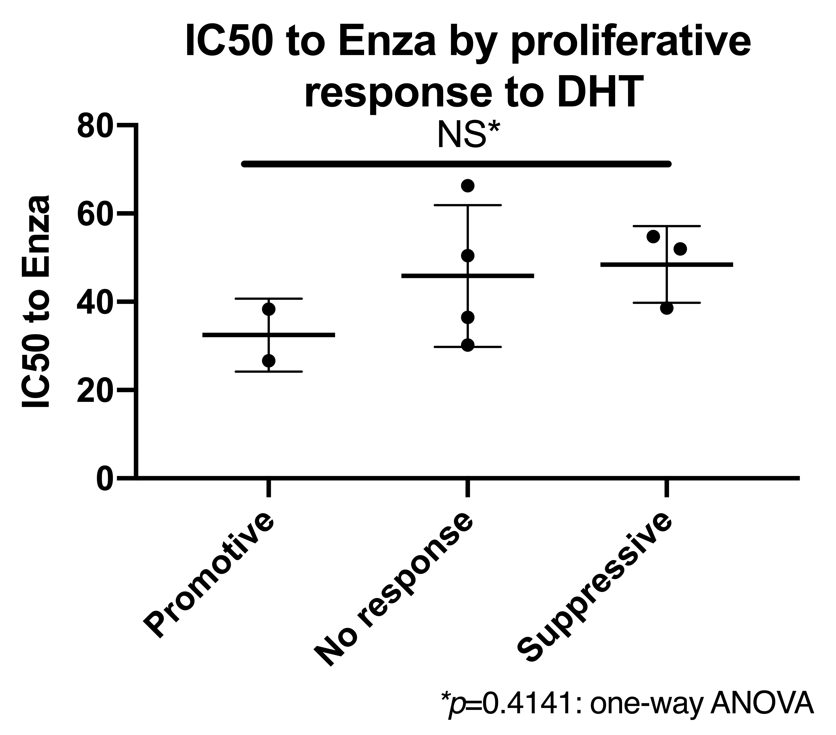
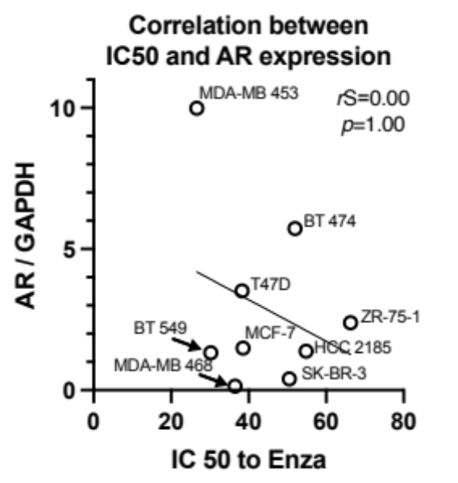
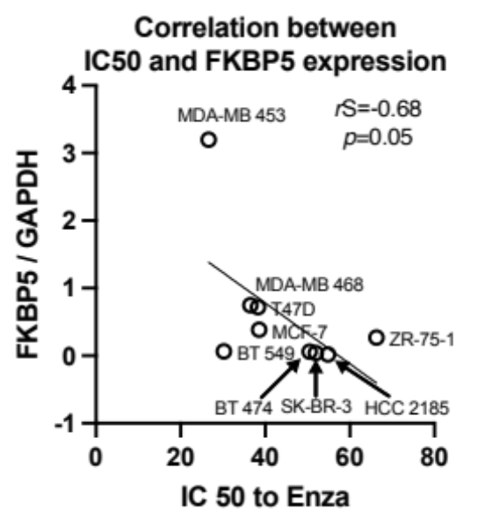
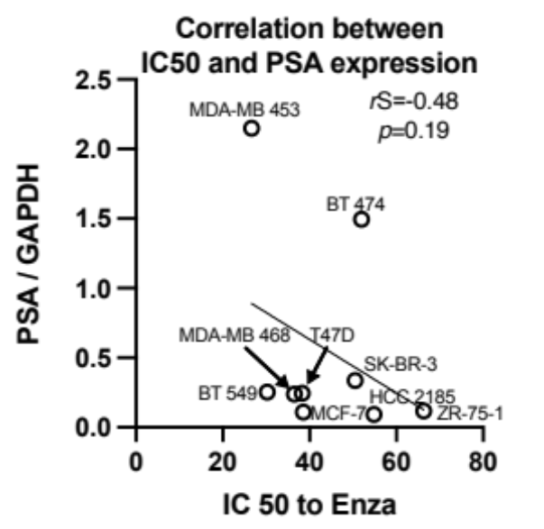
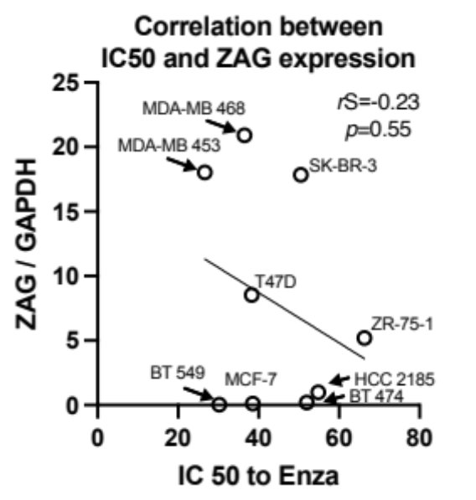
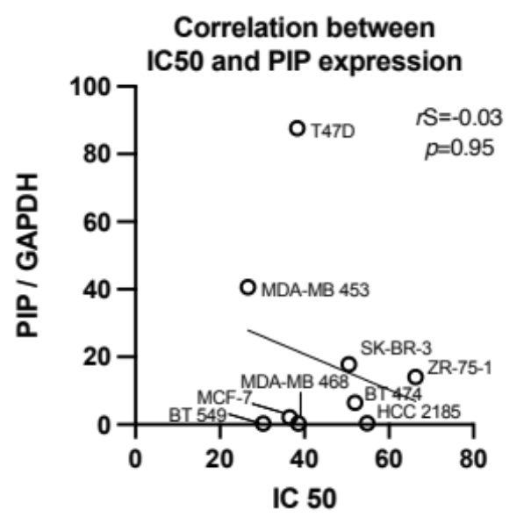
Supplementary Figure 2
a
b
Subtype | Cell line | IC 50 (μM)
ER- / HER2- | HCC2185 | 54.81
 | BT-549 | 30.21
 | MDA-MB-468 | 36.47
ER- / HER2± | MDA-MB-453 | 26.64
ER- / HER2+ | SK-BR-3 | 50.47
ER+ / HER2+ | BT-474 | 51.99
 | ZR-75-1 | 66.29
ER+ / HER2- | MCF7 | 38.56
 | T-47D | 38.31
c
d
Cell line | Proliferative response to DHT | IC 50 (μM)
MDA-MB 453 | Promotive | 26.64
HCC 2185 | Suppressive | 54.81
BT 549 | No response | 30.21
MDA-MB 468 | No response | 36.47
ZR-75-1 | No response | 66.29
SK-BR-3 | No response | 50.47
BT 474 | Suppressive | 51.99
MCF-7 | Suppressive | 38.56
T47D | Promotive | 38.31
0
e

