Slide 1
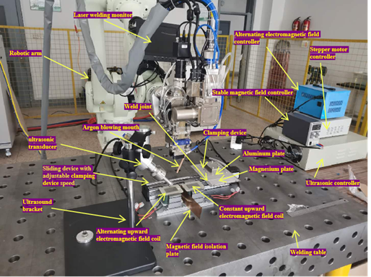
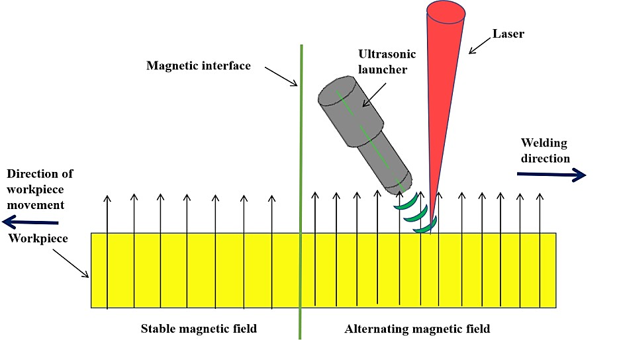
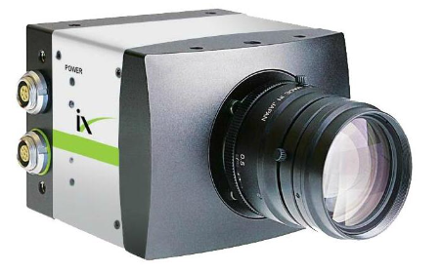

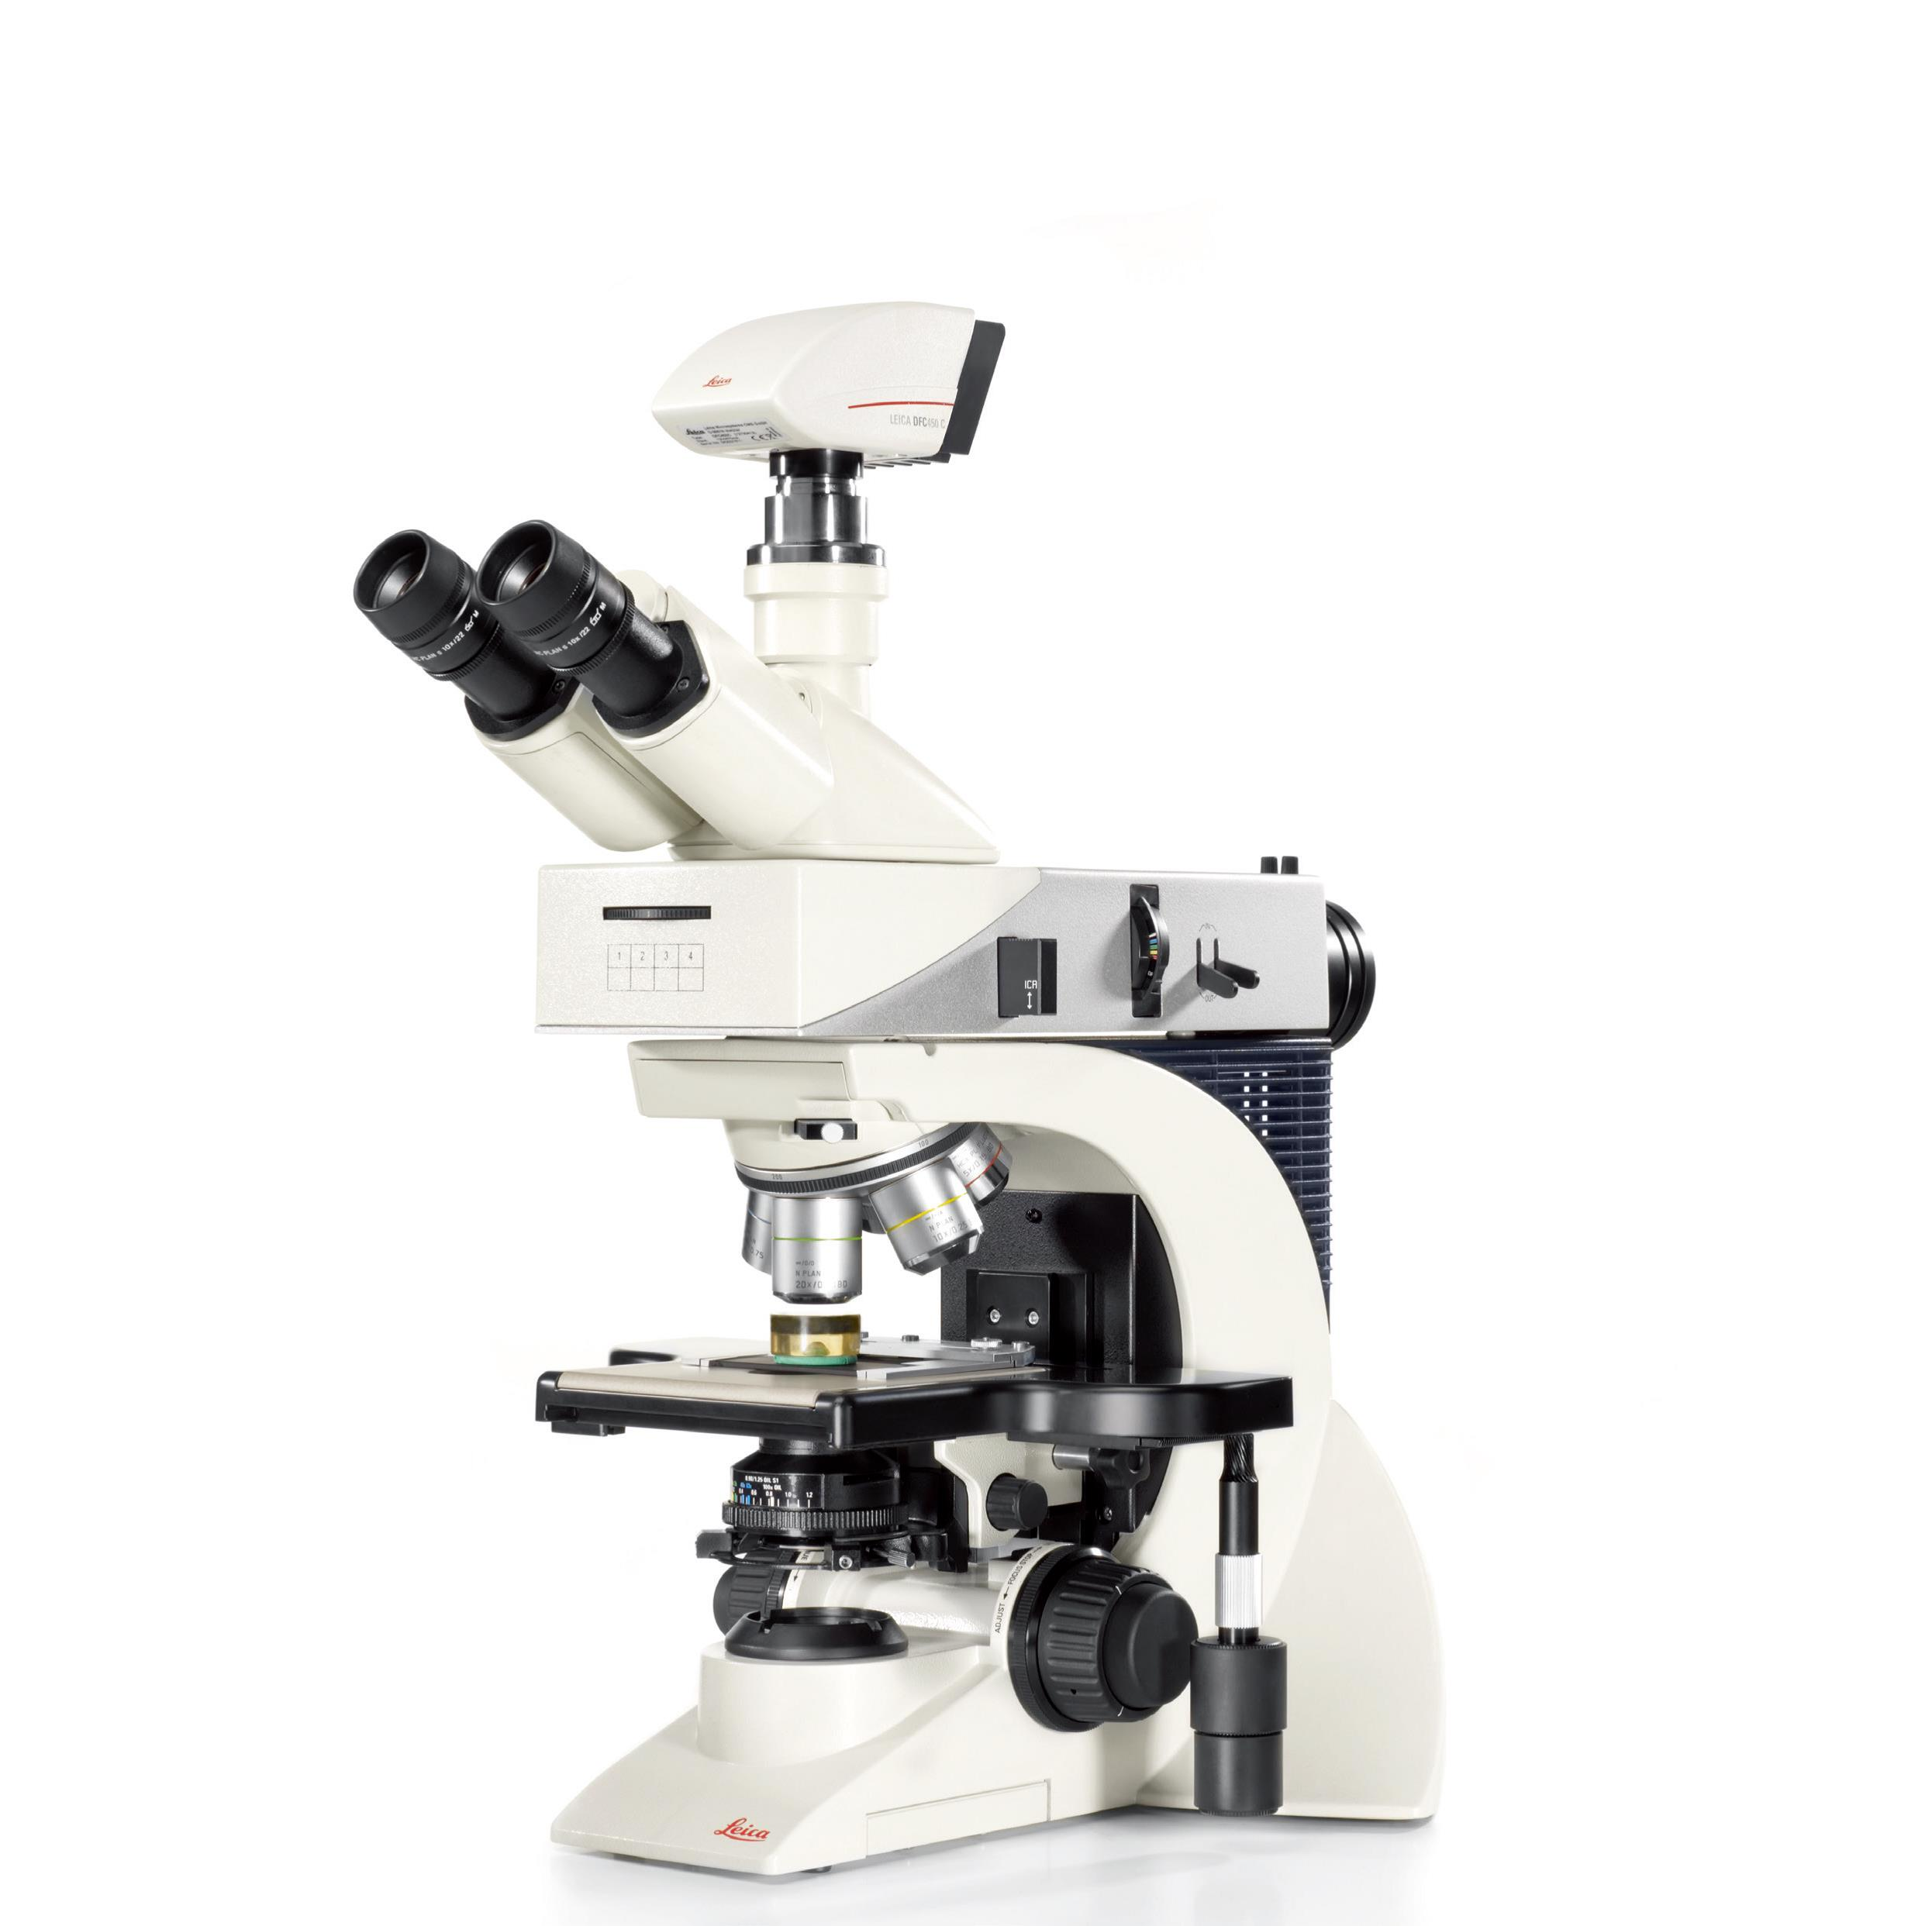
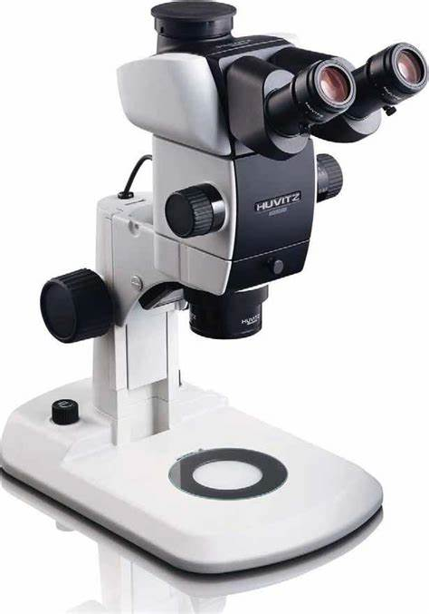
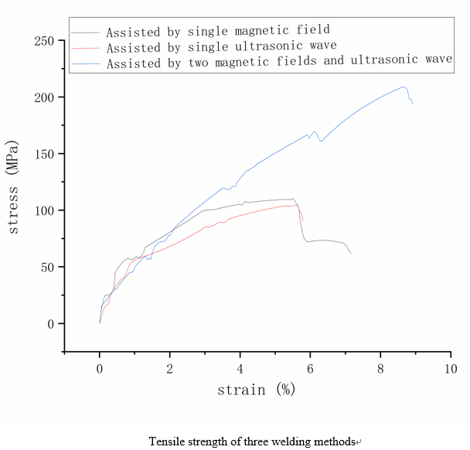
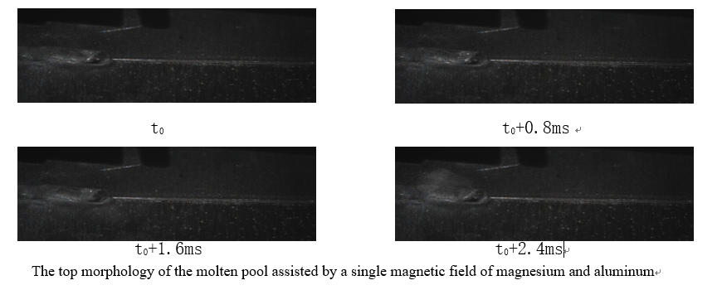

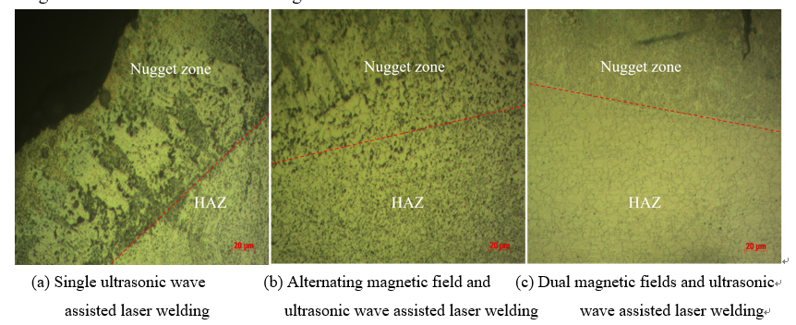
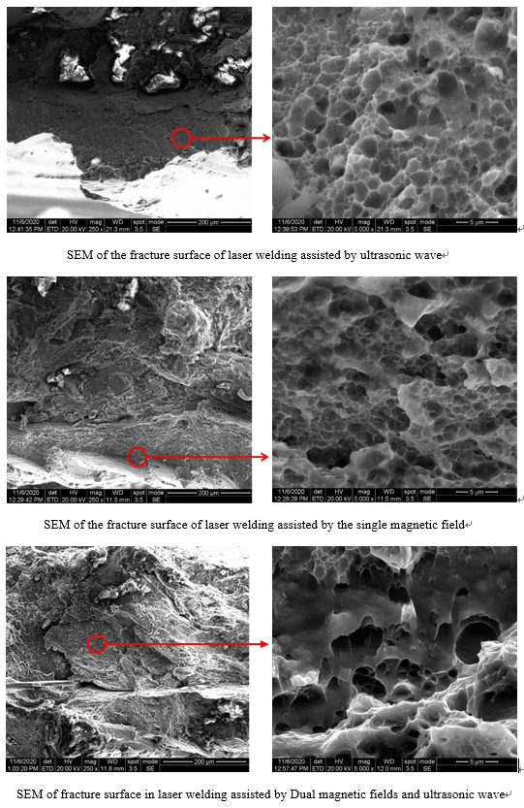
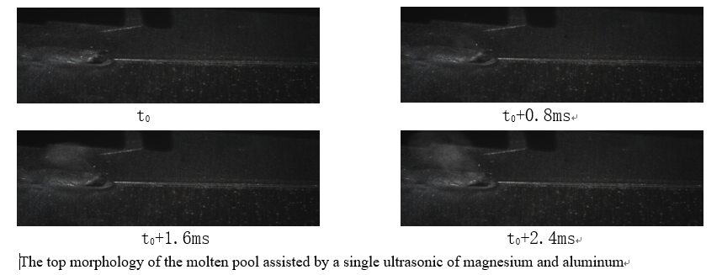
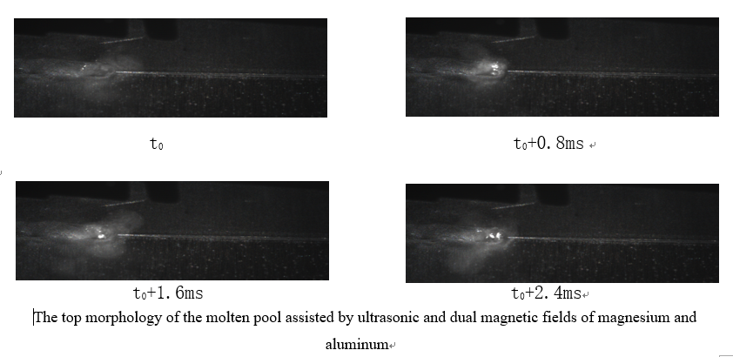
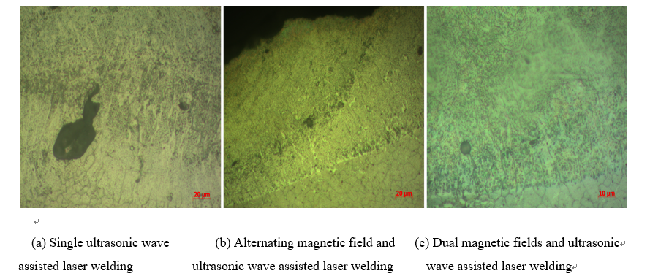
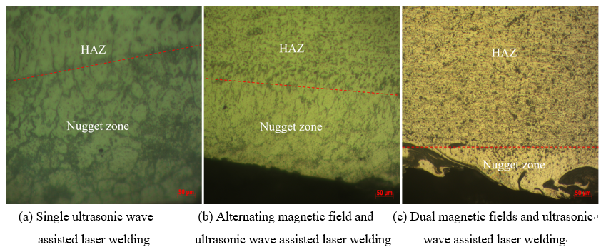
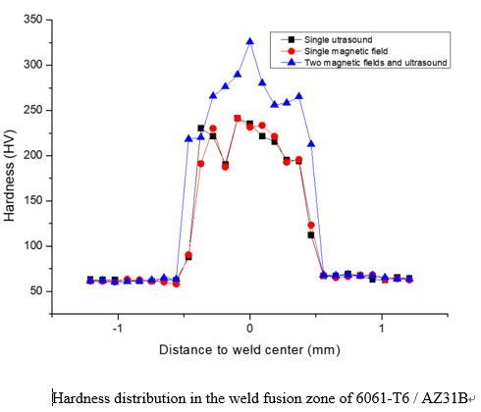
Pore suppression study on Mg/Al joint in laser welding by dual magnetic fields and ultrasound
Mg
Al
Experimental Equipment Construction
Laser Welding Process
The state of the molten pool is observed by a high-speed camera under three welding methods
The size and distribution of bubbles in the cross-section of weld seams under three welding methods
The metallographic structures on the magnesium side and the aluminum
side under three welding methods under three welding methods
Tensile tests, fracture scanning electron microscopy (SEM),
and weld hardness tests under three welding methods
Draw conclusions and verify the best welding method

