Slide 1
Supplemental Figure 1
A
B
C
D
E
F
G
H
I
J
K
L
M
N
O
P

Slide 2
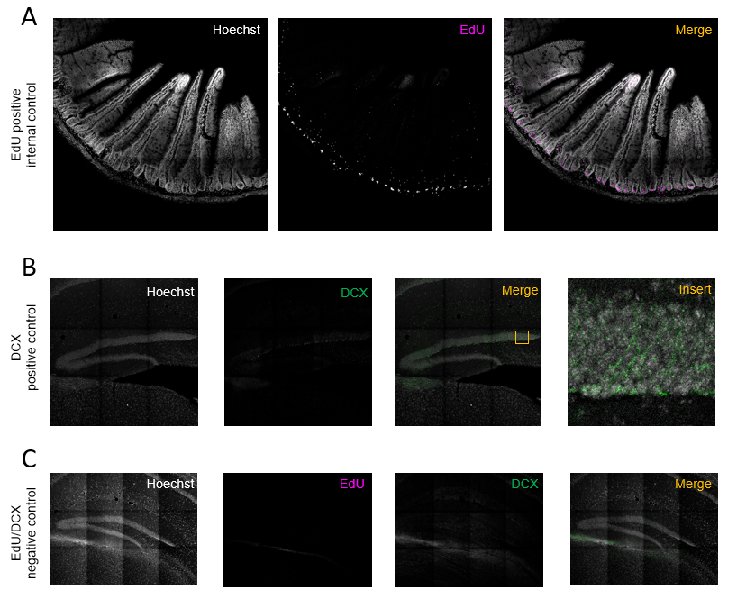
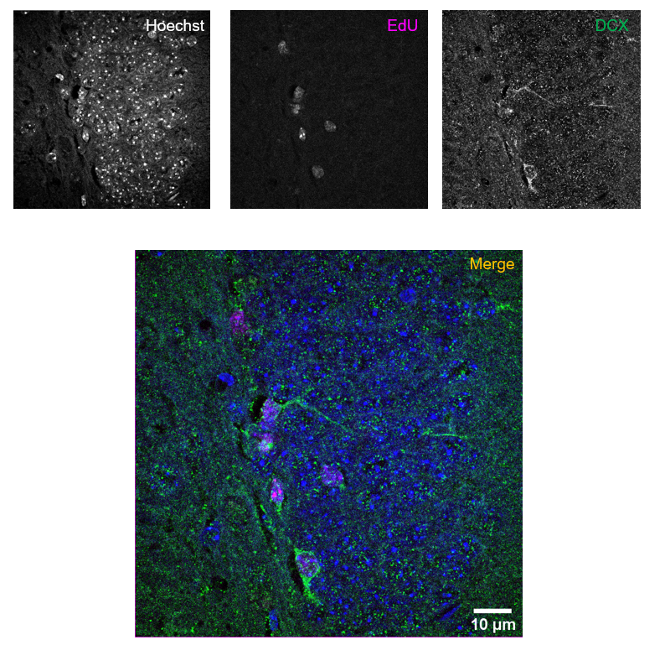

Supplemental Figure 2
A
B
C
D
E
F

