Slide 1
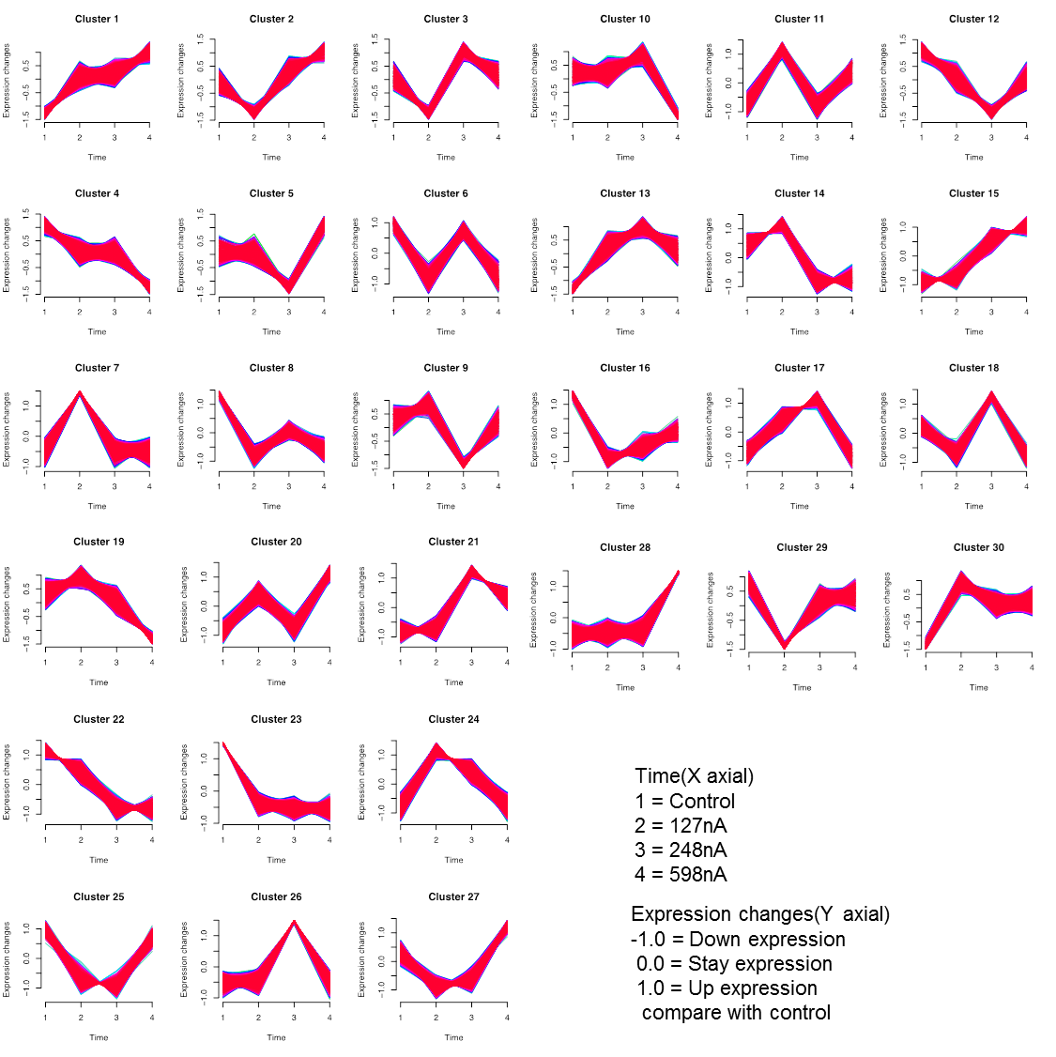
Figure S3
(A)

