Slide 1
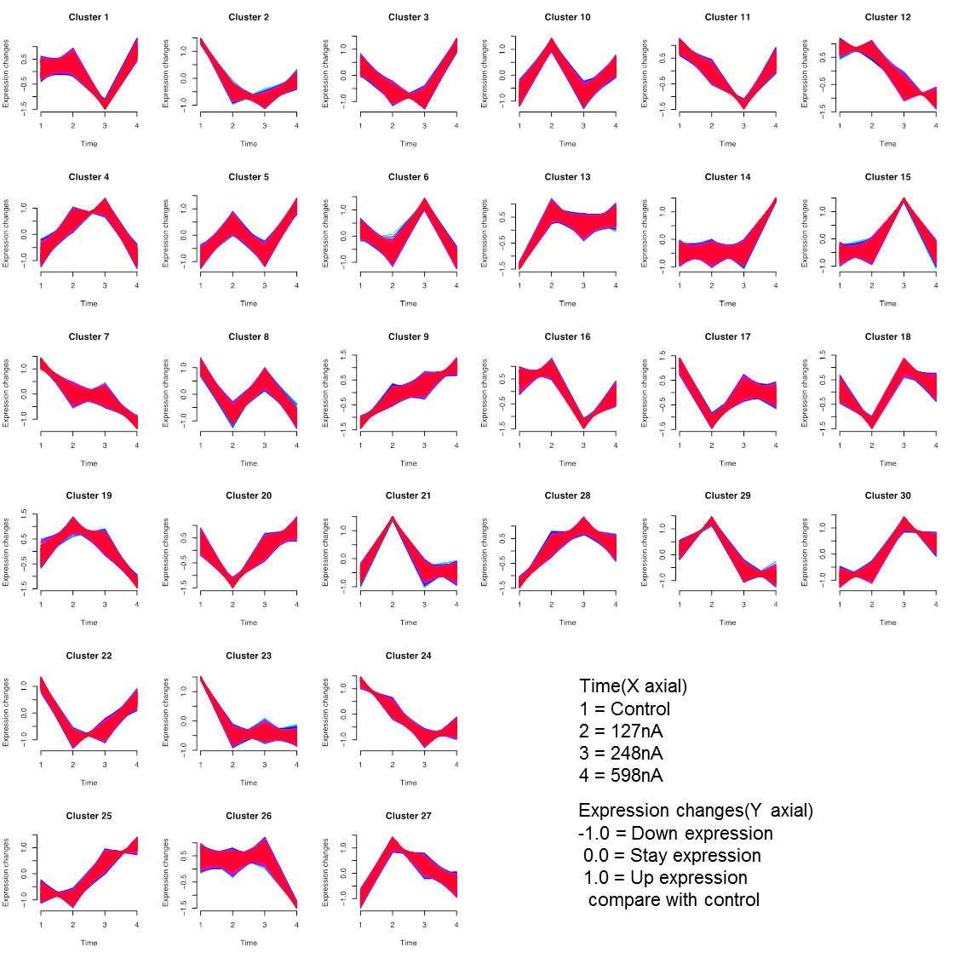
Figure S3
(B)

