Slide 1
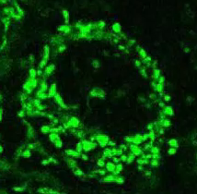
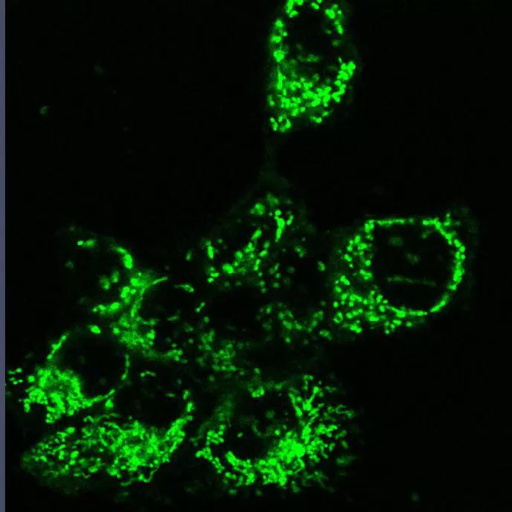
Supplemental Figure 2 (movie)
si-con
sieEF2

