Slide 1




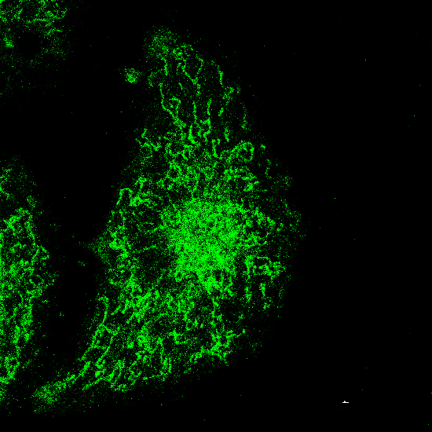
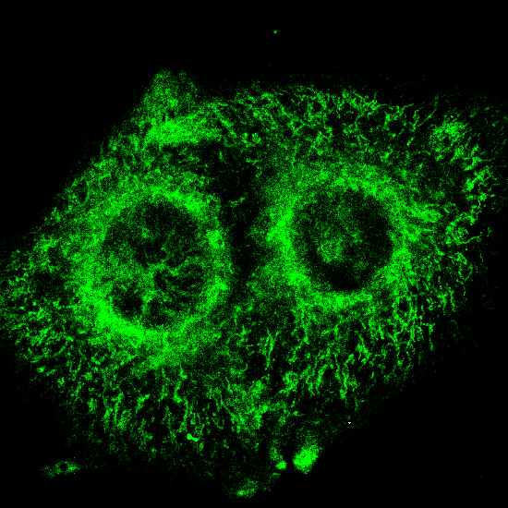

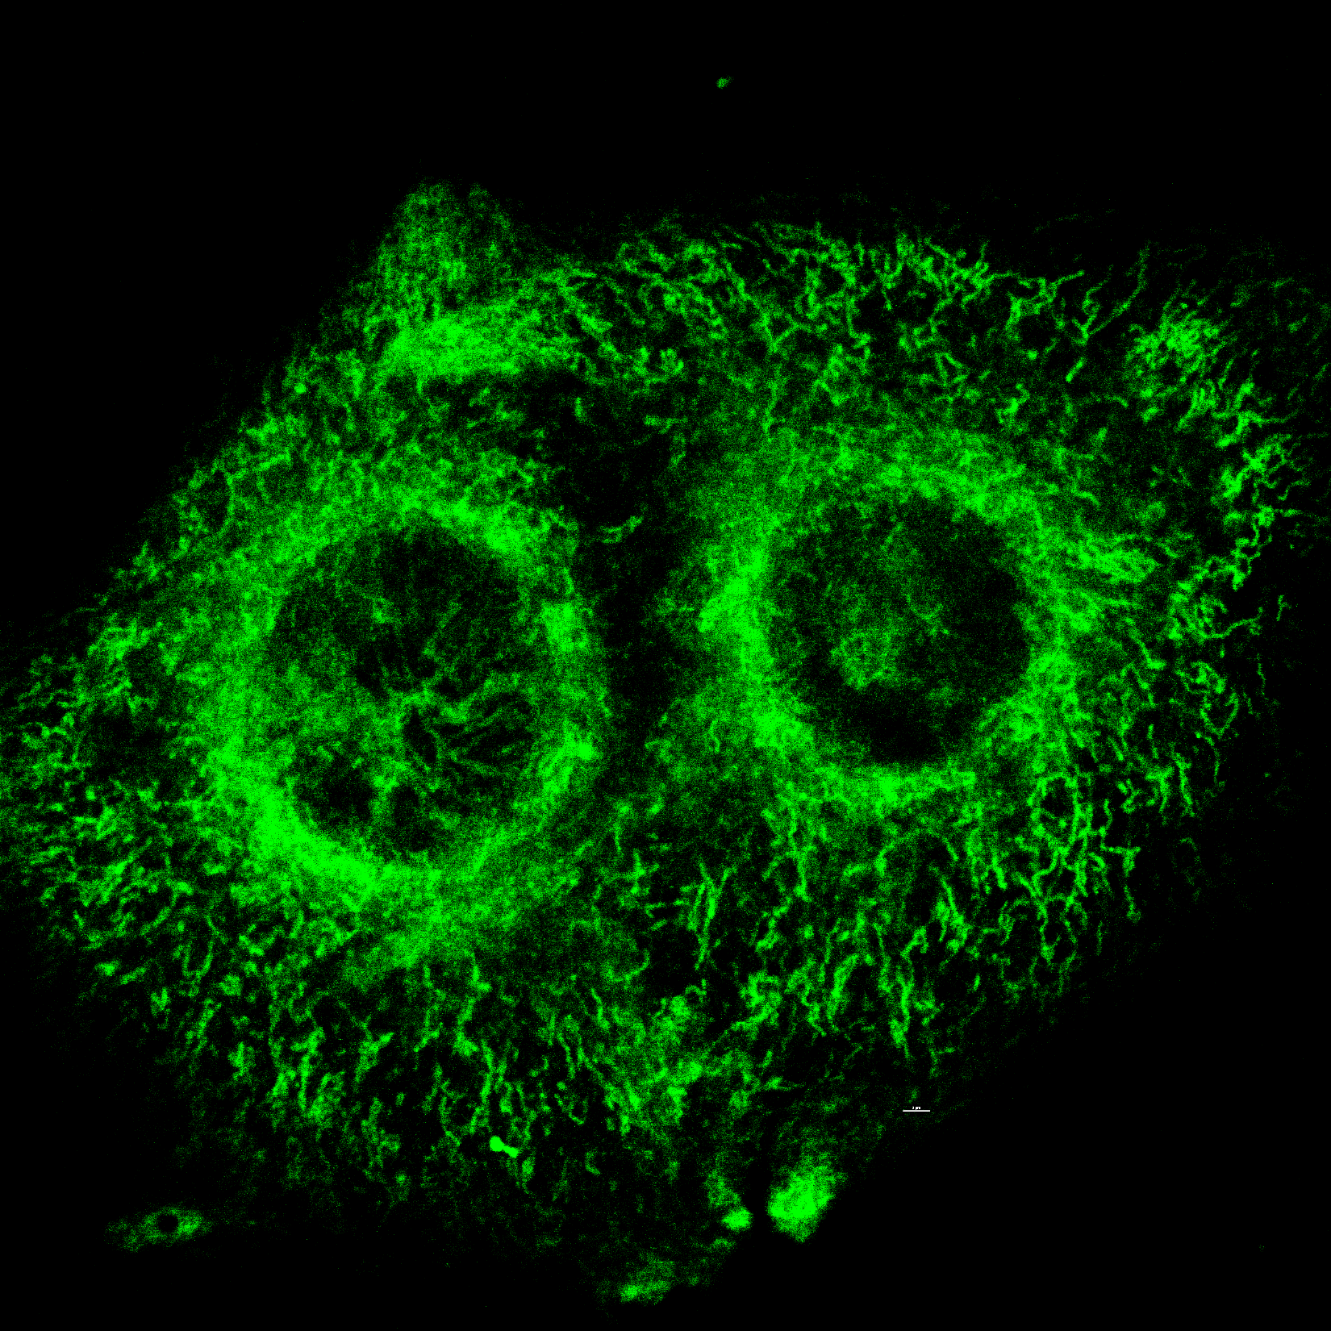
Supplemental Figure 4
a
eEF2K KO
MocK
eEF2K
eEF2
p-eEF2
GAPDH
b
B16 OVA
B16 OVA eEF2K KO
Mito-tracker Green
***
Mitochondria length (nM)

