Slide 1
Supplemental Figures and Tables Chan et al

Slide 2
Creation of calibrator Cell Line Microarray (CMA)
LC-MS/MS
Antibody Titration and Assay Limit Definition
Different Antibody Concentrations Test
Validation on WTS and ROI Selection
40 WTS staining
CMA Construction
Analytical Validation of Assay
Accuracy
Precision
ROIs Annotation & Scanning
Reproducibility Test of Optimal Concentration
Unit Transformation into amol/mm²
LOD/LOQ Determination
Quantitative analysis in QuPath-Qymia Software
Reference Interval and Reportable Range
Acceptance Criteria of Assay
Supplemental Figure 1: Schematic diagram of new laboratory test development process for TROPLEX assay optimization and validation

Slide 3
Consort Flow Diagram
Prospectively collected Breast Cancer Specimens enrolled in Yale New Haven Hospital from 2023 to 2024 (n=166)
Assessed clinicopathological information including ER, PR status and HER2 IHC scores (n=166)
Age Range: 31 to 96 (Average Age: 60) ER Status: Positive (n=136), Negative (n=23), Unknown (n=1) PR Status: Positive (n=115), Negative (n=44), Unknown (n=1) HER2 IHC scores: Zero (n=45), 1+ (n=49 ), 2+/FISH- (n=50 ), 2+/FISH+ (n=3 ), 3+ (n= 11), Unknown (n=2)
Subjected to TROPLEX assay on Leica BOND RX (n=166)
Exclusion (n= 6): Not sufficient tumor or tissue fold after staining
Included in QuPath-Qymia quantification and final statistical analysis (n=160)
Supplemental Figure 2. Consort flow diagram of TROPLEX prospective study

Slide 4
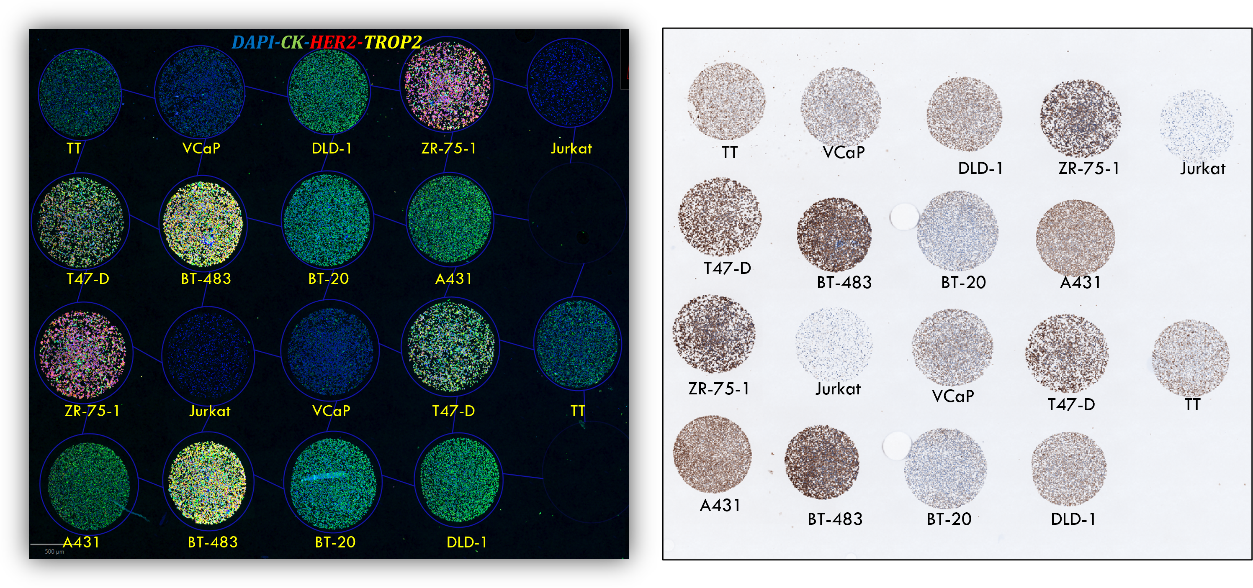
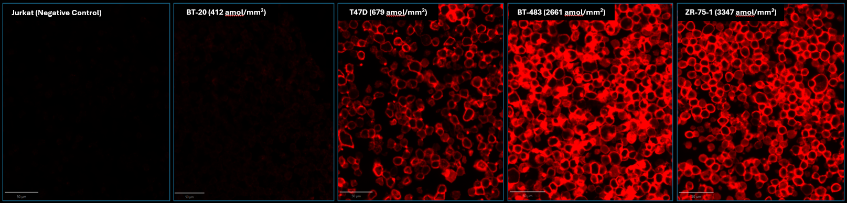
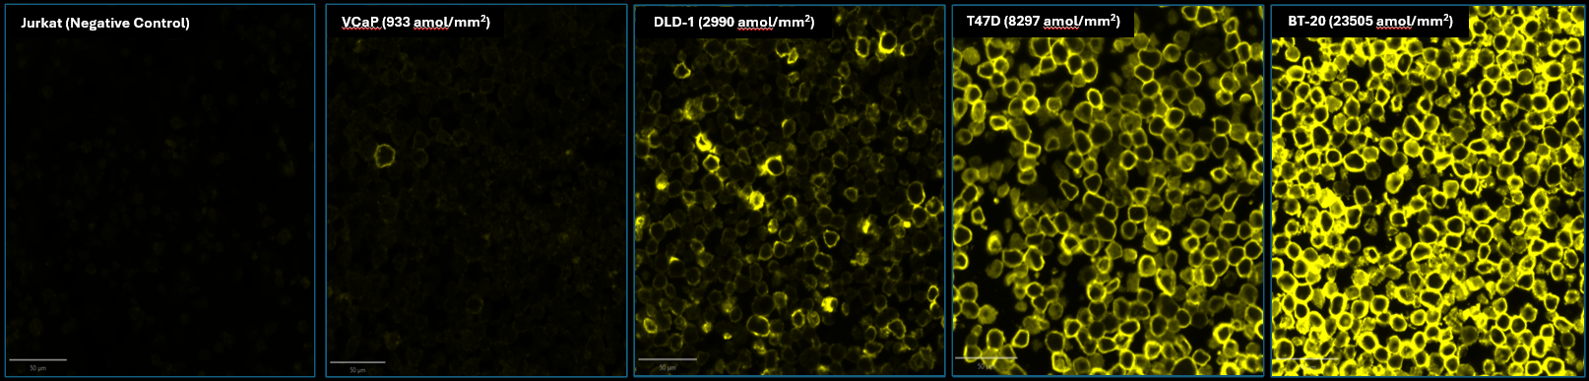
CMA625 Array Map
HER2 (upper) & TROP2 (lower) Staining Pattern in Different Standard Cell Lines
Supplemental Figure 3. Representative images of fluorescent and chromogenic staining on the index CMA (cell line microarray)

Slide 5
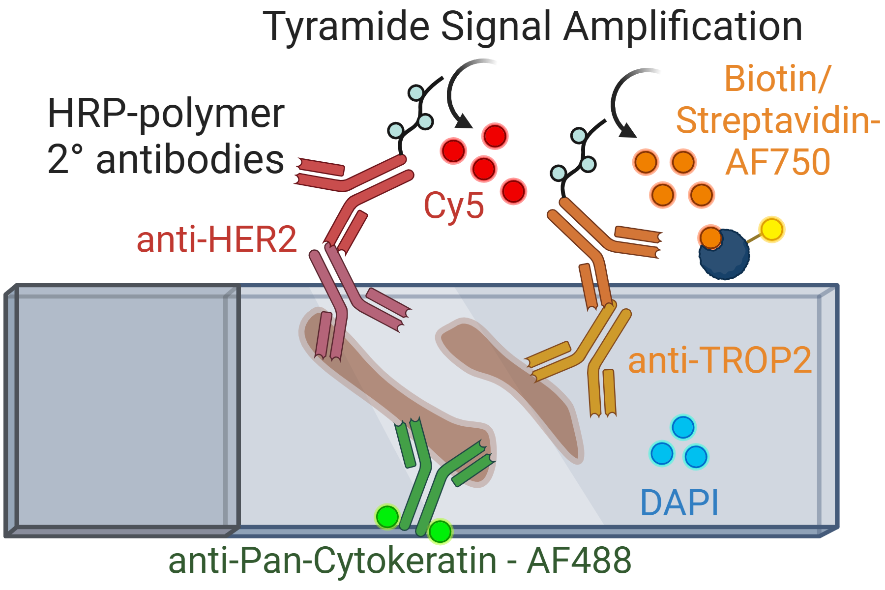
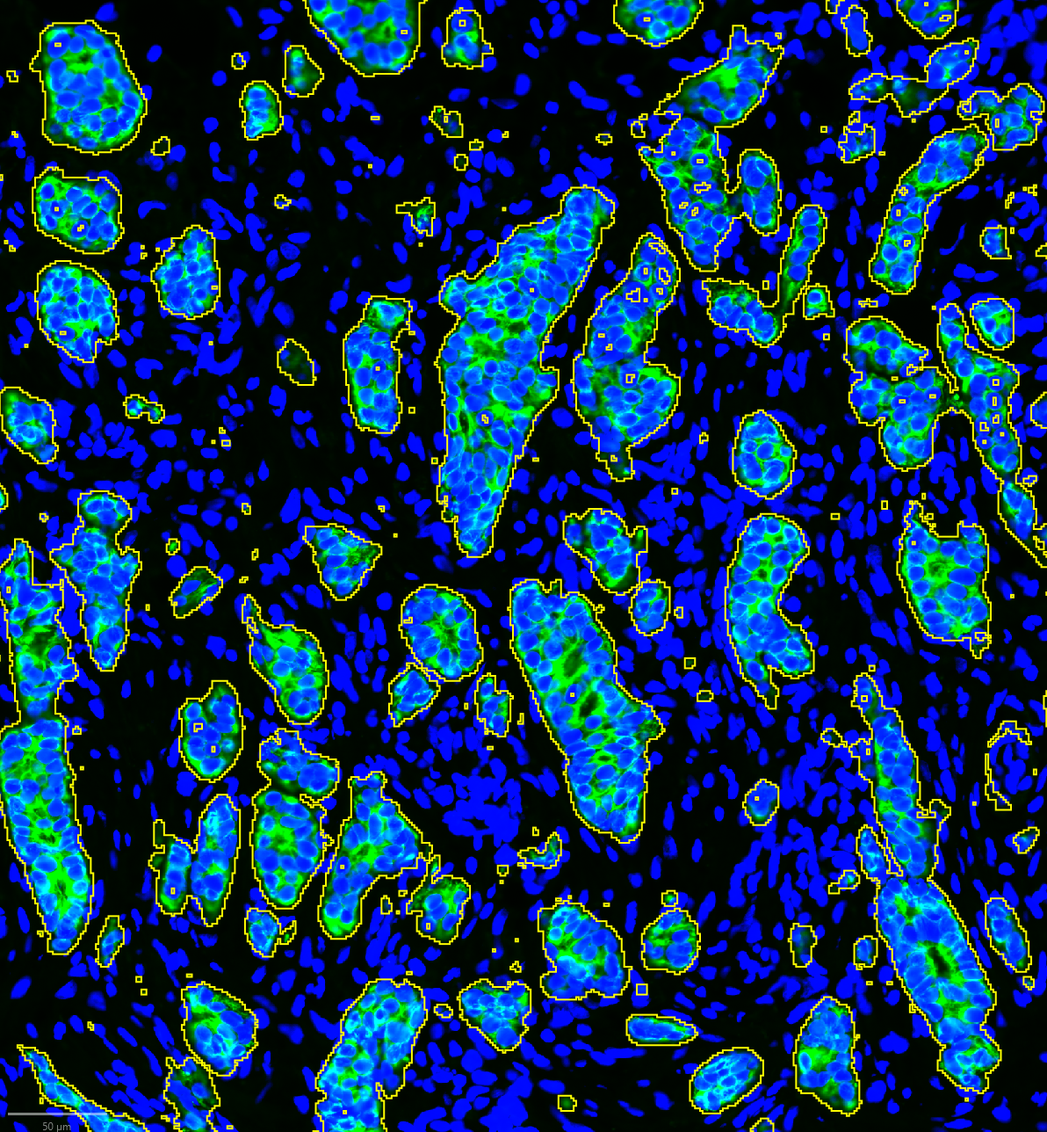
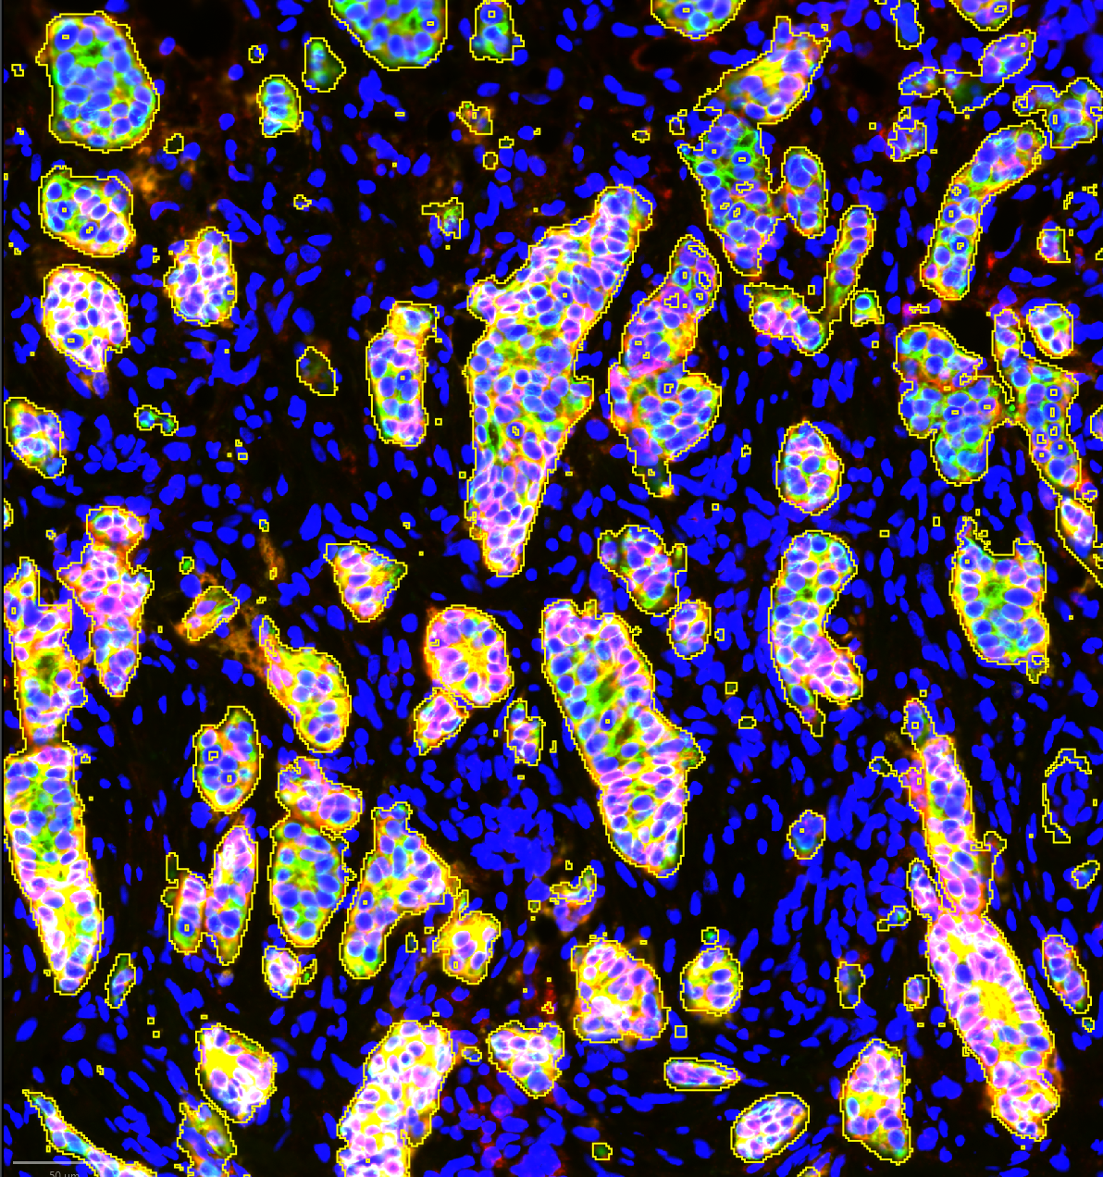
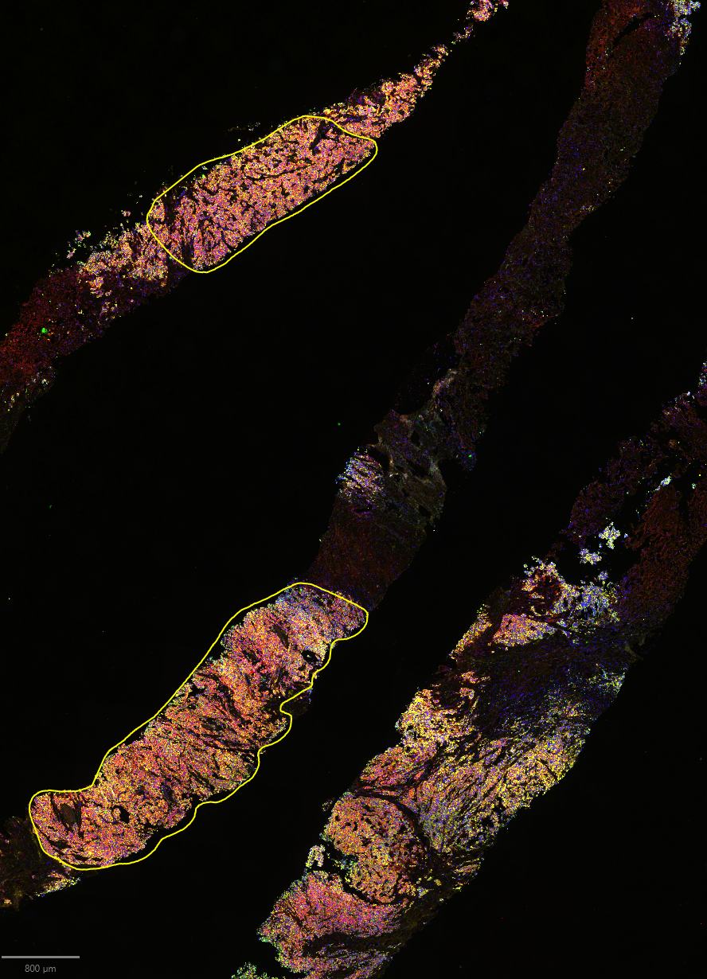
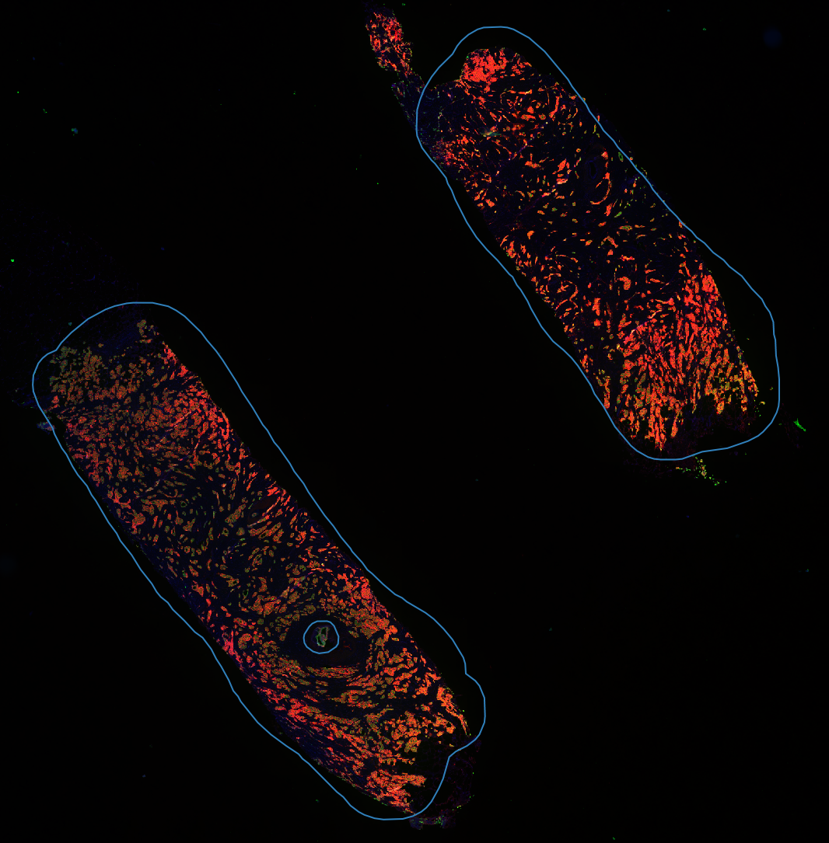
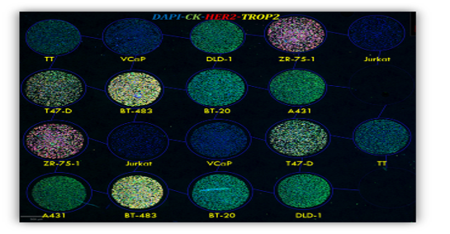
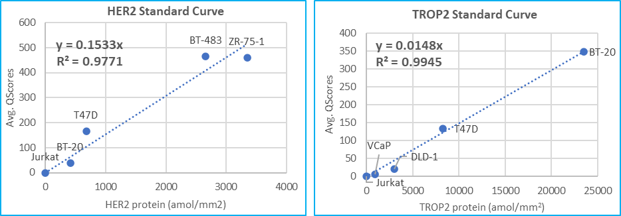
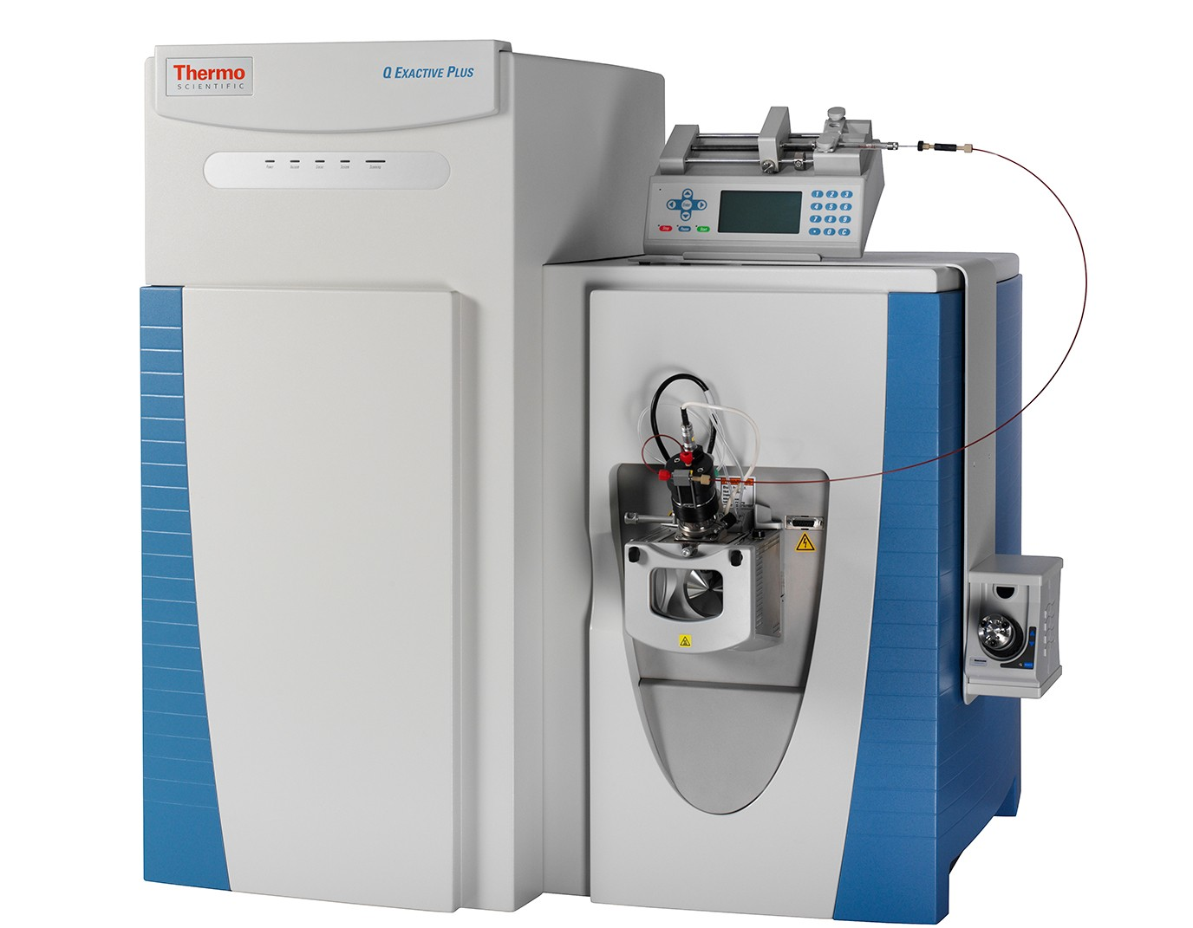
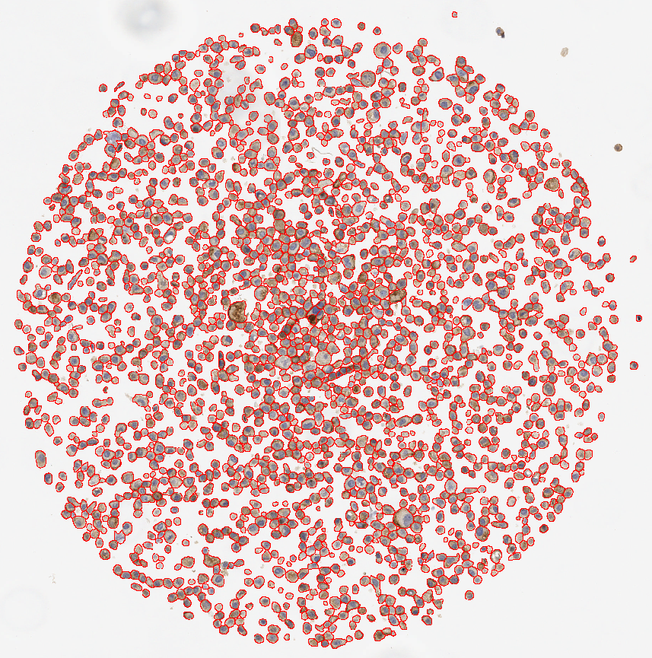
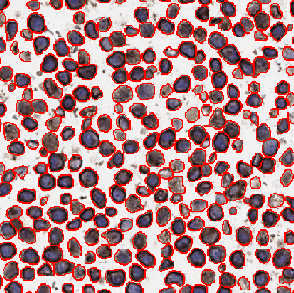



Immunofluorescence Assay
Molecular Compartmentalization
Report Quantitative Measurements in pathologist-annotated ROIs
Cy3
Tumor (CK+)
HER2-TROP2 in CK Mask
+
$$Qymia Score∝ \frac{Σ Intensity}{Σ Compartment Area \left(μm^{2}\right)}$$
Cell line array standard
Convert Qymia Score to $\frac{amol}{mm2}$
HER2 & TROP2 Quantification:
LC-MS/MS (protein per cell)
$\frac{amol}{cell}$ to $\frac{amol}{mm2}$
Cell Segmentation
Supplemental Figure 4. Overview of Quantitative High-sensitivity HER2 & TROP2 Multiplex Immunofluorescence assay
Notes:
Change the TMAs to conceptual figures.
Make “report” look more like a report.
Change lime green to a darker green for calibration curves.
Capitalize TROP2.
Use fmol instead of amol.

Slide 6
Revised
Supplemental Figure 5: A regression showing levels of HER2 in amol/mm² in the HS-HER2 single-plex assay compared to HER2 measured in the Troplex assay

Slide 7
Mass Spec Data of Selected Cell Lines
Cell Lines | HER2 protein (amol/mm²) | TROP2 protein (amol/mm²)
Jurkat | 0 | 0
TT | 0 | 0
VCaP | 105.3 | 933.2
DLD-1 | 438.9 | 2990.2
BT-483 | 2660.5 | 5546.3
T47D | 678.8 | 8296.5
ZR-75-1 | 3346.9 | 10285.8
BT-20 | 412.4 | 23505.1
A431 | 457.9 | 36557.9
Supplemental Table 1. HER2 & TROP2 measurements of each cell line

