Slide 1
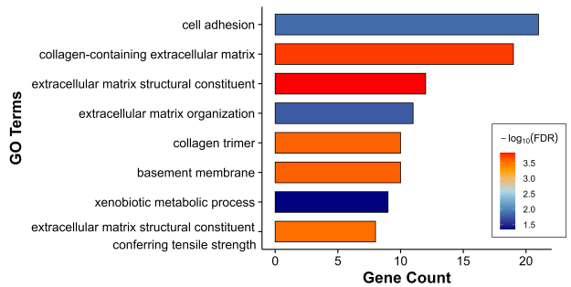
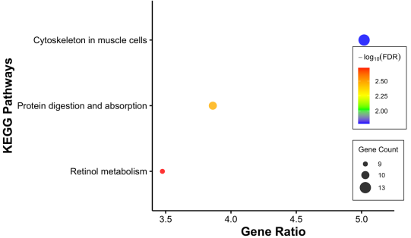
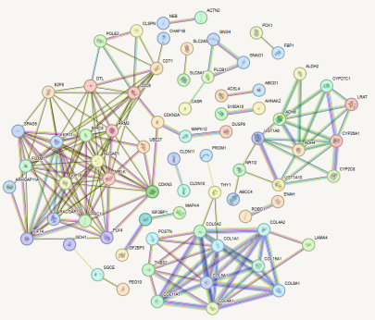
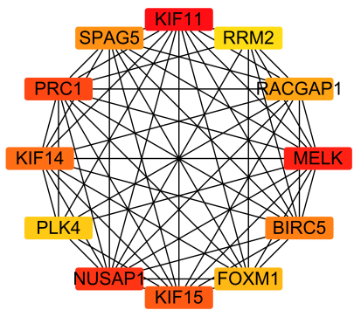
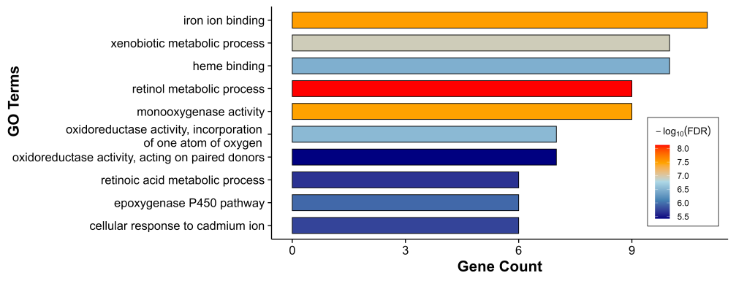
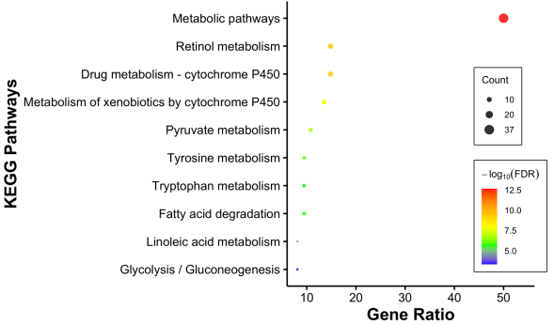
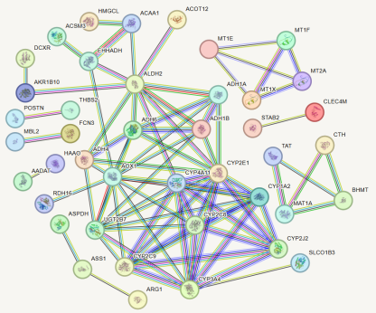
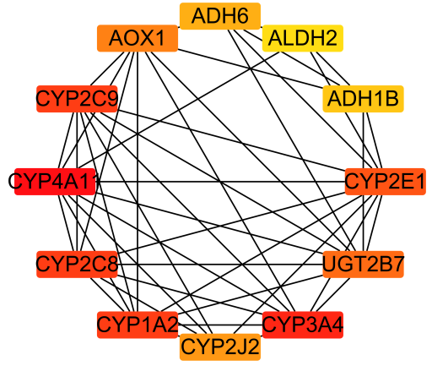
A
B
C
D
E
F
G
H
Supplementary Figure 1. Enrichment and network analysis of methylation-regulated genes.
(A, B) GO (A) and KEGG (B) enrichment analyses of 268 differentially methylated and expressed genes (DMEGs).
(C, D) PPI network of 268 DMEGs (C) and the top 10 hub genes identified by connectivity (D).
(E, F) GO (E) and KEGG (F) enrichment analyses of 74 genes consistently altered at both mRNA and protein levels.
(G, H) PPI network of the 74 multi-omics consistent genes (G) and the corresponding top 10 hub genes (H).

