Slide 1
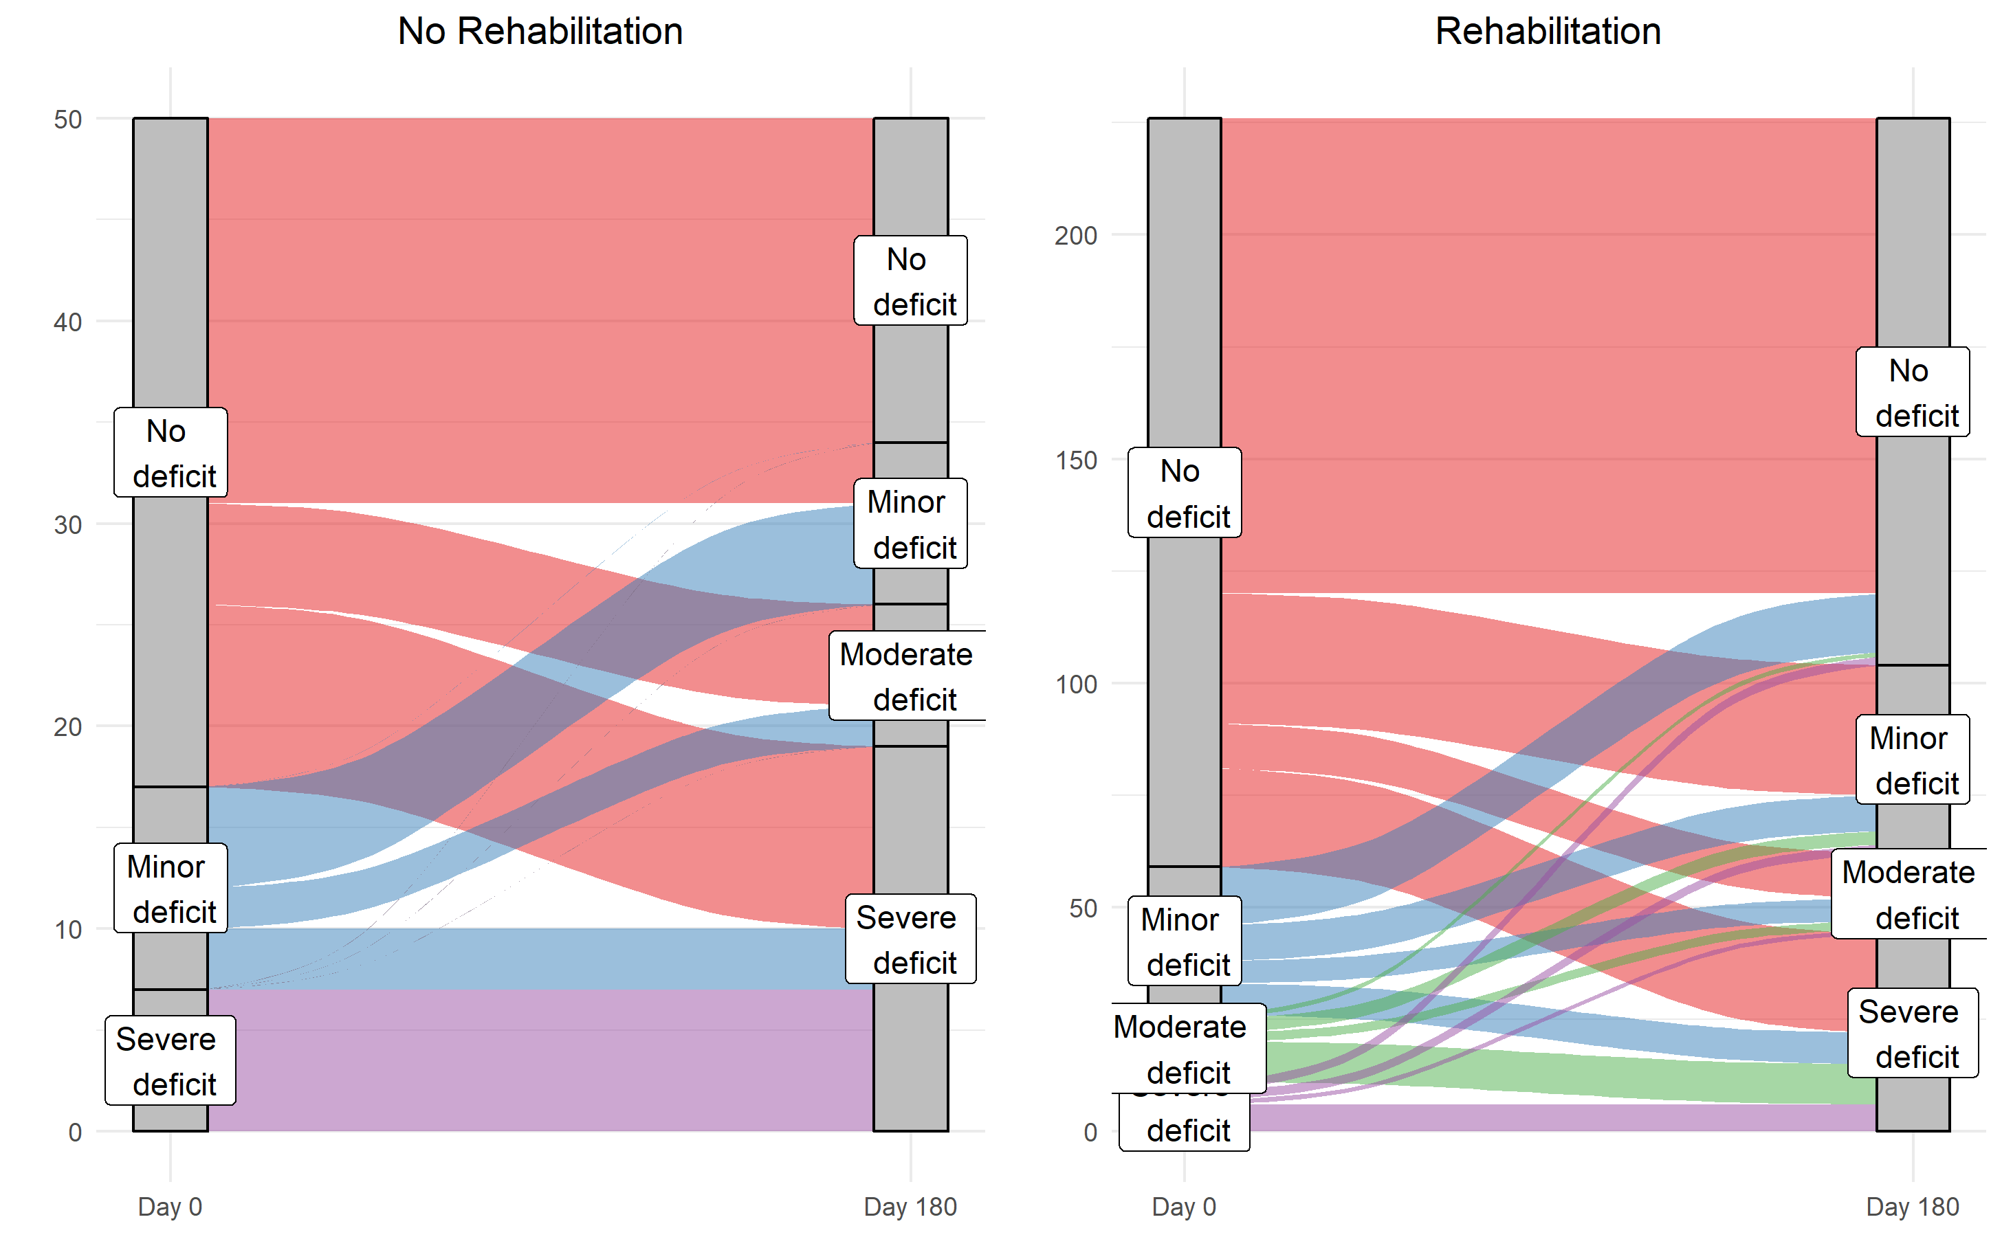
The absence of rehabilitation during the ICU stay of elderly patients is associated with a decreased long-term autonomy
FRAGIREA Cohort
ICU patients ≥70 years old, admitted in ICU, with an expected length of stay ≥48 hours
n=548
Exclusion: death before day 180, loss to follow-up, baseline and 6-month autonomy scores not available
n=276
Rehabilitation: Out of bed during their ICU stay
n=226 (82%)
Decreased autonomy: Loss of >1 point of baseline ADL score
n=63 (23%)
Objective: Estimation of the effect of rehabilitation during the ICU stay on the 6-month decreased autonomy
After adjustment on the main confounding factors, rehabilitation was associated with a lower risk of decreased autonomy at 6 months post ICU admission
OR [95%CI]
0.41 [0.20; 0.84]
Thiolliere F, Allaouchiche B, Marie M, AZUREA Study group, Friggeri A, Vacheron CH

