Slide 1
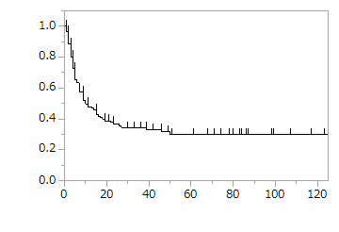
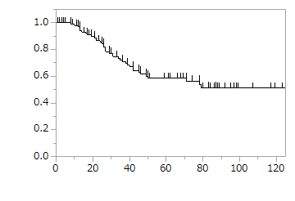
Additional file 1
(a)
(b)
Survival rate
RFS rate
Months after R0 resection
Months after liver resection
Number at risk
Number at risk
N
115
39
26
18
12
6
4
N
115
84
52
35
20
8
5

