Slide 1
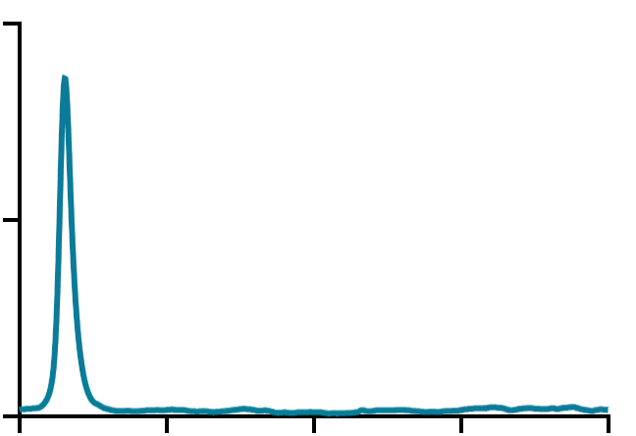
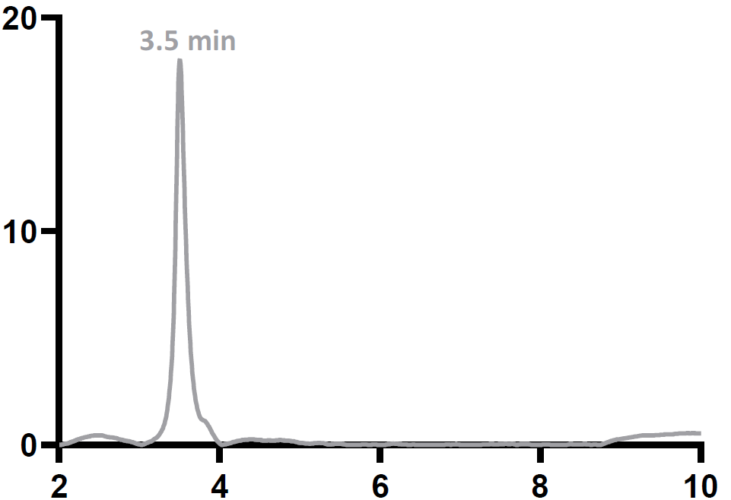
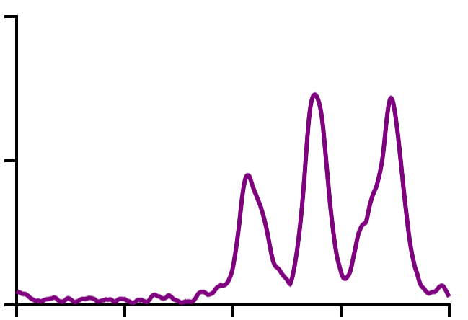
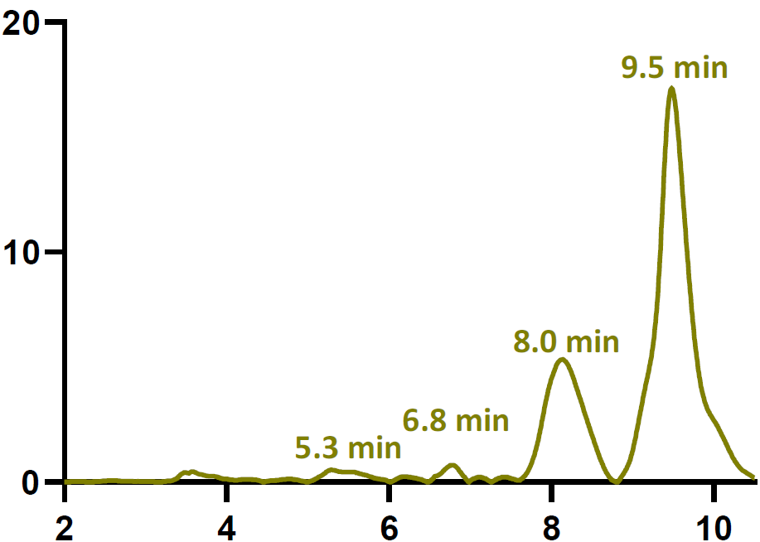
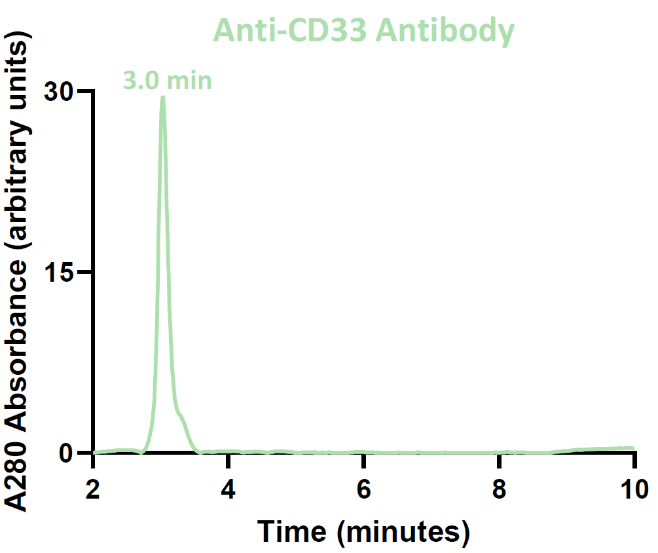
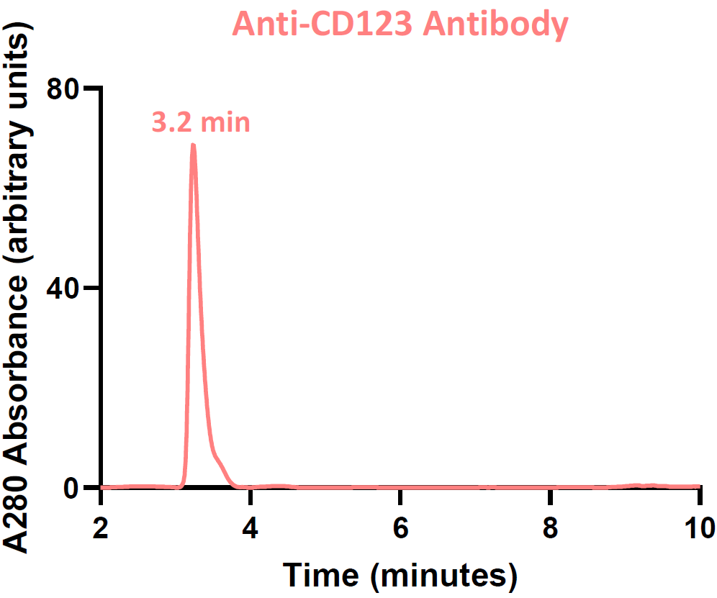
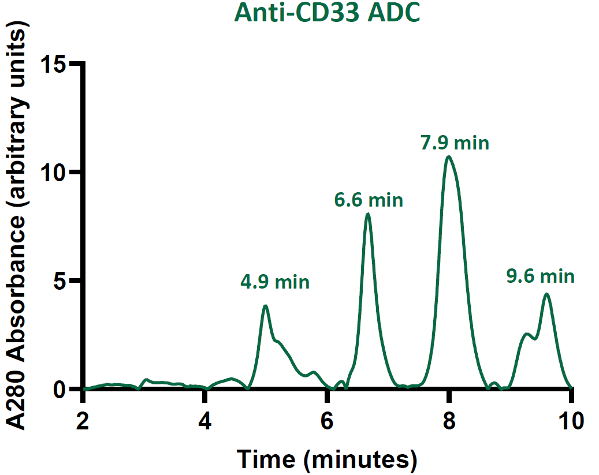
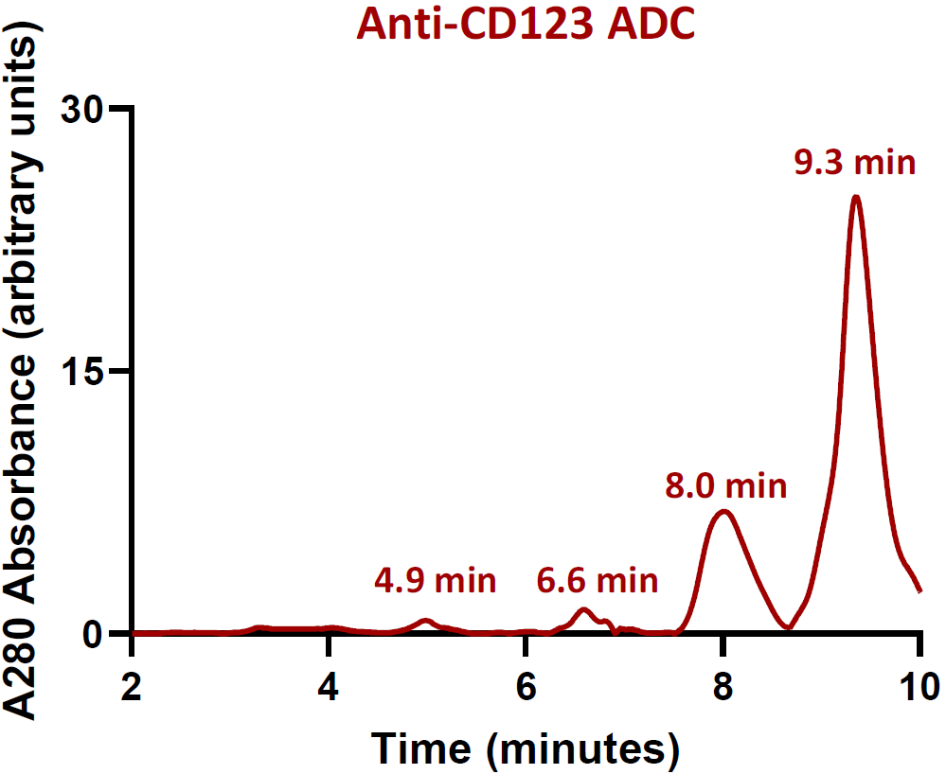
50
Anti-CCRL2 antibody
A
B
C
D
IgG2a
TF-1
2.6 min
25
Survival
Survival
TF-1
0
A280 absorbance (arbitrary units)
2
4
6
8
10
A280 absorbance (arbitrary units)
Time (minutes)
Time (minutes)
20
Anti-CCRL2 ADC
Conjugated IgG2a
7.5 min
8.9 min
10
6.3 min
0
2
4
6
8
10
Time (minutes)
Time (minutes)
E
F
CCRL2 MFI
Supplementary Figure 1

Slide 2
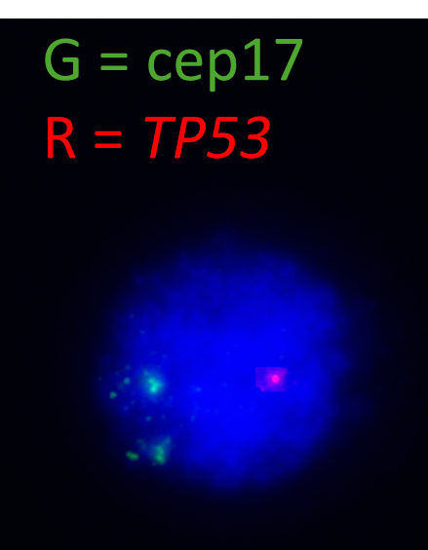
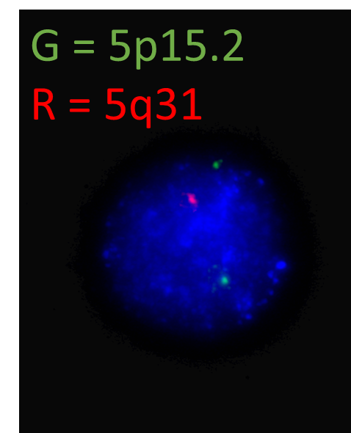
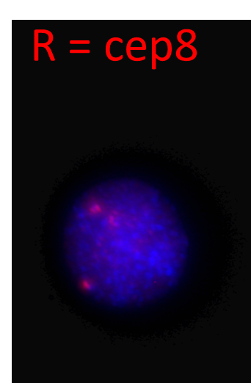
Patient 1
Patient 2
Cells%
Cells%
IgG2a
Anti-CCRL2
IgG2a
Anti-CCRL2
Supplementary Figure 2

Slide 3
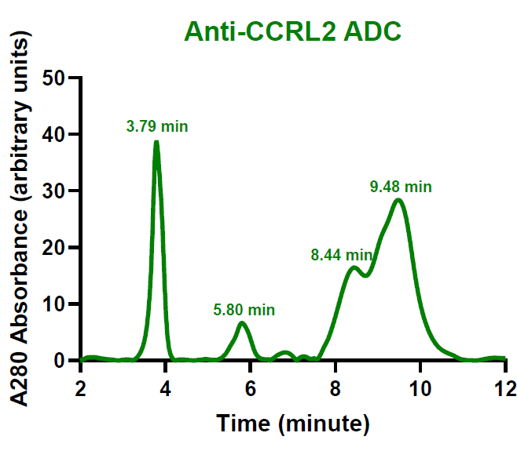
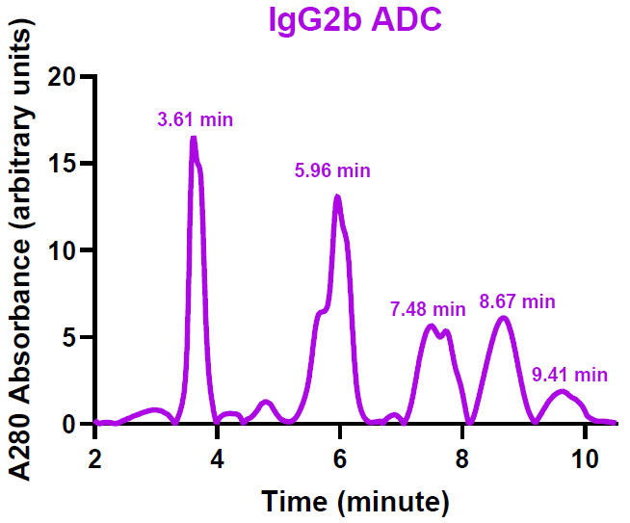
A
Anti-mouse CCRL2 ADC
B
C
IgG2b ADC
D
Supplementary Figure 3

Slide 4
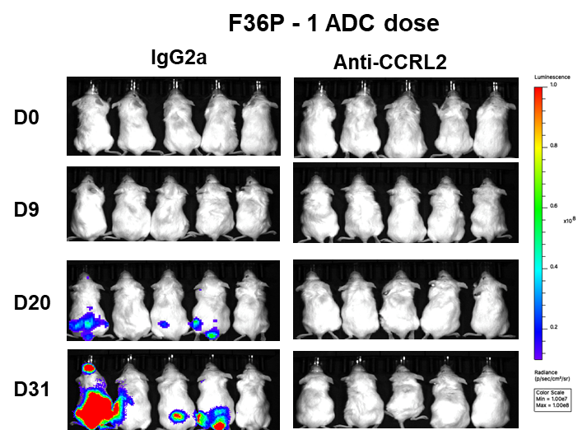
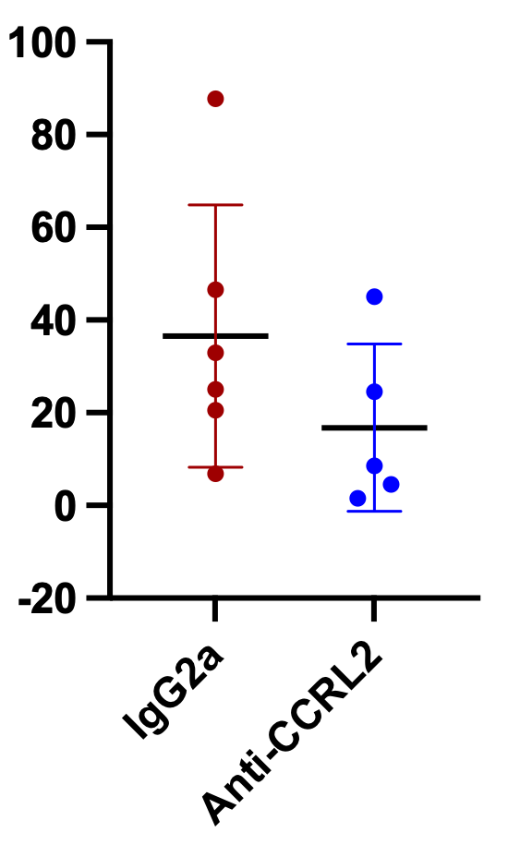
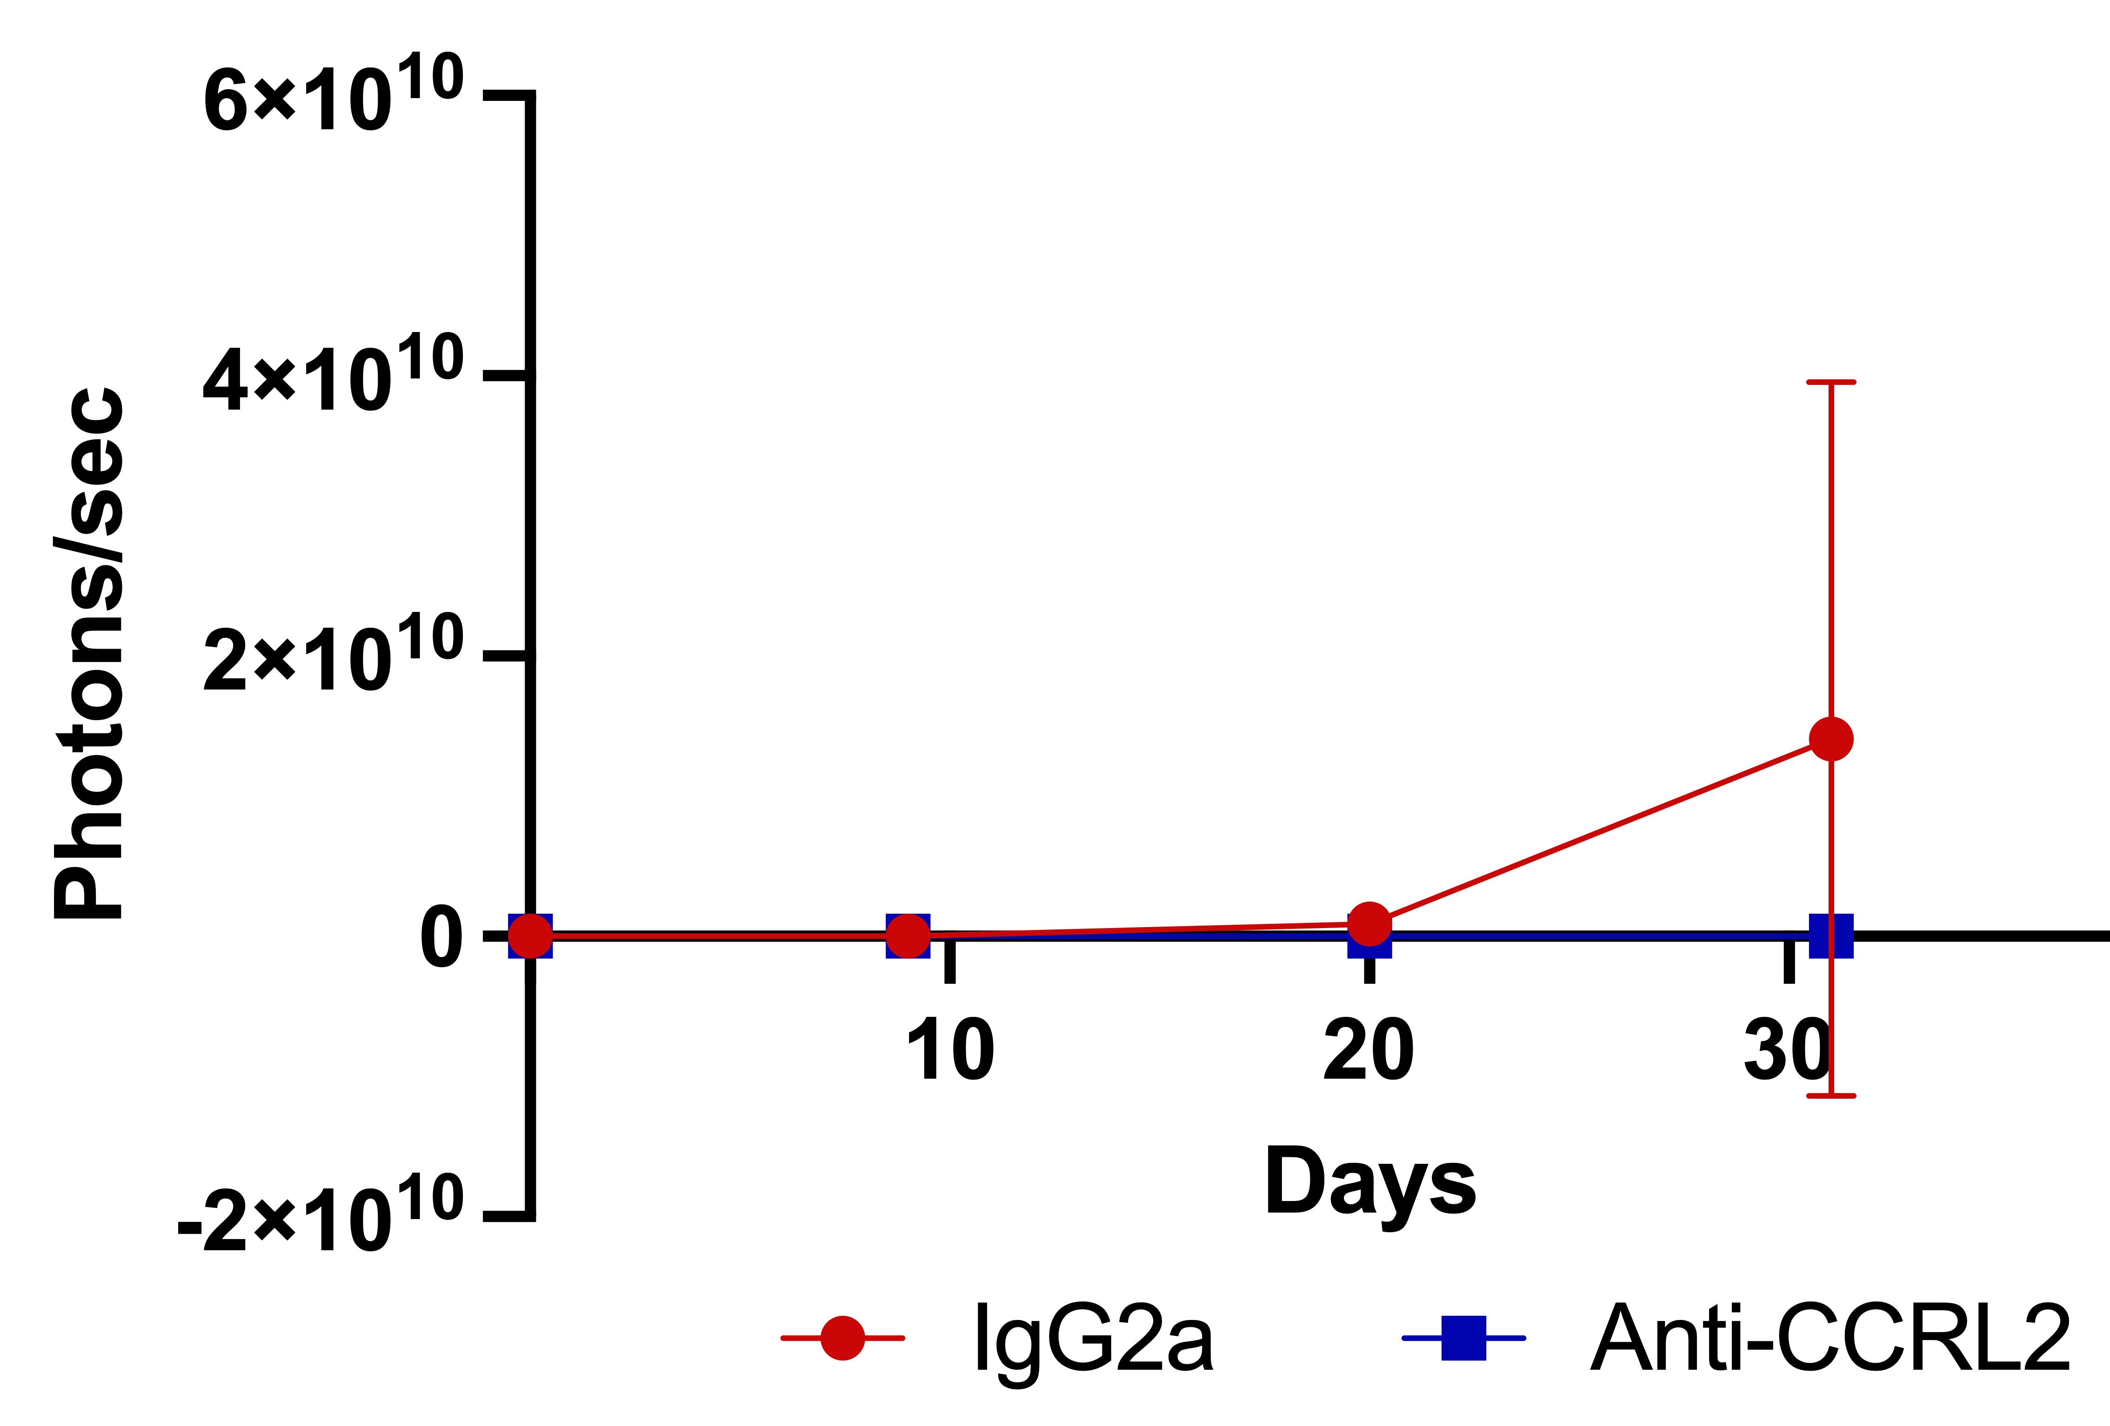
A
B
p=0.178
Bone Marrow hCD45+%
C
MDS/AML involvement score
Bone Marrow
Normal 0 point
Dysplasia 1 point
Blasts 1 point
Spleen
No blasts 0 point
Focal blasts 1
Patchy blasts 2
Diffuse/sheets 3
Liver
Normal 0 point
Atypical infiltrates 1 point
Supplementary Figure 4

