Slide 1
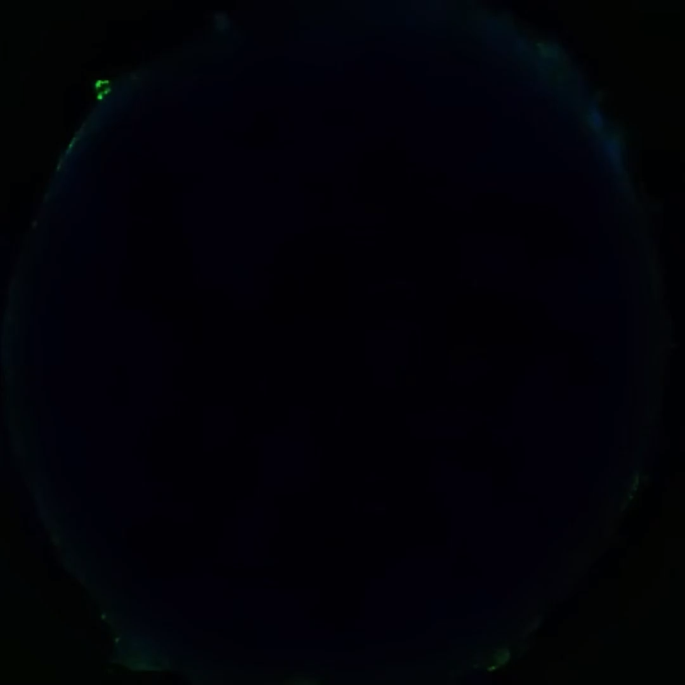
Supplementary video 2: Representative 3D visualisation of the skeletal muscle stroma models. Neutral lipids are stained with BODIPY™ (green) and nuclei are stained with DAPI (blue).

