Slide 1
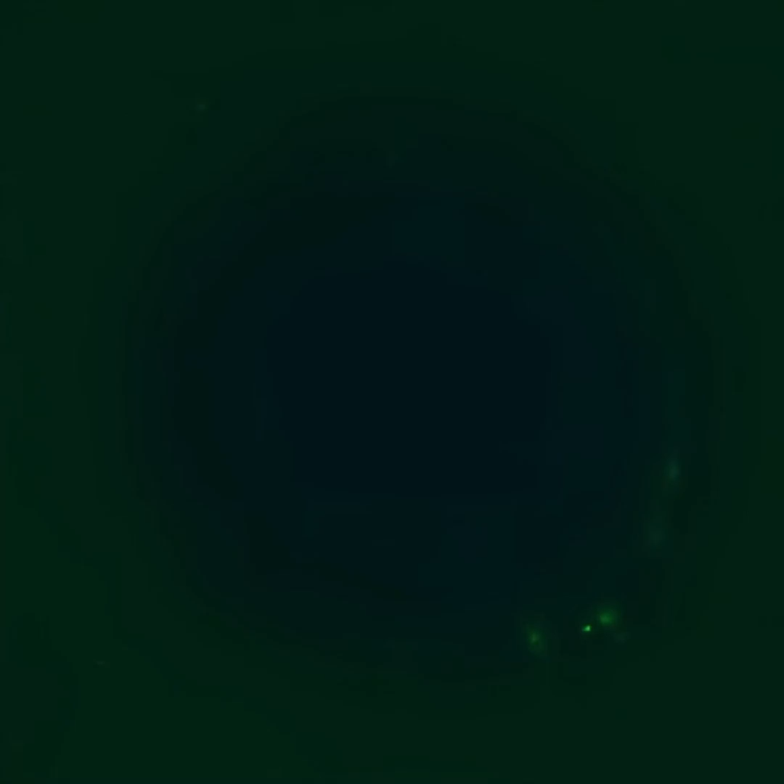
Supplementary video 1: Representative 3D visualisation of the intramuscular adipose tissue models. Neutral lipids are stained with BODIPY™ (green) and nuclei are stained with DAPI (blue).

