Slide 1
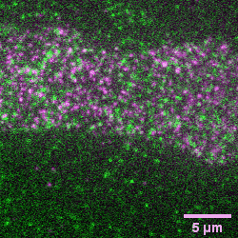
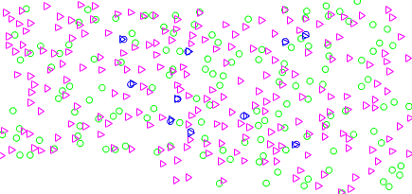
GPVI – Basal
SNAP-tag-GPVI
HaloTag-GPVI

Slide 2
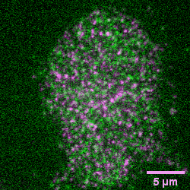
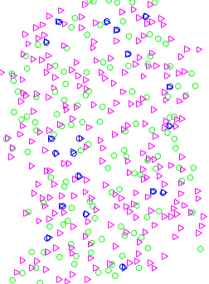
GPVI – Nb2-2 (100 nM)
SNAP-tag-GPVI
HaloTag-GPVI

Slide 3
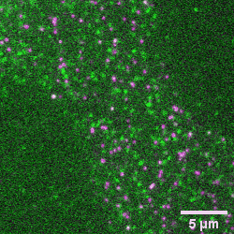
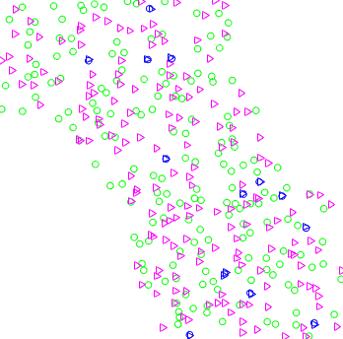
GPVI – Nb2-3 (100 nM)
SNAP-tag-GPVI
HaloTag-GPVI

Slide 4
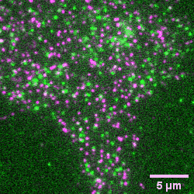
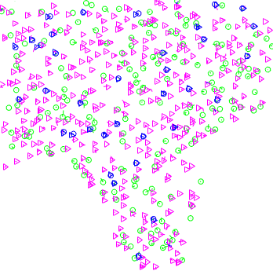
CLEC-2 – Basal
SNAP-tag-CLEC-2
HaloTag-CLEC-2

Slide 5
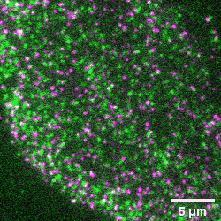
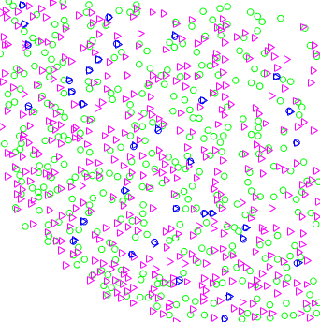
CLEC-2 – Nb4-2 (100 nM)
SNAP-tag-CLEC-2
HaloTag-CLEC-2

Slide 6
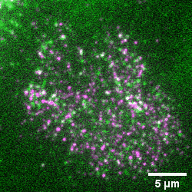
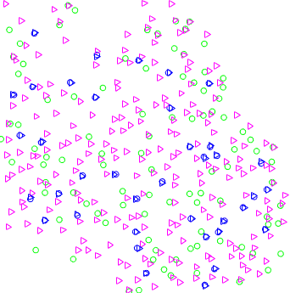
CLEC-2 – Nb4-3 (100 nM)
SNAP-tag-CLEC-2
HaloTag-CLEC-2

