Slide 1
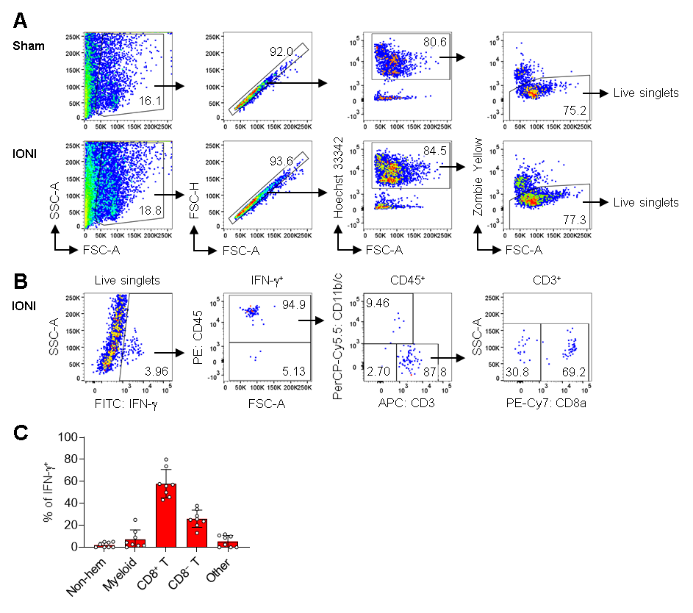

Supplementary Fig. 1

