Slide 1
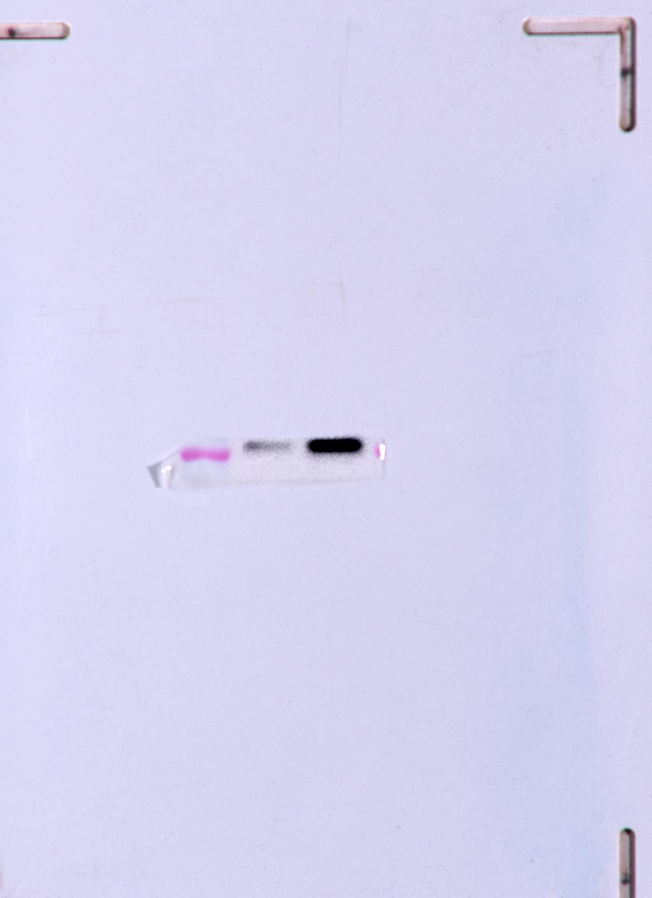
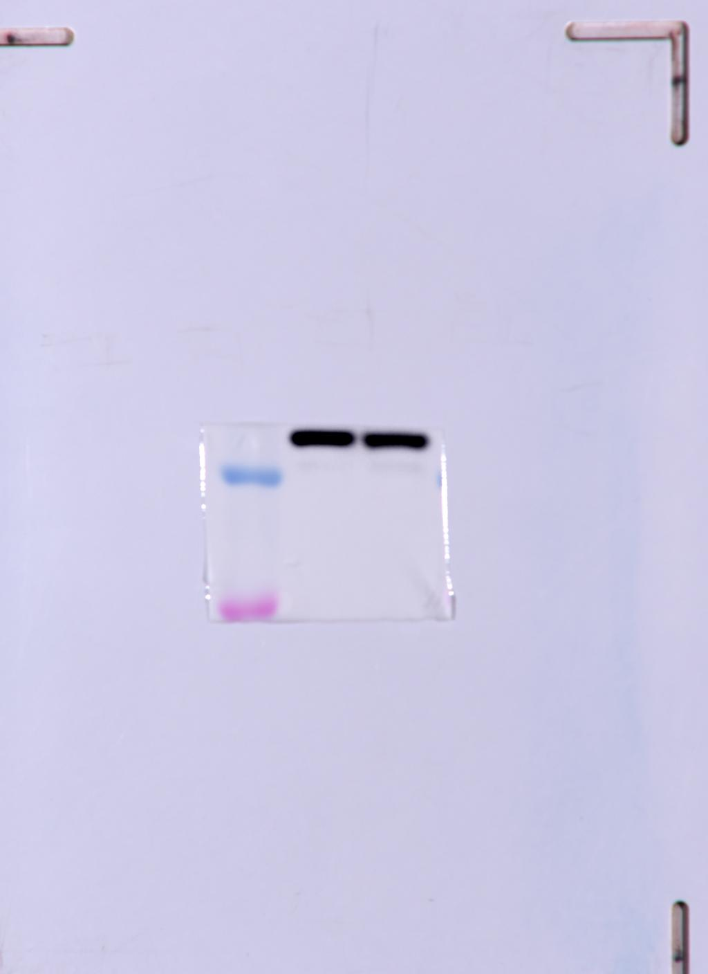
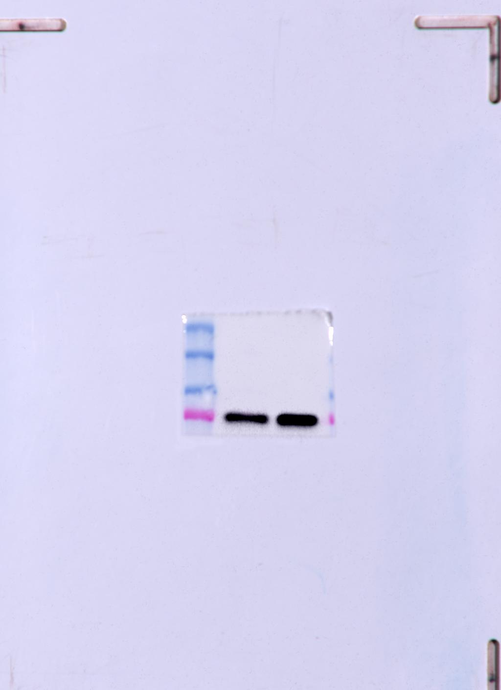
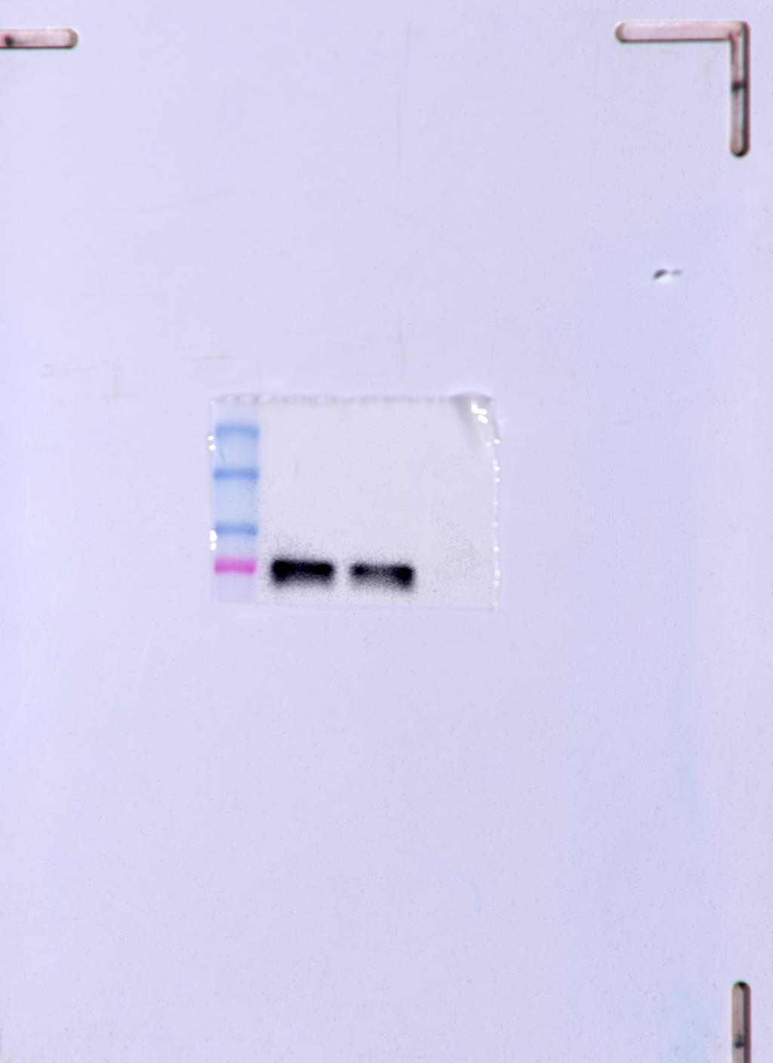
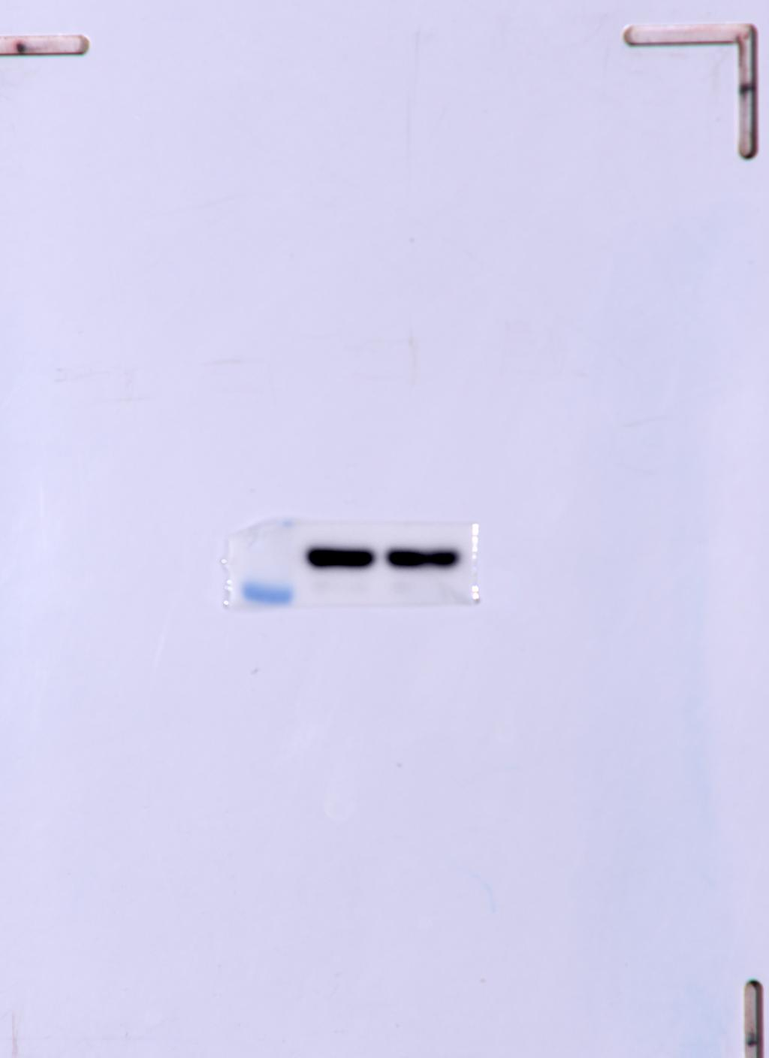
Fig. 1E Panel 1
Fig. 1E Panel 2
Fig. 1E Panel 3
Fig. 1E Panel 4
Fig. 1E Panel 5
Mfn1
β-actin
Mfn2
Drp1
β-actin
Adherence
Adherence
Spheroids
Adherence
Spheroids
Adherence
Spheroids
Adherence
Spheroids
Spheroids
82
45
45
80
80

Slide 2
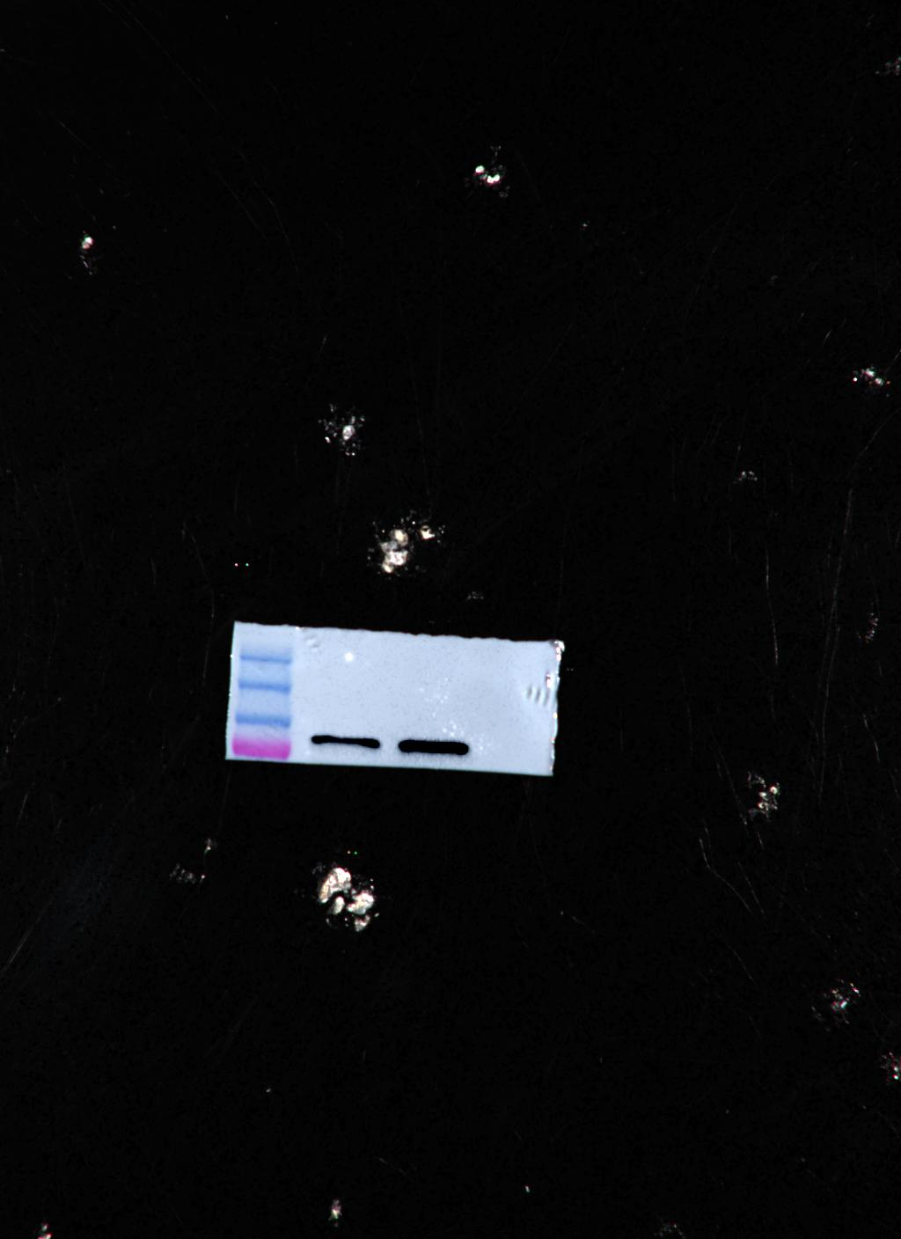
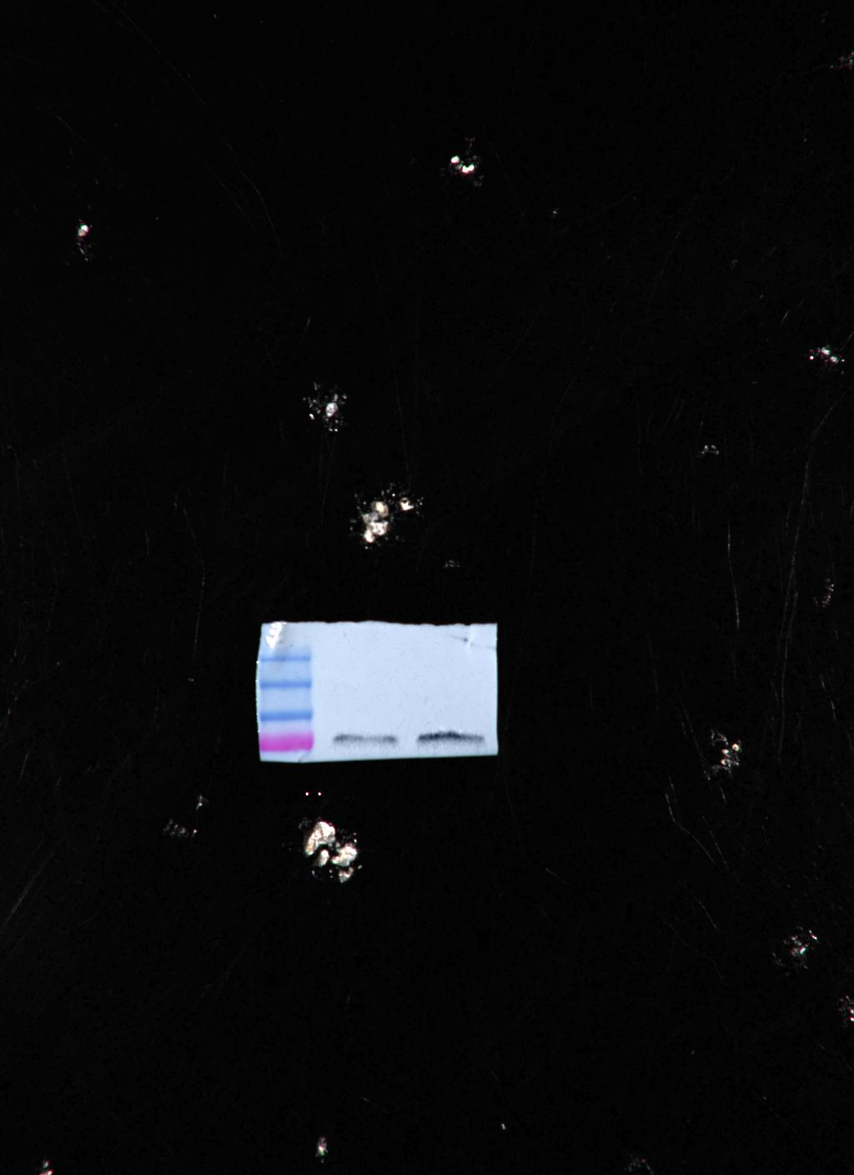
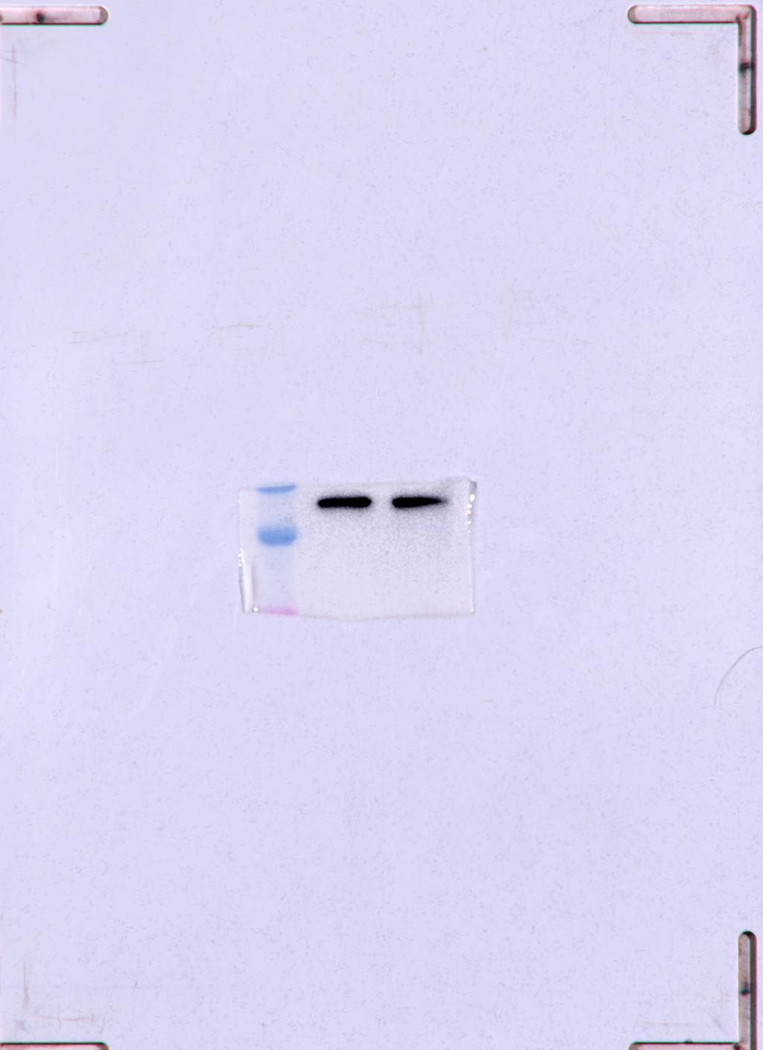
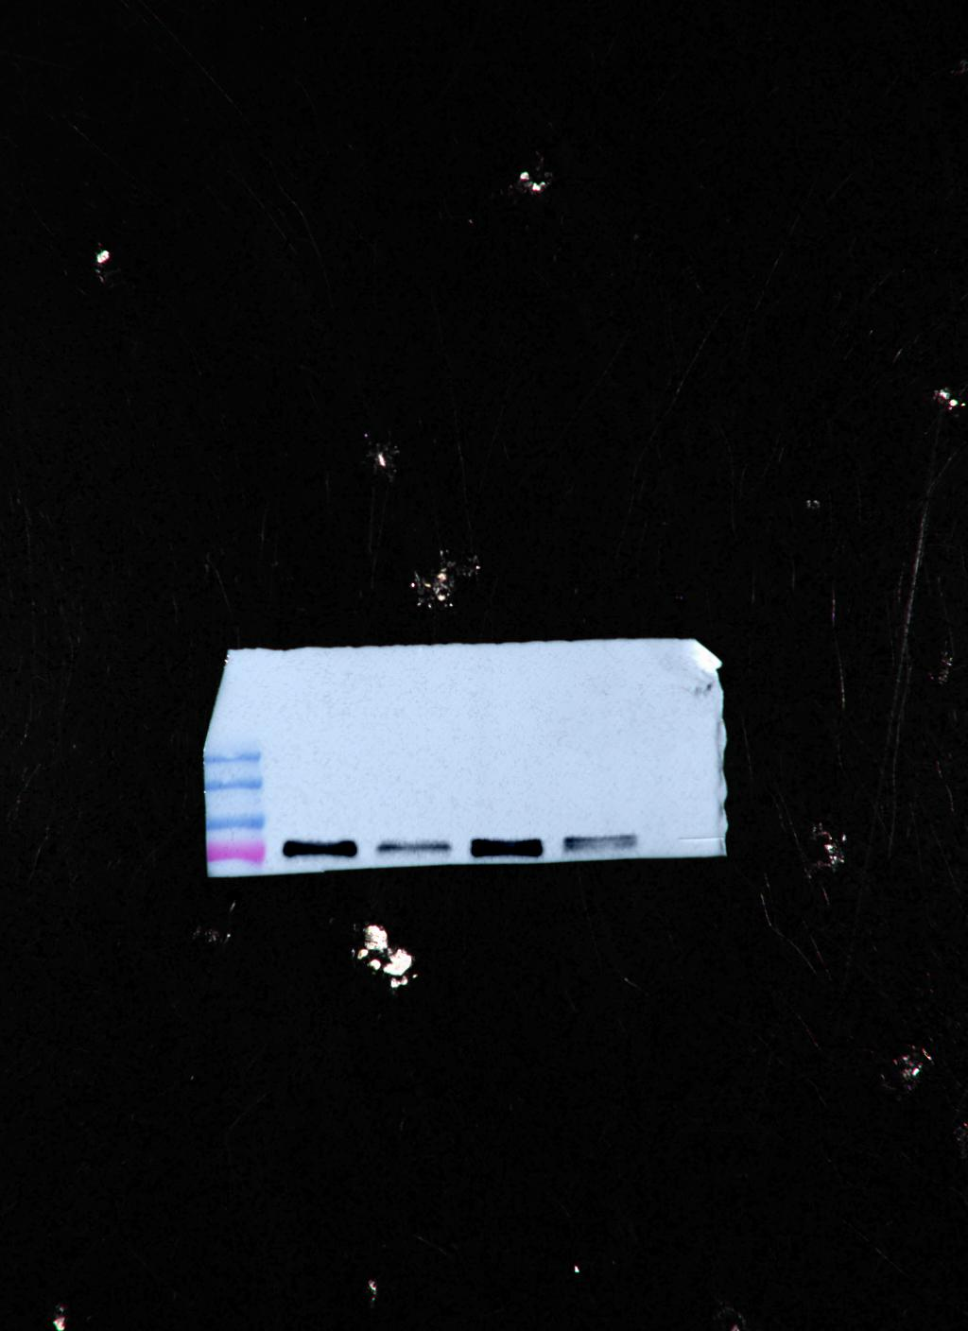
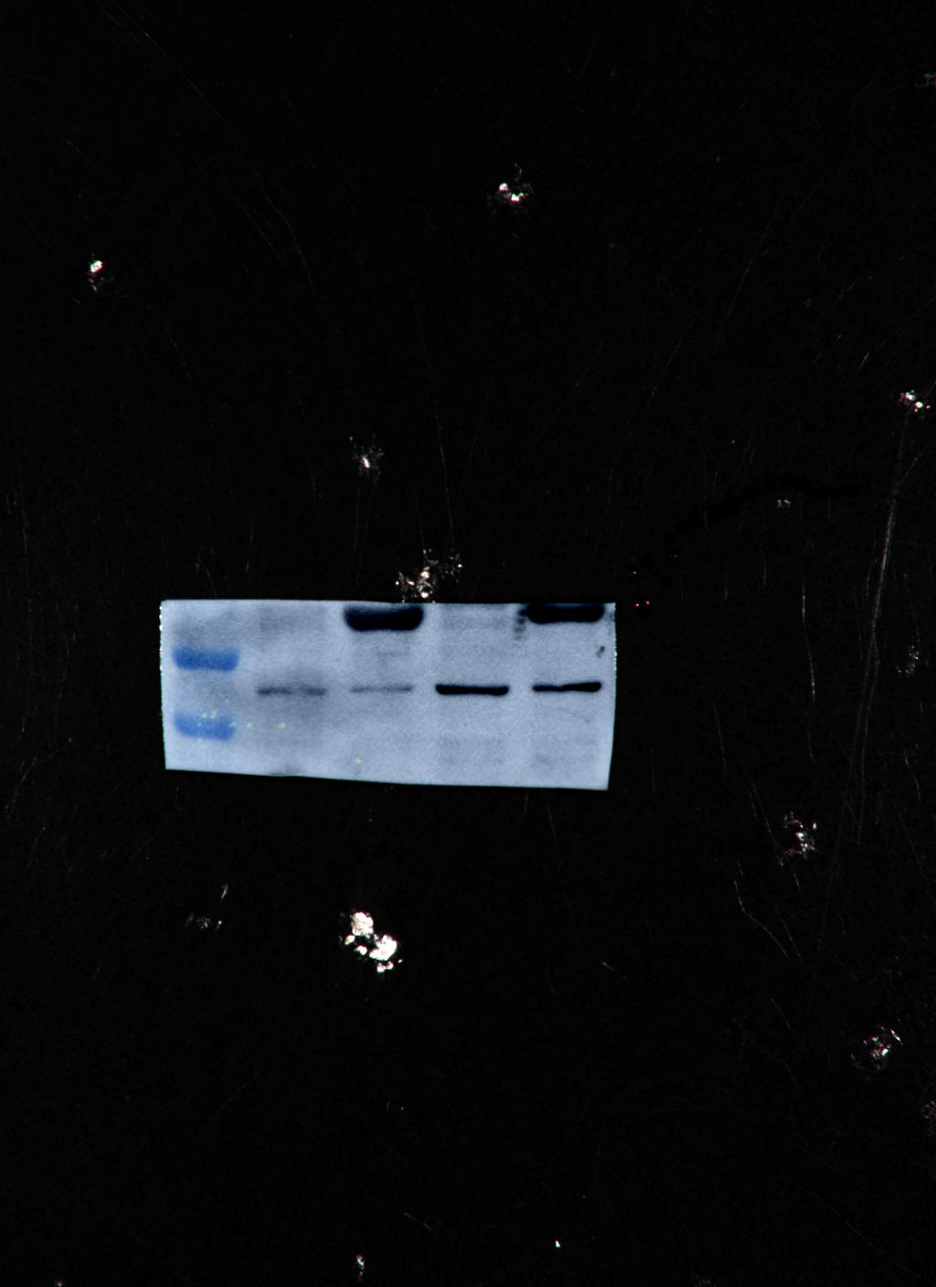
Fig. 1F Panel 1
Fig. 1F Panel 2
Fig. 1F Panel 3
Fig. 1F Panel 4
Fig. 1F Panel 5
Mfn1
Mfn2
β-actin
Drp1
β-actin
Adherence
Adherence
Adherence
Spheroids
Spheroids
Adherence
Spheroids
Spheroids
Adherence
Adherence
Spheroids
Spheroids
Adherence
Spheroids
45
82
45
80
80

Slide 3
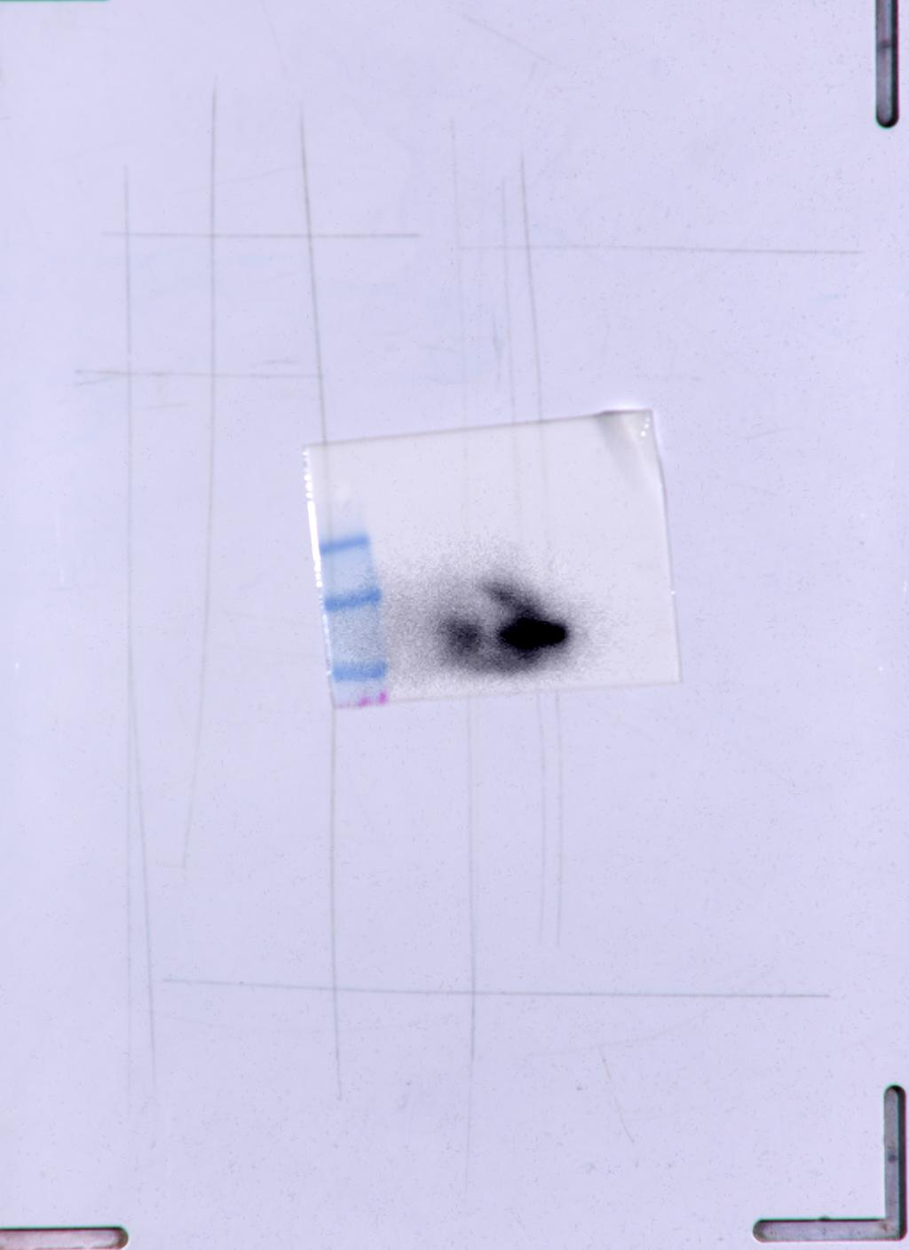
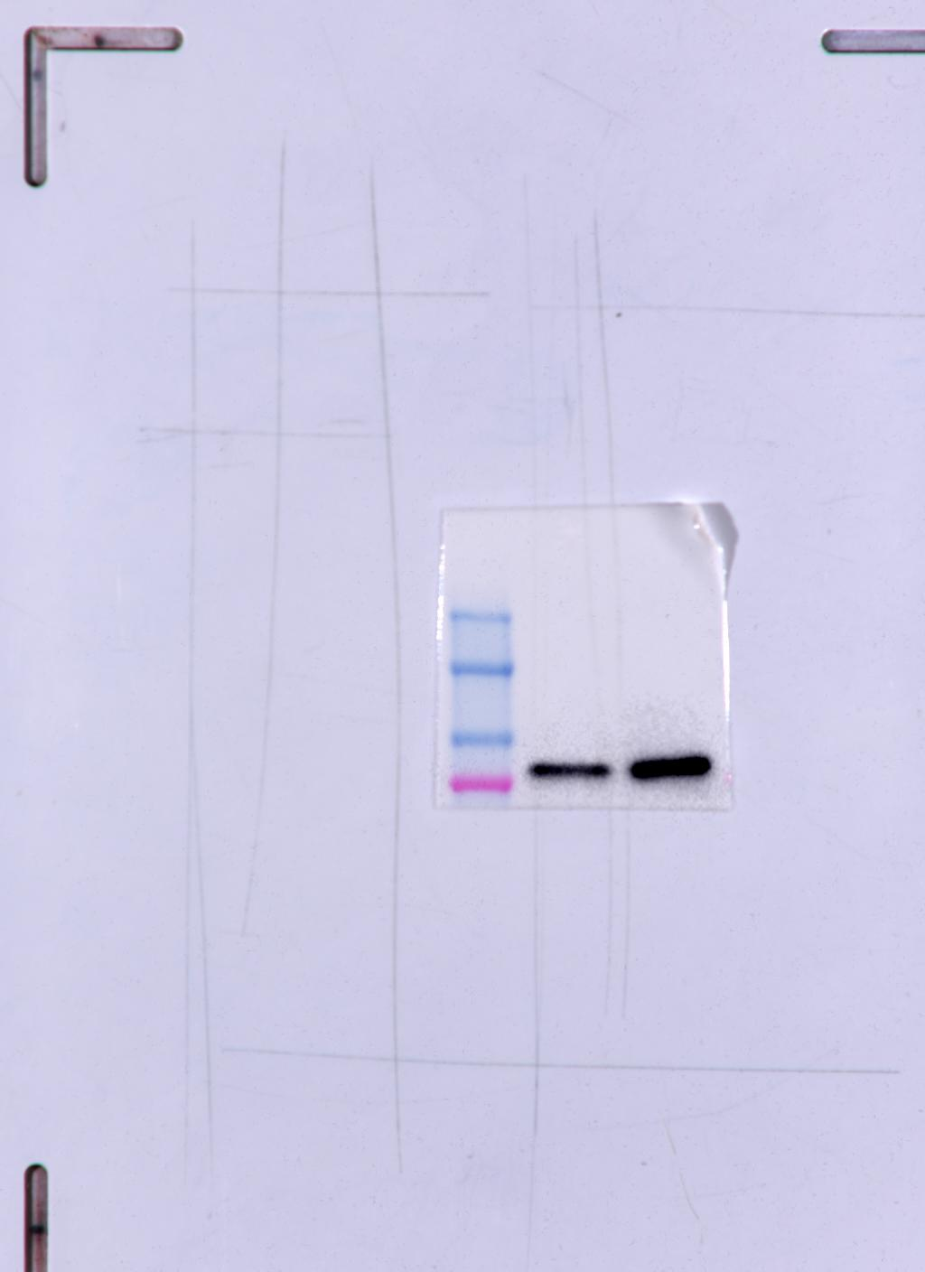
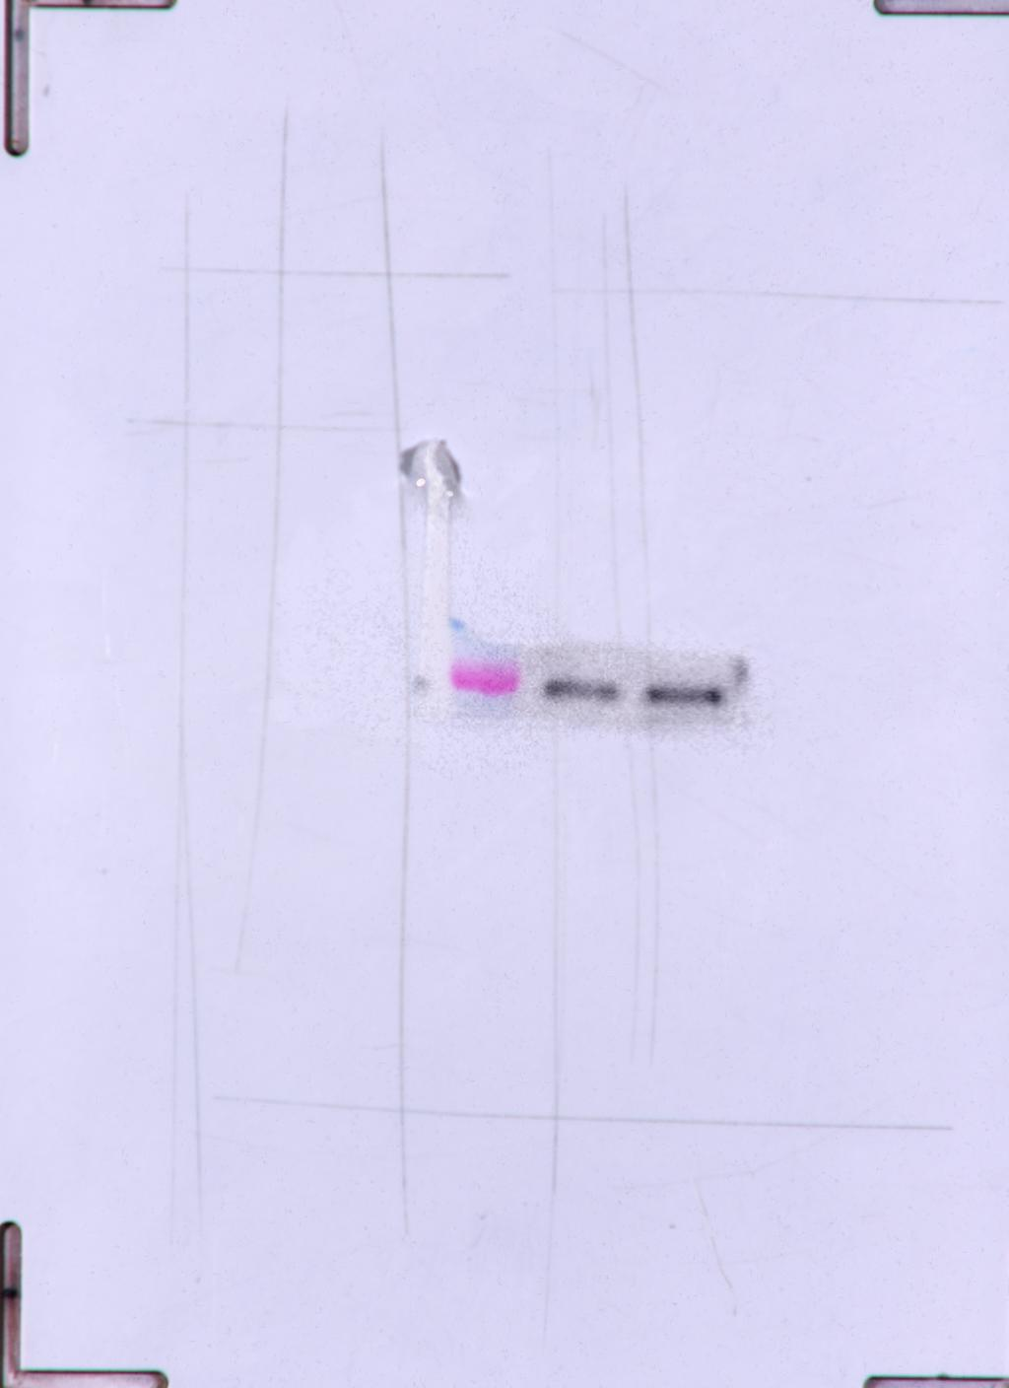
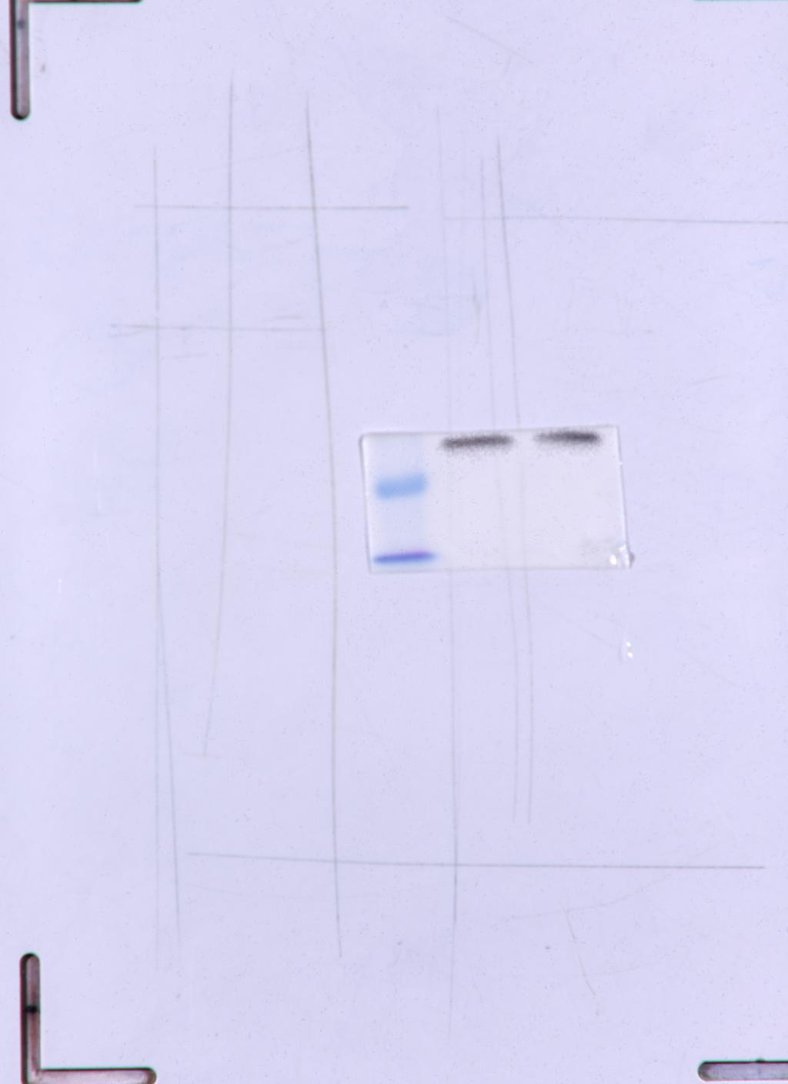
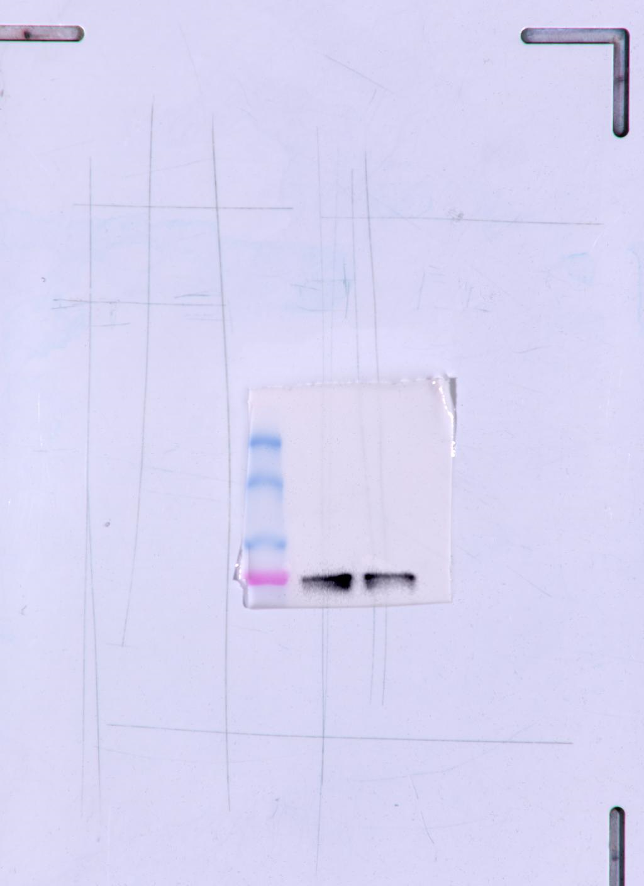
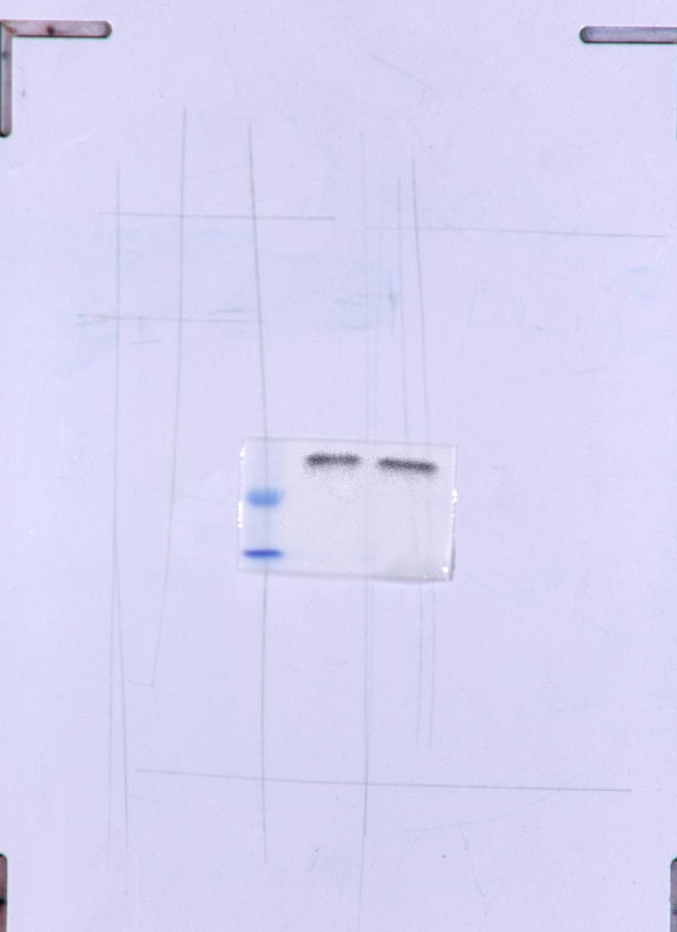
Fig. 1I Panel 1
Fig. 1I Panel 2
Fig. 1I Panel 3
Fig. 1I Panel 4
Fig. 1I Panel 5
Fig. 1I Panel 6
CD133
Mfn1
Mfn2
β-actin
Drp1
β-actin
-
+
-
+
-
+
-
+
82
45
-
+
133
80
45
80
-
+

Slide 4
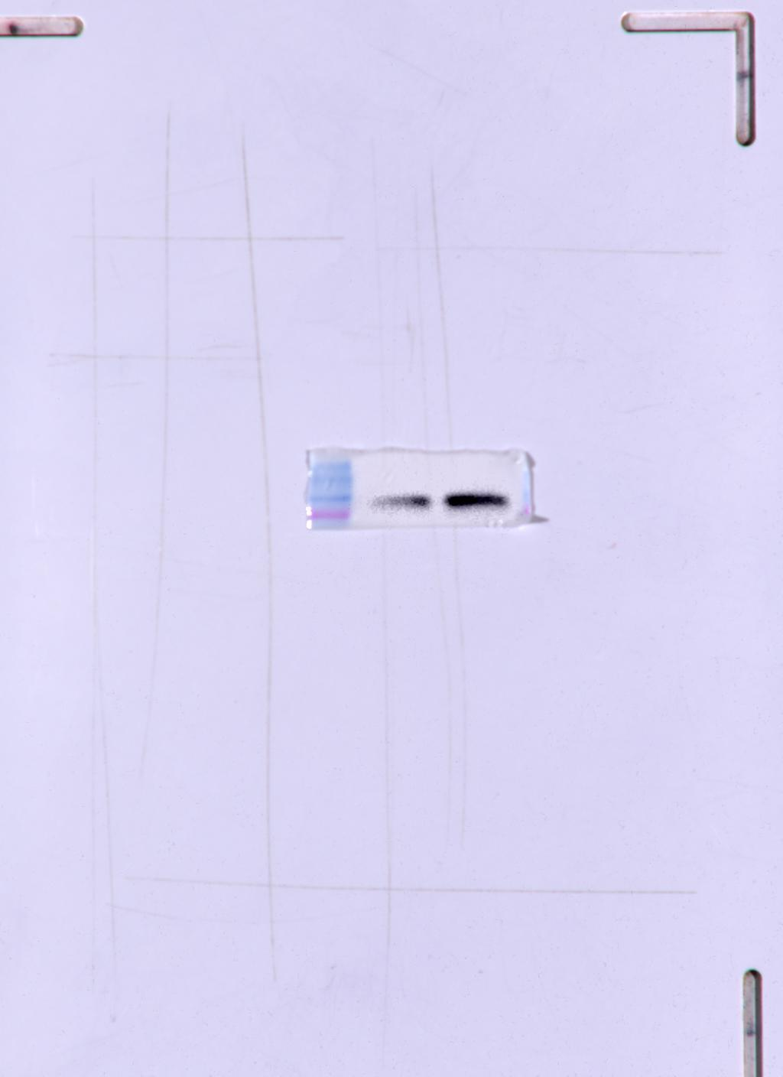
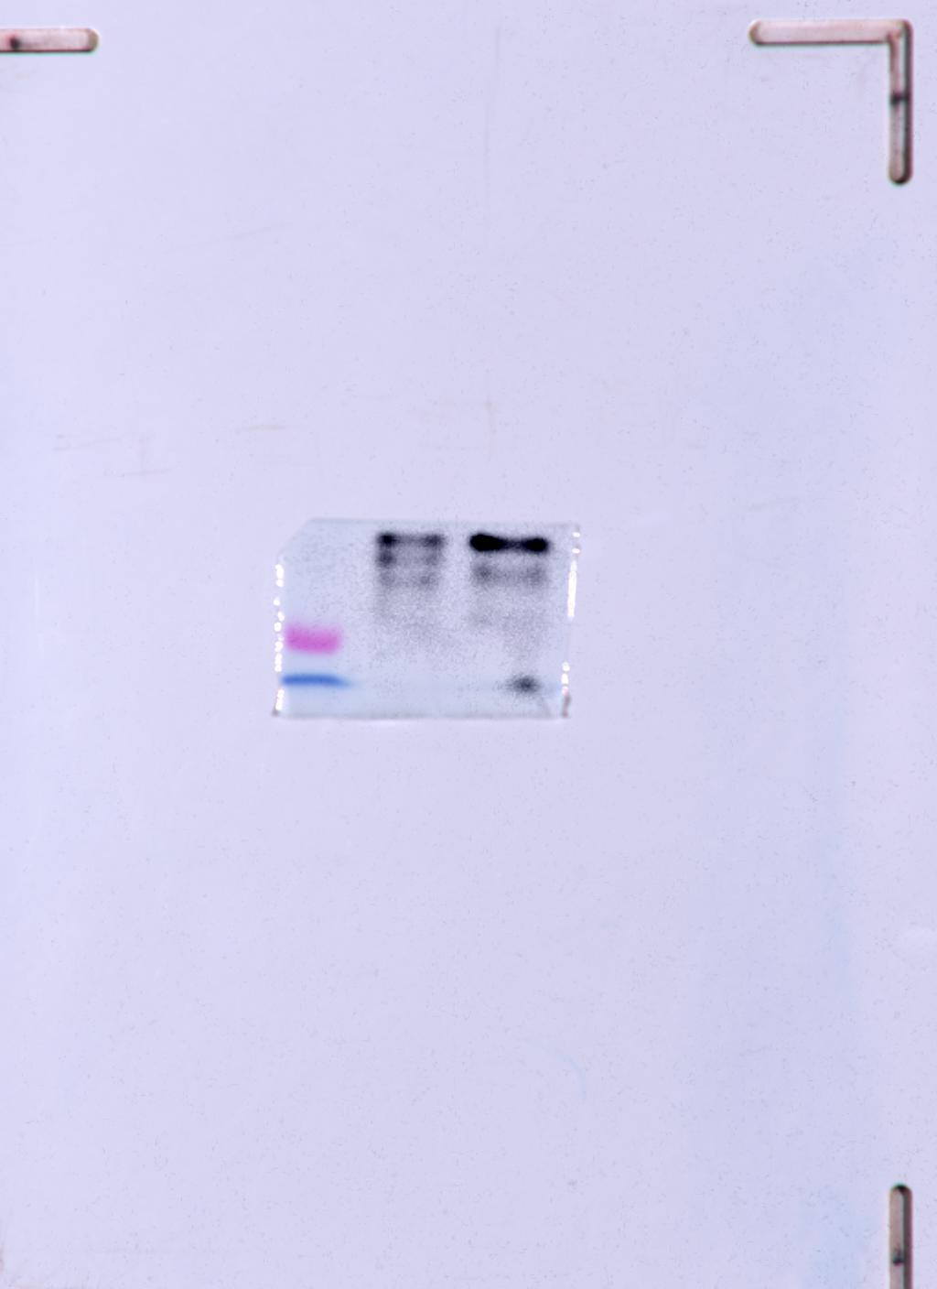
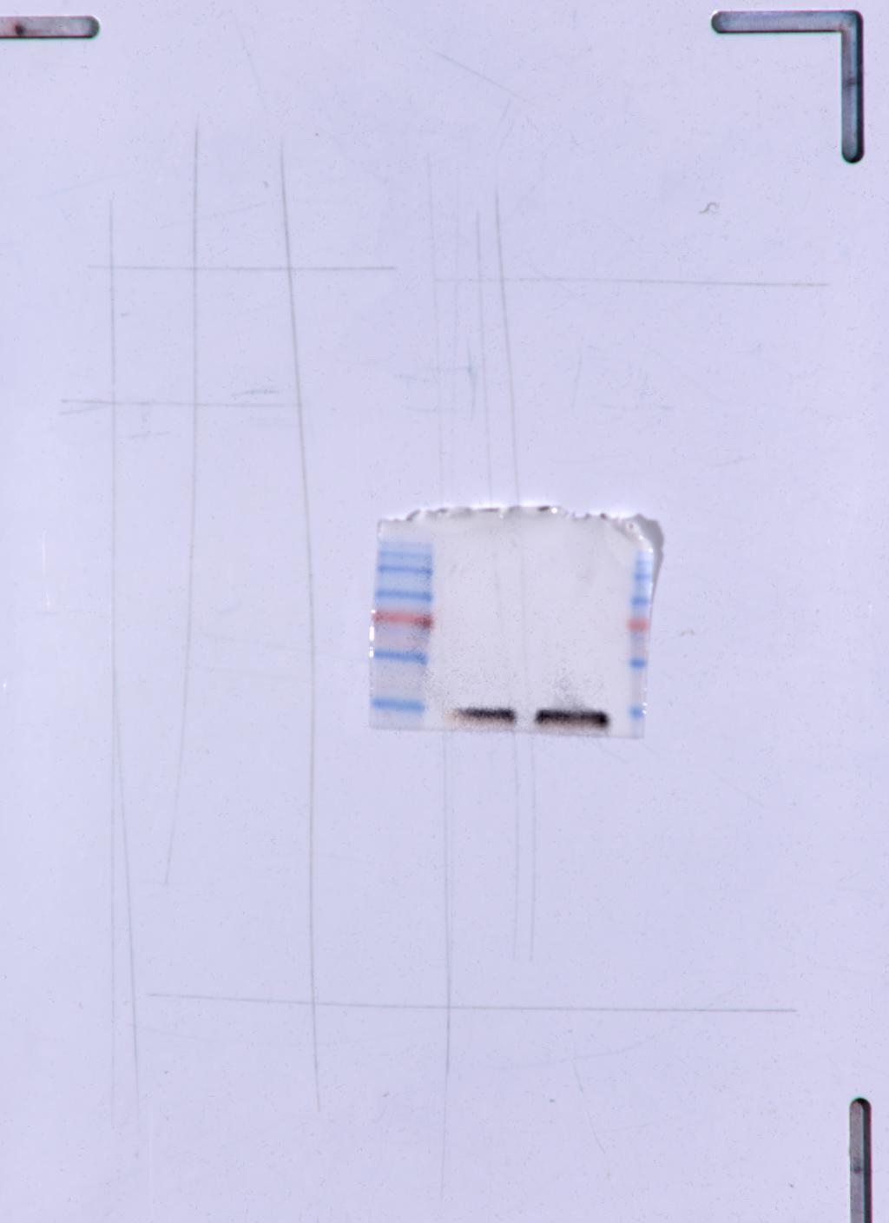
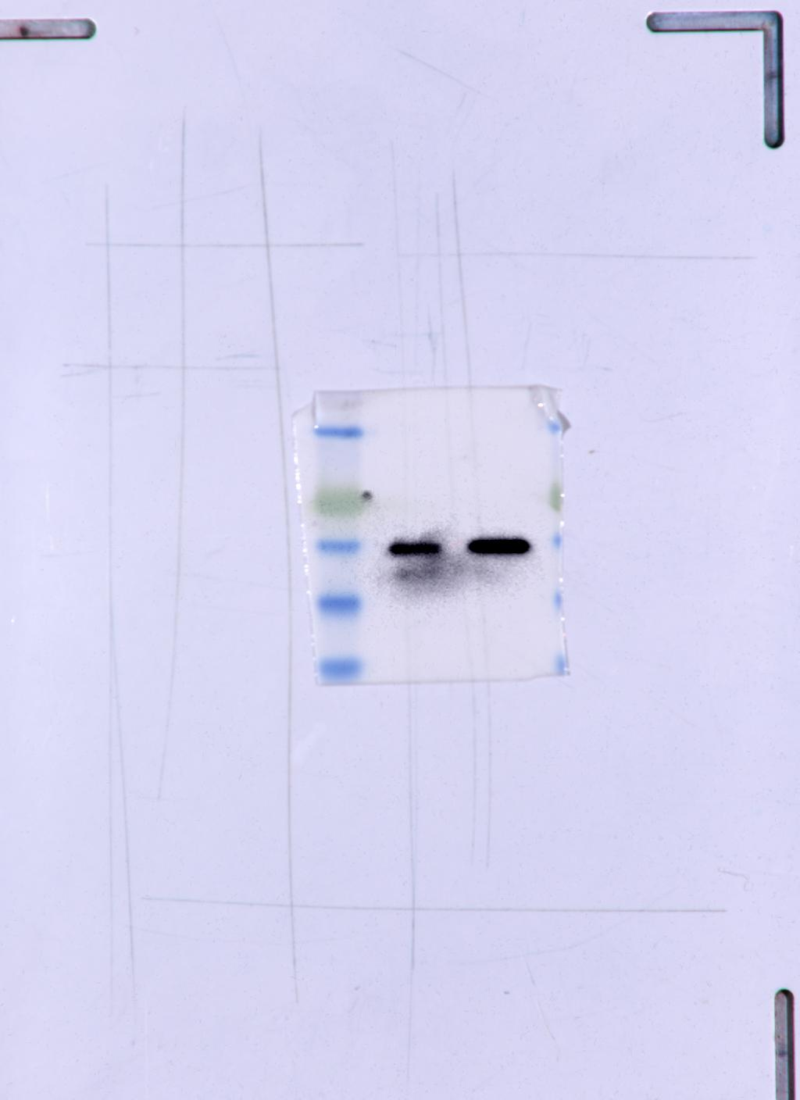
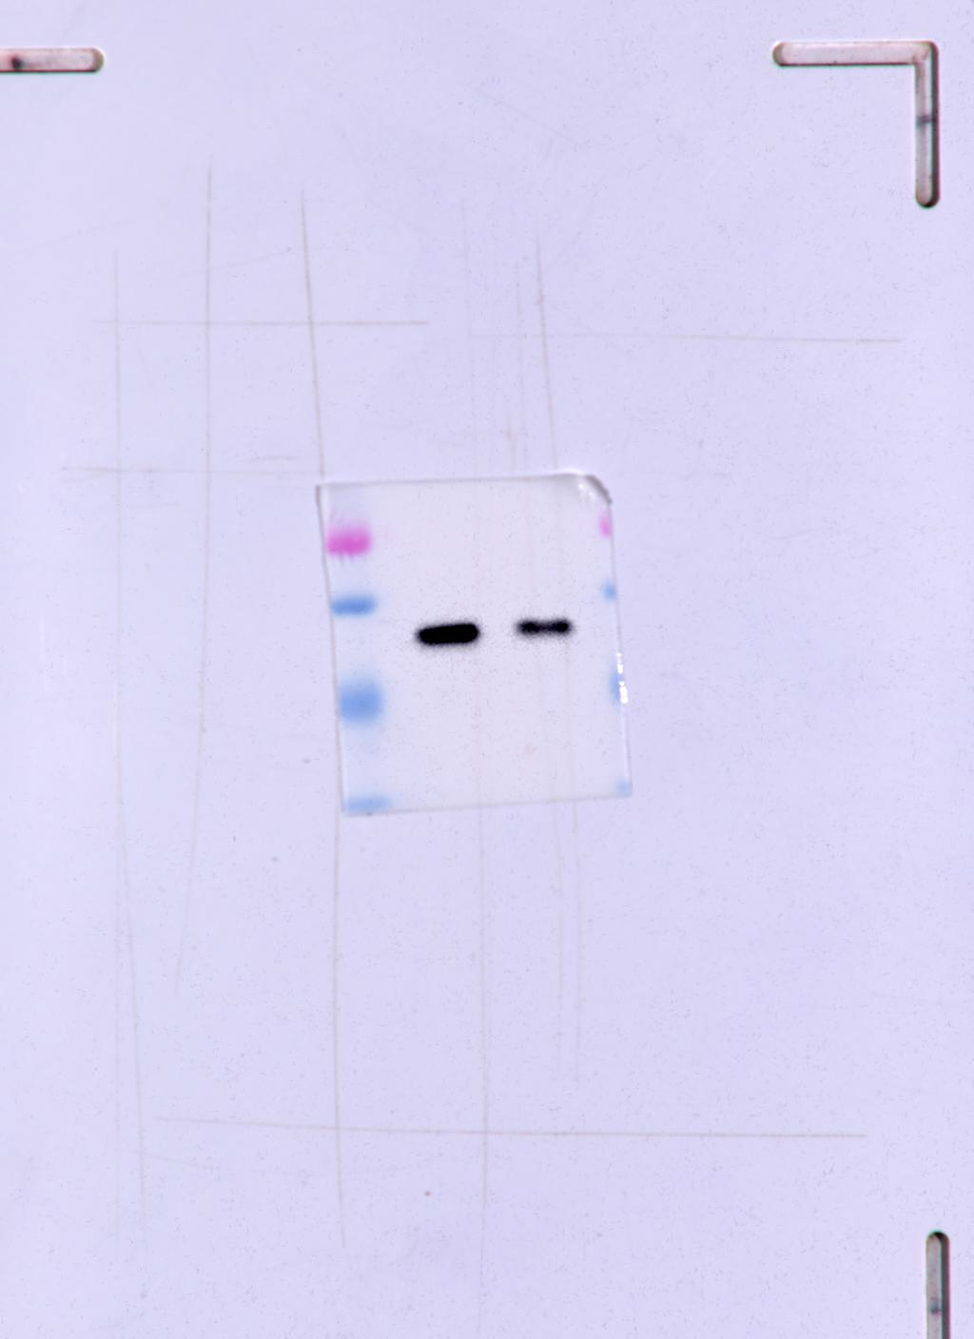
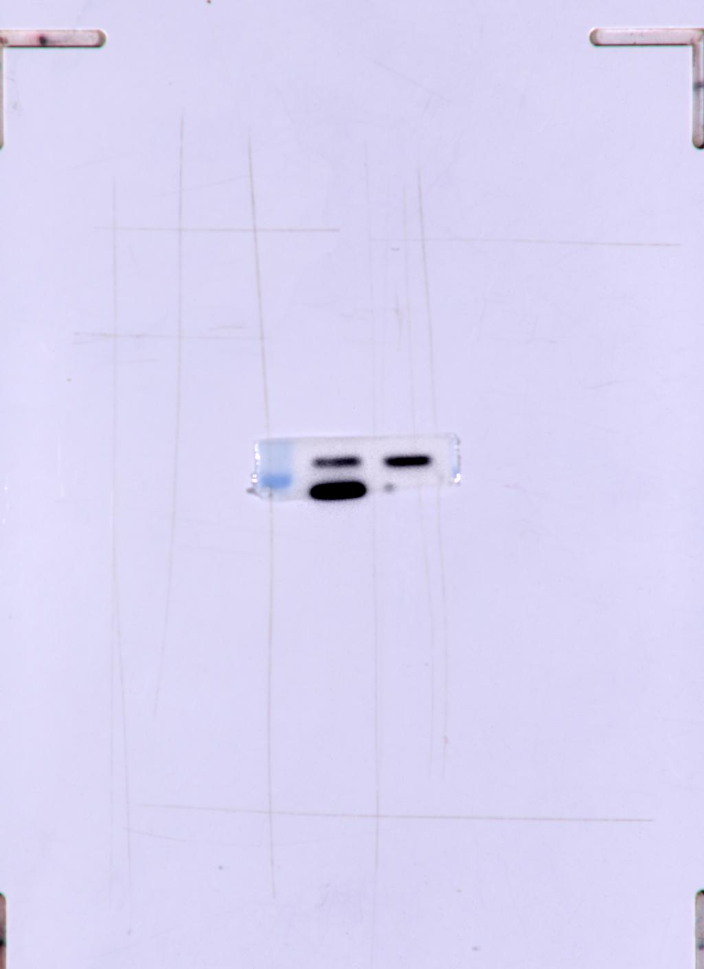
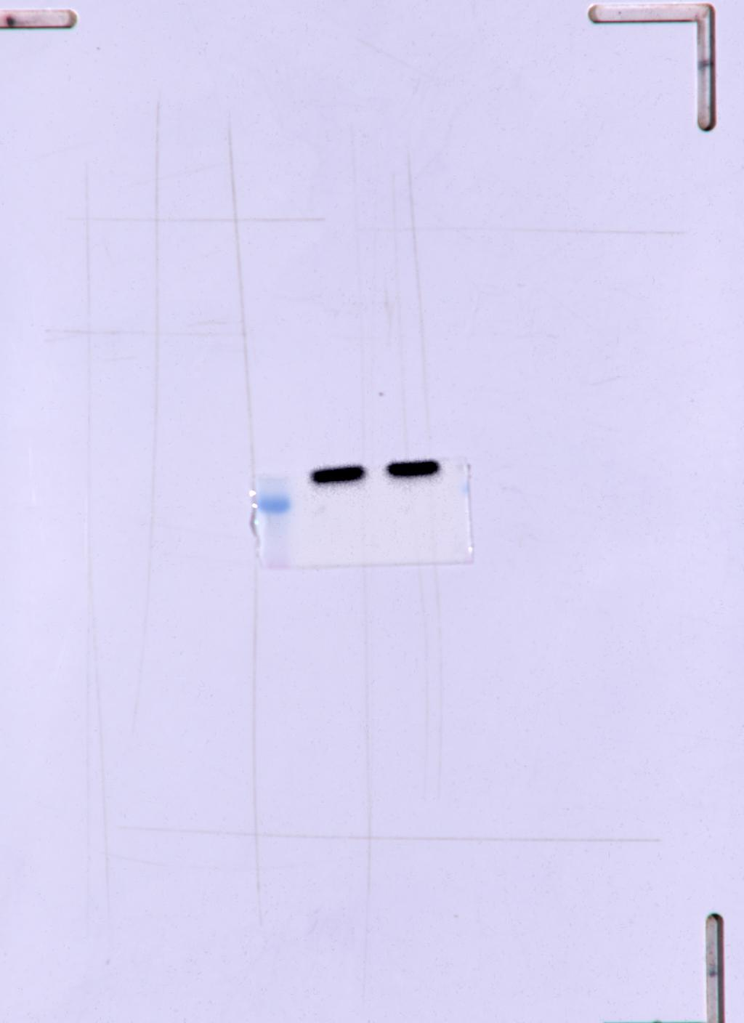
Fig. 2A Panel 1
Fig. 2A Panel 2
Fig. 2A Panel 3
Fig. 2A Panel 4
Fig. 2A Panel 4
Mfn1
SDHB
UQCRC2
MTCO2
NDUFB8
Adherence
Spheroids
Adherence
Adherence
Adherence
Spheroids
Spheroids
Spheroids
Adherence
82
Spheroids
28
22
26
kDa
49
Fig. 2A Panel 5
Fig. 2A Panel 6
ATP5A
β-actin
Adherence
Adherence
Spheroids
Spheroids
53
45

Slide 5
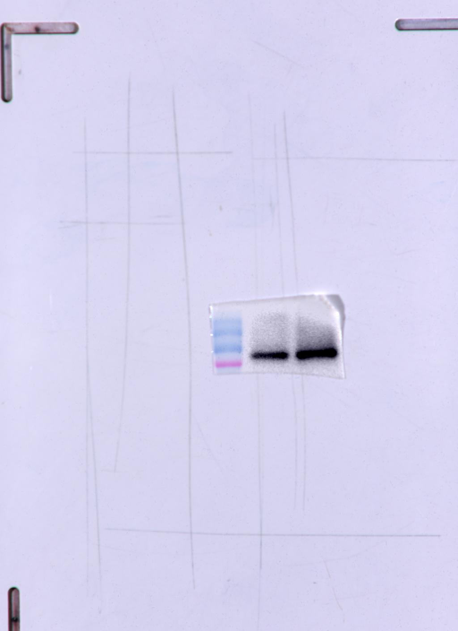
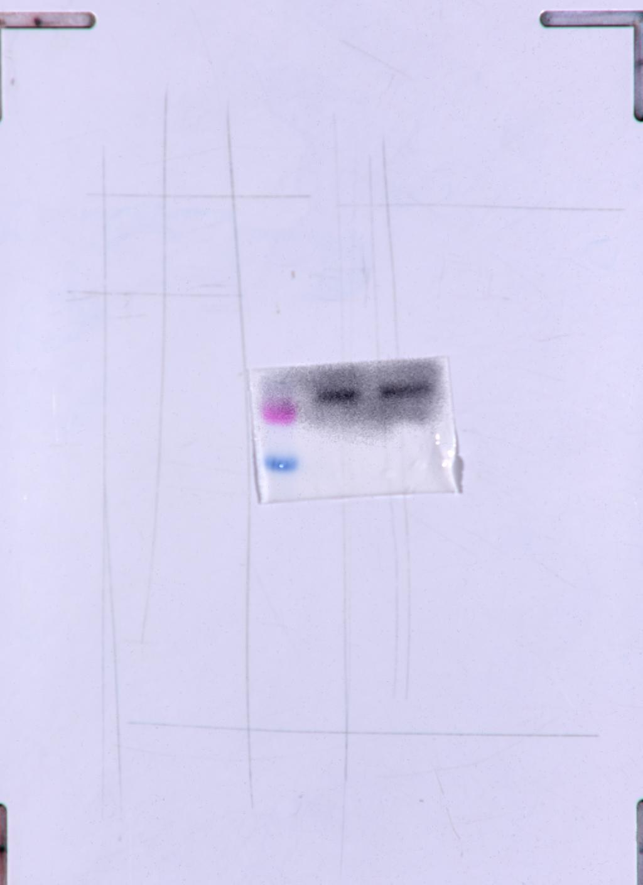
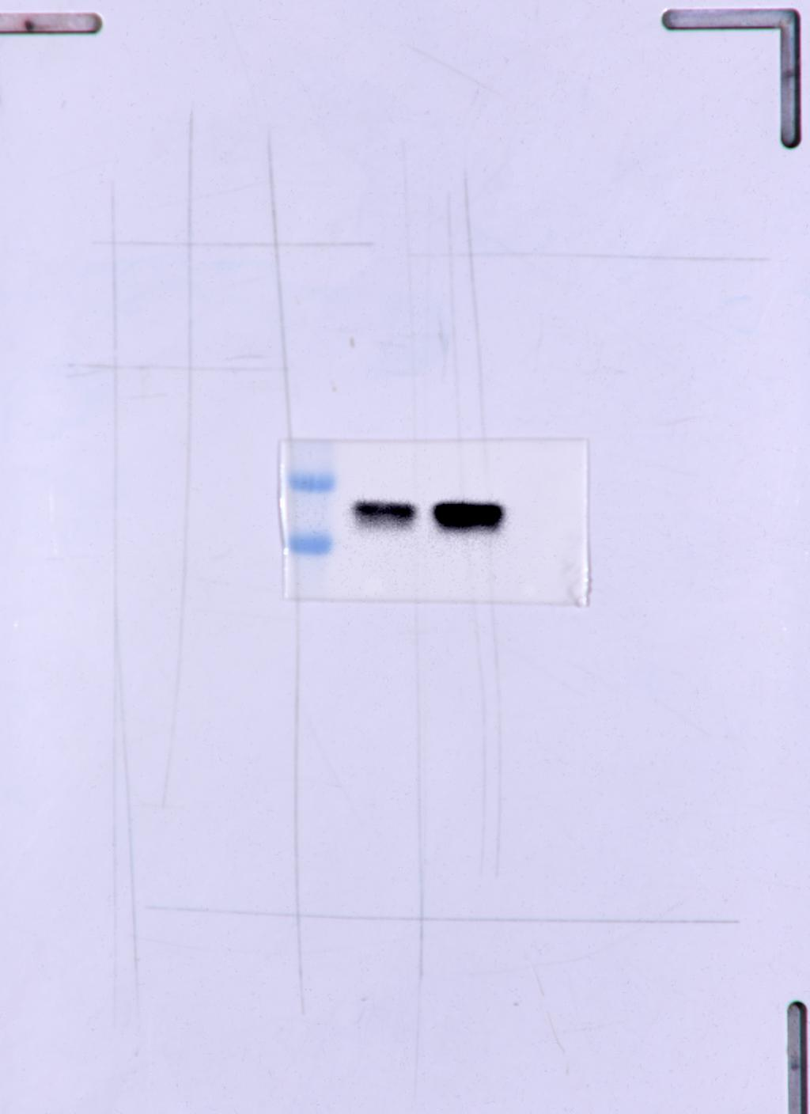
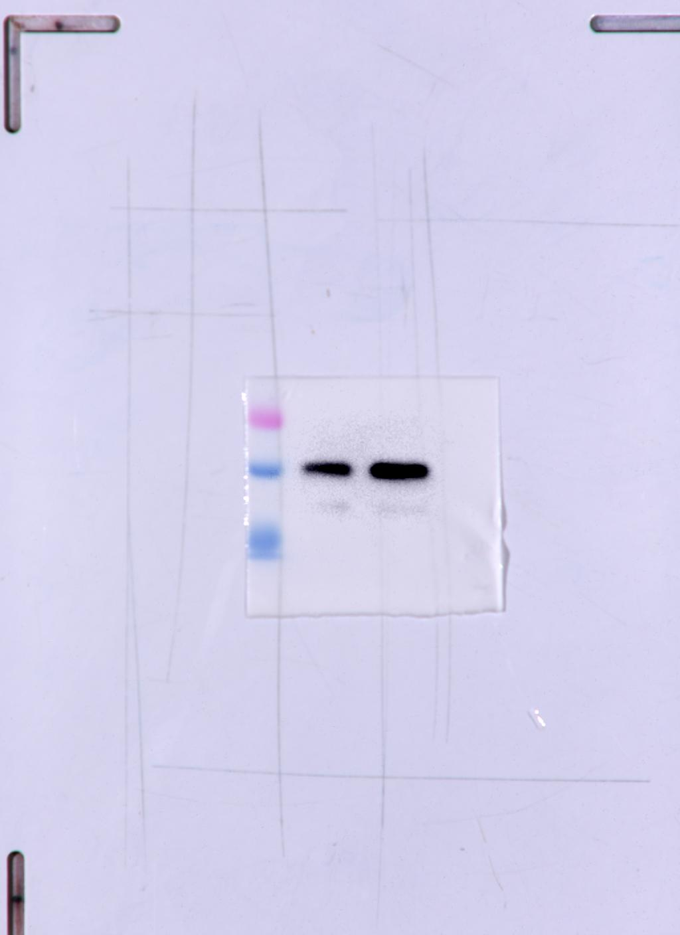
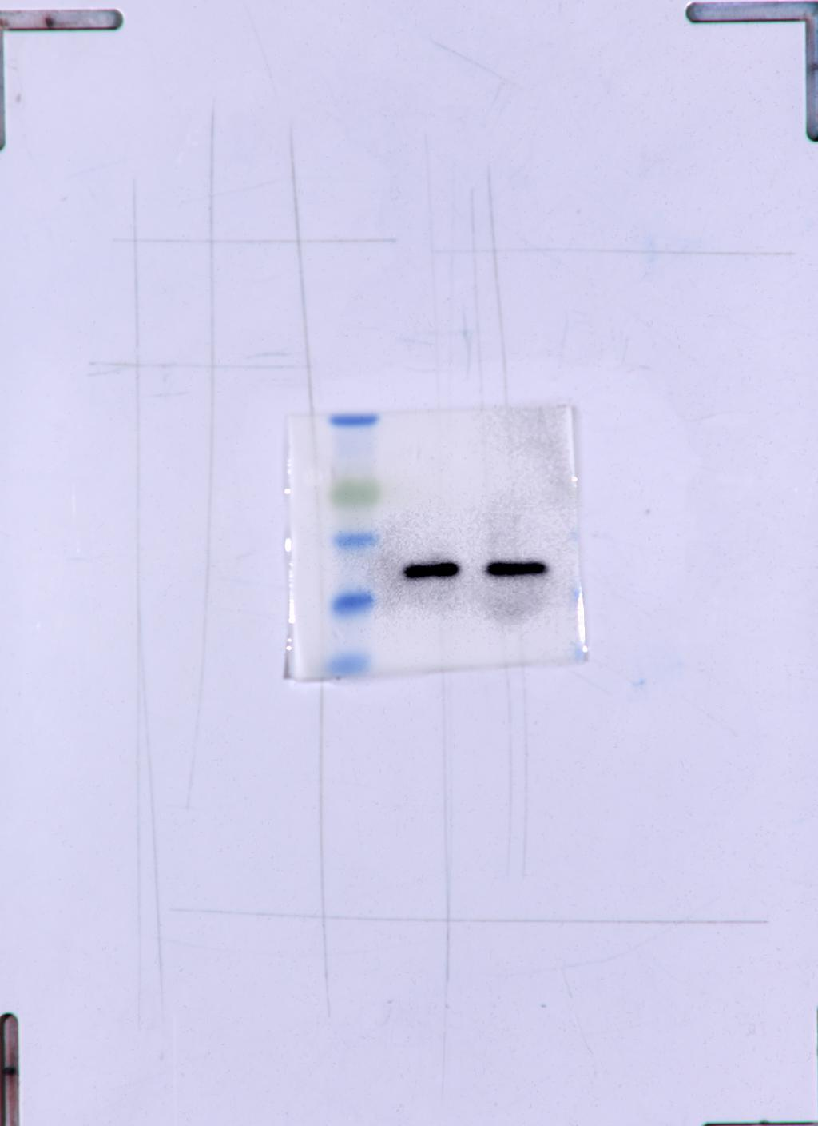
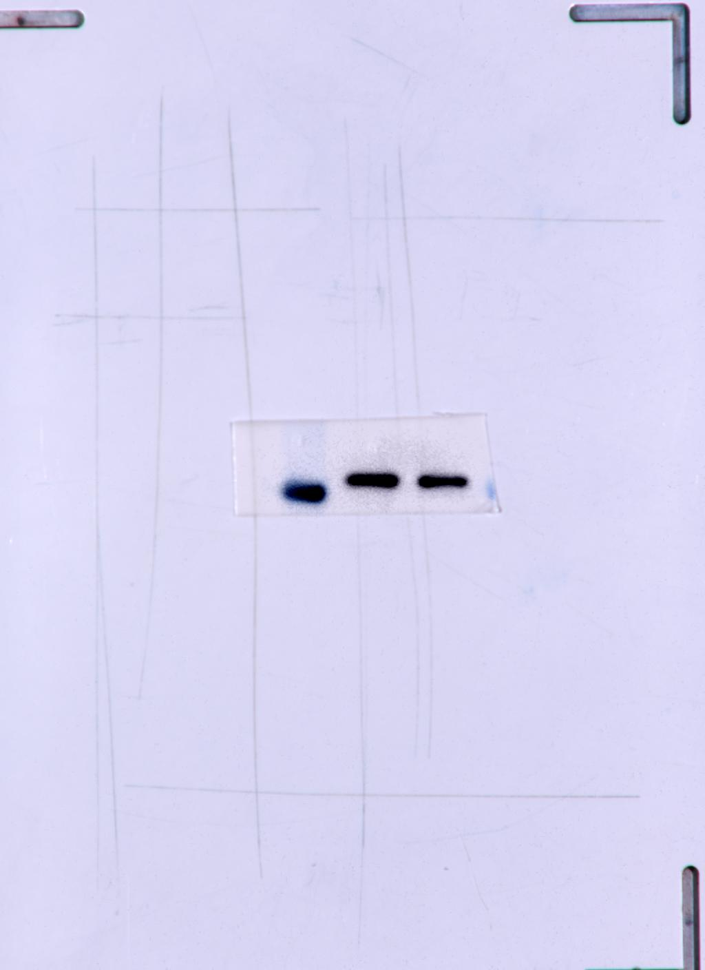
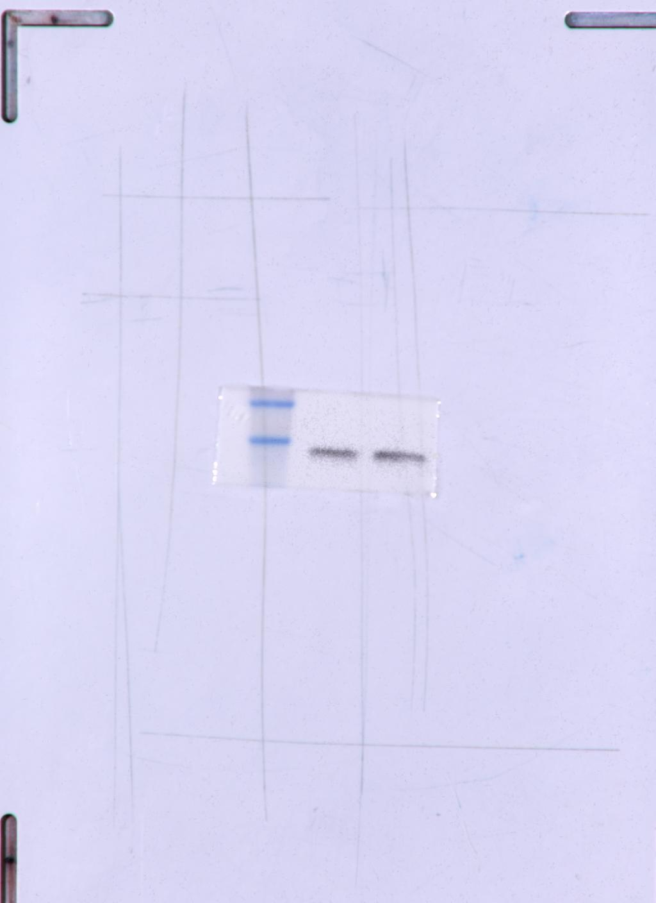
Fig. 2B Panel 1
Fig. 2B Panel 2
Fig. 2B Panel 3
Fig. 2B Panel 4
Fig. 2B Panel 5
Mfn1
SDHB
UQCRC2
MTCO2
NDUFB8
Adherence
Adherence
Adherence
Adherence
Spheroids
Adherence
Spheroids
Spheroids
Spheroids
Spheroids
28
49
26
22
82
Fig. 2B Panel 6
Fig. 2B Panel 7
ATP5A
β-actin
Adherence
Adherence
Spheroids
Spheroids
53
45

Slide 6
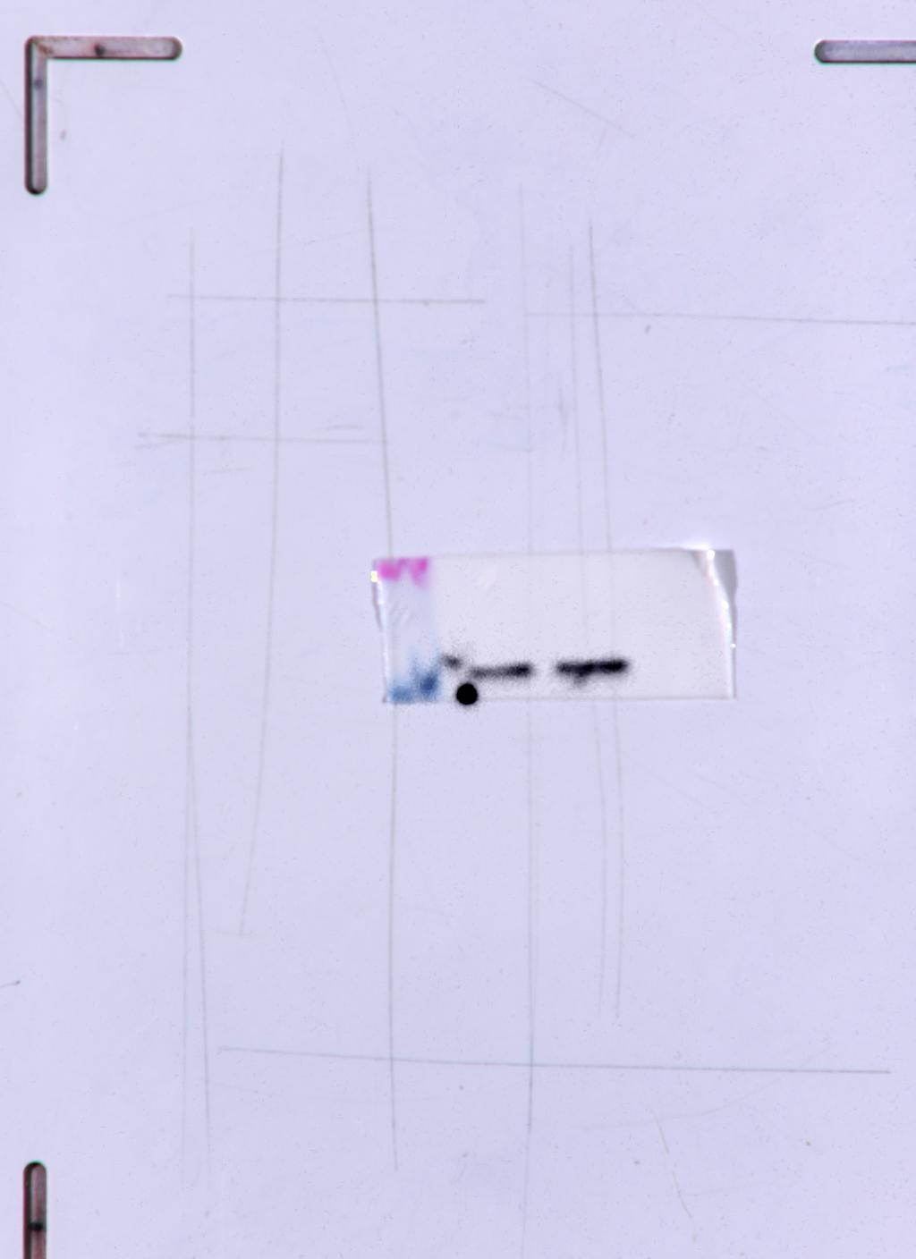
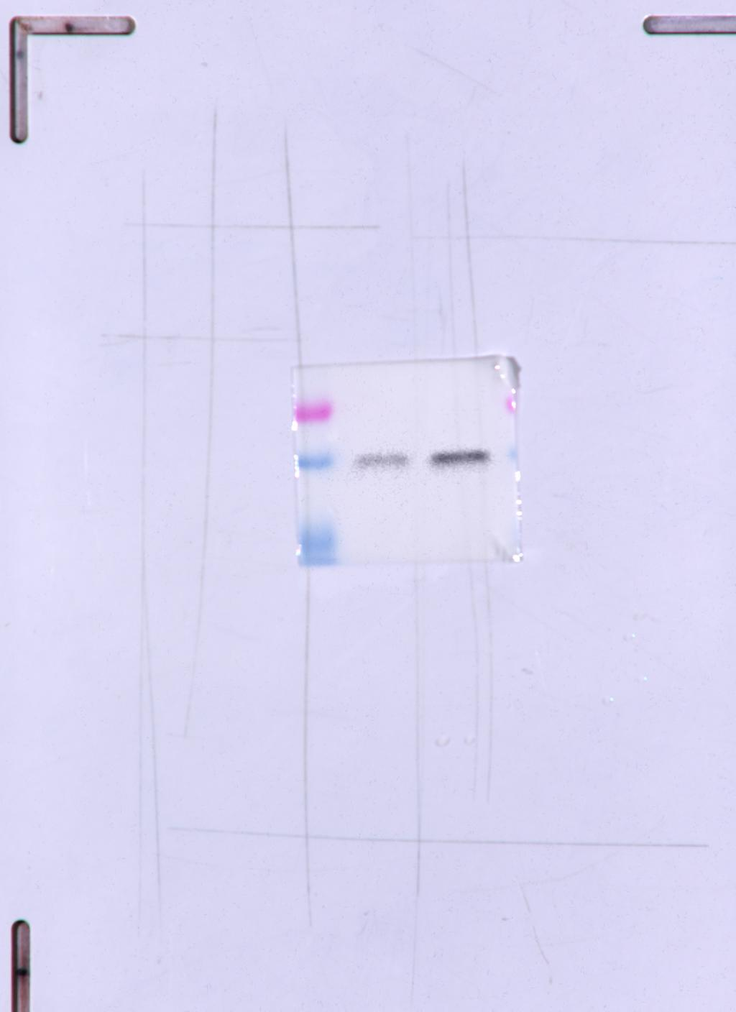
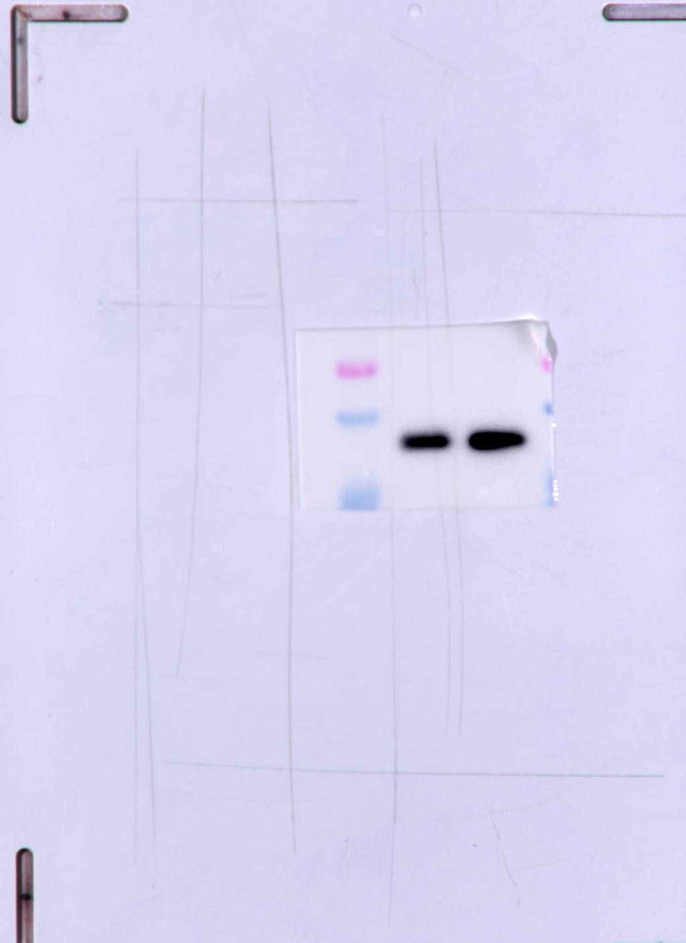
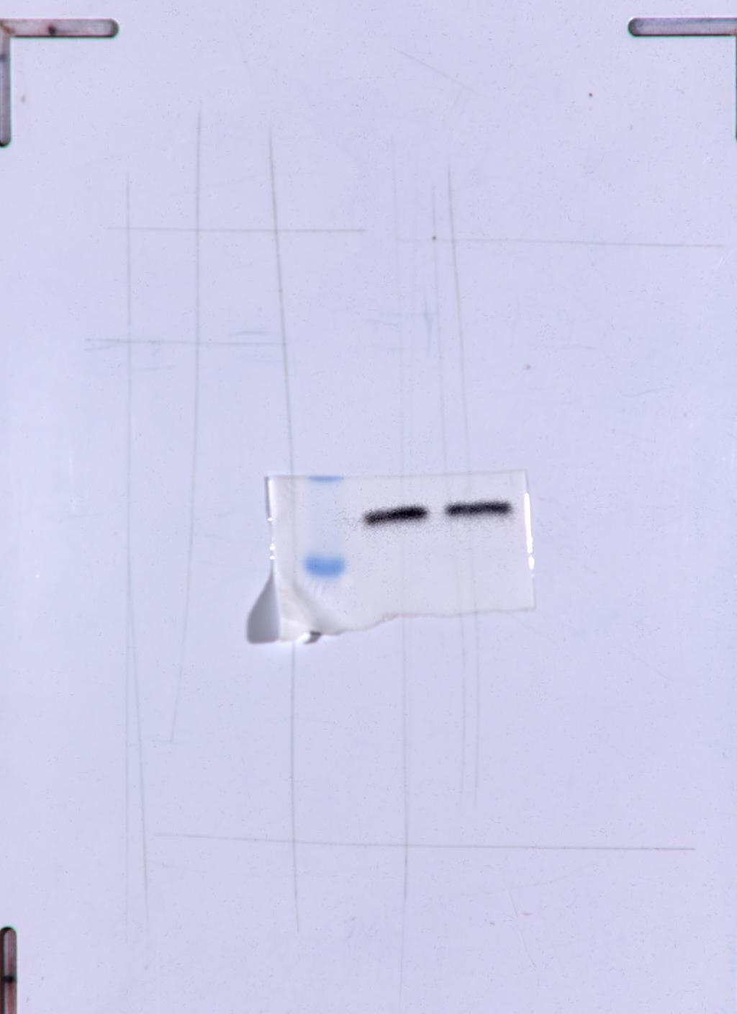
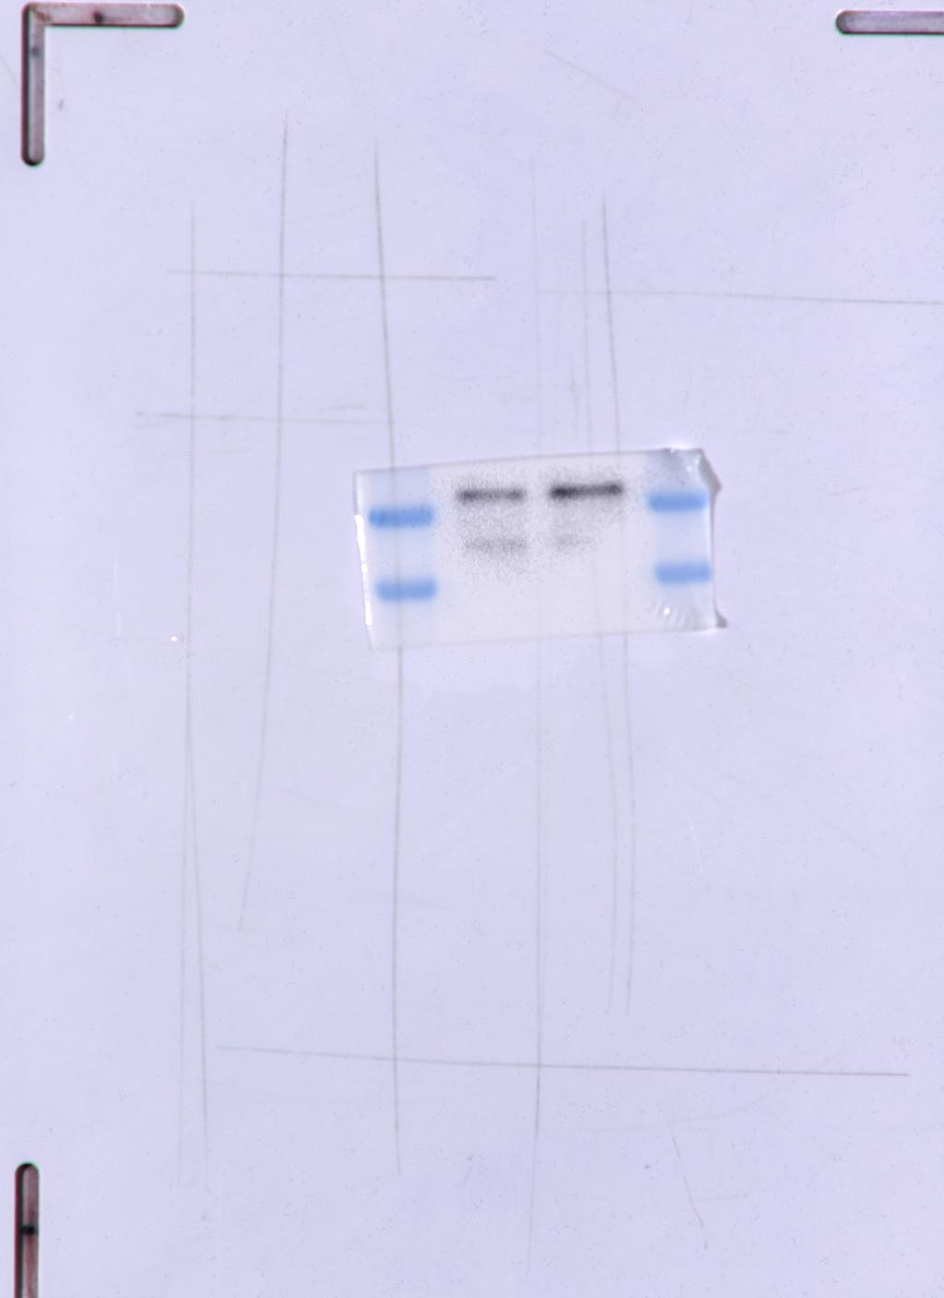
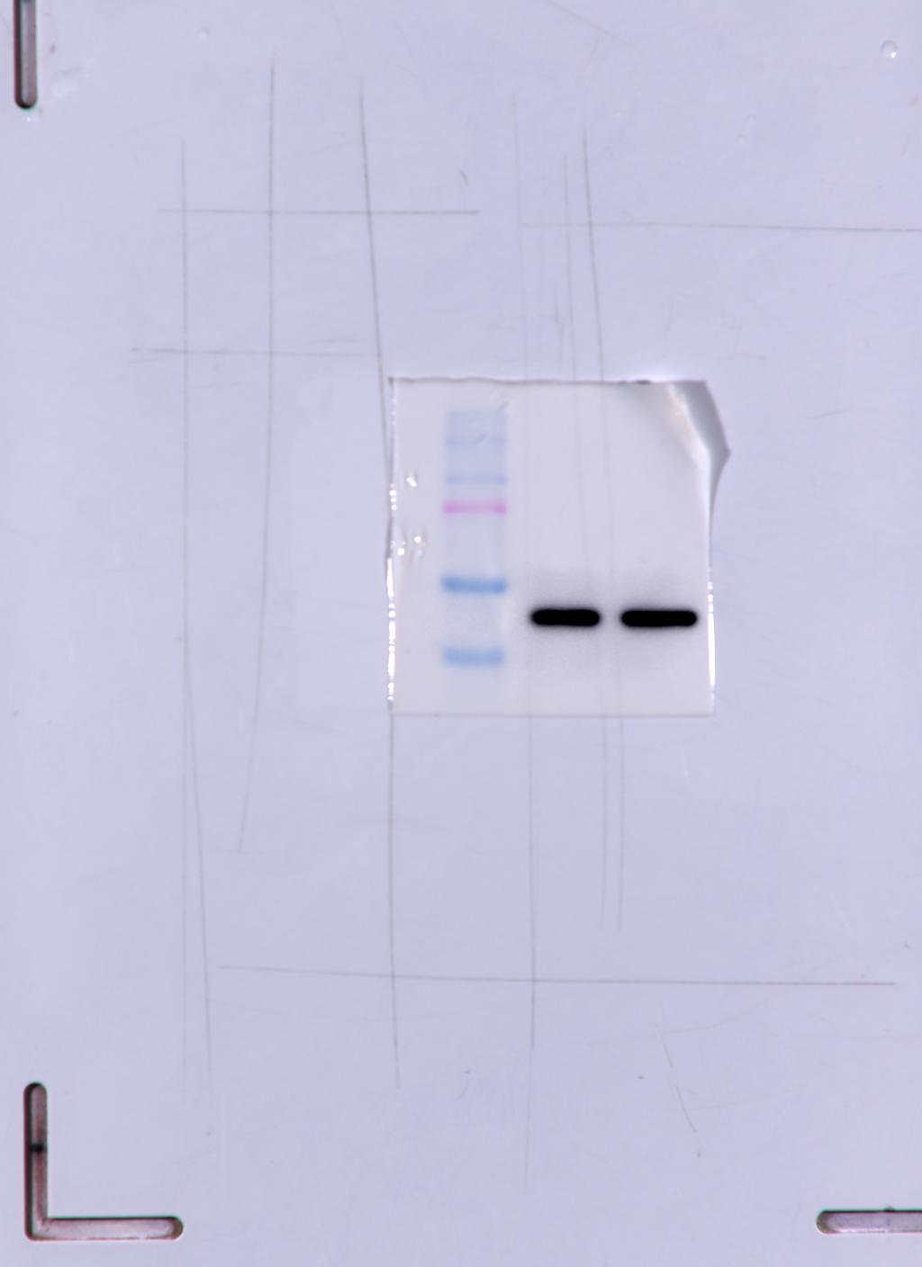
Fig. 2C Panel 1
Fig. 2C Panel 2
Fig. 2C Panel 3
Fig. 2C Panel 4
Fig. 2C Panel 5
Fig. 2C Panel 6
UQCRC2
MTCO2
NDUFB8
β-actin
ATP5A
β-actin
_
_
_
_
+
CD133
+
CD133
+
CD133
+
CD133
CD133
_
+
_
+
53
26
CD133
22
45
45
49

Slide 7
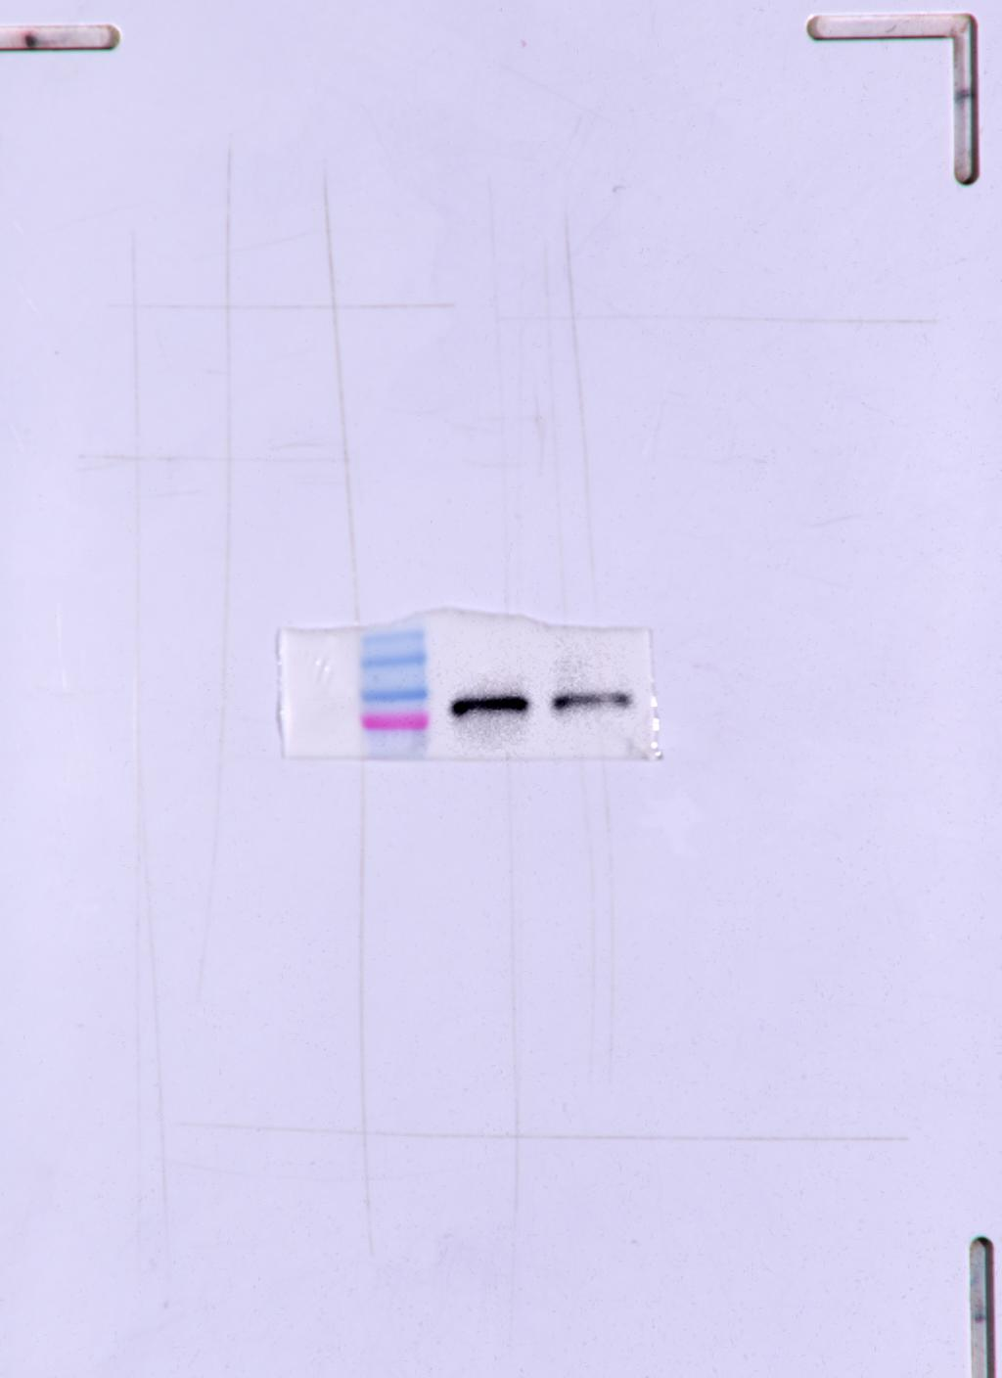
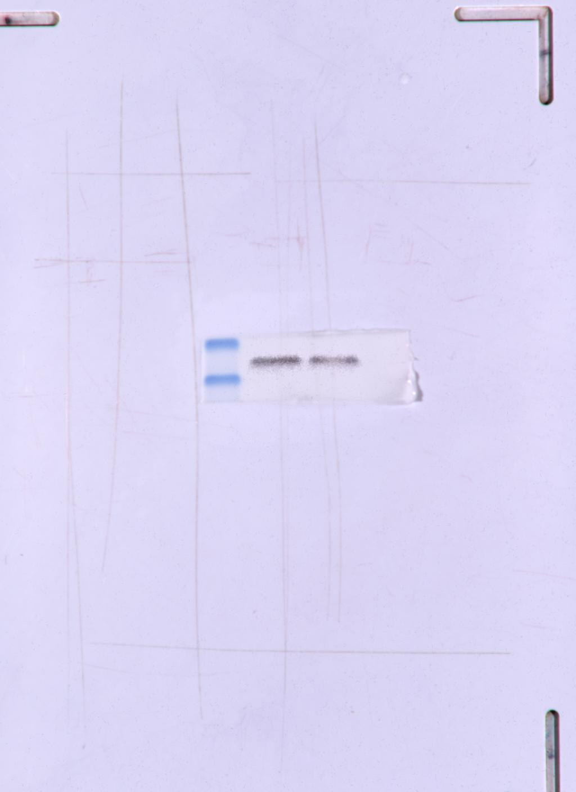
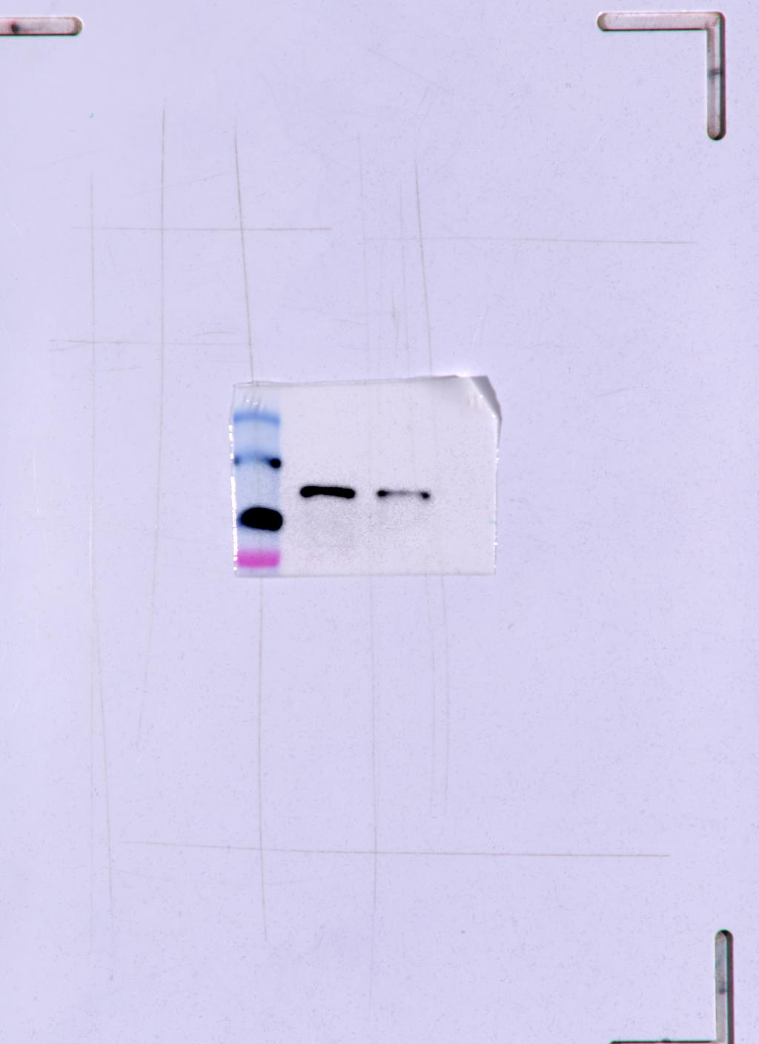
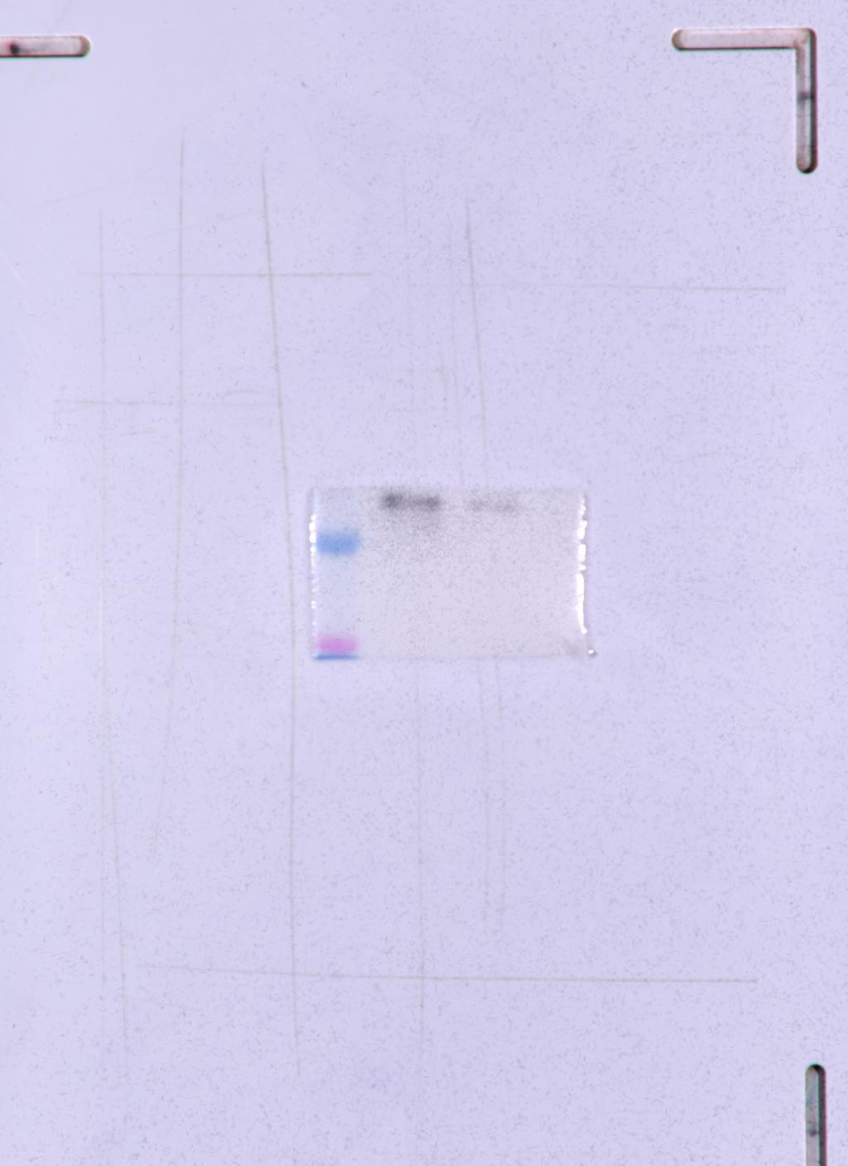
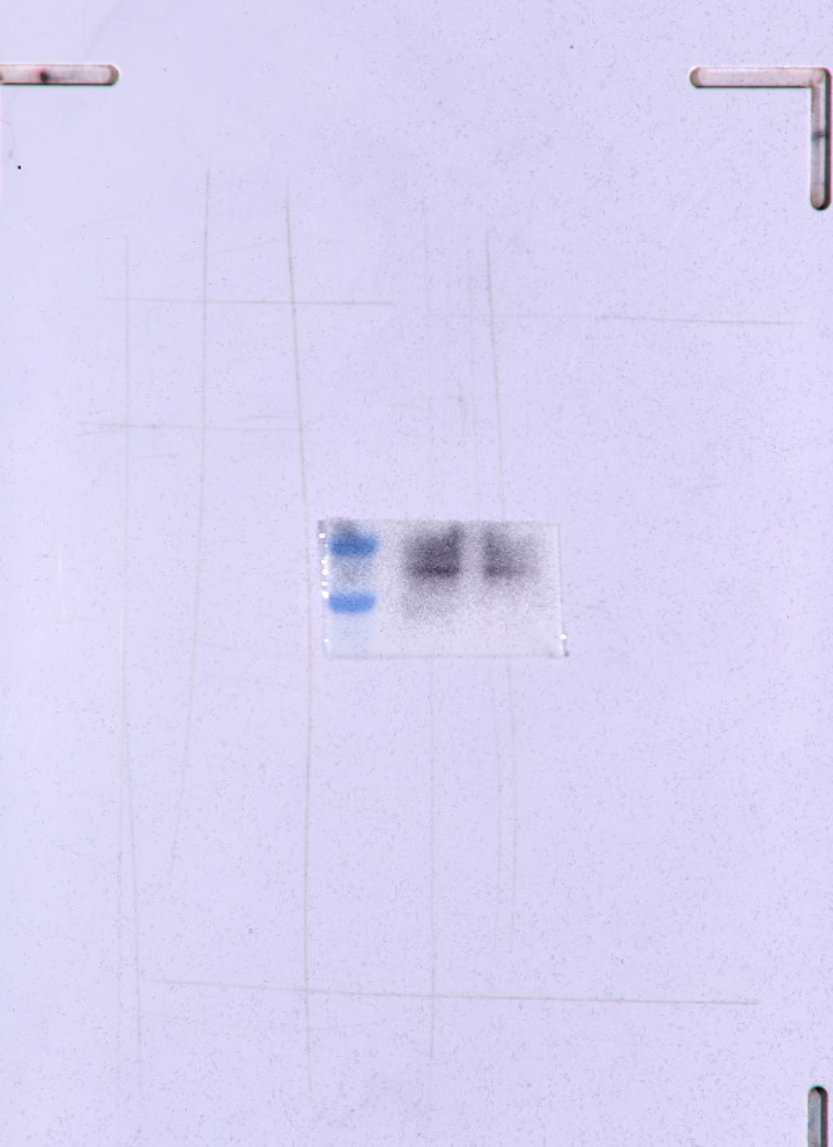
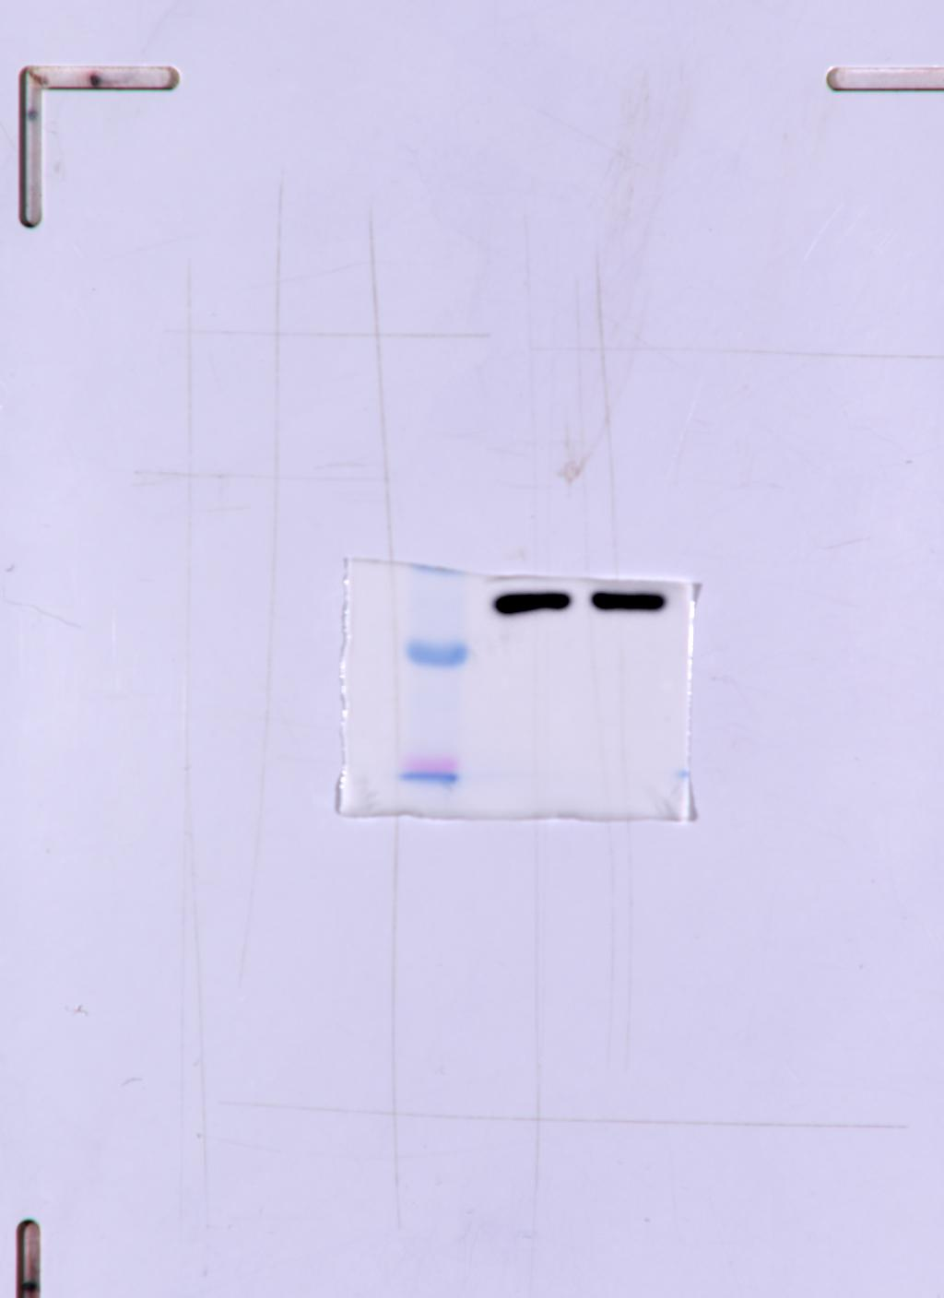
Fig. 3A Panel 1
Fig. 3A Panel 2
Fig. 3A Panel 3
Fig. 3A Panel 4
Fig. 3A Panel 5
Fig. 3A Panel 6
Mfn1
Oct4
CD44
Nanog
Sox2
β-actin
shMfn1
Control
shMfn1
Control
Control
shMfn1
shMfn1
Control
shMfn1
shMfn1
Control
Control
45
80
42
35
45
82

Slide 8
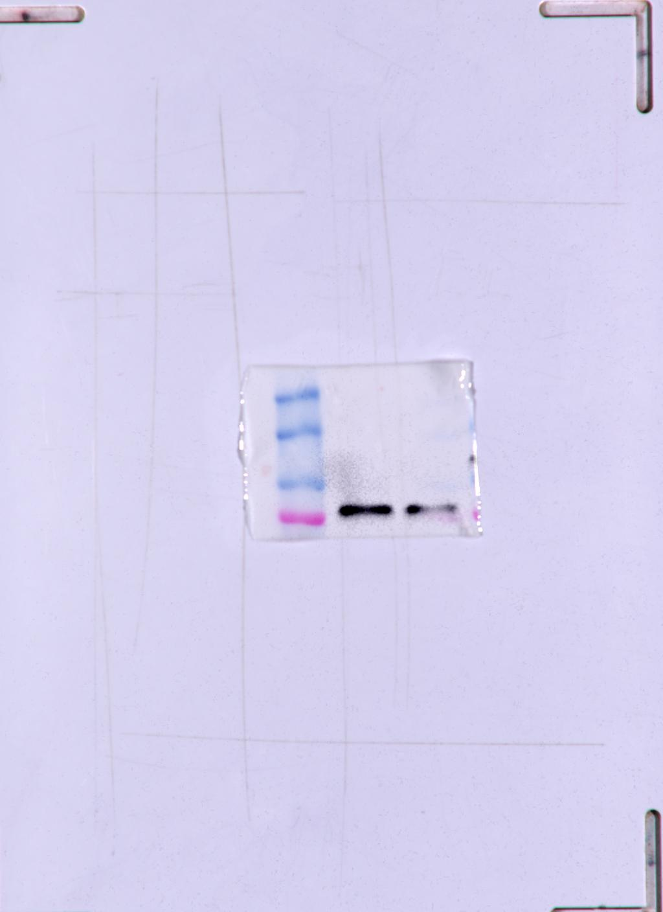
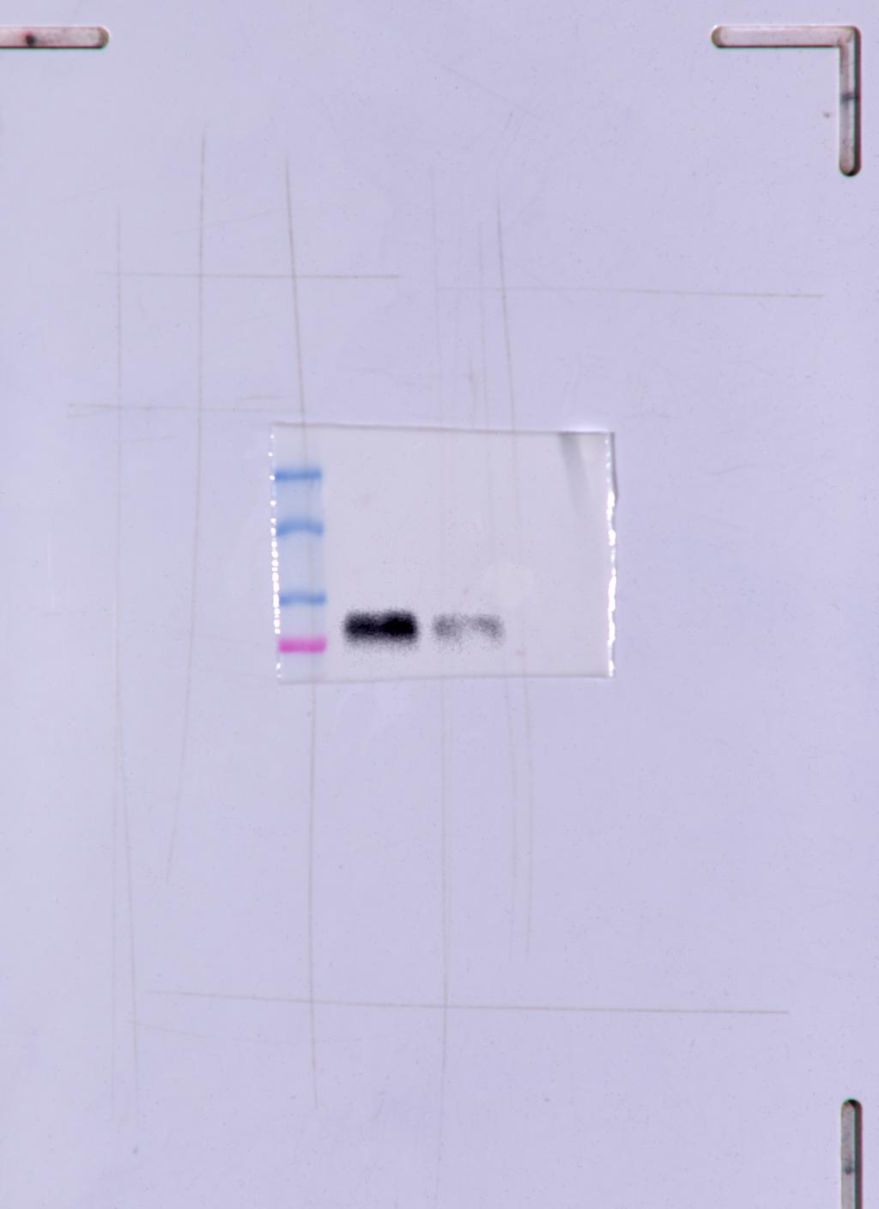
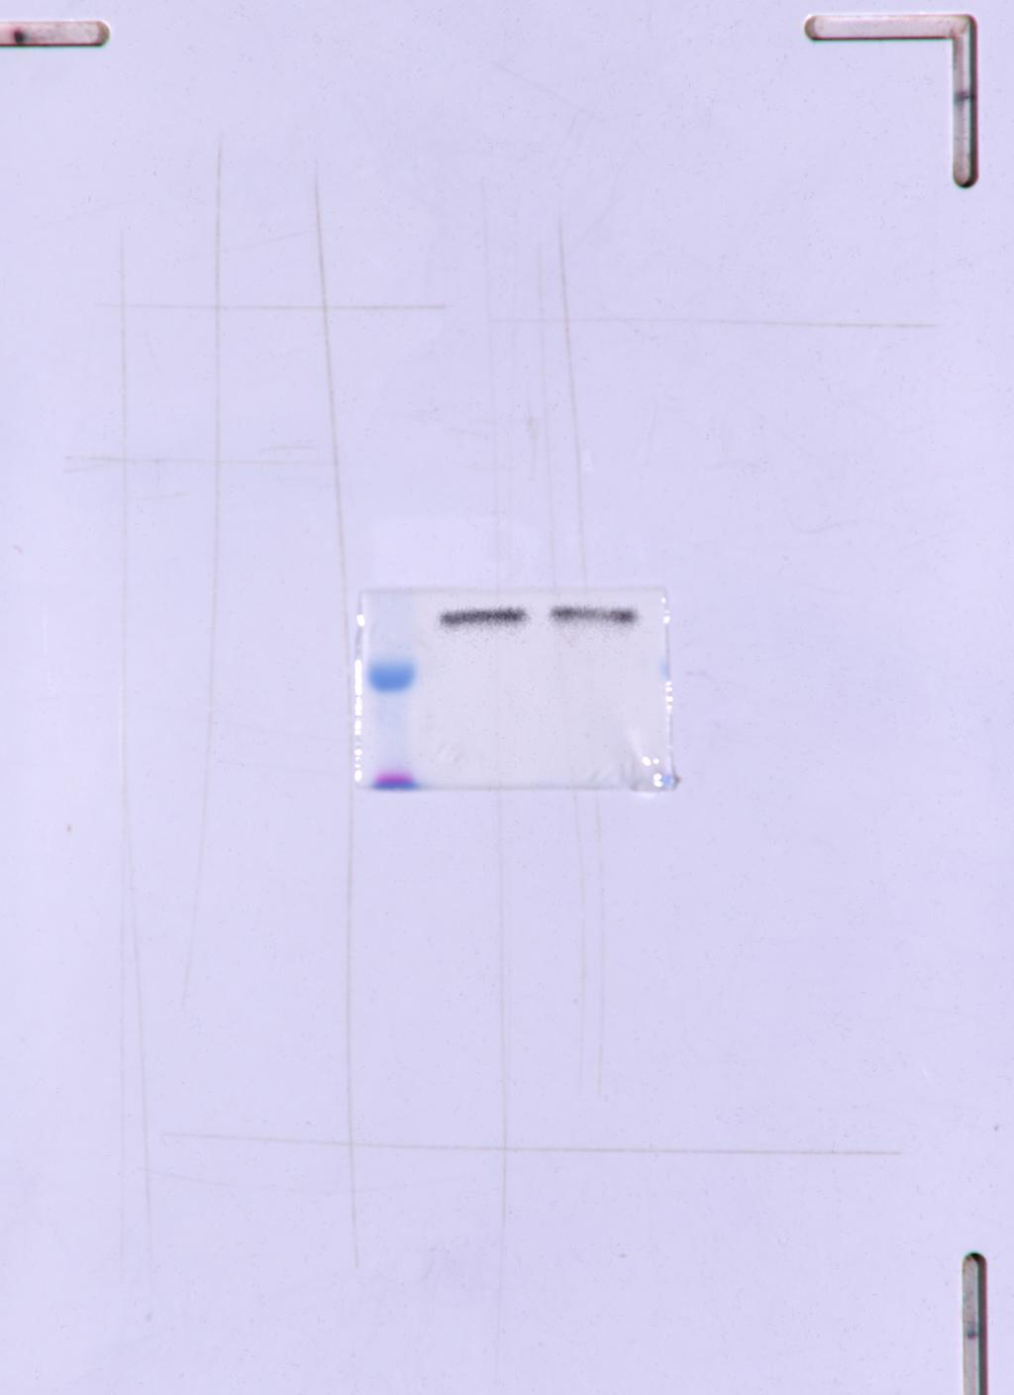
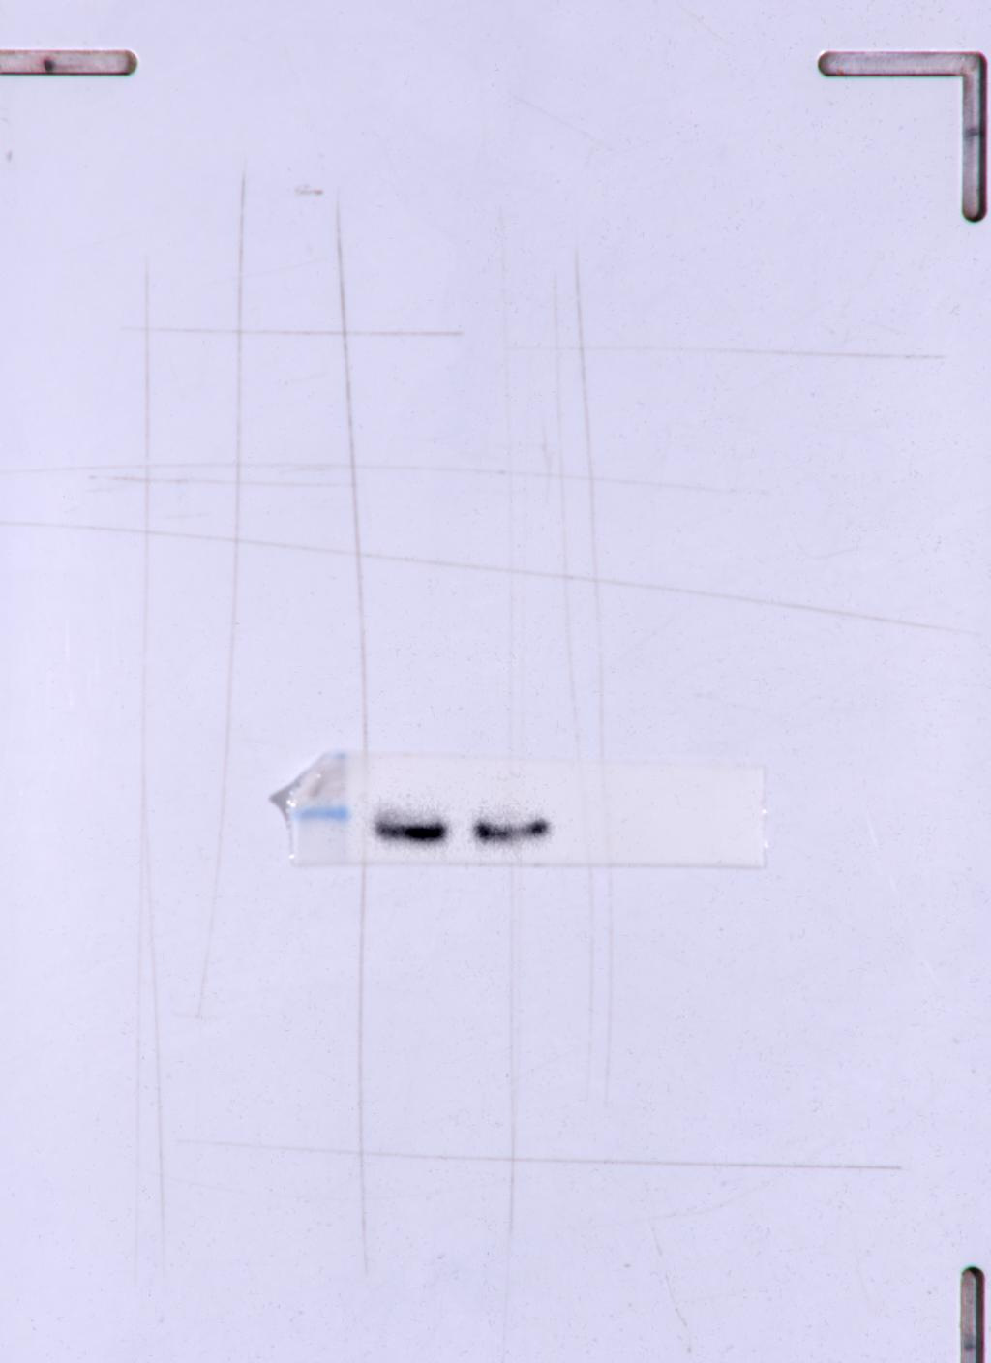
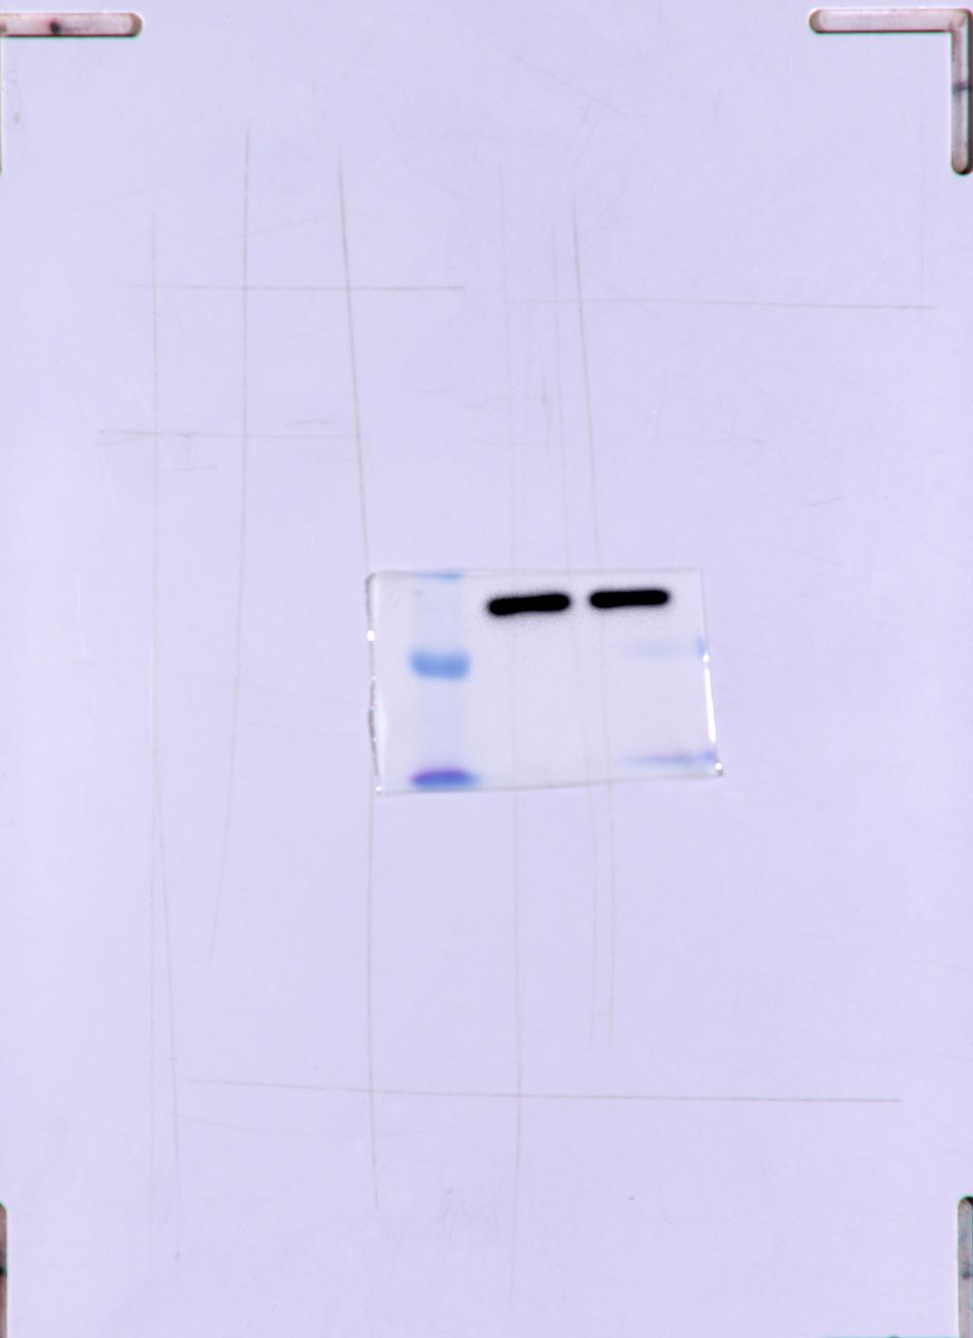
Fig. 3B Panel 1
Fig. 3B Panel 2
Fig. 3B Panel 3
Fig. 3B Panel 4
Fig. 3B Panel 5
Mfn1
CD44
Oct4
Nanog
β-actin
shMfn1
shMfn1
Control
Control
shMfn1
Control
shMfn1
Control
shMfn1
45
Control
45
82
80
42

Slide 9
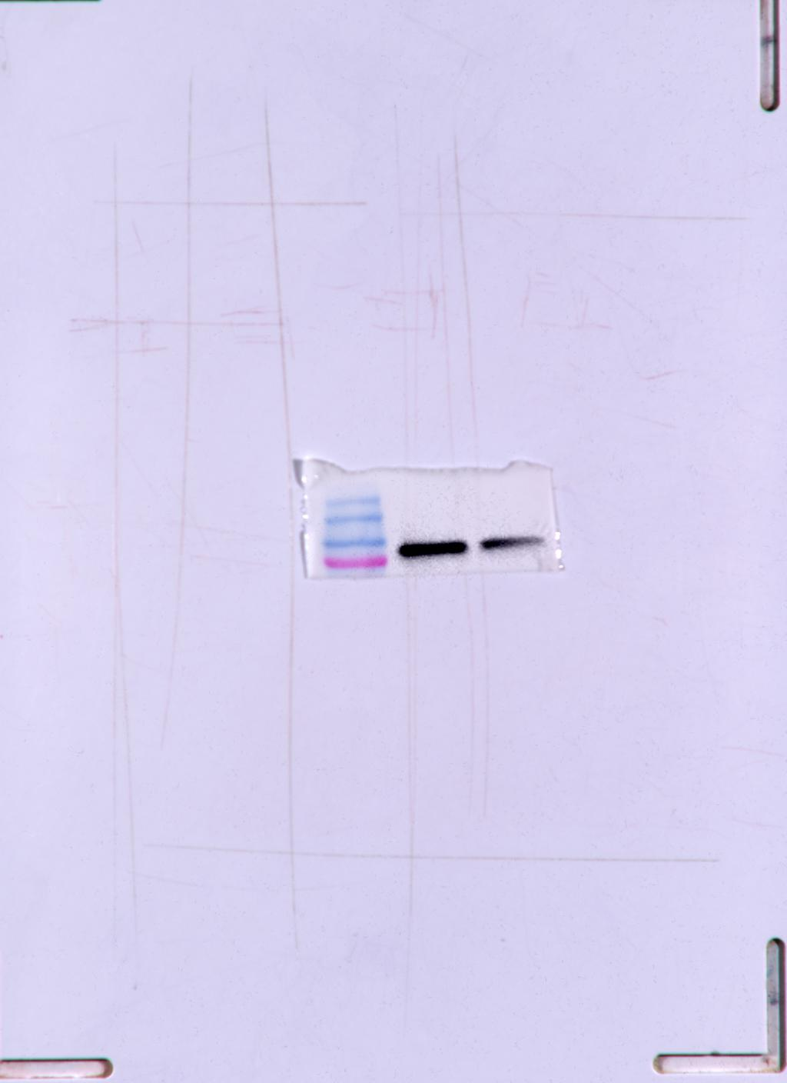
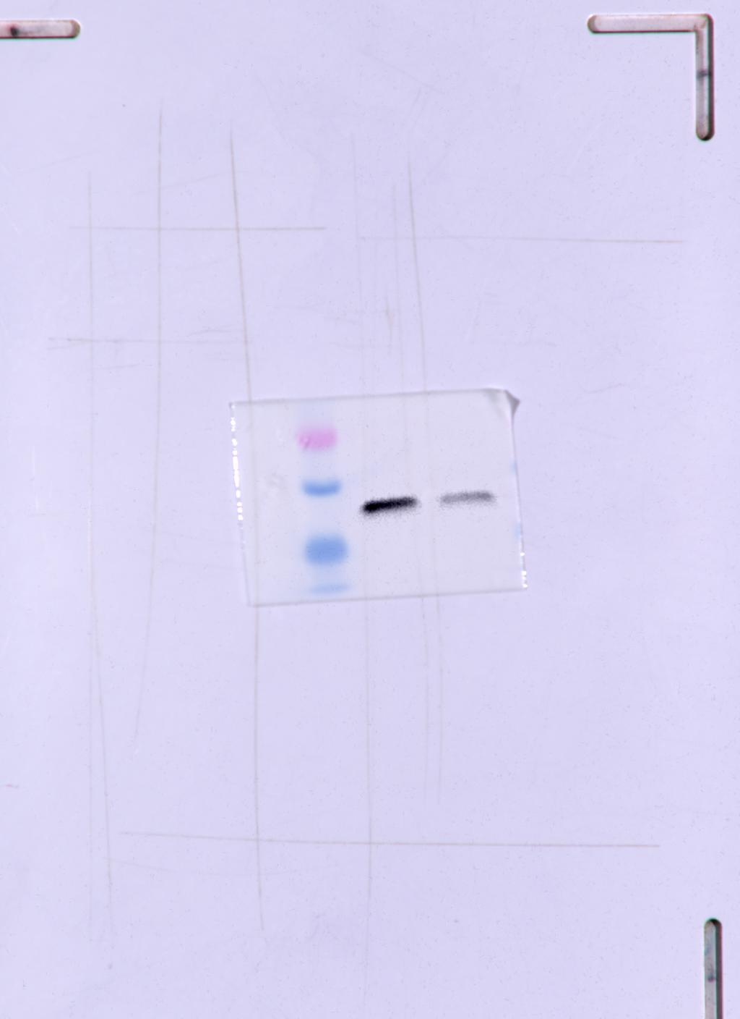
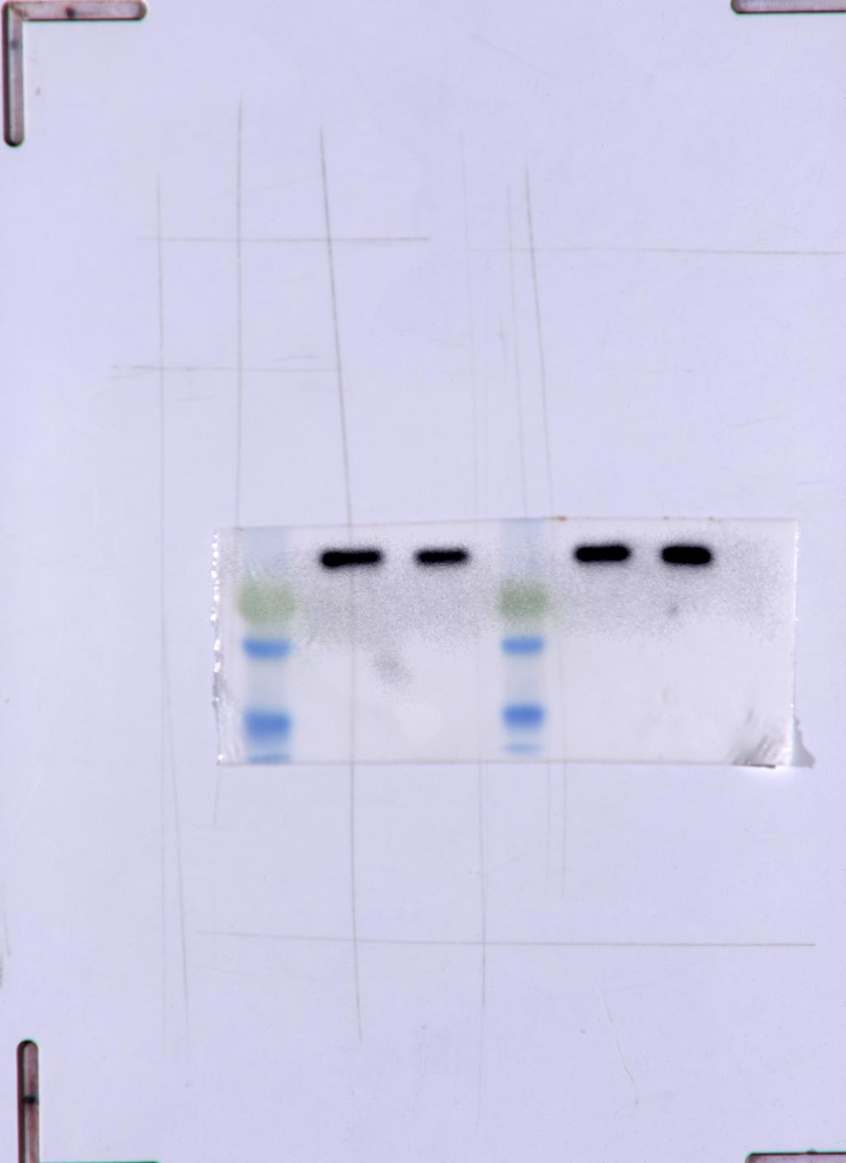




Fig. 4A Panel 1
Fig. 4A Panel 2
Fig. 4A Panel 3
Fig. 4A Panel 4
Fig. 4A Panel 5
Mfn1
NDUFB8
SDHB
UQCRC2
MTCO2
shMfn1
Control
shMfn1
shMfn1
Control
Control
shMfn1
Control
shMfn1
82
Control
22
28
26
49
Fig. 4A Panel 6
Fig. 4A Panel 7
ATP5A
β-actin
shMfn1
Control
shMfn1
Control
45
53

Slide 10





Fig. 4B Panel 1
Fig. 4B Panel 2
Fig. 4B Panel 3
Fig. 4B Panel 4
Fig. 4B Panel 5
Mfn1
SDHB
UQCRC2
ATP5A
β-actin
shMfn1
Control
shMfn1
Control
shMfn1
Control
shMfn1
Control
shMfn1
Control
82
28
49
53
45

Slide 11





Fig. 4G Panel 1
Fig. 4G Panel 2
Fig. 4G Panel 3
Fig. 4G Panel 4
Fig. 4G Panel 5
Mfn1
MTCO2
ATP5A
NDUFB8
β-actin
shMfn1
Mfn1 O/E
Control
shMfn1
Mfn1 O/E
Control
shMfn1
Mfn1 O/E
shMfn1
Control
Mfn1 O/E
Control
shMfn1
Mfn1 O/E
Control
shMfn1
Mfn1 O/E
Control
53
45
82
26
22
Mfn1 O/E band size increase because 6 Myc tag present in the Overexpression plasmid

Slide 12






Fig. 5A Panel 1
Fig. 5A Panel 2
Fig. 5A Panel 3
Fig. 5A Panel 4
Fig. 5A Panel 5
Fig. 5A Panel 6
ATP5A
SDHB
UQCRC2
NDUFB8
MTCO2
β-actin
2-DG (mM)
2.5
0
5
1.25
2-DG (mM)
2.5
0
5
2-DG (mM)
2.5
2-DG (mM)
1.25
0
5
1.25
2.5
0
5
2-DG (mM)
2.5
1.25
0
5
1.25
2-DG (mM)
22
2.5
0
5
49
26
1.25
53
28
45

Slide 13






Figure 5B Panel 1
Figure 5B Panel 2
Figure 5B Panel 3
Figure 5B Panel 4
Figure 5B Panel 5
Figure 5B Panel 6
ATP5A
SDHB
UQCRC2
NDUFB8
MTCO2
β-actin
2-DG (mM)
2.5
0
5
1.25
2-DG (mM)
2.5
2-DG (mM)
0
5
2-DG (mM)
2-DG (mM)
2.5
1.25
2.5
5
5
0
0
1.25
1.25
2.5
0
5
1.25
2-DG (mM)
2.5
0
5
28
1.25
53
49
22
26
45

Slide 14








Figure 5C Panel 1
Figure 5C Panel 2
Figure 5C Panel 3
Figure 5C Panel 4
Figure 5C Panel 5
Figure 5C Panel 6
Mfn1
ATP5A
SDHB
UQCRC2
β-actin
NDUFB8
_
_
2-DG (mM)
_
+
_
+
2-DG (mM)
_
+
_
+
2-DG (mM)
+
+
CD133
_
_
+
+
2-DG (mM)
_
+
_
+
2-DG (mM)
_
+
_
+
2-DG (mM)
_
+
_
+
CD133
_
_
+
CD133
_
_
+
+
CD133
_
_
+
CD133
_
_
+
+
CD133
_
_
+
+
+
28
+
82
53
49
45
22
Figure 5C Panel 7
Figure 5C Panel 8
MTCO2
β-actin
2-DG (mM)
_
+
_
+
2-DG (mM)
_
+
_
+
CD133
_
_
+
+
CD133
_
_
+
+
26
45

Slide 15






Fig. 5D Panel 1
Fig. 5D Panel 2
Fig. 5D Panel 3
Fig. 5D Panel 4
Fig. 5D Panel 5
Fig. 5D Panel 6
Mfn1
MTCO2
UQCRC2
NDUFB8
ATP5A
β-actin
Control
shMfn1
Control
Control
shMfn1
Control
shMfn1
shMfn1
shMfn1
Control
shMfn1
Control
Control
Control
shMfn1
shMfn1
shMfn1
Control
shMfn1
Control
shMfn1
Control
Control
shMfn1
82
26
22
53
45
_
+
_
+
49
_
2-DG (mM)
_
+
_
+
2-DG (mM)
+
_
+
2-DG (mM)
_
_
_
_
_
+
_
+
2-DG (mM)
+
+
2-DG (mM)
+
+
2-DG (mM)

Slide 16






Figure 5E Panel 1
Figure 5E Panel 2
Figure 5E Panel 3
Figure 5E Panel 4
Figure 5E Panel 5
Figure 5E Panel 6
Mfn1
MTCO2
UQCRC2
NDUFB8
ATP5A
β-actin
Control
shMfn1
Control
shMfn1
Control
shMfn1
Control
shMfn1
Control
shMfn1
Control
Control
shMfn1
Control
shMfn1
shMfn1
shMfn1
Control
shMfn1
Control
shMfn1
Control
26
Control
shMfn1
82
22
53
45
_
+
_
+
49
_
_
_
2-DG (mM)
_
+
_
+
_
_
2-DG (mM)
+
_
+
2-DG (mM)
+
+
2-DG (mM)
2-DG (mM)
+
+
_
+
_
+
2-DG (mM)

Slide 17





Fig. 6A Panel 1
Fig. 6A Panel 2
Fig. 6A Panel 3
Fig. 6A Panel 4
Fig. 6A Panel 5
Mfn1
CD133
Nanog
Oct4
β-actin
2-DG (mM)
2-DG (mM)
2.5
0
5
2.5
1.25
0
5
1.25
2-DG (mM)
2-DG (mM)
2.5
0
5
2.5
1.25
0
5
2-DG (mM)
2.5
1.25
45
45
0
5
1.25
133
42
82

Slide 18




Fig. 6B Panel 1
Fig. 6B Panel 2
Fig. 6B Panel 3
Fig. 6B Panel 4
Mfn1
CD133
Nanog
β-actin
2-DG (mM)
2-DG (mM)
2.5
2-DG (mM)
0
5
2.5
1.25
5
2.5
0
5
1.25
0
2-DG (mM)
2.5
1.25
0
5
1.25
45
133
42
82

Slide 19



Fig. 6C Panel 1
Fig. 6C Panel 2
Fig. 6C Panel 3
Mfn1
Oct4
β-actin
2-DG (mM)
2.5
0
5
1.25
2-DG (mM)
2.5
0
5
2-DG (mM)
1.25
2.5
0
5
1.25
45
82
45

Slide 20





Fig. 6D Panel 1
Fig. 6D Panel 2
Fig. 6D Panel 3
Fig. 6D Panel 4
Fig. 6D Panel 5
CD133
Oct4
Nanog
Sox2
β-actin
2-DG (mM)
_
+
_
+
_
_
2-DG (mM)
_
+
_
+
2-DG (mM)
_
+
_
+
CD133
_
_
+
+
2-DG (mM)
+
+
CD133
_
_
+
+
2-DG (mM)
_
+
_
+
CD133
_
_
+
+
45
CD133
_
_
+
+
CD133
_
_
+
+
42
35
45
133

Slide 21





Fig. 6E Panel 1
Fig. 6E Panel 2
Fig. 6E Panel 3
Fig. 6E Panel 4
Fig. 6E Panel 3
Mfn1
CD133
Oct4
Nanog
β-actin
Control
shMfn1
Control
shMfn1
Control
shMfn1
Control
shMfn1
Control
shMfn1
Control
shMfn1
Control
shMfn1
Control
shMfn1
Control
shMfn1
Control
shMfn1
Control
shMfn1
Control
shMfn1
133
45
_
+
_
+
45
82
2-DG (mM)
_
+
_
+
_
_
_
+
_
+
2-DG (mM)
2-DG (mM)
+
+
2-DG (mM)
_
+
_
+
_
+
_
+
2-DG (mM)
2-DG (mM)

Slide 22





Fig. 6F Panel 1
Fig. 6F Panel 2
Fig. 6F Panel 3
Fig. 6F Panel 4
Fig. 6F Panel 5
Mfn1
CD133
Oct4
Nanog
β-actin
Control
shMfn1
Control
shMfn1
Control
shMfn1
Control
shMfn1
Control
shMfn1
Control
shMfn1
Control
shMfn1
Control
Control
shMfn1
shMfn1
Control
shMfn1
133
45
42
_
45
82
_
+
_
+
_
_
2-DG (mM)
+
_
+
_
_
+
2-DG (mM)
2-DG (mM)
+
+
2-DG (mM)
+
_
+
_
+
2-DG (mM)

Slide 23





Fig. 7A Panel 1
Fig. 7A Panel 2
Fig. 7A Panel 3
Fig. 7A Panel 4
Fig. 7A Panel 5
CD133
ATG5
LC3- I / II
ABCG2
β-actin
CD 133
_
+
_
+
CD 133
_
+
CD 133
_
+
CD 133
CD 133
_
+
45
133
16
70
55
14

Slide 24





Fig. 7B Panel 1
Fig. 7B Panel 2
Fig. 7B Panel 3
Fig. 7B Panel 4
Fig. 7B Panel 5
Mfn1
p62
LC3- I / II
ABCG2
β-actin
shMfn1
Control
shMfn1
Control
shMfn1
shMfn1
Control
Control
shMfn1
82
Control
62
70
45
16
14

