Slide 1
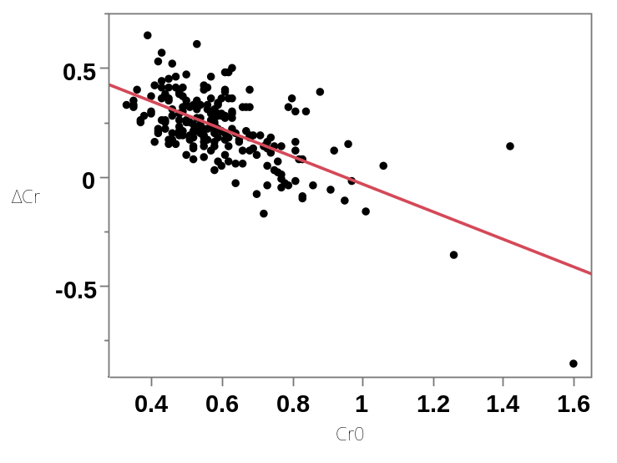
Relationship between initial serum creatinine after birth and
subsequent changes to the peak level in preterm neonates
PURPOSE: To determine the relationship between the serum creatinine (sCr) level after birth (Cr₀) and ΔCr (the difference between the peak Cr level and Cr₀) in preterm neonates
DESIGN & OUTCOMES:
Simple linear regression
Mechanism of sCr changes
ΔCr = 0.602 − 0.635 × Cr₀
R² = 0.423, P < 0.001
Serum Cr
(mg/dL)
Preterm
neonates
Cr₀ and ΔCr
available
Changes in sCr
levels reflecting
kidney function
in neonates
GA ≤29 wks: day 2 peak
GA ≥30 wks: day 1 peak
0.95
ΔCr (mg/dL)
GA gestational age
467 neonates
225
neonates
Cr₀ = 0.95
Cr₀ (mg/dL)
Day 0
Day 1-2
Shimabukuro et al. 2025
CONCLUSION: sCr level tended to converge toward 0.95 mg/dL after birth between day 1 and day 2 before subsequently declining.

