Slide 1
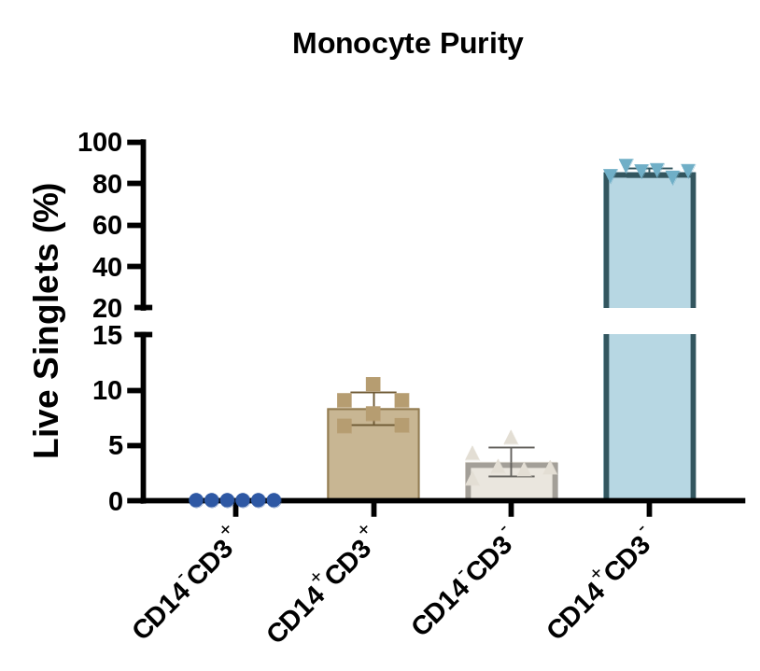
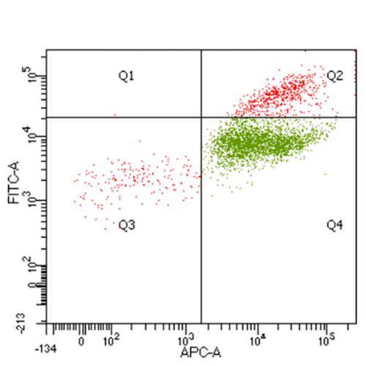
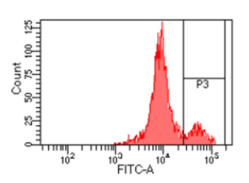
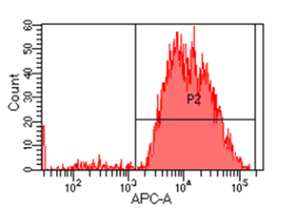
CD3 Positive Cells
CD14 Positive Cells
CD14 (APC) vs CD3 (FITC)
Supplementary Figure S1. Equine monocytes purity assessment. Flow cytometry analysis of adhesion-isolated monocytes prior to macrophage differentiation. (A) CD14 (APC) vs CD3 (FITC) dot plot showing four quadrants: Q1 (CD14⁻ CD3⁺) residual T cells, Q2 (CD14⁺ CD3⁺) doublets or aggregates, Q3 (CD14⁻ CD3⁻) other cells or debris and Q4 (CD14⁺ CD3⁻) monocytes. (B) CD14 expression profile within live singlets. (C) CD3 expression profile, highlighting residual T cell contamination. (D) Bar graph summarizing the percentage of live singlets in each quadrant (Q1-Q4), providing a quantitative overview of monocyte purity and remaining contaminating populations.

