Slide 1
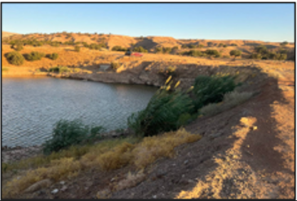
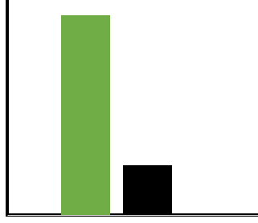




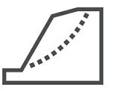



Graphical Abstract - Farmer-built Earth Dams
Essential Small-Scale Water Infrastructure
Under Assessment
Built Beyond Standard Engineering Codes
Comprehensive Evaluation
Good Deviated
Failure Risk
Field Survey
Key Findings
Soil Plasticity > 10 is more reliable than geometric compliance.
Soil Testing
3D Confinement and Vegetation Reinforcement Influence Dam Safety
Slope Stability Modeling
Spillway Failure Risk Dominates
Hydrological Analysis
Cost: 1–11% of the government dams

