Slide 1







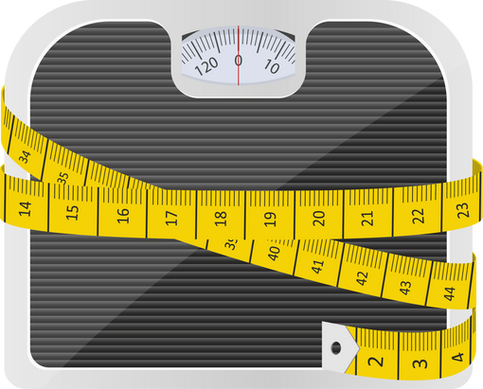
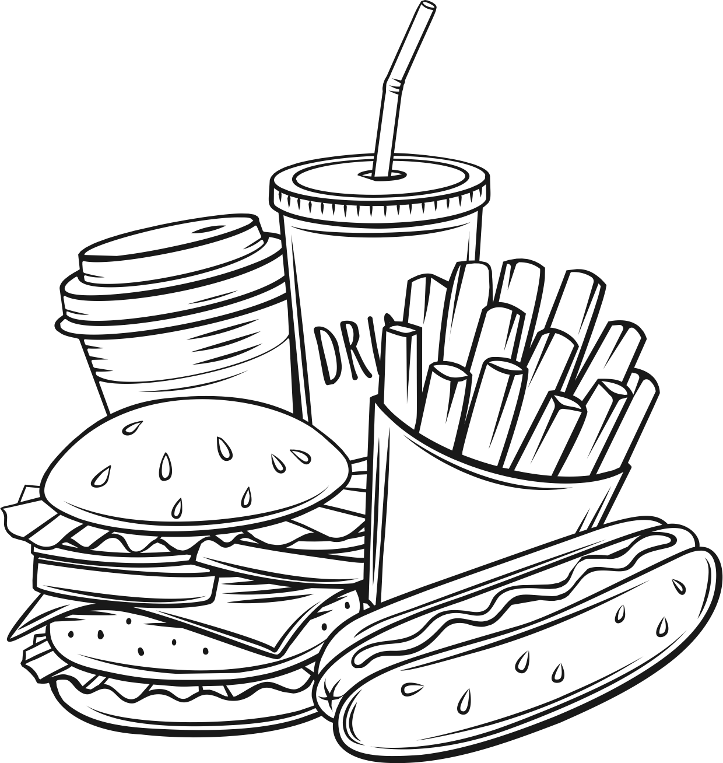

Gender Disparities in Dietary Habits and Physical Activity Among University Boarders: A Comparative Analysis
Introduction
University students' eating habits impact health; gender influences dietary choices
Objective
Gender-based analysis of diet, nutrition, and activity in university boarders
Methods
Cross-sectional study
222 university boarders analyzed
Assessed diet, health, and activity
Gender-based comparisons conducted
Results
Gender-based dietary analysis
Higher male BMI (23.2 vs 21.2)
Female fast-food preference
Activity level disparities (indoor/outdoor)
Macronutrient intake differences
Conclusion
Gender-specific dietary strategies are needed
Address metabolic and physiological differences
Caption: Gender Disparities in Dietary Habits and Physical Activity Among University Boarders: A Comparative Analysis

Slide 2
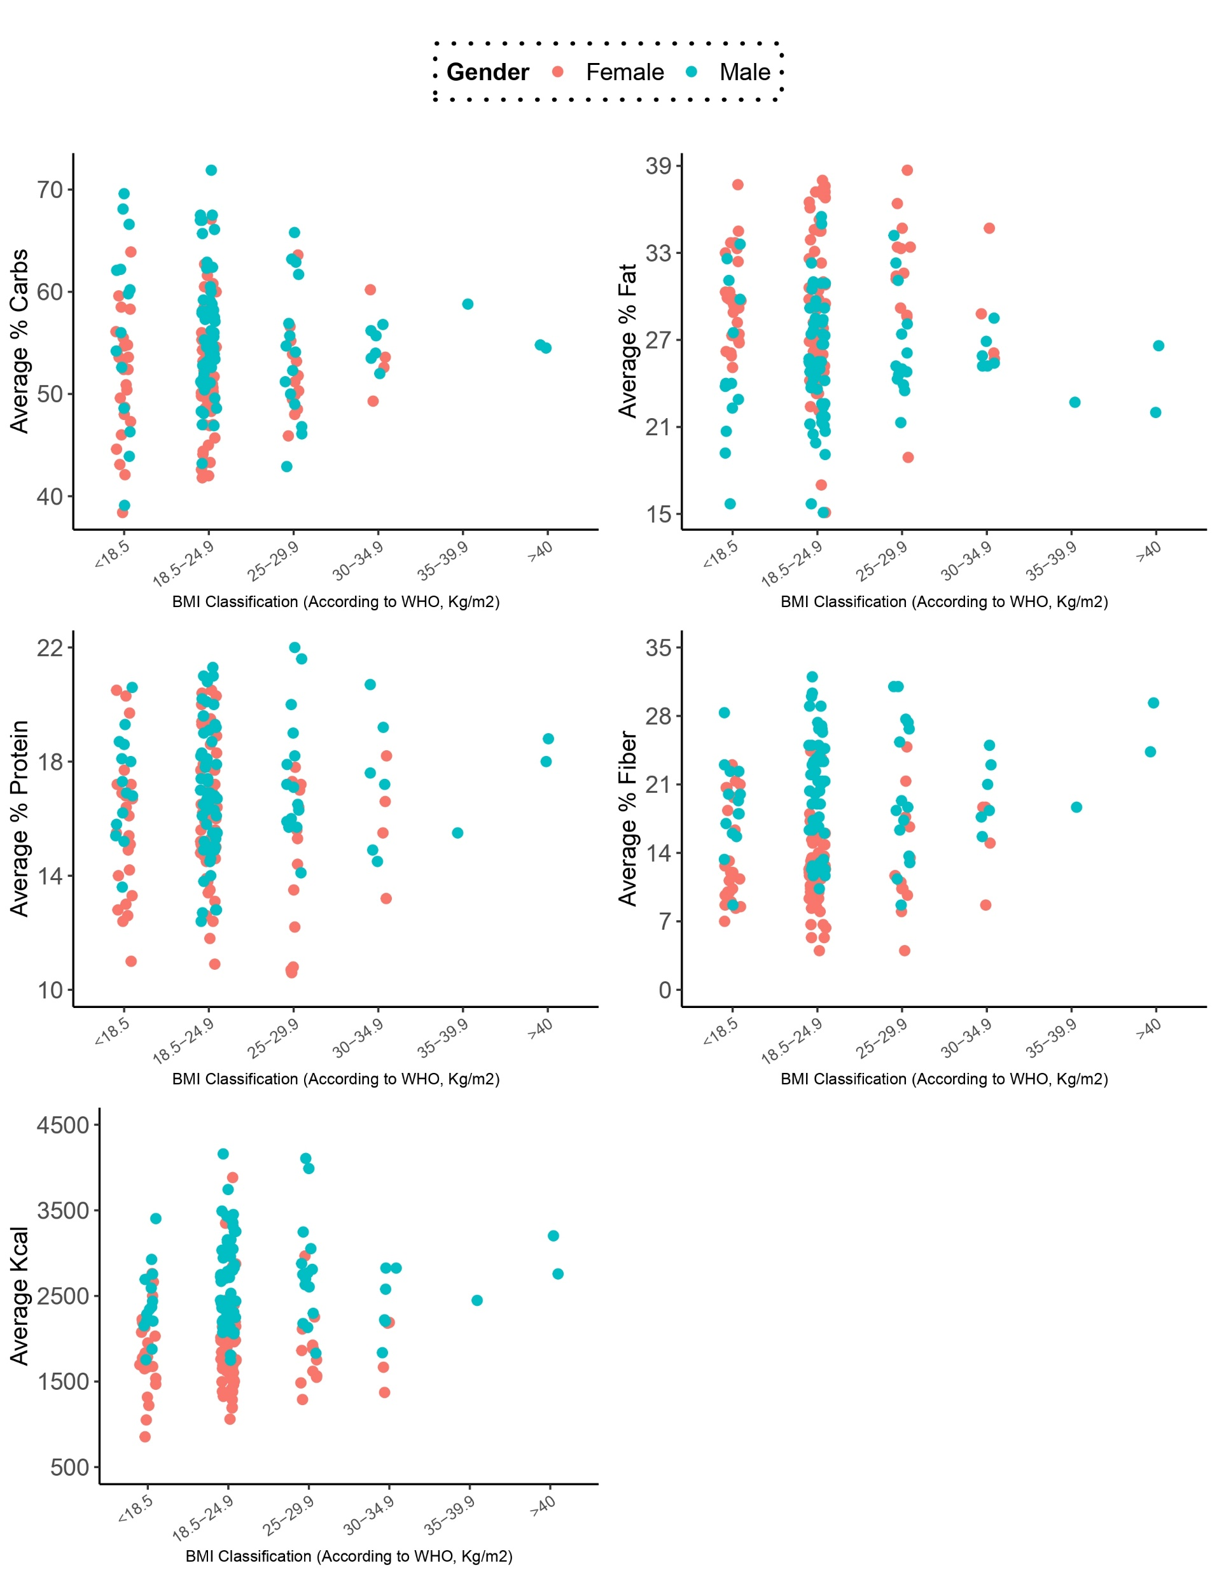
A
B
C
D
E

Slide 3
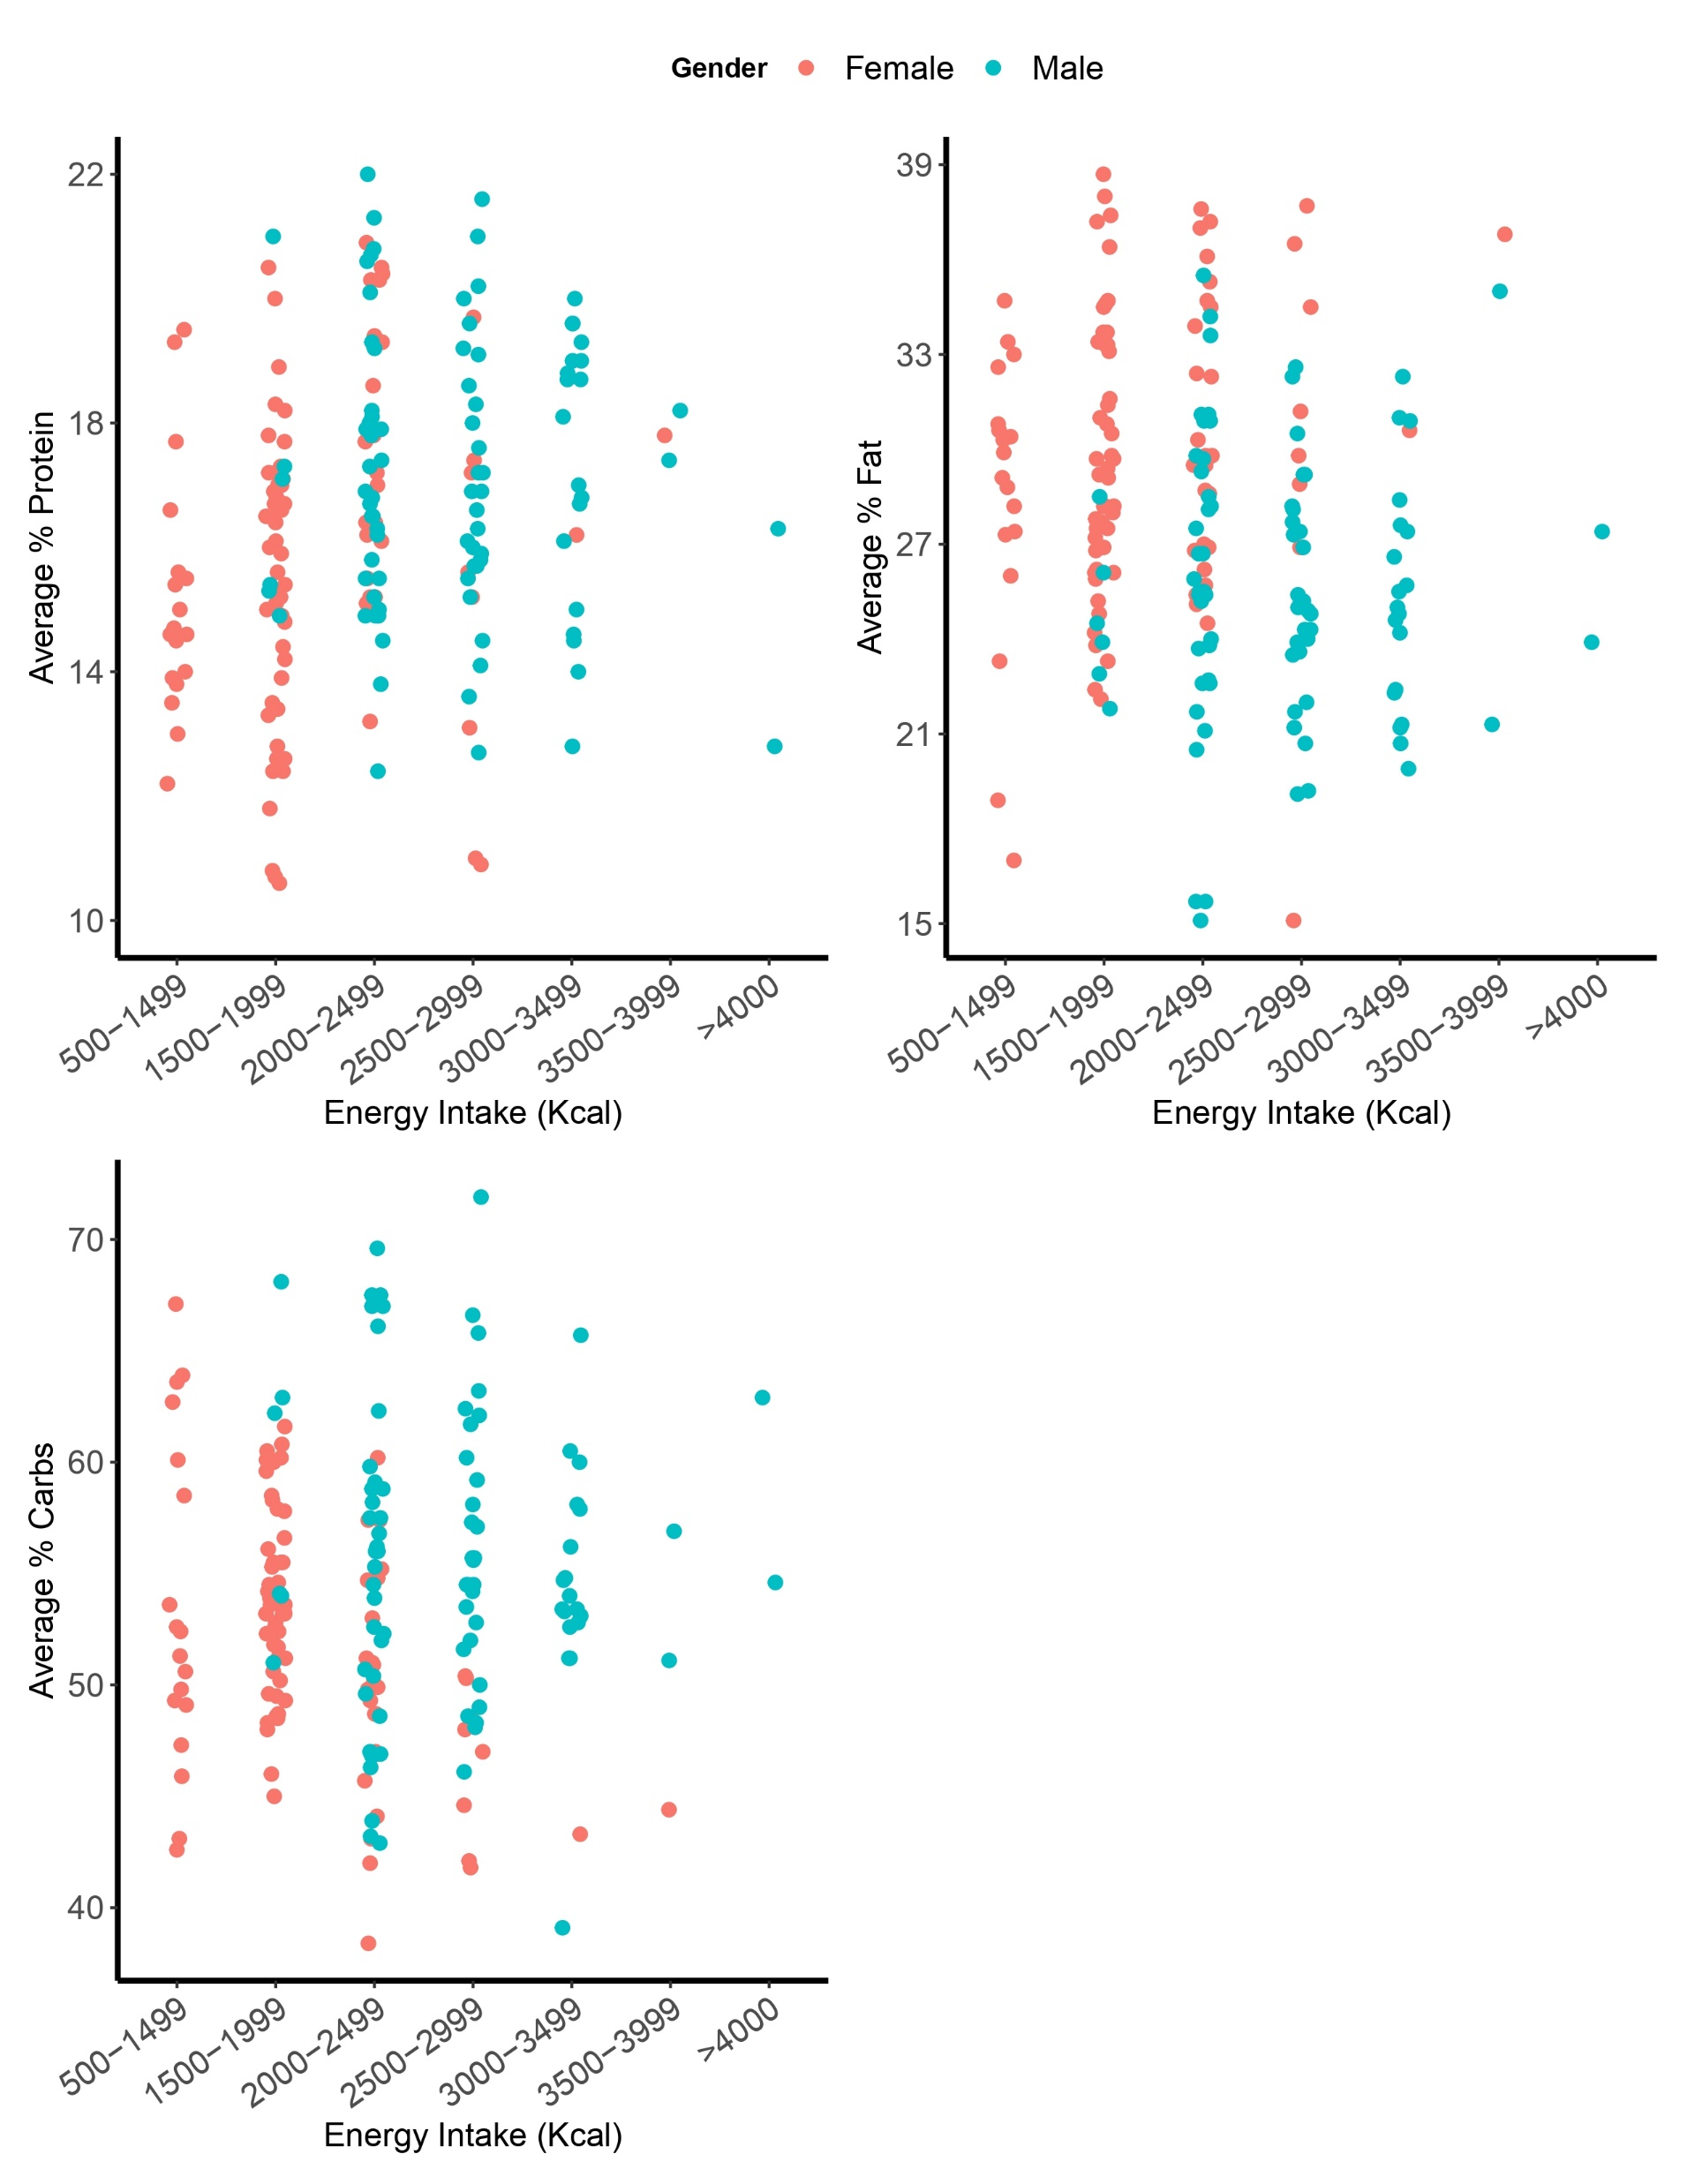
A
B
C

