Slide 1
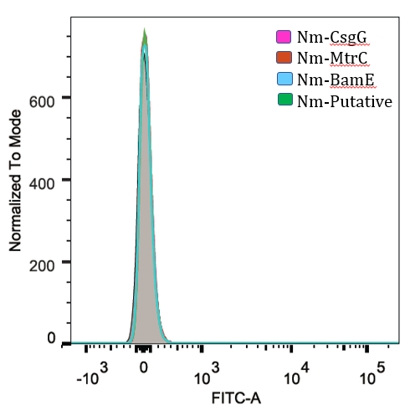
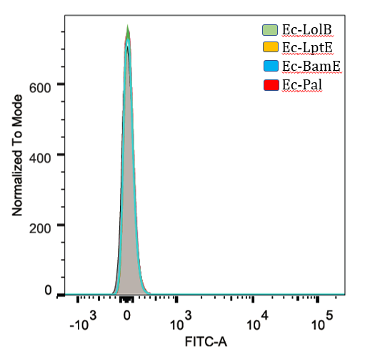
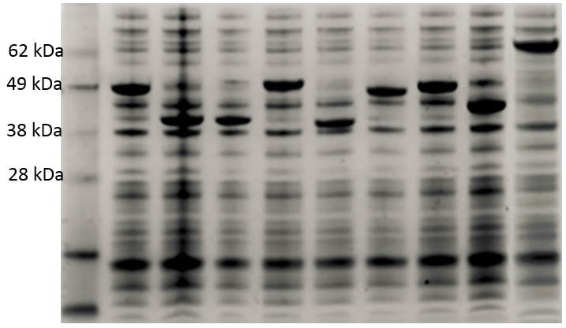
InaK-NC (FACS using FLAG antibodies)
InaK-NC
37 °C
37 °C
B
C
25 °C
25 °C
25 °C
A
-Marker
-INP-NmCsgG
-INP- NmBamE
4-INP-Nmputative lipoprotein
5-INP –EcLolB
6-INP-EcBamE
7-INP-EcLptE
8- INP -EcPal
9-INP-NmMtrC
D
E
Lane:
1
2
3
4
5
6
7
8
9

