Slide 1
Supplementary Information
Heparin CX-01 promotes adipogenesis and counteracts liposarcoma dedifferentiation
Cinzia Lanzi, Enrica Favini, Laura Dal Bo, Monica Tortoreto, Stefano Percio, Valentina Zuco, Gian Paolo Dagrada, Silvia Brich, Paola Collini, Loris De Cecco, Dario Callegaro, Roberta Sanfilippo, Alessandro Gronchi, Nadia Zaffaroni, Sandro Pasquali, Giuliana Cassinelli

Slide 2
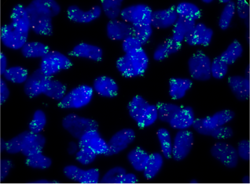
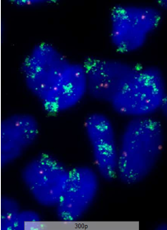
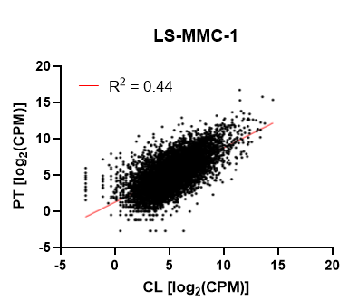




Supplementary Figure S1 Lanzi et al.
A
LS-MMC-1
MDM2/Centromere 12
B
C
LS-MMC-1
LS-GD-1
LS-BZ-1
MDM2
vinculin
CDK4
vinculin
pFRS2
FRS2
vinculin

Slide 3





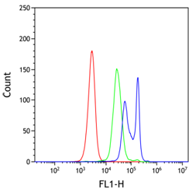
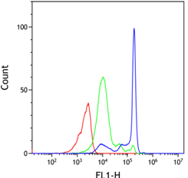
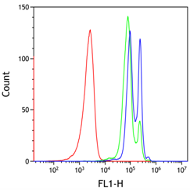

Supplementary Figure S2 Lanzi et al.
A
C
Soft agar assay
LS-BZ-1
LS-GD-1
LS-MMC-1
LS-BZ-1
LS-GD-1
- +
- +
- +
ssLMWH
100
adiponectin
100
actin
80
80
SREBP1 (m)
60
colonies
(% of control)
****
60
actin
40
40
****
20
20
D
0
-
ssLMWH
0
-
ssLMWH
LS-BZ-1
LS-GD-1
B
- +
- +
ssLMWH
Bodipy staining
unstained
control
ssLMWH
pMet
Met
LS-BZ-1
LS-GD-1
LS-MMC-1
vinculin
5d
3d
6d
pERK
ERK
pAKT
AKT
actin

Slide 4
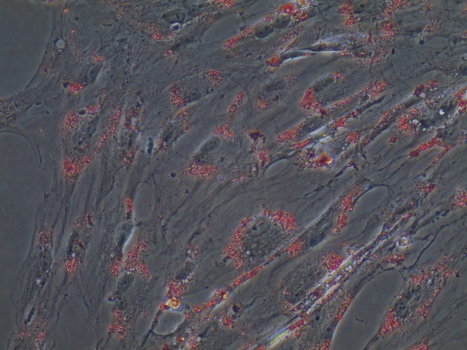
Supplementary Figure S3 Lanzi et al.
A
LS-BZ-1
LS-GD-1
control
SU11274
B
LS-BZ-1
LS-GD-1
LS-MMC-1
control
perifosine

Slide 5
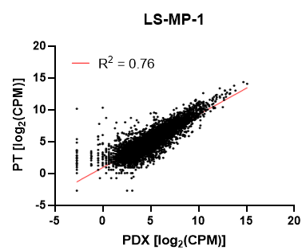

Supplementary Figure S4 Lanzi et al.
A
B
C
LS-MP-1-PDX
PDX
LS-MP-1
LS-BZ-1
H&E
MDM2
CDK4
vinculin
MDM2
FRS2
actin

Slide 6
Supplementary Figure S5 Lanzi et al.
A
B
LS-BZ-1
LS-MMC-1
4
days
3
6
days
- + CX-01
- + - + CX-01
pSMAD2
pSMAD2
SMAD2
SMAD2
vinculin
vinculin
C
LS-BZ-1
D
LS-MMC-1
4
5
days
3
4
5
6
days
- + - + CX-01
- + - + - + - + CX-01
TIMP-1
TIMP-1
vinculin
vinculin

Slide 7
Supplemental Table 2. Leading Edge Genes of statistically significant GSEA of RNA-seq data comparing whole transcriptomes of tumor samples from control and LS-BZ-1 PDX treated with CX-01.
 | LEADING EDGE GENES | Additional DEGs involved in the process/pathway
HALLMARK GENE SETS
Adipogenesis | STOM, NDUFS3, NDUFAB1, ARL4A, MTCH2, CMPK1, DNAJC15, PRDX3, DHRS7B, UQCR11, UCP2, CHUK, CD36, CYC1, NDUFB7, SDHC, MGST3, NDUFA5, COQ3, ATP1B3, ATL2, AK2, PPARG, SDHB, IFNGR1, SLC66A3, COX6A1, UQCR10, MRPL15, COX7B, SOD1, SCP2, MTARC2, COX8A, CD302 | SDC1, FGF2, TIMP1, FN1, MYLK, MYH3, TNFSF12, FABP5
Fatty acid metabolism | H2AZ1, CBR1, ODC1, PTS, SDHD, PCBD1, PDHB, ECI2, BPHL, ACOT8, MIX23, CD36, SDHC, MDH1, NTHL1, CBR3, ELOVL5, S100A10, HSDL2, CRYZ, YWHAH, MAOA, HCCS, AUH, ADSL, UROD, UROS, ACAT2, SUCLG1, BLVRA, SUCLA2, ALDH3A2, ENO3, NCAPH2, ACAA1, GLUL RAP1GDS1, GCDH
Inflammatory response | IRAK2, RELA, MMP14, ICAM1, NFKBIA, NFKB1, CSF1, CD82, TNFRSF1B, RHOG, EDN1, IRF1, OSMR, RIPK2, ATP2A2, NAMPT, PLAUR, SLC11A2, SLC4A4, AHR, LPAR1, TLR3, SLC7A1, TIMP1, TAPBP, BEST1, LIF, LDLR, CXCL8, IL1R1, IL4R, PSEN1, ADRM1, ITGA5, MYC, ABI1, TPBG, IRF7, SLC1A2, HBEGF, SELENOS, DCBLD2 | CXCL1, PTGS2, NFKB2, C1QTNF1, NFKBIZ, IL32, TNFSF4, RELB, BCL3
TGF beta signaling | NCOR2, LTBP2, HIPK2, TJP1, SMAD7, SPTBN1, WWTR1, SMURF1, ENG, JUNB, SMAD6, SMURF2, BMPR2, CDK9, ID3, ARID4B, SKI, SKIL, SLC20A1, PPP1R15A, XIAP, SERPINE1 | TGFBR2, LRRC32, MMP14, TIMP1
OTHER GENE SETS
WANG et. al. [35] Secreted protein coding genes | FN1, EMILIN1, THBS2, FBN1, PLAUR, TRIO, COL5A1, TIMP1, ECM1, P4HA2. MMP14
PID syndecan-1 pathway | BSG, CASK, CCL5, COL10A1, COL11A1, COL11A2, COL12A1, COL13A1, COL14A1, COL15A1, COL16A1, COL17A1, COL1A1, COL1A2, COL2A1, COL3A1, COL4A1, COL4A3, COL4A4, COL4A, COL4A6, COL5A1, COL5A2, COL6A1, COL6A2, COL6A3, COL7A1, COL8A1, COL8A2, COL9A1, COL9A2, COL9A3, HGF, HPSE, LAMA5, MAPK1, MAPK3, MET, MMP1, MMP7, MMP9, PPIB, PRKACA, SDC1, SDCBP, TGFB1
REACTOME syndecan-1 interactions | ACTN1, CASK, COL1A1, COL1A2, COL3A1, COL5A1, COL5A2, COL5A3, FGF2, FN1, ITGA2, ITGA6, ITGAV, ITGB1, ITGB3, ITGB4, ITGB5, PRKCA, SDC1, SDC2, SDC3, SDC4, TGFB1, THBS1, TNC, TRAPPC4, VTN
Blue, genes downregulated by treatment; red, genes upregulated by treatment; bold, genes shared in multiple gene sets

Slide 8
Supplementary Figure Legends
Suppl. Fig. 1. Characterization of the novel DDLPS cell line LS-MMC-1. A) Left panel, G banded metaphase spread from cultured LS-MMC-1 cells showing hyperdiploidy and giant chromosomes (red arrows). Right panel and inset, interphase nuclei from LS-MMC-1 cells hybridized with MDM2 (Spectrum Green) and centromere 12 (Spectrum Orange) probes showing large clusters of amplified MDM2 gene copies. DAPI counterstaining highlights nuclei. B) Western blots showing MDM2, CDK4 and FRS2 expression levels along with FRS2 phosphorylation in DDLPS cell lines. Anti-vinculin blots are shown as loading controls. C) Scatter plot showing correspondence of the RNA-Seq transcriptomic profiles between the patient’s primary tumor (PT) and the LS-MMC-1 cell line (CL). Linear model trend (red line) and Spearman’correlation coefficient (r_{s} = 0.65, P<0.0001) were calculated).
Suppl. Fig. 2 Super sulfated low molecular weight heparin (ssLMWH) inhibits DDLPS cell anchorage-independent growth and promotes adipocytic differentiation. A) Soft agar assay. Cells were seeded in soft agar and incubated in the presence or absence of 1 mg/ml ssLMWH for 7-10 days, Colonies were then stained with a vital dye and counted under a magnifying projector. Average data ± SE from three independent experiments, performed in duplicate, are shown. ****, P < 0.0001, drug-treated vs untreated cells. B) Lipid staining. Control and 0.5 mg/ml ssLMWH-treated cells were collected at the indicated times and incubated with BODIPY 493/503 for lipid content quantification by FACS. Histograms show a prevalent accumulation of neutral lipids in drug-treated cells. C) and D) Adipogenic marker induction and c-Met signaling inhibition. Cells were exposed to 1 mg/ml ssLMWH for 48h, then lysed and processed for Western blot analysis with the indicated antibodies. Blots show induction of adiponectin and mature SREBP1(m) (C) and inhibition of Met-ERK-AKT pathway (D) in treated cells. Blots are representative of at least two independent experiments.
Suppl. Fig. 3. The c-Met kinase inhibitor SU11274 and the AKT inhibitor perifosine enhance lipid content in DDLPS cells. A) Representative images of Oil Red O (ORO) stained cells exposed to solvent (control) or 10 uM SU11274 for 24h (original magnification 20x). B) Representative images of ORO stained cells exposed to solvent (control) or 20 uM perifosine for 72h (original magnification 40x).

Slide 9
Suppl. Fig. 4
Characterization of the novel DDLPS PDX model LS-MP-1. A) Representative pictures showing LS-MP-1 PDX histology revealed by H&E staining, and MDM2 protein detected by immunohistochemistry. B) Scatter plot showing correspondence of the RNA-Seq transcriptomic profiles between the patient’s primary tumor (PT) and the LS-MP-1 PDX. Linear model trend (red line) and Spearman’correlation coefficient (r_{s} = 0.88, P<0.0001) were calculated. C) Western blots showing MDM2, CDK4, FRS2 protein levels in LS-BZ-1 and LS-MP-1 PDXs. Actin, and vinculin blots are shown as loading controls. Representative blots from two independent experiments are shown.
Suppl. Fig. 5. CX-01 treatment inhibits phosphorylation of the TGFβ effector SMAD2 (A, B) and reduces TIMP1 levels (C, D) in DDLPS cells. LS-BZ-1 and LS-MMC-1 cells were exposed to 1 mg/ml CX-01 for 72h, then medium was replaced and drug treatment repeated. Days from the first treatment are indicated. Representative blots from two independent experiments are shown.

Slide 10
SUPPLEMENTARY MATERIALS AND METHODS
In vitro assays
For the anchorage-independent growth assay, cells, seeded at 1000-3000 cells/cm², were grown in semi-solid agar in the presence or absence of the drug. After 7-14 days, colonies were stained with vital dye and counted under a magnifying projector as previously described [22].
For the invasion assay, cells, pretreated with the indicated drug in complete medium for 24h, were harvested and transferred to the upper chamber of 24-well Transwell plates (Costa, Corning Inc., Corning, NY, USA) previously coated with Growth Factor Reduced Matrigel (Suppl. Table. 1) (6–18 x 10⁴ cells/filter, according to the spontaneous invasive ability). The same drug concentration used for cell pretreatment was added to both the upper and lower chambers. Where indicated, human recombinant growth factors were added into the lower chamber at 50 ng/ml (Suppl. Table 1). After 24h, cells that invaded Matrigel were stained with sulforhodamine B and counted under an inverted microscope as described [21]. Alternatively, cells (20000 cells/well) were layered onto Matrigel-coated wells (8.1 µg/ml) in 48-well plates in serum free medium for the branching morphogenesis assay. Photos were taken 8h later by using EVOS XL CORE (Invitrogen, Carlsbad, CA).
For quantification of neutral lipid content, cells, exposed to drugs as indicated, were subjected to BODIPY™ 493/503 staining (Suppl. Table 1) according to the manufacture’s instruction. Cells were then harvested and analyzed by flow cytometry using the BD Accuri C6 instrument (Becton, Dickinson, Franklin Lakes, NJ). Data were elaborated using the Kaluza Analysis Software (version 2.1.00002.20011) (Beckman Coulter Life Science, Brea, CA). Alternatively, to avoid interference by small molecule autofluorescence (e.g. SU11274), neutral lipid content was detected by Oil Red O (ORO) staining (Suppl. Table. 1). According to the manufacturer’s protocol, cells treated as indicated were fixed and stained with the dye solution. After cell photo capture by microscope EVOS XL CORE, the dye was dissolved in isopropanol and samples read at 490 nm with iMark microplate reader (Biorad, Hercules, CA). OD readings were corrected for sample protein content (experiments with SU11274, perifosine) or cell number (experiments with OGT2115) measured in parallel.

Slide 11
Biochemical analyses and Western blotting
Proteomic profiling of phosphorylated RTKs in DDLPS cells was performed by using the Human phospho-RTK array kit ARY001B (R&D system, Minneapolis, MN) according to the manufacturer’s instructions.
For biochemical analyses, exponentially growing cells were seeded in complete medium and the day after treated with drugs at the indicated concentrations and exposure times. Total cell protein extraction and Western blotting were performed as previously described in detail [22]. Antibodies used are listed in Suppl. Table 1. Otherwise, Western blot analysis was performed on lysates from frozen PDX tumors analogously processed after pulverization by the Mikro-Dismembrator II (B. Brown Biotech International, Melsungen, Germany) [27]. The densitometric analysis on blots was done using Image J 1.46 R (https://imagej. net).
Immunofluorescence microscopy
Cells growing on coverslips were fixed in 2% paraformaldehyde for 15 min and permeabilized in 70% ethanol at -20°C for 20 min. After blocking in 1% BSA in PBS for 1 h, cells were incubated with primary anti-beta tubulin (1:500) or -vimentin (1:50) antibody followed by secondary Alexa Fluor 488 or 594 (1:500) anti-mouse antibody. Alternatively, slides were incubated with Fluorescein Isothiocyanate Labeled Phalloidin (1:500). Nuclei were counterstained with Hoechst 33342. Slides, mounted with Prolong, were examined by a fluorescence microscope equipped with digital camera. Suppliers’ details for antibodies and reagents are listed in Suppl. Table S1.
FISH, histological and immunohistological analyses
The novel LS-MMC-1 cell line was subjected to cytogenetic and FISH analyses for diagnostic confirmation by a sarcoma-dedicated cytogeneticist. FISH was carried out on interphase nuclei from cultured cells using the the ZytoLight SPEC MDM2/CEN 12 Dual Color Probe (PL18) (ZytoVision GmbH, Bremerhaven, Germany). Slides were scored with a Leica DM 6000B (Wetzlar, Germany) microscope at ×1000 magnification and the appropriate fluorescence filters. The images were captured using Cytovision software (v. 7.0, Leica, Wetzlar, Germany).
For morphological analysis and MDM2 expression evaluation, 4 µm sections of LS-MP-1 PDX formalin-fixed paraffin-embedded (FFPE), were stained with hematoxylin and eosin (H&E) and immunostained w ith anti-MDM2 antibody (Ab-1, mAb, IF2, Calbiochem, San Diego, CA #OP46, dilution 1:40).

Slide 12
Supplementary Table 1
Name | Manufacturer | Catalog. N° | RRID
Mouse monoclonal antibodies
Syndecan (A-6) | Santa Cruz Biotechnology, Santa Cruz, CA | sc-390791
tubulin | Sigma-Aldrich, St. Louis, MO | T-4026 | AB_477577
GAPDH | Sigma-Aldrich, St. Louis, MO | G8795 | AB_1078994
vinculin | Sigma-Aldrich, St. Louis, MO | V-9264 | AB_10603627
Adiponectin | Abcam, Cambridge, UK | Ab22554 | AB_447152
MET (25H2) | Cell Signaling Technology, Beverly, MA | 3127 | AB_331361
AKT | BD Transduction, Lexington, KY | 610861 | AB_398180
CDK4(DCS-35) | Santa Cruz Biotechnology, Santa Cruz, CA | 23896 | AB_627239
HistoneH4 | Cell Signaling Technology, Beverly, MA | 2935 | AB_1147658
MDM2 (SMP-14) | Santa Cruz Biotechnology, Santa Cruz, CA | sc-965 | AB_627920
Rabbit monoclonal antibodies
FABP4 | Abcam,Cambridge,UK | Ab 92501 | AB_10562486
Phospho-MET (Y1234/1235) | Cell Signaling Technology, Beverly, MA | 3077 | AB_2143884
TIMP-1 (D10E6) | Cell Signaling Technology, Beverly, MA | 8946 | AB_10891805
Vimentin (for IF) | Dako, Agilent, Santa Clara, CA | M0725 | AB_10013485
Rabbit polyclonal antibodies
actin | Sigma-Aldrich, St. Louis, MO | A 2066 | AB_476693
phospho-p44/42MAP Kinase (Thr202/Tyr204) | Cell Signaling Technology, Beverly, MA | 9101 | AB_331646
p44/42 MAPK | Cell Signaling Technology, Beverly, MA | 9102 | AB_330744
phospho-Akt (Ser473) | Cell Signaling Technology, Beverly, MA | 9271 | AB_329825
acetyl histone H4 (Lys12) | Cell Signaling Technology, Beverly, MA | 2591 | AB_2118617
SREBP1 | Abcam, Cambridge, UK | Ab 28481 | AB_778069
Phospho-FRS2(Y436) | R&D system, Minneapolis, MN | AF 5126 | AB_2106234
FRS2(H81) | Santa Cruz Biotechnology, Santa Cruz, CA | sc8318 | AB_2106228
Phospho-GSK3 α/β (ser21/9) | Cell Signaling Technology, Beverly, MA | 9331 | AB_329830
GSK3 β | Santa Cruz Biotechnology, Santa Cruz, CA | sc9166 | AB_647604
PSMAD2 (S465/467) | Cell Signaling Technology, Beverly, MA | 3108 | AB_490941
SMAD2 | Cell Signaling Technology, Beverly, MA | 5339 | AB_10626777
Secondary antibodies
Anti-mouse IgG HRP-linked | Cell Signaling Technology, Beverly, MA | 7076 | AB_330924
Anti-rabbit IgG HRP-linked | Cell Signaling Technology, Beverly, MA | 7074 | AB_2099233
Goat anti-Mouse IgG (H+L) Superclonal™ Secondary Antibody, Alexa Fluor™ 488 | Invitrogen, Waltham, MA | A28175 | AB_2536161
Goat anti-Mouse IgG (H+L) Cross-Adsorbed Secondary Antibody, Alexa Fluor™ 594 | Invitrogen, Waltham, MA | A11005 | AB_2534073

Slide 13
Drugs/Reagents | Manufacturer | Catalog. N°.
SU11274 | SelleckChem, Houston, TX | S1080
OGT2115 | Santa Cruz Biotechnology, Dallas, TX | sc-204144A
Perifosine | SelleckChem, Houston, TX | S1037
HGF | Sigma, St. Louis, MO | H1404
bFGF | Peprotech, Rocky Hill, NJ | 100-18B
BODIPY™ 493/503 | Molecular Probes, Eugene, OR | D3922
Oil Red O (ORO | ScienCell, Carlsbad, CA | 0843a
Prolong TM Gold antifade | Invitrogen, Waltham, MA | P10144
Hoechst 33342 | Invitrogen, Waltham, MA | H3570
sulforodhamine B (SRB) | Sigma, St. Louis, MO | S-9012
Growth Factor Reduced Matrigel | BD Biosciences, San Jose, CA | 356231
siRNA
Name | Sequence (5’-3’) | Manufacturer | Catalog. N°.
siSDC1-1 | (sense GGAGGAAUUCUAUGCCUGAtt) (antisense UCAGGCAUAGAAUUCCUCCtg) | Ambion, Austin, TX | 12527
siSDC1-2 | (sense GCAGGUGCUUUGCAAGAUAtt) (antisense UAUCUUGCAAAGCACCUGCac) | Ambion, Austin, TX | s12634
siSDC1-3 | (sense CCAUUCUGACUCGGUUUCUtt) (antisense AGAAACCGAGUCAGAAUGGtg) | Ambion, Austin, TX | 142557
Negative control siRNA (Silencer Select #2) |  | Invitrogen, Waltham, MA | 4390846
Assay
Assays
Name | Manufacturer | Catalog. N°
GAPDH PrimeTime Std qPCR assay | Integrated DNA Technologies, IDT, Coralville, IA | 235728378
SDC1 PrimeTime Std qPCR assay | Integrated DNA Technologies, IDT, Coralville, IA | 235728382

