Slide 1
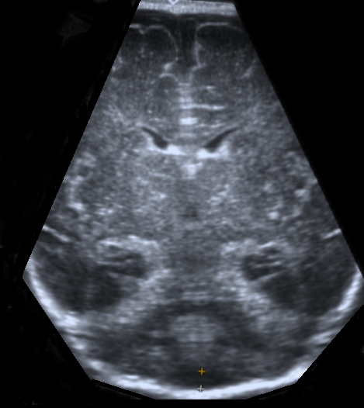

Ultrasonographic Assessment of Subarachnoid Space Dimensions in Healthy Infants: Normative Data for the First Three Months of Life
Subarachnoid Space Measurements According to Age
Age | Right frontal side (mm) |  | Left frontal side (mm) |  | Mean CCW | Mean SCW | IHW | CMW
 | CCW | SCW | CCW | SCW
0 - 28 days | 1.17 ± 0.34 (0.5 - 2.0) | 2.01 ± 0.66 (0.9 - 3.4) | 1.35 ± 0.52 (0.7 - 3.0) | 2.05 ± 0.72 (0.9 - 3.7) | 1.26 ± 0.34 (0.8 - 2.3) | 2.03 ± 0.61 (1.0 - 3.3) | 2.10 ± 0.80 (1.0 – 4.1) | 3.21 ± 1.27 (1.2 – 6.0)
1 - 2 months | 1.60 ± 0.56 (0.5 - 3.0) | 2.40 ± 0.81 (0.7 – 4.9) | 1.85 ± 0.70 (0.9 - 3.7) | 2.57 ± 0.80 (0.8 – 4.0) | 1.72 ± 0.56 (0.7 - 3.3) | 2.49 ± 0.71 (0.9 – 4.1) | 2.36 ± 0.93 (0.5 – 4.8) | 3.18 ± 1.14 (1.3 – 6.8)
2 - 3 months | 2.39 ± 1.06 (1.1 - 4.2) | 2.70 ± 1.08 (1.3 – 5.2) | 2.24 ± 0.91 (1.1 - 4.7) | 3.01 ± 1.11 (1.4 – 5.1) | 2.31 ± 0.87 (1.1 - 4.4) | 2.85 ± 0.96 (1.6 – 4.9) | 2.78 ± 1.05 (1.2 – 5.1) | 4.27 ± 1.12 (2.1 – 5.7)
A
B
(A)Ultrasonographic coronal section at the level of the foramen of Monro (black arrow), demonstrating the craniocortical width (CCW, white line), sinocortical width (SCW, single white arrow), and interhemispheric width (IHW, double white arrows).
(B) Ultrasonographic coronal section showing the cisterna magna width (CMW)
The availability of accurate and reliable estimates of subarachnoid dimensions may facilitate the early diagnosis and follow-up of infants with suspected enlargement of the subarachnoid space.
Notes:
Graphical Abstract for Original Research

