Slide 1

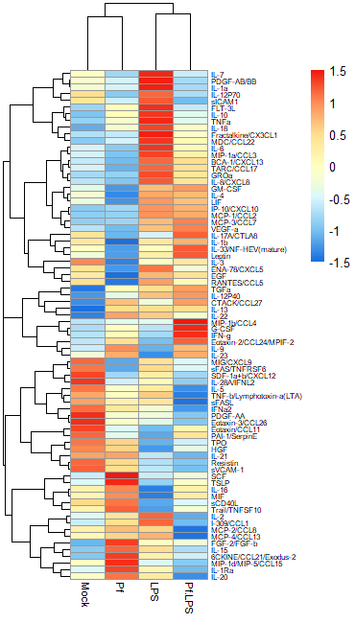


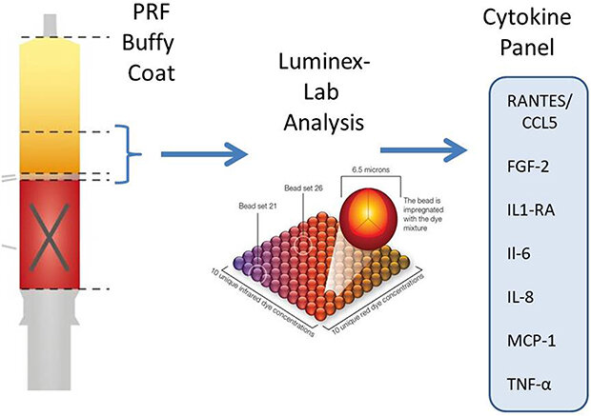
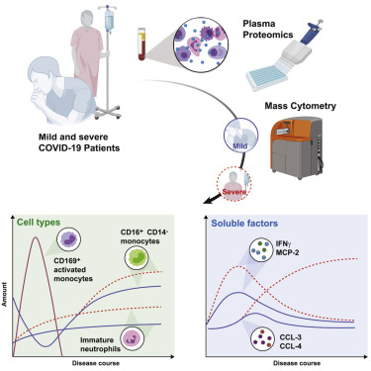
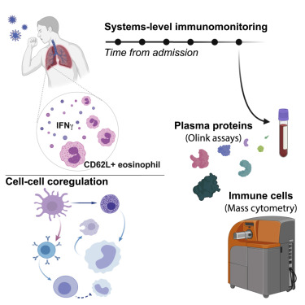
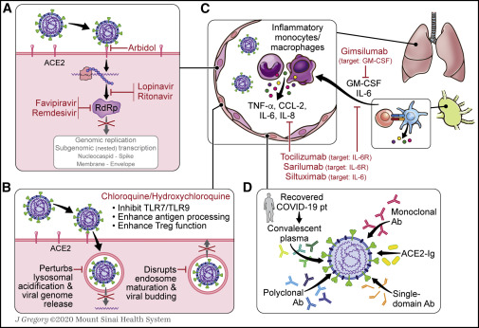
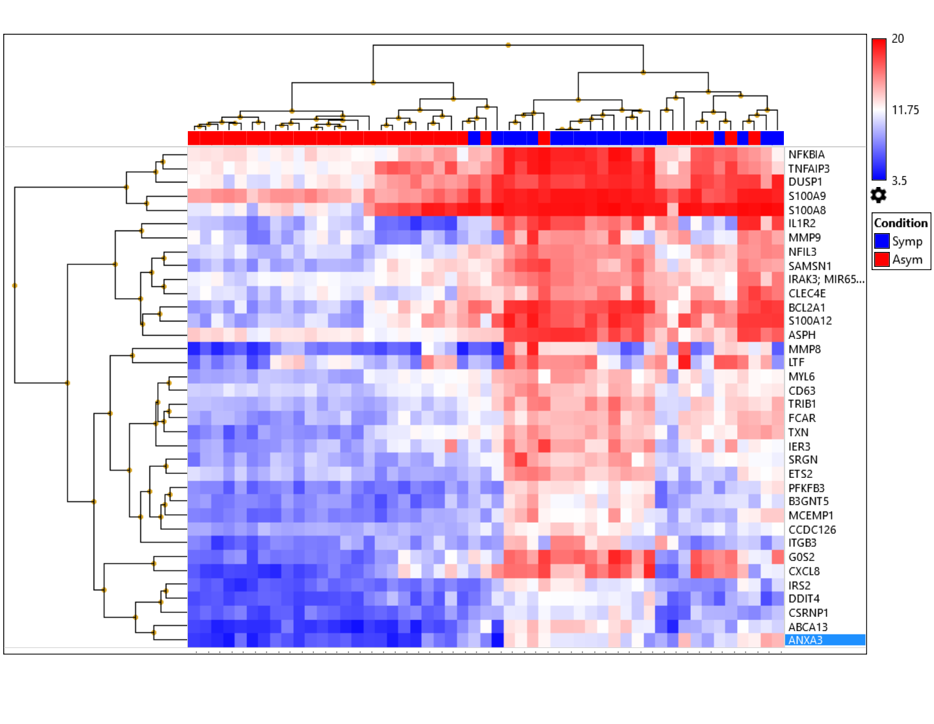
EC, IGRA-ve (n=22)
A
B
IGRA
Controls
No diabetes (n=51)
LTBI, IGRA+ve (n=29)
luminex multiplex cytokine Detection
DM, IGRA-ve (n=30)
IGRA
Those with diabetes (n=49)
DM-LTBI, IGRA+ve (n=19)
Transcriptomic analysis
S Fig 1.

Slide 2
S Fig 1. Scheme of the study. The flow chart depicts categorization of study subjects either normoglycemic or hyperglycemic individuals who were later screened by IGRA using the QuanTIFERON-Gold in tube assay to identify IGRA-ve and IGRA+ve individuals. Healthy Endemic controls (EC) were normoglycemic and IGRA negative. LTBI are normoglycemics who were IGRA positive. DM are diabetics, IGRA negative. DM-LTBI were IGRA positive individuals who had diabetes. A, Supernatants collected from IGRA assay tubes were measured for cytokines using the Luminex assay. B, RNA isolated from whole blood of study subjects was processed for testing using the Clariom S, RNA Microarray, Affymetrix Inc. Data were analysed using TACS software and GO biological pathways using R software.

Slide 3
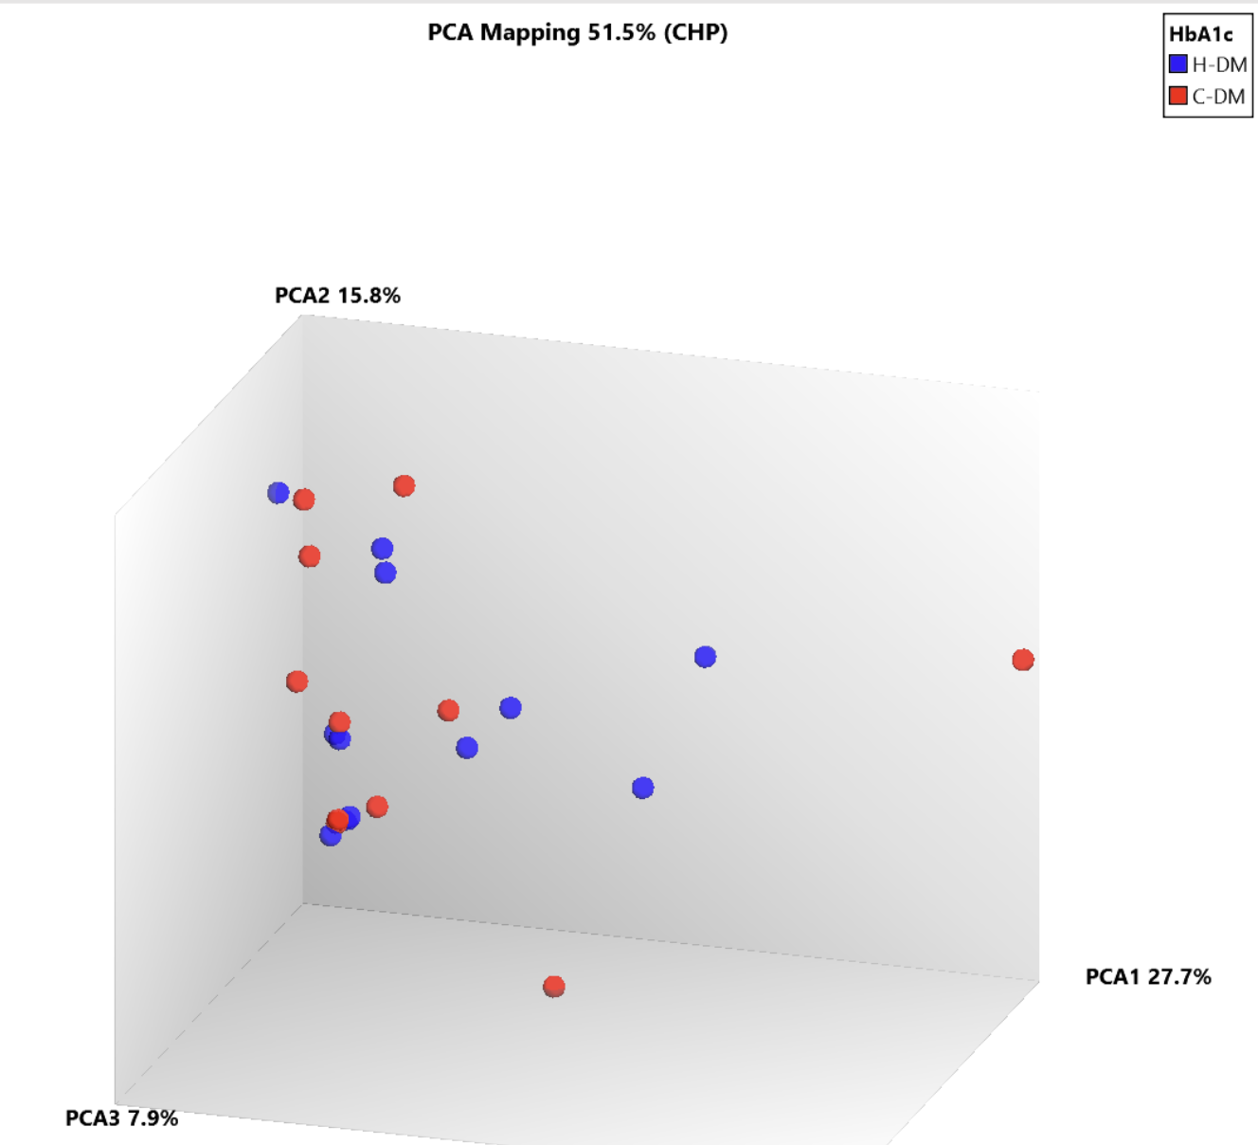
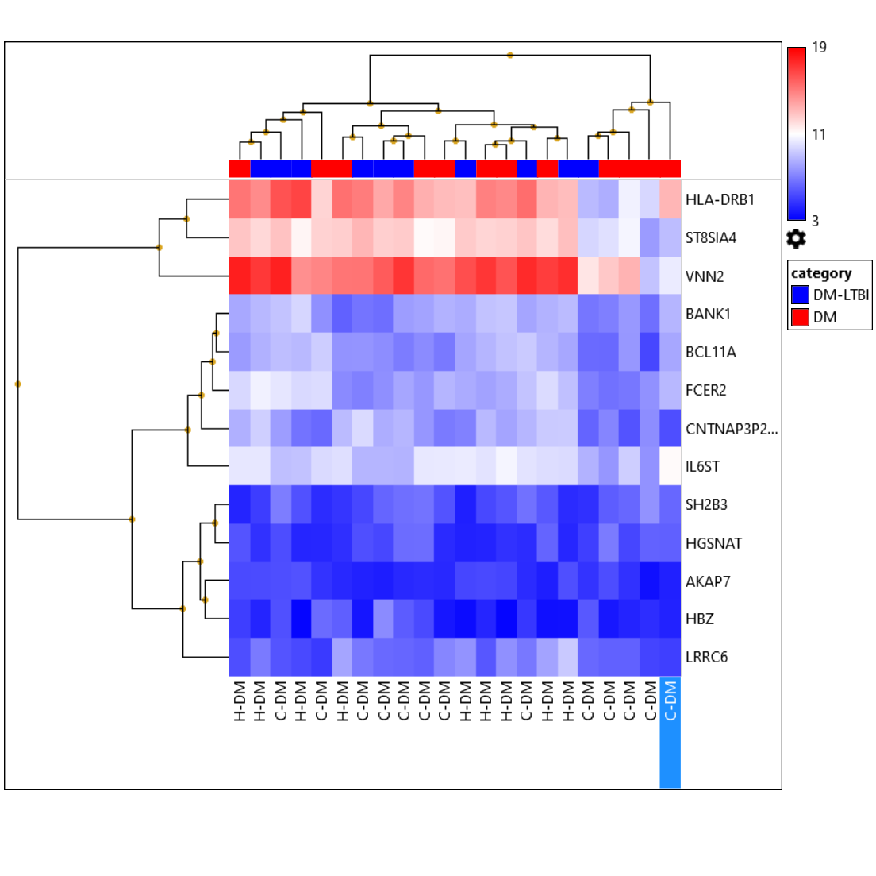
S Fig 2.
A. PCA B. Heatmap of DEGs

Slide 4
S Fig 2. Differentially regulated genes between those with uncontrolled versus controlled hyper-glycemia. Of the 22 study participants with diabetes we compared host blood transcripts between those with uncontrolled (H-DM, n=9) as compared with controlled (C-DM, n=13) hyperglycemia. 13 DEGs were identified with 10 Up- and 3 Down-DEGs. A, PCA analysis of depicts the profiles of transcripts in individuals with H-DM (blue dots) and C-DM (red dots). B. Unsupervised hierarchacial clustering shows DEGs identifying those with absolute fold change ≥ 2 or ≤ -2 and p <0.05. Range for DM stratification was; Controlled DM –HbA1c 6.4- 8%, Uncontrolled DM – HbA1c >8%.

Slide 5
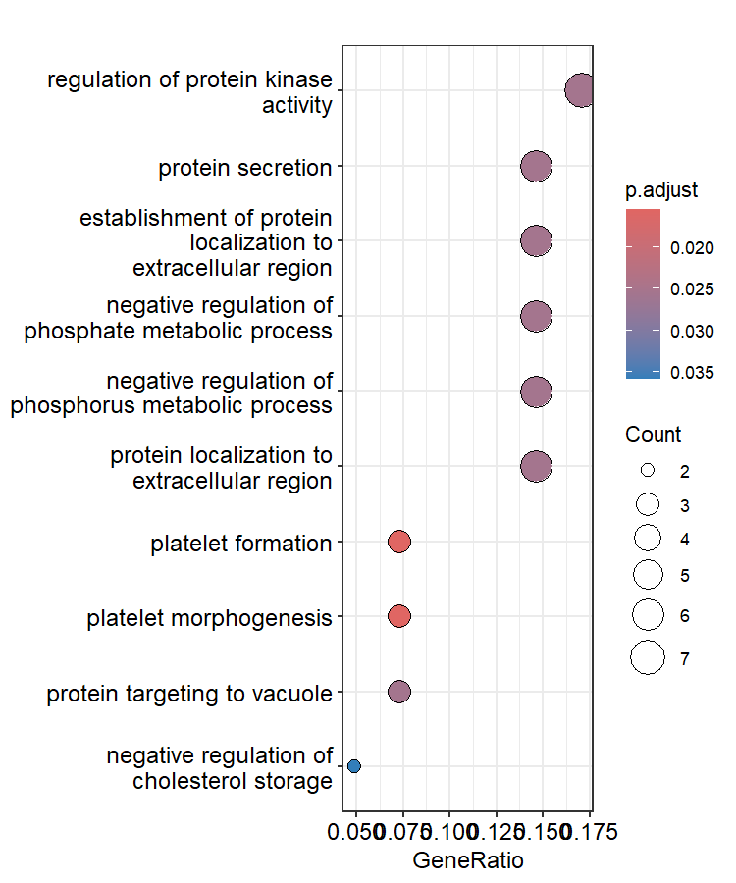
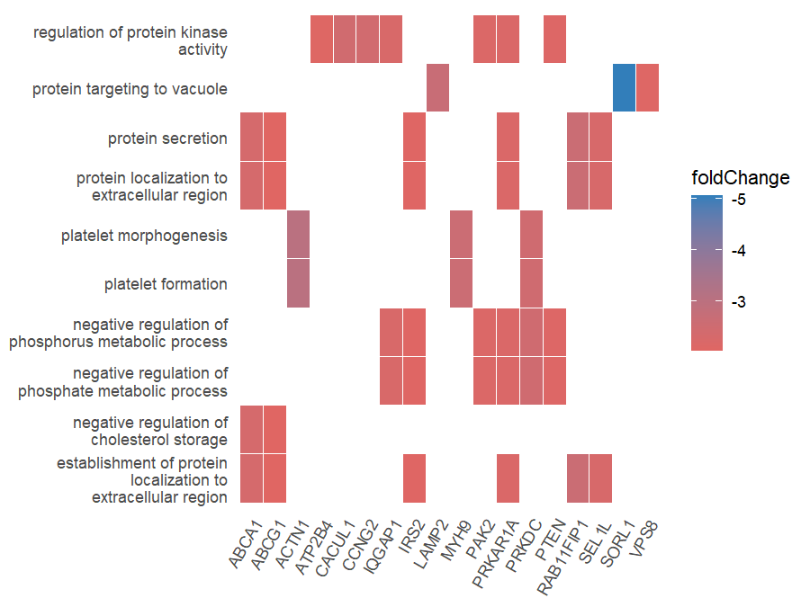
S Fig 3.
A. Enrich GO BP B. Heatmap of Enrich GO BP

Slide 6
S Fig. 3. Common overlap between downregulated cellular signaling and metabolic pathways in individuals with diabetes. We compared DEGs found in the DM/EC comparison with those found in (this study) against the reference study by Eckold et al.. 41 Down- DEGs found to be common between the two studies (Sup Table 3A) are analysed here. A, The top ten pathways affected were identified through Enrich GO biological pathway. B, Genes involved in the Enrich GO BP are illustrated through a heatmap.

Slide 7
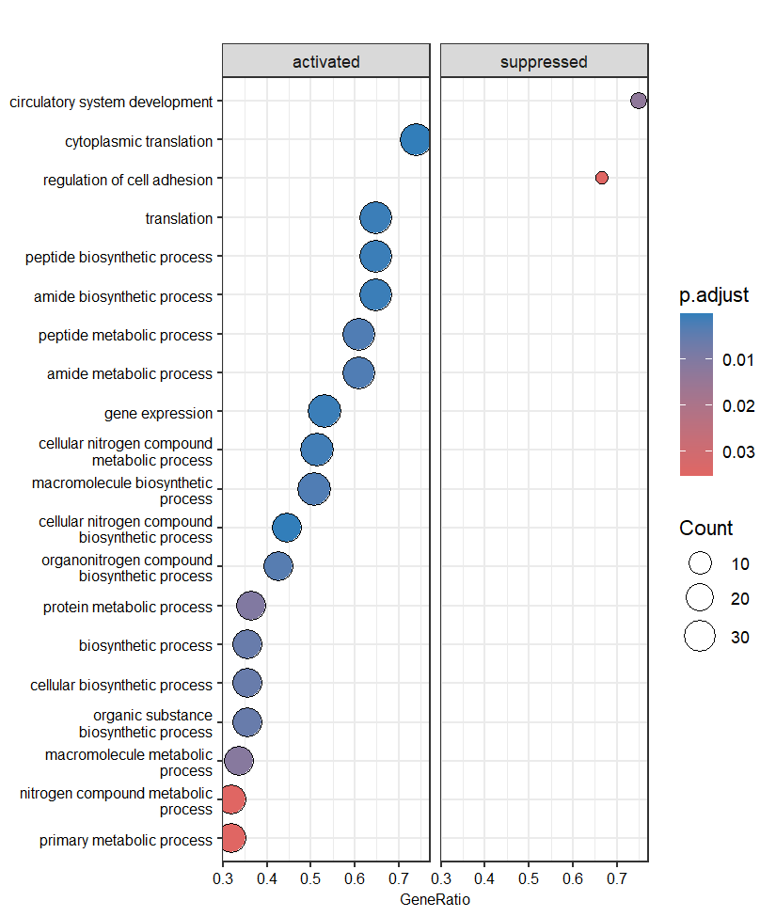
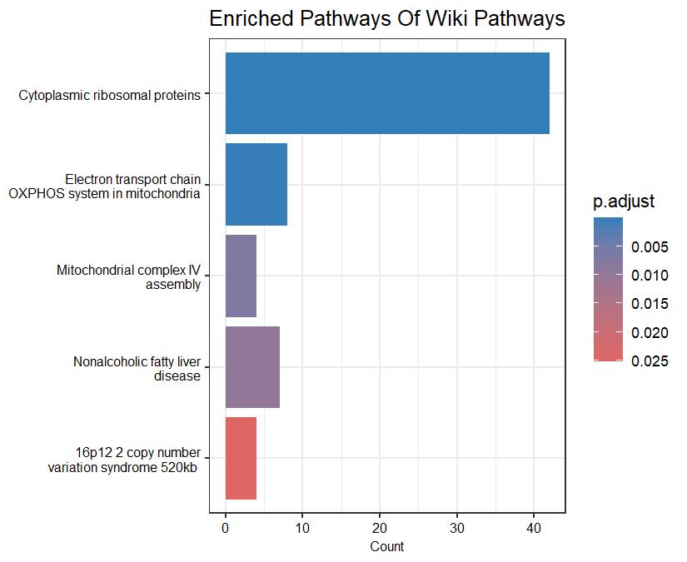
S Fig. 4. A. GSE GO-BP B. Enriched pathways of Wiki pathways heatmap

Slide 8
S Fig. 4. Common overlap between downregulation of cellular synthetic and metabolic processes in individuals with diabetes. We compared DEGs found in the DM-LTBI/LTBI comparison with those found in (this study) and of the reference study by Eckold et al.. 100 common DEGs were found, with 13 Down- and 87 Up- genes between the two studies (Sup Table 3A) are analysed here. A, GSE GO biological pathways. B, Enriched analysis of Wiki pathways.

