Slide 1
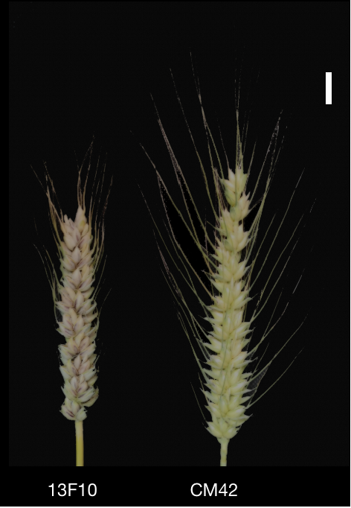
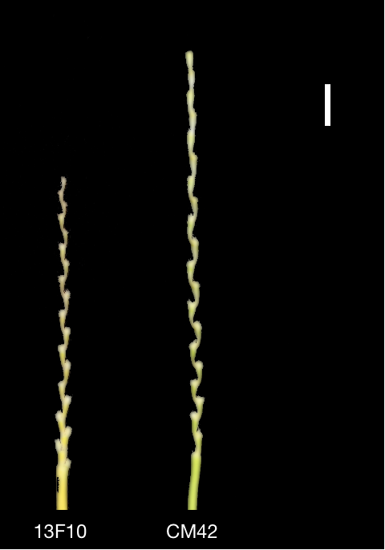
Supplemental Fig. 1
a
b

Slide 2
Supplemental Fig. 2
15
3.0
Spikelet Number per Spike
30
Spike Lengtn (cm)
Spike Density
2.5
25
10
2.0
20
1.5
15
5
1.0
10
2017SL
2017SF
2018SL
2018SF
2019SL
2019SF
BLUE
2017SL
2017SF
2018SL
2018SF
2019SL
2019SF
BLUE
2017SL
2017SF
2018SL
2018SF
2019SL
2019SF
BLUE
9
Thousand Grain Weight (g)
80
Grain Length (mm)
Grain Width (mm)
4
8
60
7
3
40
6
5
2
20
2017SL
2017SF
2018SL
2018SF
2019SL
2019SF
BLUE
2017SL
2017SF
2018SL
2018SF
2019SL
2019SF
BLUE
2017SL
2017SF
2018SL
2018SF
2019SL
2019SF
BLUE

Slide 3
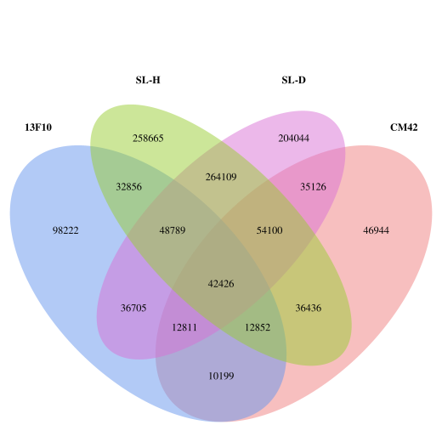
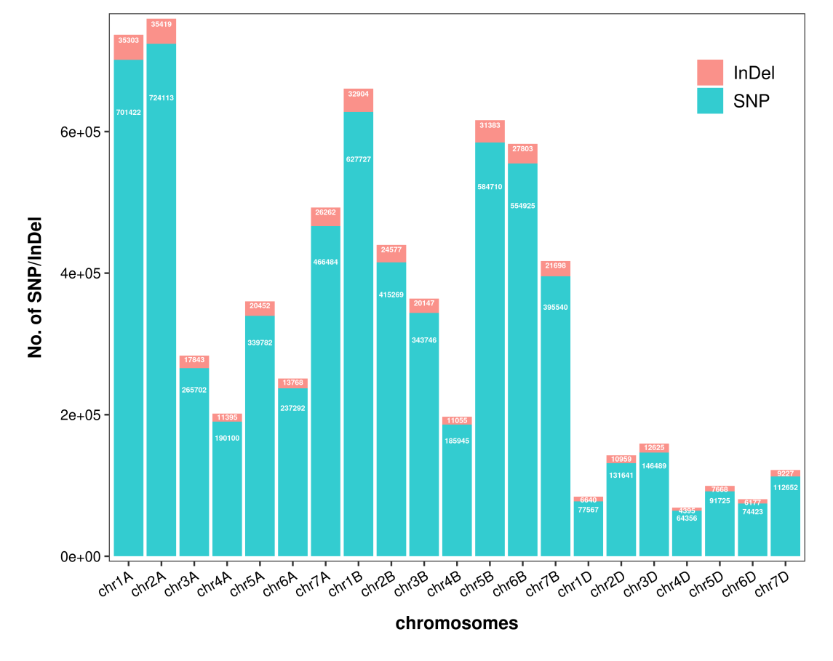

Supplemental Fig. 3
a
b
SNP
c
InDel

Slide 4
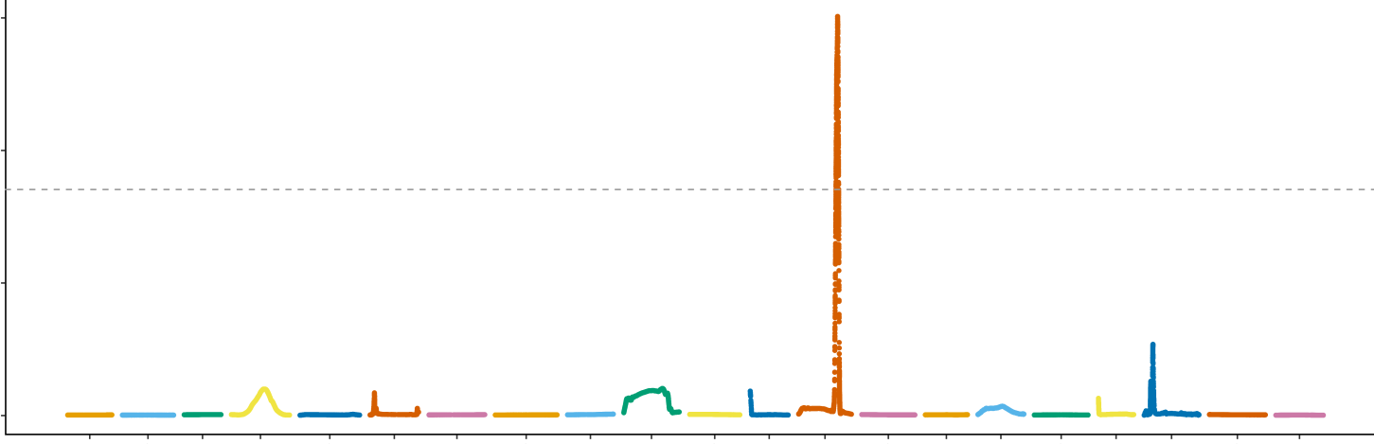
Supplemental Fig. 4
1.5
Loess fit of ED4
1.0
0.5
0.0
1A 1B 1D 2A 2B 2D 3A 3B 3D 4A 4B 4D 5A 5B 5D 6A 6B 6D 7A 7B 7D
Chromosomes

Slide 5
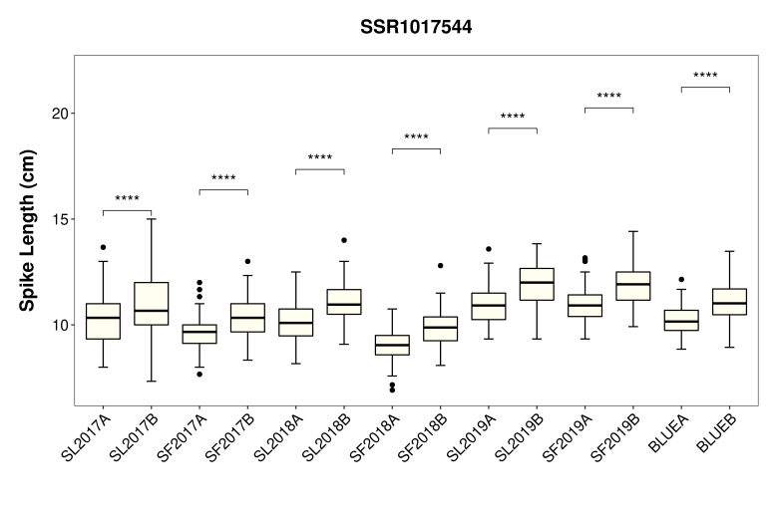
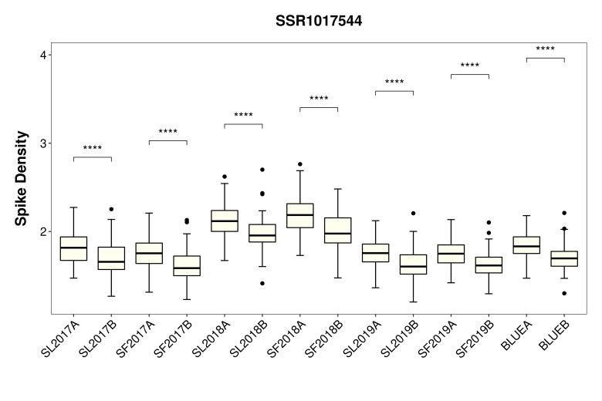
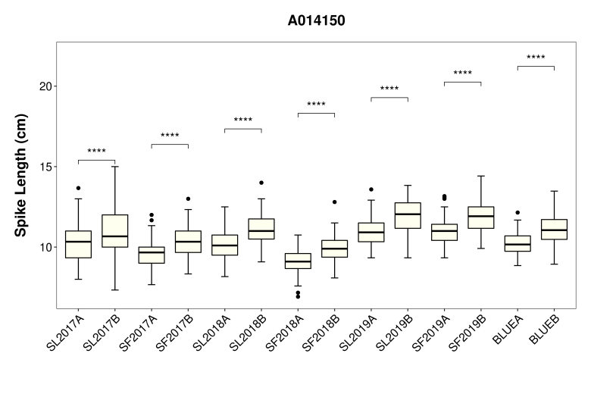
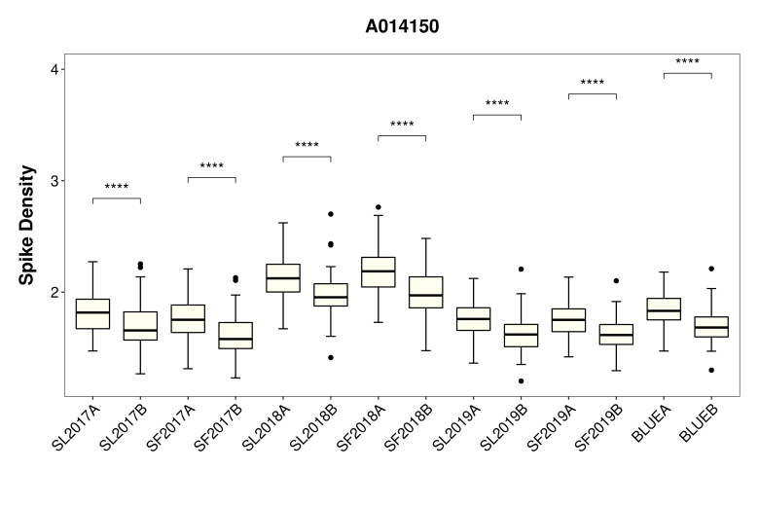
Supplemental Fig. 5
SSR1017719
SSR1017719
A014150
A014150

Slide 6
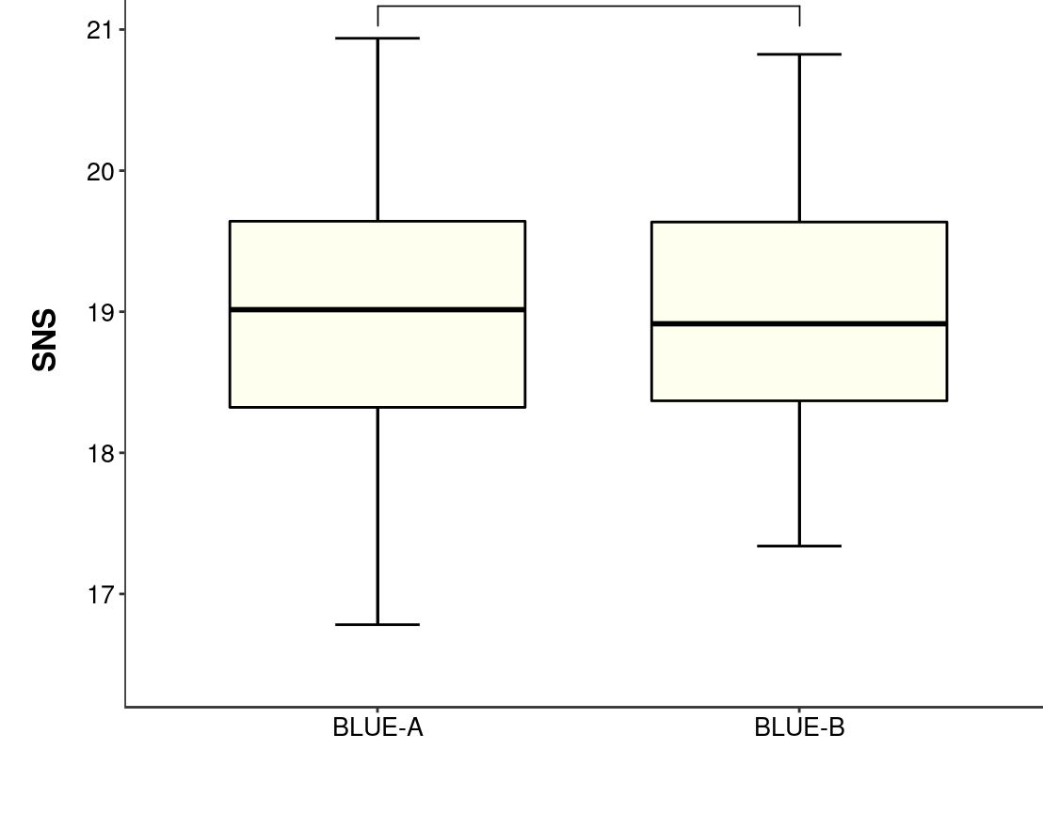
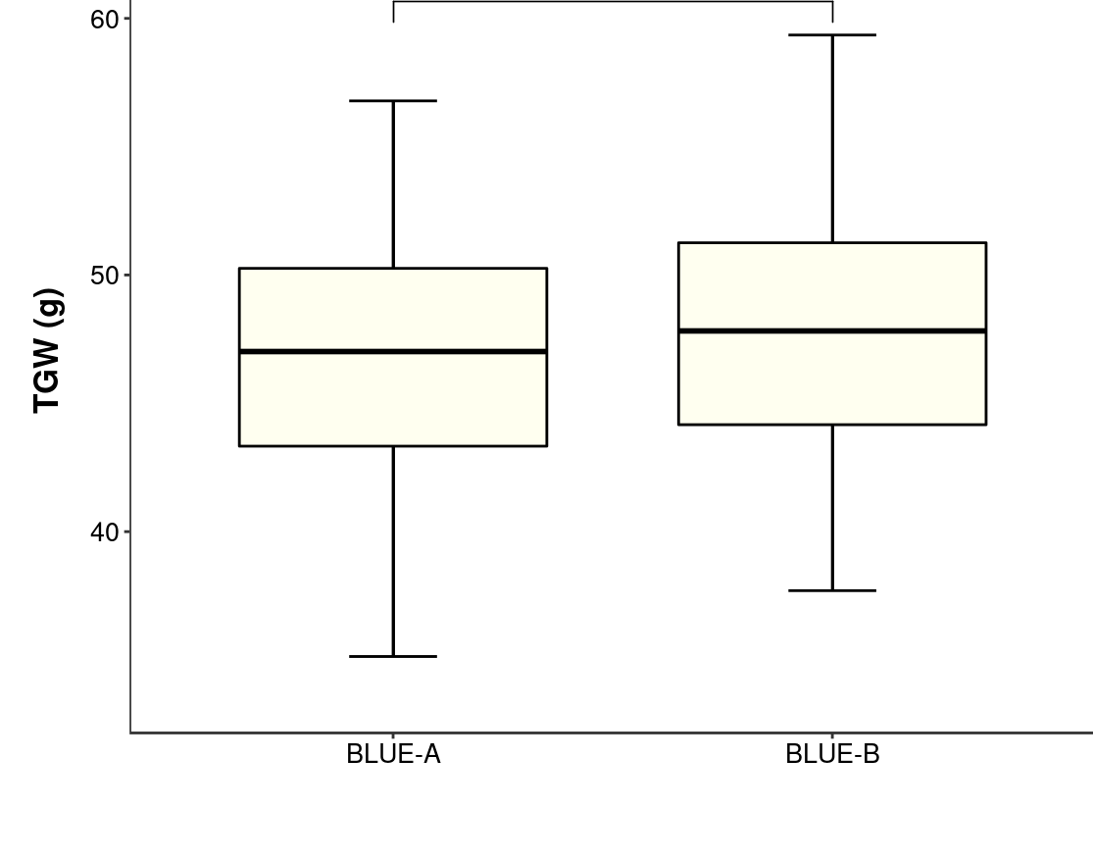
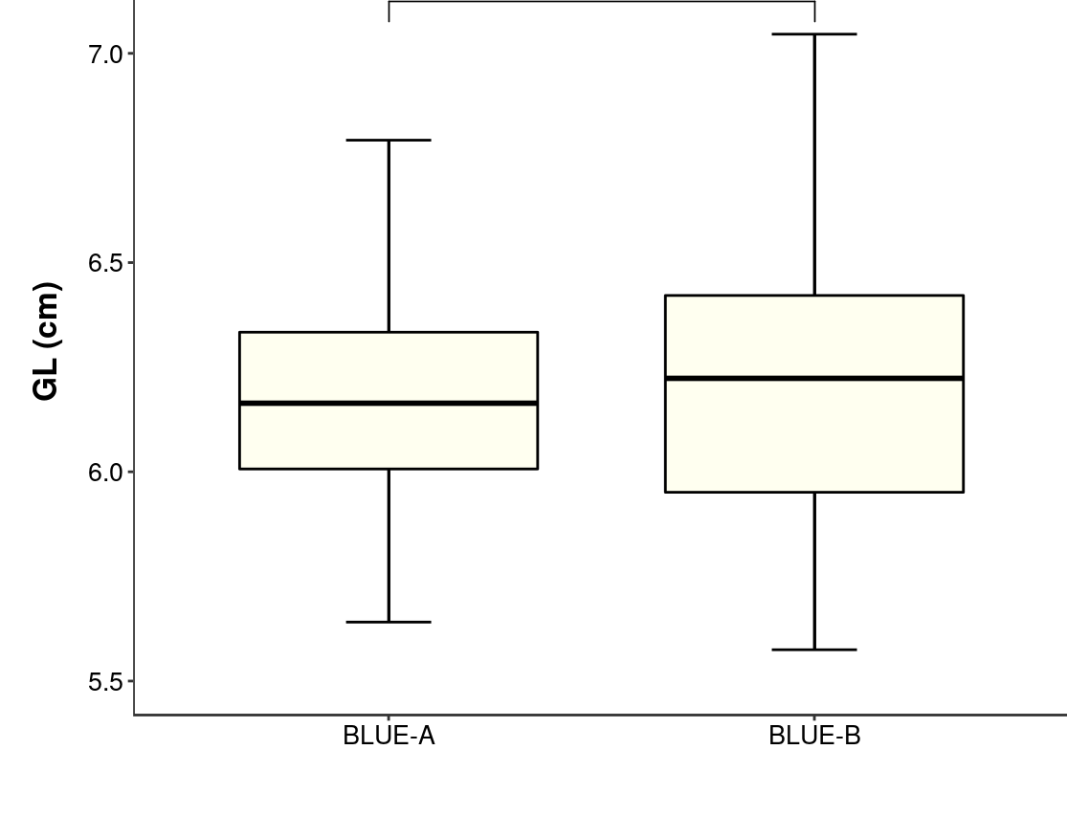
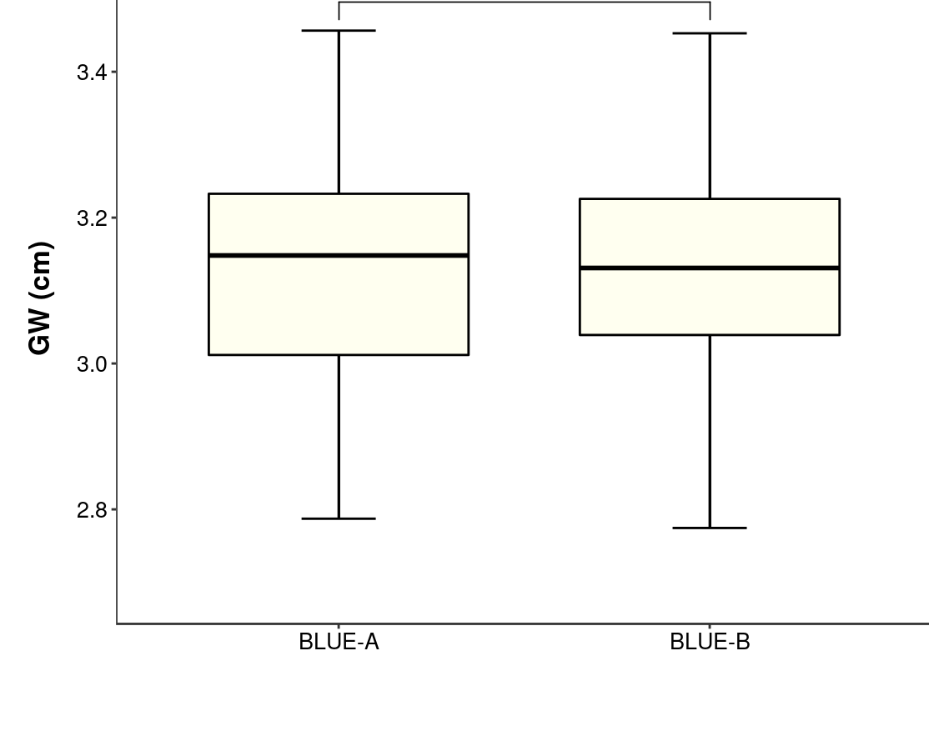
Supplemental Fig. 6
p=0.876
p=0.335
p=0.475
p=0.949

Slide 7
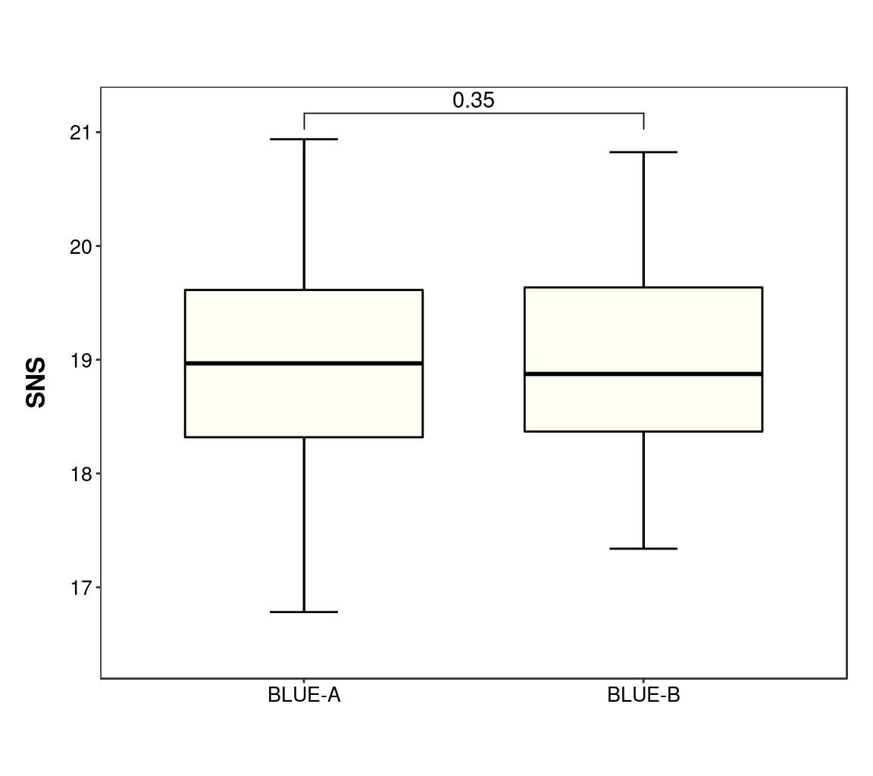
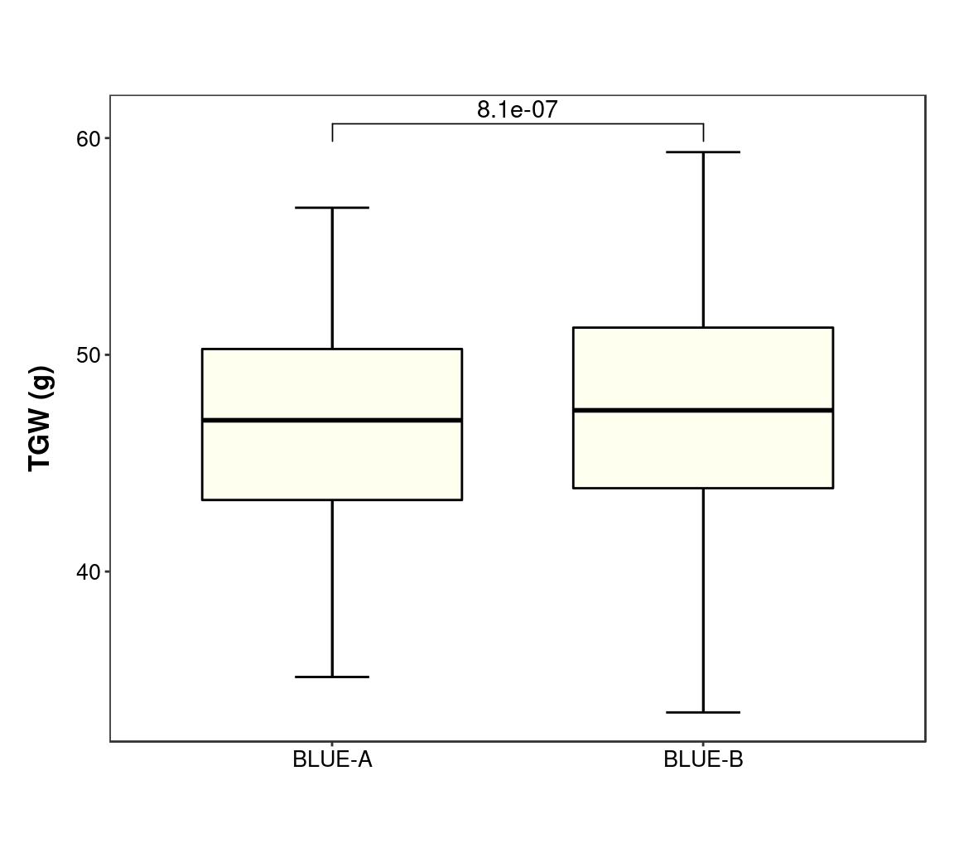
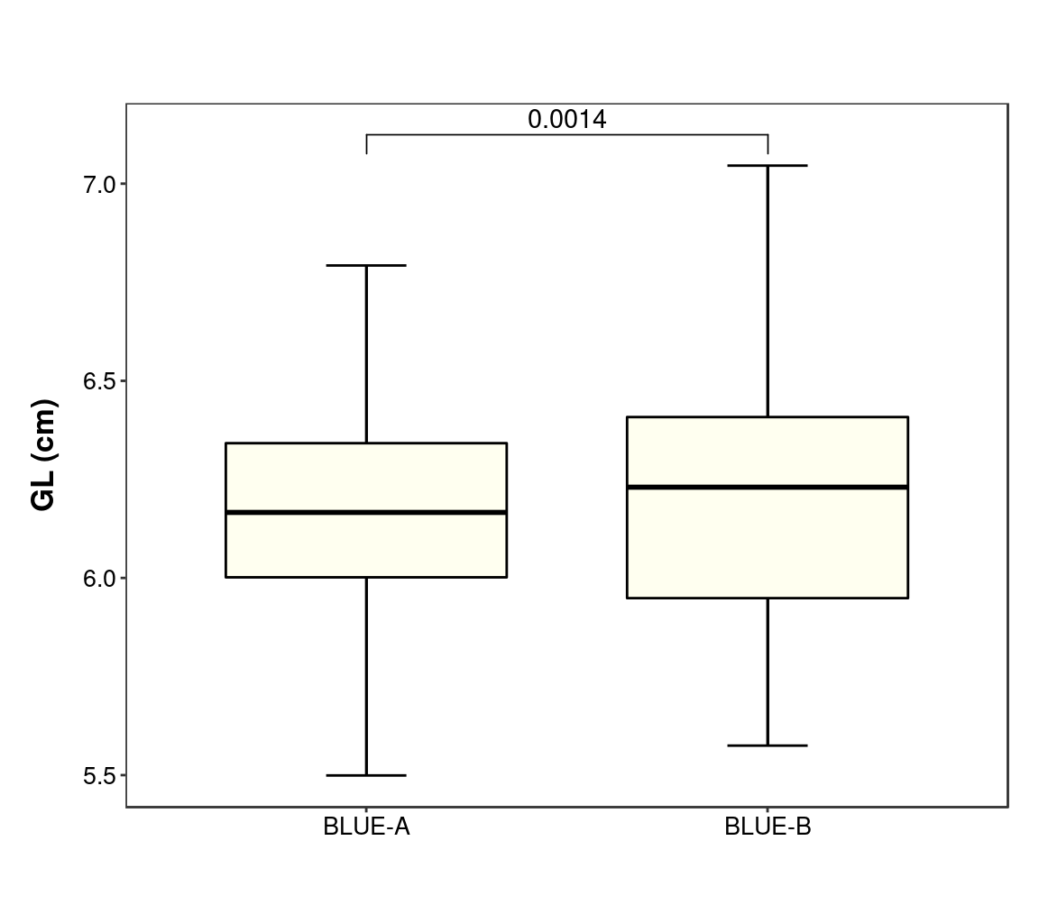
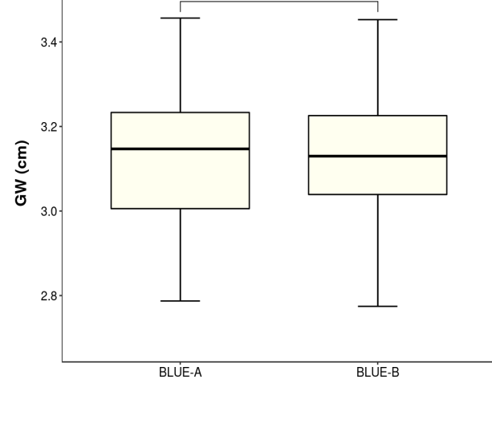
Supplemental Fig. 7
p=0.926
p=0.427
p=0.62
p=0.988

Slide 8
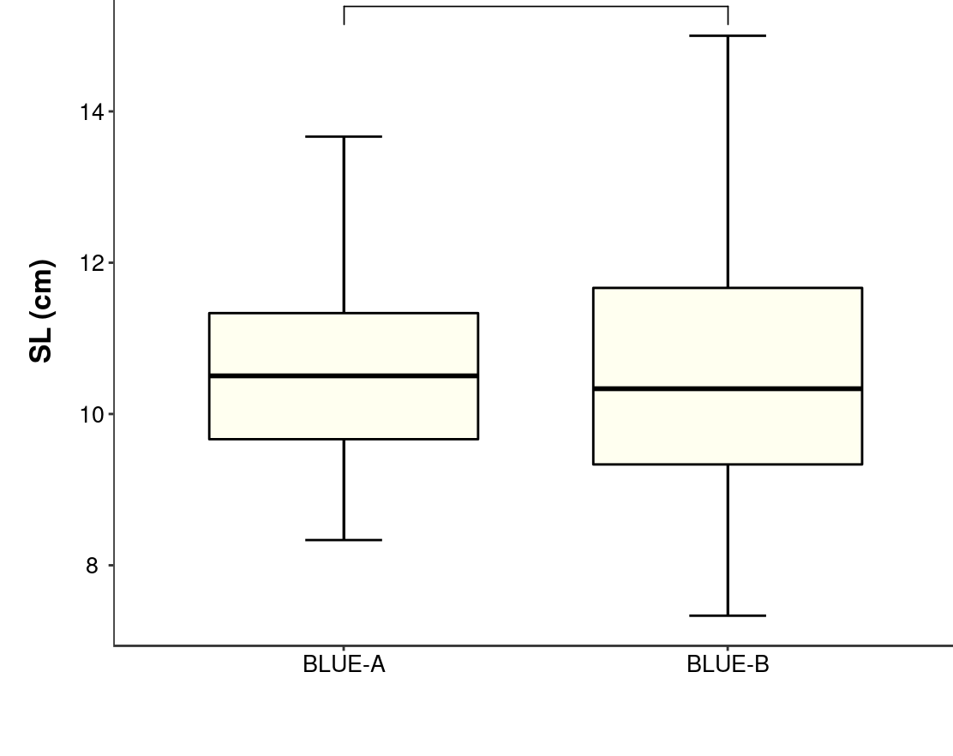
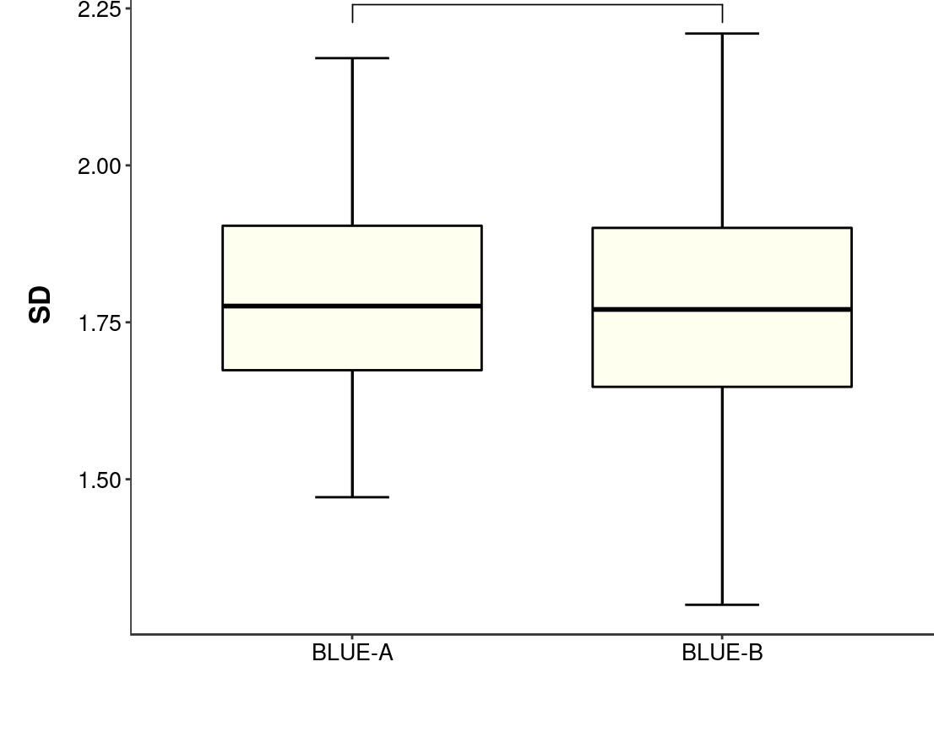
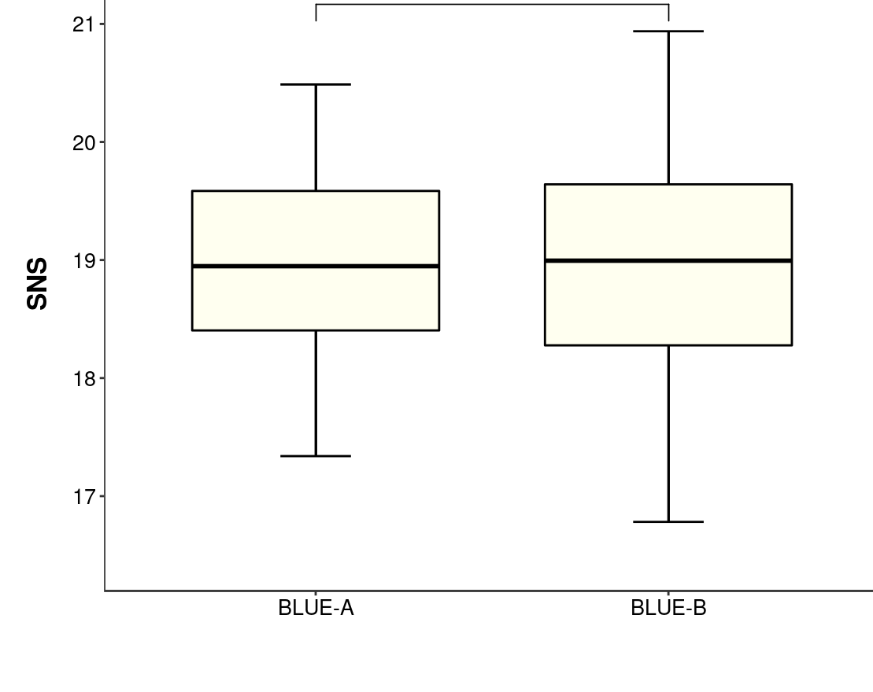
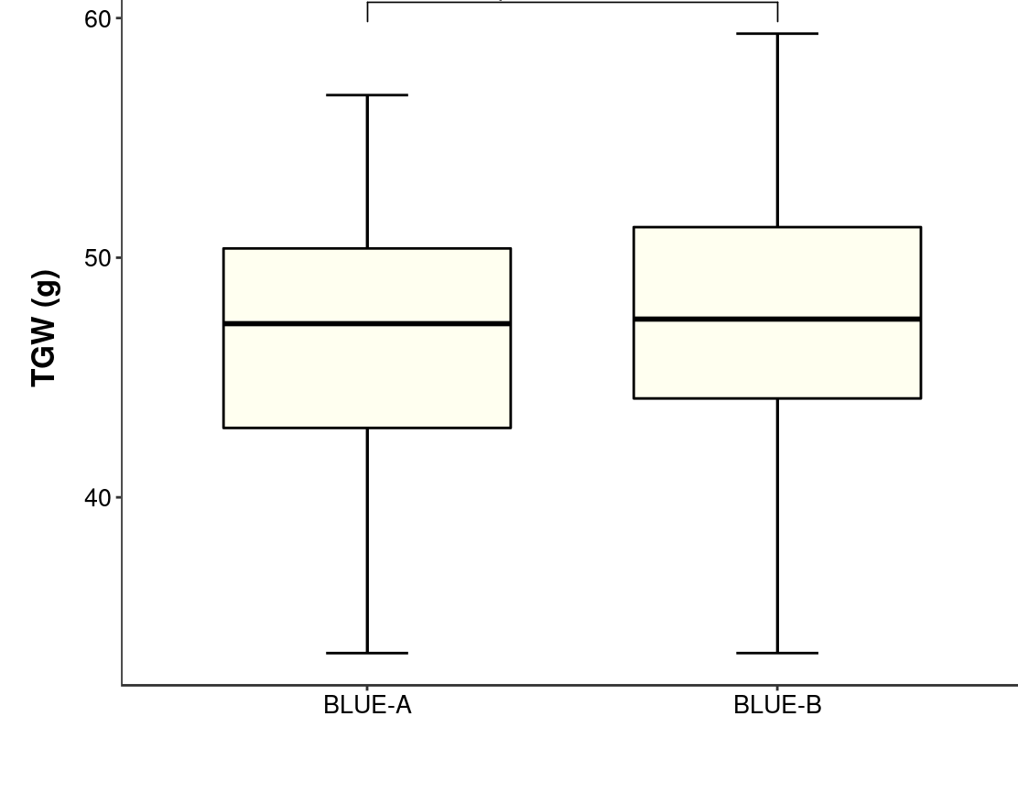
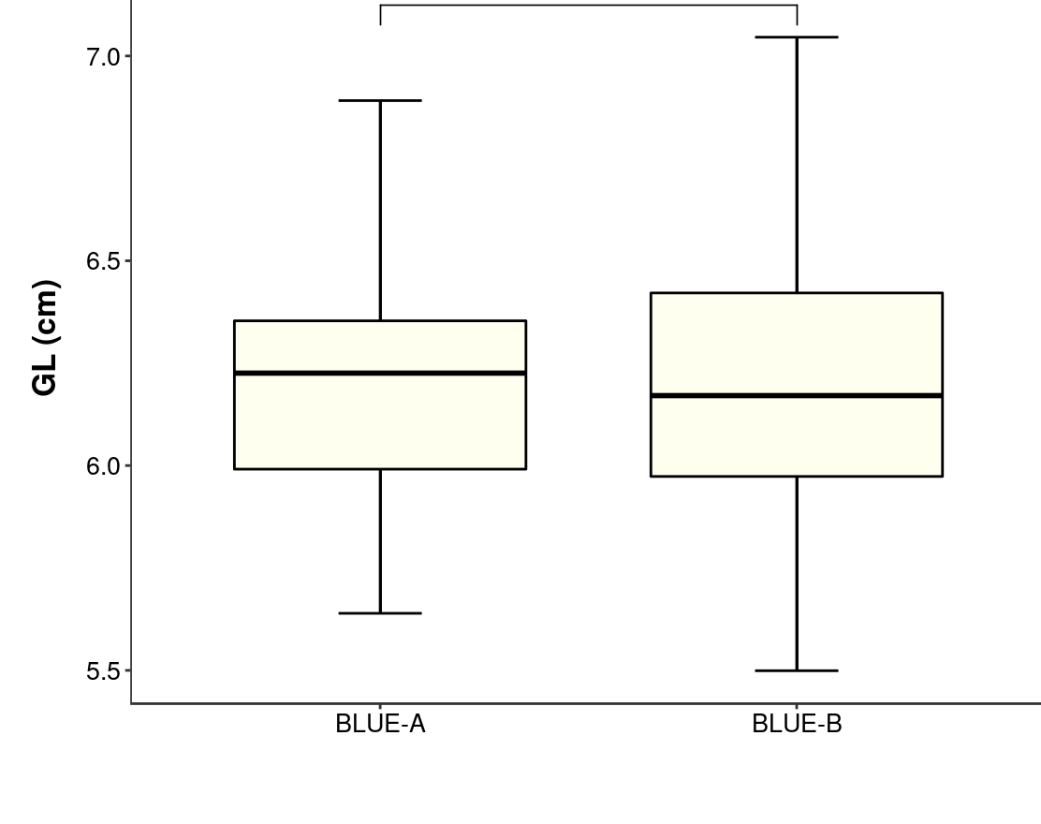
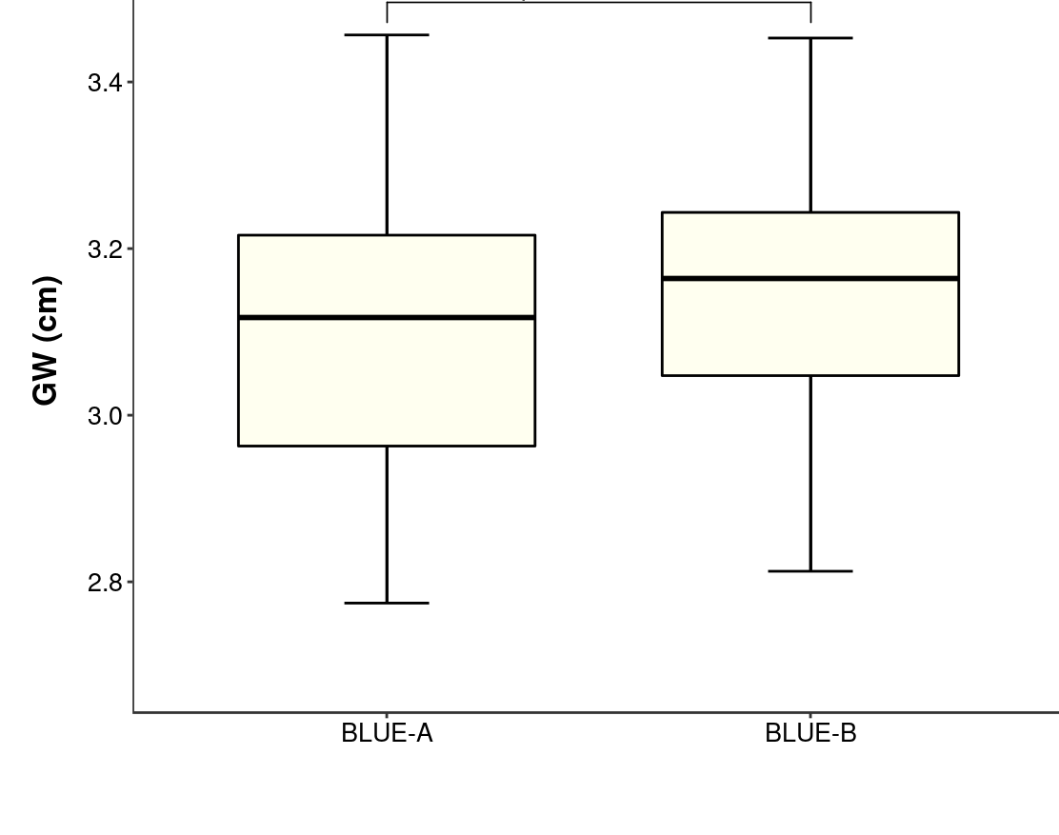
Supplemental Fig. 8
p=0.518
p=0.72
p=0.805
p=0.154
p=0.866
p=0.04 *

Slide 9
Supplemental Fig. 9
Figure S9
13F10
CM42
Chinese Spring
13F10
CM42
Chinese Spring
13F10
CM42
Chinese Spring

