Slide 1

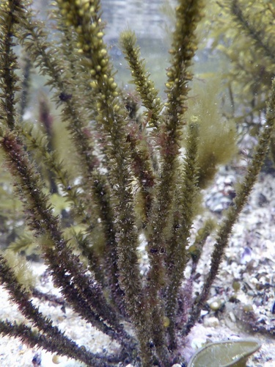
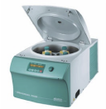

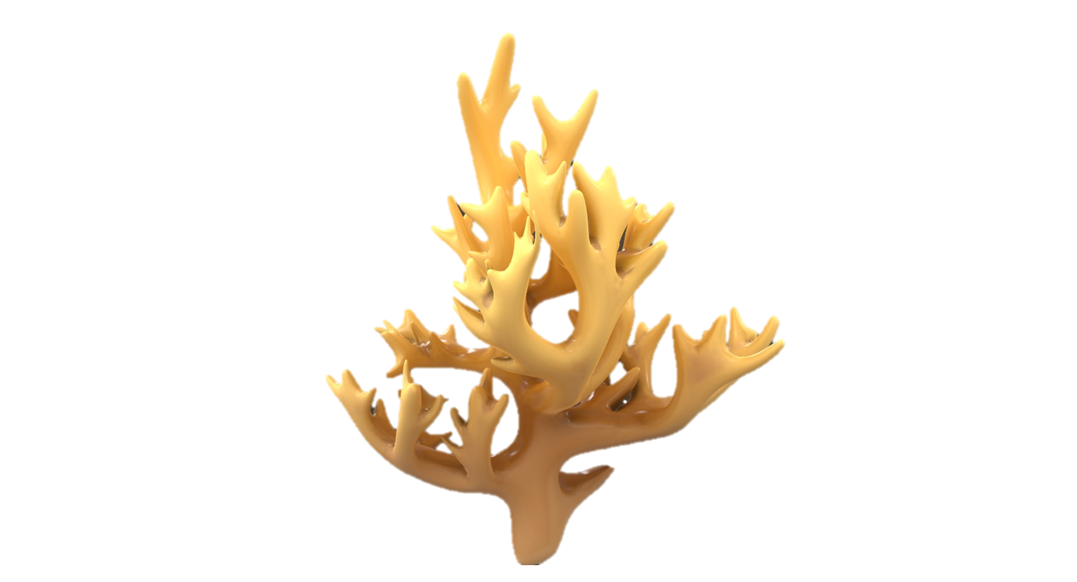
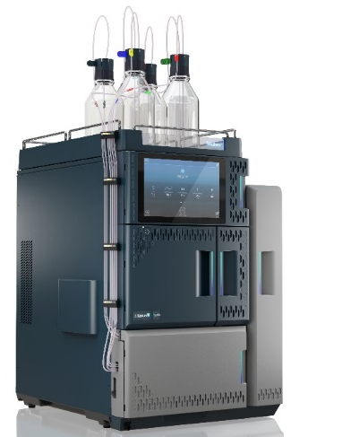
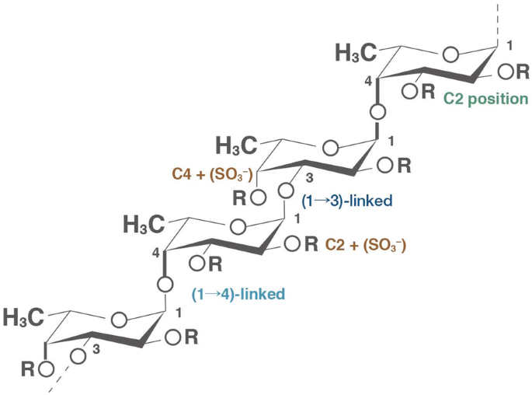
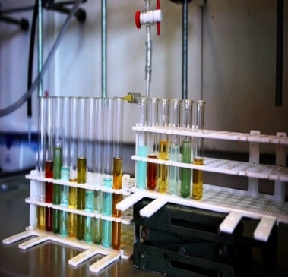

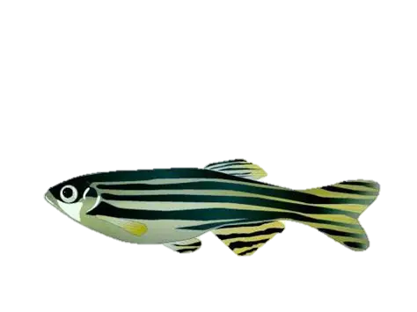
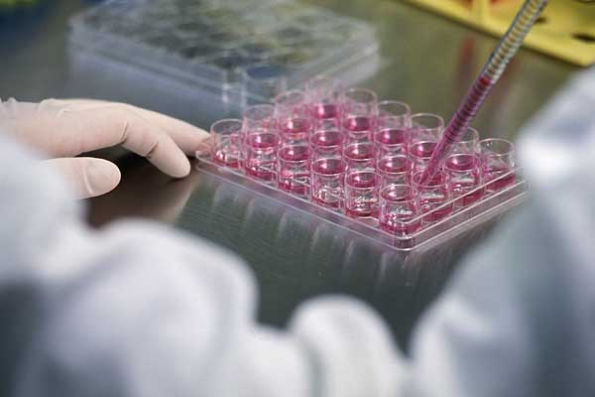
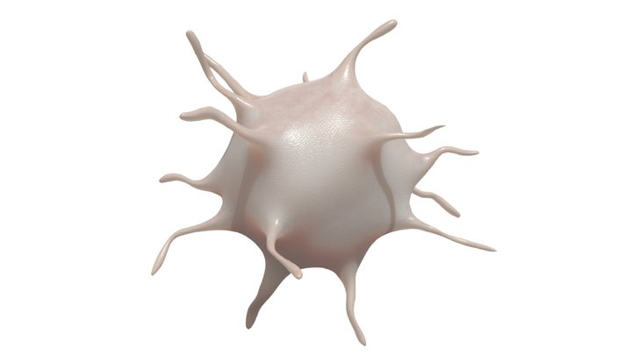
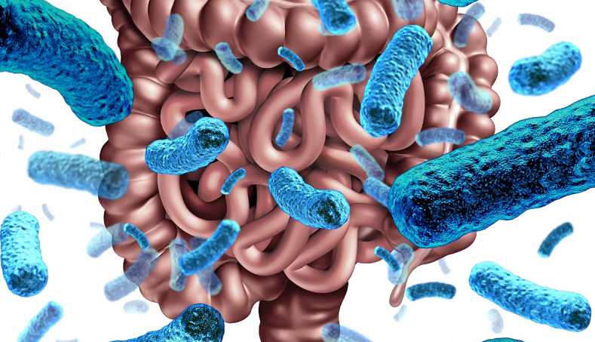
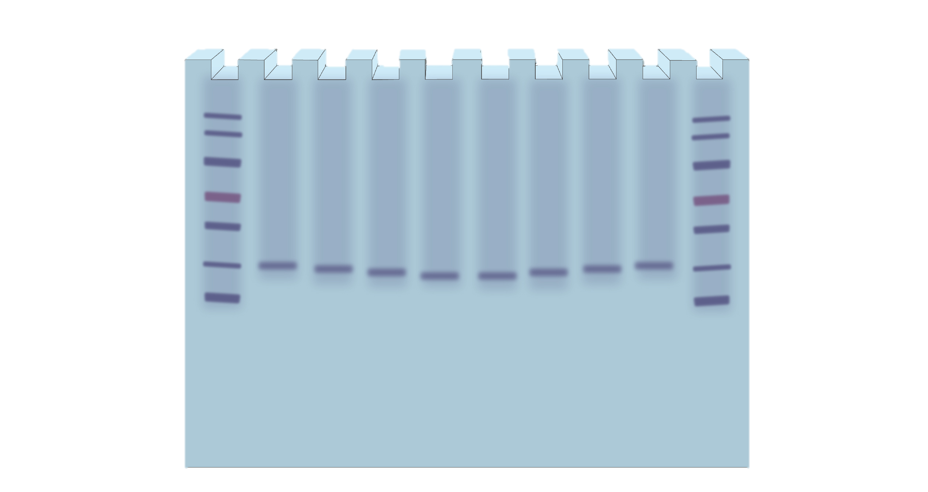
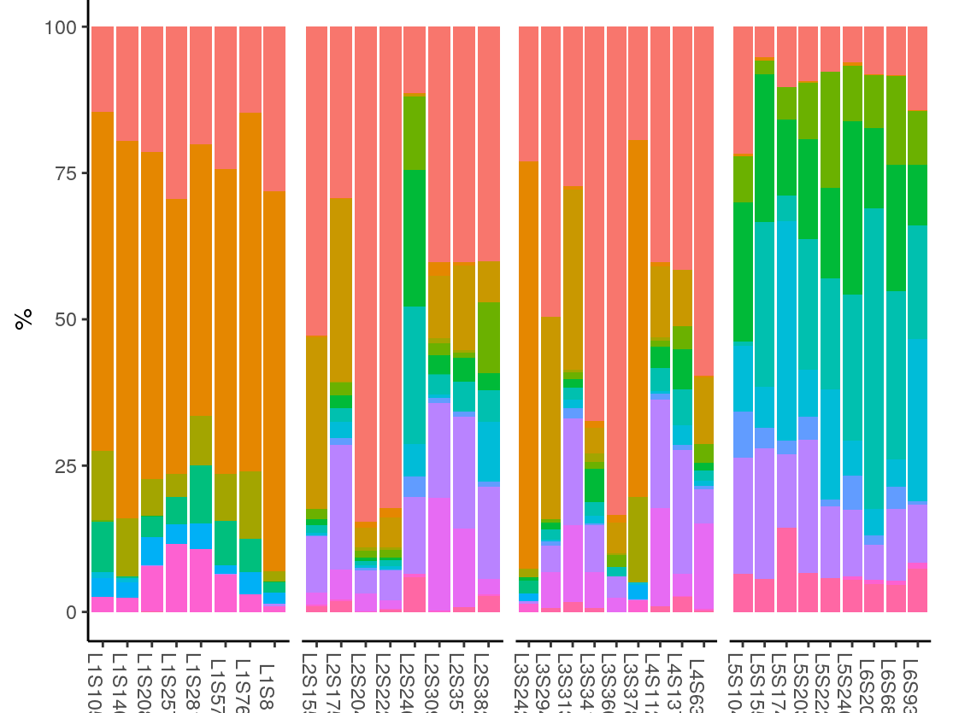
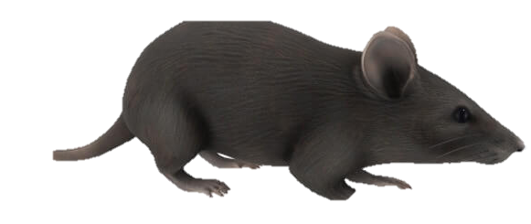
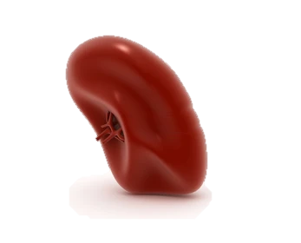
Soaking in
1% acetic acid
5% CaCl₂ treatment, pH 11
Centrifugation
Heating and concentration
95% EtOH
precipitation
Crude fucoidan extract
Sargassum thunbergii
Fucoidan
Physicochemical properties of Fucoidan
Immunomodulatory activity
In vivo effects on inflammation and gut health using zebrafish
Immune-enhancing activity using murine macrophages
IL-6
IL-1β
Sargassum thunbergii fucoidan Extract
Anti-inflammatory effect using suppressed TH17 polarization

