Slide 1
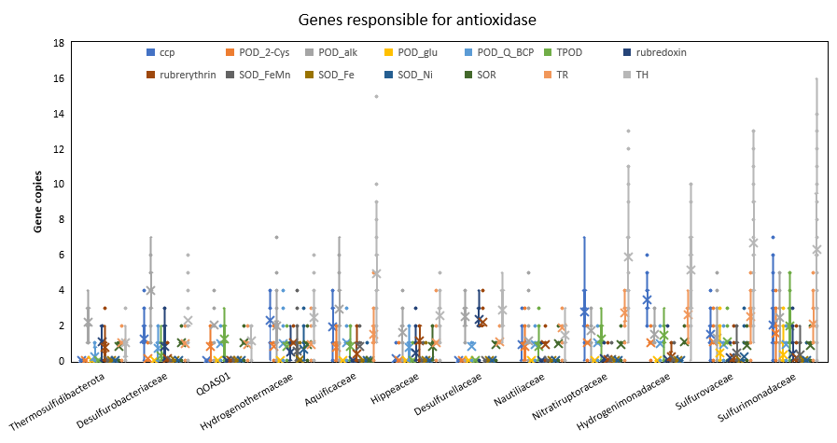
Extended Data Fig. 1 Box plot showing the antioxidase genes in CAT families
anaerobic
aerobic
anaerobic
aerobic
Thermosulfidibacterota+Aquificota
Campylobacterota
Antioxidases are essential enzymes to eliminate oxidative stress. These gene copies in facultatively aerobic CAT families are higher than those in anaerobic CAT families. In the figure, ccp denotes cytochrome c peroxidases, POD_2-cys denotes 2-Cys peroxiredoxin, POD_alk denotes alkylhydroperoxidase, POD_Q_BCP denotes peroxiredoxin_Q/BCP, and TPOD denotes thiol peroxidase. Superoxide dismutases include FeMn, Fe, and Ni types. TH denotes Thioredoxin, TR denotes thioredoxin reductase.

Slide 2
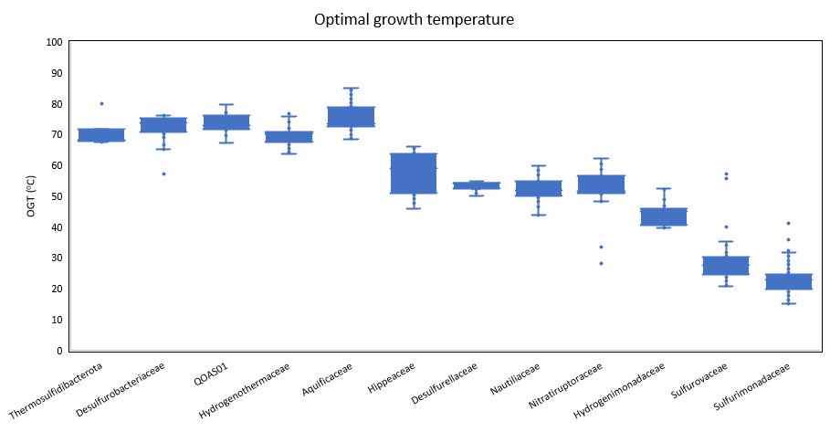
Extended Data Fig. 2 Box plot showing the predicted optimal growth temperature (OGT) of the CAT families
anaerobic
aerobic
anaerobic
aerobic
Thermosulfidibacterota+Aquificota
Campylobacterota
The predicted optimal growth temperature showed that the Thermosulfidibacterota and Aquificota phyla adapt to higher temperatures than the Camplylobacterota. The families Sulfurovaceae and Sulfurimonadaceae possess the lowest optimal growth temperature.

