Slide 1
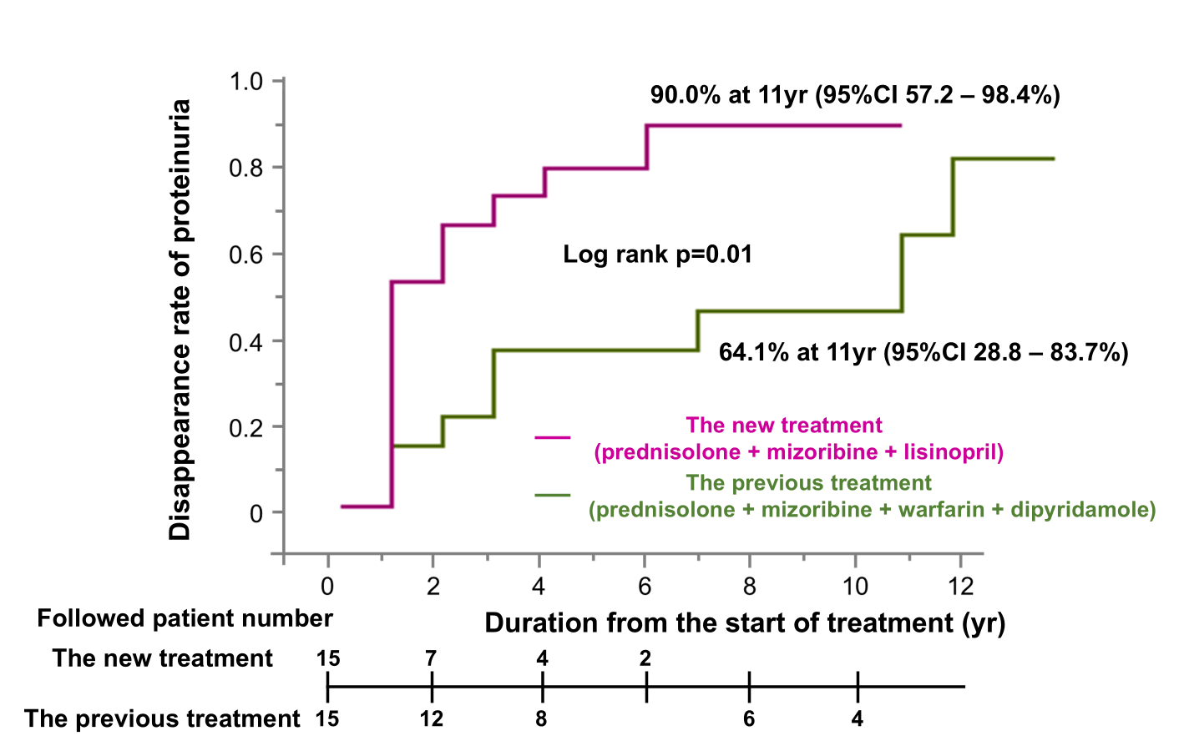
Safety and efficacy of prednisolone, mizoribine and lisinopril combination therapy for severe childhood IgA Nephropathy
AIM: To examine the safety and efficacy of the new combined regimen for severe childhood IgA nephropathy
DESIGN & OUTCOMES
1:1 propensity score matching
Proteinuria, eGFR, and
the proportion of the patients with C0-2
Disappearance of proteinuria
Median observation periods
5 years ( 2 – 10 years)
77 IgAN with
the previous treatment
(prednisolone, mizoribine warfarin, and dipyridamole)
15 IgAN with
the previous treatment
(prednisolone, mizoribine warfarin, and dipyridamole)
567 childhood IgAN
1977 - 2020
93 severe IgAN with prednisolone and mizoribine
16 IgAN with
the new treatment
(prednisolone, mizoribine and lisinopril )
15 IgAN with
the new treatment
(prednisolone, mizoribine and lisinopril)
No significant difference in baseline characteristics.
CONCLUSION: The new combined regimen demonstrated greater efficacy in achieving proteinuria remission with lower dose of steroids while maintaining comparable safety profiles.
Shima Y et al. 2025

