Slide 1
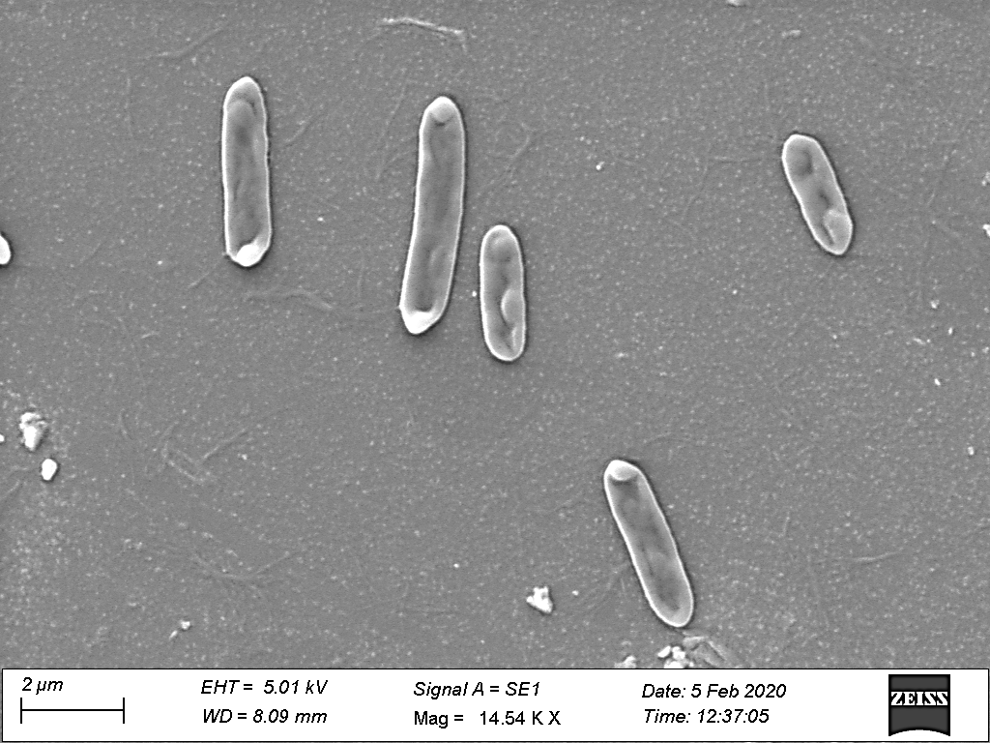
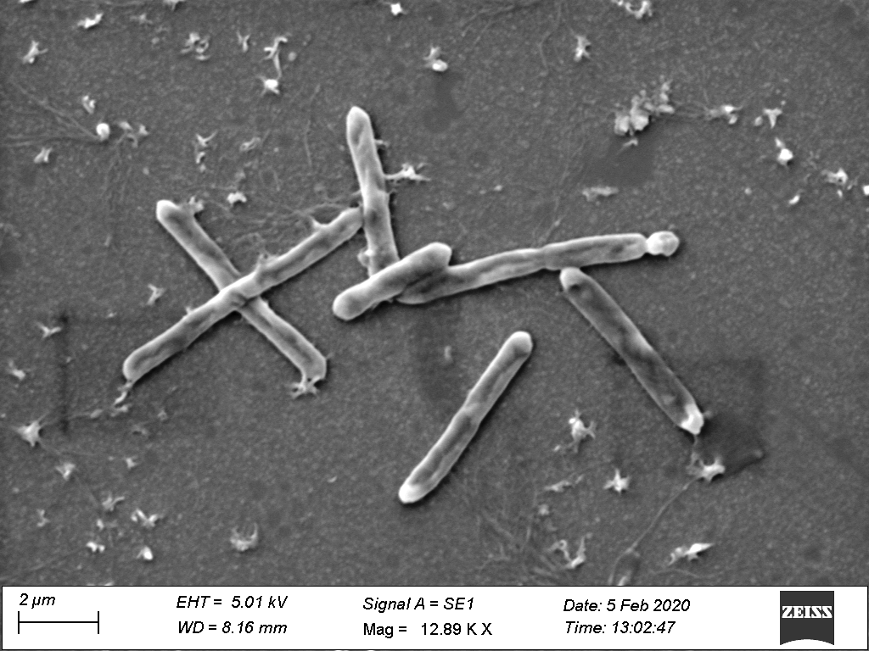
(a)
(b)
Supplementary figure S1. Scanning Electron Micrograph of strain UniB2^{T} (a), and UniB3^{T} (b)

Slide 2
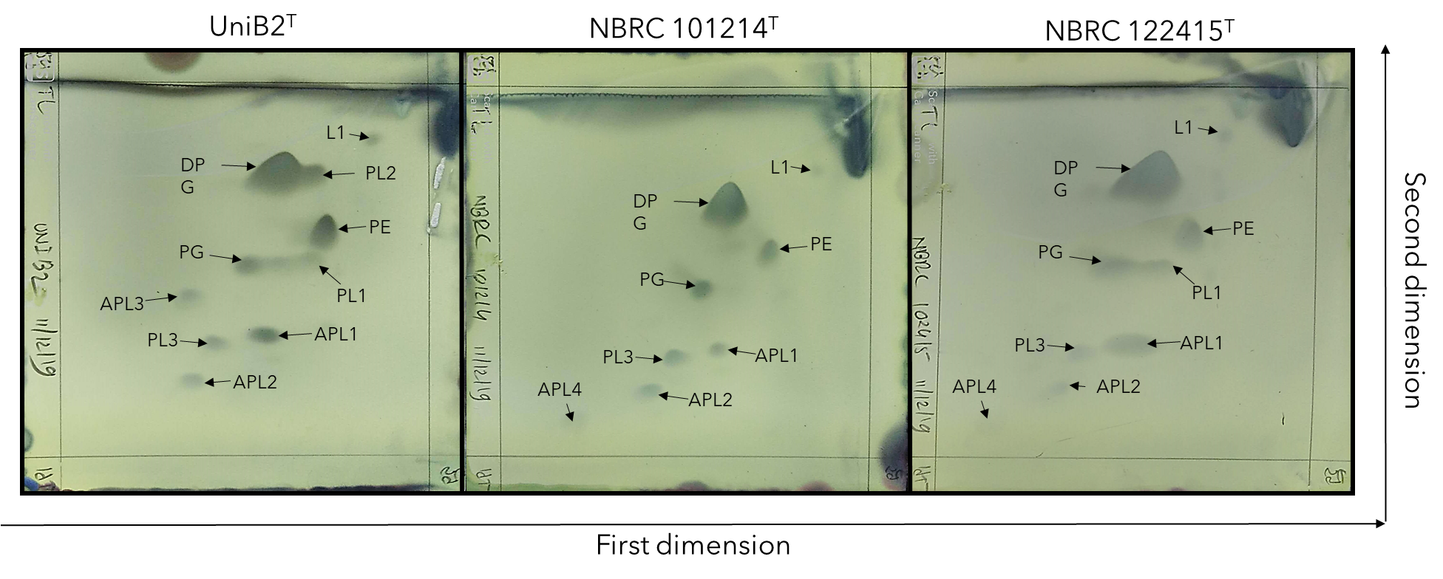
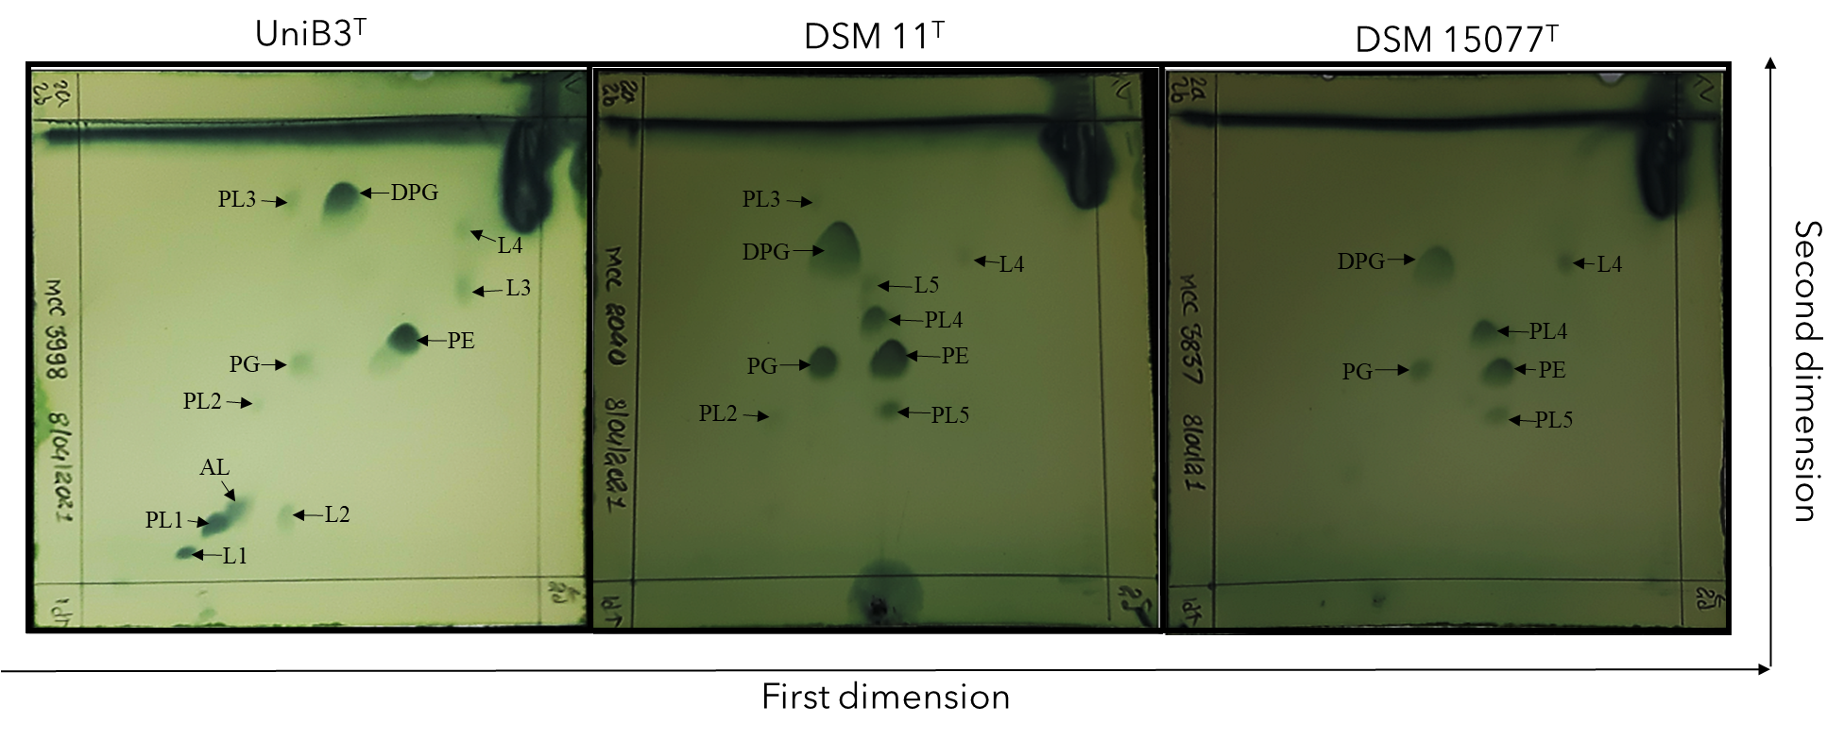
(a)
(b)
Supplementary figure S2. Polar Lipid Analysis of strain UniB2^{T} and its closest phylogenetic neighbours. Paenibacillus humicus (NBRC 102415^{T}), Paenibacillus pasadenensis NBRC 101214^{T} (a); Polar Lipid Analysis of strain UniB3^{T} and its closest phylogenetic neighbours. Niallia circulans DSM 11^{T} and Niallia nealsonii DSM 15077^{T} (b). All the data obtained from this study.

Slide 3
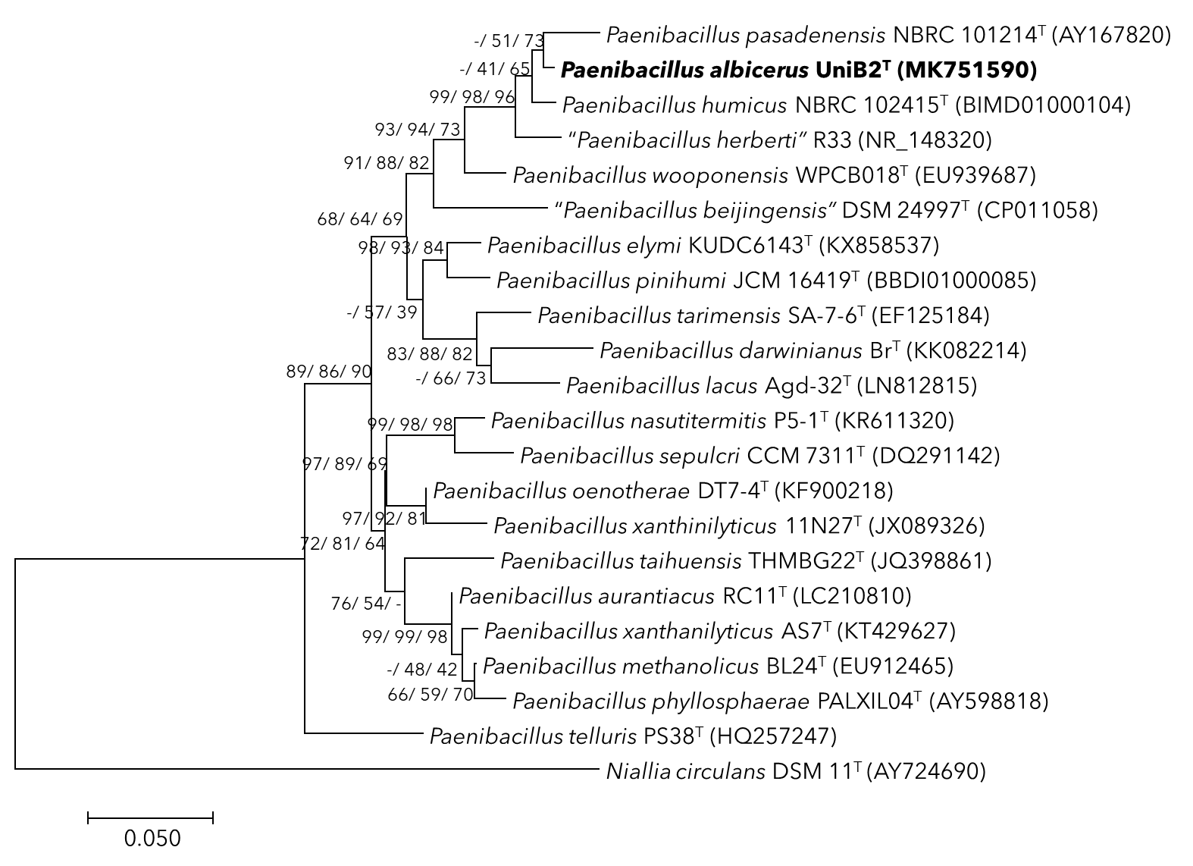
Supplementary Figure S3: Phylogenetic tree inferred from analysis of 16S rRNA gene sequences showing the relationship of strain UniB2^{T} with other closely related members of the genus Paenibacillus. The neighbour-joining (NJ), maximum-likelihood (ML) and maximum parsimony (MP) methods were used for the phylogenetic tree-building using MEGA 7. The topologies of the trees were evaluated by bootstrap analysis based on 1000 replicates. Figures at nodes of the branches indicate the percentage of replicate trees obtained from the NJ, ML and MP methods, respectively, in which the associated taxa clustered together in the bootstrap test. There were a total of 1367 positions in the final dataset. The 16S rRNA gene sequence of Niallia circulans ATCC 4513 (AY724690) was used as an outgroup. Bar indicates the number of nucleotide substitutions per site.
Notes:
UniB2 16S rRNA Tree
Figure 1 (a): Phylogenetic tree inferred from analysis of 16S rRNA gene sequences showing the relationship of strain UniB2^{T} with other closely related members of the genus Paenibacillus. The neighbour-joining (NJ), maximum-likelihood (ML) and maximum parsimony (MP) methods were used for the phylogenetic tree-building using MEGA 7. The topologies of the trees were evaluated by bootstrap analysis based on 1000 replicates. Figures at nodes of the branches indicate the percentage of replicate trees obtained from the NJ, ML and MP methods, respectively, in which the associated taxa clustered together in the bootstrap test. There were a total of 1367 positions in the final dataset. The 16S rRNA gene sequence of Niallia circulans DSM 11^{T} (AY724690) was used as an outgroup. Bar indicates the number of nucleotide substitutions per site.

Slide 4
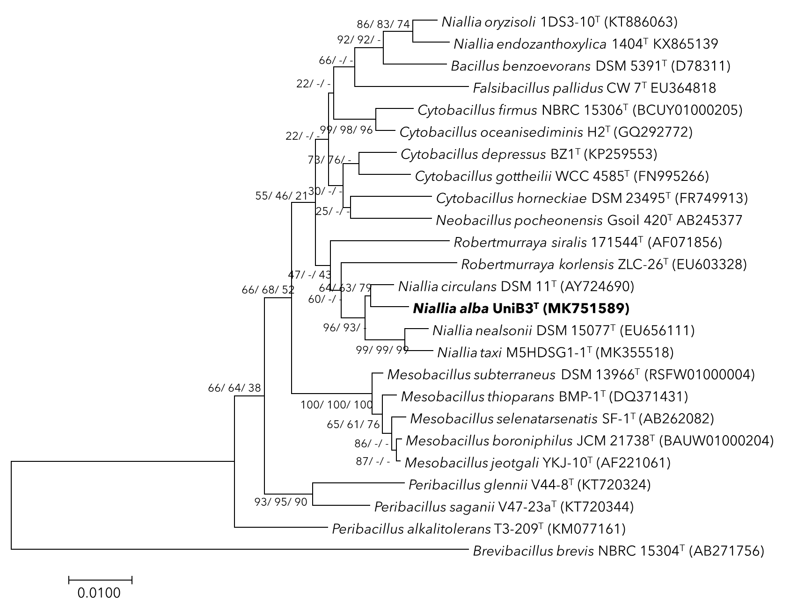
Supplementary Figure S4: Phylogenetic tree inferred from analysis of 16S rRNA gene sequences showing the relationship of strain UniB3^{T} with other closely related members of the genus Niallia and other genera. The neighbour-joining (NJ), maximum-likelihood (ML) and maximum parsimony (MP) methods were used for the phylogenetic tree-building using MEGA 7. The topologies of the trees were evaluated by bootstrap analysis based on 1000 replicates. Figures at nodes of the branches indicate the percentage of replicate trees obtained from the NJ, ML and MP methods, respectively, in which the associated taxa clustered together in the bootstrap test. There were a total of 1383 positions in the final dataset. The 16S rRNA gene sequence of Brevibacillus brevis NBRC 15304 (AB271756) was used as an outgroup. Bar indicates the number of nucleotide substitutions per site.
Notes:
UniB3 16S rRNA tree
Figure 2 (a): Phylogenetic tree inferred from analysis of 16S rRNA gene sequences showing the relationship of strain UniB3^{T} with other closely related members of the genus Niallia and other genera. The neighbour-joining (NJ), maximum-likelihood (ML) and maximum parsimony (MP) methods were used for the phylogenetic tree-building using MEGA 7. The topologies of the trees were evaluated by bootstrap analysis based on 1000 replicates. Figures at nodes of the branches indicate the percentage of replicate trees obtained from the NJ, ML and MP methods, respectively, in which the associated taxa clustered together in the bootstrap test. There were a total of 1383 positions in the final dataset. The 16S rRNA gene sequence of Brevibacillus brevis NBRC 15304^{T} (AB271756) was used as an outgroup. Bar indicates the number of nucleotide substitutions per site.

