Slide 1
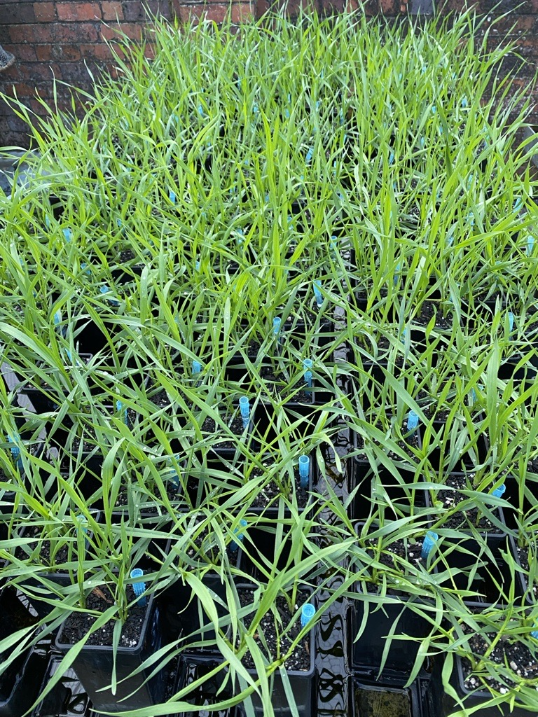
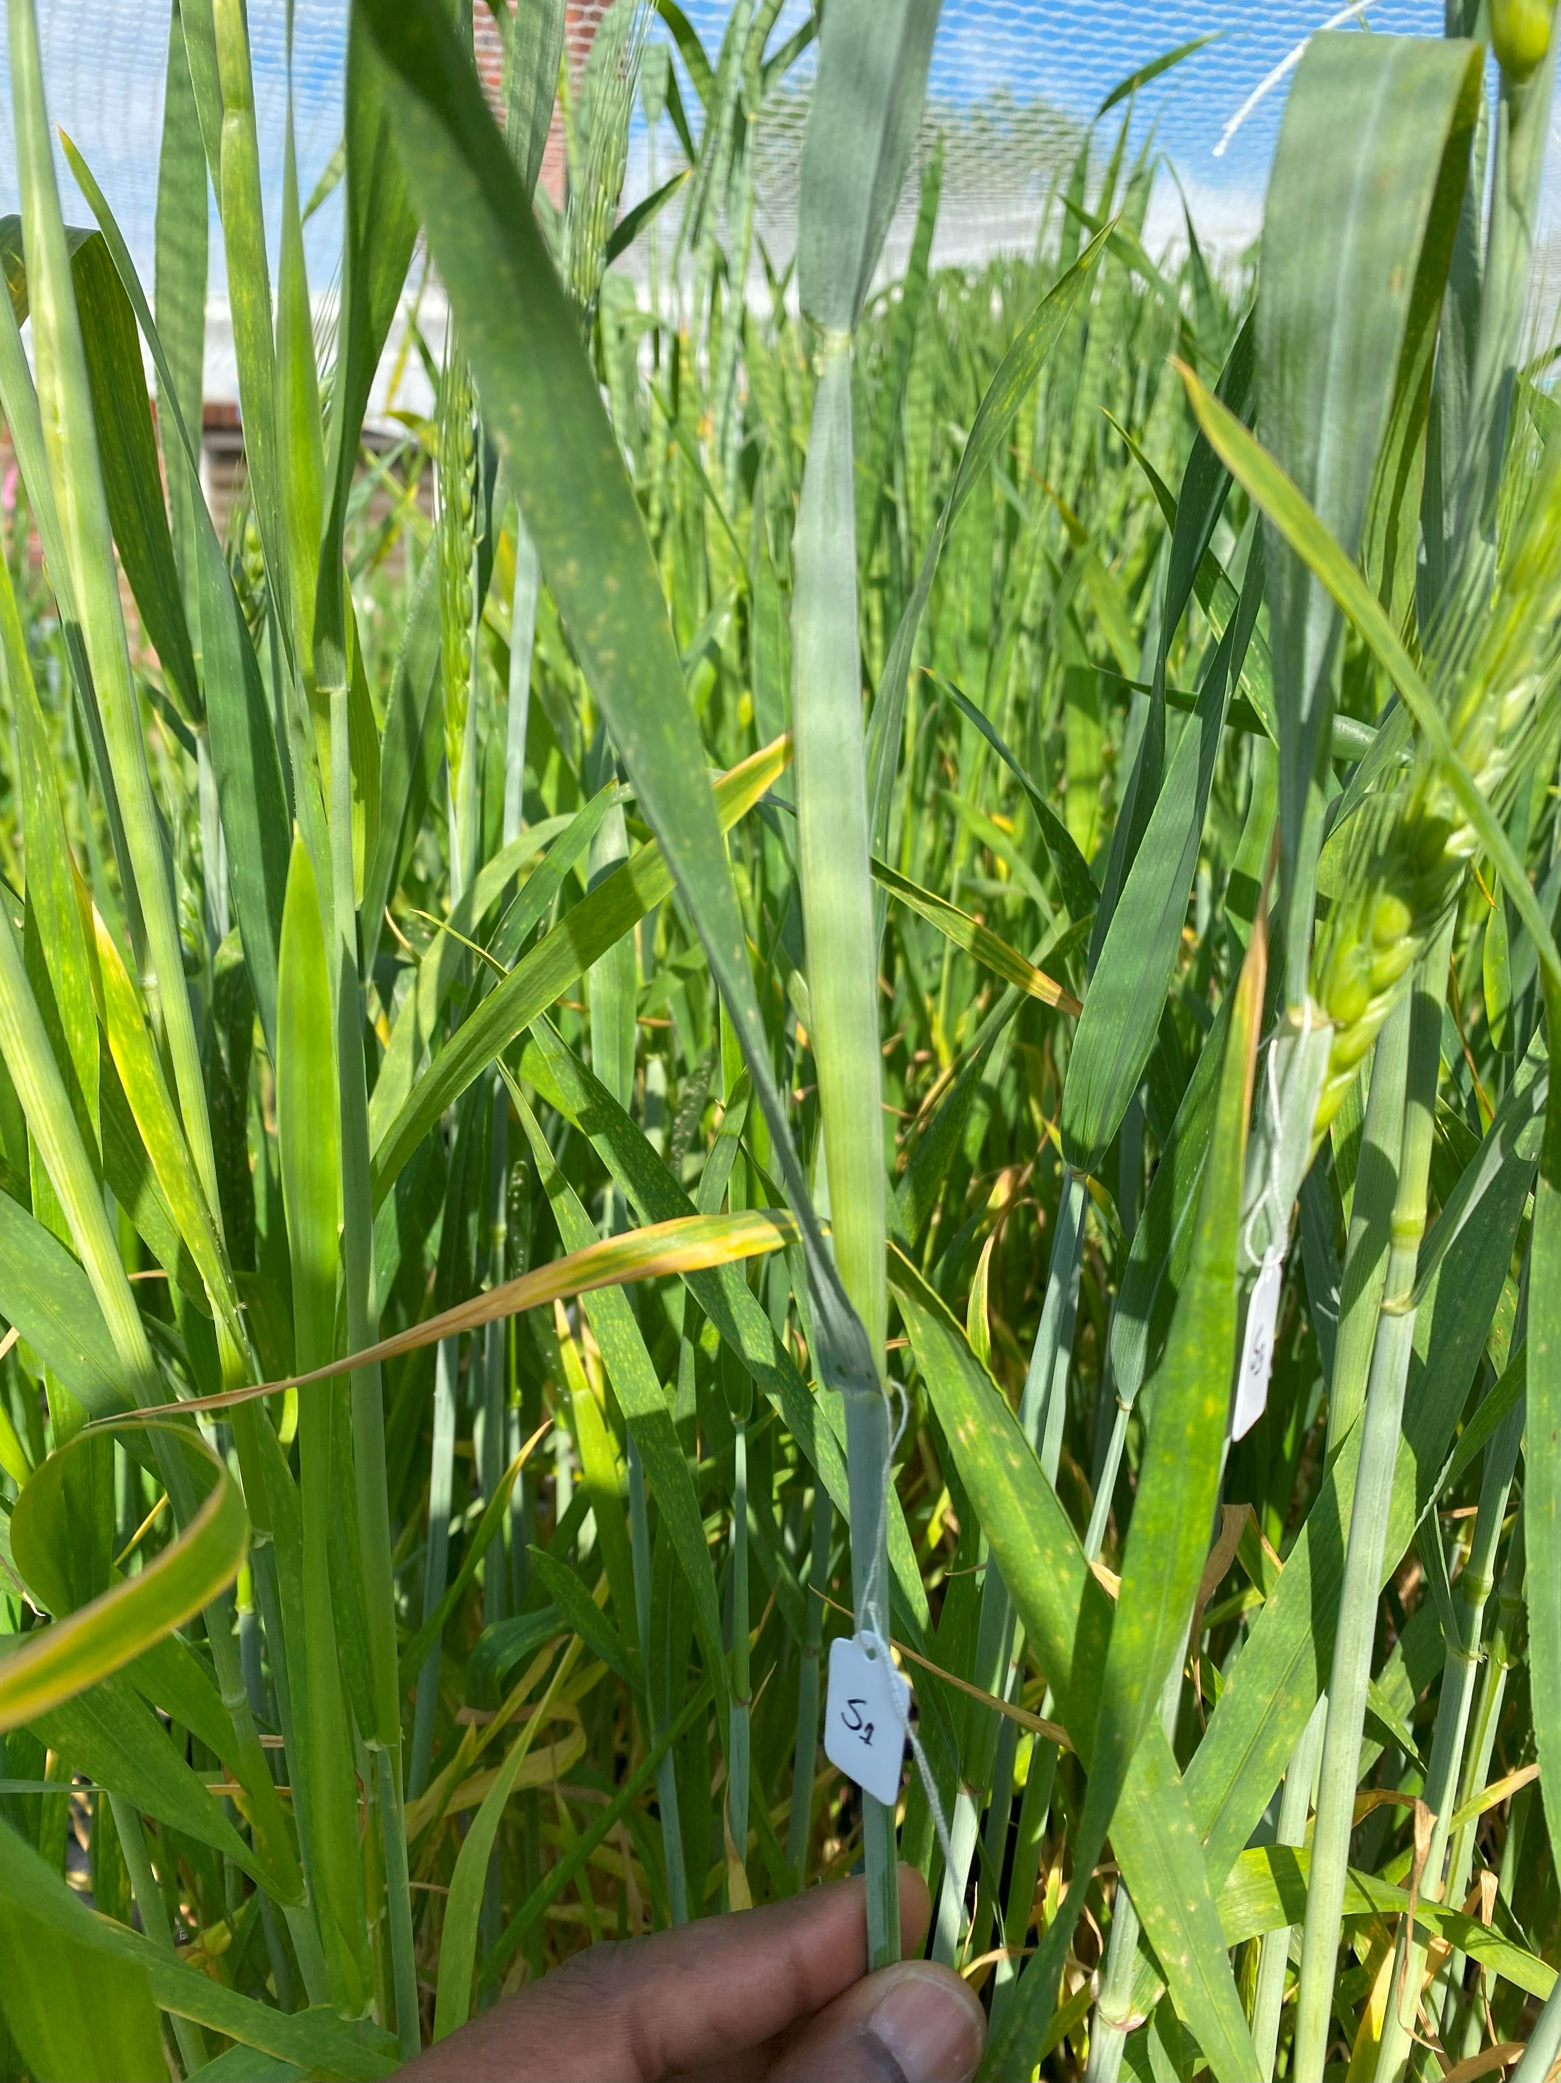
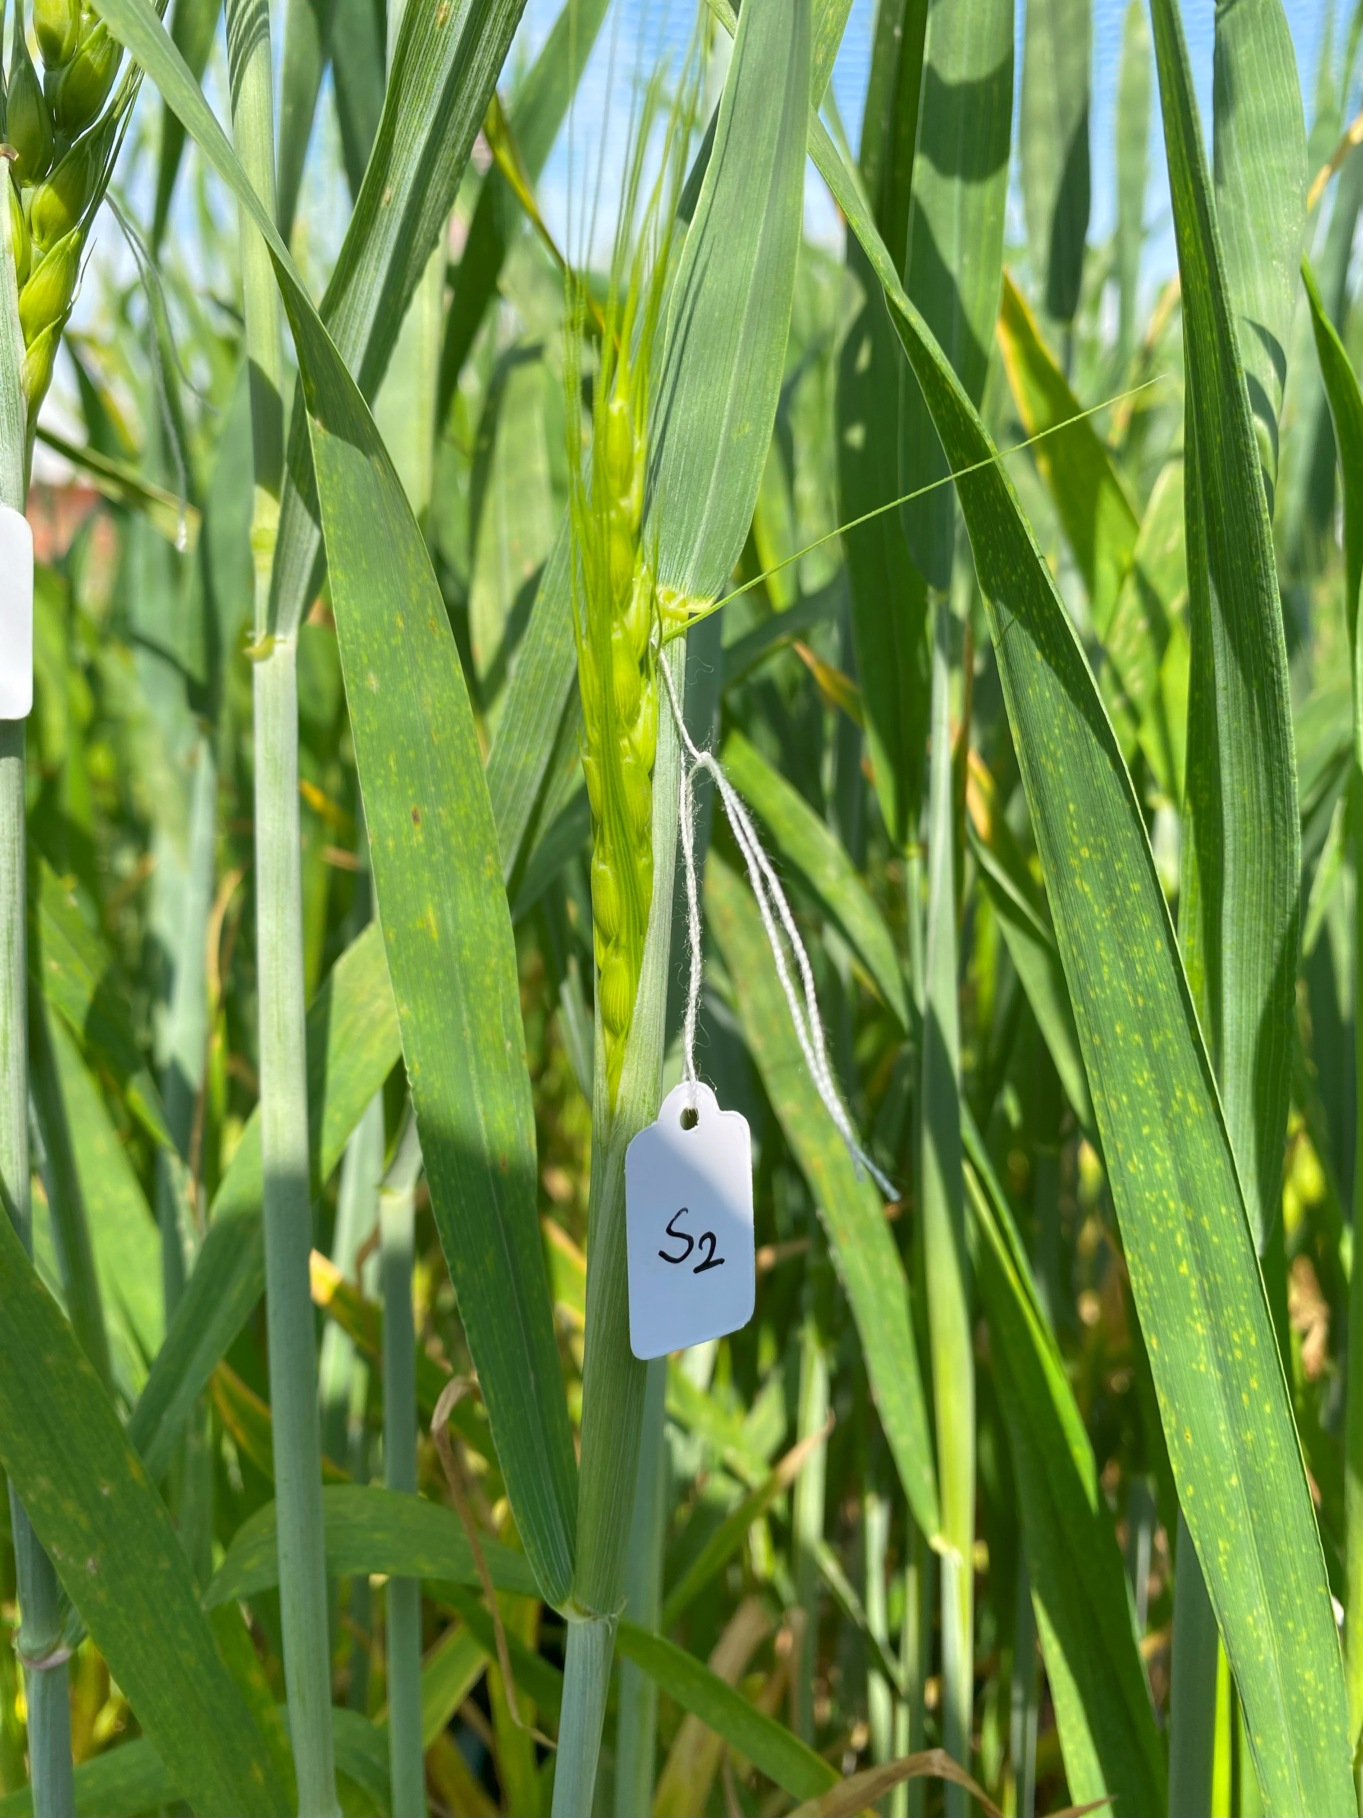
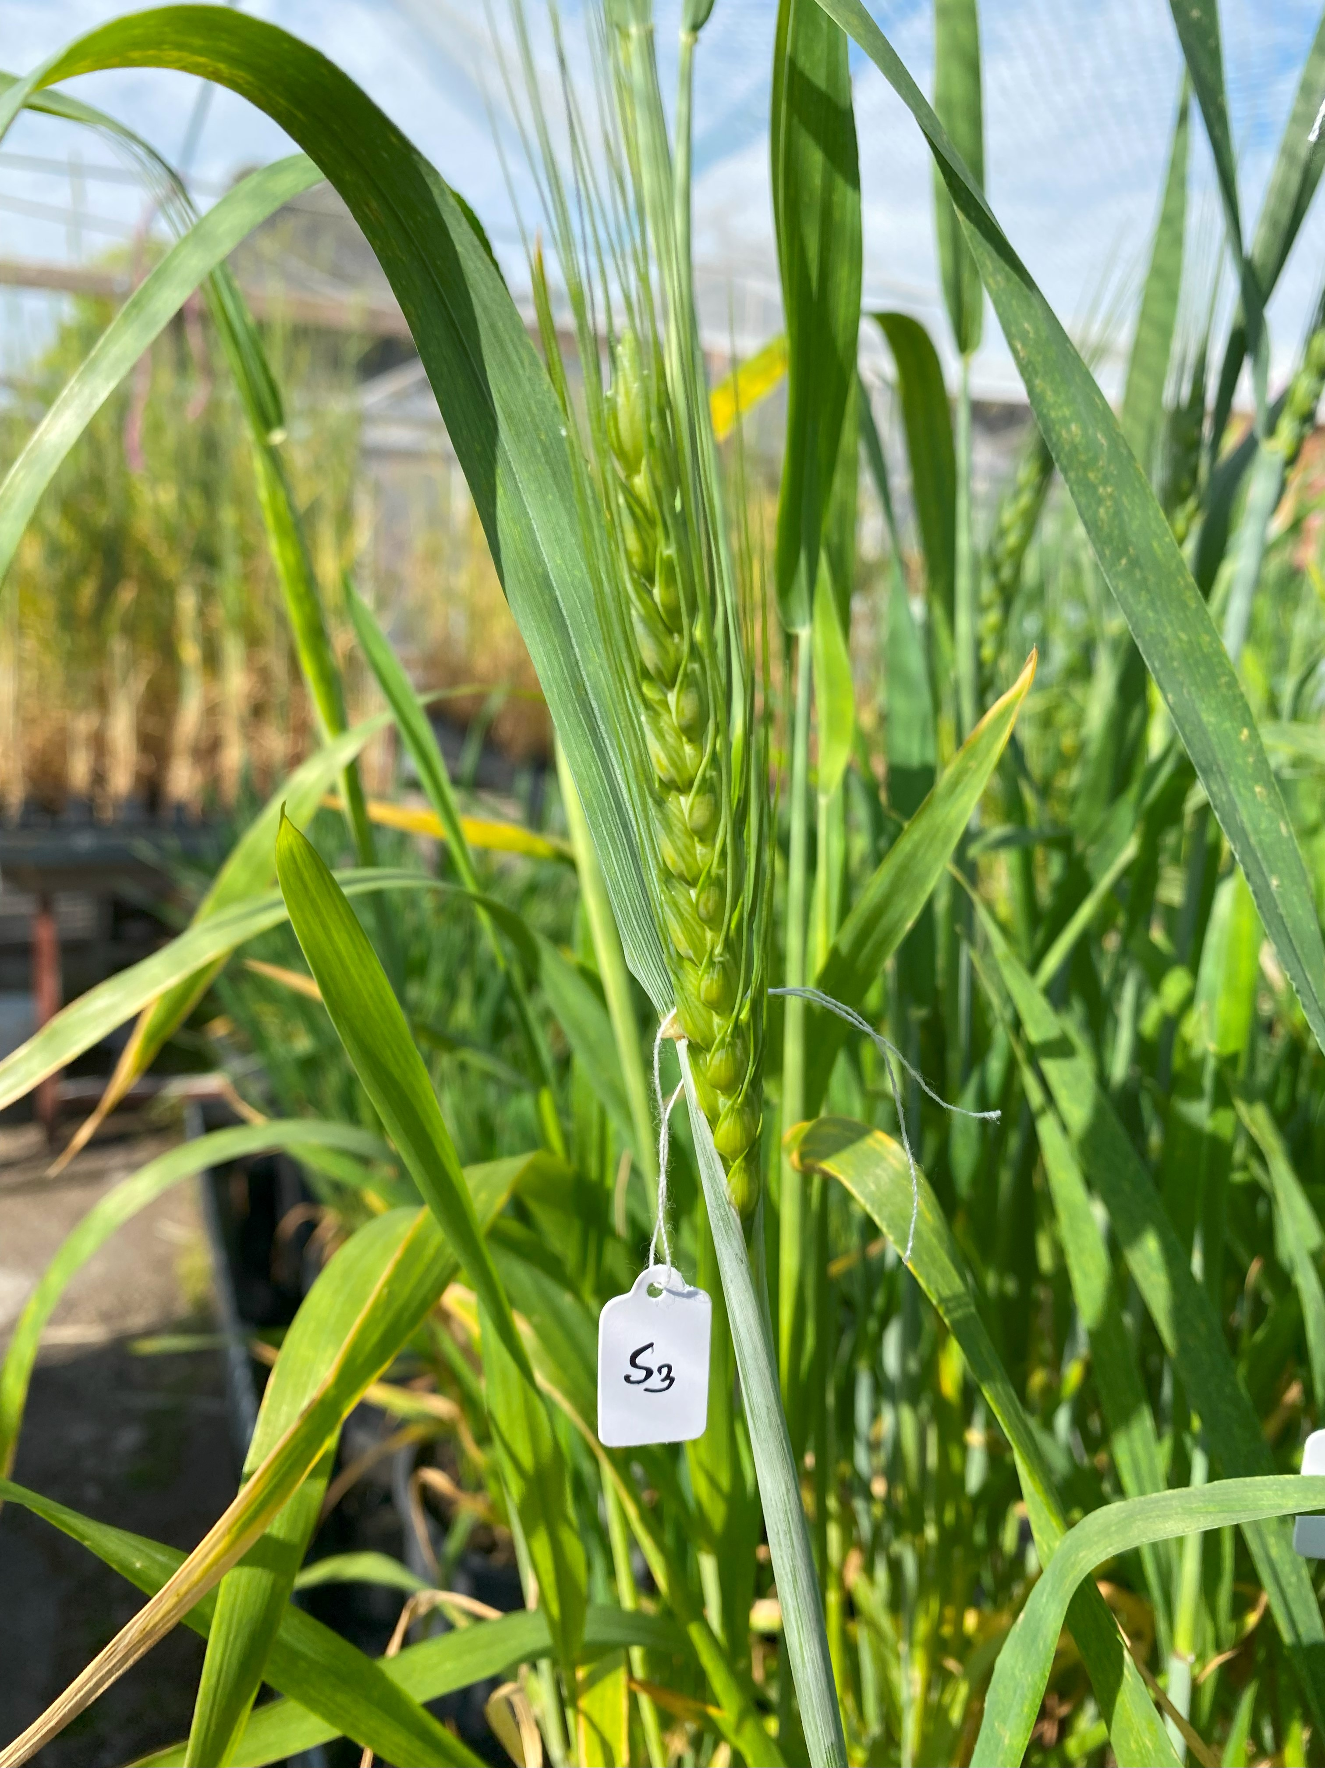
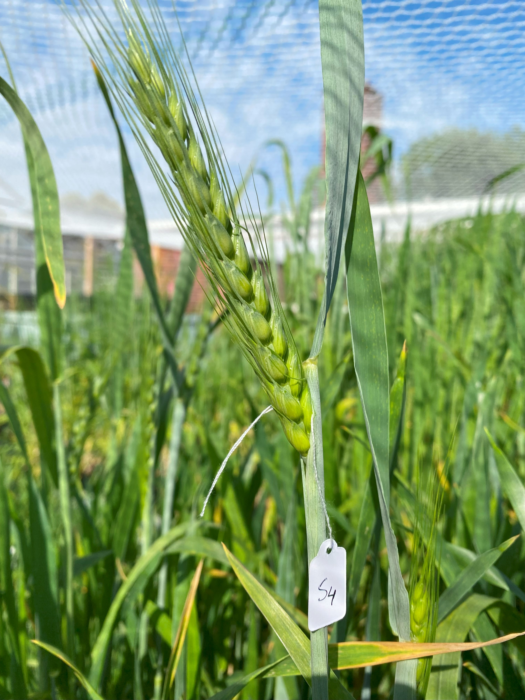
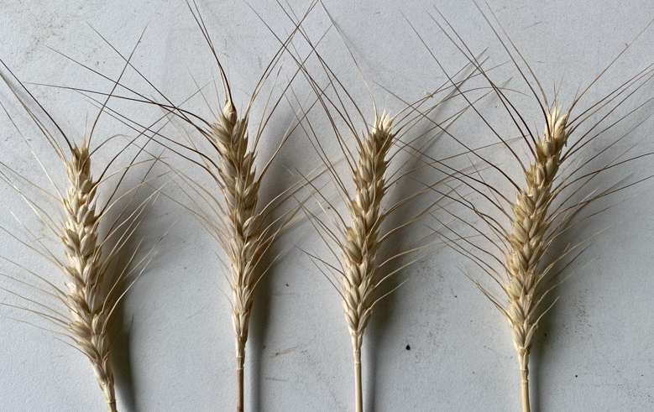
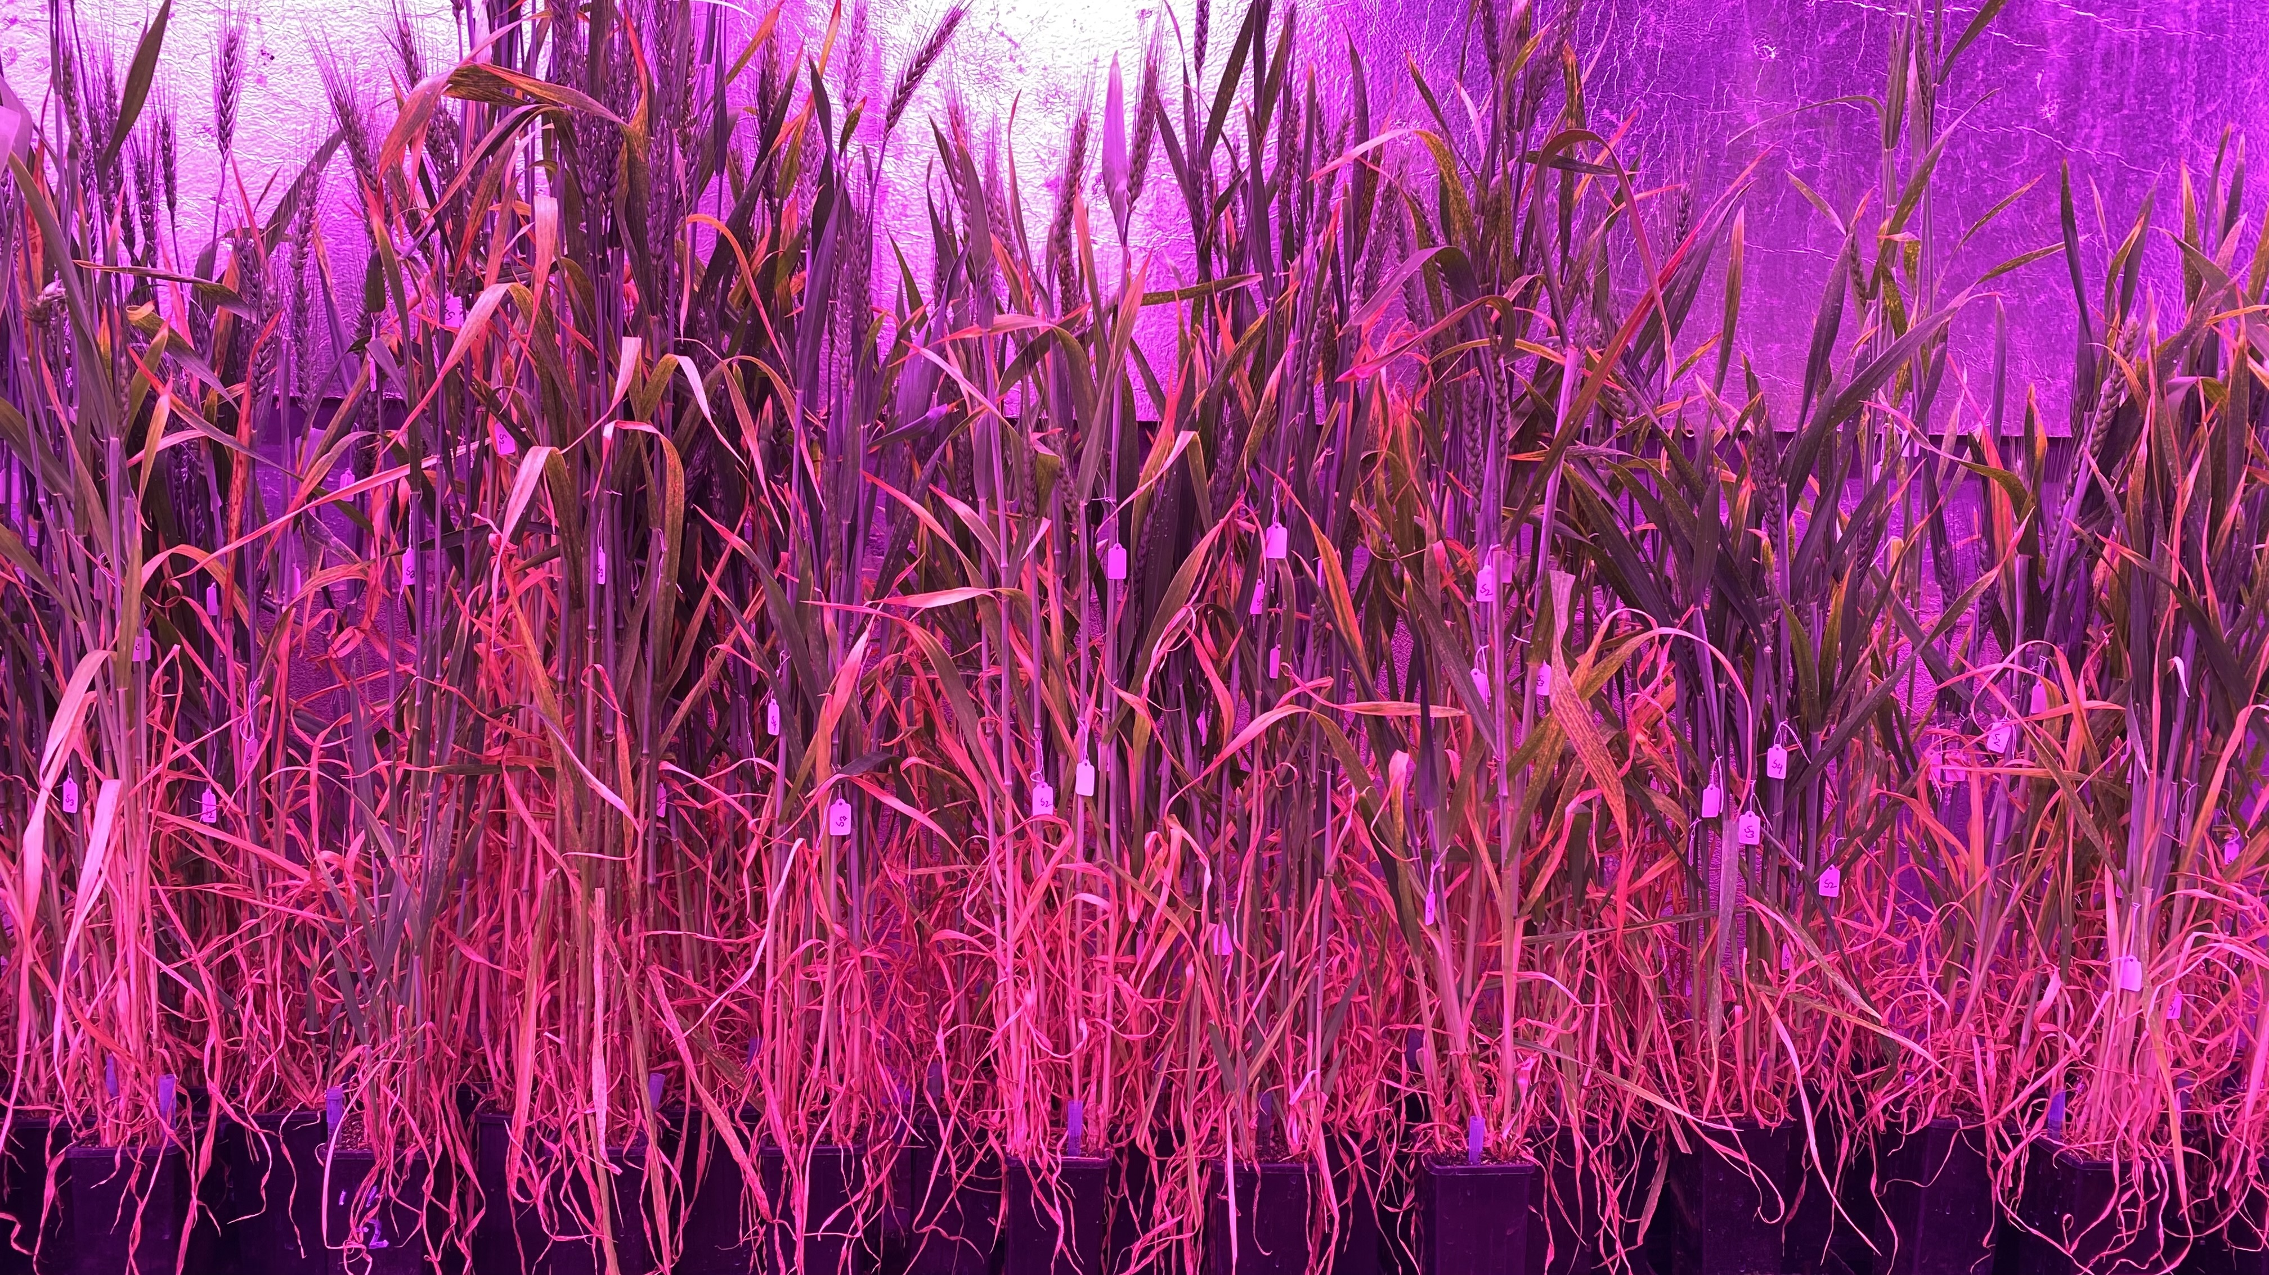
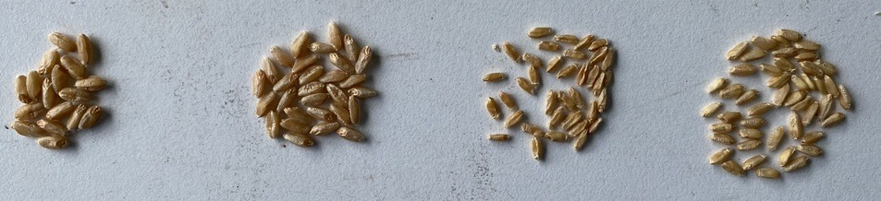
Supplementary Figures
319 lines, 4 plants/pot
Tagging S1, S2, S3, and S4 based on heading stage
37°C, 2 weeks
Seed set data recording
Figure S1. Overview of glasshouse experiments involving tagging ear emergence stage as indicated by S₁(very early booting stage), S₂ (early booting stage), S₃ (early ear emergence stage) and S₄ (very early flowering stage). Plants were exposed to two weeks of heat treatment in controlled grow room with sufficient water. Spikes from each tagged ear was harvested separately for grain filling data recording.

Slide 2
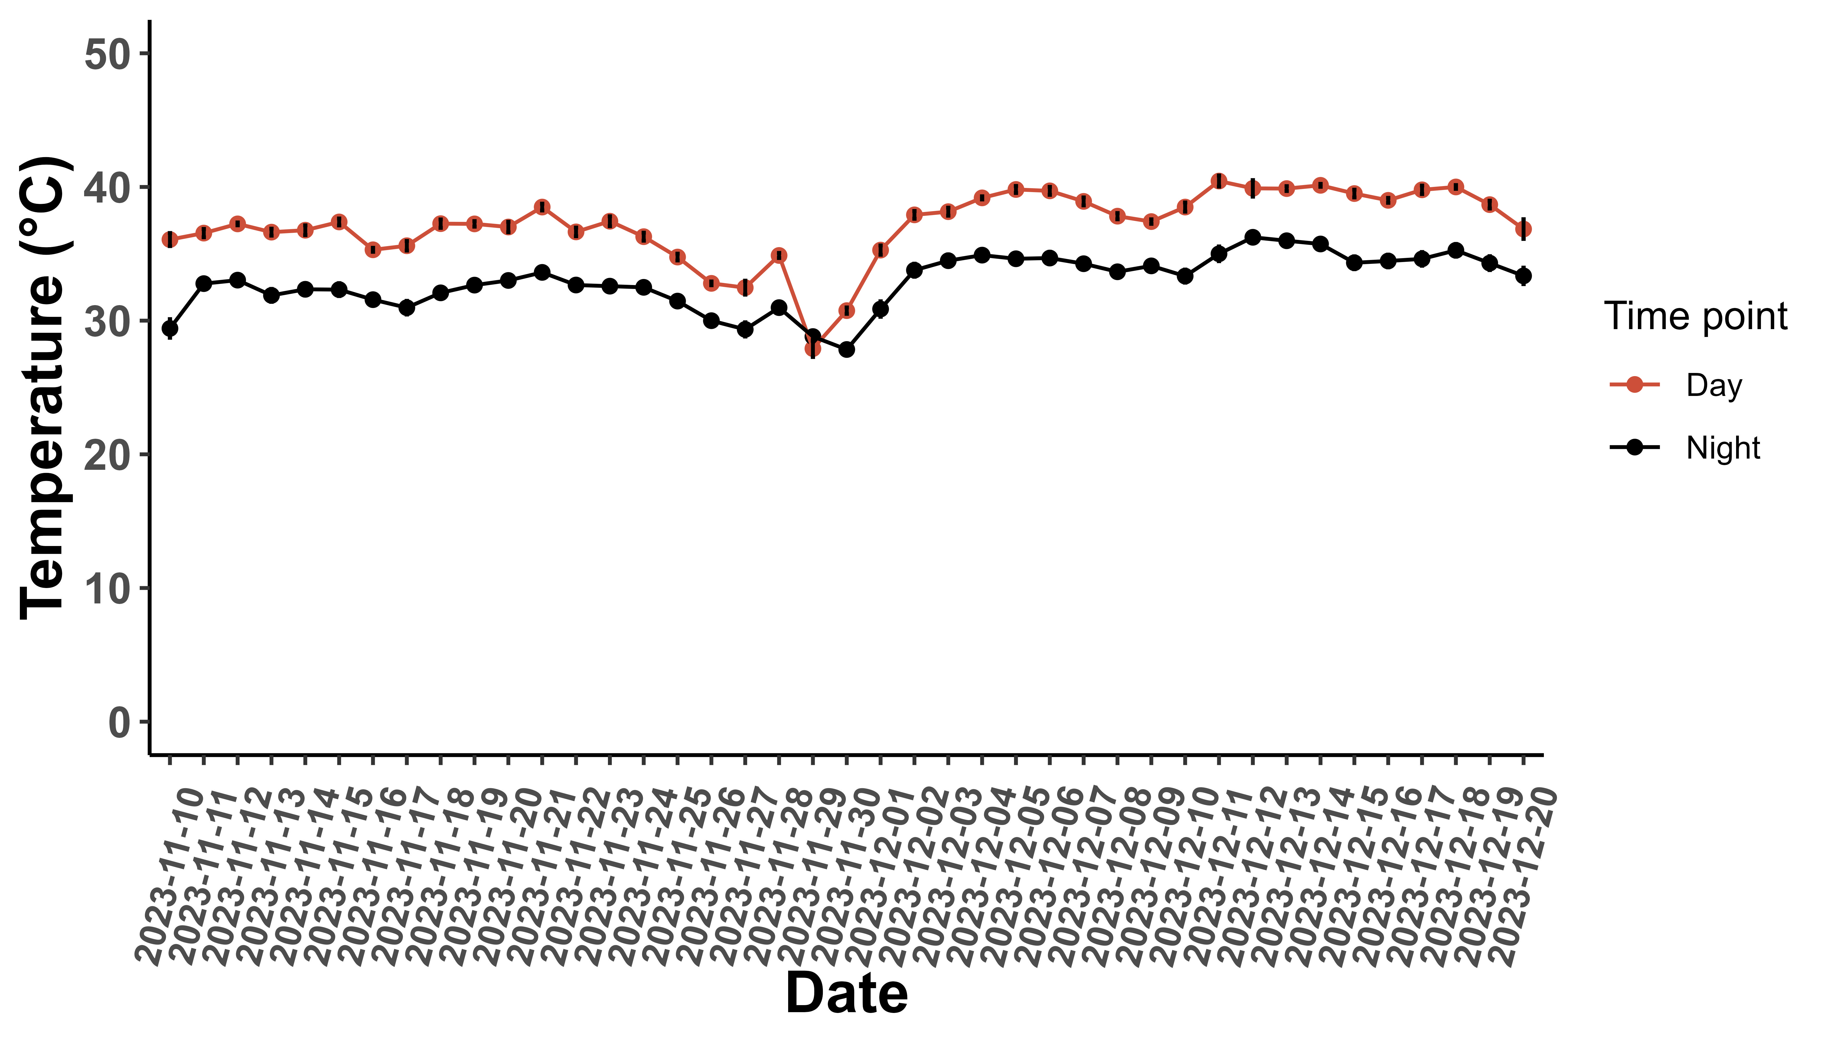
Figure S2. Day and night temperature in the controlled grow room during the heat treatment of 319 wheat lines. Temperature was recorded every half an hour and later categorized as night and day temperature.

Slide 3
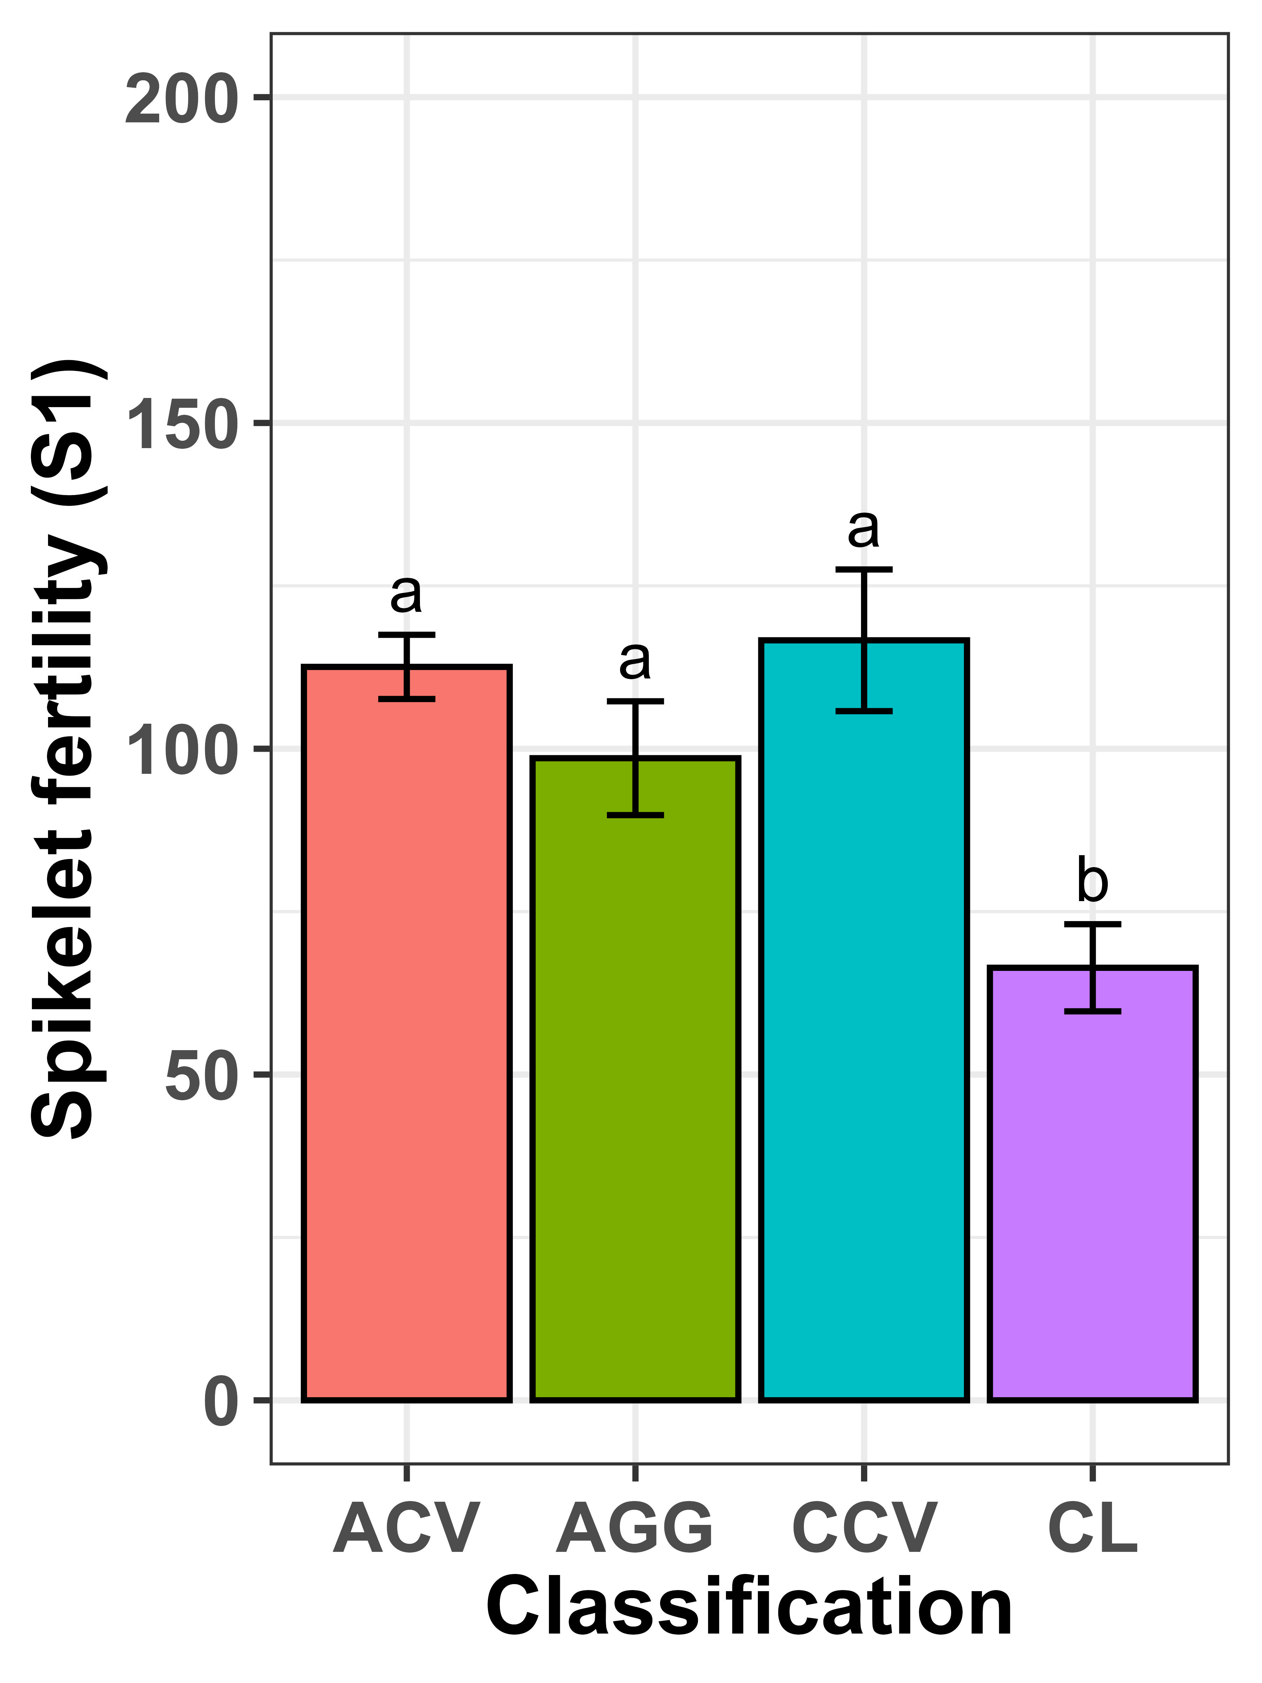
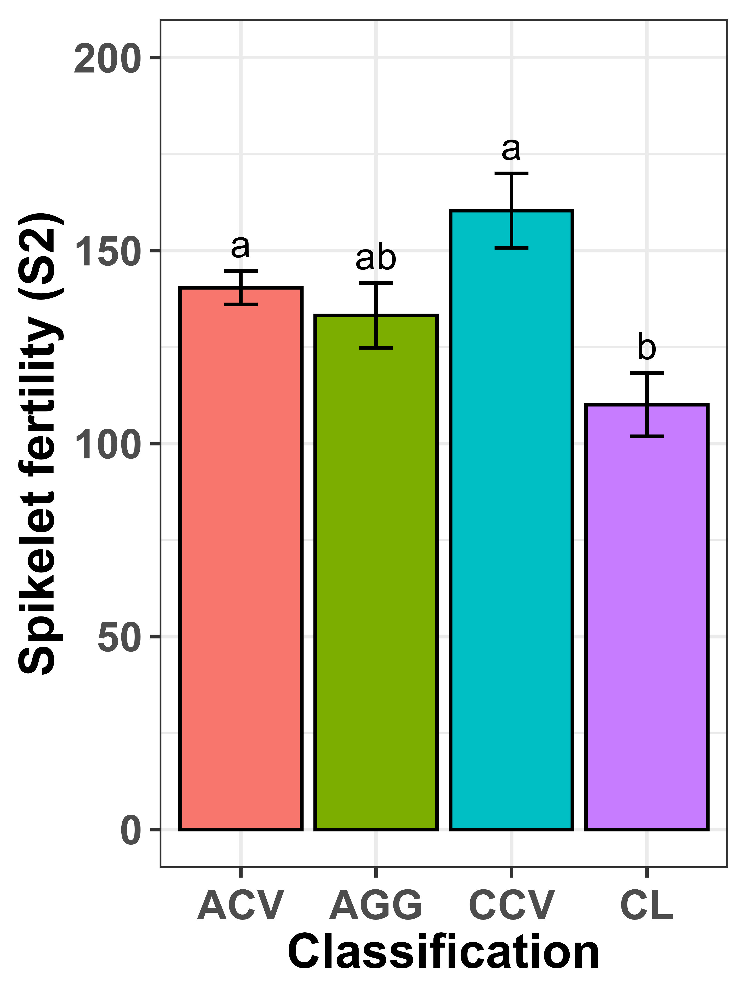
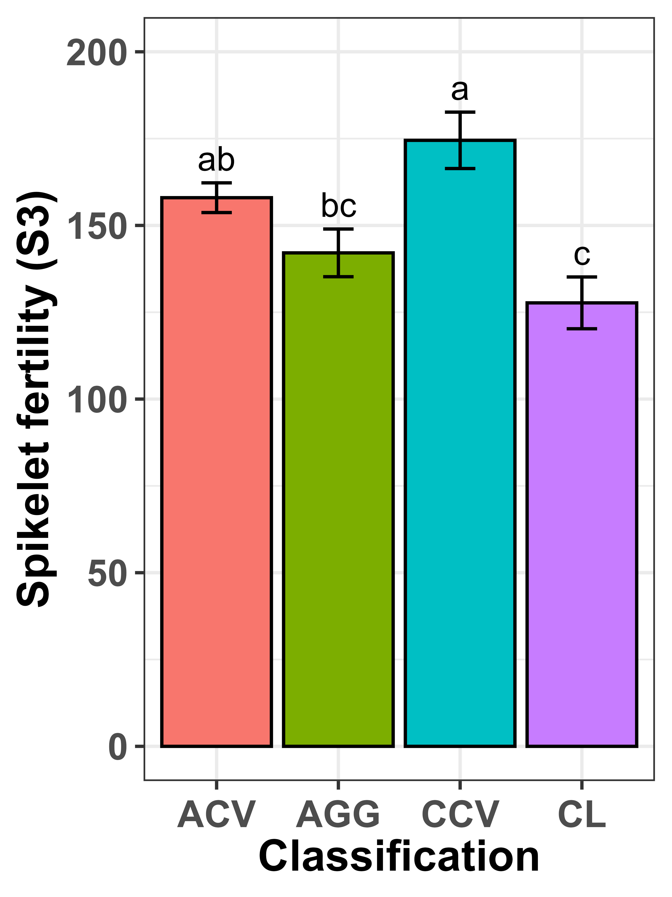
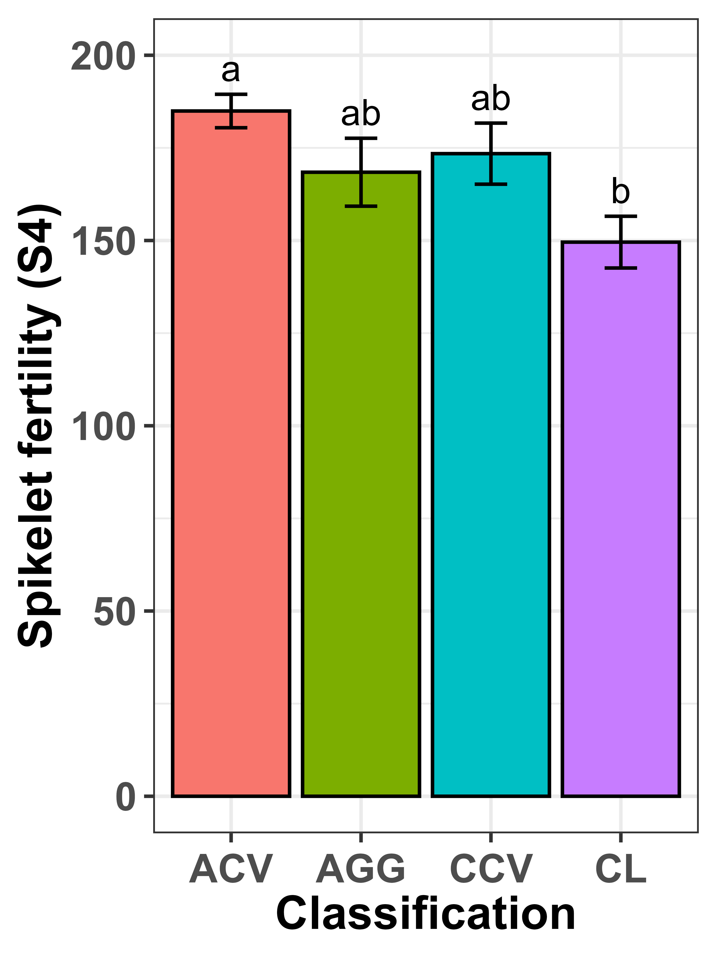
A
B
C
D
Figure S3: Mean comparison of spikelet fertility of early- and late-stage heat treatment on 319 wheat lines based on their classification. Mean value is presented as the bar graph with standard error bar and letter indicates the significant differences at 5% level of significance.

Slide 4
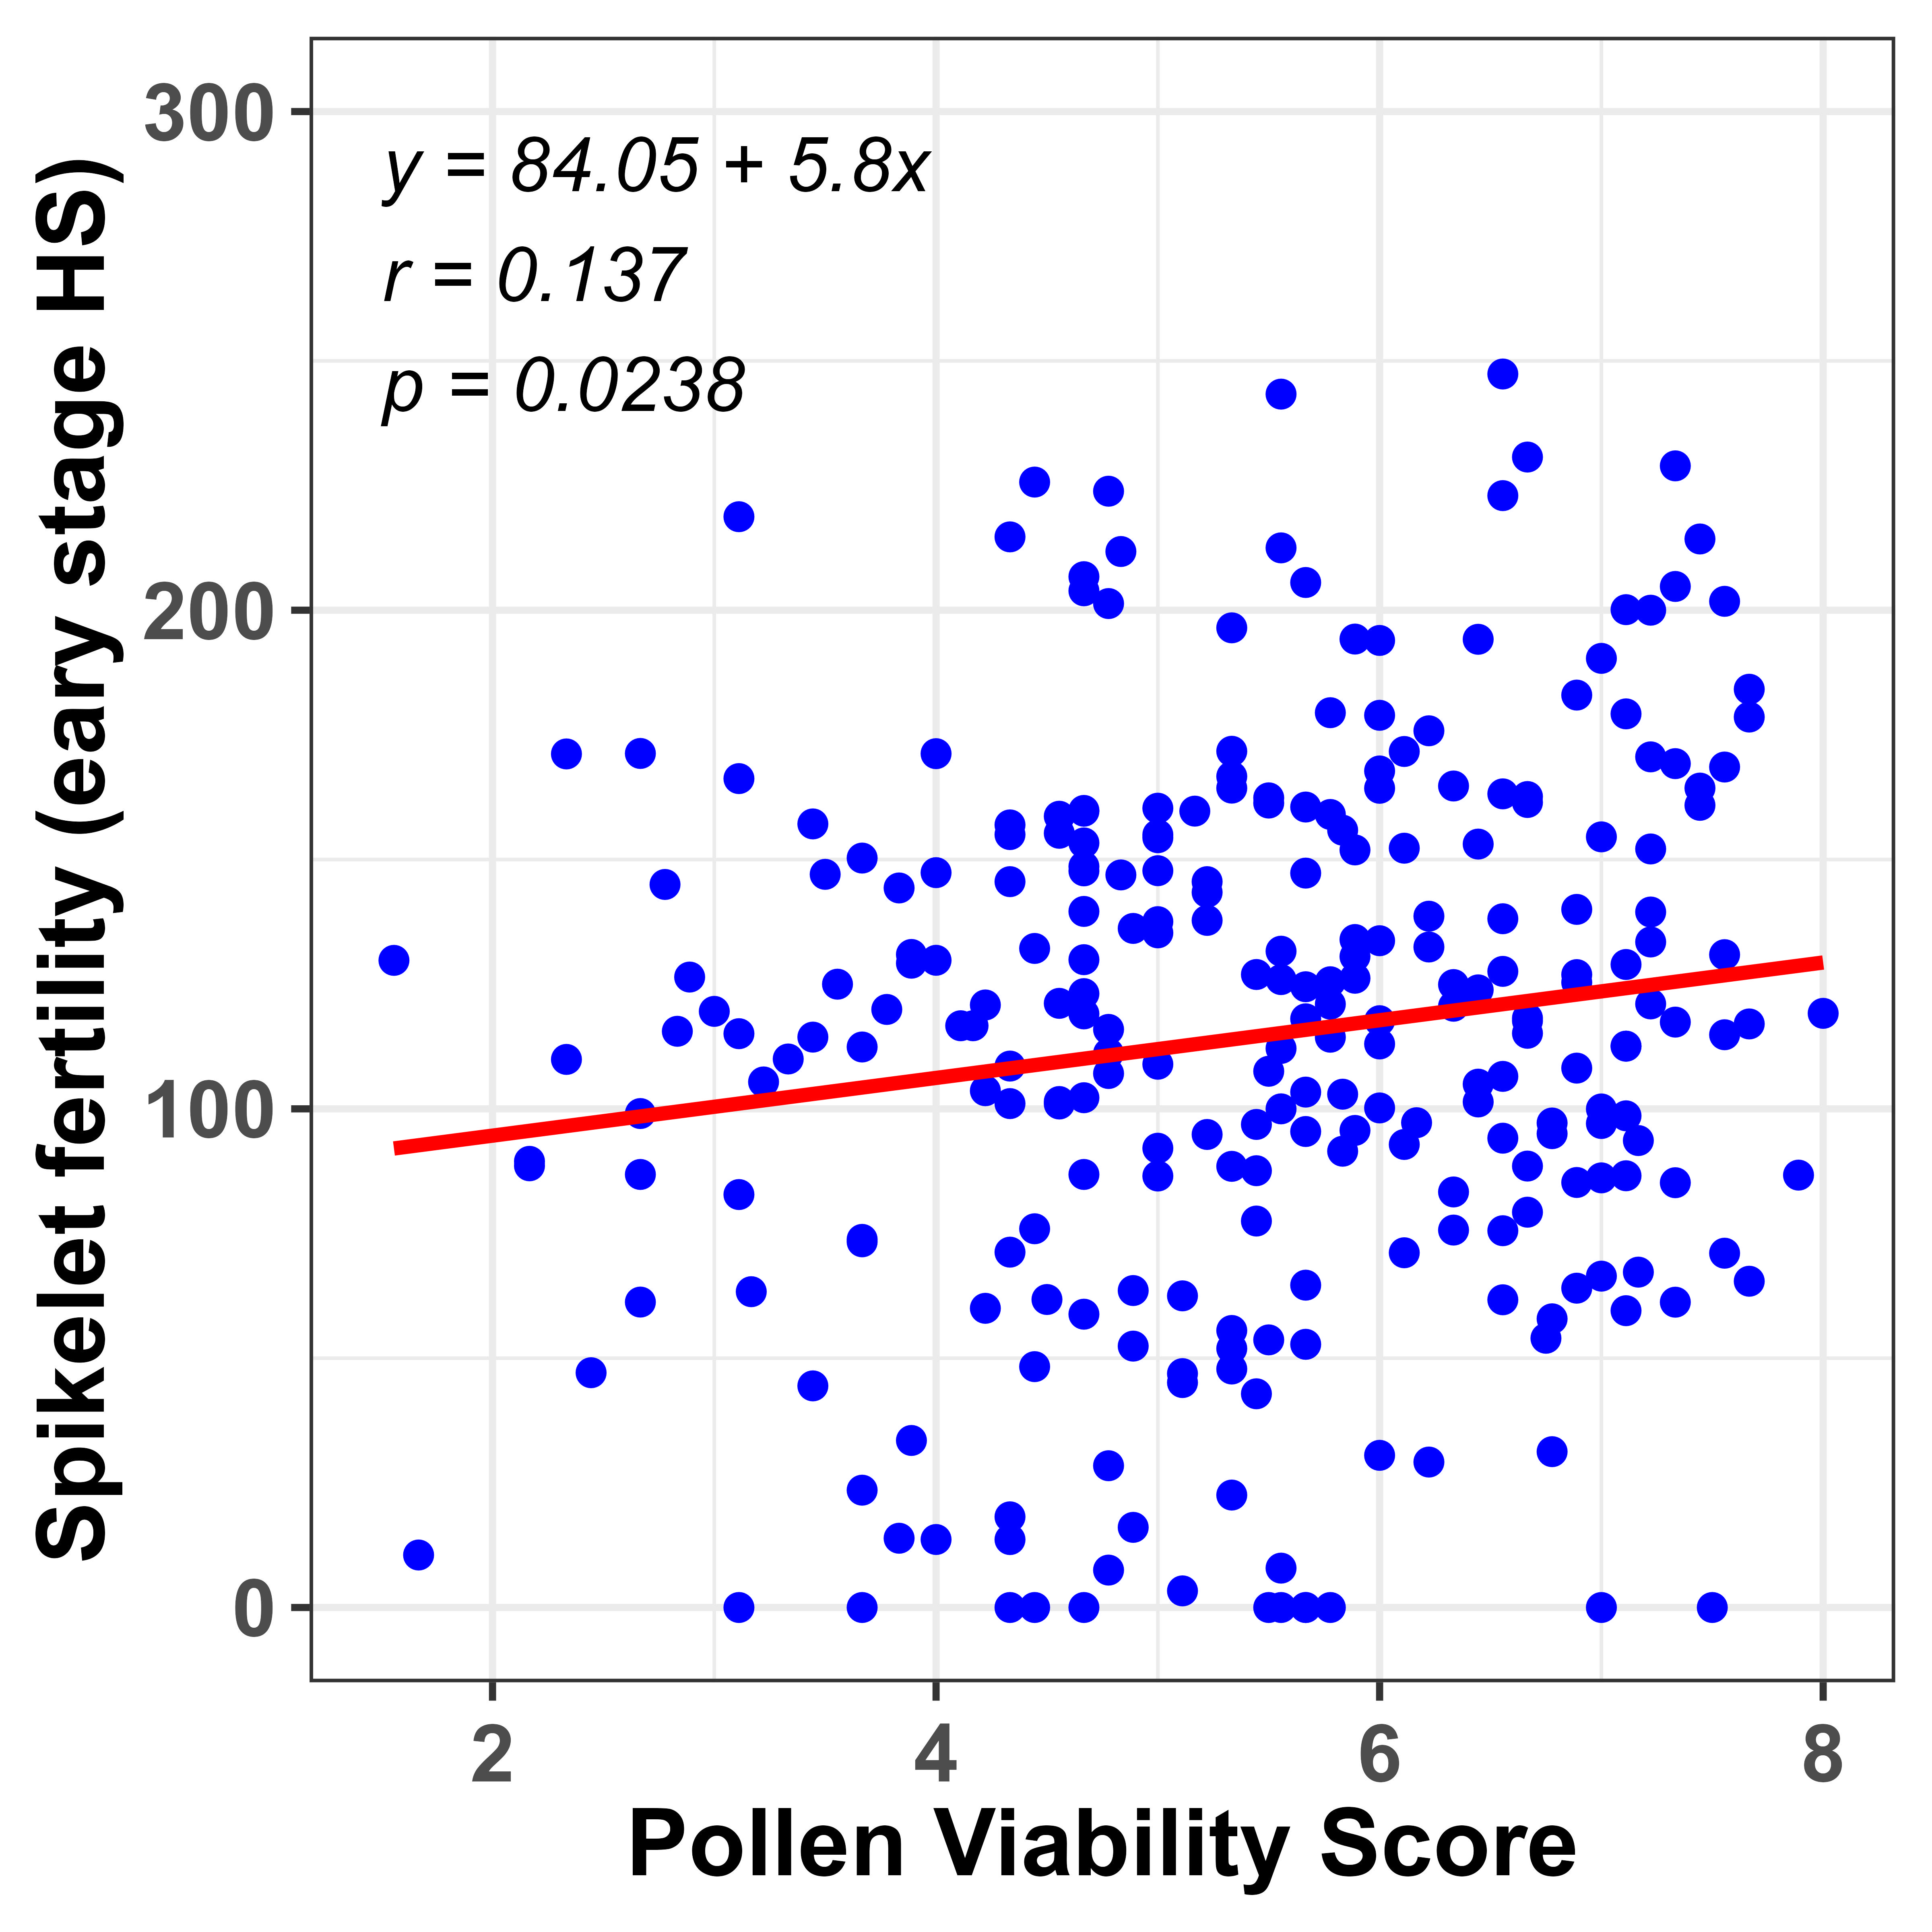
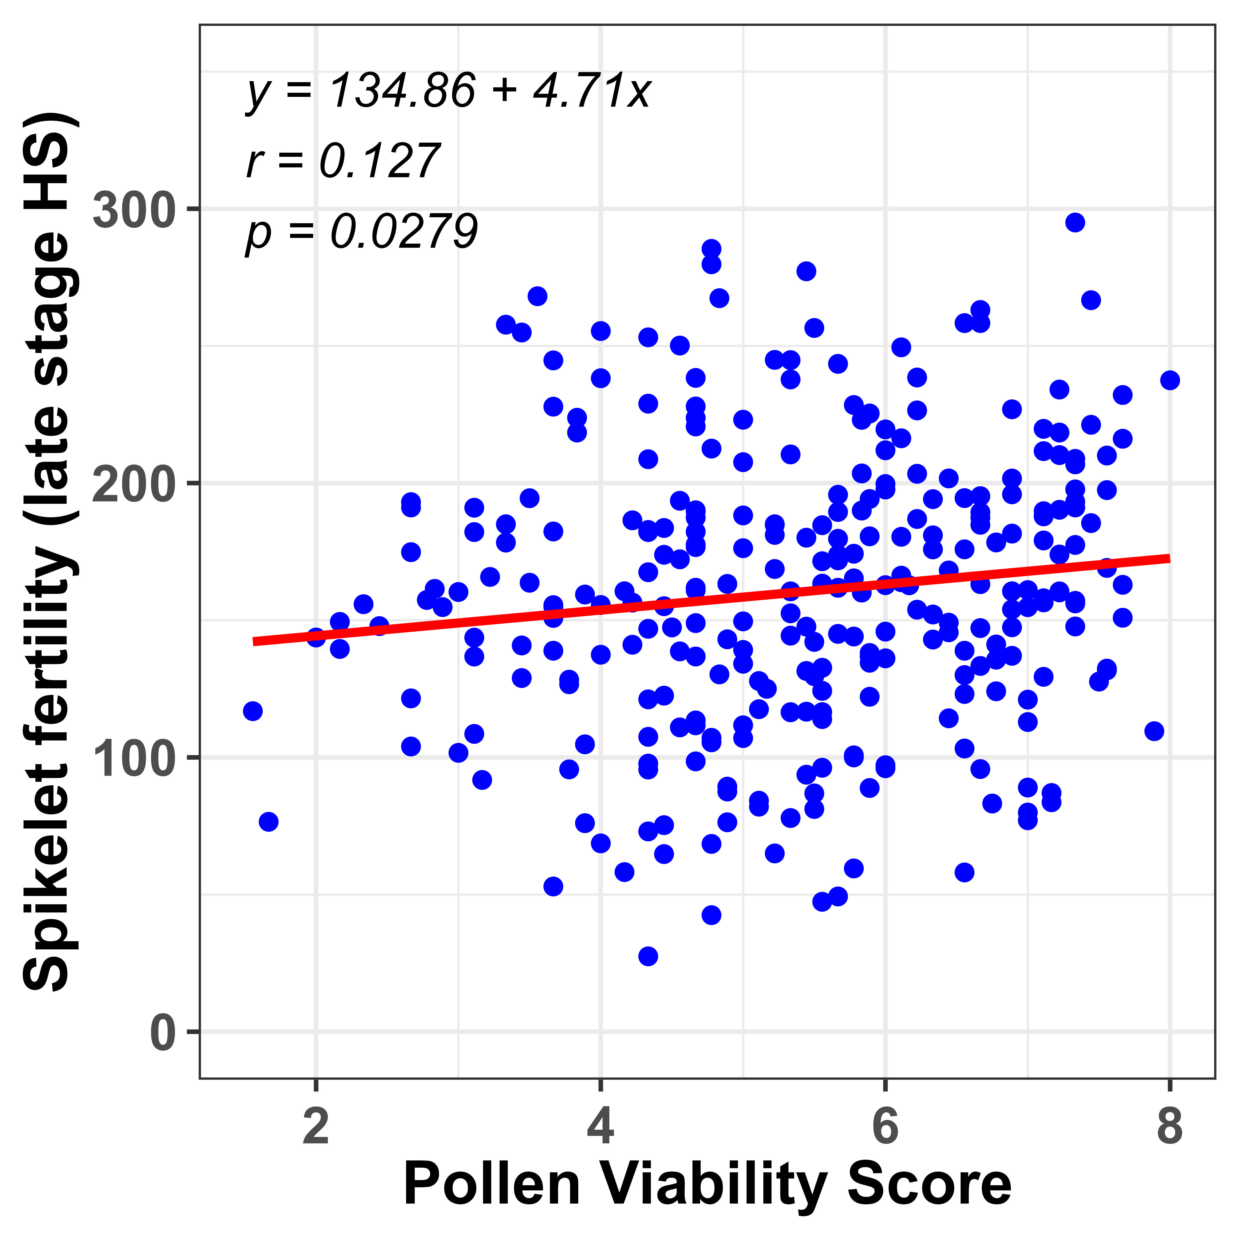
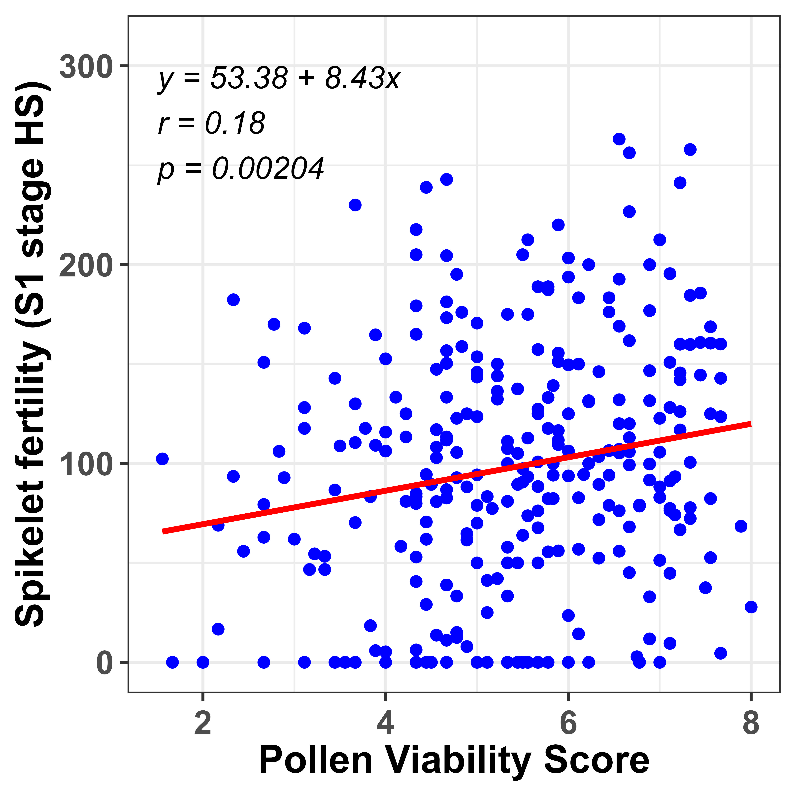
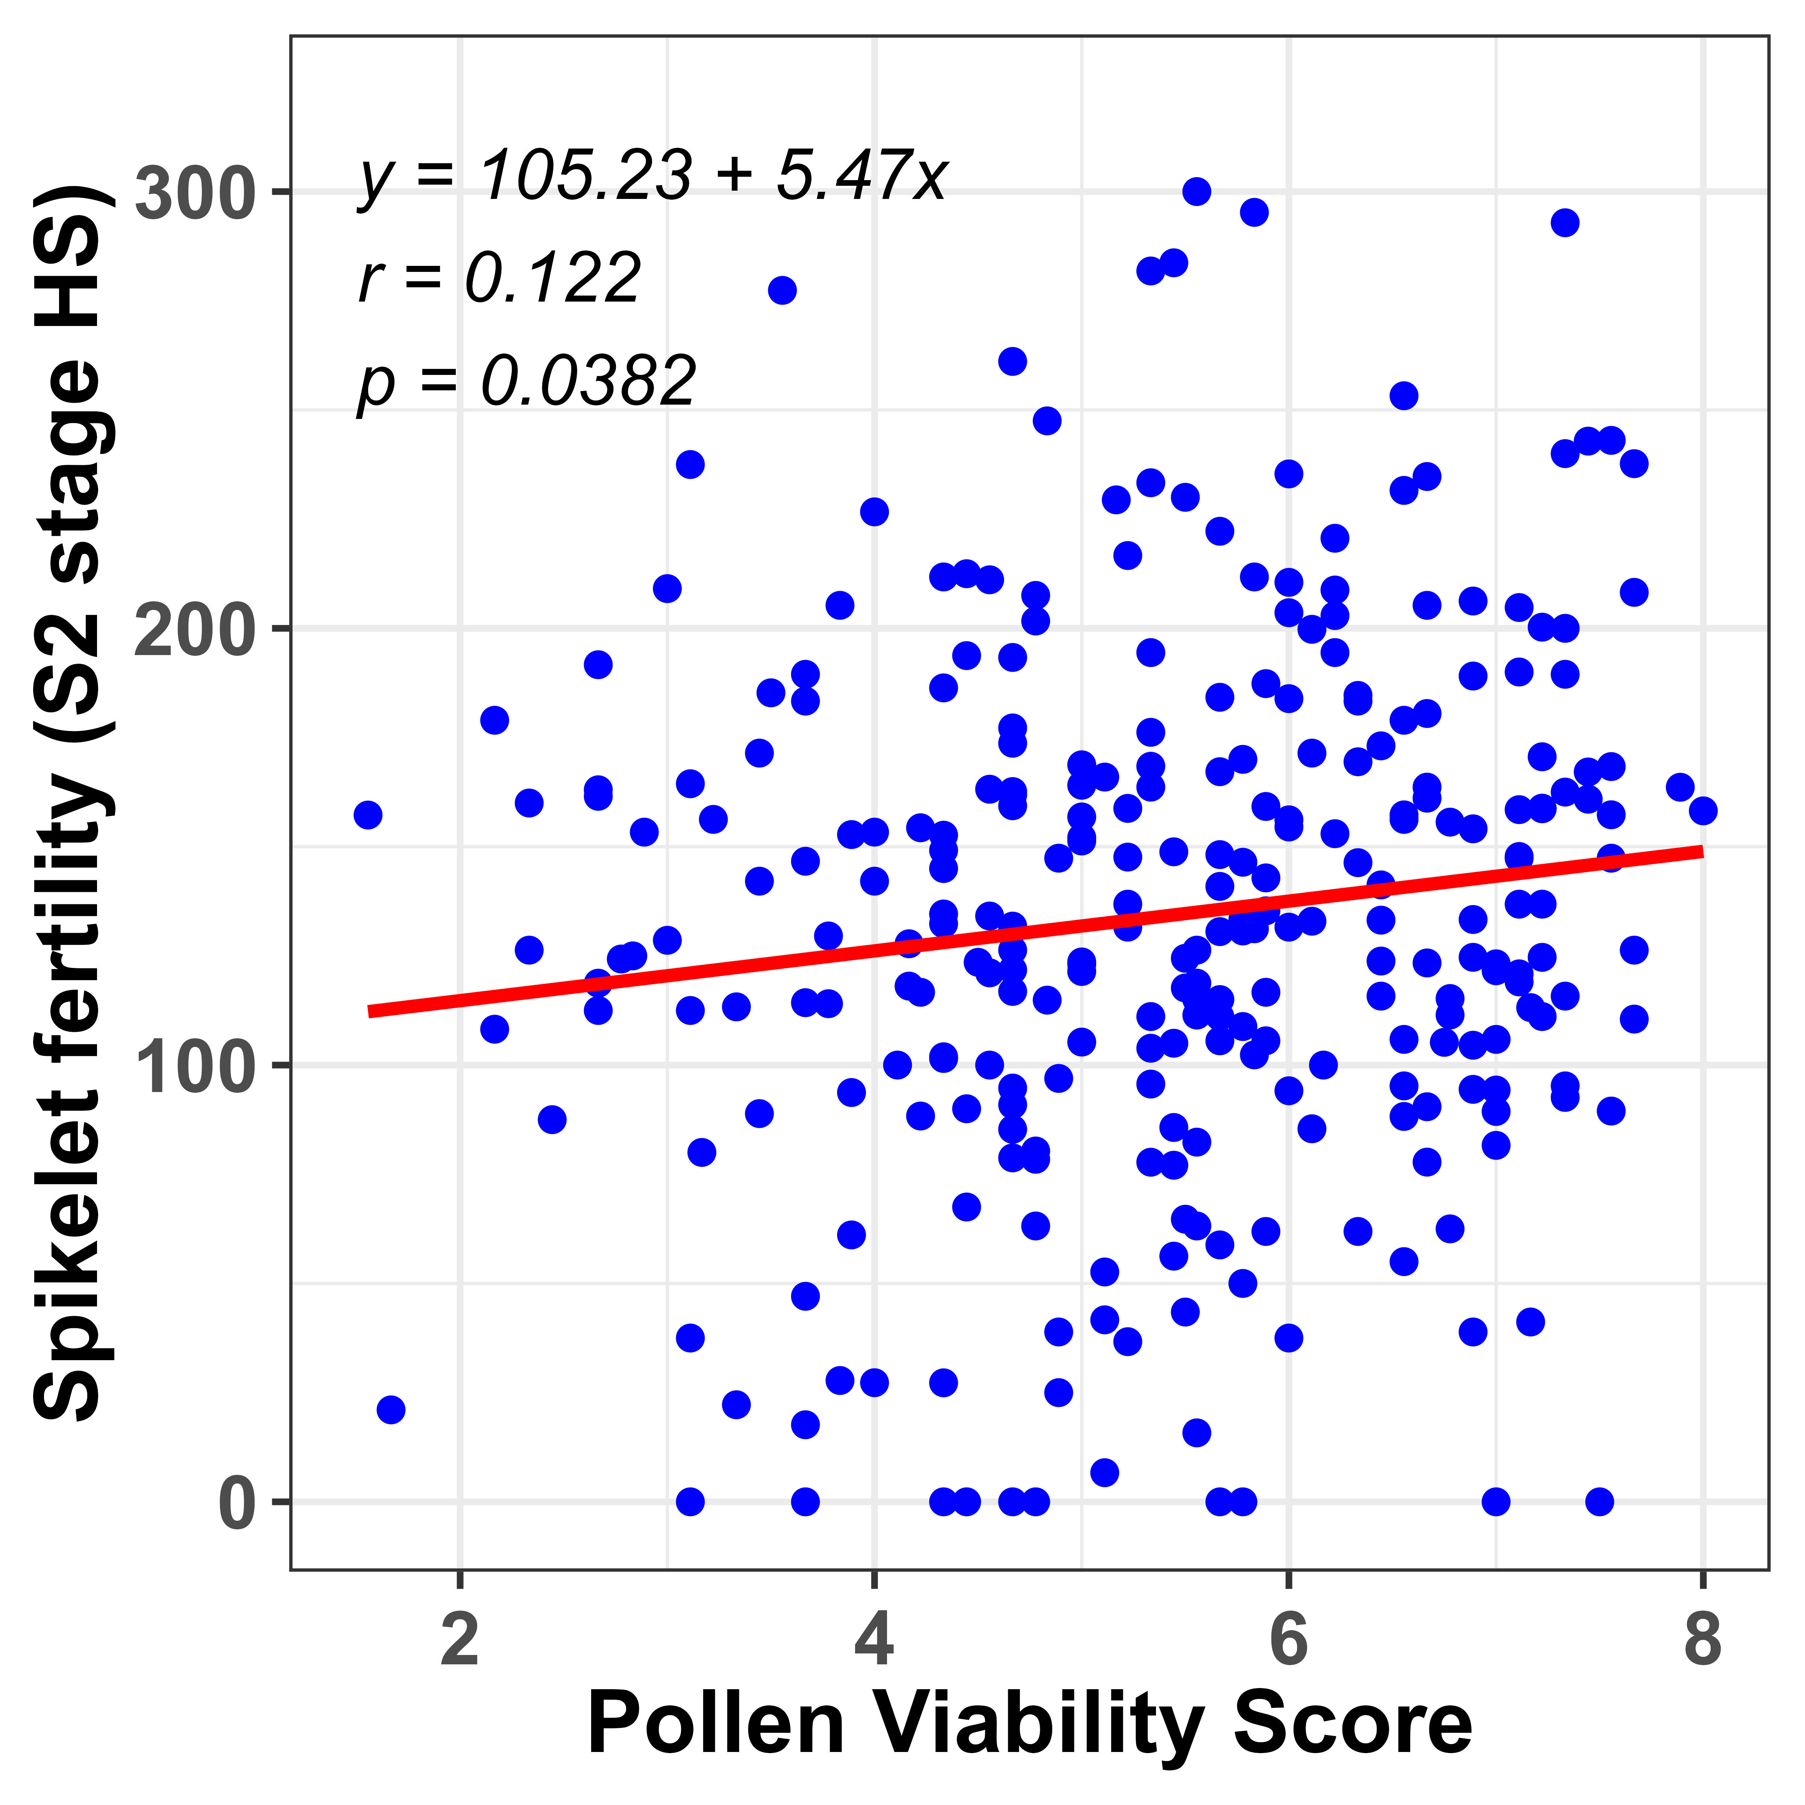
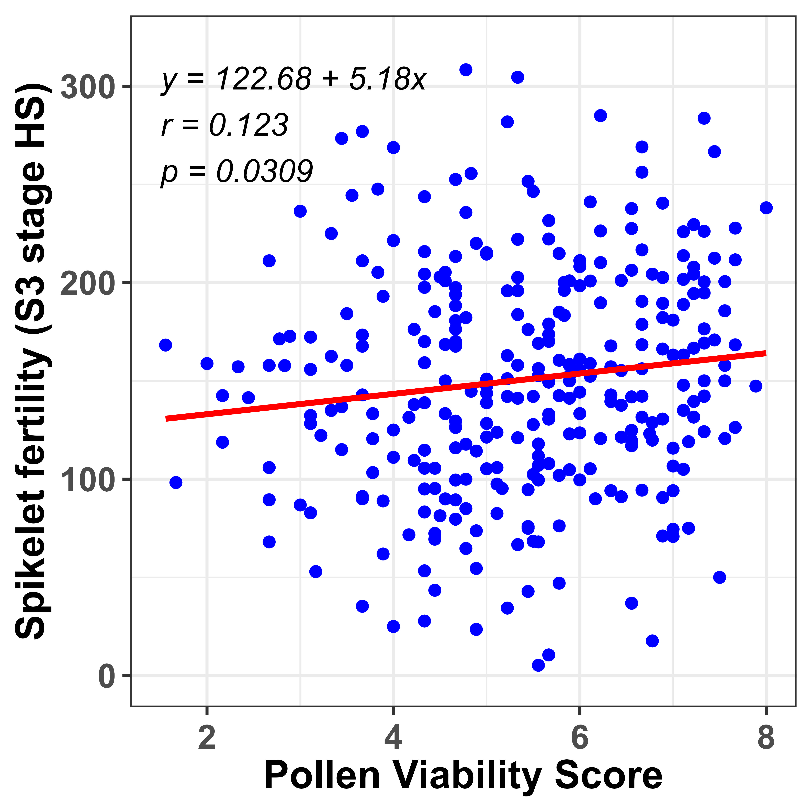
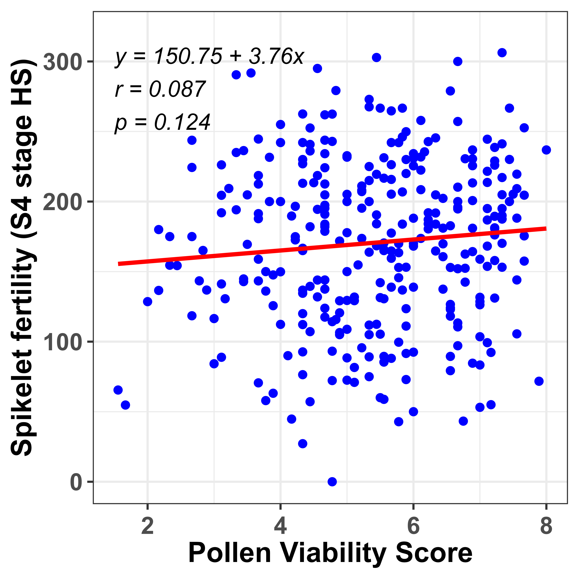
A
B
C
D
E
F
Figure S4: Pearson correlation between pollen viability score and spikelet fertility (early- and late-stage heat treatment). (A-B) Overall correlation between PVS and spikelet fertility and (C-D) Correlation between PVS with spikelet fertility of individual four ear emergence stage.

Slide 5
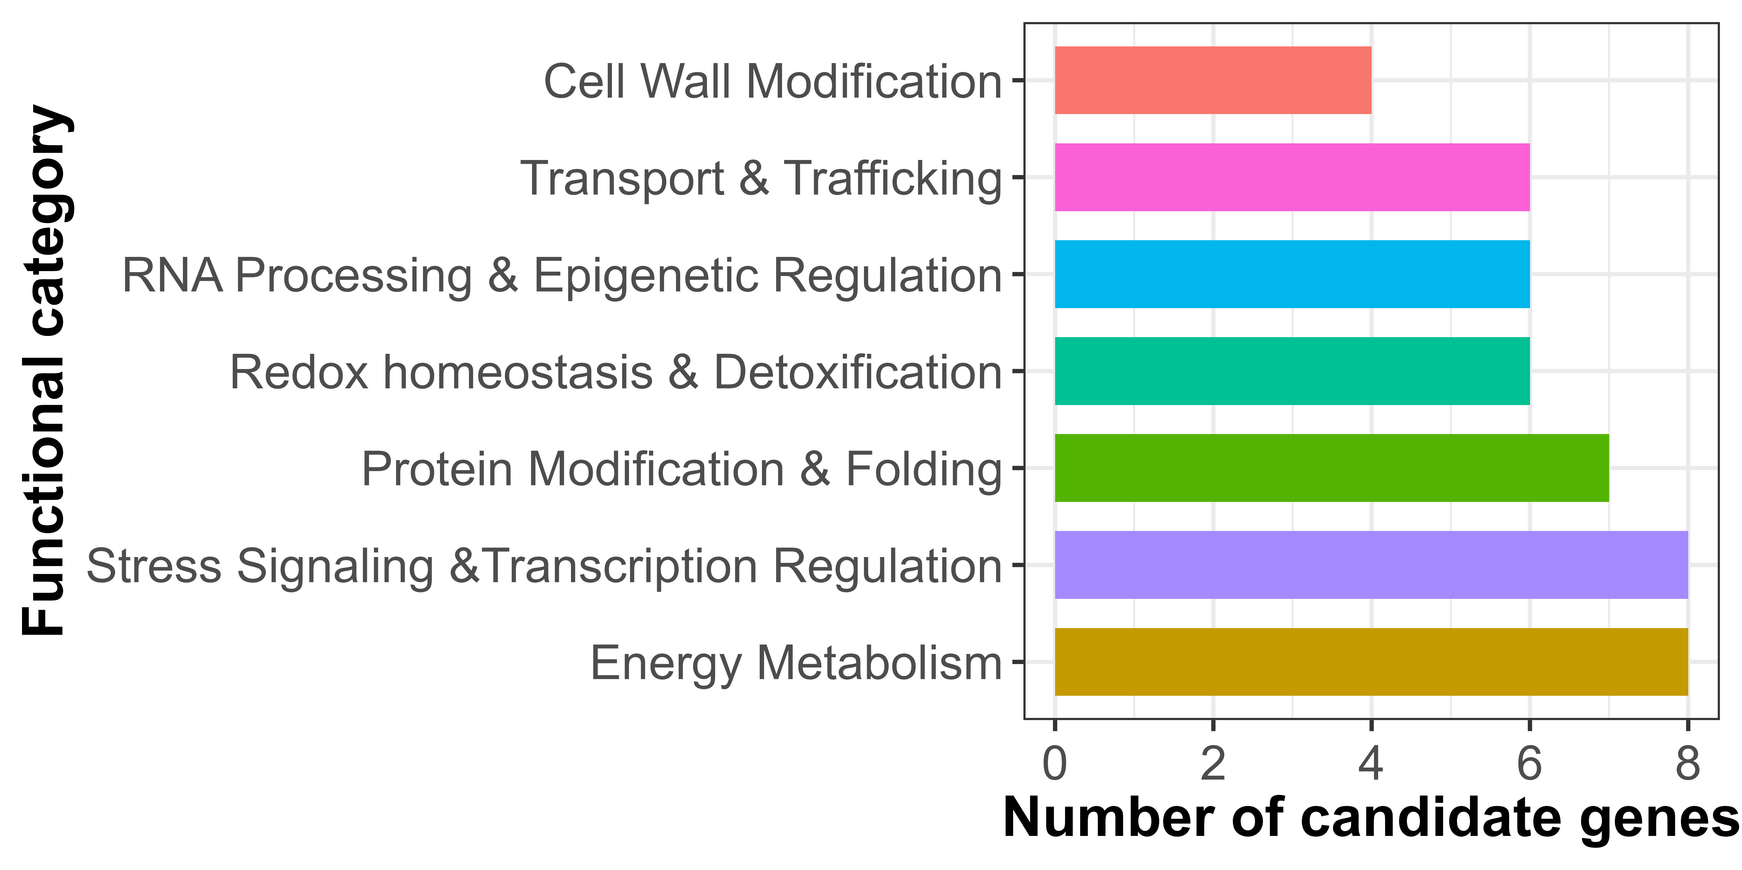
Figure S5. Broad functional categories of identified candidate genes near the significant SNPS associated with pollen viability score and spikelet fertility. Candidate genes were assigned to specific functional category based on their available description.

