Slide 1
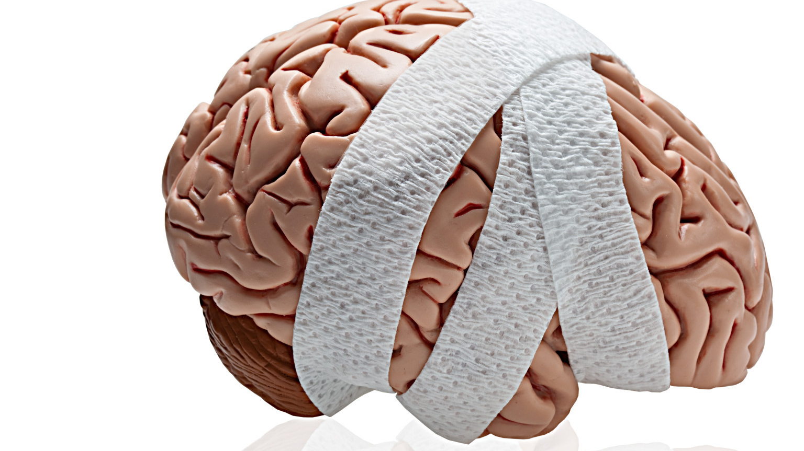
Brain Injury and Disorders of Consciousness
Clinical, Communication, and Ethical Issues

Slide 2
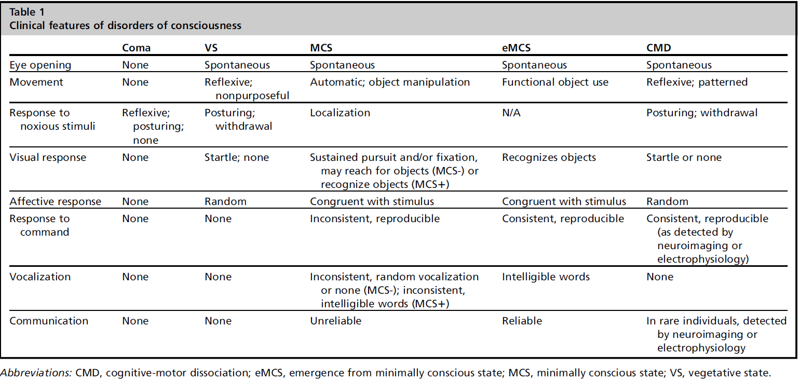

Slide 3
Case
Georgina Ludka, a 45-year-old female, was boating on Lake Cass when she fell overboard. She was unable to swim such that she was underwater for approximately 15 minutes before EMS arrived. At their first assessment, there was no palpable pulse and the ECG detected pulseless electrical activity. She was intubated and chest compressions were initiated. After six rounds, ROSC was obtained. Her vitals were BP 100/60, pulse 80 with no spontaneous respirations. Georgina’s husband, Nick, who was with her at the time of the accident, is the surrogate decision-maker for Georgina and is in the room with Georgina at the moment.
Objectives
Explain to the surrogate decision-maker that you will be performing a neurological assessment.
Perform a neurological assessment. Please verbalize the exam and your findings.
  If you have questions regarding the exam or its findings, you can call the attending neurologist using the phone in the room.
After you have completed the exam, communicate the results to the surrogate decision-maker.
Remember: What happens in the simulation stays in the simulation.

Slide 4
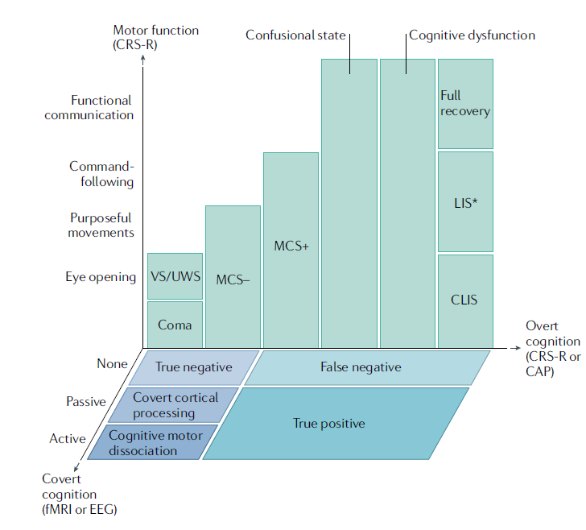

Slide 5
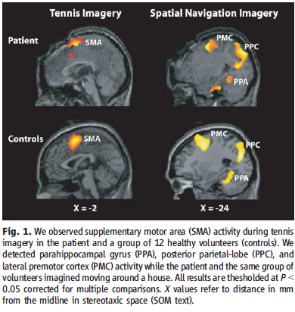
Diagnosis and Prognosis
Diagnosis is done behaviorally, and misdiagnosis is common (~40%, usually for TBI) (Childs, 1993).
Common causes of misdiagnosis via behavioral assessment is failure to detect purposeful eye movement (Schnackers, 2009). Best practices include morning assessments, use of mirrors, involving family (Goss, 2022).
Even when behavioral assessment is done correctly, studies began to reveal that many patients were “covertly aware,” able to respond to commands but only via neuroimaging (Monti, 2010).
Best practice for diagnosis now includes behavioral, imaging, and EEG (Edlow, 2020).
The Adaptive Recovery Index is a promising new approach for determining possibility for recovering consciousness in a patient with severe brain injury (Duclos, 2022).
Older prognostic thresholds for “permanent” VS (3 mo after anoxic, 12 months after TBI) have proven unreliable. AAN recommends saying “chronic” instead (Giacino, 2018).

Slide 6
Treatment vs Comfort
A dilemma arises between prognostic clarity and the “window of opportunity” to withdraw life-sustaining treatment from a highly dependent patient (Kitzinger, 2012).
Treatment:
  Continuing LST (usually trach/PEG).
  Amantadine (Giacino, 2012).
  DBS: proof of principle study showing improvement in attentive responsiveness, limb control, oral feeding, and spoken language (Schiff et al 2009).
Concern about “halfway technology,” raising consciousness just enough to make patients more aware of their poor situation.
Comfort:
  Withdrawing LST (usually a vent if within the “window of opportunity”).
  Organ procurement process: DCD only. Can only be discussed after a decision to withdraw or before IF raised by family.

Slide 7
Communicating with surrogates
Communicate uncertainty where it exists.
Avoid perpetuating traditional understanding of VS as permanent, which may lead to early withdrawal of LST.
Avoiding statements of universally poor prognosis when discussing goals of care with surrogates.
Acknowledge own uncertainty.
Communicate uncertainty with bracketed range (best case vs worse case).
Be specific about what “meaningful recovery” means to surrogates.
Ethical question: Should the possible detection of covert awareness be stated to surrogates when imaging is not available to do the testing?

Slide 8
Communicating with patient
How to ask:
Standardize system (one blink for “yes,” two blinks for “no”).
Attempt to establish a “timeout needed” signal (e.g., a sustained 5 second blink) for the patient to give during questioning.
Establish reliability by asking the patient questions we know the answers to (“Are you in the hospital?”, “Are you in Michigan?”).
Finally, the patient may be asked direct questions about preferences related to treatment.
What to ask about:
Low risk: Are you in pain?
Medium risk: Do you want X to be your decision maker?
High risk: Do you want to withdraw LST? (Peterson, 2010).
How to interpret (consent/assent):
Reliable binary responses sufficient for consent in low/medium risk decisions.
Reliable binary responses sufficient for assent in high-risk decisions (code status, comfort care) to aid/relieve surrogate burden.

