Slide 1
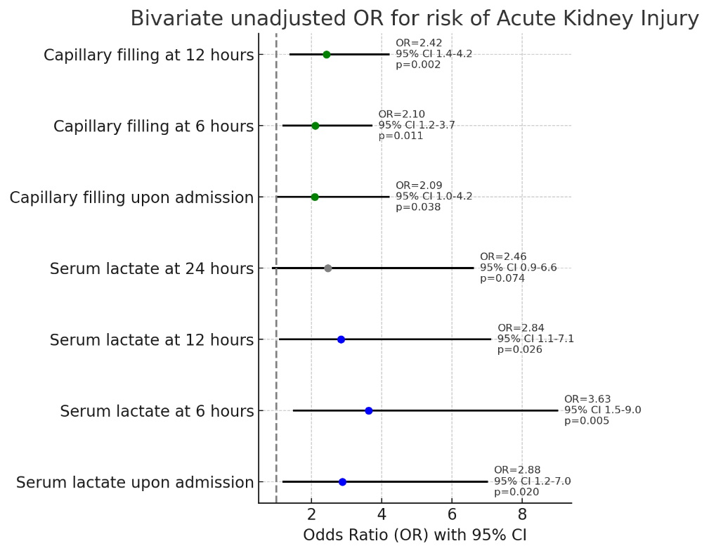
Clinical Impact Of Serum Lactate And Capillary Filling In Acute Kidney Injury Pediatric Patients Undergoing Cardiovascular Surgery
AIM: Determine the clinical impact of prolonged capillary filling and elevated serum lactate as a risk factor in acute kidney injury in pediatric patients undergoing cardiovascular surgery.
DESIGN & OUTCOMES:
Prolonged capillary filling associated with increased risk of AKI
131 total patients
25 Patients with AKI
106 Patients without AKI
Elevated serum lactate levels associated with increased risk of AKI
Prospective single centre study
CONCLUSION: Elevated serum lactate at 6-12 hours postoperatively, and prolonged capillary filling are risk factors in development of AKI in pediatric patients who underwent cardiovascular surgery.
Restrepo et al. 2025

