Slide 1
Supplementary Figures
Metabolic Reprogramming and GM-CSF Secretion in Areca Nut-Activated Fibroblast Drives Oral Precancer Progression

Slide 2
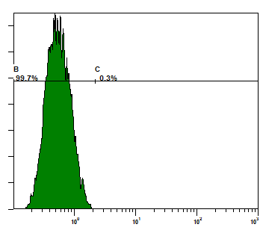
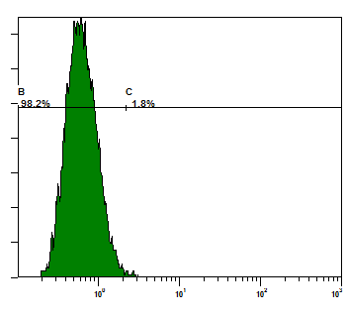
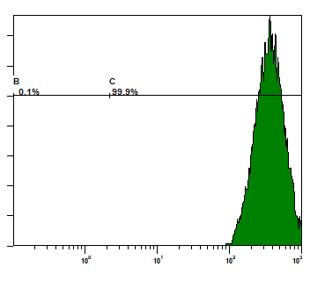

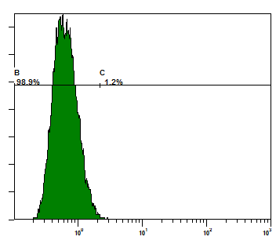
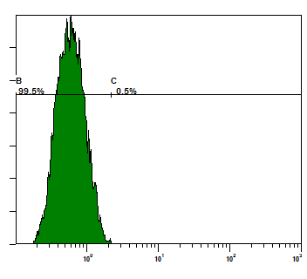
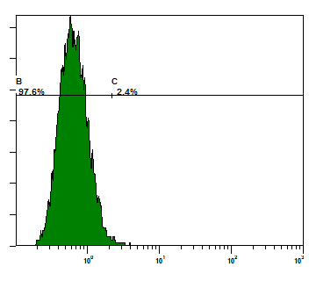
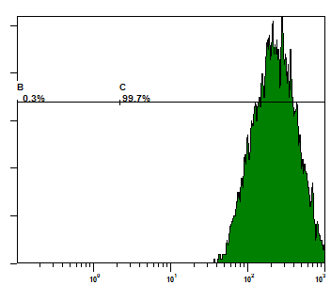


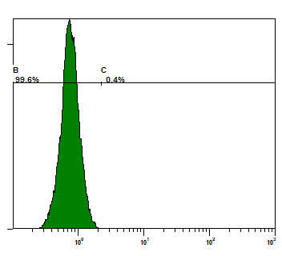
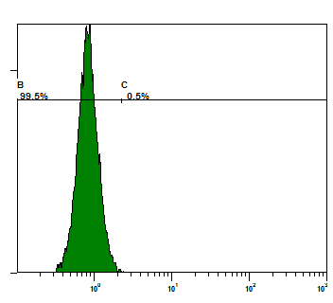
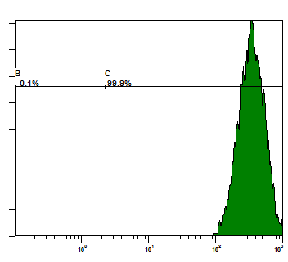
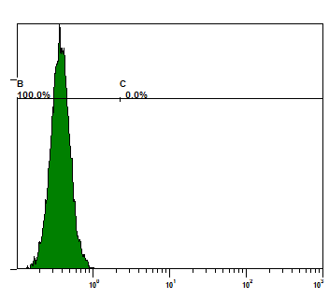
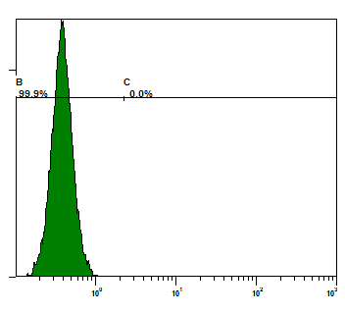
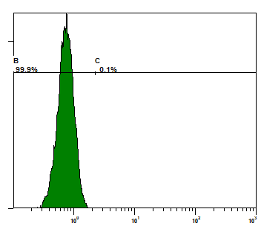
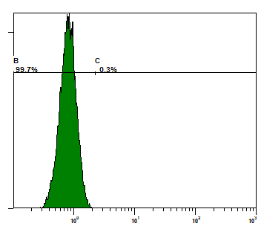
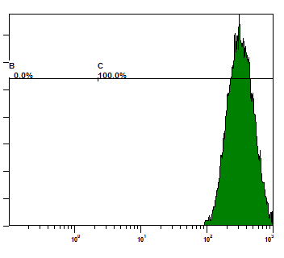
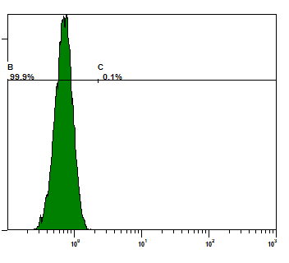
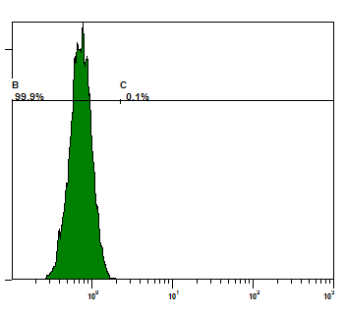
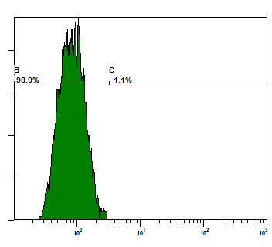
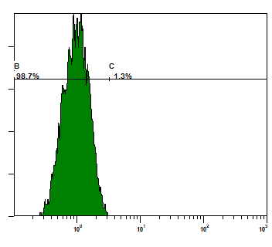
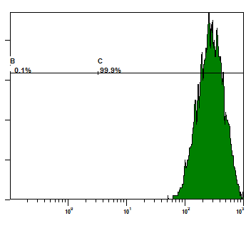
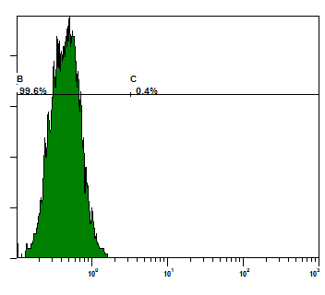
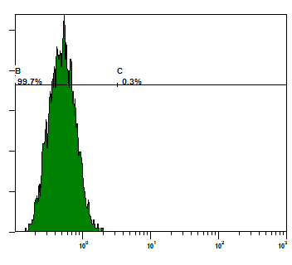
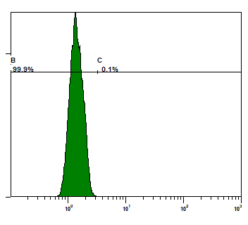
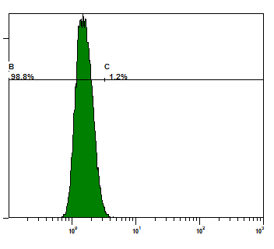
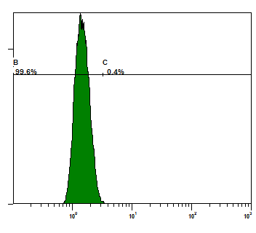
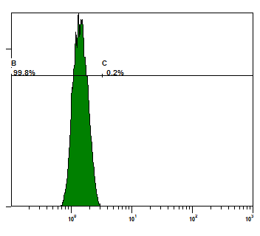
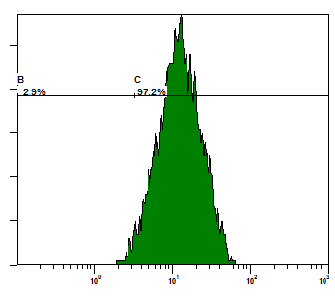
Supplementary Figure S1
A
B
 | Arecoline | Arecaidine | Guvacoline | Guvacine
Linear range (ppb) | 100~2500 | 100~2500 | 100~2500 | 100~2500
R² | 0.9953 | 0.9978 | 0.9965 | 0.9965
Retention time (min) | 1.81 | 1.21 | 1.81 | 1.16
ANE_01 Concentration (ppb) | 38929 (0.2508 mM) | 7124 | 1714 | 372
ANE_02 Concentration (ppb) | 33331 (0.2147 mM) | 6420 | 1587 | 343
C
Wild-type
Mouse-IgG
Case2 N
CD90
CD45
CD326 (EpCAM)
0.3%
1.8%
99.9%
0.8%
1.2%
Wild-type
Mouse-IgG
Case2 L
CD90
CD45
CD326 (EpCAM)
0.5%
2.4%
99.7%
1.7%
1.3%
Wild-type
Mouse-IgG
Case4 N
CD90
CD45
CD326 (EpCAM)
0.4%
0.5%
99.9%
0%
0%
Wild-type
Mouse-IgG
Case4 L
CD90
CD45
CD326 (EpCAM)
0.1%
0.3%
100%
0.1%
0.1%
Wild-type
Mouse-IgG
HGF
CD90
CD45
CD326 (EpCAM)
1.1%
1.3%
99.9%
0.4%
0.3%
Wild-type
Mouse-IgG
OECM-1
CD90
CD45
CD326 (EpCAM)
0.1%
1.2%
0.4%
0.2%
97.2%

Slide 3
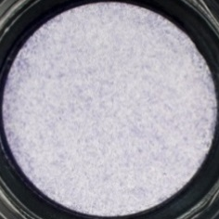
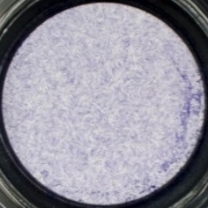
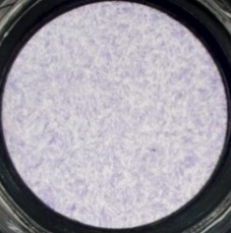
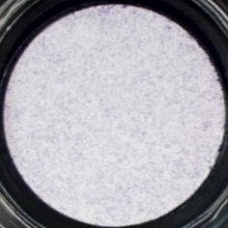
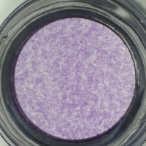
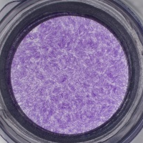
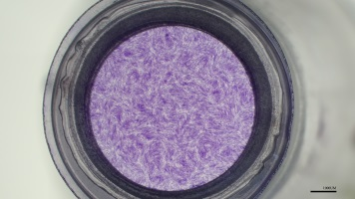
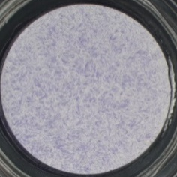
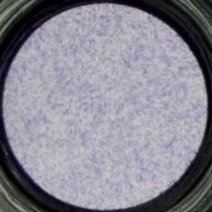
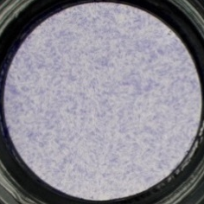
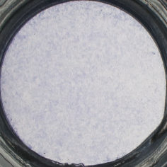
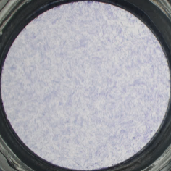
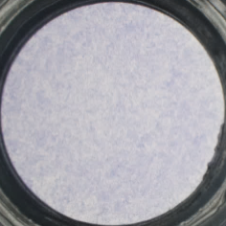
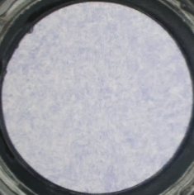
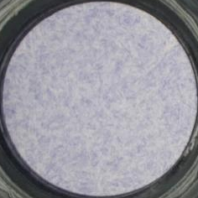
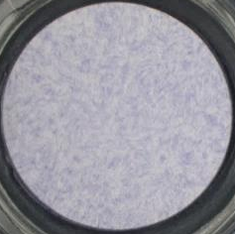
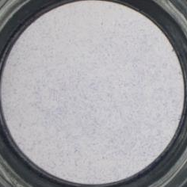
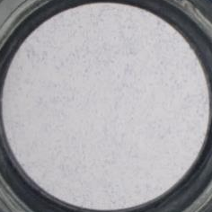
Supplementary Figure S1
D
Case1 N
Case1 L
Case2 N
Case2 L
ANE
-
+
-
+
-
+
-
+
Case4 N
Case4 L
Case5 N
Case5 L
ANE
-
+
-
+
-
+
-
+
Case6 N
Case6 L
ANE
-
+
-
+
Supplementary Figure S1. (A) XTT assay was performed to assess the cell viability after ANE treatment for 72 hours. (B) Data shows the major components of areca nut extract using LC/MS. (C) Cell surface markers were examined using flow cytometry analysis. (D) In the presence or absence of ANE, cell migration ability of primary fibroblasts was assessed using trans-well migration assay after plating out for 48 hours. The data were presented as mean ± SD from three independent experiments. ***, p < 0.001; ****, p < 0.0001.

Slide 4
Supplementary Figure S2
A
B
C
D
HGF
Metformin (mM)
0
0.625
1.25
0
0
0
0
Antimycin A (nM)
0
0
0
2
4
0
0
Rotenone (nM)
0
0
0
0
0
7.5
15
-
ANE
+
Supplementary Figure S2. XTT assays were performed to assess HGF cells viability at various concentrations of (A) metformin, (B) rotenone, and (C) antimycin A. (D) Migration ability of HGF cells under treatment of either metformin, rotenone, or antimycin A. The data were presented as mean ± SD from three independent experiments. *, p < 0.05; **, p < 0.01; ***, p < 0.001.

Slide 5
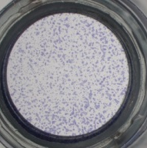
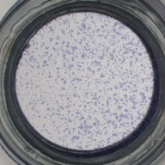
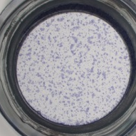
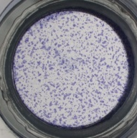
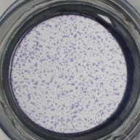


Supplementary Figure S3
A
B
DOK
2hr
24hr
Gefitinib (μM)
0 0.05 0.1 0 0.05 0.1
p-EGFR (Tyr1086)
EGFR
α-Tubulin
C
D
DOK
rbGM-CSF
- - - + + +
Gefitinib (μM)
0 0.05 0.1 0 0.05 0.1
E
DOK
rbGM-CSF
- - - + + +
Gefitinib (μM)
0 0.05 0.1 0 0.05 0.1
Supplementary Figure S3. (A) XTT assays were performed to assess HGF cell viability after treatment of various doses of EGFR inhibitor Gefitinib for 48 hours. (B-C) The expression of p-EGFR (Tyr1086) and EGFR after 2 and 24 hours treatment of Gefitinib was examined using Western blot. (D) Migration ability and (E) invasion ability of HGF cells after treatment of recombinant protein GM-CSF and Gefitinib, alone or combination. The data were presented as mean ± SD from three independent experiments. *, p < 0.05; **, p < 0.01; ****, p < 0.0001.

Slide 6











Supplementary Figure S4
A
H&E
Pre-cancer
Cancer
B
p-EGFR
12W
Mineral oil
8W
DMBA
8W
DMBA
8W
DMBA+ANE
8W
DMBA+ANE
Normal
(MED)
(SCC)
(SED)
(SCC)
p-EGFR
10W
DMBA
10W
DMBA
10W
DMBA+ANE
10W
DMBA+ANE
(MED to MoED)
(SCC G1)
(SCC G1)
(SCC G2)
Supplementary Figure S4. (A) Hematoxylin and eosin (H&E) staining of representative pre-cancer and cancer lesions in hamster buccal pouch. Co-treatment of DMBA and ANE resulted in a higher rate of cancer development, compared to DMBA alone. (B) IHC staining for p-EGFR expression in normal, pre-cancer and cancer tissues from hamster buccal. W, weeks; MED, mild epithelial dysplasia; MoED, moderate epithelial dysplasia; SED, severe epithelial dysplasia; SCC, squamous cell carcinoma; G1, grade 1; G2, grade 2.

