Slide 1
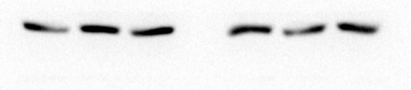
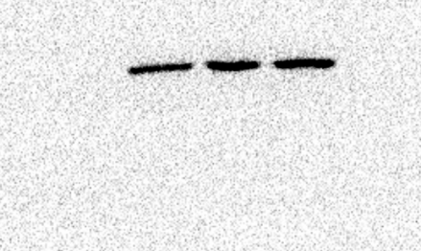
Figure 1 C
α-SMA
FAP
α-Tubulin

Slide 2
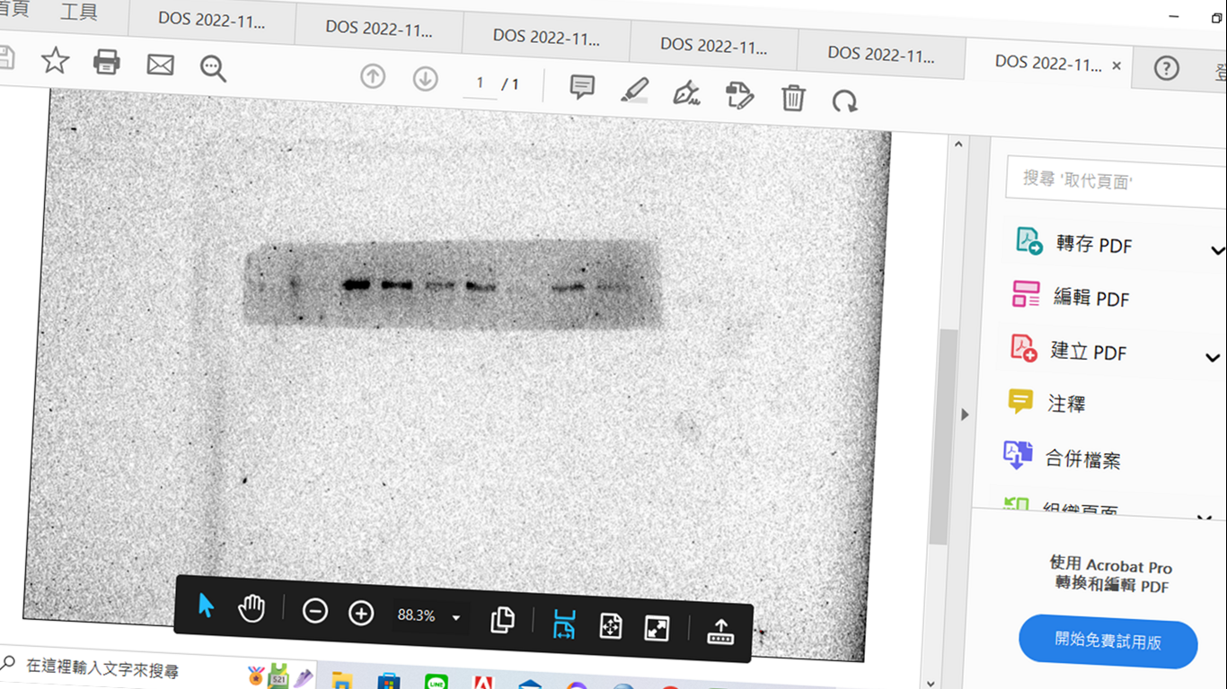
Figure 1 E
β-Catenin
ZO-1
α-Tubulin

Slide 3
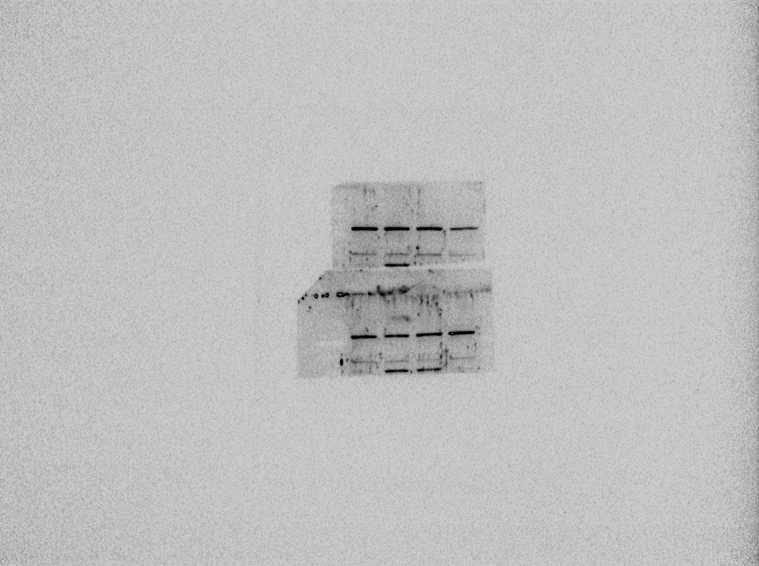
Figure 4 C
Vimentin
Claudin-1
ZO-1

Slide 4
α-Tubulin

Slide 5
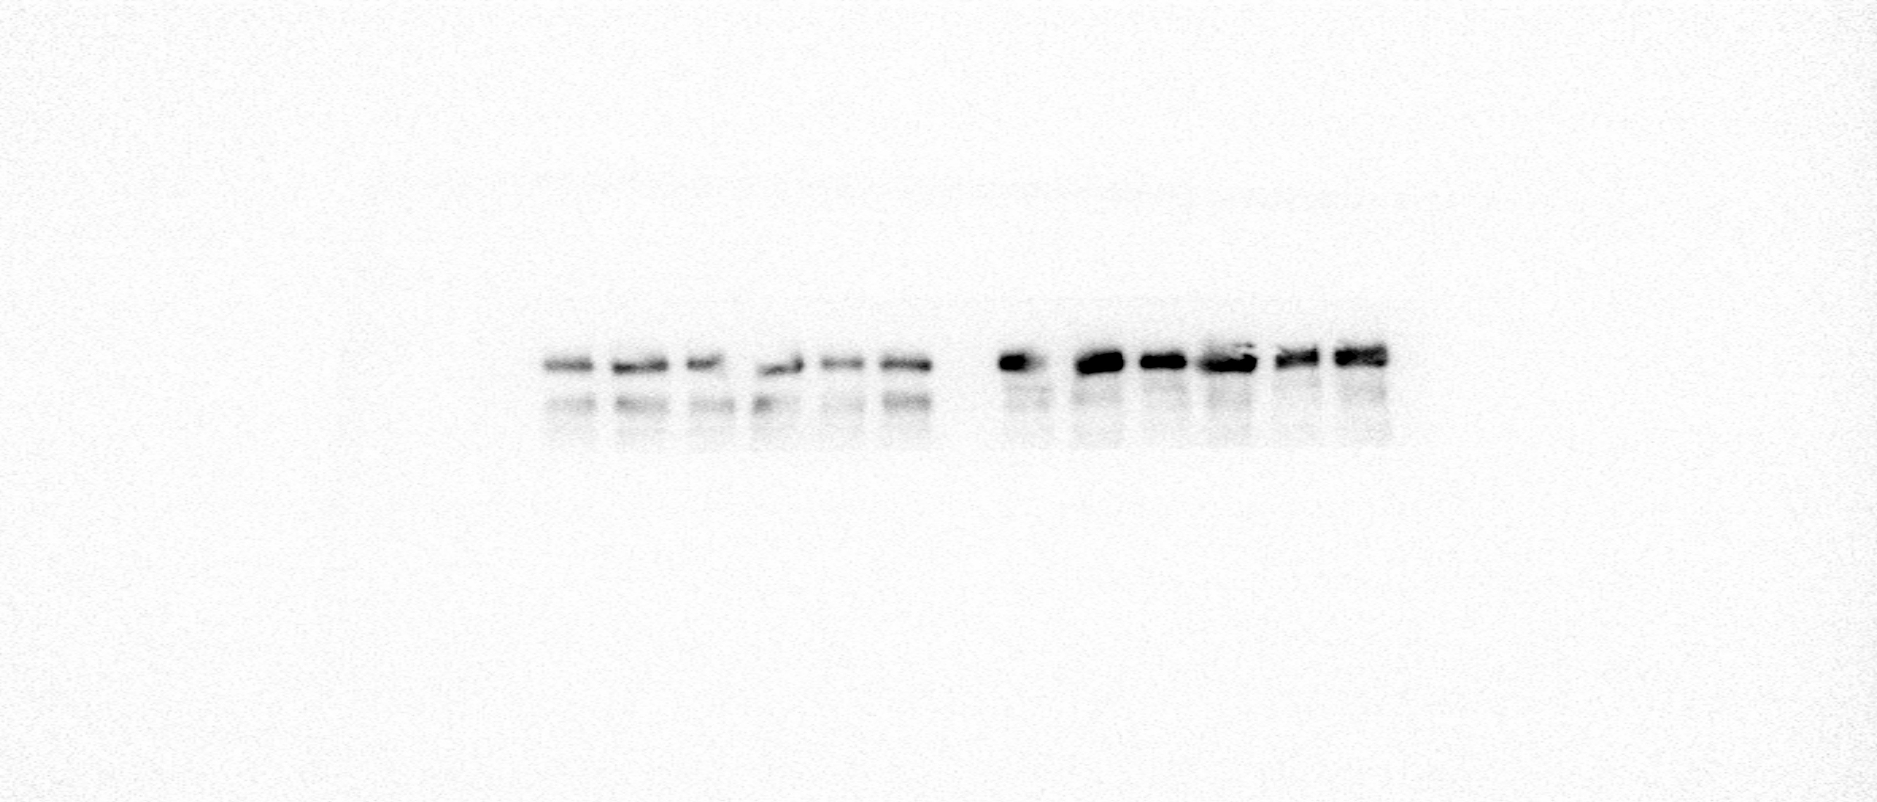
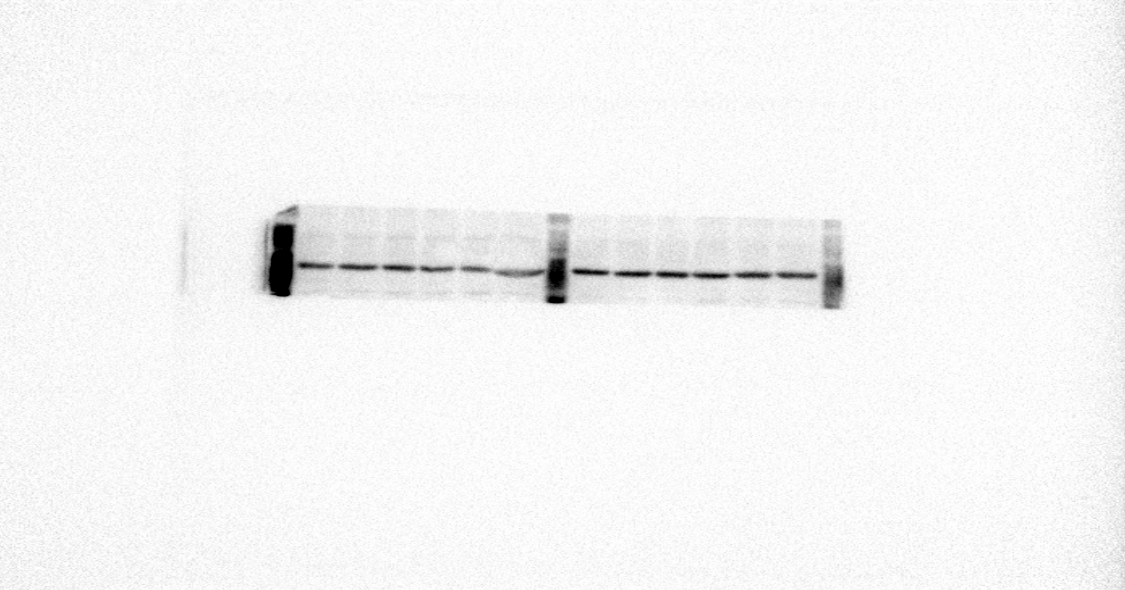
Figure 5 B
p-EGFR
EGFR
α-Tubulin

Slide 6
Figure 5 C
p-EGFR
α-Tubulin
EGFR

Slide 7
Figure 5 D
p-EGFR
α-Tubulin
EGFR

Slide 8
Supplementary Figure S3 B
p-EGFR
EGFR

Slide 9
α-Tubulin

