Slide 1
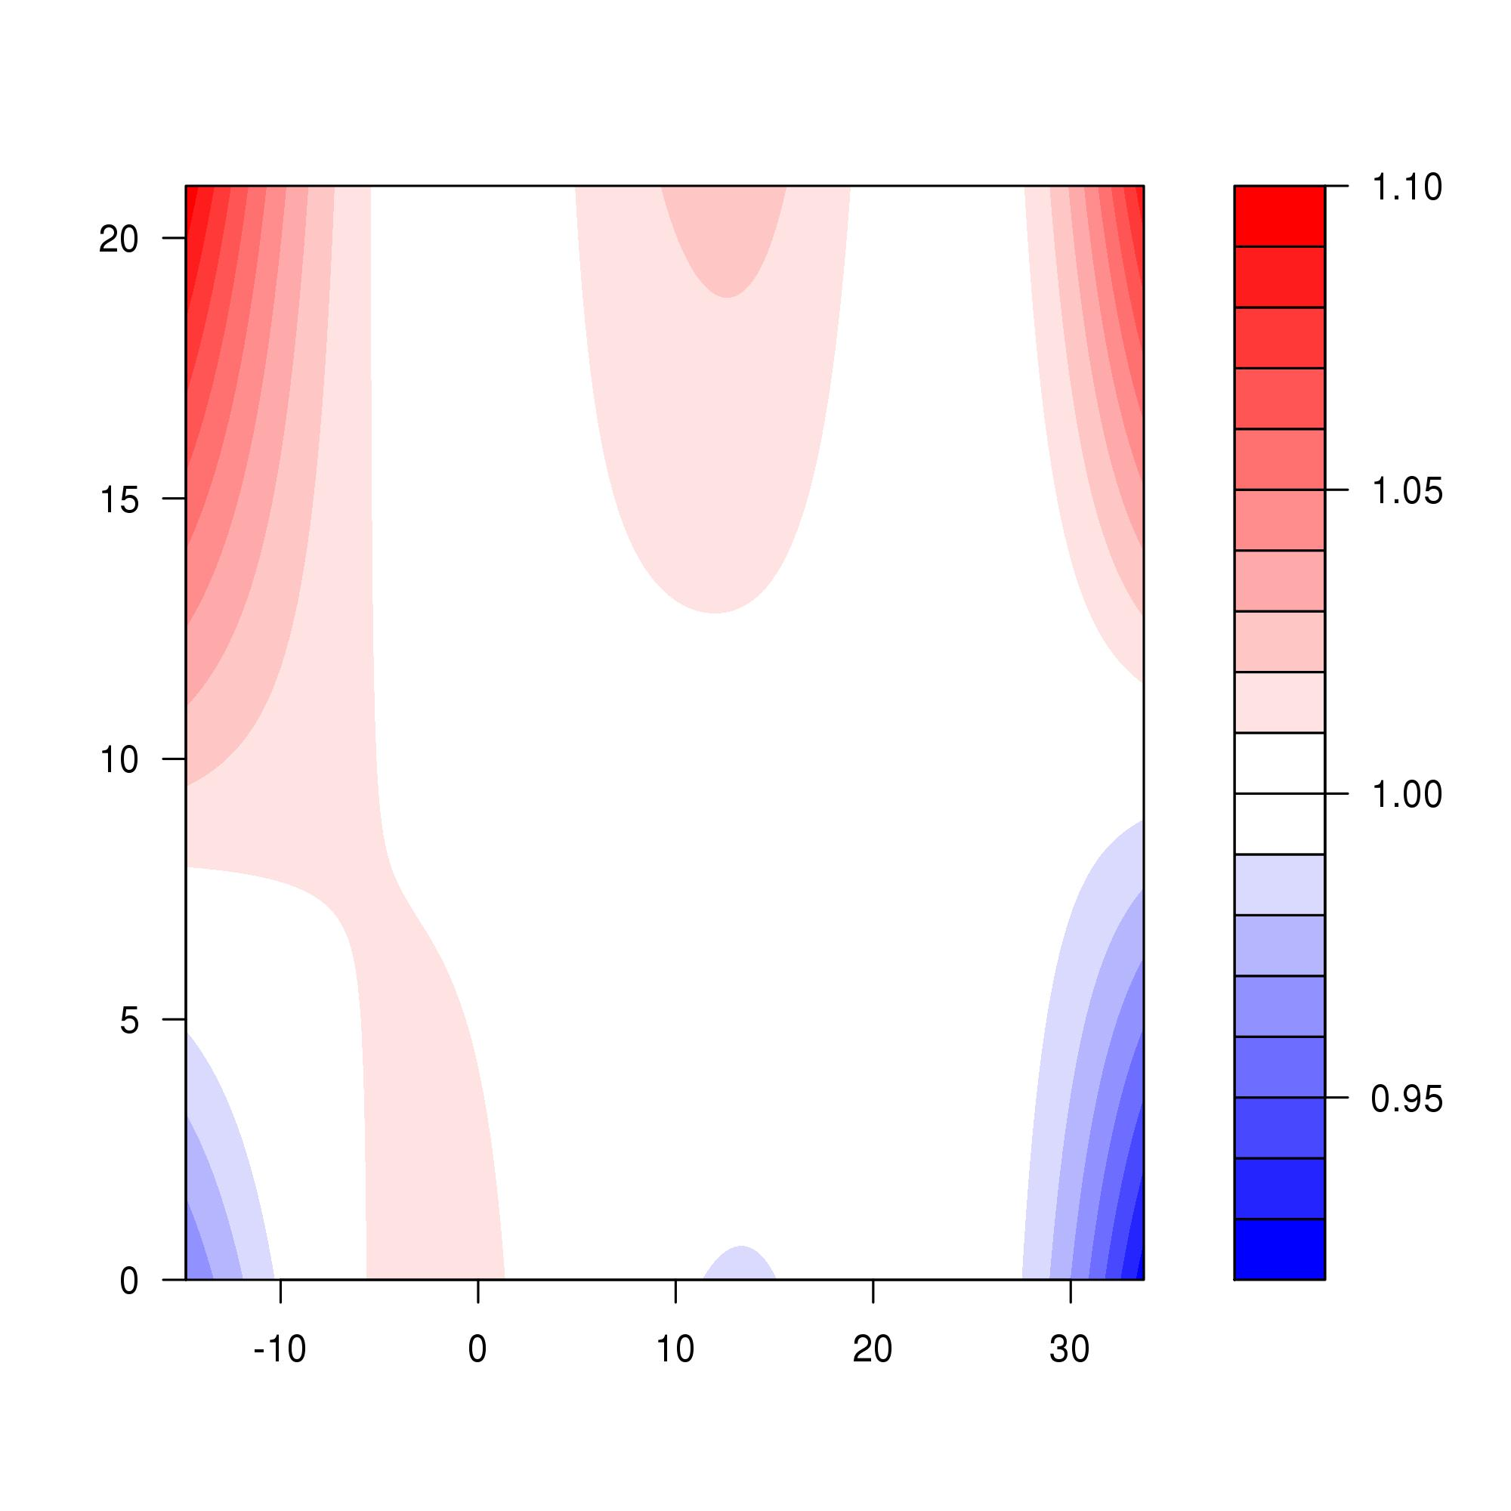
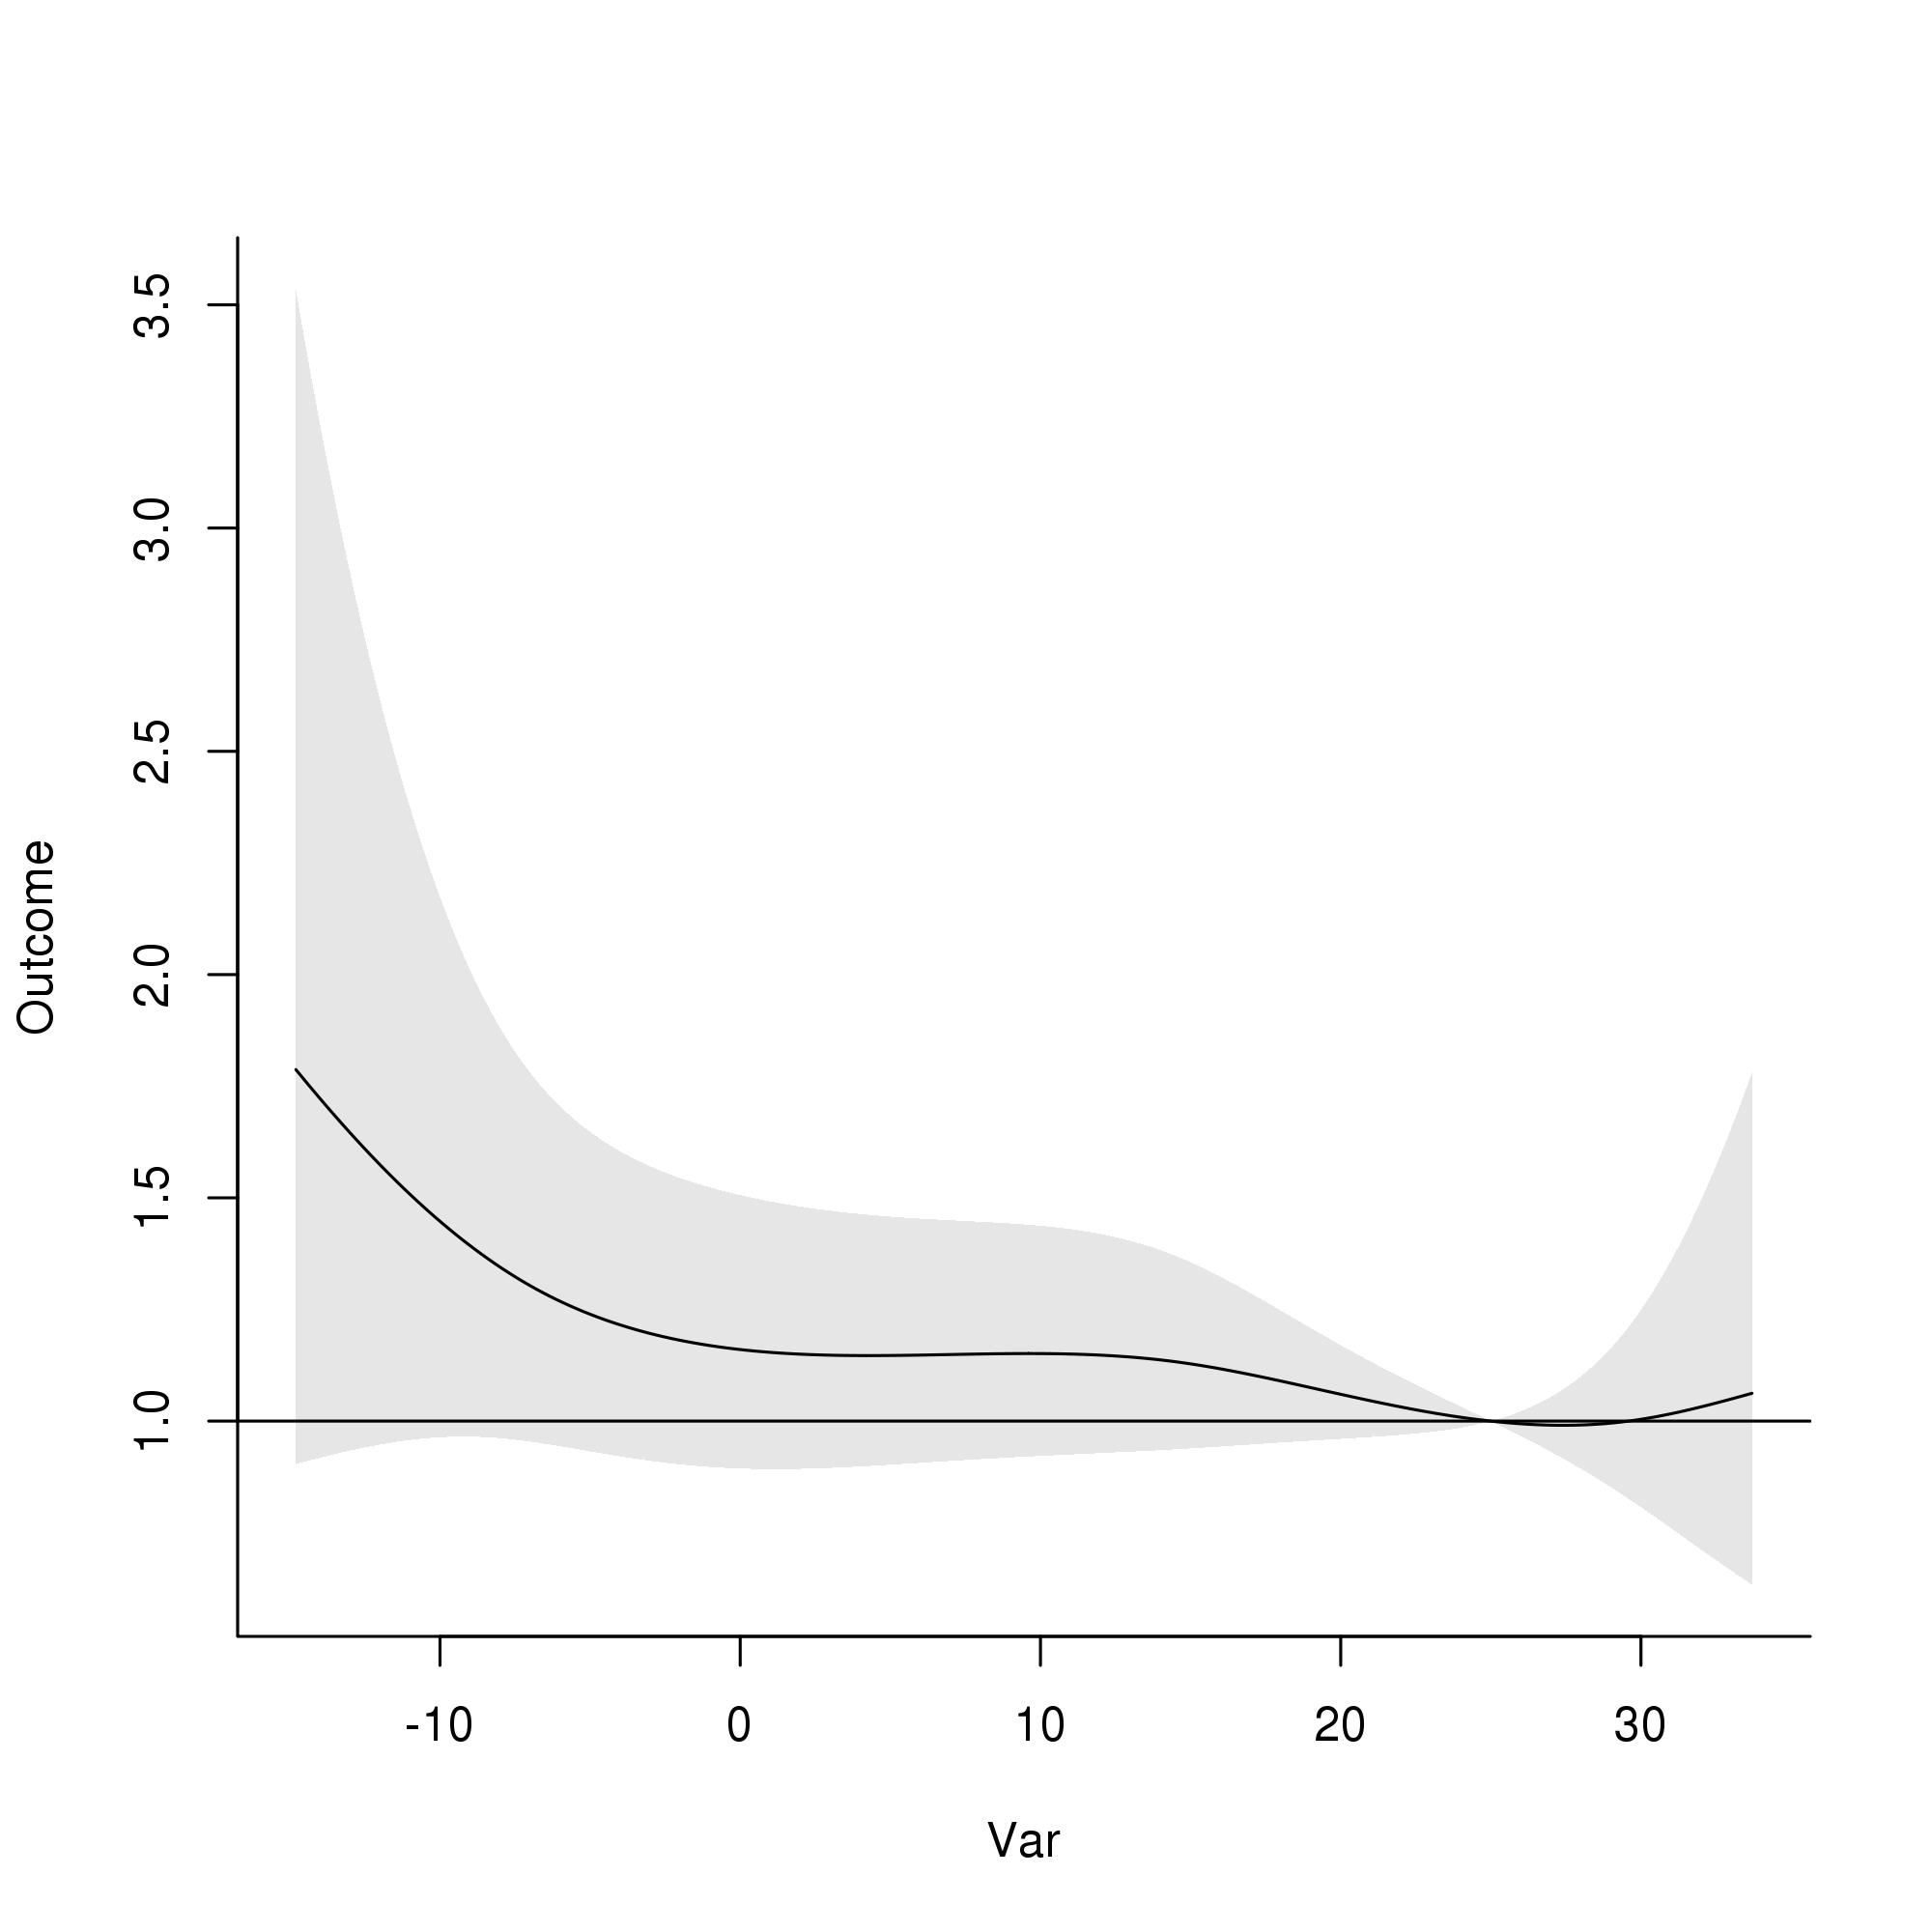
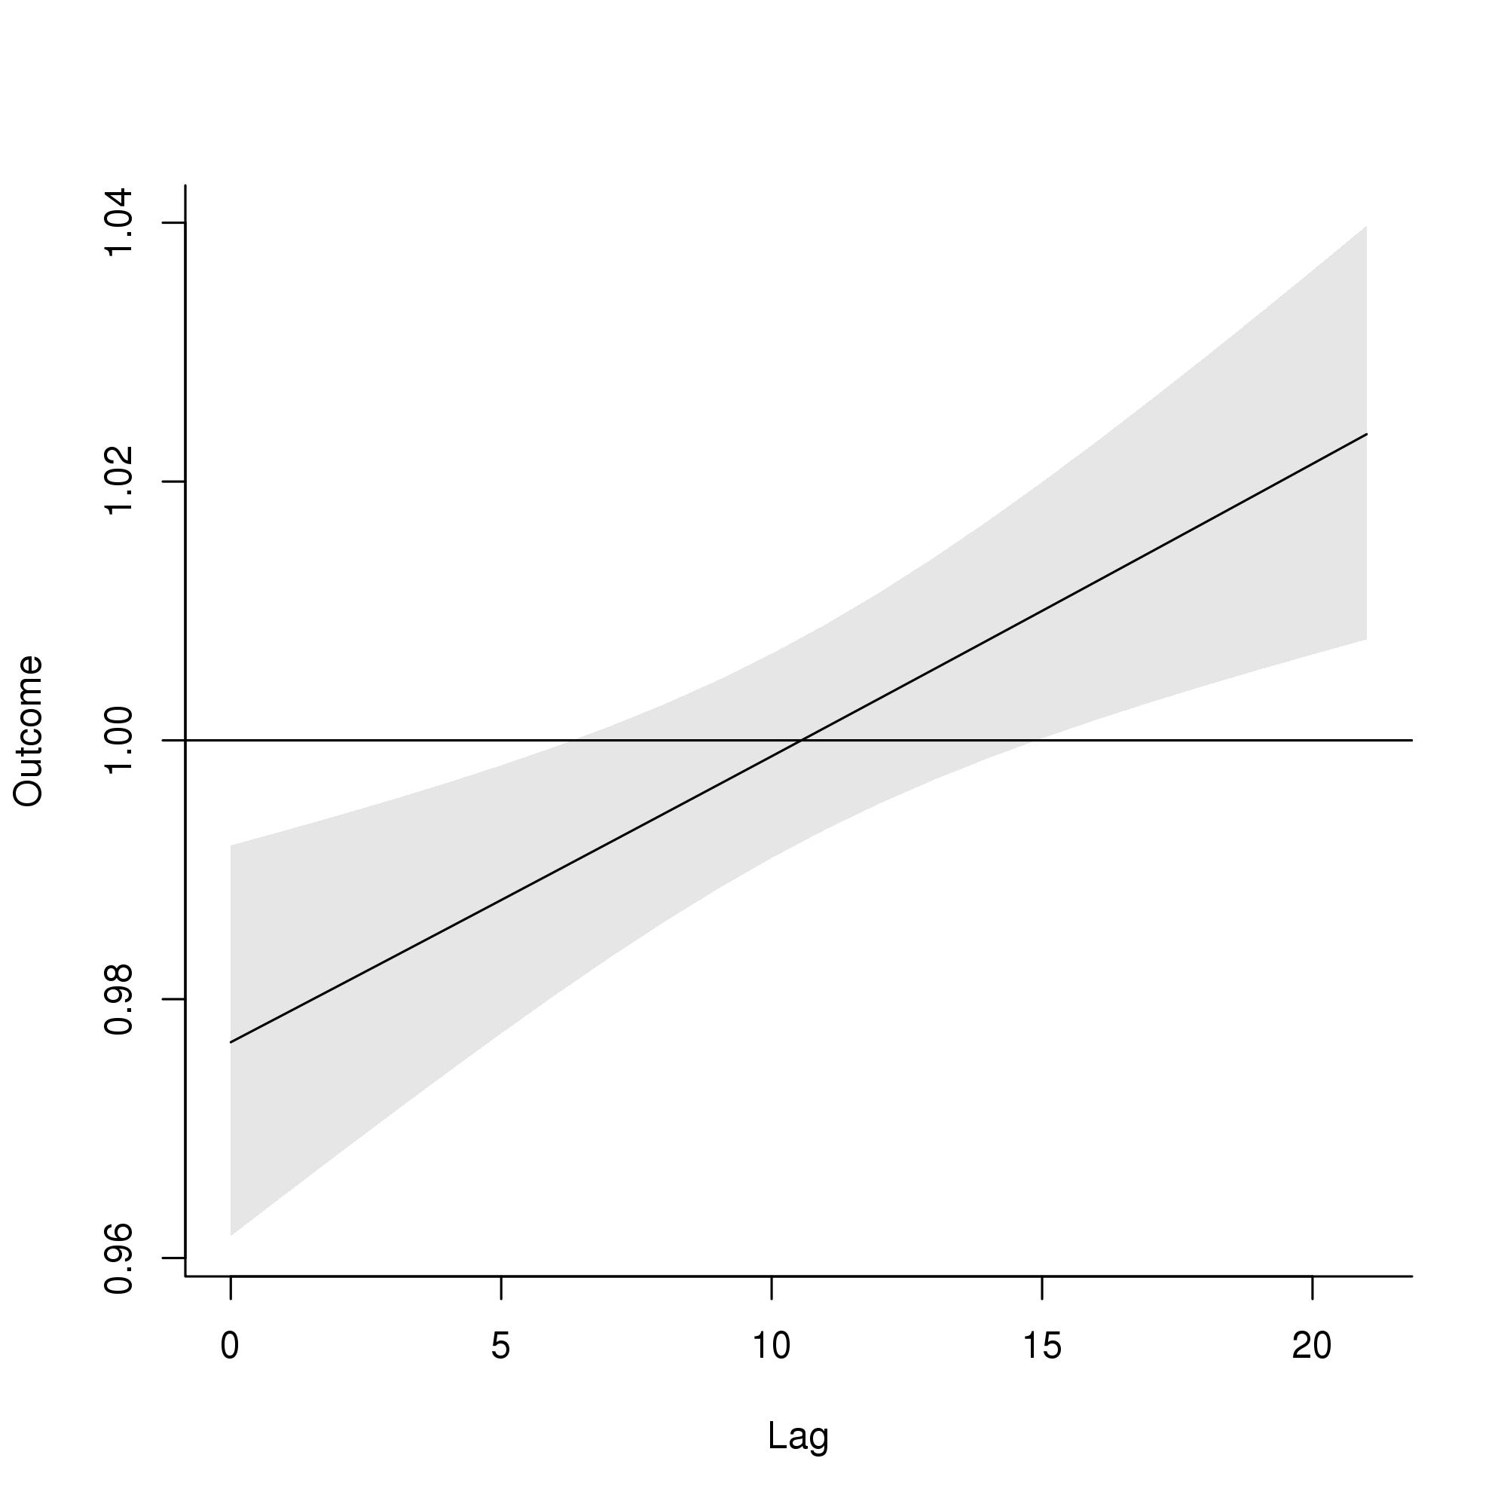
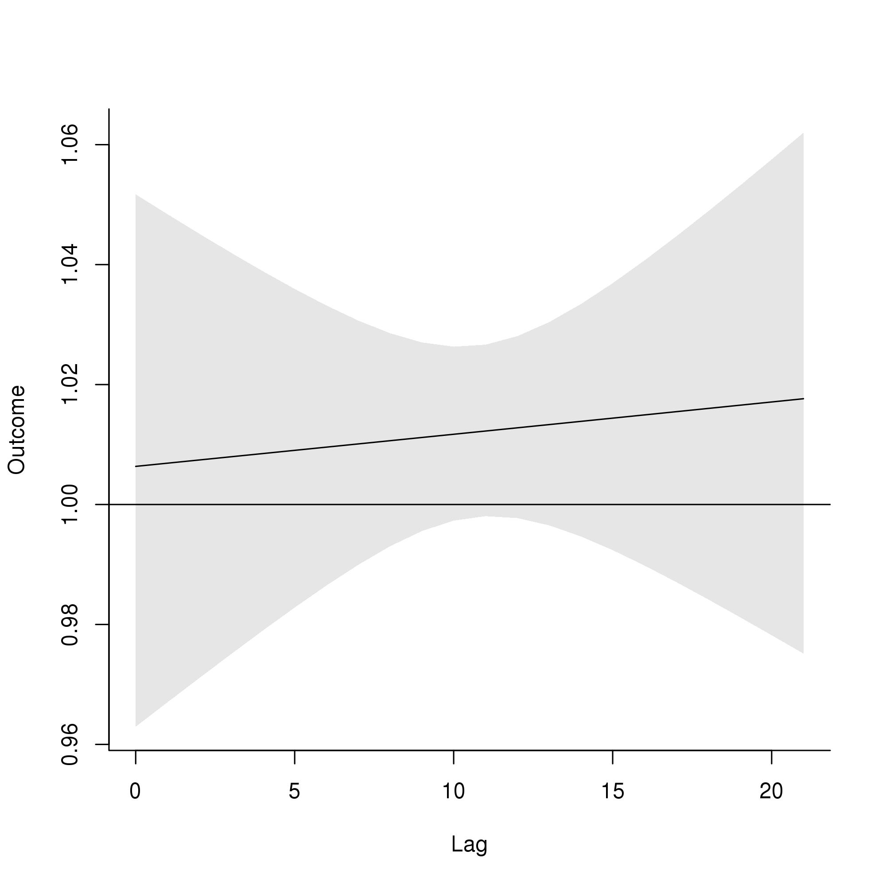
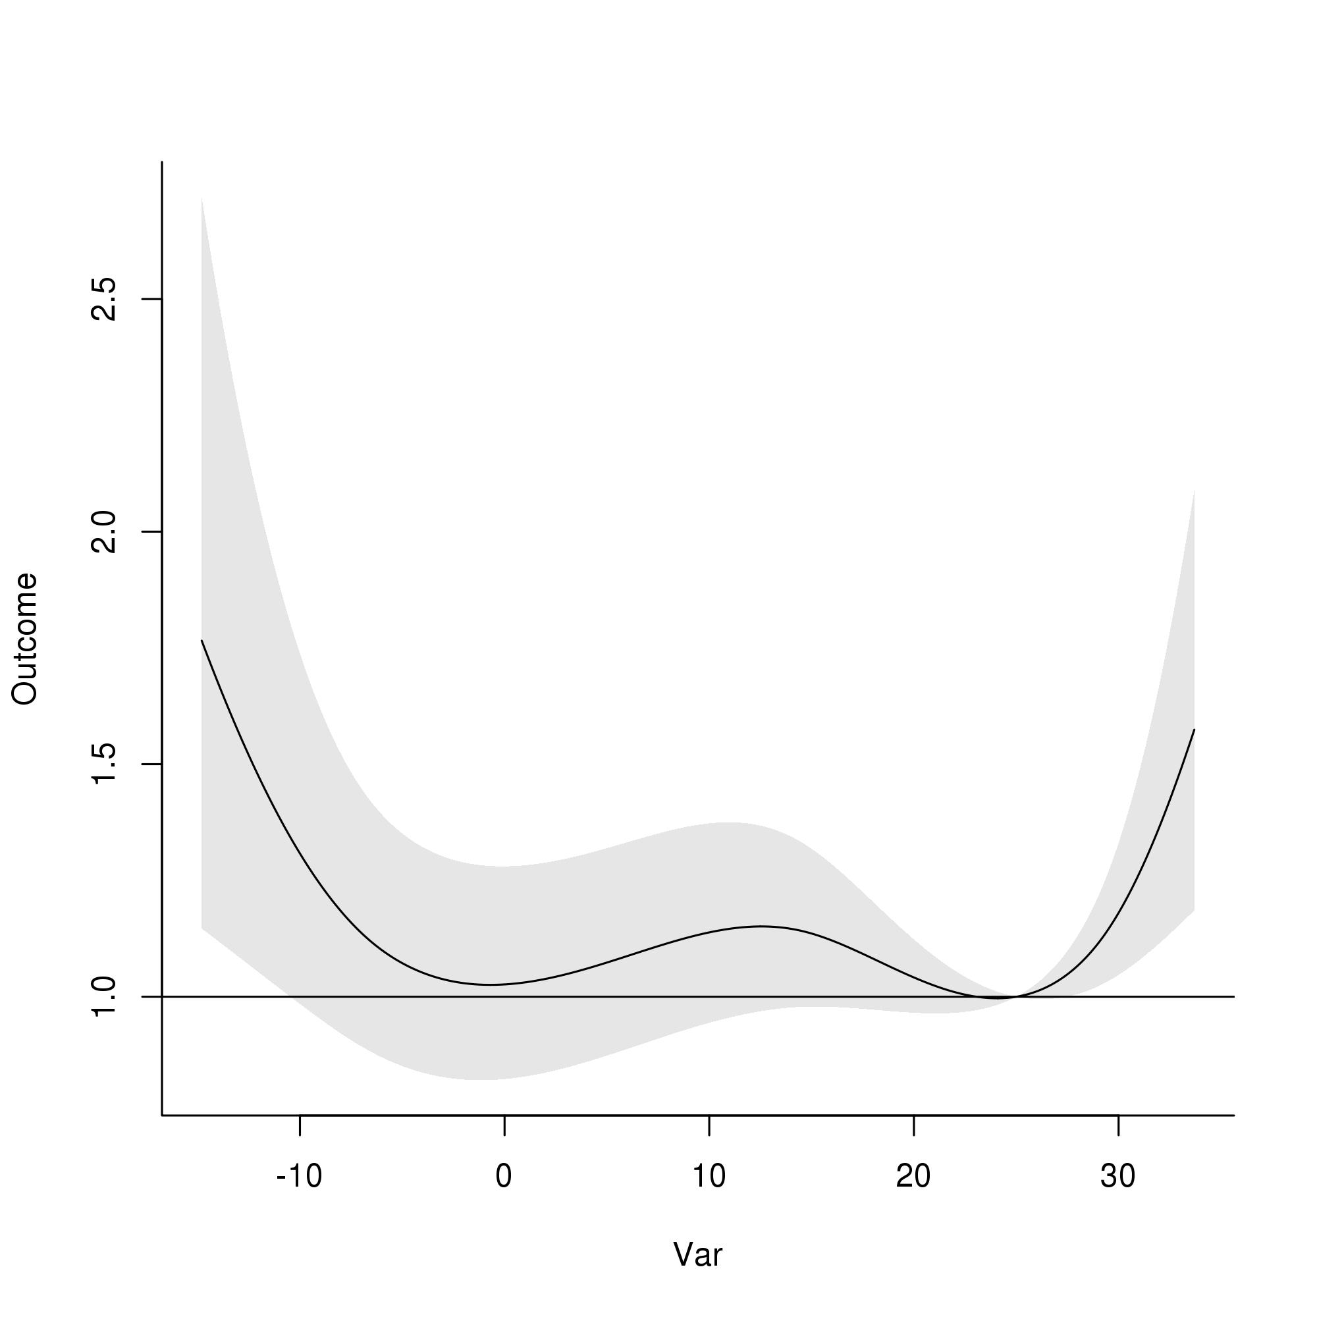
DLNM results, 1–4 ages, Case-crossover design
A
OR
B
Lag
OR
Daily mean temperature (°C)
Daily mean temperature (°C)
C
D
E
OR
OR
OR
Daily mean temperature (°C)

Slide 2
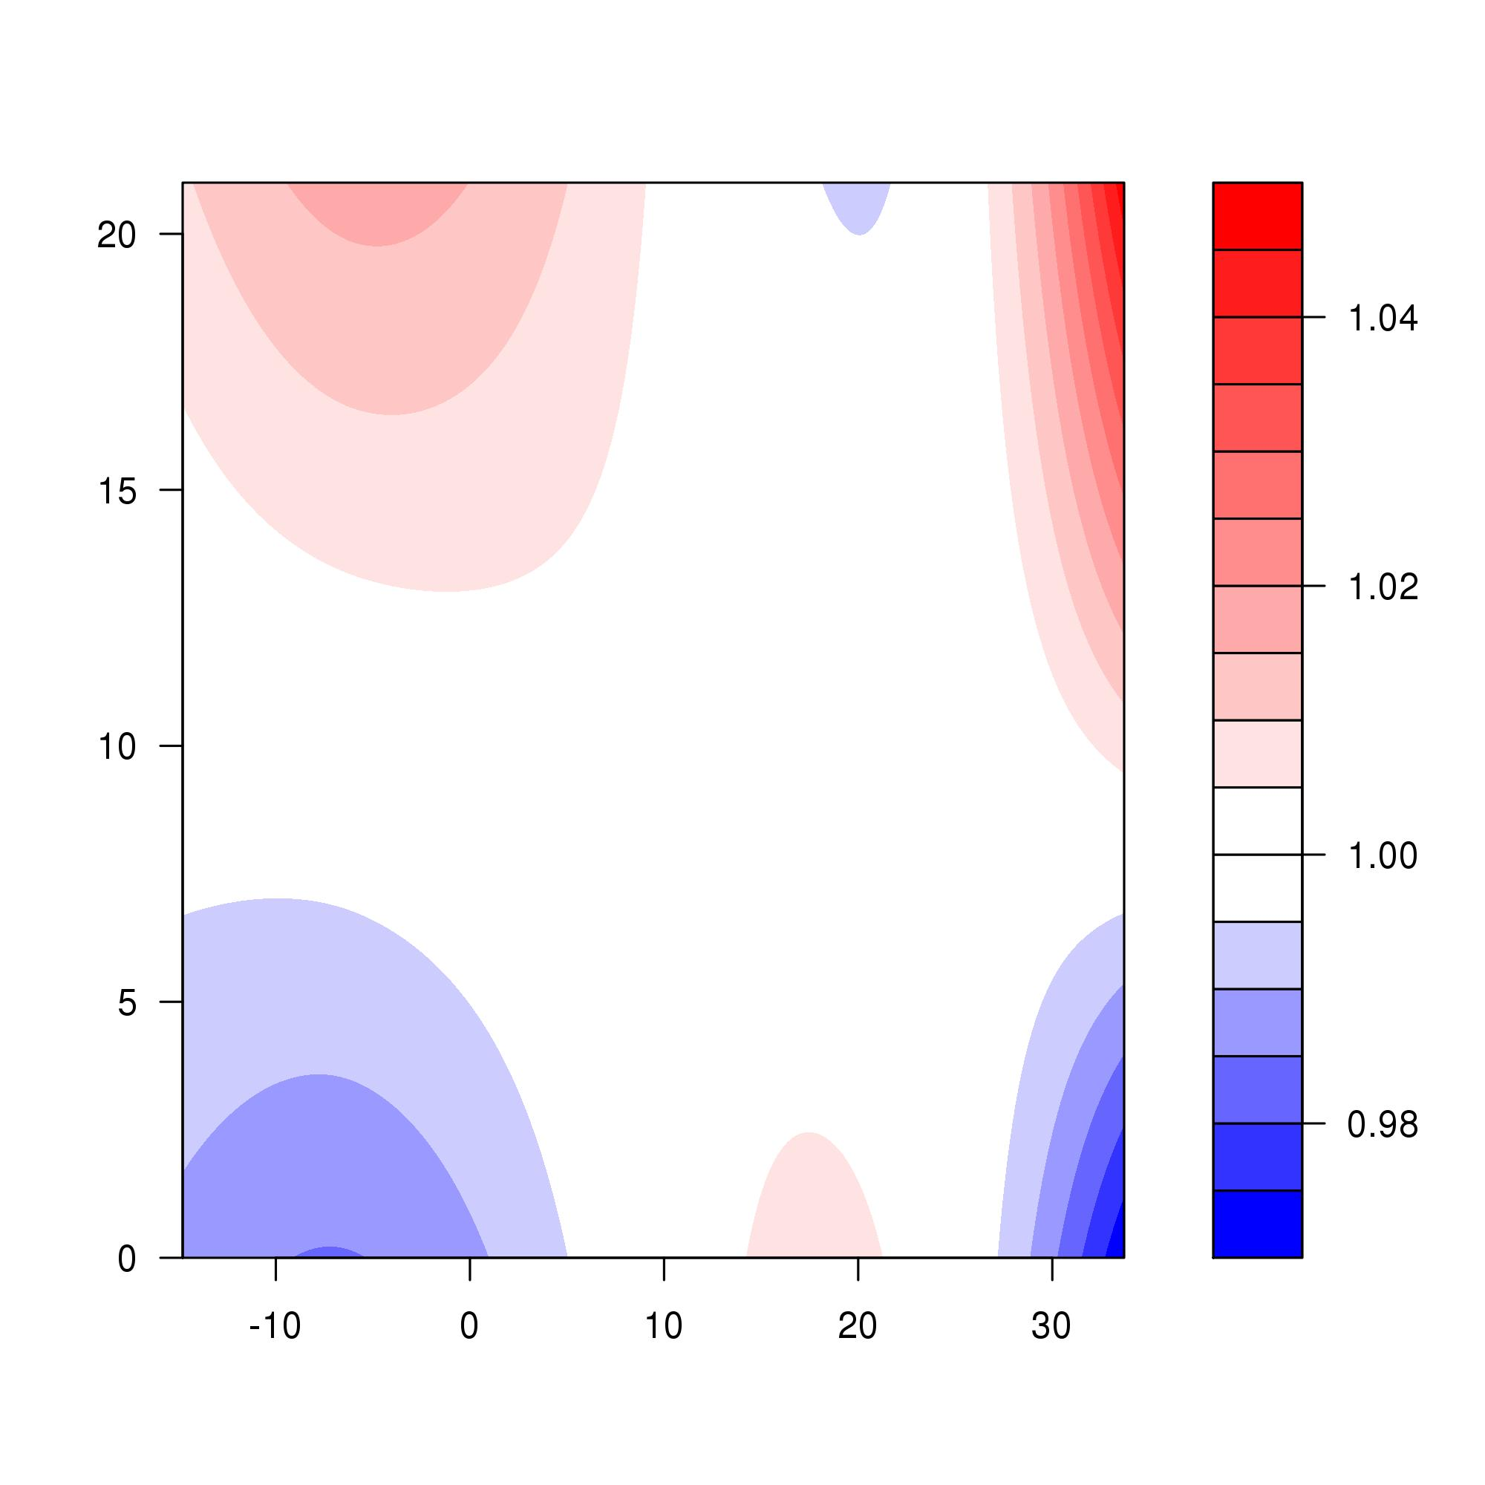
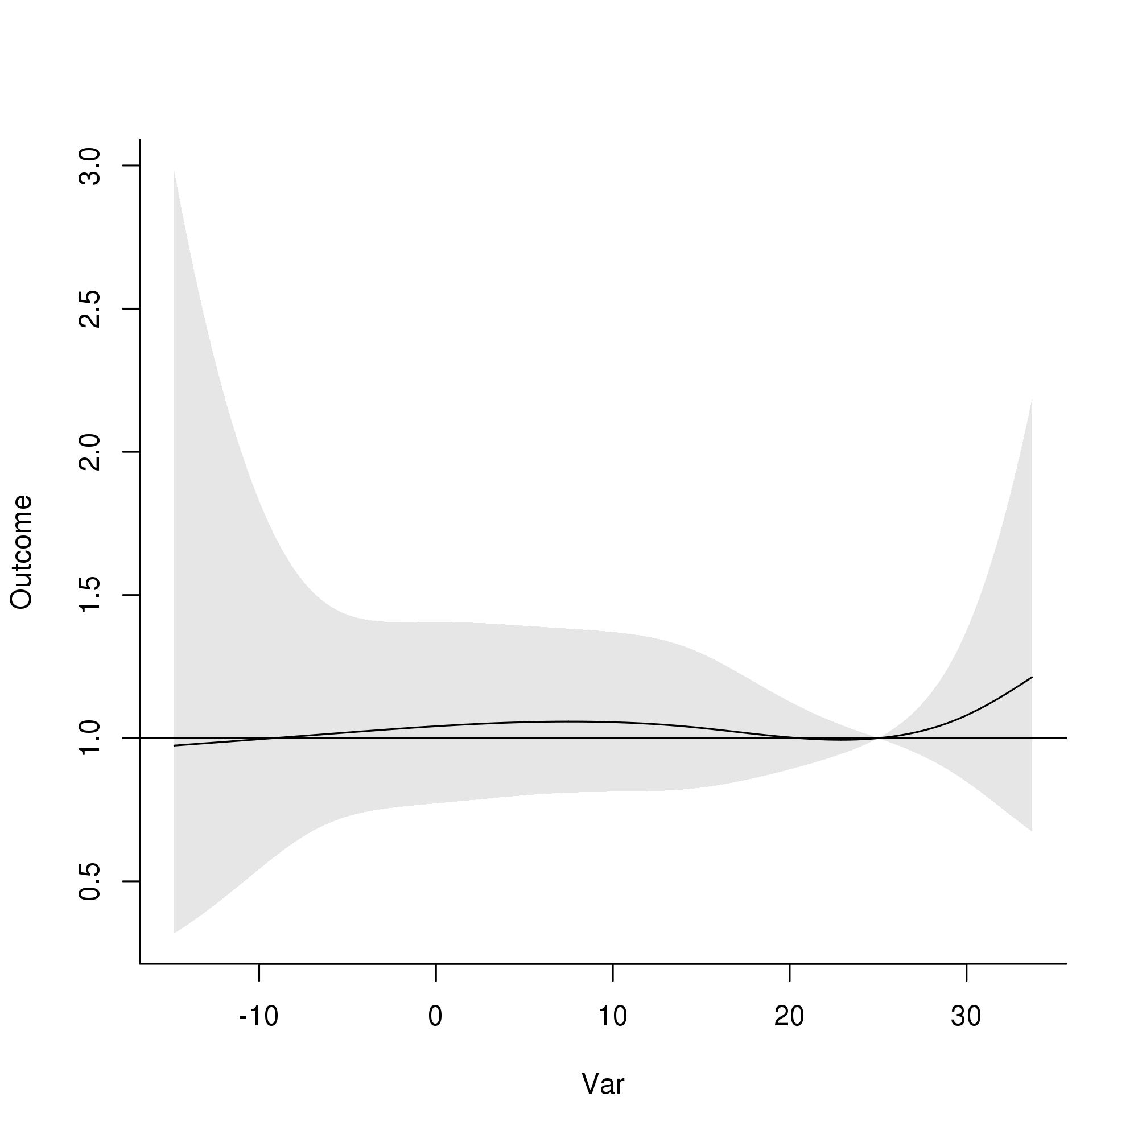
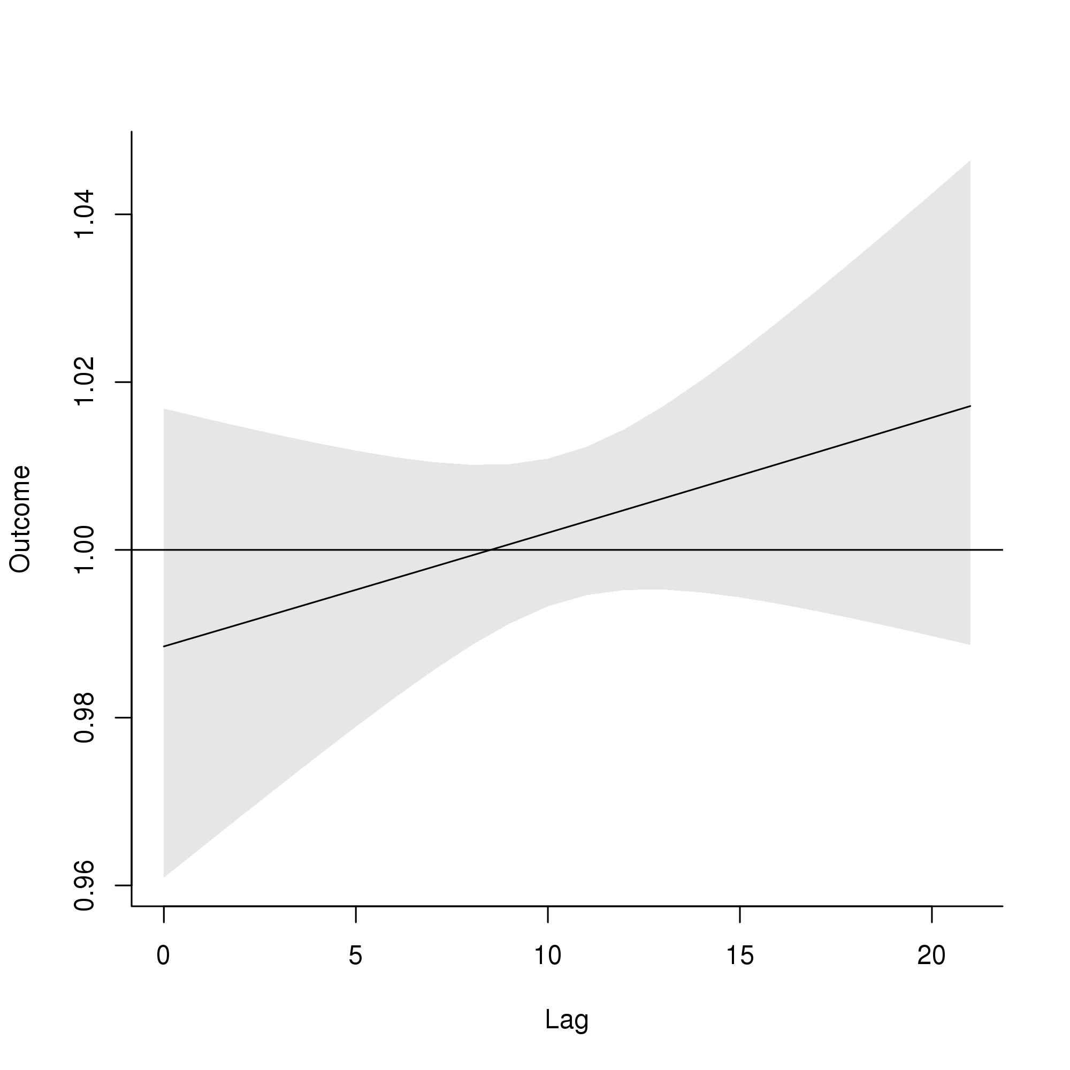
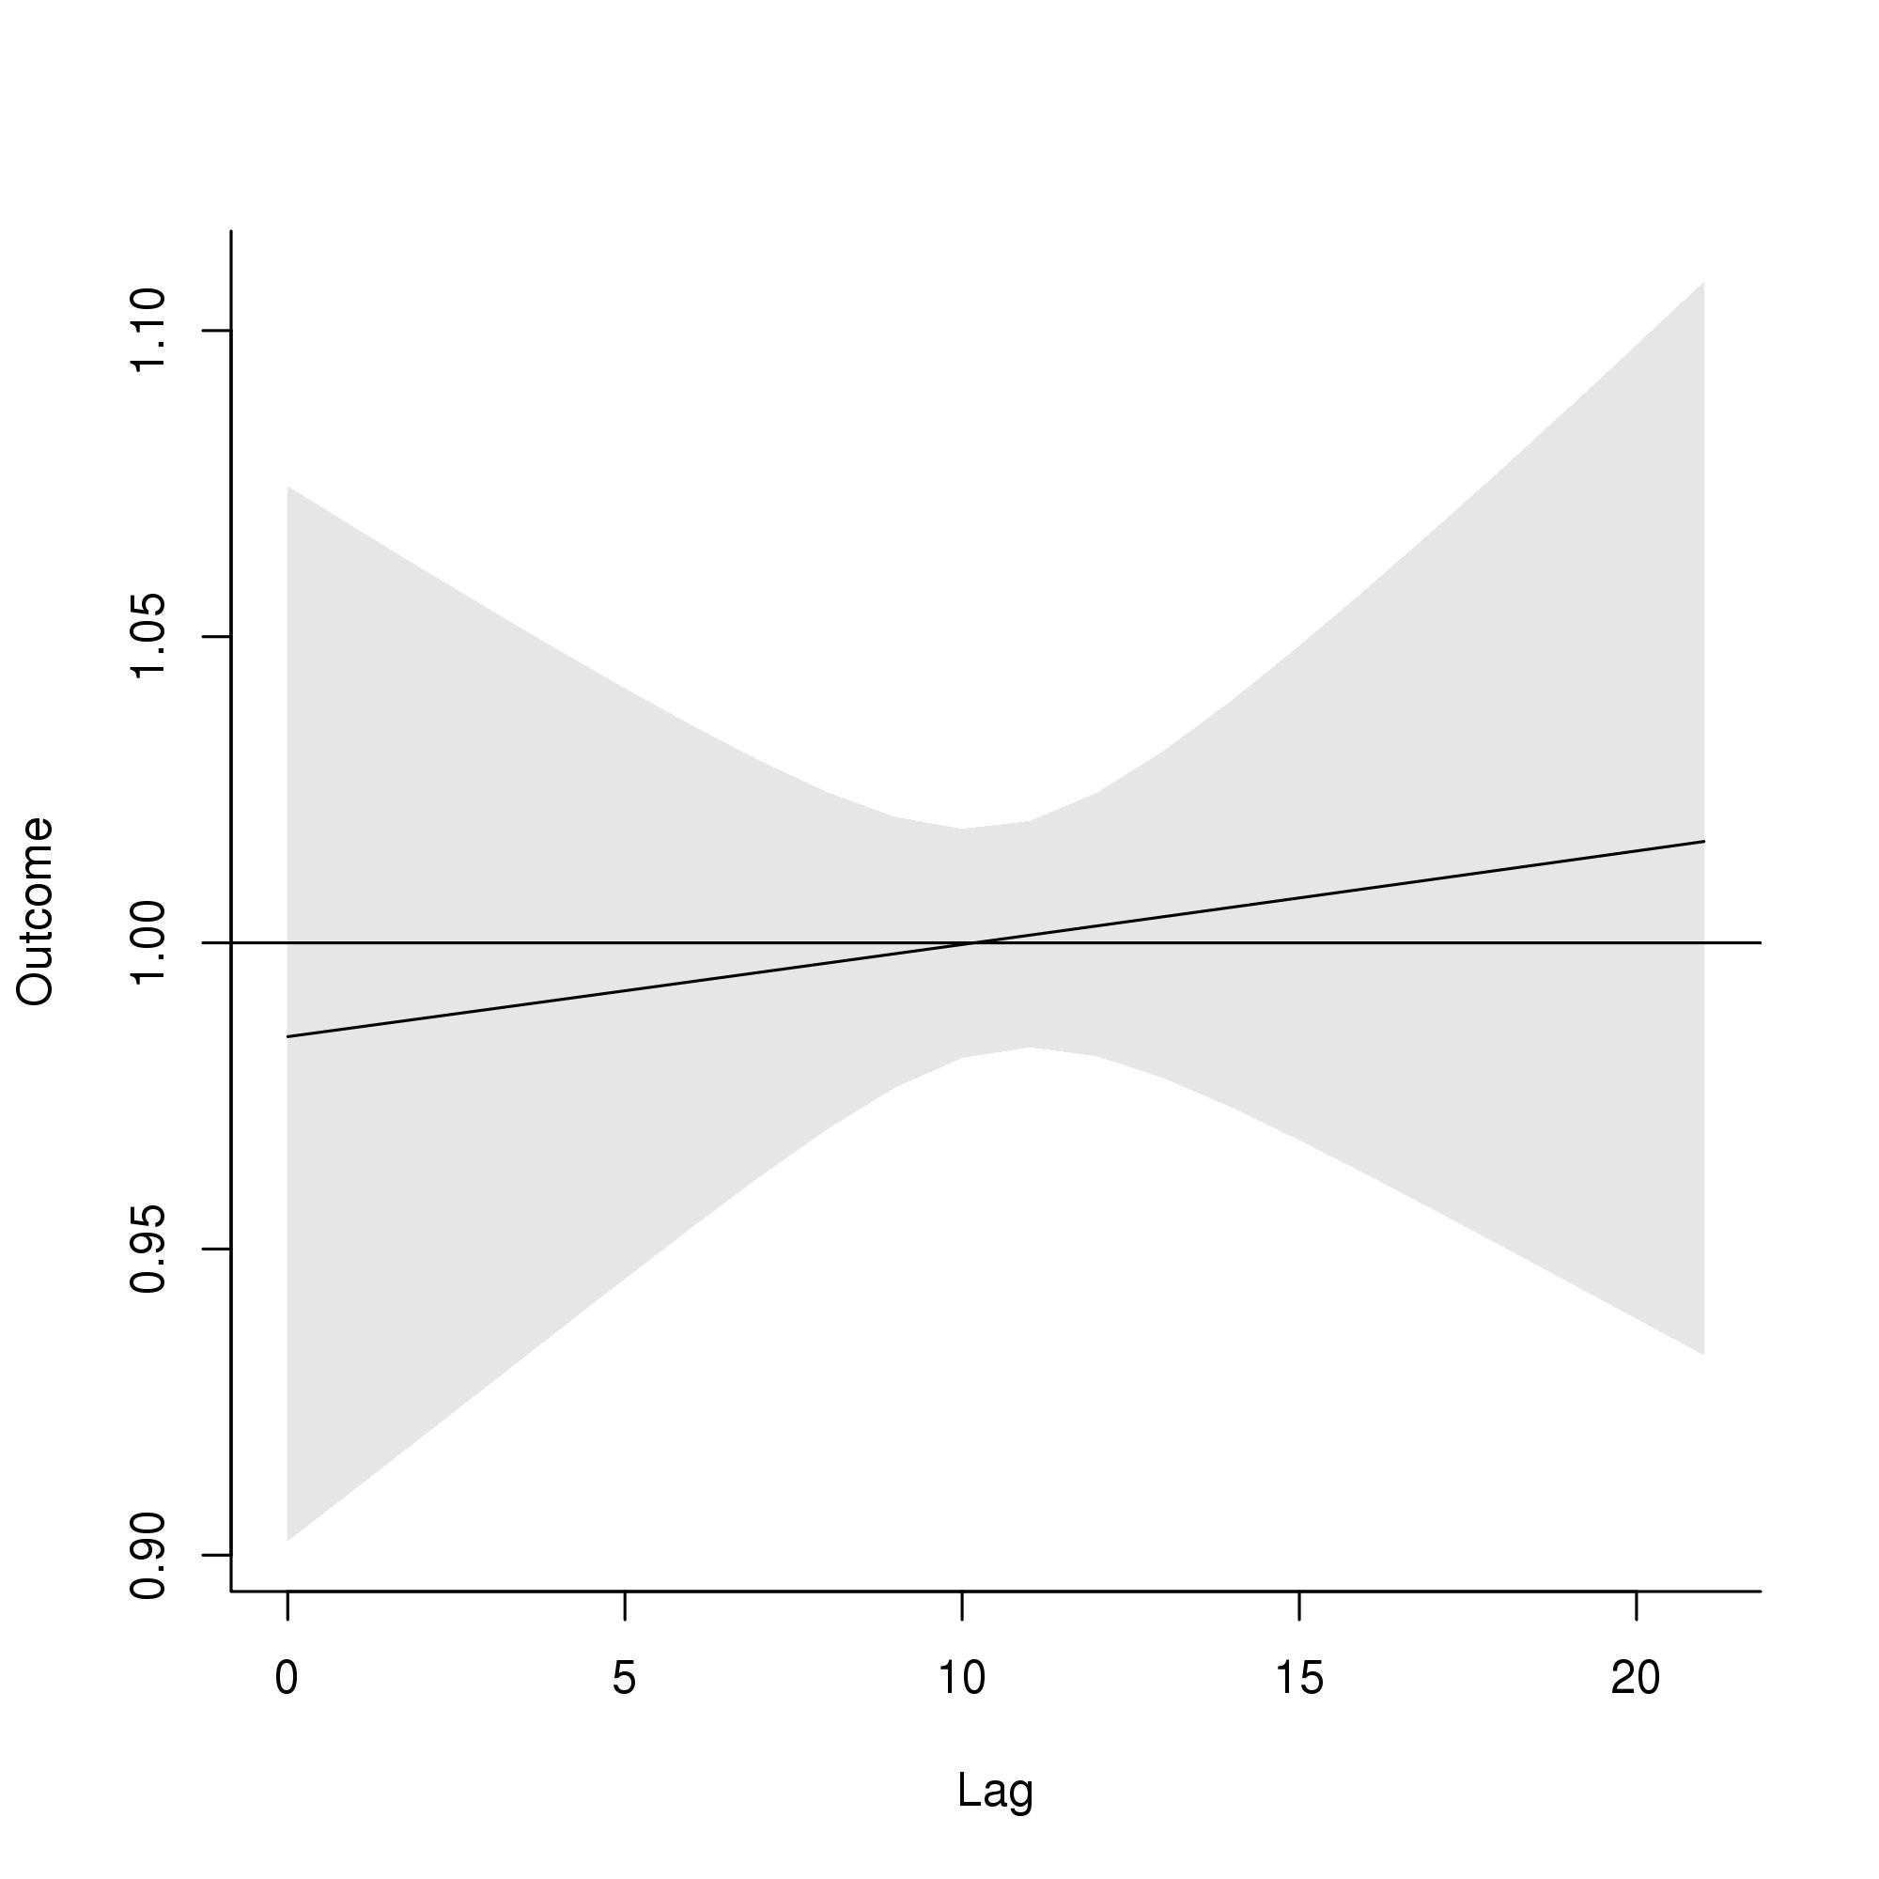
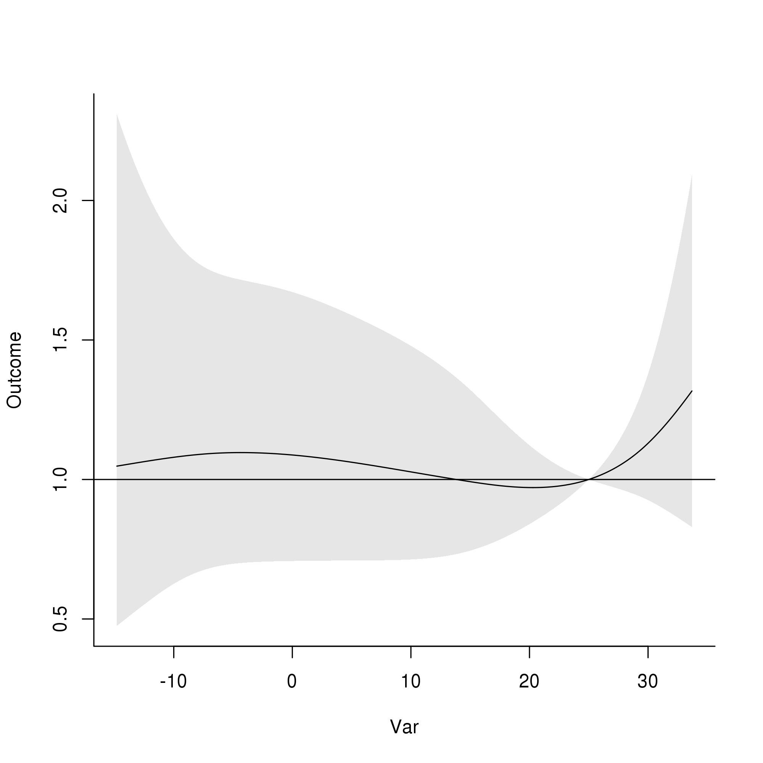
DLNM results, 5–9 ages, Case-crossover design
A
OR
B
Lag
OR
Daily mean temperature (°C)
Daily mean temperature (°C)
C
D
E
OR
OR
OR
Daily mean temperature (°C)

Slide 3
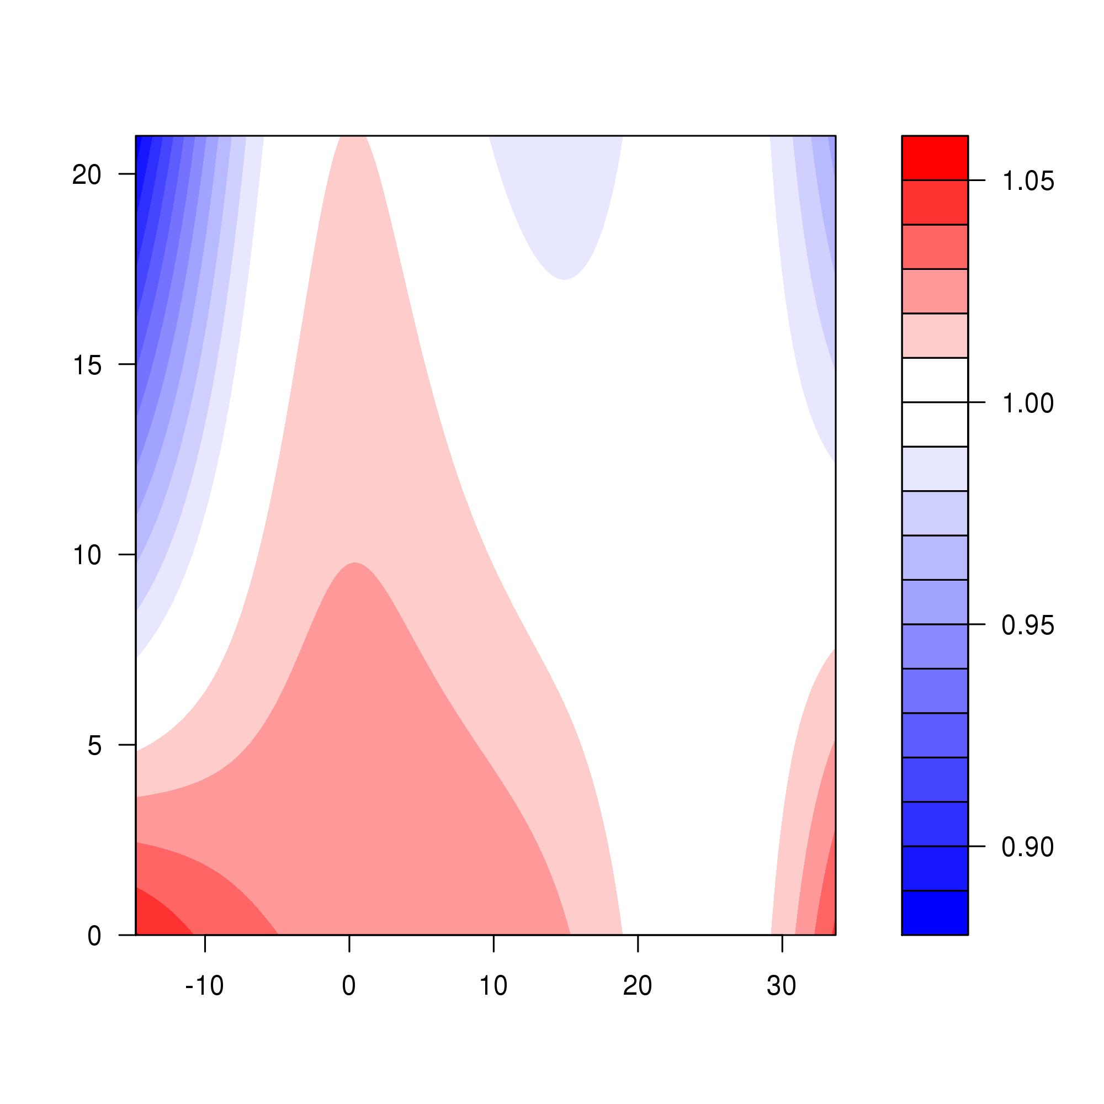
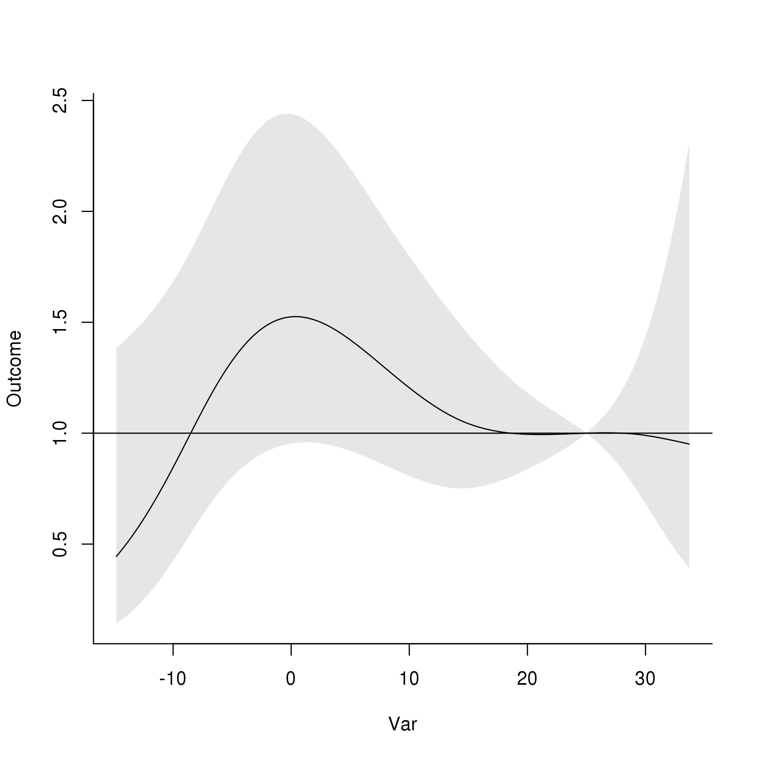
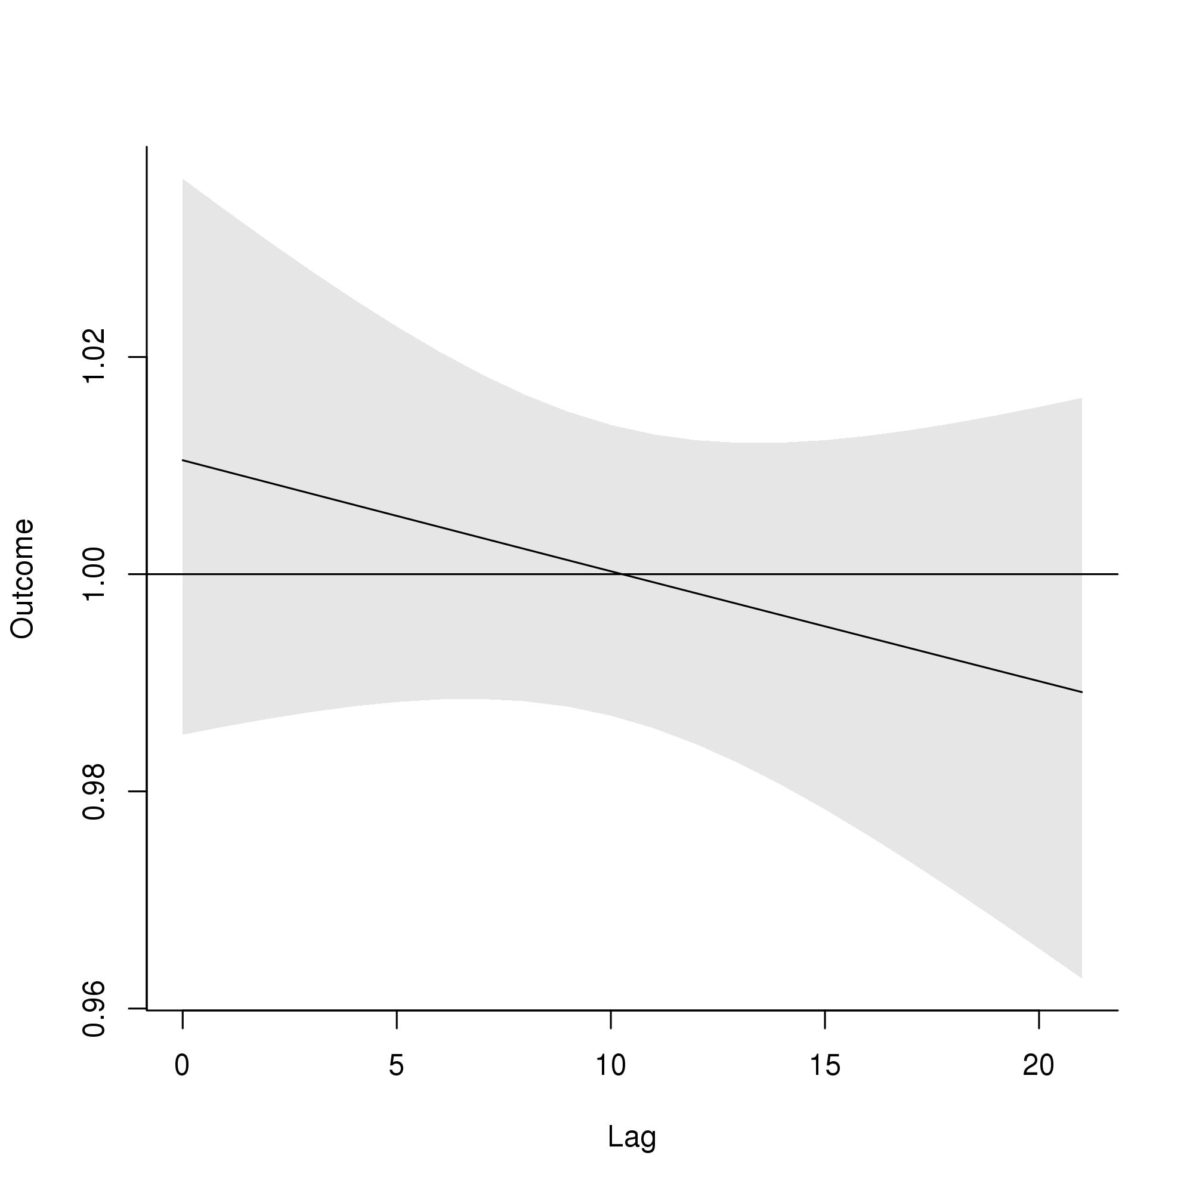
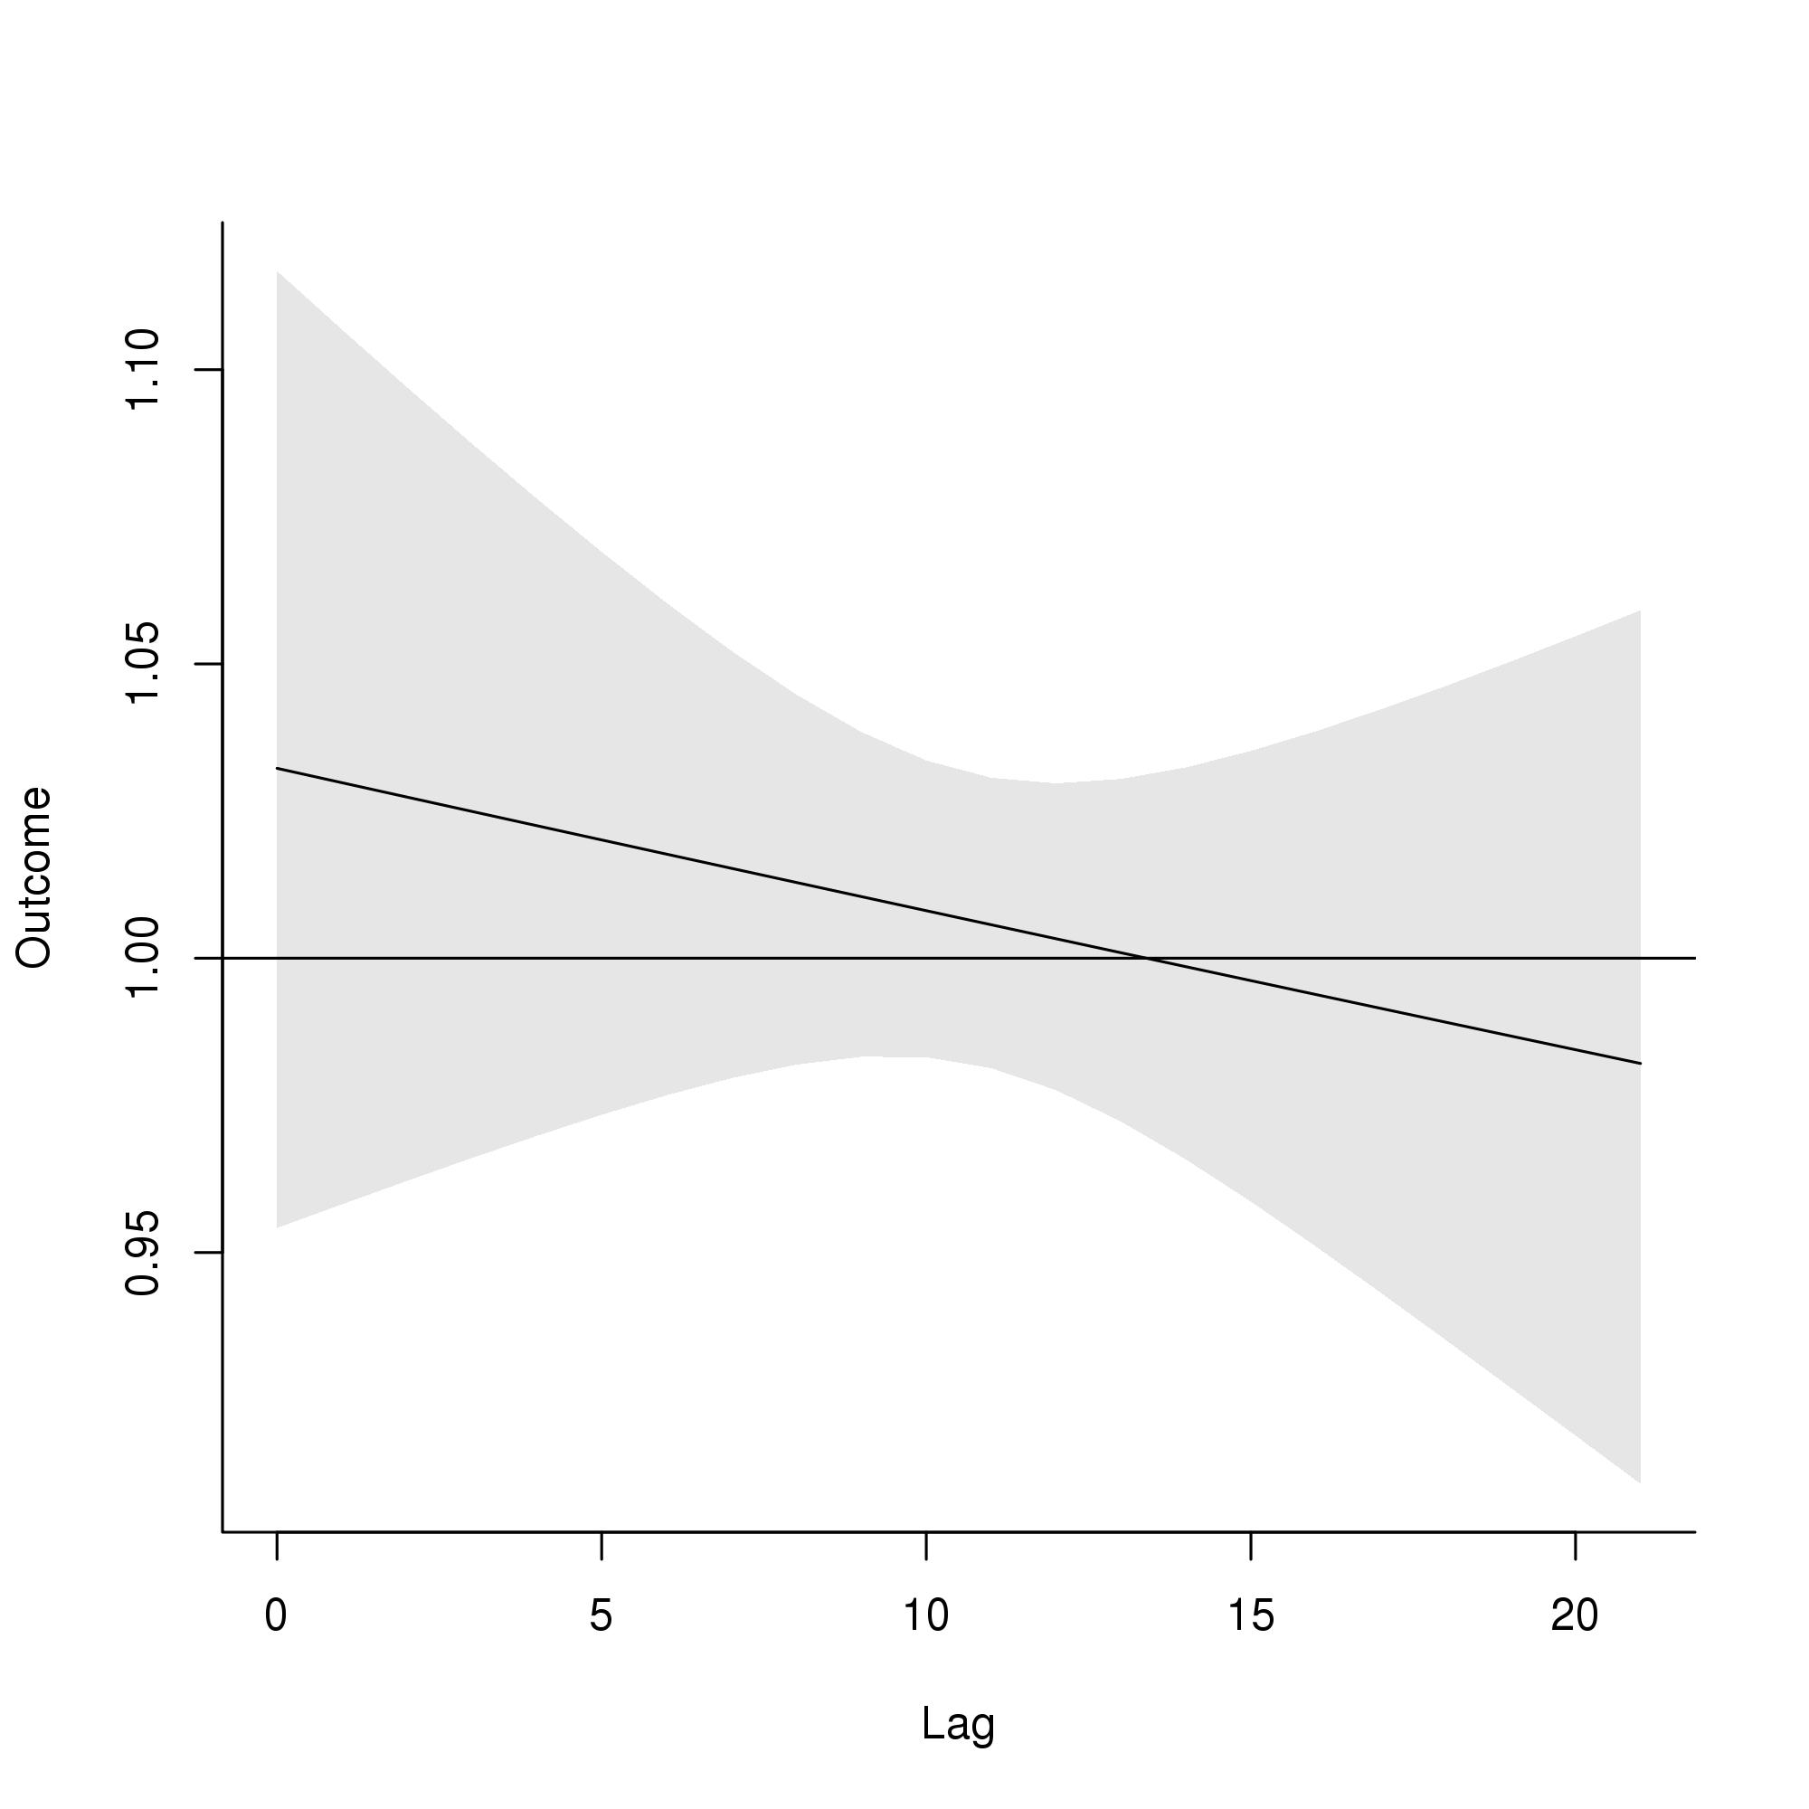
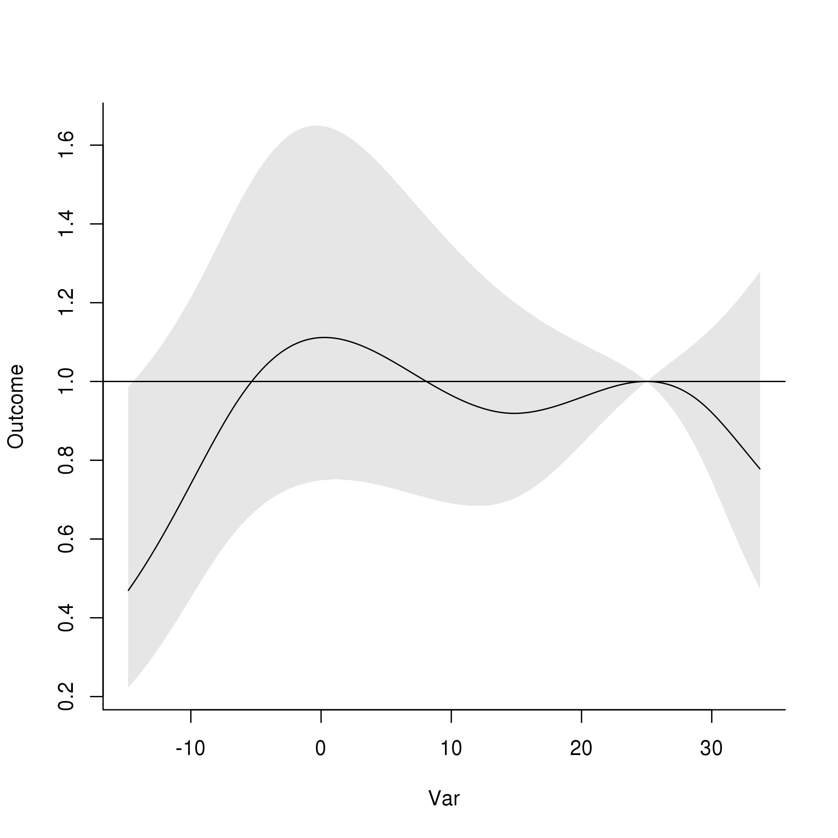
DLNM results, <1 ages, Case-crossover design
A
OR
B
Lag
OR
Daily mean temperature (°C)
Daily mean temperature (°C)
C
D
E
OR
OR
OR
Daily mean temperature (°C)

Slide 4
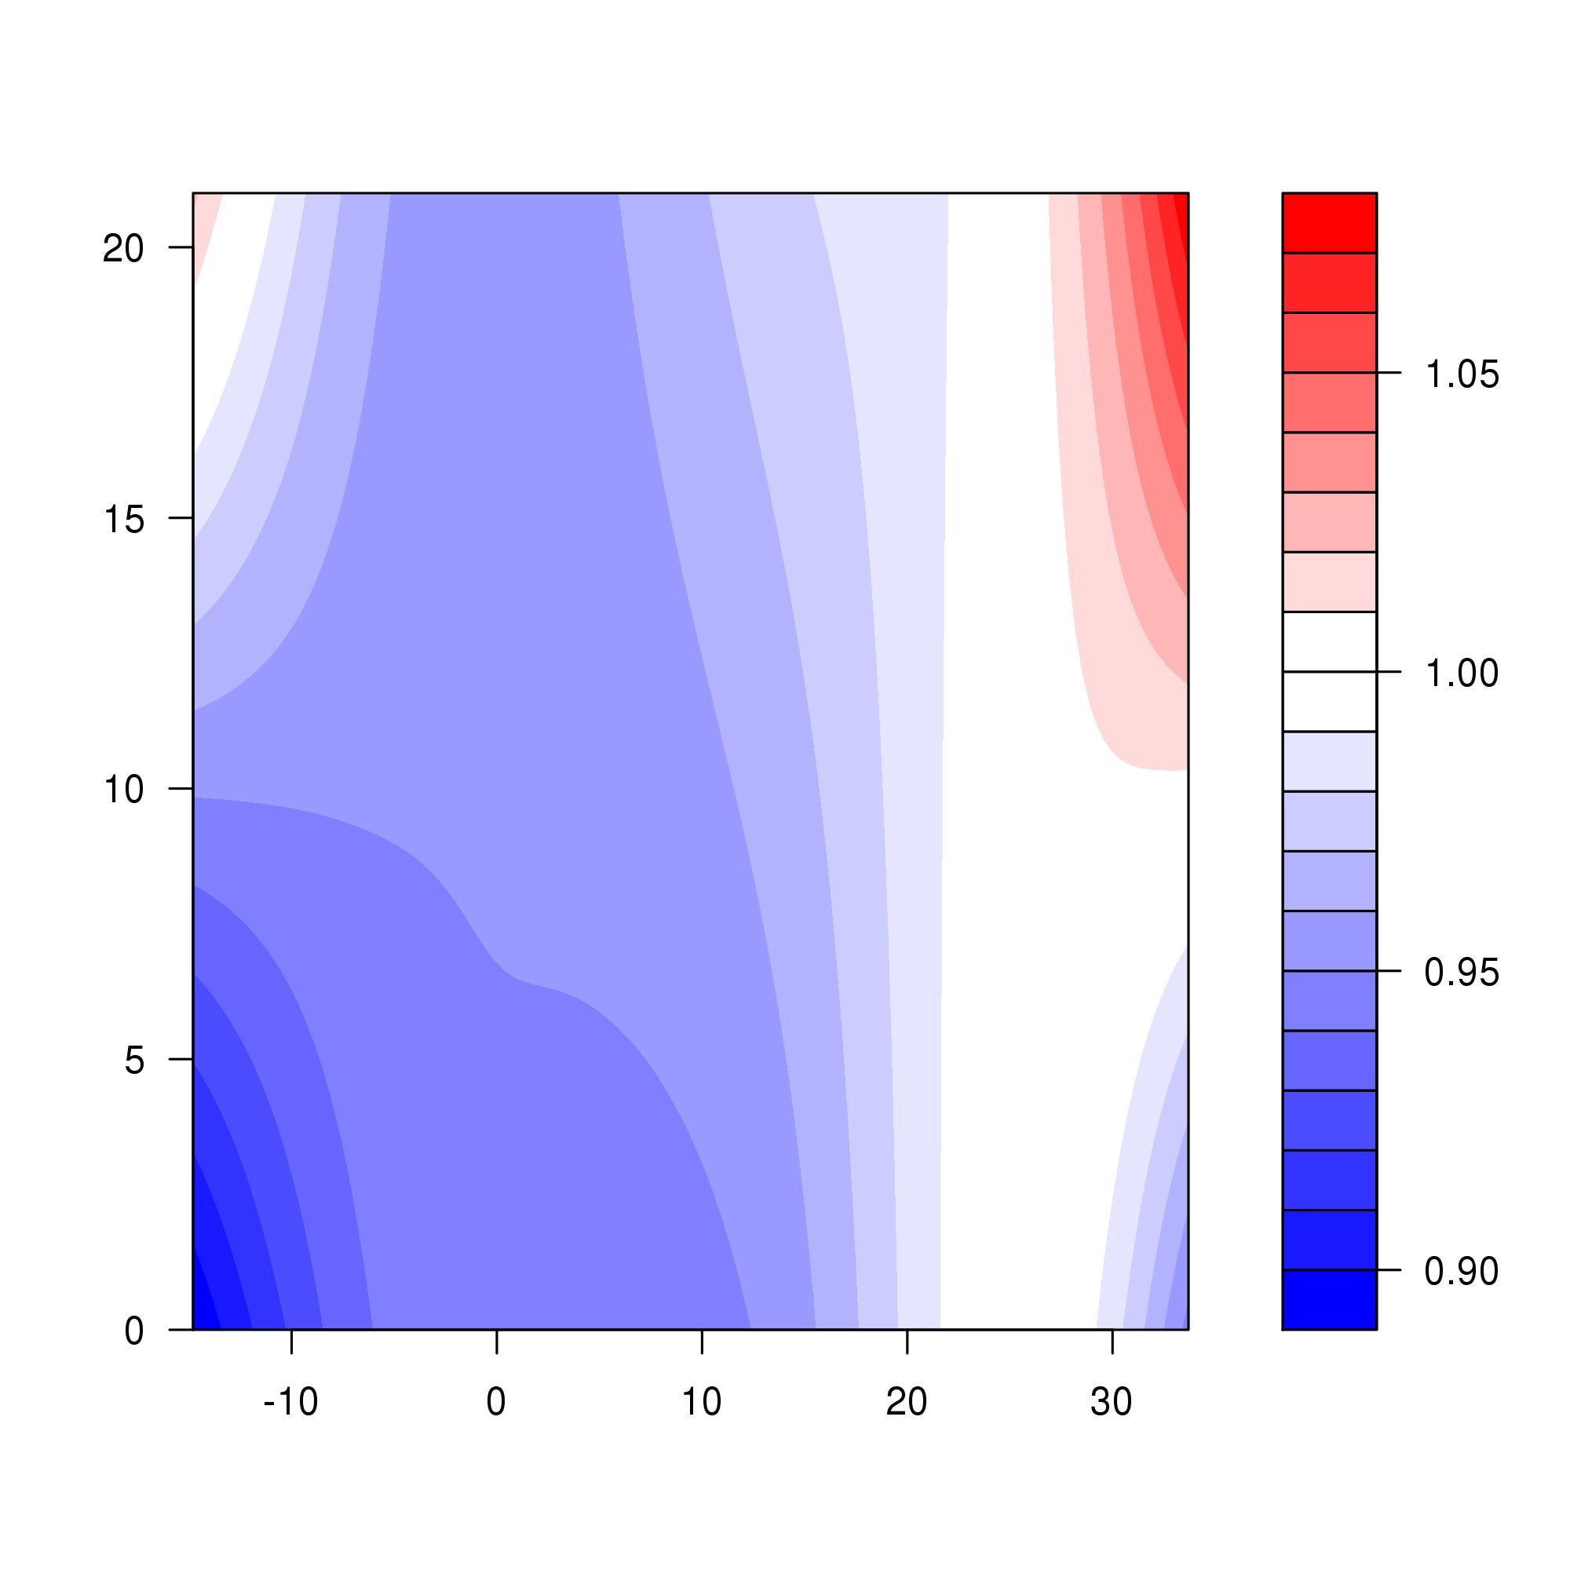
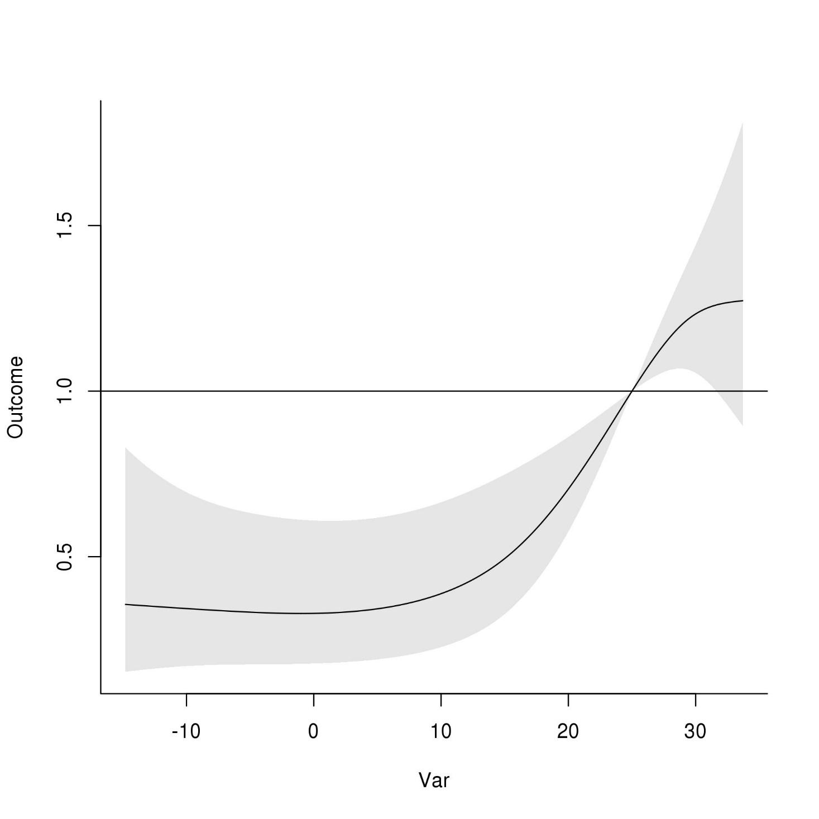
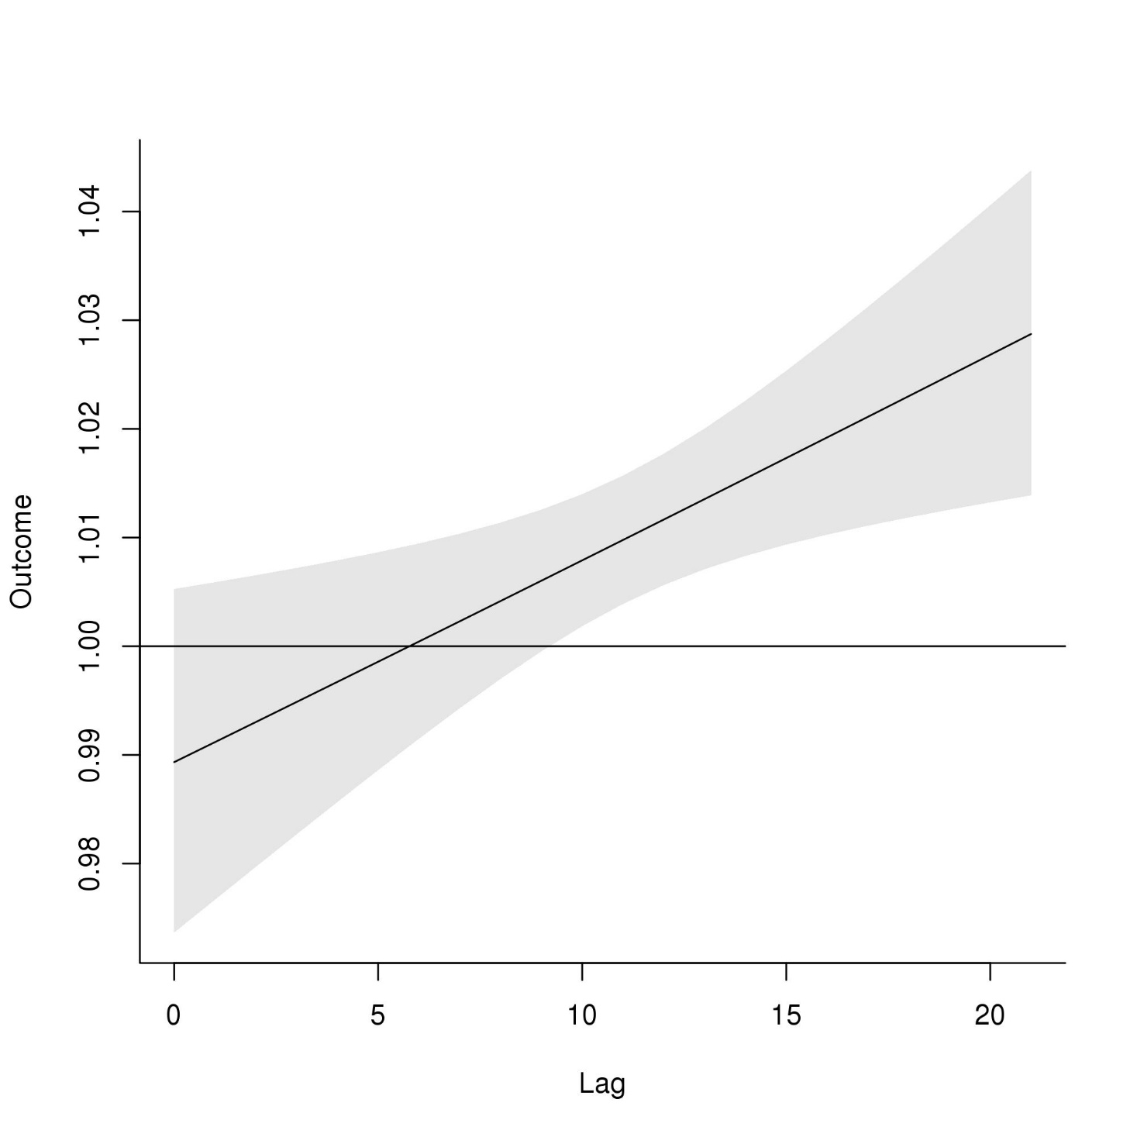
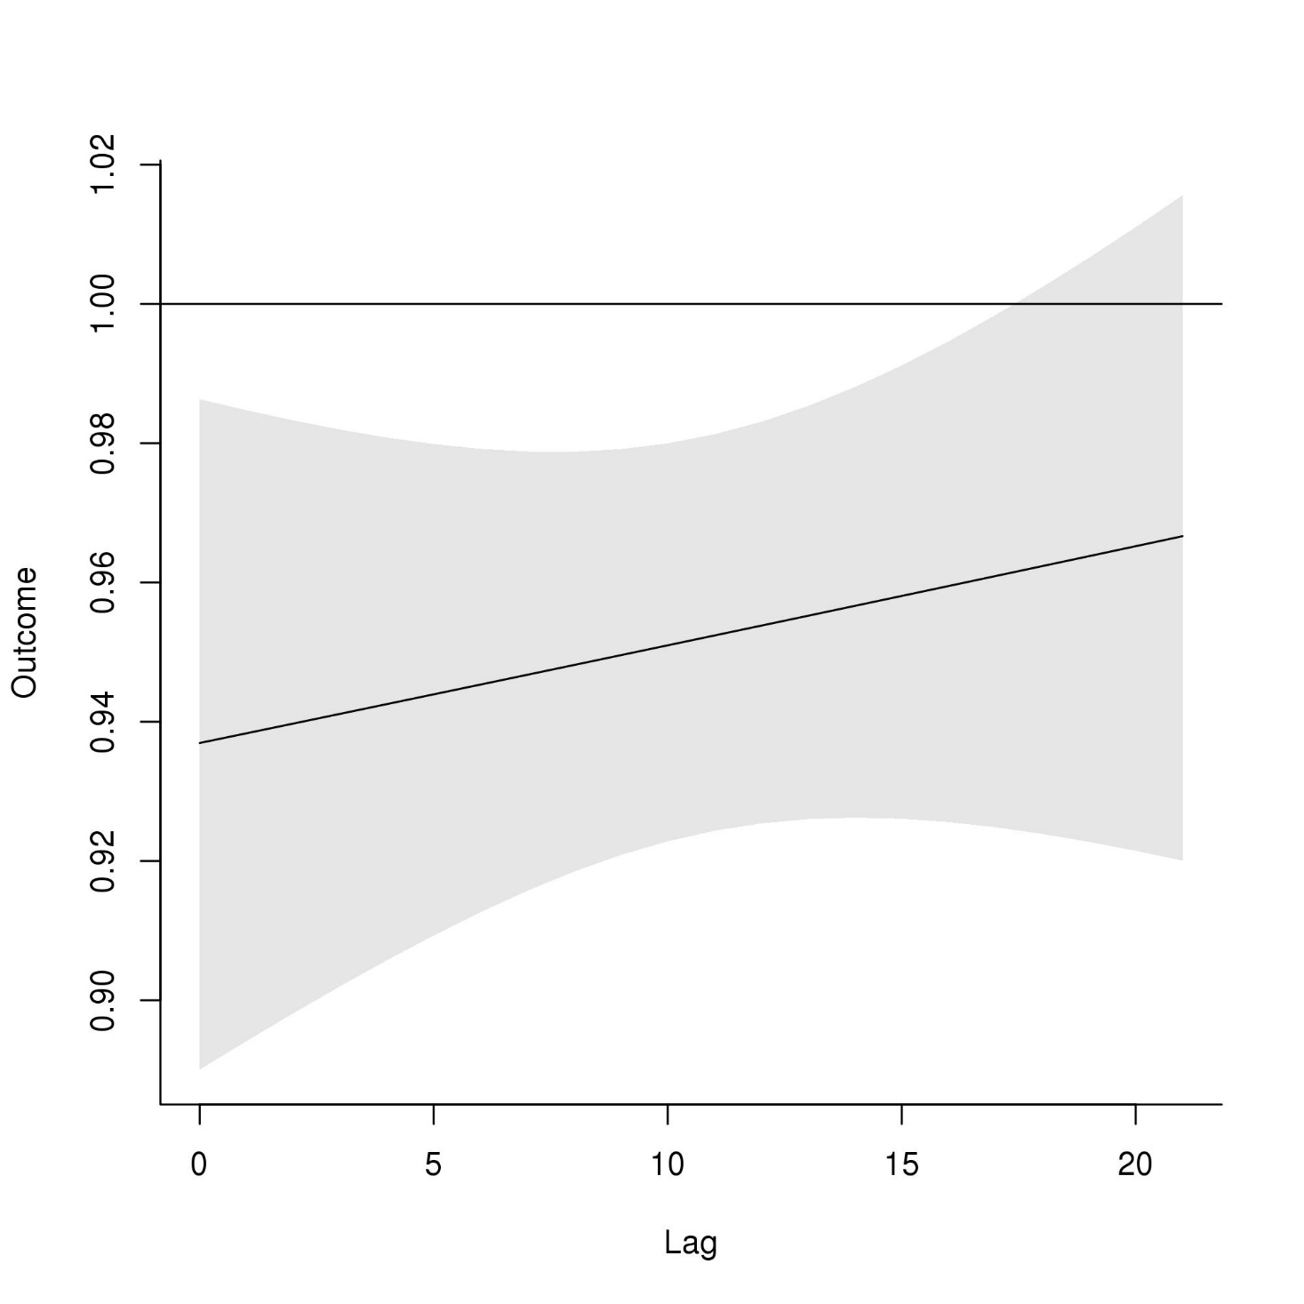
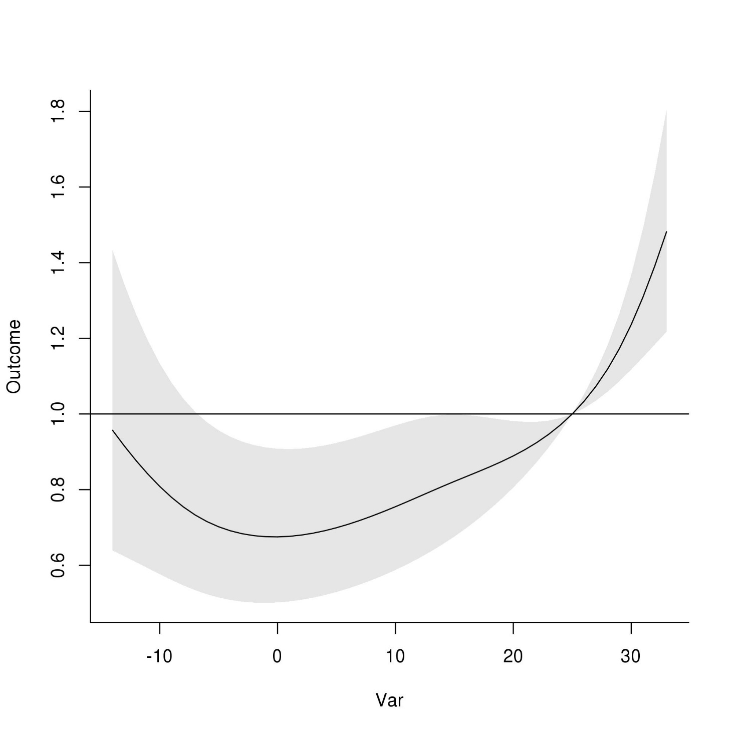
DLNM results, 1–4 ages, Time-series design
A
RR
B
Lag
RR
Daily mean temperature (°C)
Daily mean temperature (°C)
C
D
E
RR
RR
RR
Daily mean temperature (°C)

Slide 5
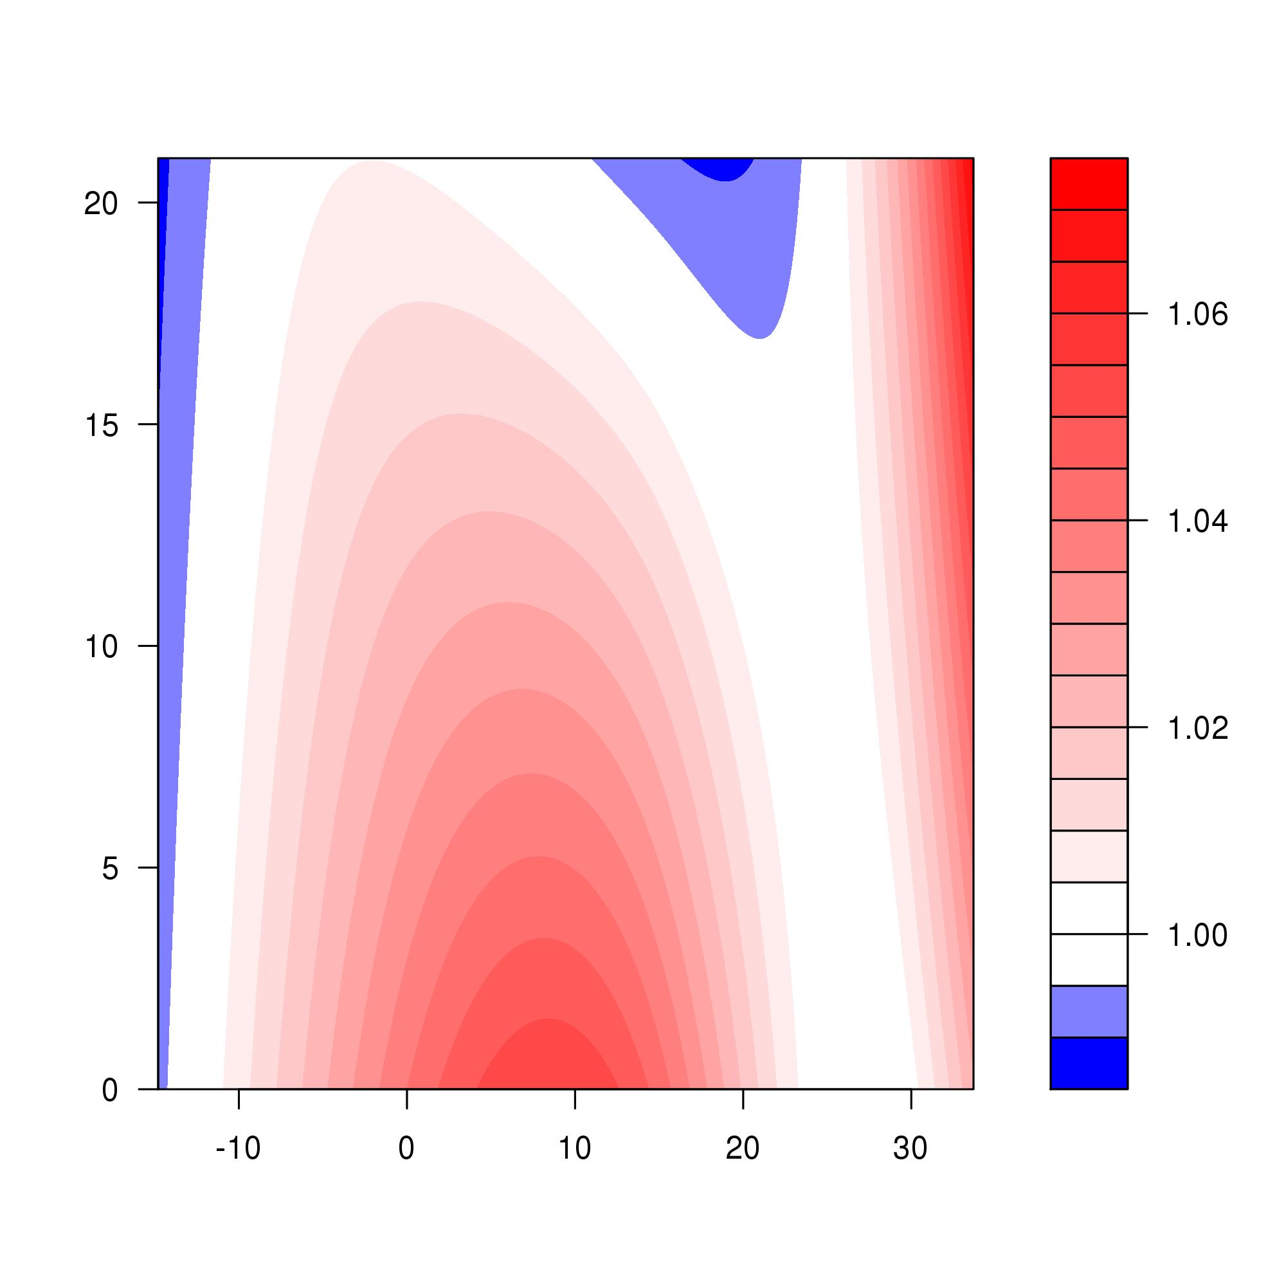
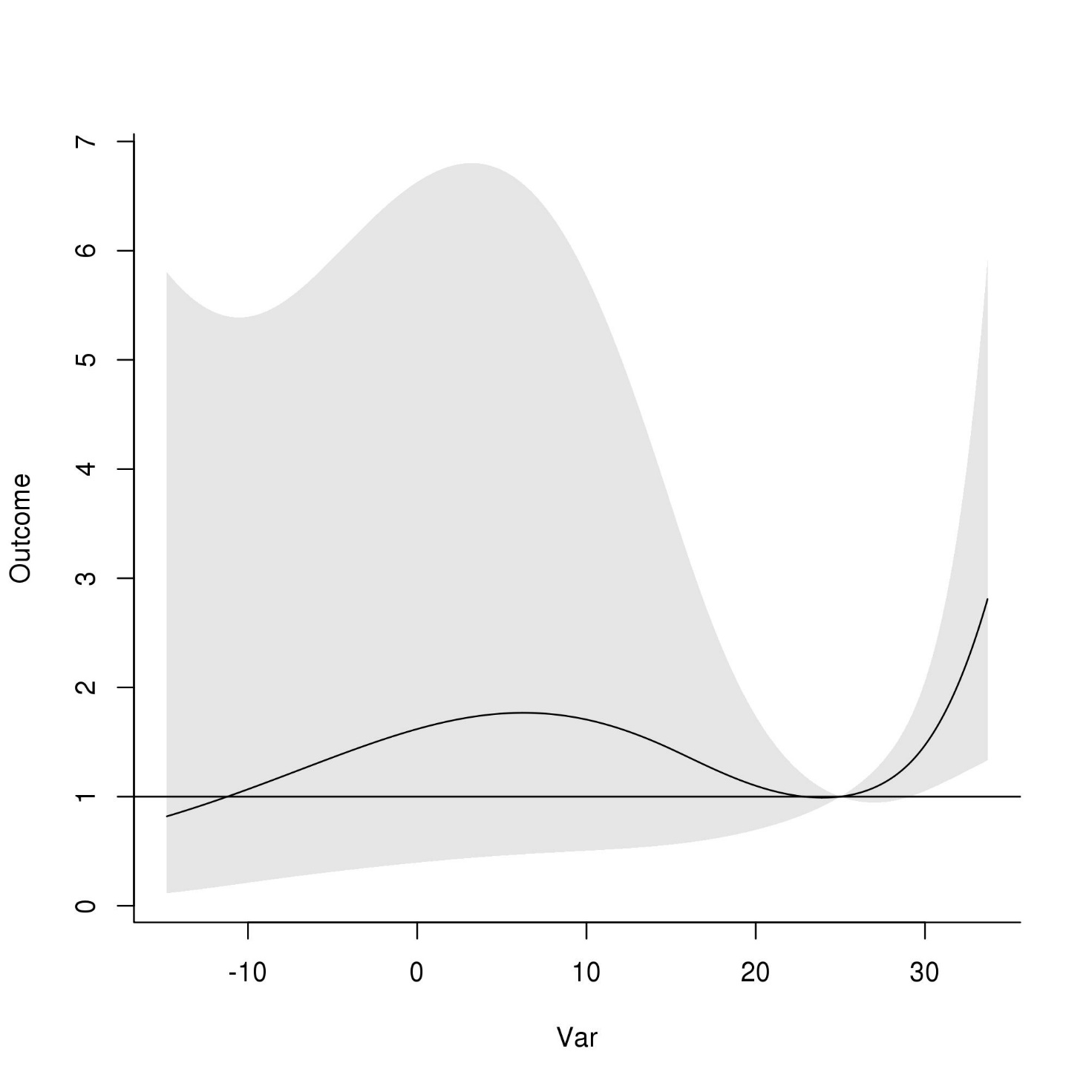
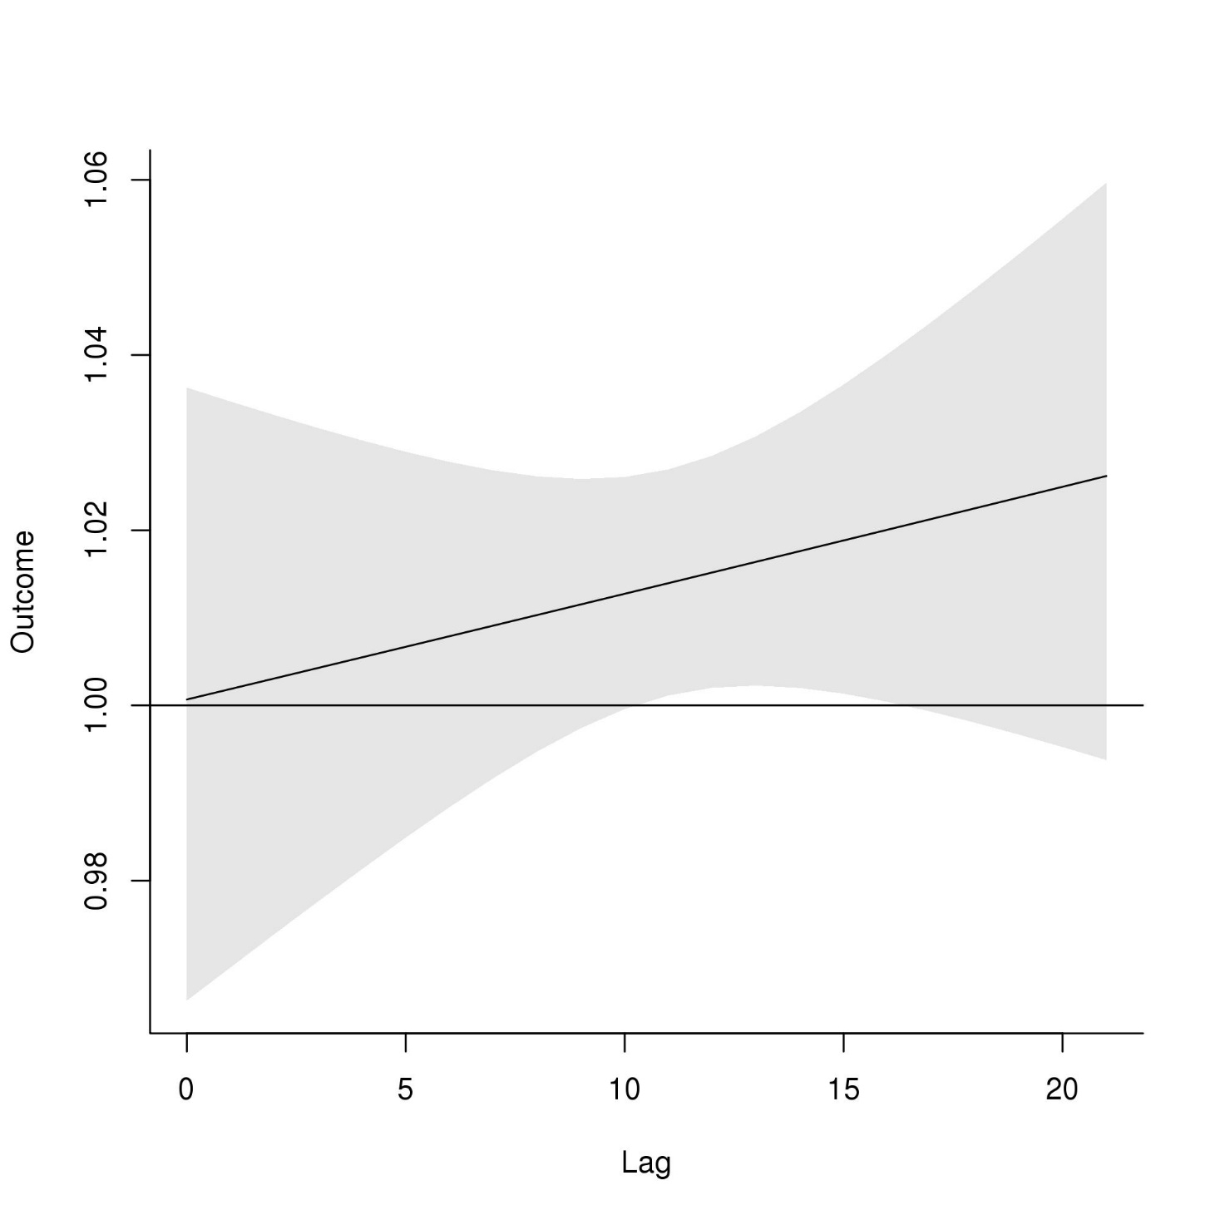
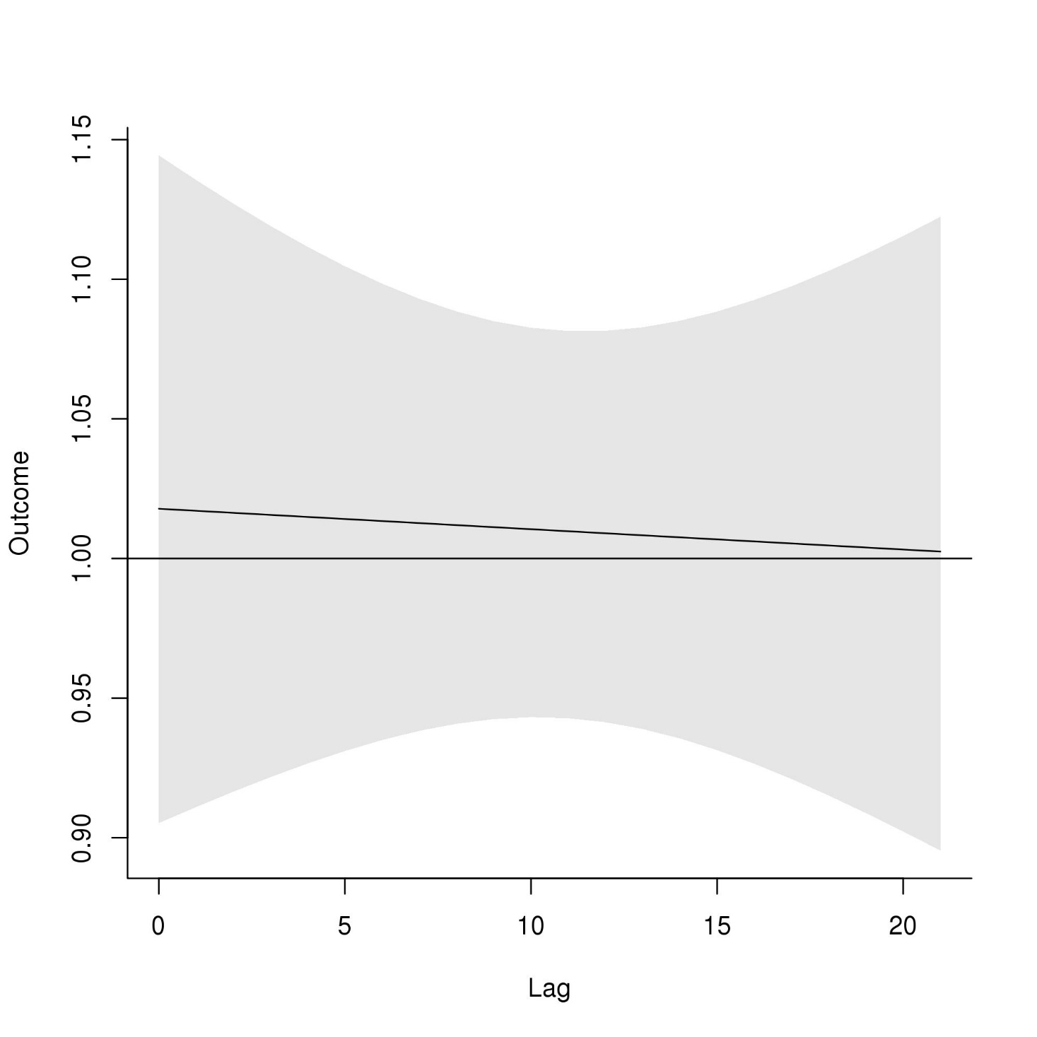
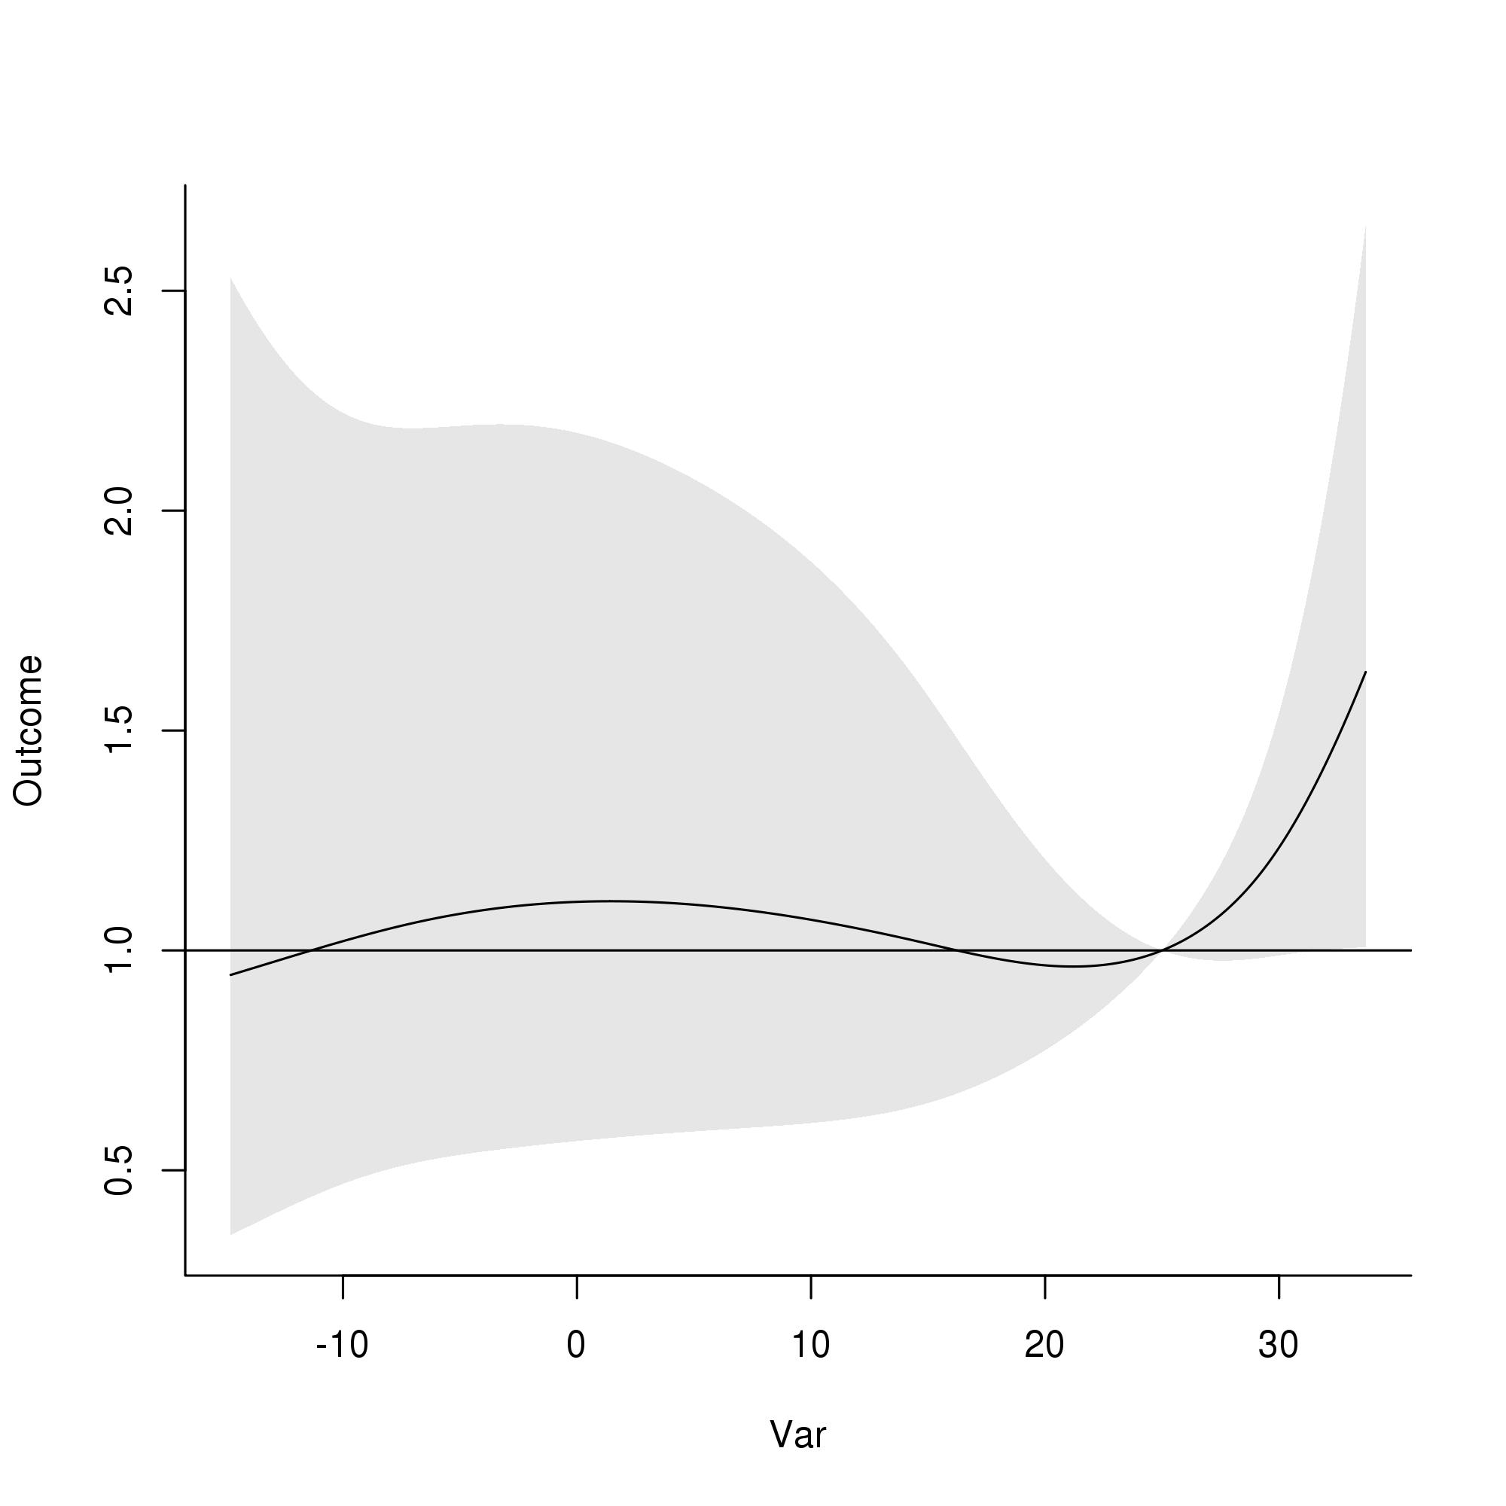
DLNM results, 5–9 ages, Time-series design
A
OR
B
Lag
RR
Daily mean temperature (°C)
Daily mean temperature (°C)
C
D
E
RR
RR
RR
Daily mean temperature (°C)

Slide 6
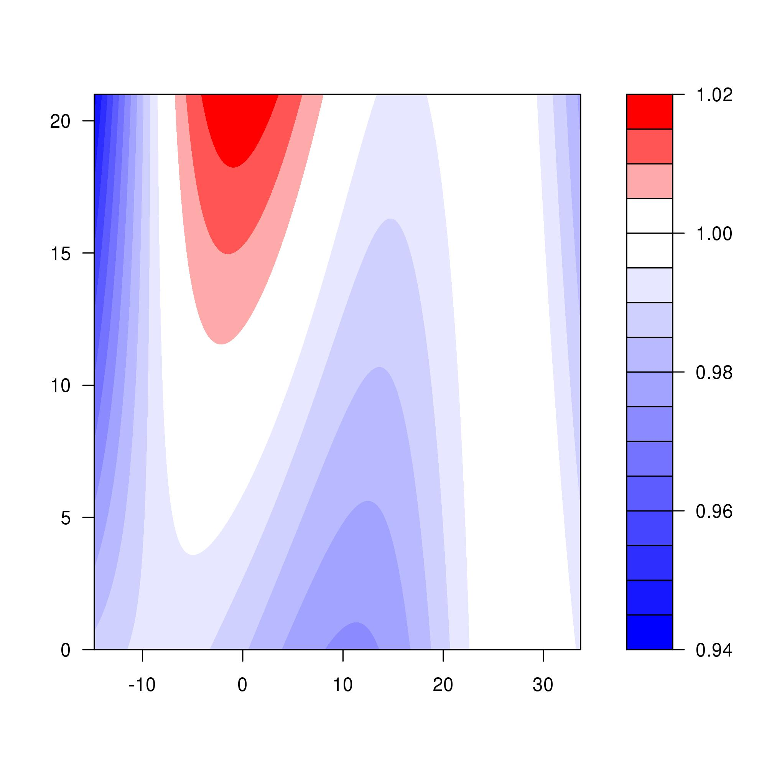
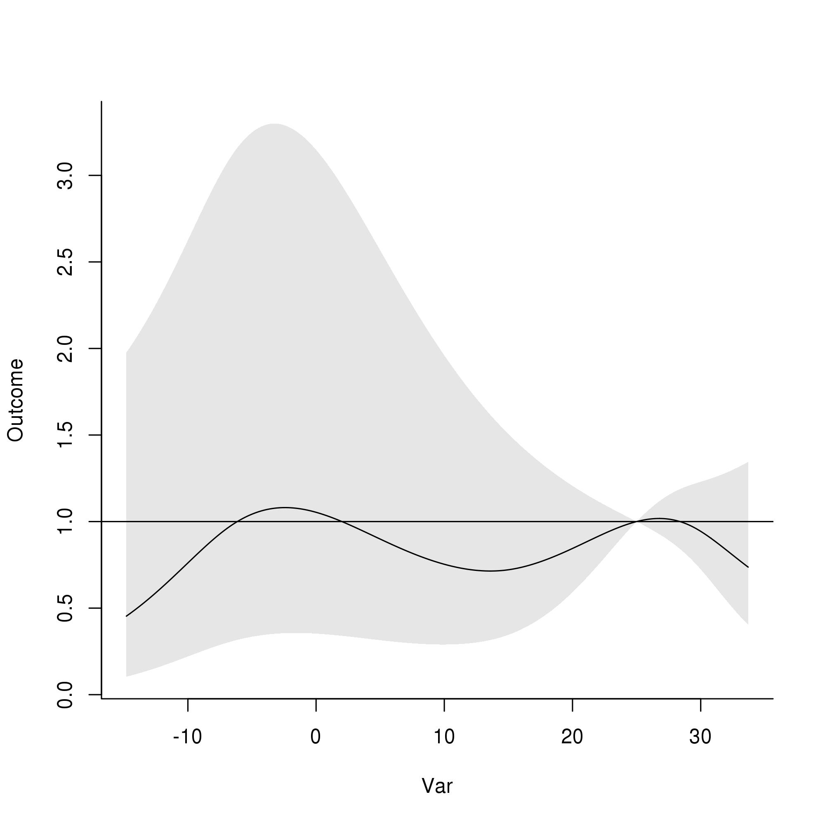
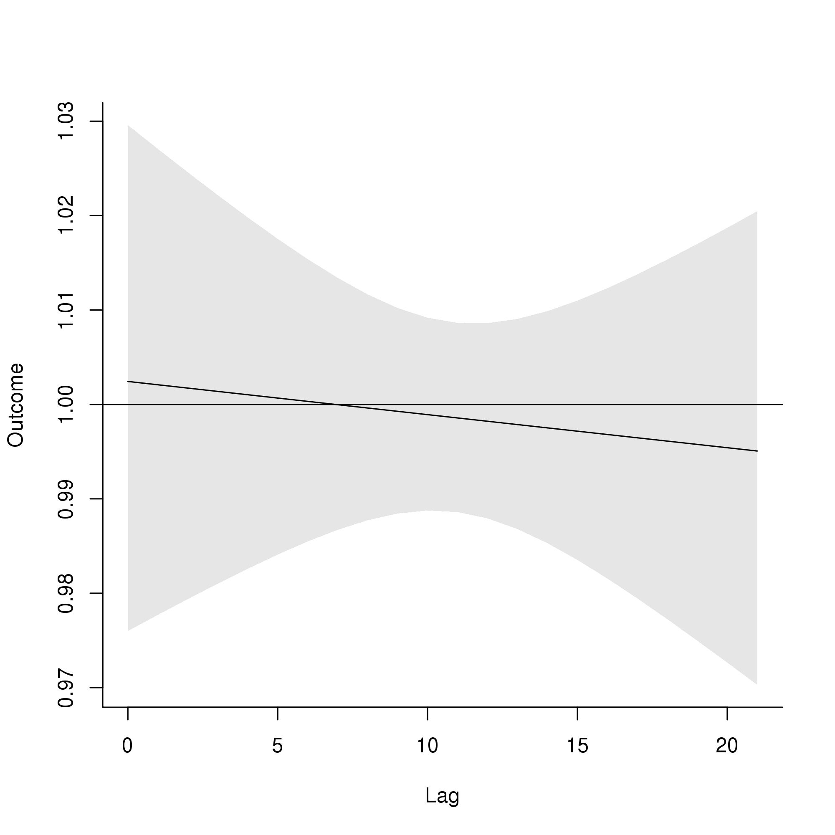
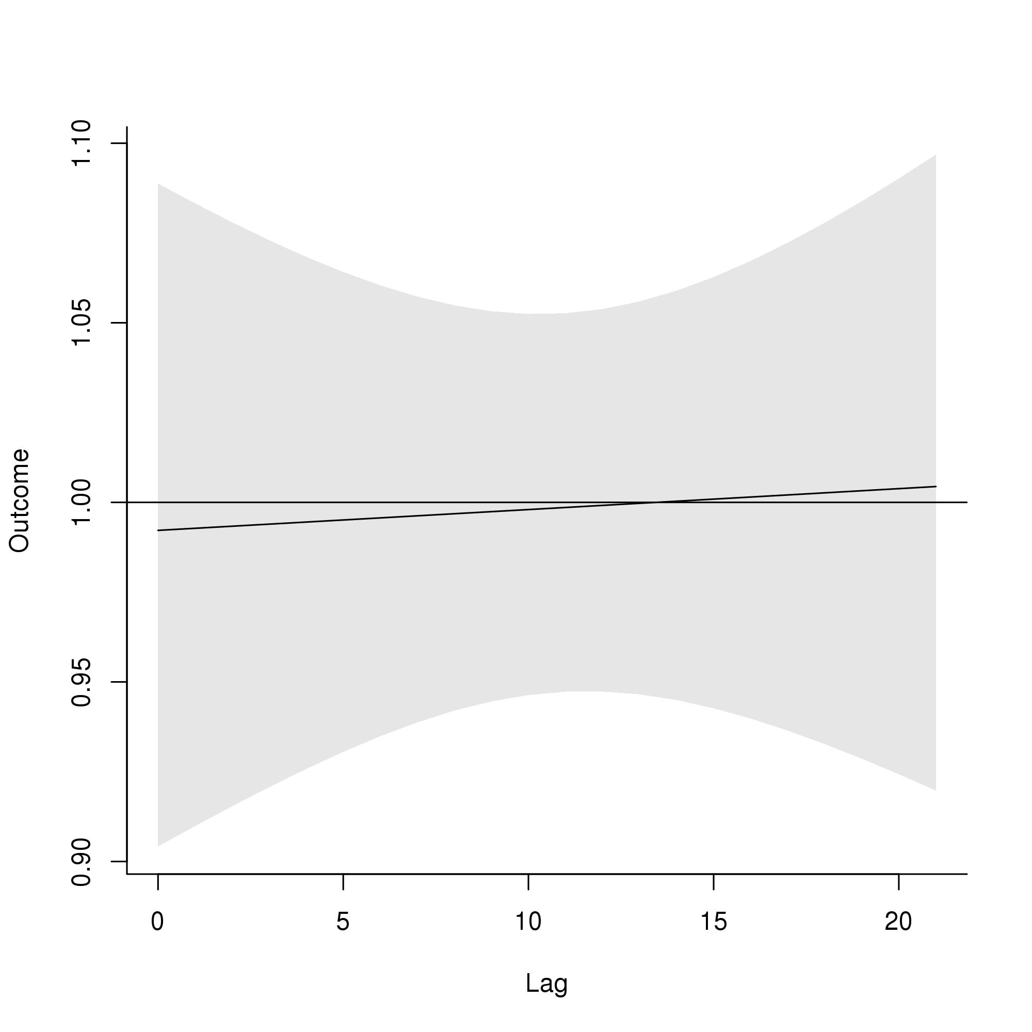
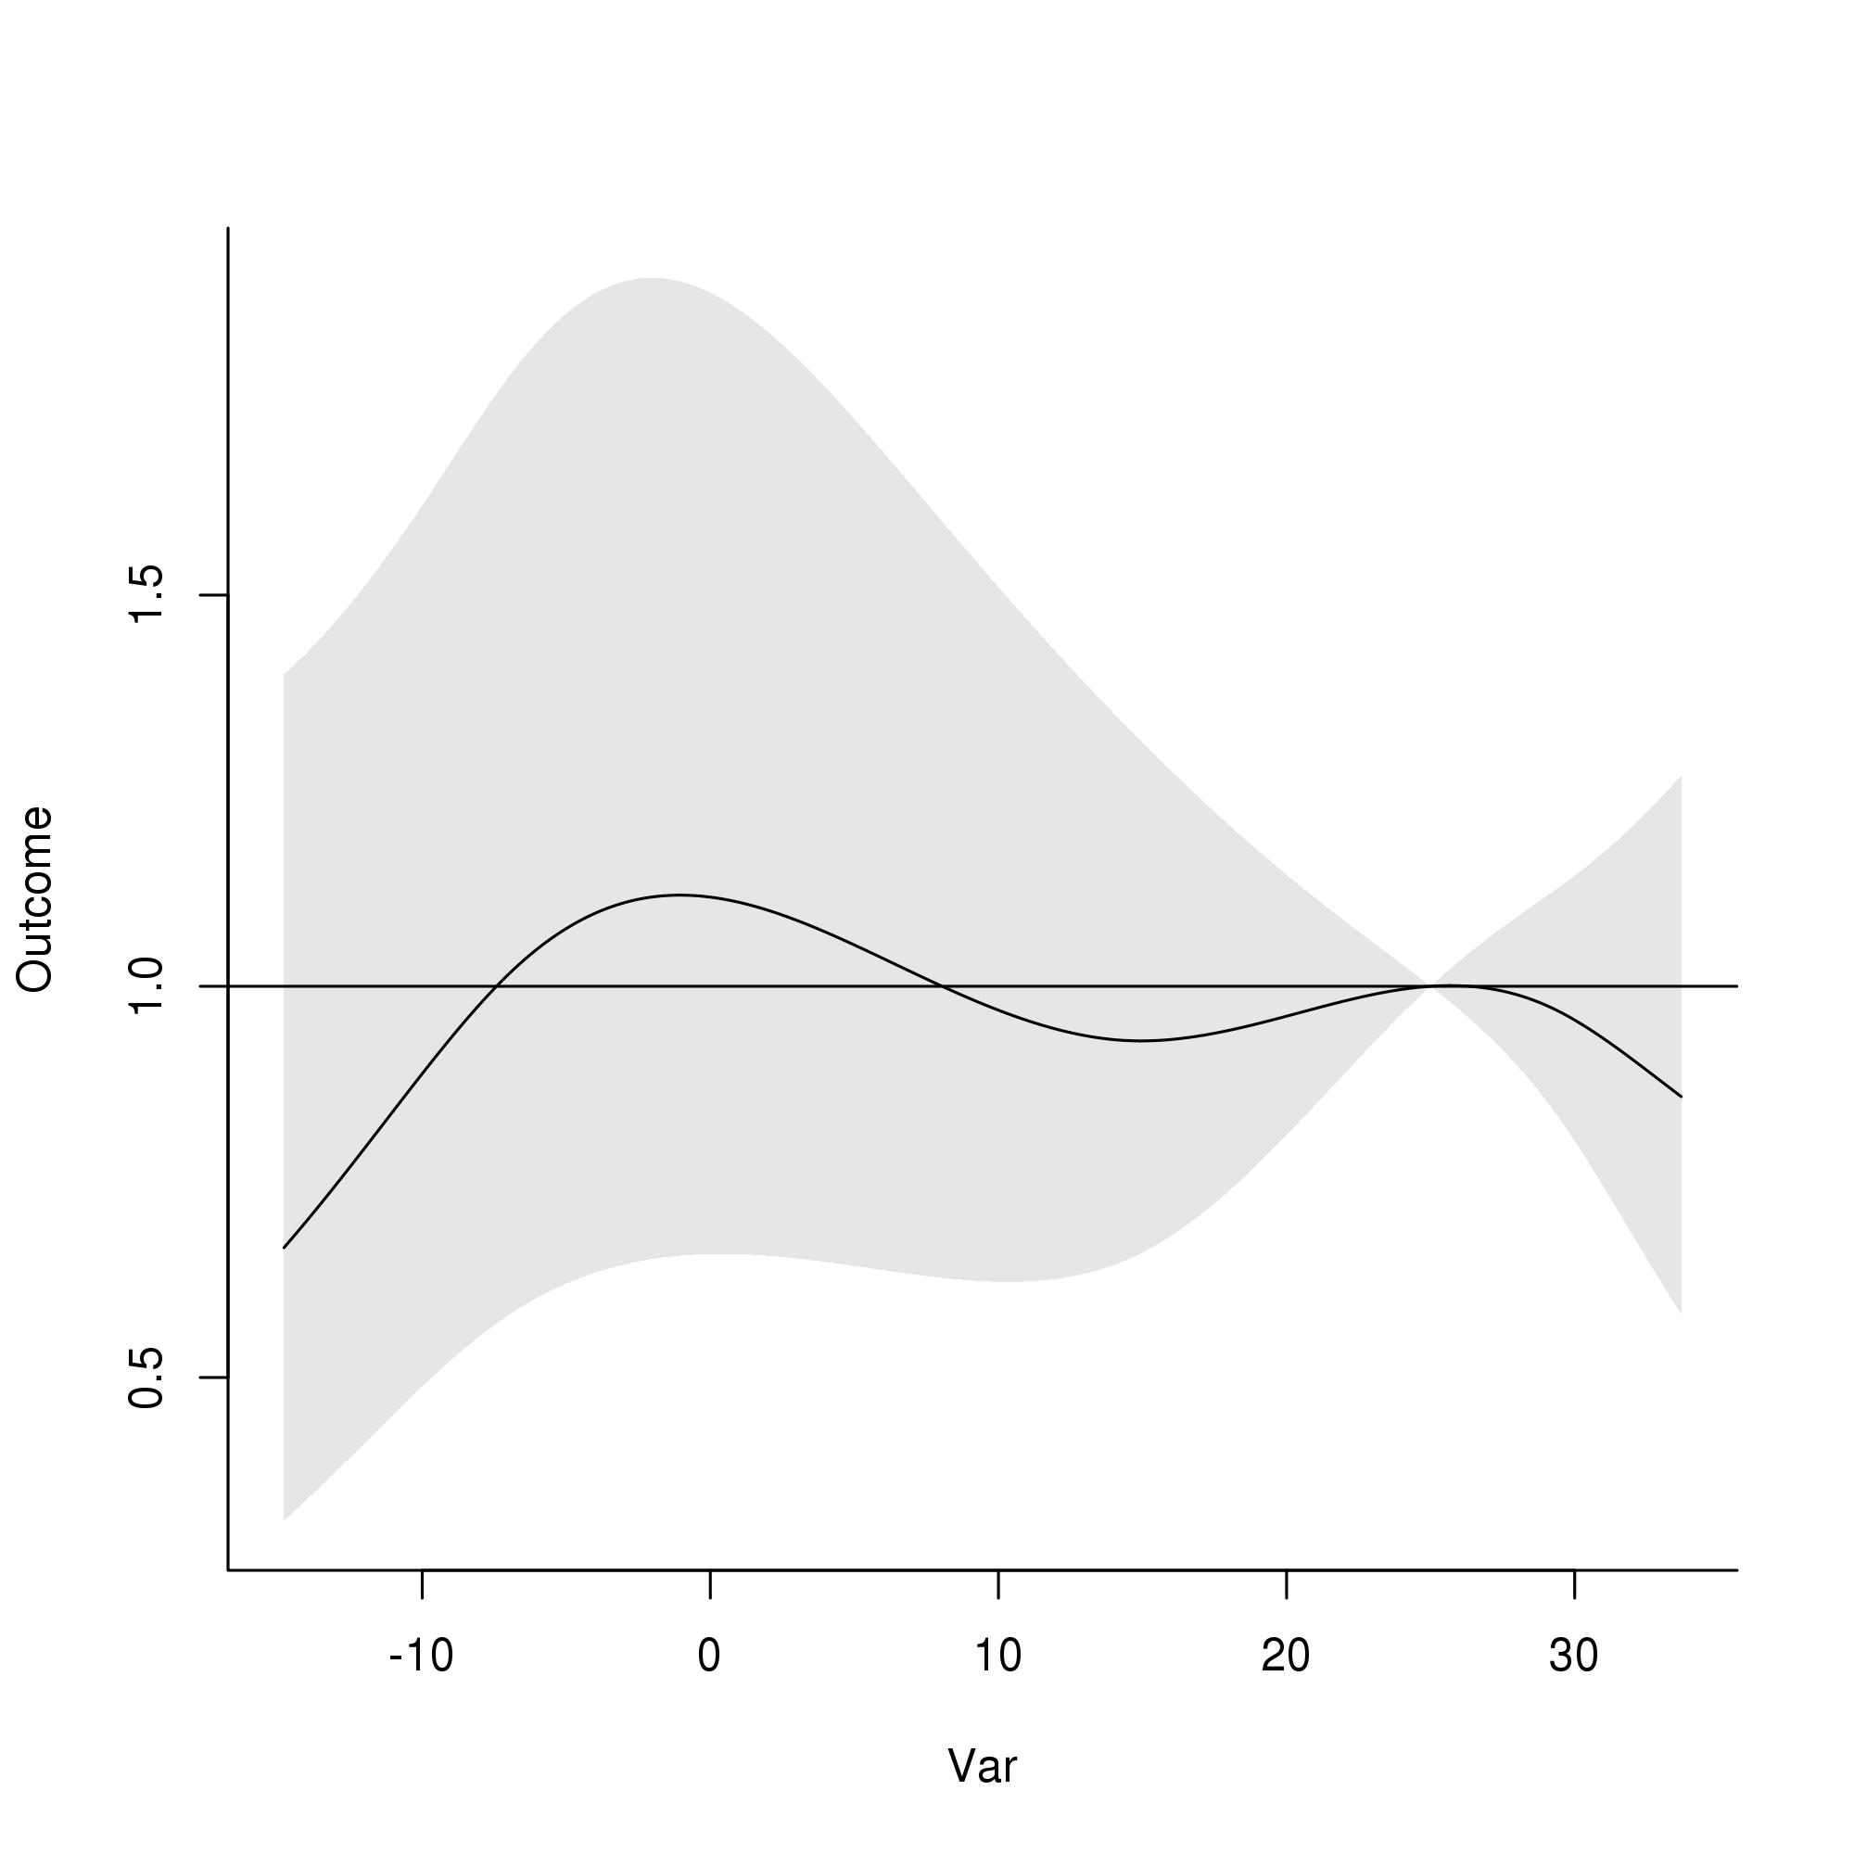
DLNM results, <1 ages, Time-series design
A
OR
B
Lag
RR
Daily mean temperature (°C)
Daily mean temperature (°C)
C
D
E
RR
RR
RR
Daily mean temperature (°C)

