Slide 1
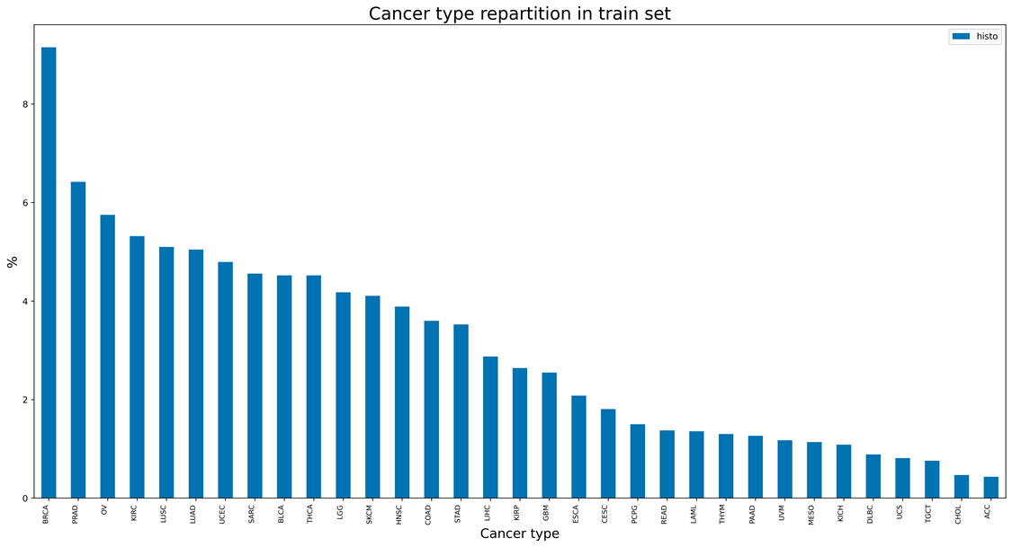
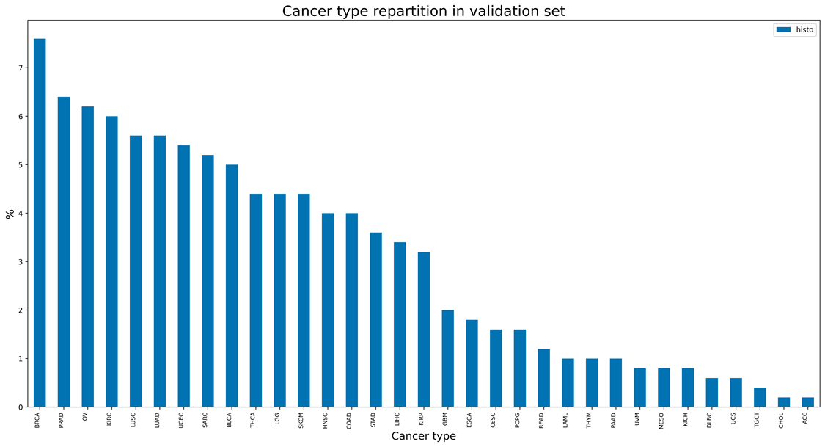
Supplementary Figure 1
a
b

Slide 2
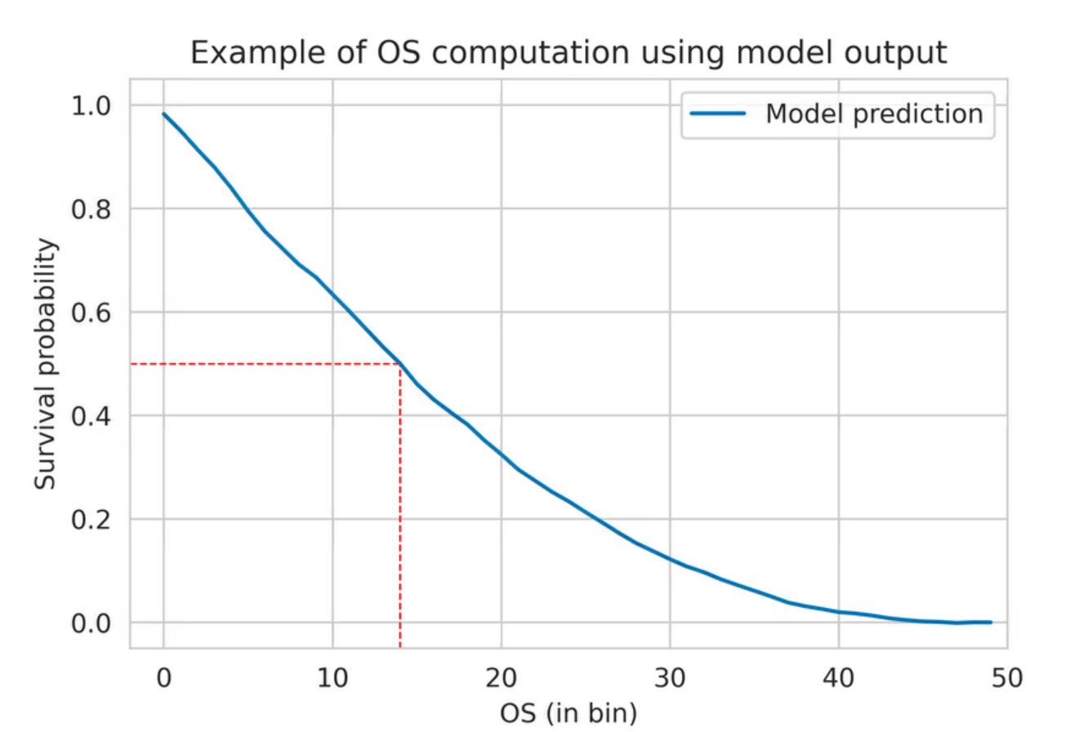
Supplementary Figure 2
TPM
input
Gene selection (N=4,499)
Gaussian noise reduction
Dense layer
ReLU
Organ-specific task
Batch normalization
Dropout
…
Dense layer
ReLU
Batch normalization
Dropout
Dense layer
ReLU
Survival-specific task
Batch normalization
Dropout
…
Dense layer
ReLU
Batch normalization
Dropout
Dense layer
High dimentionality
Linear (survival) or softmax (organ)
output
Low dimentionality
Time interval survival probability
Survival probability
Time intervals

Slide 3
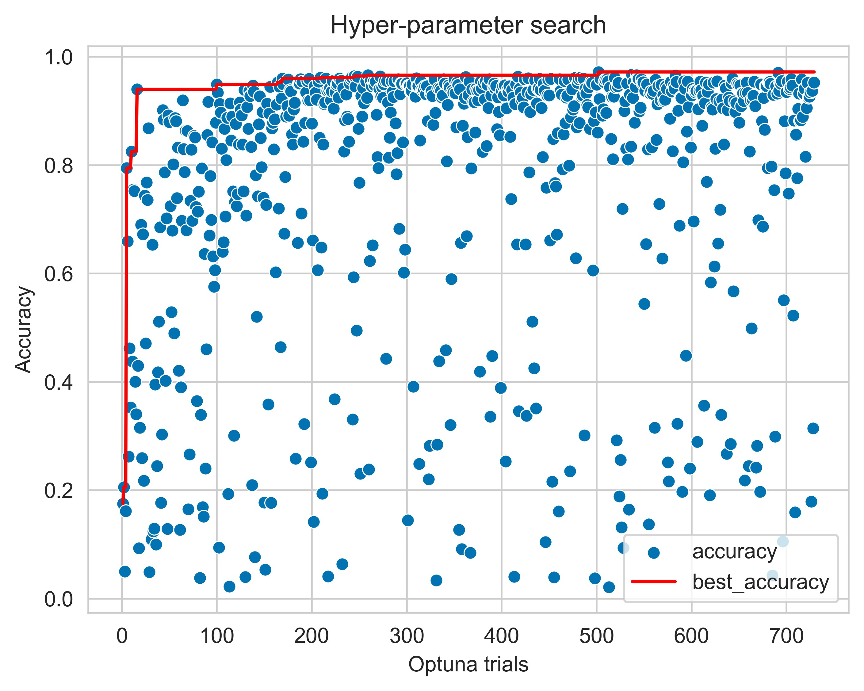
Supplementary Figure 3
a
b
Best organ model confusion matrix
Predicted
Number of samples
Truth

Slide 4
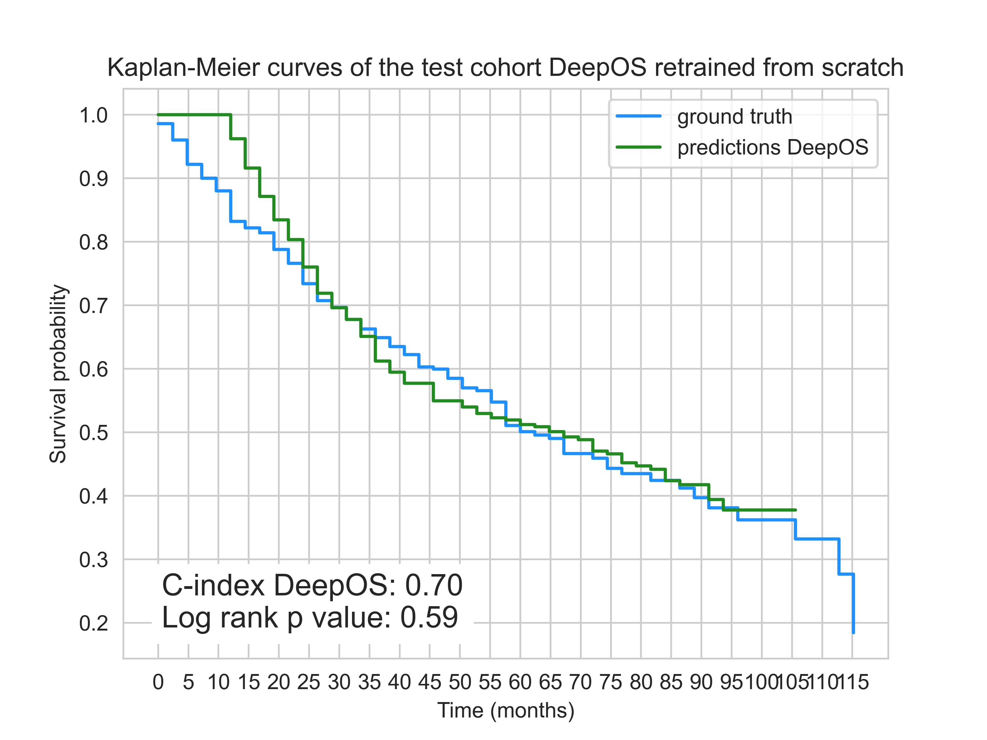
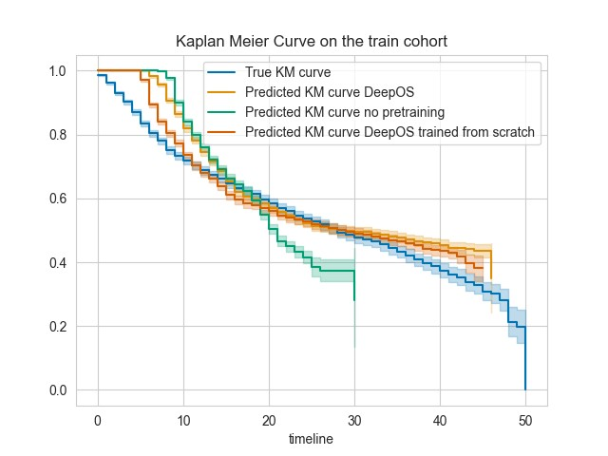
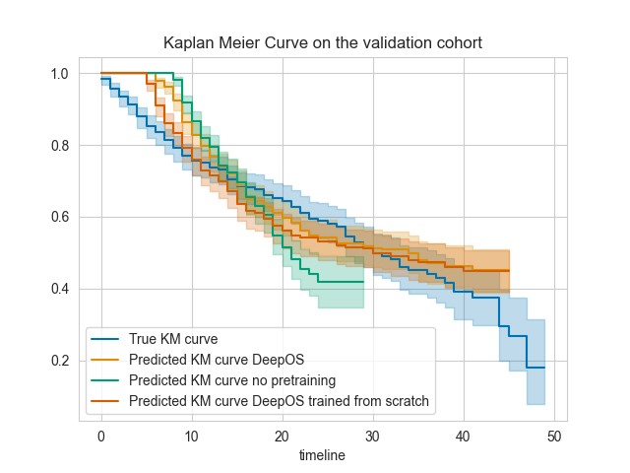
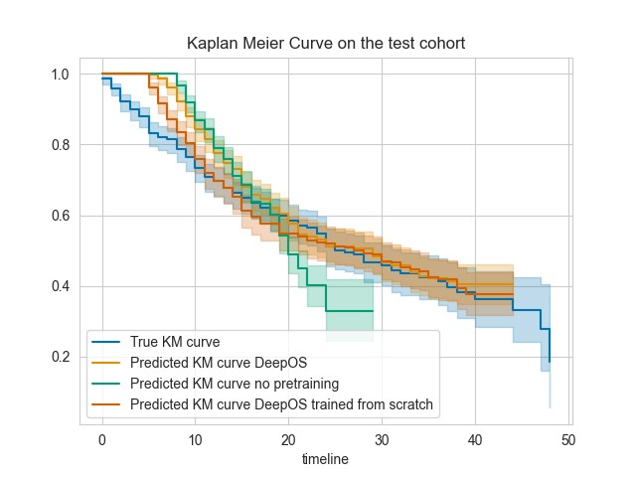
Supplementary Figure 4
a
with pretrained hyperparameters
Survival probability
b
pretrained hyperparameters
Survival probability
c
Survival probability
pretrained hyperparameters
d
Survival probability
pretrained hyperparameters

Slide 5
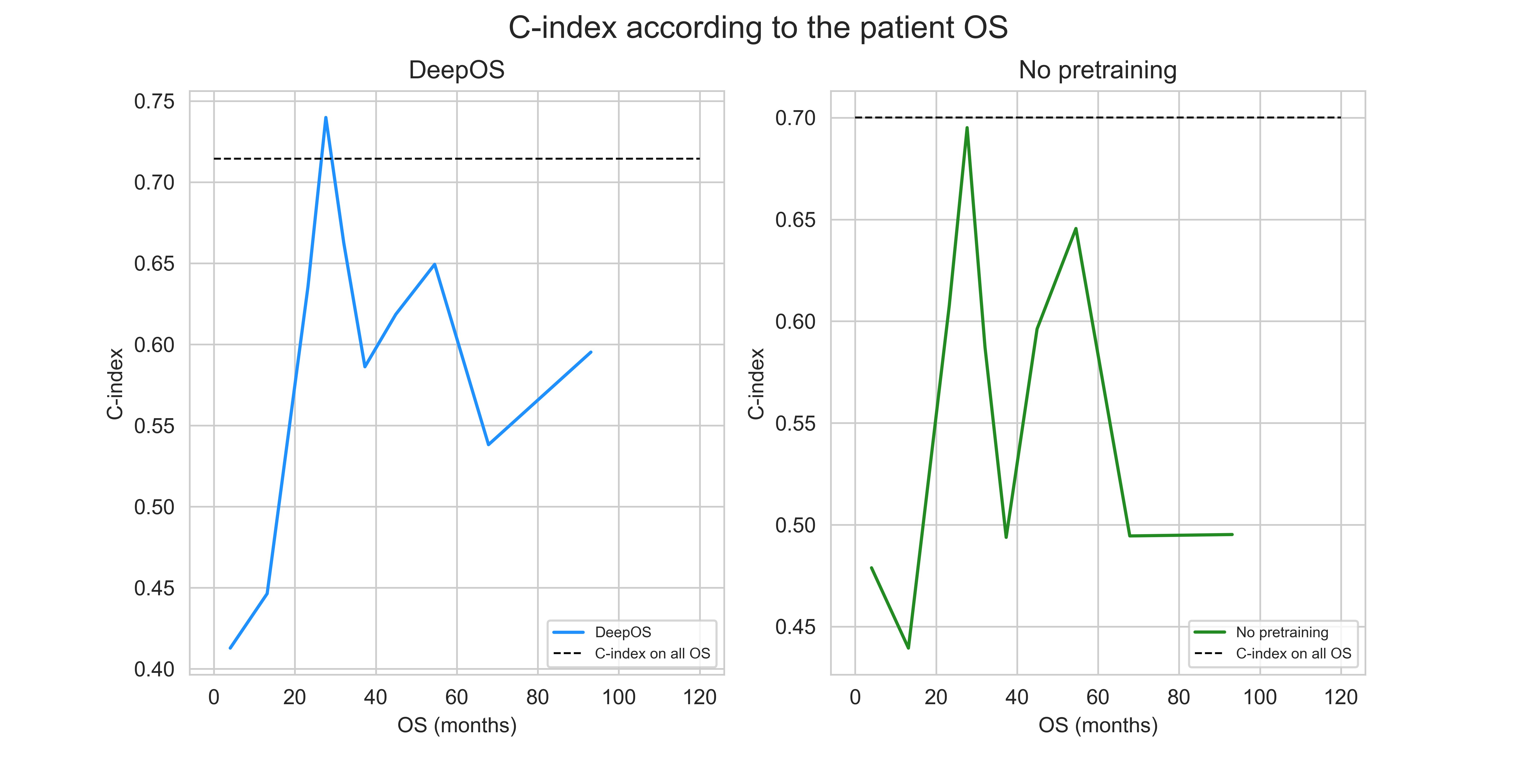
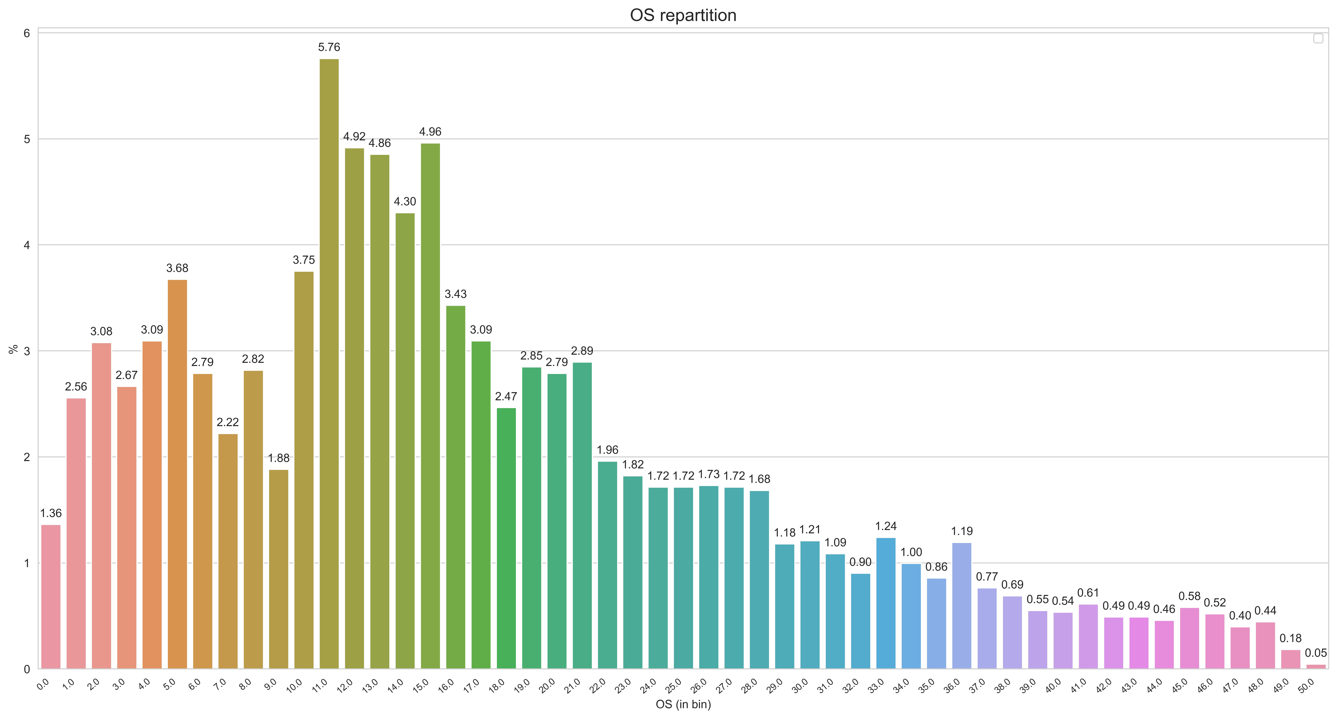
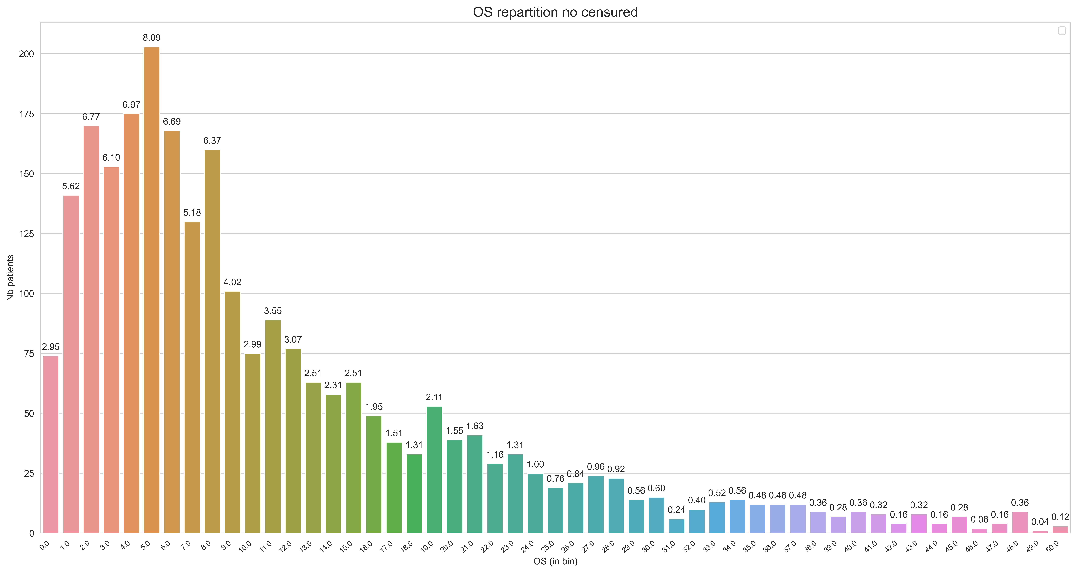
Supplementary Figure 5
a
b
Distribution of OS including censored data
Percentage of patients
Without censored data
Percentage of patients
Time intervals: 1 bin= 72 days

Slide 6
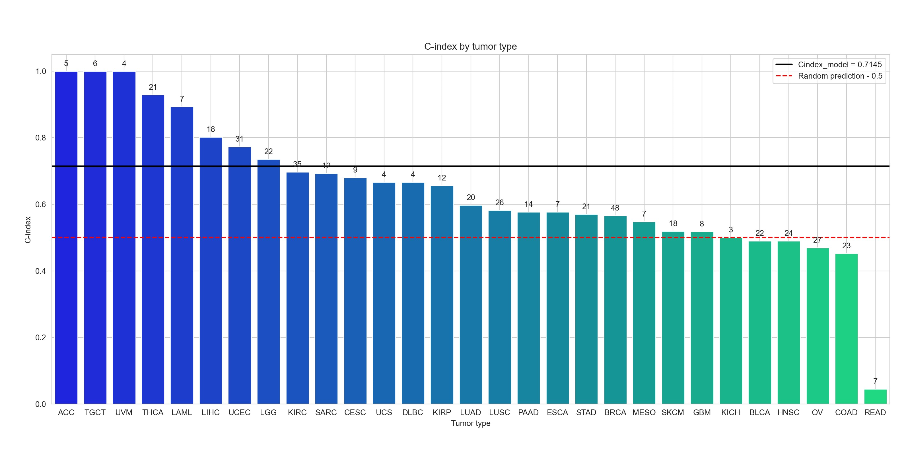
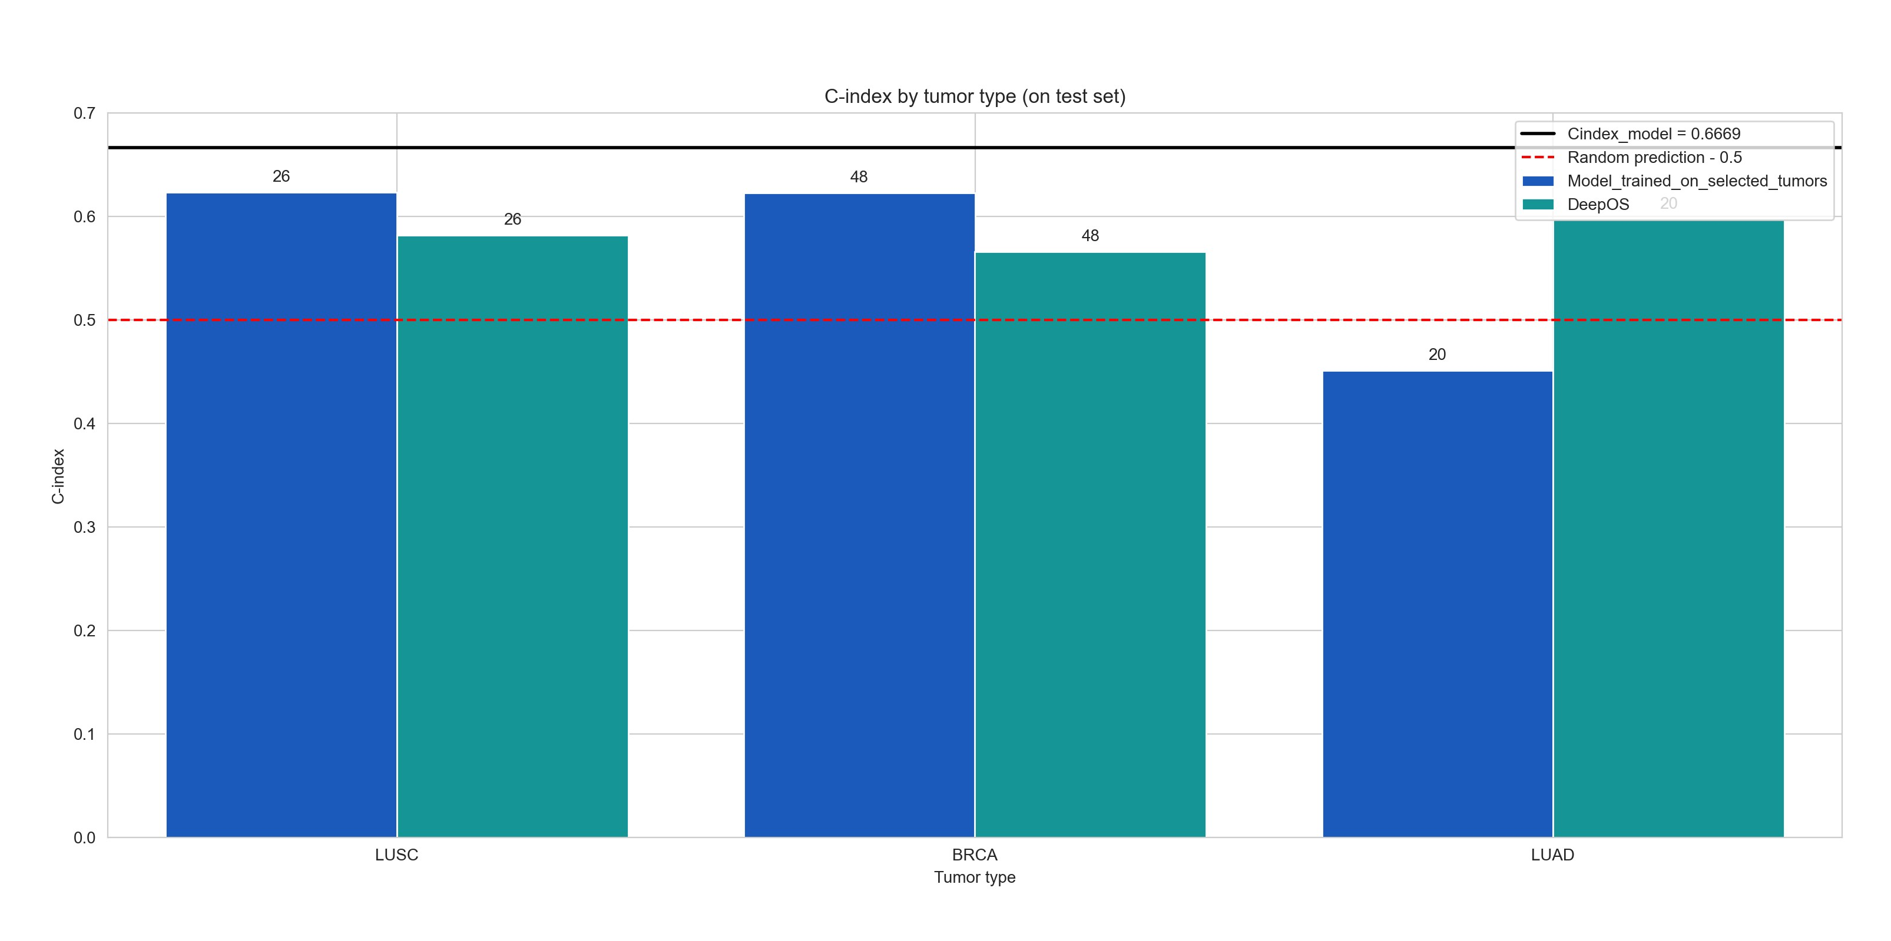
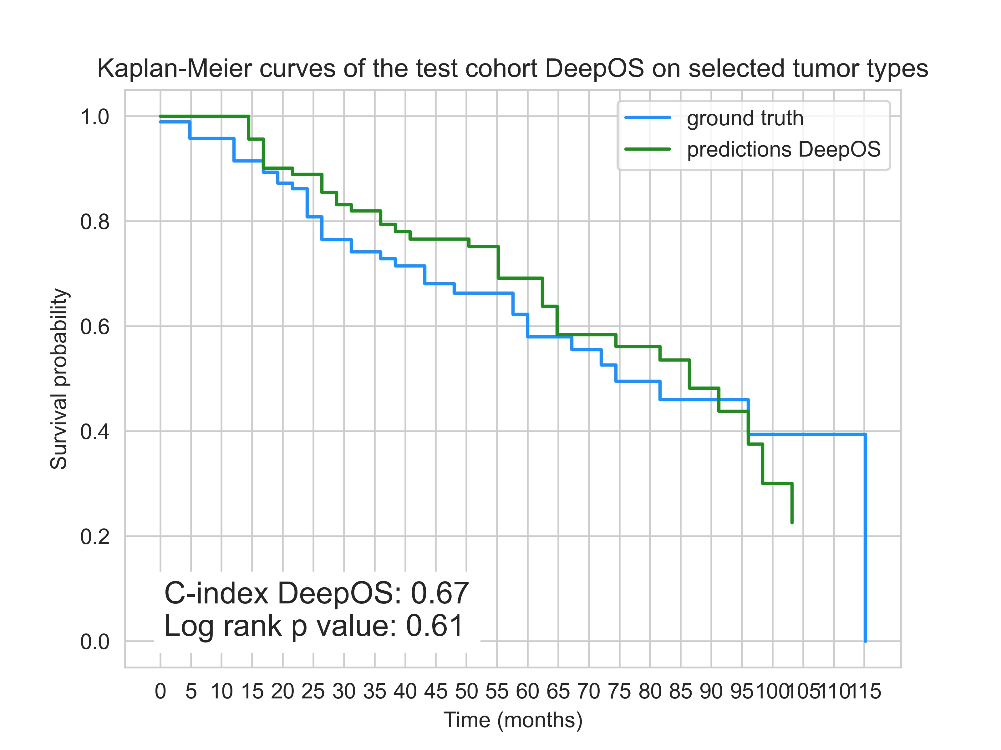
Supplementary Figure 6
a
No pretraining
C-index of DeepOS by tumor type
C-index
b
Few-shot learning for BRCA, LUSC and LUAD
Few-shot learning
C-index
Survival curve with few-shot learning
c

Slide 7
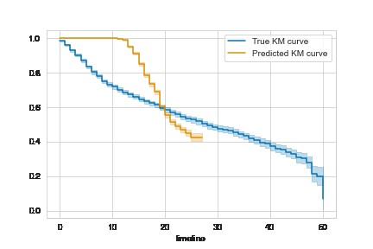
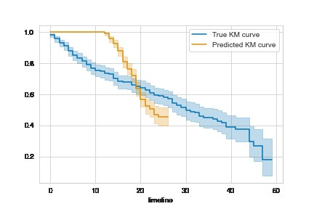
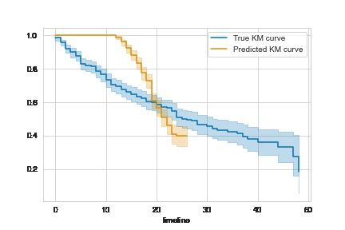
Supplementary Figure 7
a
Kaplan-Meier curves on the train set for the full input gene
Survival probability
b
Kaplan-Meier curves on the train set for the full input gene
Survival probability
c
Survival probability

Slide 8
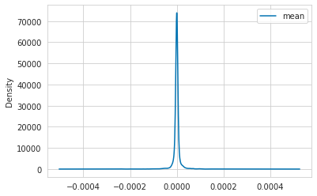
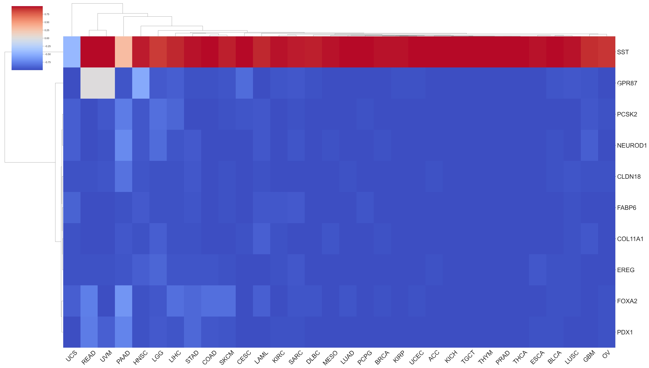
Supplementary Figure 8
a
Mean SHAP values distribution
Density
SHAP values
b
Mean SHAP values
Mean SHAP values according to tumor types

Slide 9
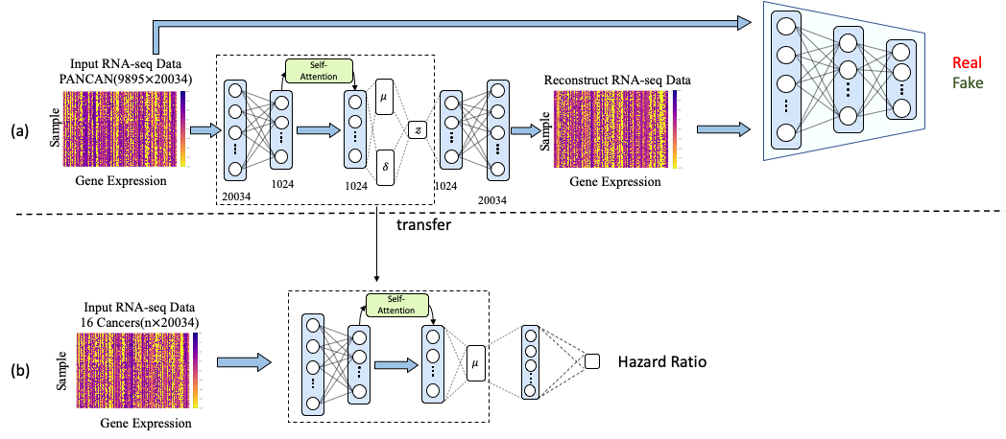
Supplementary Figure 9

