Slide 1
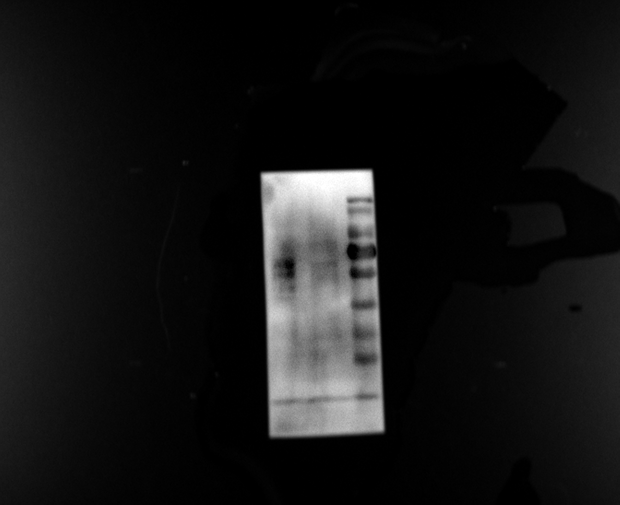
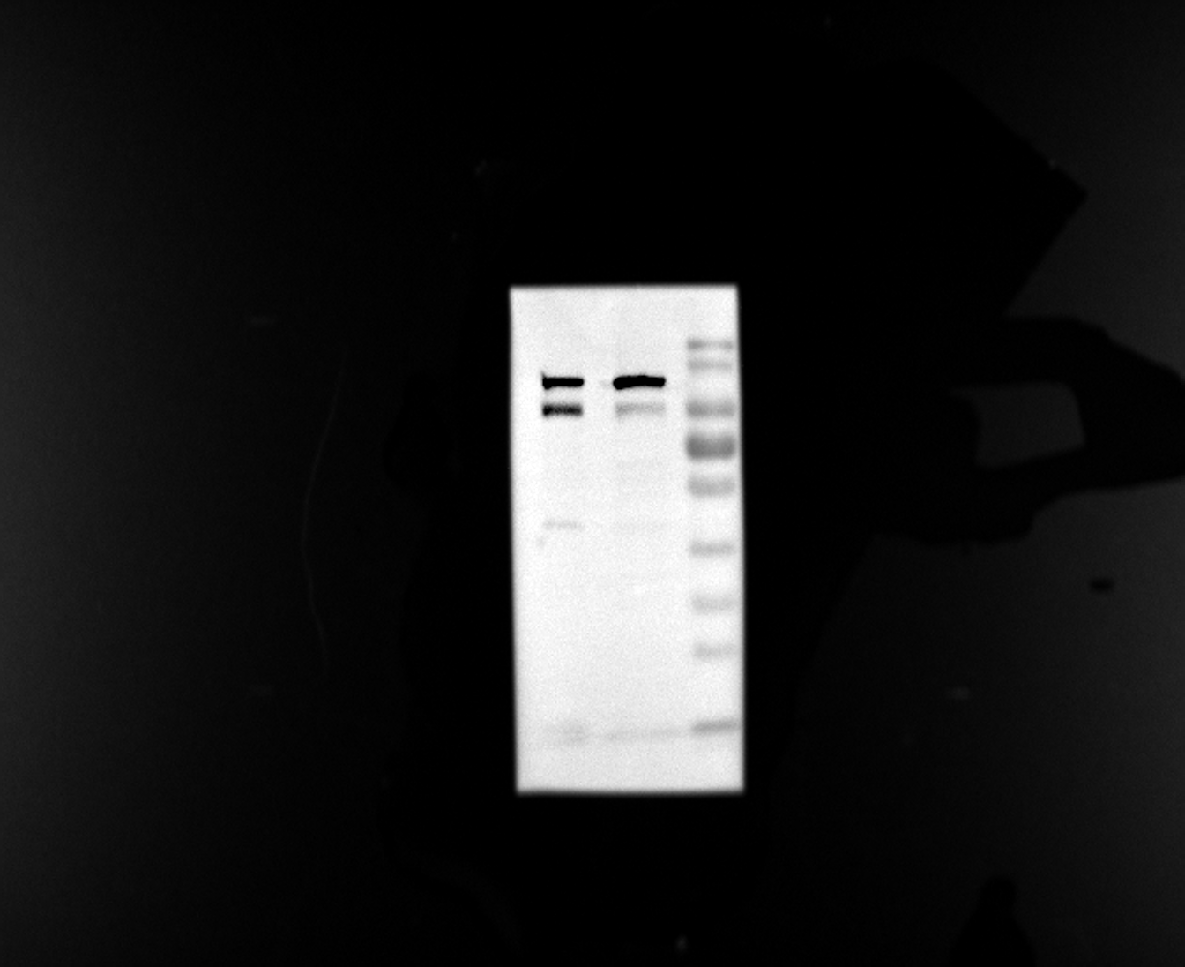
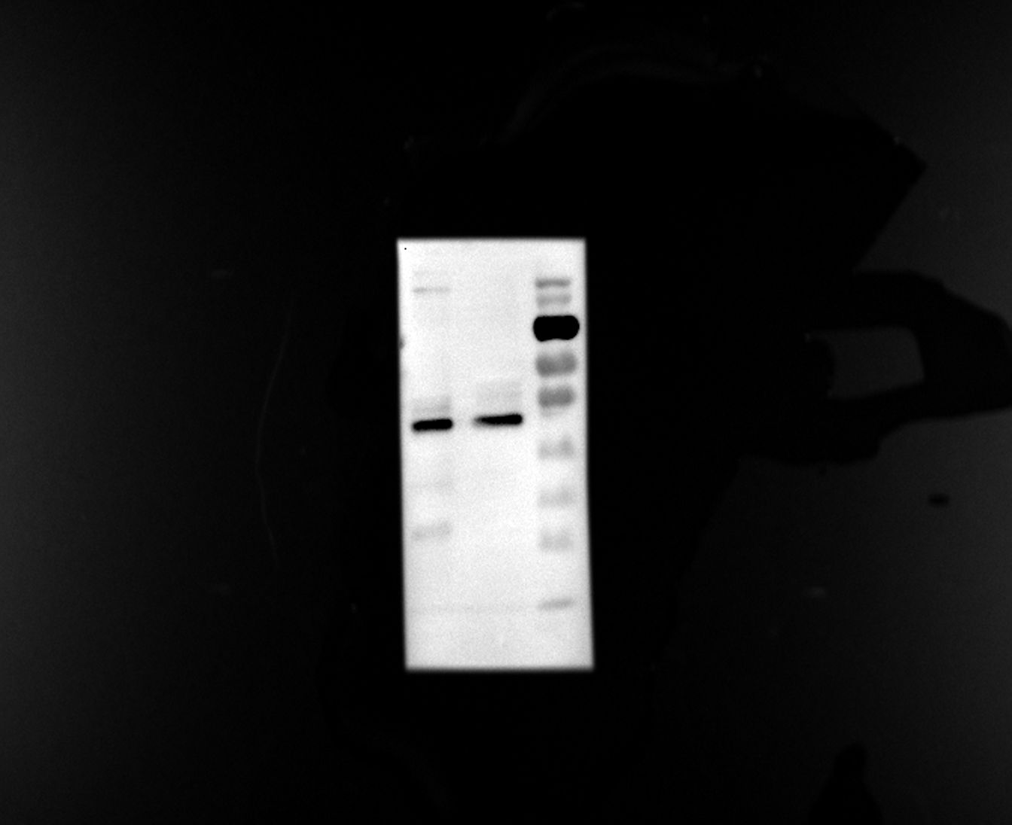
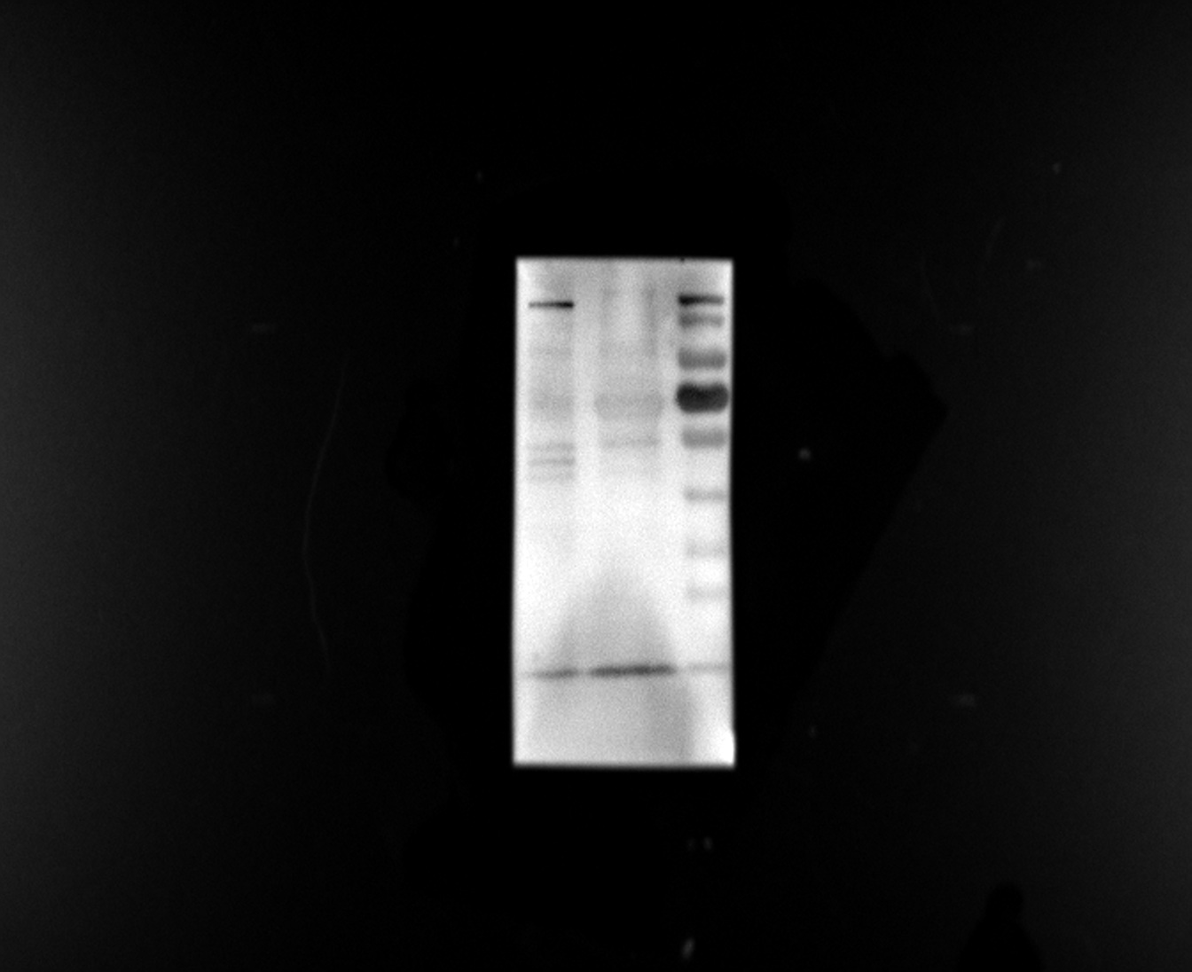

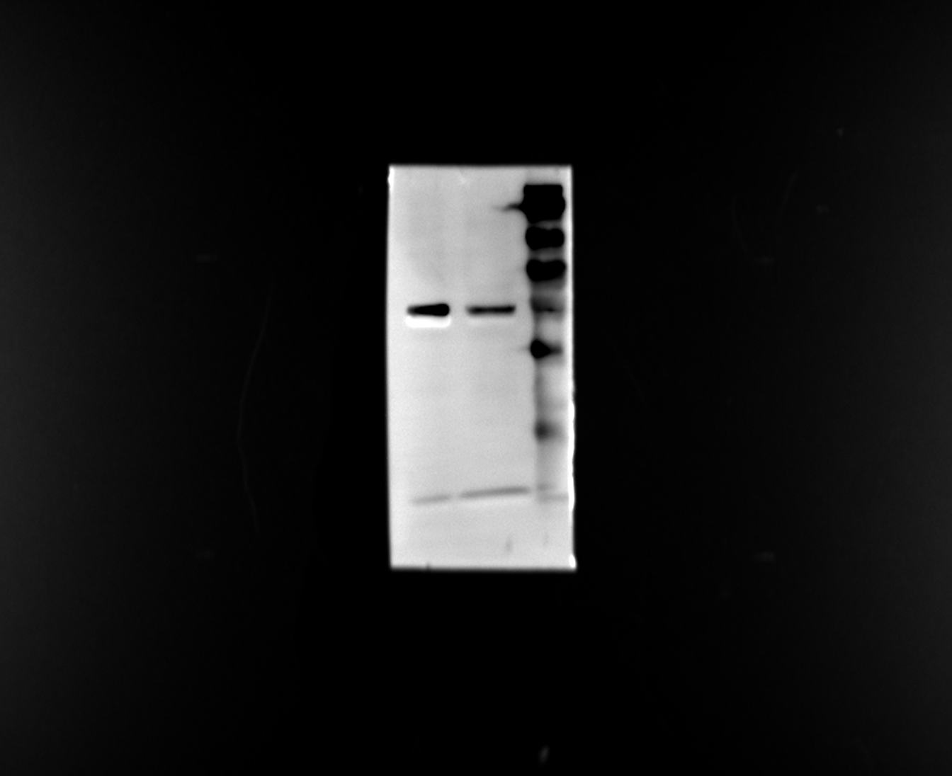
Fig1 D
NK
NK-EVs
NK
NK-EVs
NK
NK-EVs
NK
NK-EVs
NK
NK-EVs
NK
NK-EVs
KDa
KDa
KDa
KDa
KDa
KDa
180
180
180
180
180
130
180
130
130
130
130
100
130
100
100
100
100
70
100
70
70
70
70
55
70
55
55
55
55
55
40
40
40
40
40
40
35
35
35
35
35
35
25
25
25
25
25
25
15
15
15
15
15
15
CD63
56 kDa
Alix
95 kDa
TSG101
44 kDa
Perforin
75 kDa
Granzyme B
35 kDa
β-Tubulin
55 kDa

Slide 2
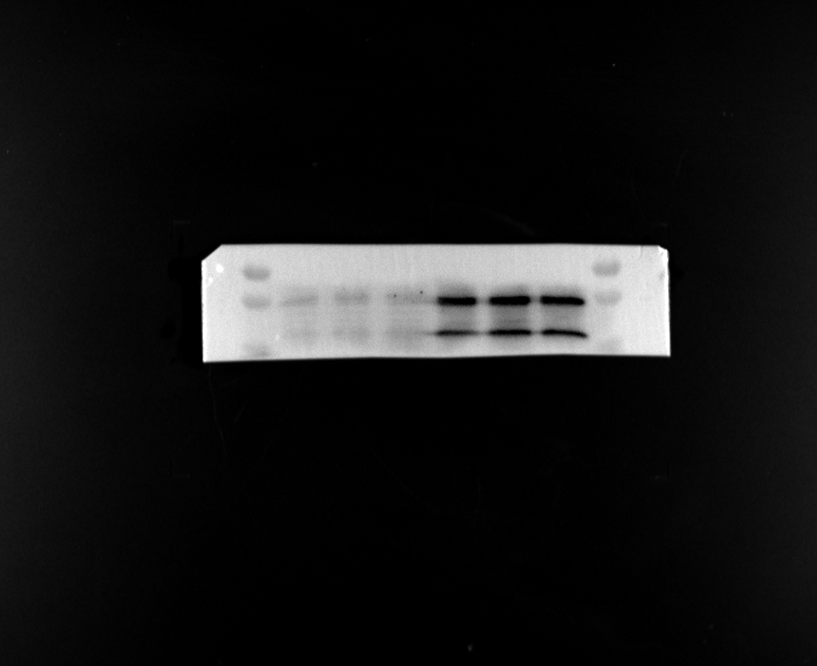
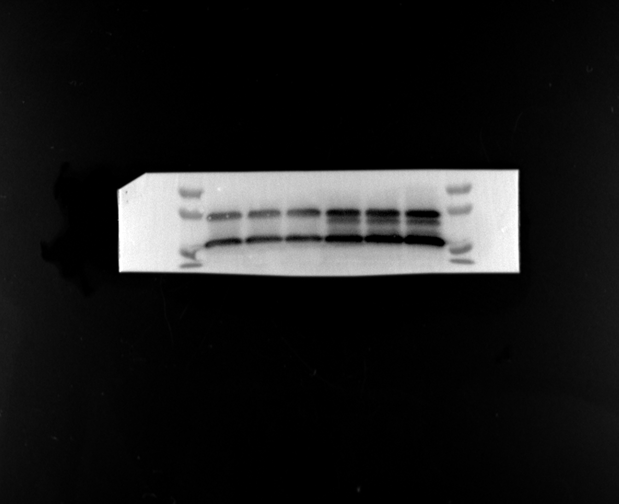
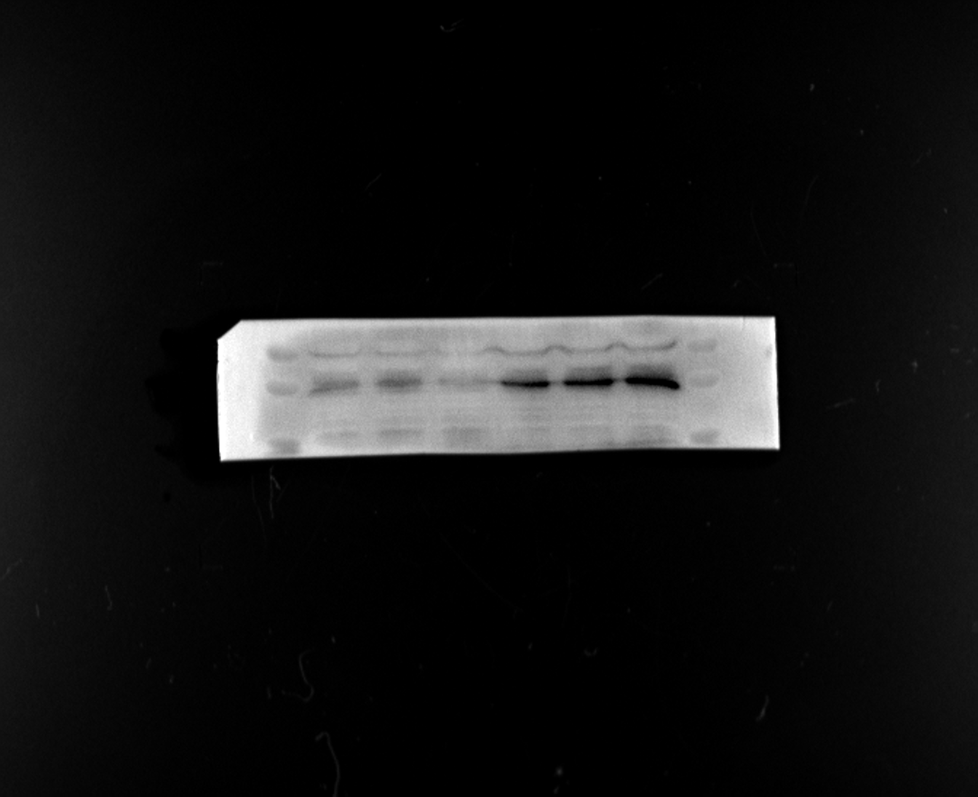
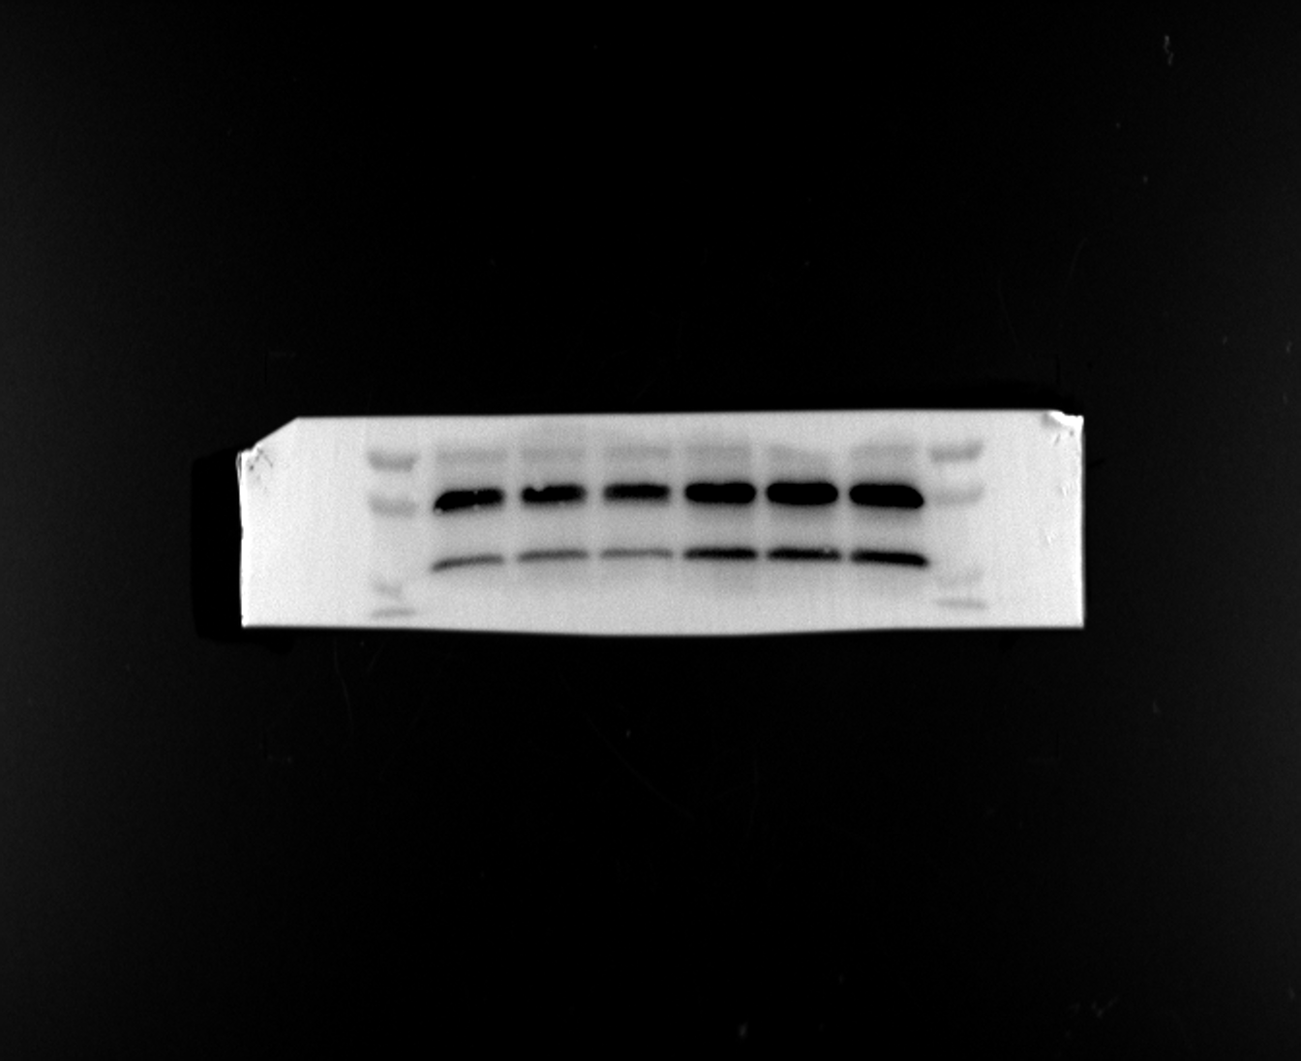
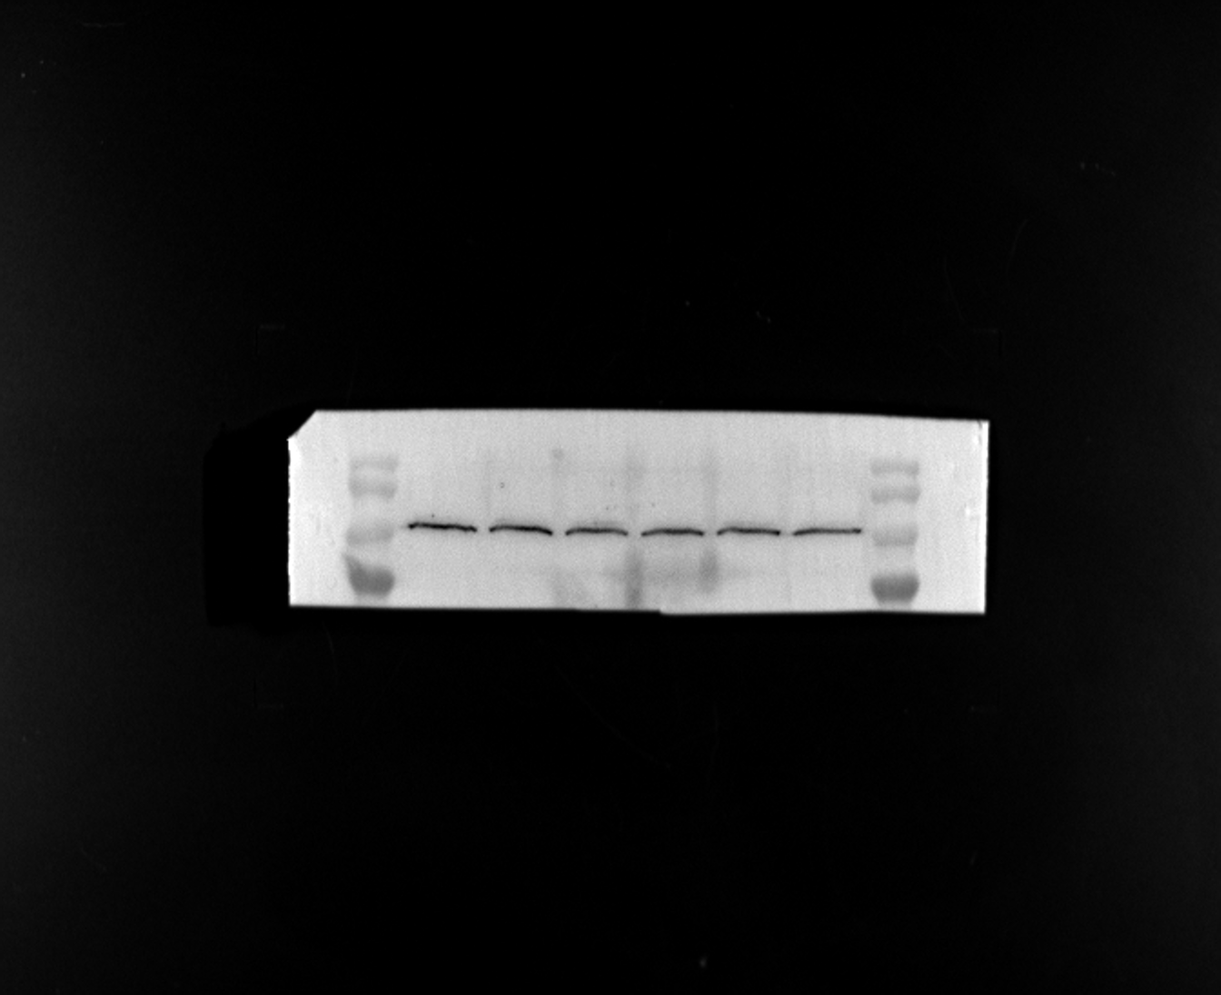
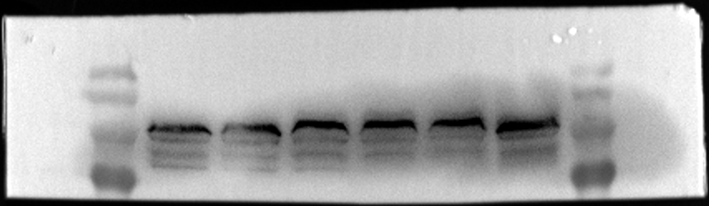
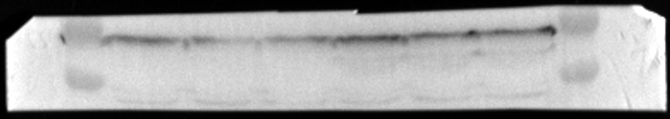
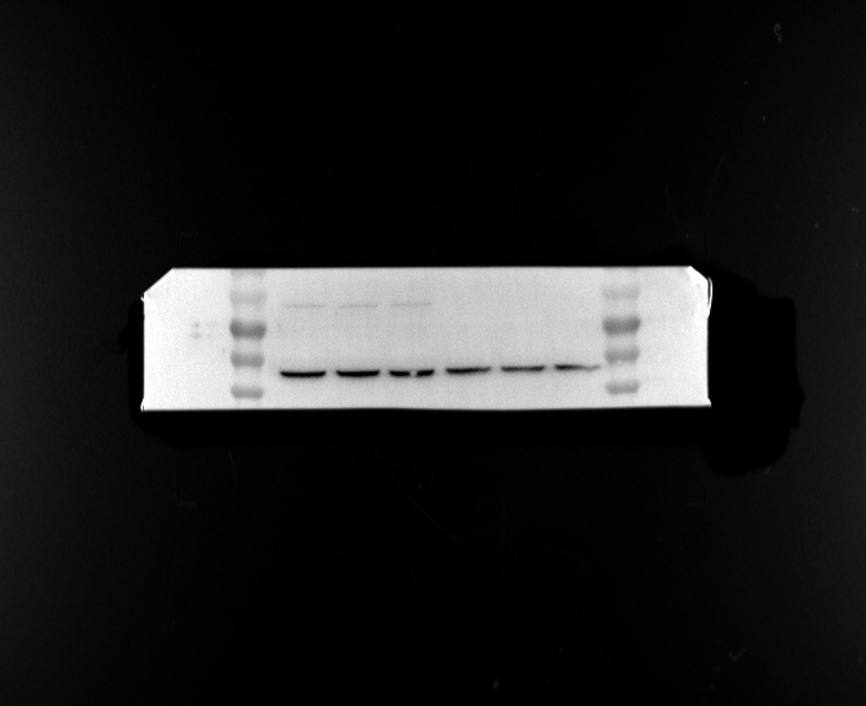
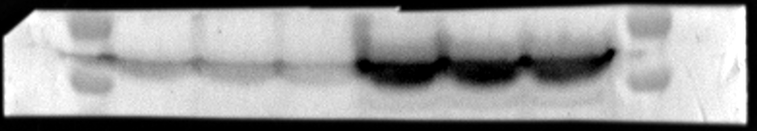
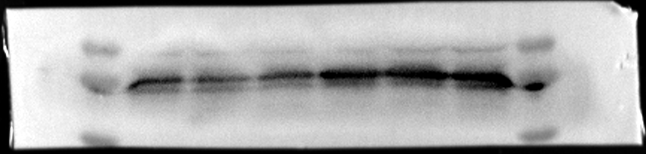
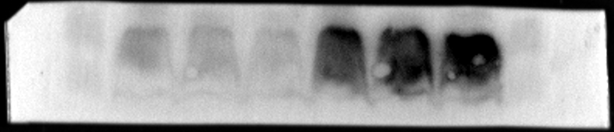
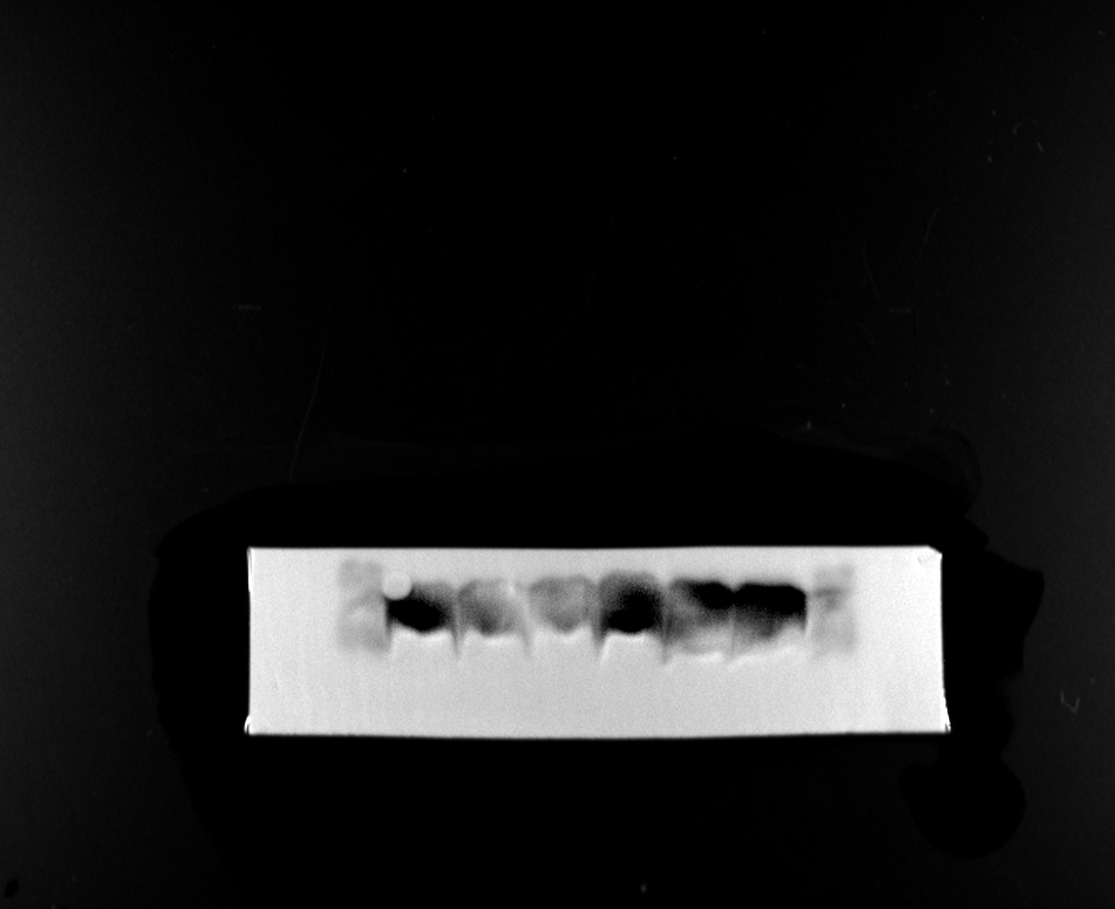
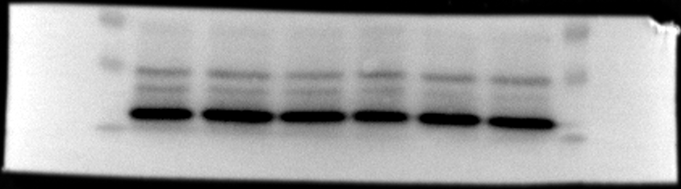
Fig3 A
MCF-7
Fig3 C
MDA-MB-231
PBS NK-EVs
PBS NK-EVs
KDa
KDa
35
PSMB9
21、23 kDa
35
PSMB9
21、23 kDa
25
25
15
15
35
PSMB10
27 kDa
35
PSMB10
27 kDa
25
25
15
15
TAP1
81 kDa
180
180
130
TAP1
81 kDa
130
100
100
70
70
TAP2
46 kDa
55
TAP2
46 kDa
100
40
70
55
TAPBP
48 kDa
55
40
40
TAPBP
48 kDa
55
40
B2M
14 kDa
15
35
10
B2M
14 kDa
15
10
MHCⅠ
45 kDa
70
55
MHCⅠ
45 kDa
70
40
55
p-STAT
84 kDa
100
40
70
p-STAT
84 kDa
100
55
70
β-Tubulin
50 kDa
70
β-Tubulin
50 kDa
70
55
55
40
40

Slide 3
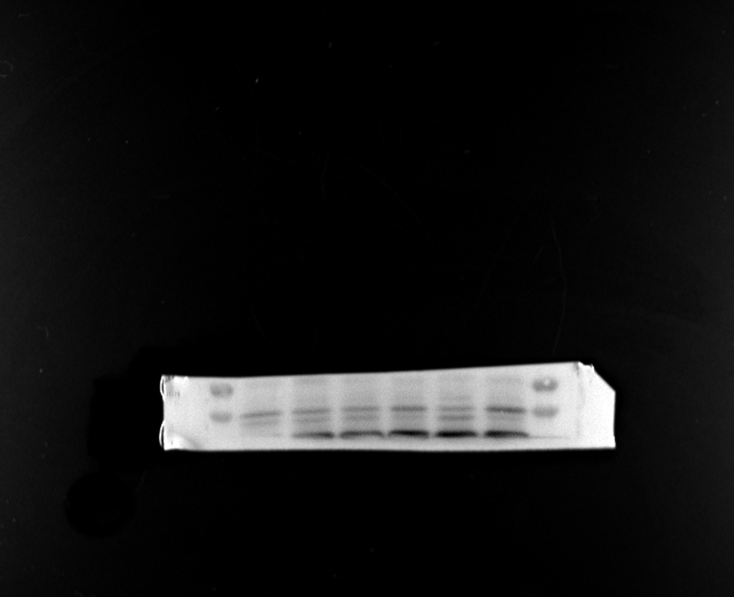
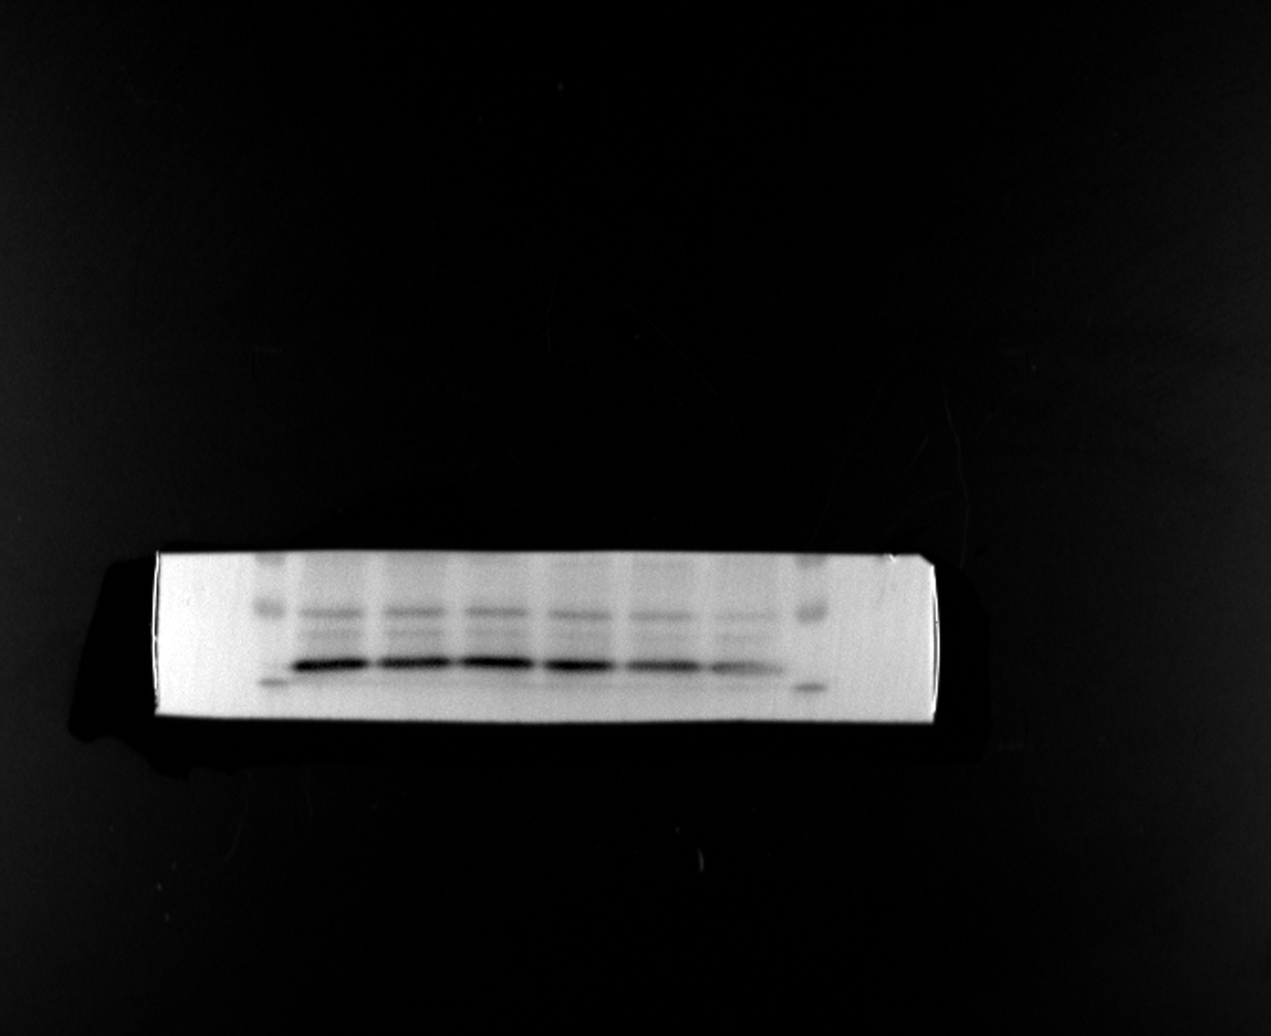
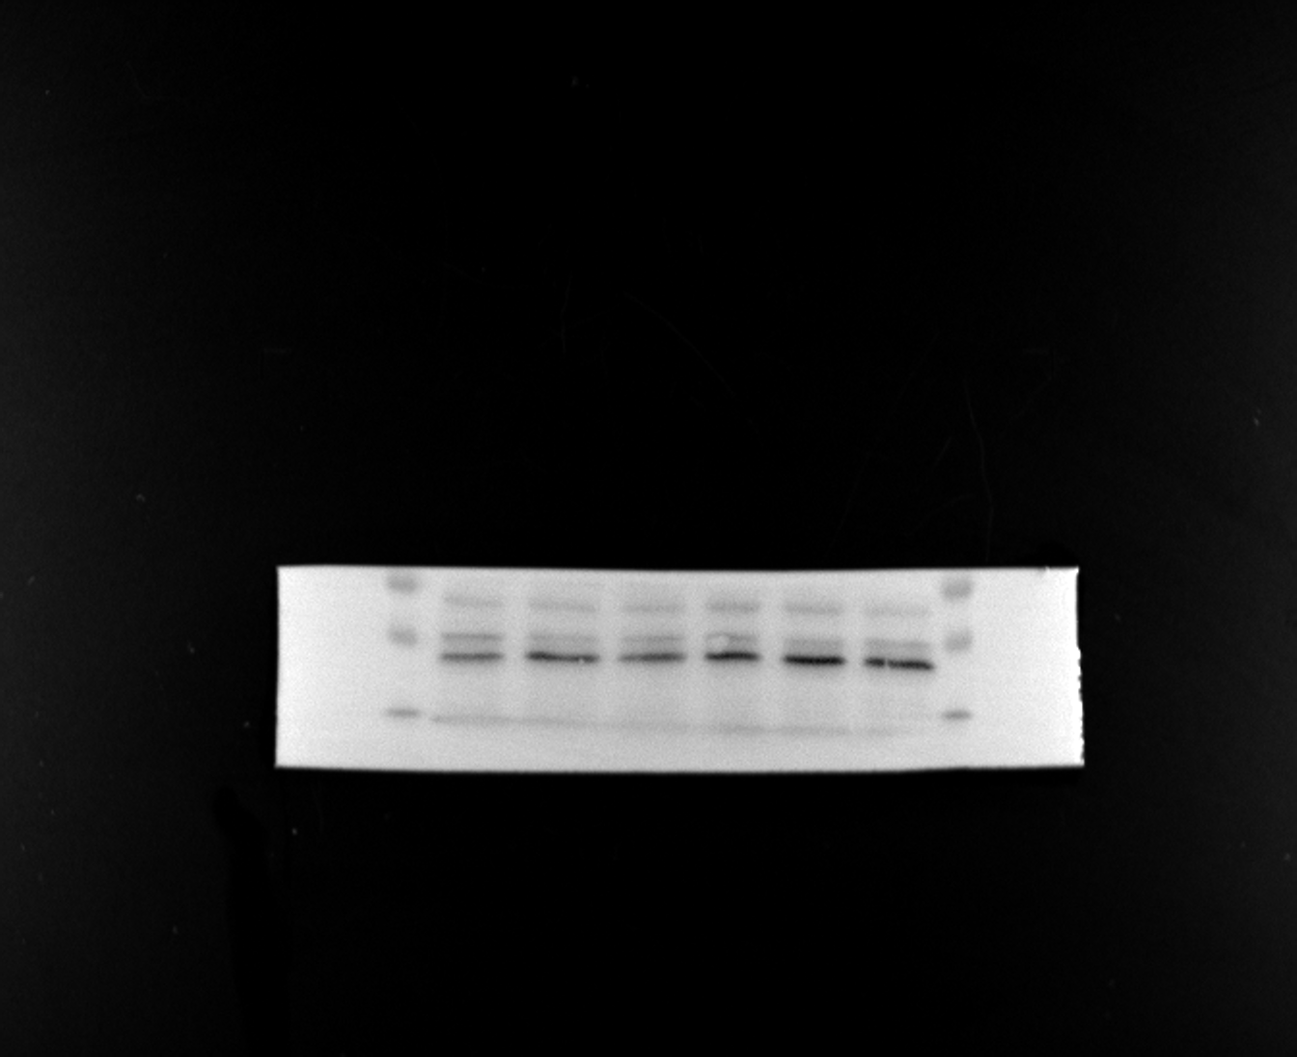
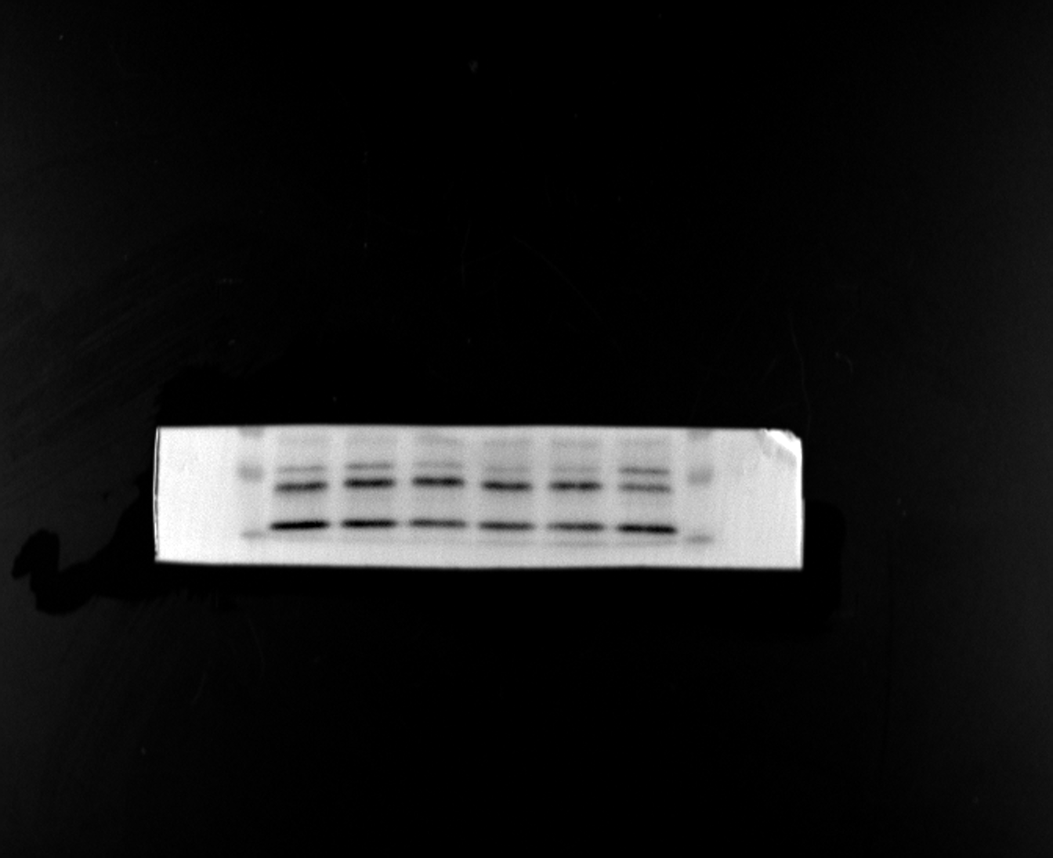
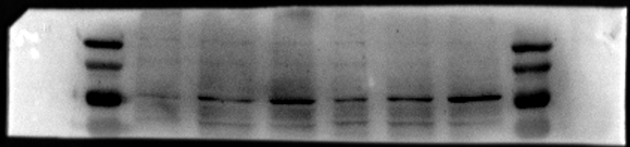
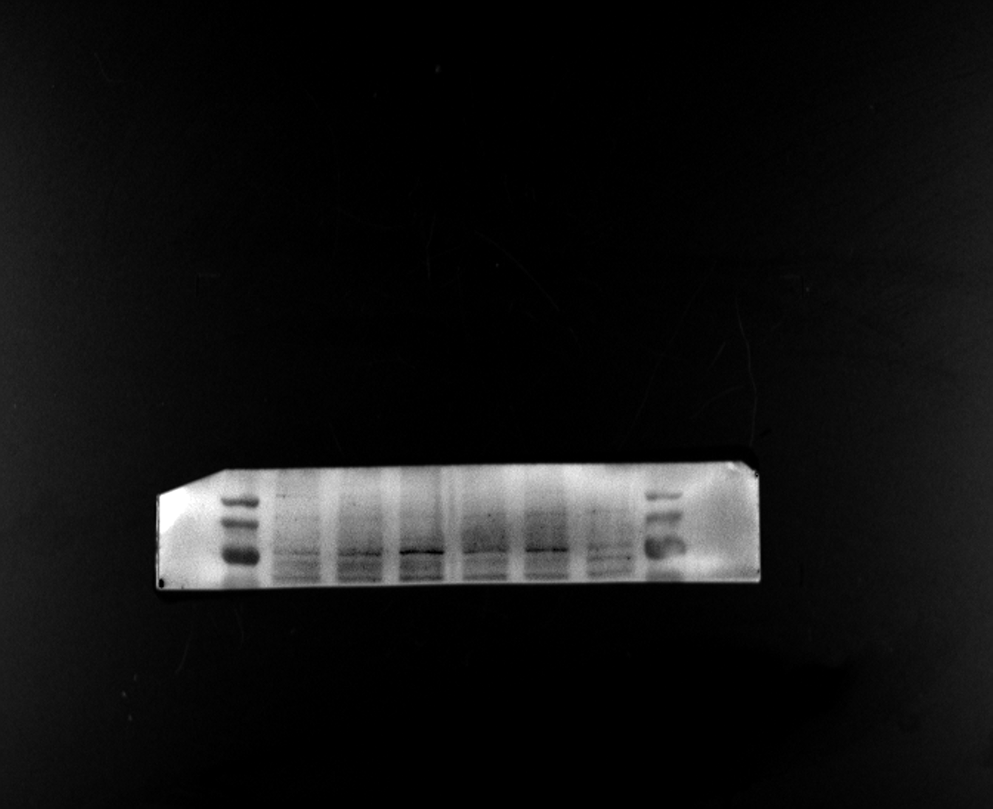
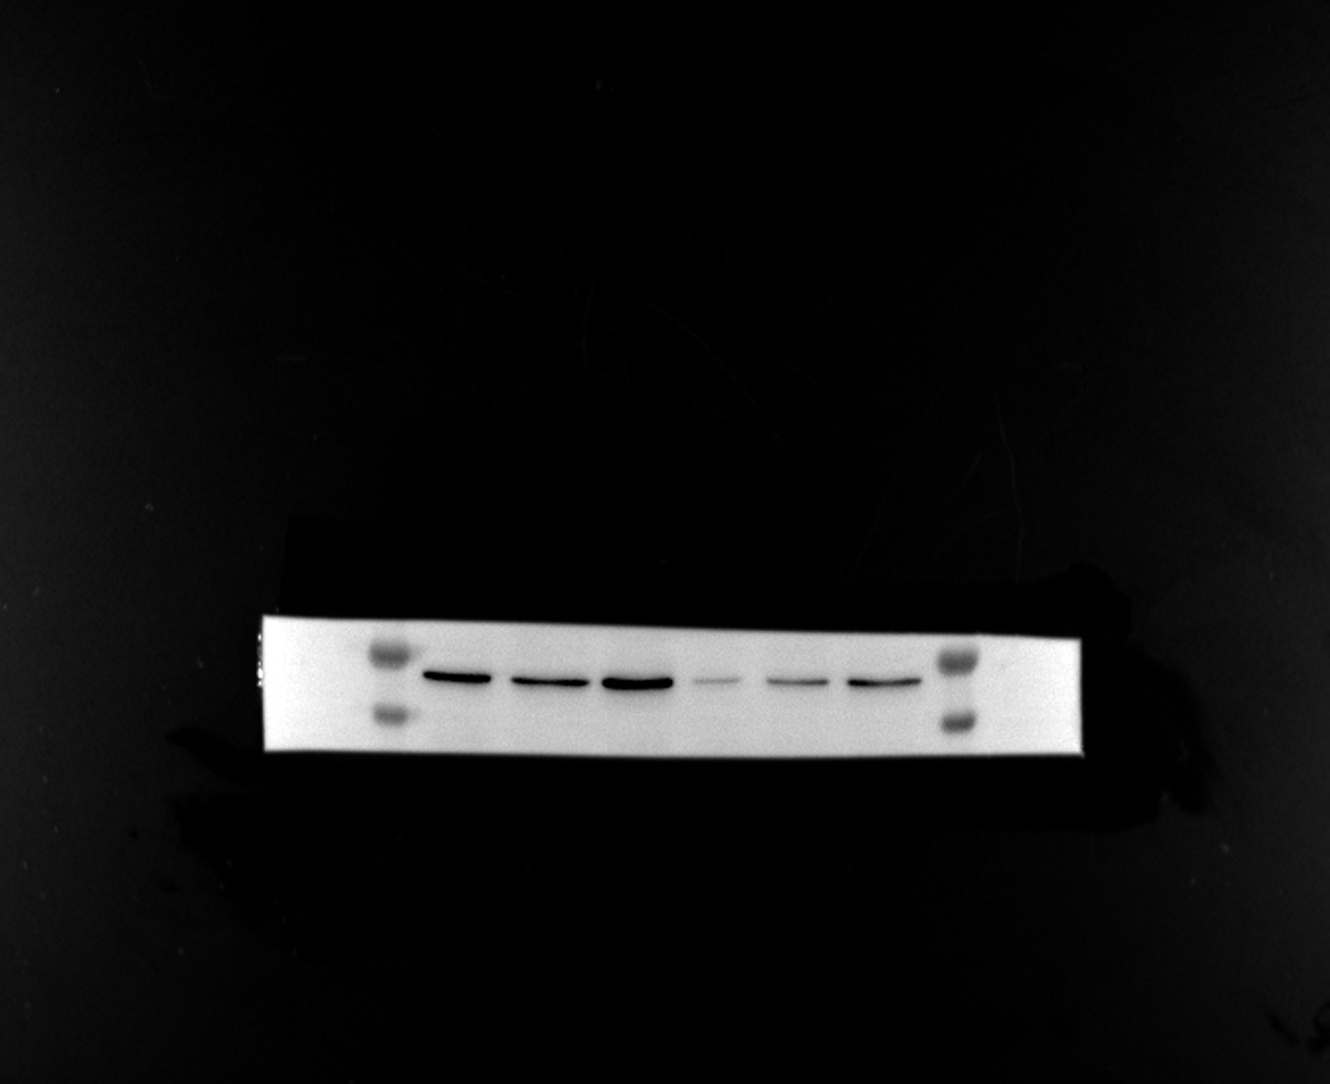
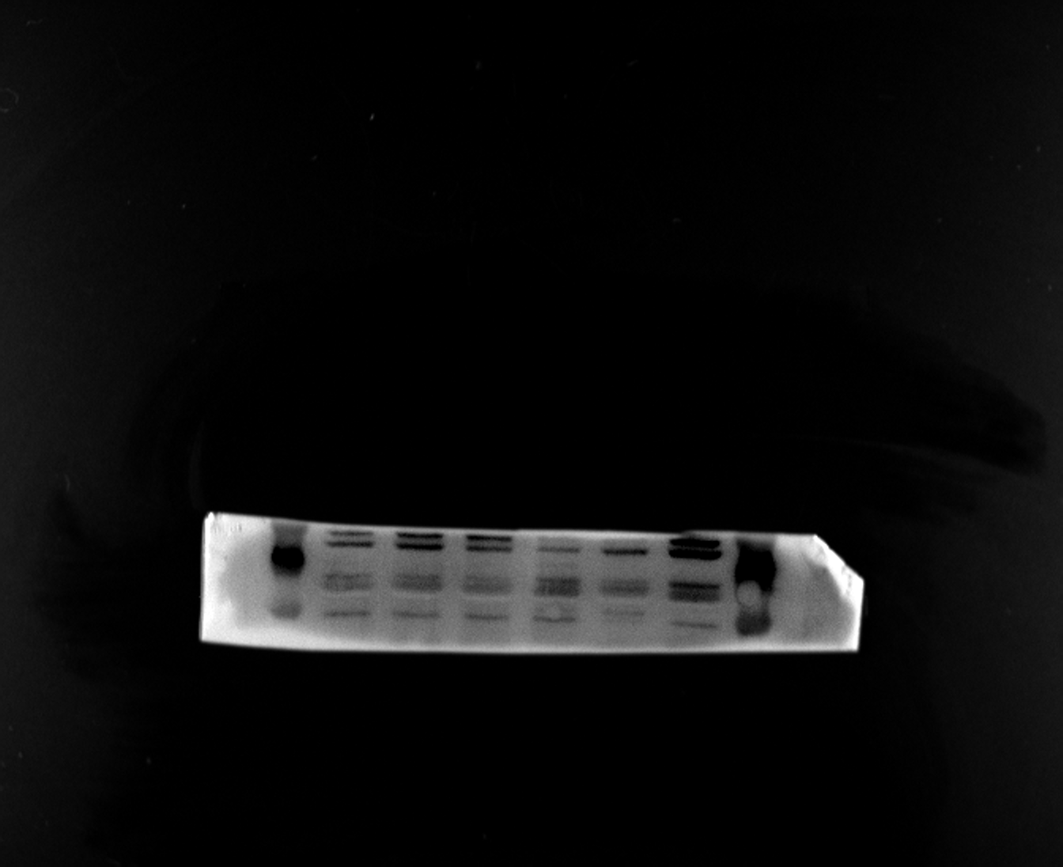
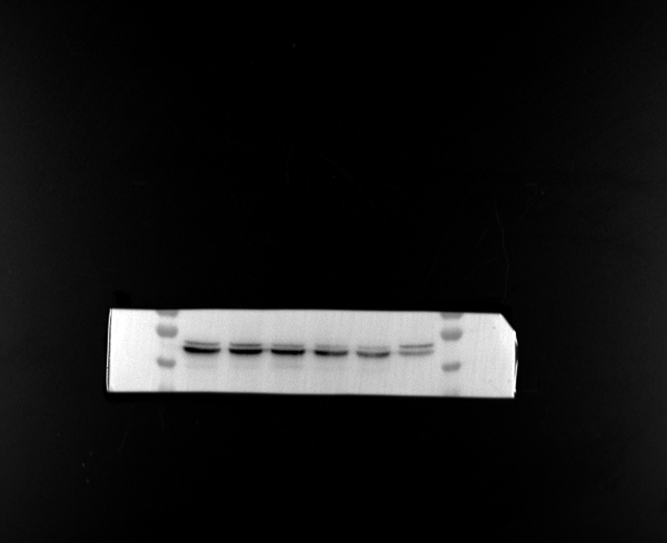
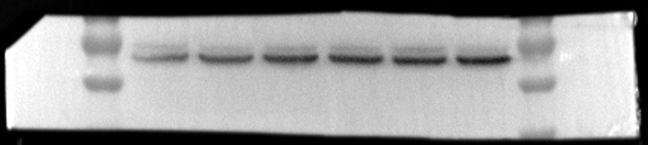
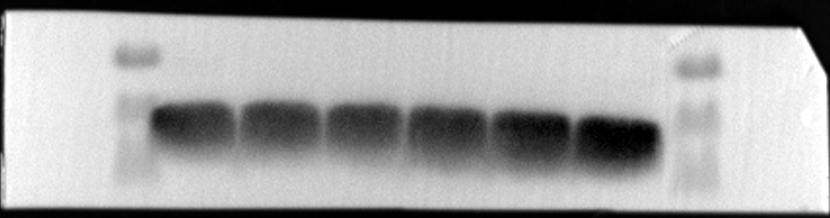
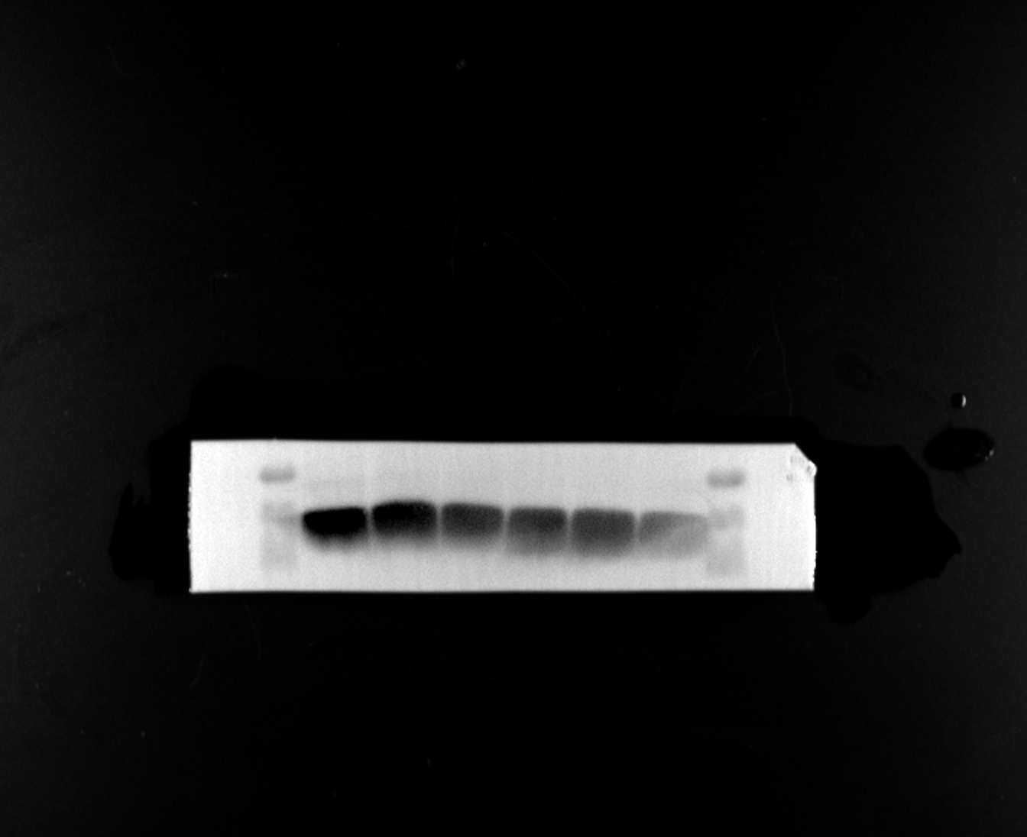
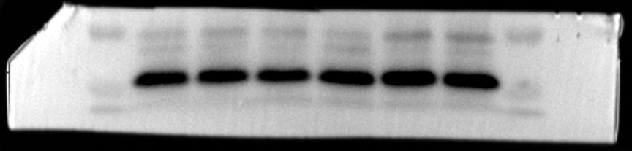
Fig6 A
PBS NK-EVs
KDa
KDa
PBS NK-EVs
PSMB9
21、23 kDa
35
35
25
25
15
15
PSMB10
27 kDa
35
35
25
25
15
15
TAP1
81 kDa
130
130
100
100
70
70
55
55
TAP2
46 kDa
55
55
40
40
70
70
TAPBP
48 kDa
55
55
40
40
35
35
B2M
14 kDa
25
25
15
15
10
10
β-Tubulin
50 kDa
55
55
40
40
35
35

