Slide 1
Supplementary Figures and Tables

Slide 2
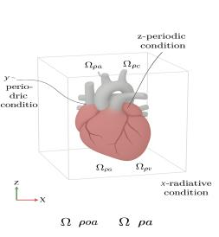
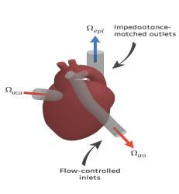
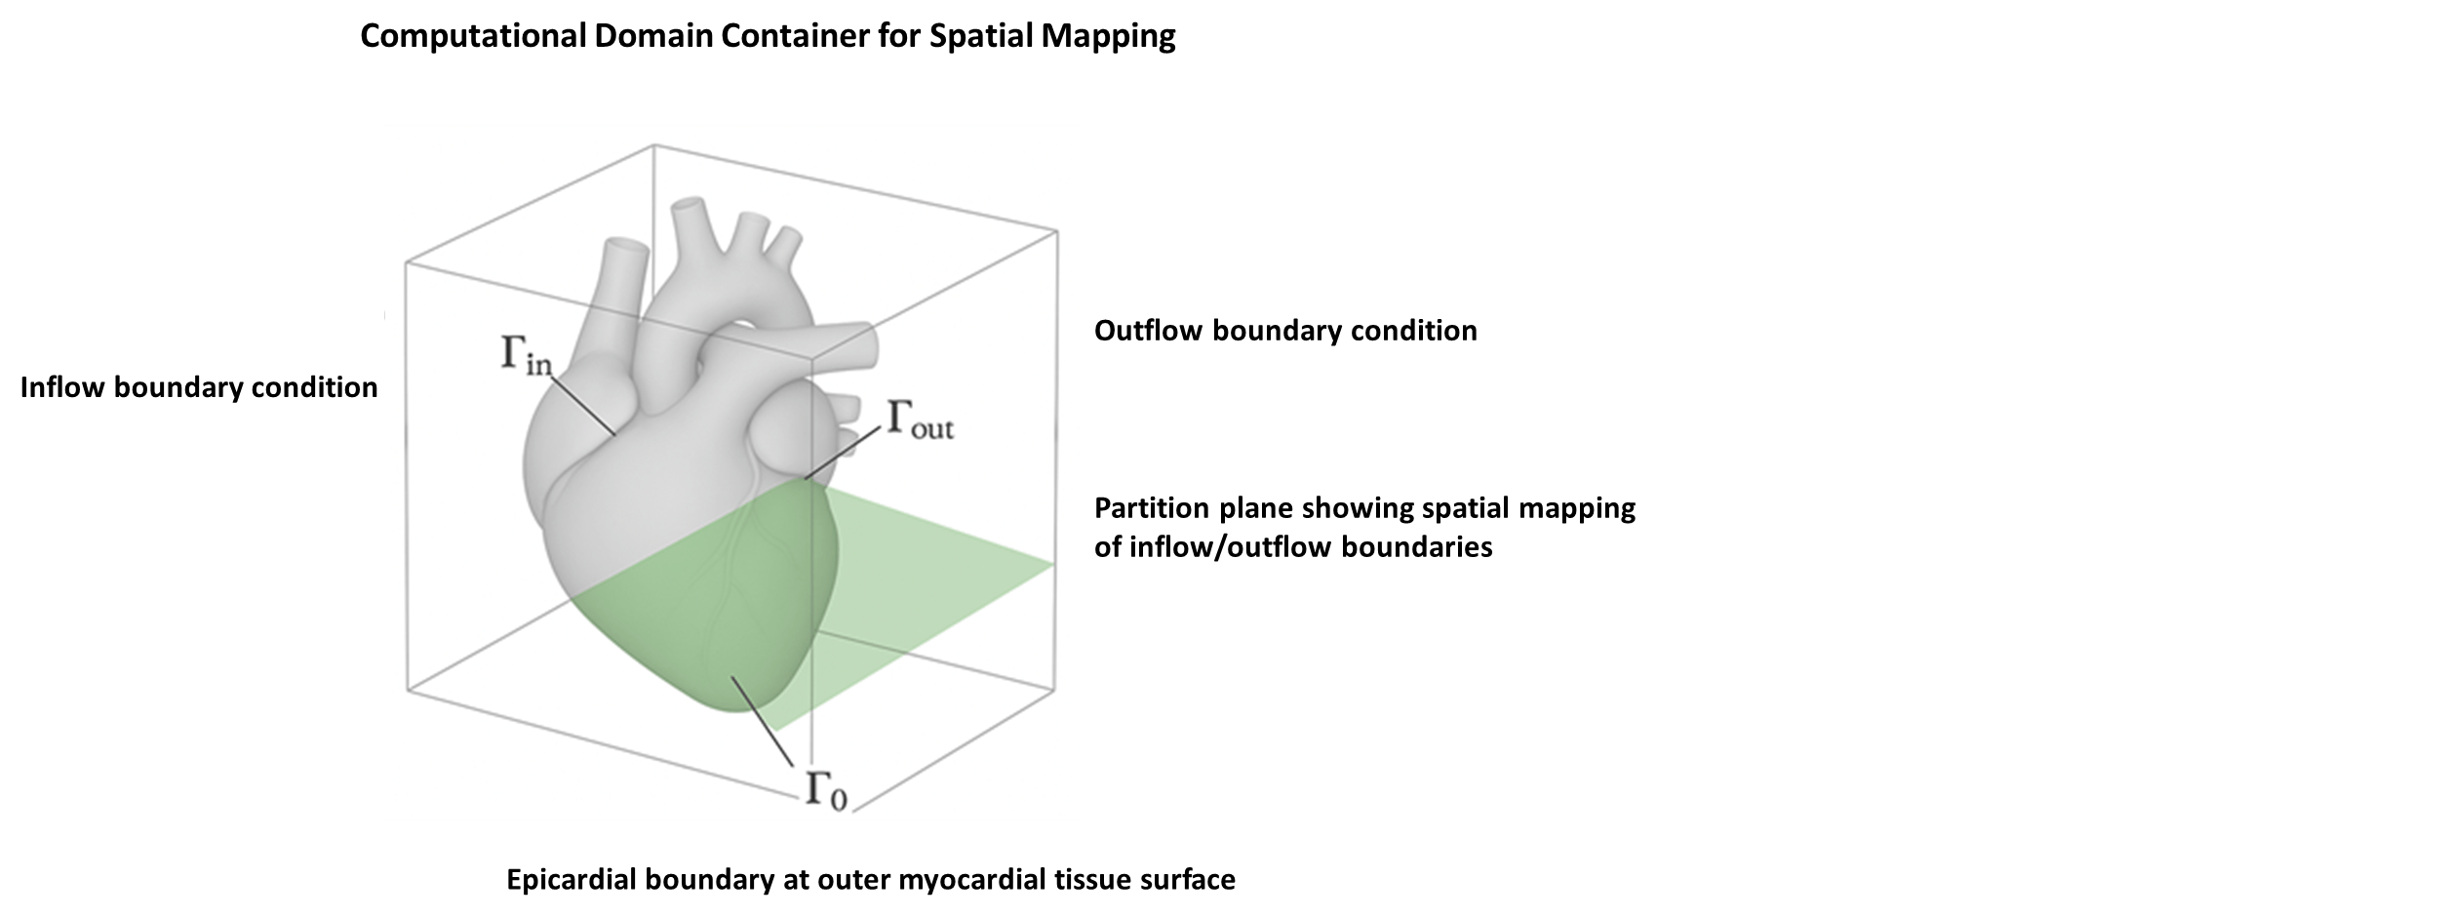
(A)
(B)
(C)
Supplementary Figure S1. Computational domain, boundary conditions, and physiological mapping of the cardiac digital twin. (A) The heart embedded in the computational cube with z- and y-periodic conditions and x-radiative boundary conditions, maintaining numerical stability and preventing artificial reflections. Anatomical labels include pulmonary arteries (Ωρpa), pulmonary veins (Ωρpv), and pulmonary circulation (Ωρpc). (B) Flow-controlled inlets (Ωvca) and impedance-matched outlets (Ωao, Ωepi) applied to the digital twin to reproduce physiologically realistic preload and afterload environments. (C) A full 3D representation of the human heart and attached great vessels (aorta, pulmonary veins, venae cavae) is shown in pale grey within a transparent computational cube. A semi-transparent blue slicing plane illustrates the surface partition used for boundary mapping. The inflow boundary condition (Γ_in) is applied at the mitral/venae cavae surfaces, the outflow boundary condition (Γ_out) is applied at the aortic valve region, and the epicardial boundary (Γ₀) denotes the outer myocardial tissue surface.

Slide 3
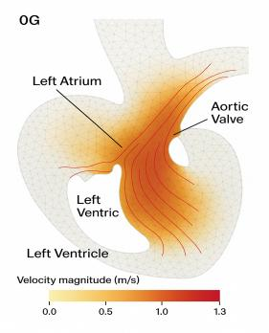
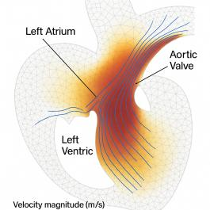
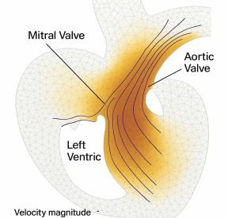
Figure 2: Velocity Streamlines and wall Shear Stress (WSS) – 1G vs 0G. (A) Mitral–Aortic Valve Plane (1G, Peak Systole). (B) Mitral–Aortic Valve Plane (0.38G, Peak Systole). (C) Mitral–Aortic Valve Plane (0G, Peak Systole). (D) Pulmonary–Tricuspid Valve Plane (1G, Peak Systole). (E) Pulmonary–Tricuspid Valve Plane (0.38G, Peak Systole). (F) Pulmonary–Tricuspid Valve Plane (0G, Peak Systole).
(A)
(B)
(C)

Slide 4
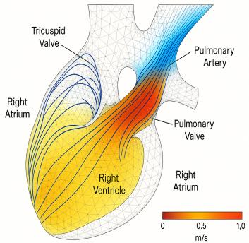
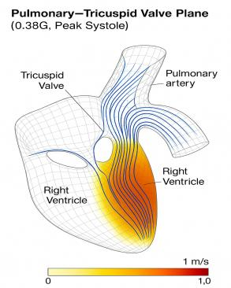
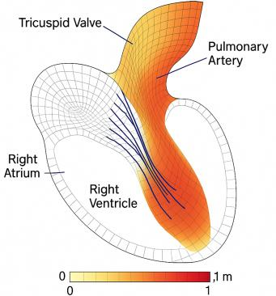
(D)
(E)
(F)

Slide 5
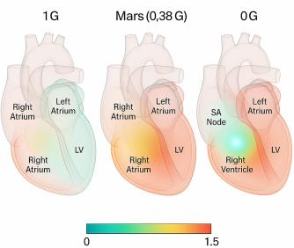
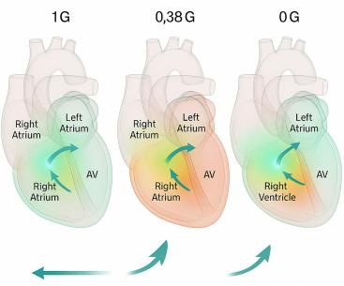
Figure 3. Electrophysiological activation sequence of the cardiac digital twin under variable gravity conditions. (A) Initial Sinoatrial Node Activation (t ≈ 0 s) under three gravitational conditions (0G, 0.38G, 1G). (B) Atrial Depolarization Spread (t = 160 ms) under varying gravity. (C) AV Node Delay (t = 190 ms) transmission with altered conduction times. (D) Ventricular Activation (t = 250 ms) myocardium depolarization, varying by gravity-induced preload. (E) Peak Ventricular Contraction Initiation (t = 400 ms) visualized with gravity-specific mechanics overlay. (F) Maximal Ventricular Contraction (t = 560 ms) showing thickened myocardial walls and peak systolic state.
(A)
(B)

Slide 6
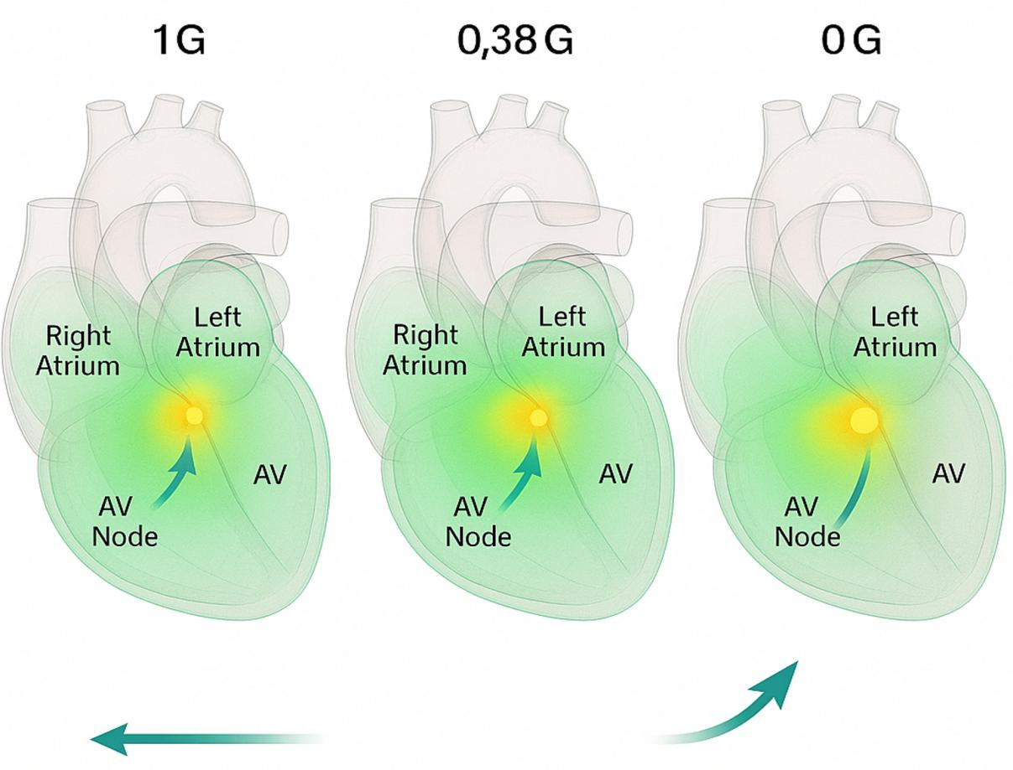
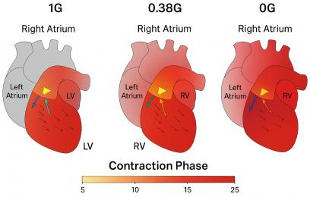
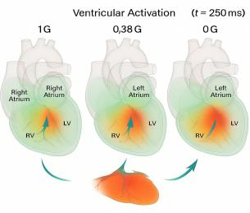
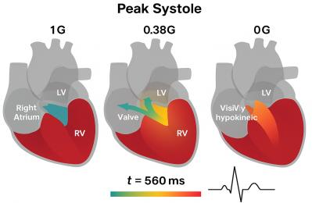
(C)
(E)
Ventricular Activation
(D)
(F)
Ventricular Depolarization

Slide 7
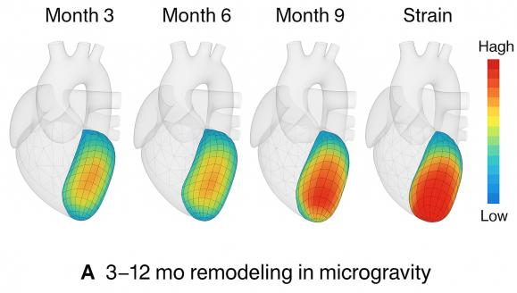
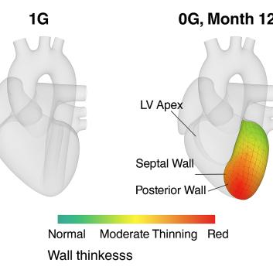

Figure 4. Time-Resolved Cardiovascular Remodeling and Functional Decline Modeled via Digital Twin Simulations Across Microgravity Mission Phases. (A) Remodeling Timeline in Microgravity of four 3D heart models showing progressive remodeling at 3, 6, 9, and 12 months in microgravity (0G) displaying strain thin wireframe mesh overlays, and subtle anatomical reshaping (LV wall thinning, apex rounding, chamber dilation).
(A)
(B)

Slide 8
Supplementary Table S1. Boundary Conditions and Material Parameters
Parameter | Value | Notes / Source
Blood Density (ρ) | 1060 kg/m³ | Standard physiological value
Blood Dynamic Viscosity (μ) | 3.5 mPa·s | Assumed Newtonian flow model
Inlet Pressure (Left Atrium) | 8–12 mmHg | Physiological range
Outlet Pressure (Aortic Valve) | 80–120 mmHg | Adjusted per gravity condition
Gravity Settings | 0 g, 0.38 g (Mars), 1 g (Earth) | Applied as body force in Navier–Stokes equations
Myocardial Material Model | Holzapfel–Ogden (anisotropic) | Hyperelastic, transversely isotropic
Cardiac Cycle Duration | 0.8 s (75 bpm) | Fixed rate for simulations
HO Material Constant C10 | 0.15 kPa | Holzapfel et al., 2009
HO Fiber Stiffness k1 | 2.5 kPa | Tuned for strain reproduction
HO Nonlinearity Parameter k2 | 12.0 | Captures nonlinear stiffening at high strain
Preload Reduction (0G) | −18% LV EDV | Based on head-down tilt studies
Chamber Compliance Adjustment | +20–30% stiffness in 0G | Modeled via altered HO constants

Slide 9
Supplementary Table S2. Mesh Convergence Metrics Across Refinement Levels
Mesh Level | Element Count | Peak LV Pressure (mmHg) | Ejection Fraction (%) | Global Strain (%) | Variation vs Finer Mesh
Coarse | ~180,000 | 112 | 54.5 | −14.2 | 6.5%
Medium | ~350,000 | 115 | 55.9 | −14.7 | 2.1%
Fine | ~650,000 | 117 | 56.4 | −14.9 | —
Note: Mesh convergence was achieved with variation <5% between medium and fine mesh levels. Fine mesh selected for final simulations.

Slide 10
Supplementary Table S3. Expanded Physiological Parameter Source Mapping with Integration Points
Parameter | Applied Value / Range | Physiological Context | Source(s) | Integration Point / Model Use
Baseline Heart Rate | 70–75 bpm | Resting rate, slight increase in reduced gravity | Astronaut ECG datasets; analog HR drift | Section 3.2 – Cardiac cycle period setting
End-Diastolic Volume (EDV) | 110–130 mL | Supine baseline; reduced in microgravity to simulate preload loss | Wilson et al., 2024; Norsk et al., 2021 | Section 3.2 (Boundary Conditions) – Initial chamber fill volume
Ejection Fraction (Baseline) | 55–70% | Astronaut LV function range | ISS MRI datasets; AHA Guidelines | Section 3.4 – Calibration and model validation
Myocardial Compliance | +30% from Earth-normal | Models preload desensitization in 0G | ESA/DLR Bedrest Campaign, 2020 | Section 3.2 – Material property adjustment in Holzapfel–Ogden model
Jugular Venous Pressure | −3 mmHg from baseline | Represents cephalad fluid shift in microgravity | Buckey et al., 1996; ISS observations | Section 3.2 – Venous return pressure in inflow boundary
Baroreflex Gain | Time-delay compensated; ↓ sensitivity in 0G | Simulates autonomic resetting during spaceflight | Norsk et al., 2021; Gunga et al., 2015 | Section 3.2 – Feedback control in HR and vascular tone equations
Wall Stress Range | 8.5–10.2 kPa | Validated against cine-MRI strain analysis | Palau et al., 2019; COMSOL FSI benchmarking | Section 3.4 – Validation target for mechanical output
Gravity Loading Values | 0 g, 0.38 g, 1 g | Microgravity → Mars → Earth simulations | COMSOL scaling algorithm; Mars analog studies | Section 3.2/3.3 – Applied body force in fluid–structure domain
Contractility (Ees) | 1.7–2.3 mmHg/mL | End-systolic elastance adjusted per gravity condition | Derived from PV loop slope; analog data | Section 3.4 – LV elastance in pressure–volume coupling
Blood Density (ρ) | 1056–1060 kg/m³ | Standard physiological property | Standard hemodynamic references | Section 3.2 – Fluid density in Navier–Stokes solver
Blood Viscosity (μ) | 3.2–3.5 mPa·s | Assumed Newtonian behavior for CFD | Clinical hemodynamic references | Section 3.2 – Fluid rheology in CFD module
Systemic Vascular Resistance (SVR) | 15–18 mmHg·min/L | Afterload variation with gravity | Modeled via baroreflex–vascular coupling equations | Section 3.4 – Outflow resistance in circulatory model
Label in your supplementary materials as Table S3 and cross-reference from the main text:“Physiological input parameters and their sources are summarized in Table 1; a full expanded traceability table is provided in Supplementary Table S3.”

Slide 11
Supplementary Table S4. Comparative Mechanical and Hemodynamic Outputs Across Gravity States
Metric | 0G (Microgravity) | 1G (Earth) | 0.38G (Mars) | % Change (0G vs 1G) | % Change (0.38G vs 1G)
Heart Rate Variability (RMSSD, ms) | 30 | 42 | 38 | −29% | −10%
Stroke Volume (SV, mL) | 62 | 78 | 70 | −20% | −10%
Cardiac Output (CO, L/min) | 4.4 | 5.5 | 5.0 | −20% | −9%
Ejection Fraction (EF, %) | 54 | 64 | 60 | −16% | −6%
Wall Shear Stress (WSS, Pa) | 1.34 | 1.85 | 1.62 | −28% | −12%
Fiber Tension (Peak, kPa) | 8.2 | 9.8 | 9.1 | −16% | −7%
End-Diastolic Volume (EDV, mL) | 100 | 122 | 110 | −18% | −10%
End-Systolic Volume (ESV, mL) | 46 | 44 | 44 | +5% | 0%
Systemic Vascular Resistance (SVR, mmHg·min/L) | 15.0 | 16.2 | 15.6 | −7% | −4%
Peak LV Pressure (mmHg) | 107 | 118 | 114 | −9% | −3%

Slide 12
Supplementary Table S5. Extended Remodeling Indices Over Time During Continuous Microgravity Exposure (0G)
Timepoint | LV Mass (g) | Ejection Fraction (%) | Wall Thickness (mm) | Circumferential Strain (%) | EDV (mL) | ESV (mL) | Global Longitudinal Strain (%)
Baseline (1G) | 150 | 64 | 10.2 | −22.3 | 122 | 44 | −18.5
1 Month (0G) | 146 | 62 | 10.0 | −21.5 | 118 | 45 | −17.8
3 Months (0G) | 140 | 59 | 9.7 | −20.7 | 116 | 47 | −16.9
6 Months (0G) | 135 | 57 | 9.4 | −19.6 | 114 | 49 | −15.8
9 Months (0G) | 132 | 56 | 9.3 | −19.0 | 113 | 50 | −15.2
12 Months (0G) | 130 | 55 | 9.1 | −18.4 | 112 | 50 | −14.6
Legend:
Remodeling indices were derived from the cardiac digital twin structural module under continuous microgravity (0G) exposure. LV mass was computed from myocardial tissue density and chamber geometry. Wall thickness was measured at the mid-ventricular septum. Global longitudinal and circumferential strain values are from 3D strain mapping. Ejection fraction (EF) was calculated from EDV and ESV. Negative strain values indicate shortening. Data extend beyond the main text figure (baseline, 3m, 12m) to include intermediate timepoints (1m, 6m, 9m) for full temporal resolution.

